Slide 1
EE40
Lecture 7
Josh Hug
7/7/2010

Slide 2
Blackboard Stuff
HW3 concerns
Any general questions people might have

Slide 3
General Info
No lab today
Midterm on Friday in class
  12:10-1:30 [be on time!]
  No electronic devices
  One 8.5”x11” (or A4) sheet of paper
    Handwritten anything you want, both sides
HW4 due next Friday (will be posted Friday)
No positive feedback circuits on the midterm (but there might be on the final)

Slide 4
Project 2
Project 2 spec to be posted over the weekend
If you’d like to do something other than the official project, you can submit a specification for your Project 2:
  Team members (up to 3)
  Parts list
  Schematic
Must have substantial hardware component
  Microcontrollers are OK, but your project shouldn’t be about assembly programming
  MyDAQ is also OK, but your project shouldn’t be about LabVIEW programming
Custom project proposals due WEDNESDAY by 5 PM

Slide 5
Guest Mini-Lecture Today
Jeff Jansen from National Instruments will be talking today for the last half hour
  MyDAQ data acquisition device
    USB device that lets you use your computer in lieu of big bulky specialized test equipment
  Can use this device to do labs from home or anywhere else a laptop functions
  If anyone wants to use these in labs, we will have 10 of them available
  Could be handy for Project 2
    Must have substantial hardware component (can’t just be LabVIEW software written for MyDAQ)

Slide 6
Course Website
I am assured that the rest of the calendar and the other 5 labs will be posted shortly. Most likely schedule is:
  7/13: Project 1 (buzzer)
  7/14: Sound synthesizer
  7/20: Power supply
  7/21: Active filter lab
  7/27-8/11: Project 2
Future reading assignments will be posted 3 days before they’re due
  Micro-deadlines are needed for me, too!

Slide 7
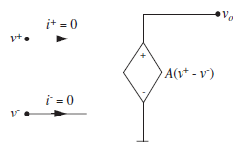
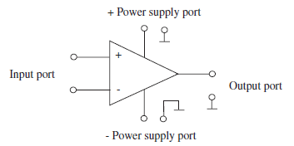
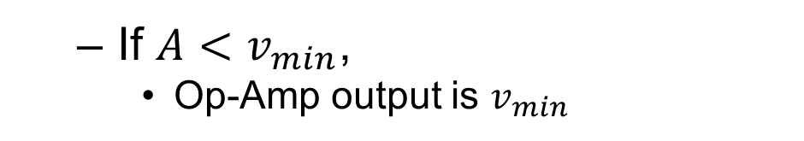
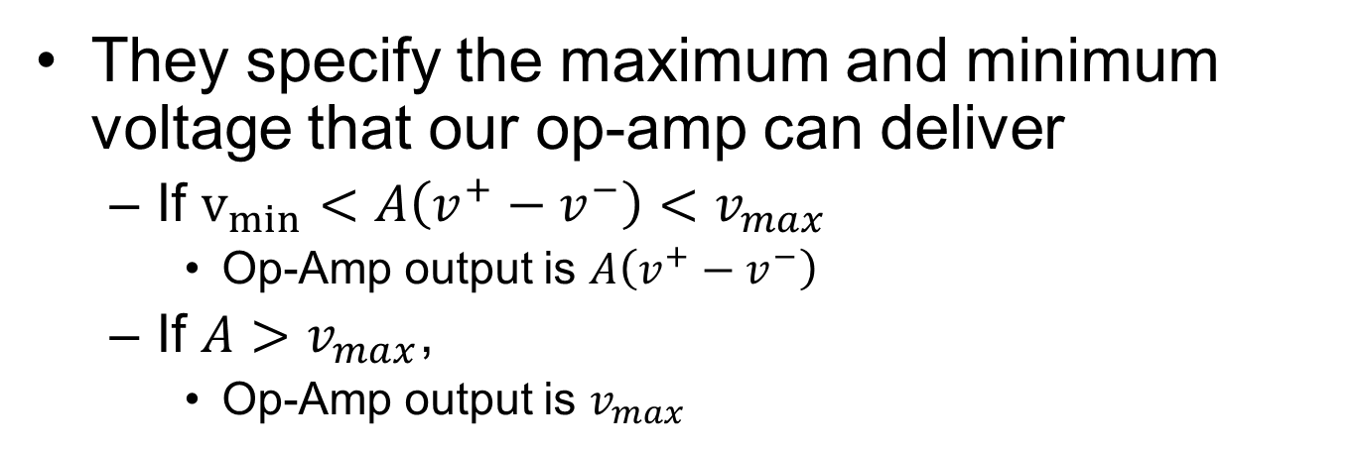
Op-Amp Saturation
Remember those power ports we’ve been ignoring?
They specify the maximum and minimum voltage that our op-amp can deliver
  If $v_{min}<A\left(v^{+}−v^{−}\right)<v_{max}$
    Op-Amp output is $A\left(v^{+}−v^{−}\right)$
  If $A>v_{max}$,
    Op-Amp output is $v_{max}$
  If $A<v_{min}$,
    Op-Amp output is $v_{min}$

Slide 8
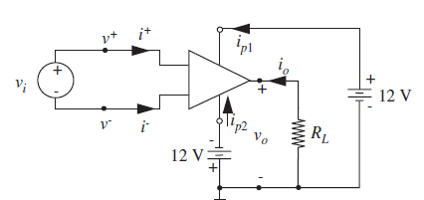
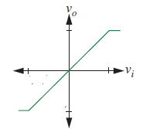
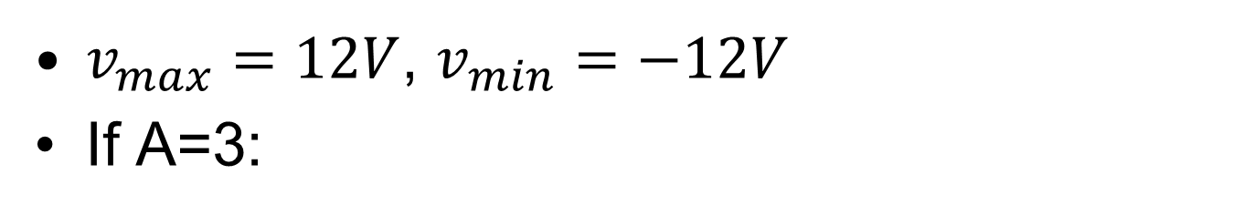
Op-Amp Saturation Example
$v_{max}=12V$, $v_{min}=−12V$
If A=3:
V_{in} | V_{o}
-5 V | -12V
-1V | -3V
2V | 6V
1,512,312V | 12V
12V
4V
-4V
-12V

Slide 9
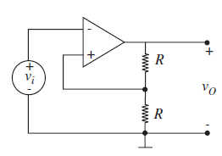
Positive Feedback
On the board

Slide 10
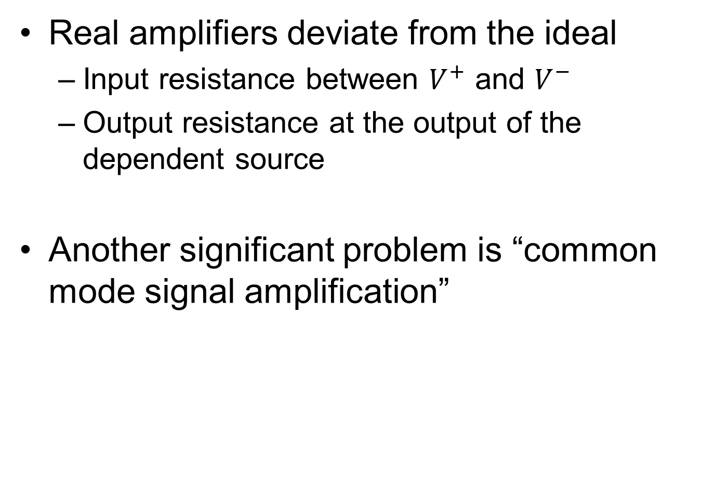
Another Op-Amp Model Revision
Real amplifiers deviate from the ideal
  Input resistance between $V^{+}$ and $V^{−}$
  Output resistance at the output of the dependent source
Another significant problem is “common mode signal amplification”

Slide 11

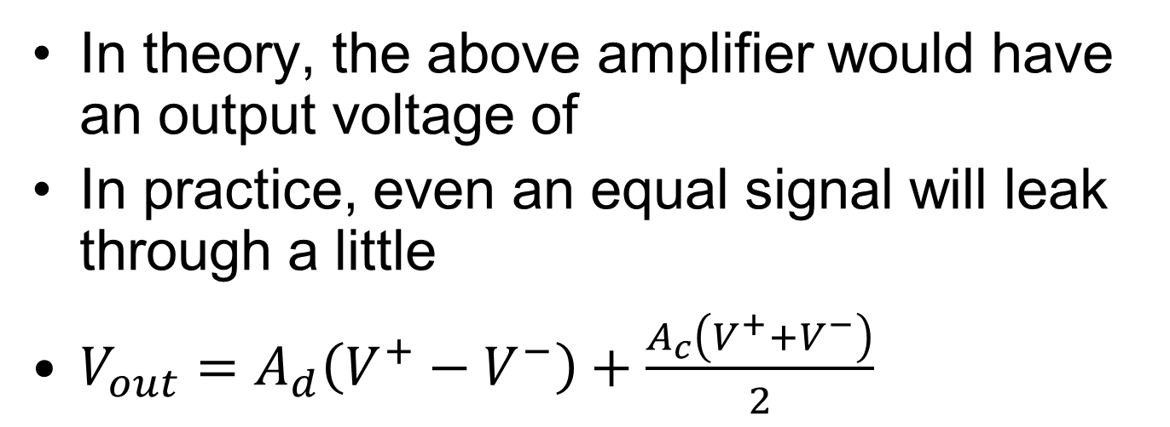
Common Mode Signal
V₁
10V
+
-
+
_
-10V
In theory, the above amplifier would have an output voltage of
In practice, even an equal signal will leak through a little
$V_{out}=A_{d}\left(V^{+}−V^{−}\right)+\frac{A_{c}\left(V^{+}+V^{−}\right)}{2}$
0V
New Term

Slide 12
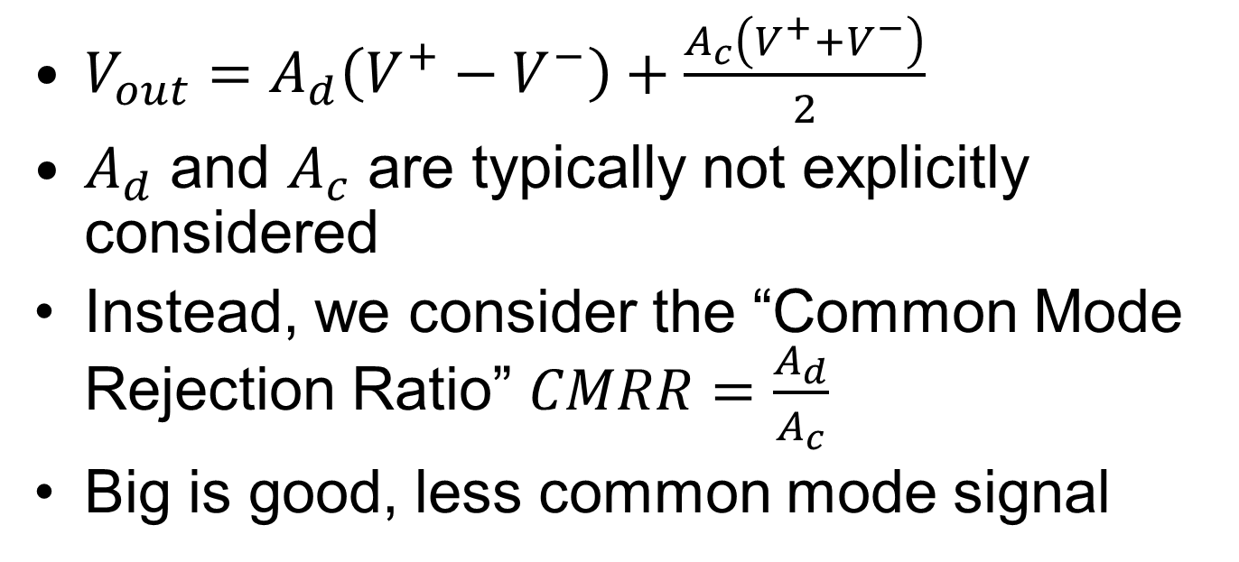
Common Mode Signal
V₁
10V
+
-
+
_
-10V
$V_{out}=A_{d}\left(V^{+}−V^{−}\right)+\frac{A_{c}\left(V^{+}+V^{−}\right)}{2}$
$A_{d}$ and $A_{c}$ are typically not explicitly considered
Instead, we consider the “Common Mode Rejection Ratio” $CMRR=\frac{A_{d}}{A_{c}}$
Big is good, less common mode signal

Slide 13

Example of using CMRR
Find $V_{o}$ as a function of $R_{s}, R_{f}, CMRR$
(On board)

Slide 14
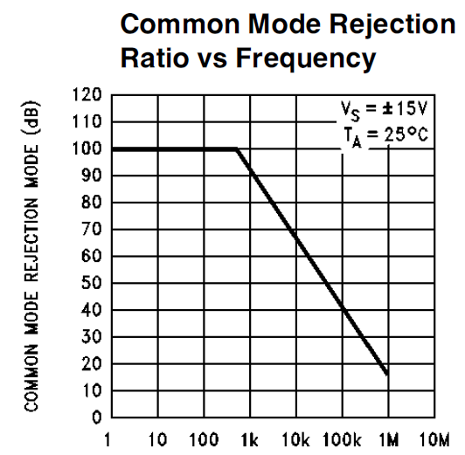
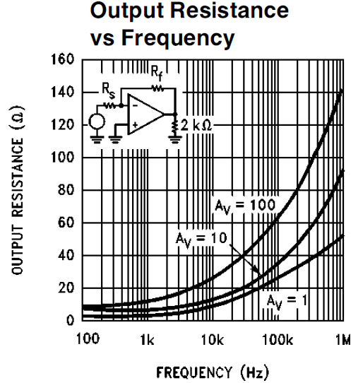
One of many Op-Amp parameters
Typical CMRR is 35,000 (~90 dB)
  Usually measured in db
    CMRR_{db}=20*log₁₀(CMRR)
In real life, Op-Amps come with multipage data sheets (as do everything else)

Slide 15
How are you feeling about…
How are you feeling about Node Voltage and solving basic circuits?
  A. Completely lost
  B. A little behind
  C. Alright
  D. Pretty good
  E. Feel like I’ve attained mastery

Slide 16
How are you feeling about…
How are you feeling about I-V characteristics and Thevenin and Norton equivalents?
  A. Completely lost
  B. A little behind
  C. Alright
  D. Pretty good
  E. Feel like I’ve attained mastery

Slide 17
How are you feeling about…
How are you feeling about Op-Amp circuits?
  A. Completely lost
  B. A little behind
  C. Alright
  D. Pretty good
  E. Feel like I’ve attained mastery

Slide 18
How are you feeling about…
How are you feeling about the midterm?
  A. Terrified
  B. A little scared
  C. Neutralish
  D. Feel prepared
  E. Feel like I will do excellently

Slide 19
Make up Labs
Do you need a make up lab?
A. Yes
B. No

Slide 20
This is where we stopped

Slide 21
UNIT 2
Elements with Memory
a.k.a. Energy Storage Elements

Slide 22
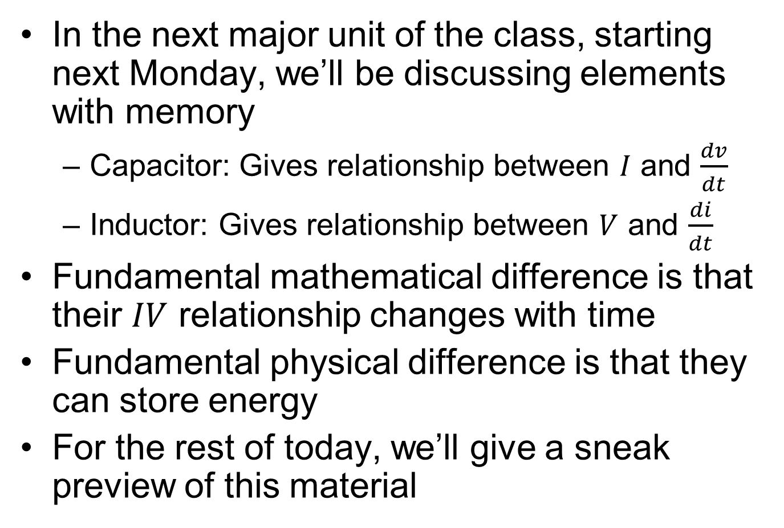
Preview of Unit 2
In the next major unit of the class, starting next Monday, we’ll be discussing elements with memory
  Capacitor: Gives relationship between $I$ and $\frac{dv}{dt}$
  Inductor: Gives relationship between $V$ and $\frac{di}{dt}$
Fundamental mathematical difference is that their $IV$ relationship changes with time
Fundamental physical difference is that they can store energy
For the rest of today, we’ll give a sneak preview of this material

Slide 23
RC Circuits
Taking the Live Demo risk, let’s check out a quick qualitative circuit simulation

Slide 24

The Capacitor
The basic idea is pretty simple
  Imagine you have two parallel metal plates, both of which have equal and opposite excess charges
  Plates are separated by an insulating layer (air, glass, wood, etc)
The charges would love to balance out
Insulator blocks them (just as the ground blocks you from falling into the center of the earth)

Slide 25


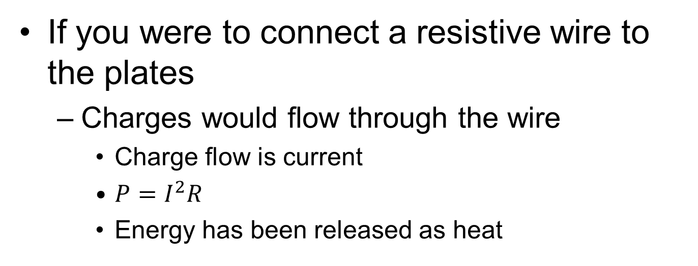
The Capacitor
If you were to connect a resistive wire to the plates
  Charges would flow through the wire
    Charge flow is current
    $P=I^{2}R$
    Energy has been released as heat

Slide 26
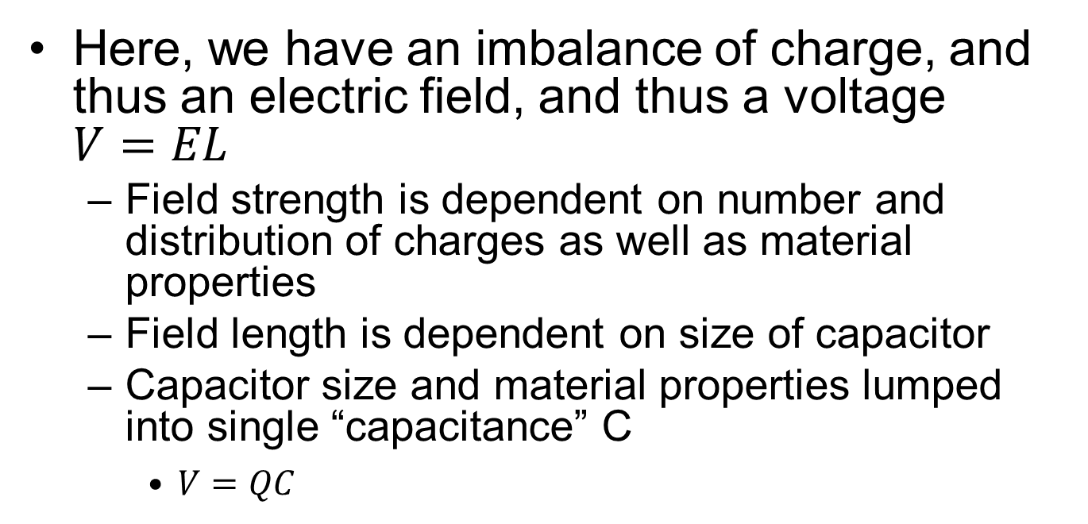
The Capacitor
Remember that a voltage is the electrical potential between two points in space
Here, we have an imbalance of charge, and thus an electric field, and thus a voltage $V=EL$
  Field strength is dependent on number and distribution of charges as well as material properties
  Field length is dependent on size of capacitor
  Capacitor size and material properties lumped into single “capacitance” C
    $V=QC$

Slide 27
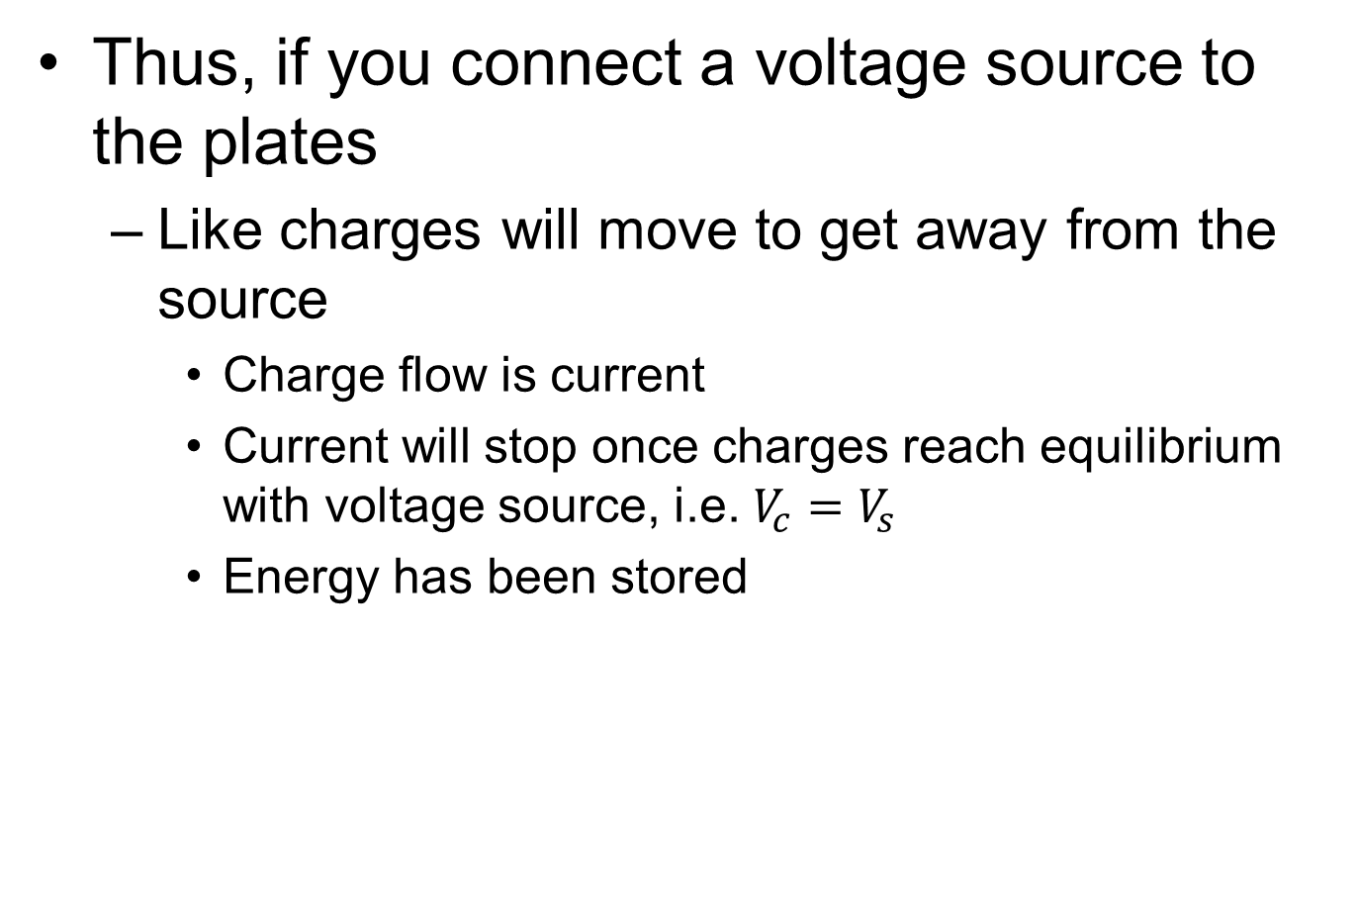
The Capacitor
Thus, if you connect a voltage source to the plates
  Like charges will move to get away from the source
    Charge flow is current
    Current will stop once charges reach equilibrium with voltage source, i.e. $V_{c}=V_{s}$
    Energy has been stored
+
-
+
-
+
-

Slide 28

The Capacitor
Lots of current
Zero current
+
-
+
-
+
-
Zero V_{C}
V_{C}=V_{S}
$$I=C\frac{dV}{dt}$$
Lots of current
Zero of current
High V_{C}
Zero V_{C}

Slide 29
Capacitor
Symbol:
Units: Farads (Coulombs/Volt)
Current-Voltage relationship:
C
or
C
C
Electrolytic (polarized)
capacitor
These have high capacitance and cannot
support voltage drops of the wrong polarity
(typical range of values: 1 pF to 1 μF; for “supercapa-
citors” up to a few F!)
i_{c}
+
v_{c}
–
Note: v_{c} must be a continuous function of time since the
charge stored on each plate cannot change suddenly

Slide 30
Node Voltage with Capacitors
i_{c}
+
v_{c}
–
On board

Slide 31
Ordinary Differential Equations
Inductors, too, give us a simple 1st order relationship between voltage and current
Node Voltage with memoryless circuits gave us algebraic equations
Node voltage with elements with memory will give us Ordinary Differential Equations (ODEs)
Next week will be a bunch of setting up and solving 1st and 2nd order linear ODEs
Higher order and especially nonlinear ODEs are tough to solve. For example…

Slide 32
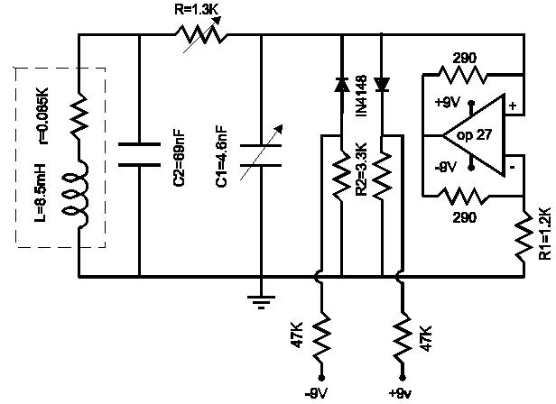



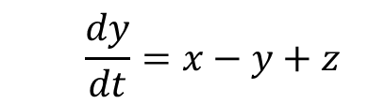


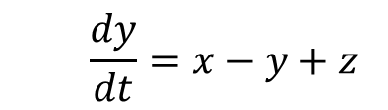
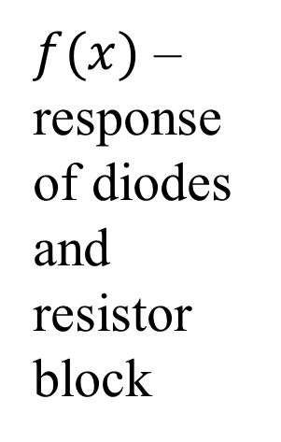


Chua’s Circuit
$f(x)$ – response of diodes and resistor block
  ODEs are:
  $$\frac{dx}{dt}=α(y−x−f\left(x\right))$$
$$x=v_{C1}$$
  $$\frac{dx}{dt}=α(y−x−f\left(x\right))$$
$$y=v_{C1}$$
  $$\frac{dy}{dt}=x−y+z$$
  $$\frac{dy}{dt}=x−y+z$$
$$z=i_{I}$$
  $$\frac{dz}{dt}=−βy$$
  $$\frac{dz}{dt}=−βy$$

Slide 33
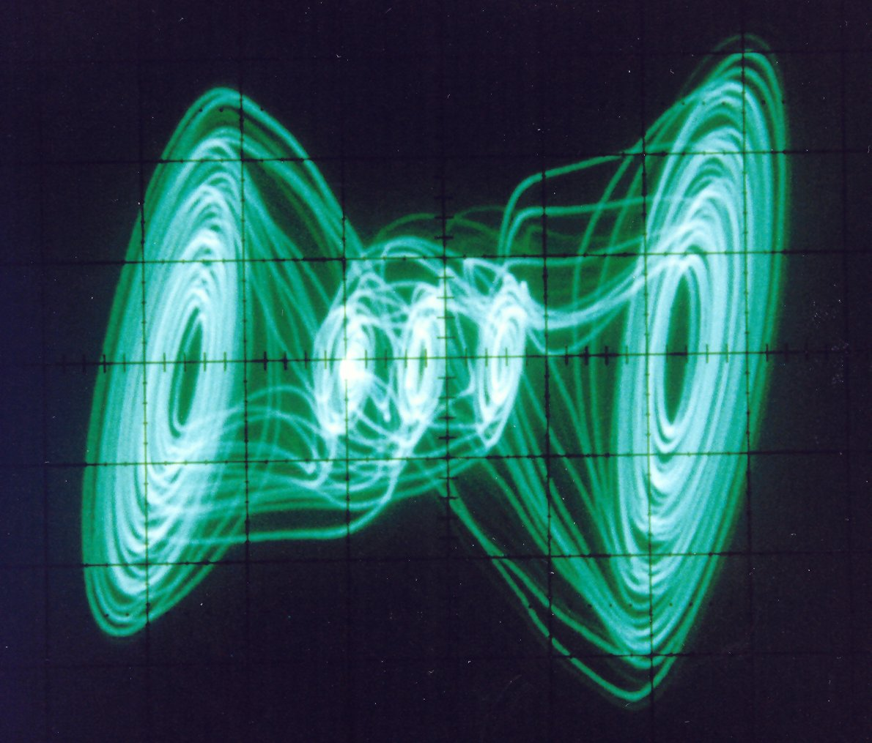
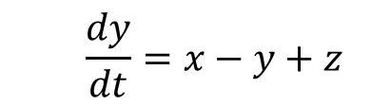


Chua’s Circuit
Despite simplicity of ODEs
Exhibits chaos!
  $$\frac{dx}{dt}=α(y−x−f\left(x\right))$$
  $$\frac{dy}{dt}=x−y+z$$
  $$\frac{dz}{dt}=−βy$$
Invented by current UC Berkeley EECS professor Leon Chua in 1983

Slide 34
Capacitors
Useful for
  Storing Energy
  Filtering
  Modeling unwanted capacitive effects, particularly delay

Slide 35
Good luck on your midterm!
Now on to Jeff’s presentation

