Slide 1
EE40 Lecture 6 Josh Hug
7/2/2010

Slide 2
General Info
HW2 due today at 5PM
HW3 out, due TUESDAY at 2PM
There will be an optional pre-midterm HW available Tuesday
No lecture Monday
Labs as usual on Tuesday
No lab Wednesday
Midterm next Friday in class
12:10-1:30 [be on time!]
No electronic devices
One 8.5”x11” (or A4) sheet of paper
Handwritten anything you want, both sides

Slide 3
Op-Amps – How Good Are They Exactly?
We’ve been studying ideal op-amps
Of course, real Op-Amps aren’t perfect
For example, you can’t drive every device in the universe from a real op-amp
How do we precisely state the quality of a voltage source?
Look at its Thevenin equivalent
Lower Thevenin resistance is better

Slide 4
Example: Batteries
Real voltage sources, like batteries, have a limit to how much current they can draw
Called “internal resistance”
This internal resistance often varies with charge status, load attached, temperature, and more
Just like Thevenin resistance
e.g., a car battery supplies 12 Volts, and can supply at most 200 amps, what is its internal resistance?
R_{TH}
+
V_{TH}
–
+
V_{out}
–
12V/200A=0.06Ω

Slide 5
Measuring the Quality of a Source
If you attach a resistive load, then the output voltage is:
$V_{out}=\frac{R_{L}}{R_{L}+R_{TH}}V_{TH}$
If you want V_{out} to be 99% of V_{TH}, then:
$\frac{99}{100}V_{TH}=\frac{R_{L}}{R_{L}+R_{TH}}V_{TH}$
$R_{L}=99R_{TH}$
So basically, for loads which are more than 99 times the Thevenin resistance, you get >99% of the Thevenin voltage
R_{TH}
+
V_{TH}
–
+
R_{L}
V_{out}
–
Lower R_{TH} is better, can handle
smaller loads

Slide 6
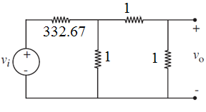
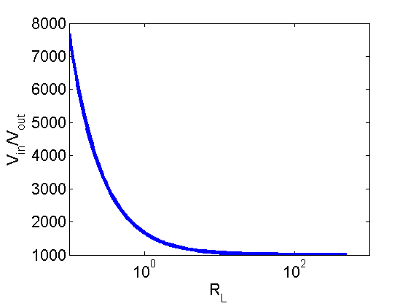
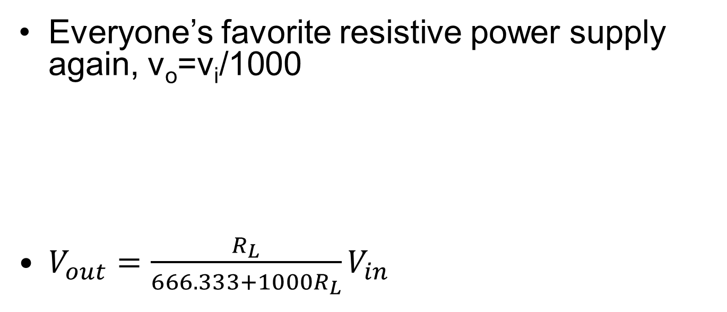
Source Quality Example
Everyone’s favorite resistive power supply again, v_{o}=v_{i}/1000
$V_{out}=\frac{R_{L}}{666.333+1000R_{L}}V_{in}$
V_{out}
V_{in}
R_{L}
2/3Ω
a
_{1/1000V}
–
+
R_{L}=99*2/3Ω=66Ω
66Ω load gets 99% of V_{TH}
b

Slide 7
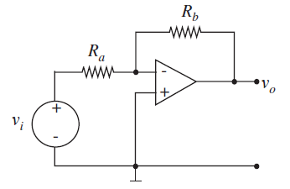
Thevenin Equivalents of Op-Amp circuits
Can find Thevenin equivalent of an op-amp circuit at its output terminals:
Just like finding Thevenin equivalent of a simple resistor based voltage attenuator at its output terminals:
R_{TH}
v_{o}
V_{TH}
–
+
2/3Ω
a
_{1/1000V}
–
+

Slide 8
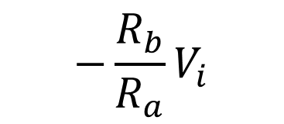
Thevenin of Inverting Amplifier
R_{TH}
v_{o}
$$−\frac{R_{b}}{R_{a}}V_{i}$$
V_{TH}
–
+
Assuming that the op-amp here is IDEAL, what’s the best way to find the Thevenin equivalent circuit?
We’ve already derived that it’s a perfect voltage source!

Slide 9
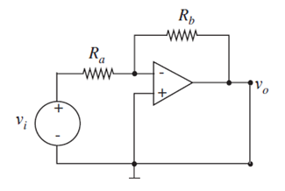
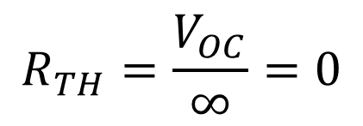
But if you really want to…
$$V_{OC}=−\frac{R_{b}}{R_{a}}V_{in}$$
$$I_{SC}=\frac{V_{out}}{0}=∞$$
$$R_{TH}=\frac{V_{OC}}{∞}=0$$
Technically you should take limits here but we are lazy…

Slide 10
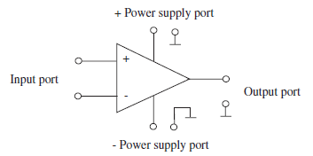
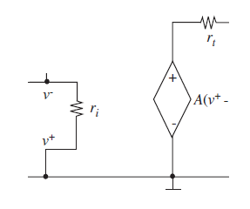
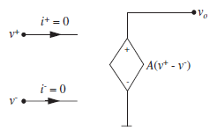
What’s wrong?
Our op-amp model is missing something
That’s why it’s the “ideal” op-amp model
We’ll now introduce the “resistive” op-amp model
Ideal
Resistive Op-Amp Model

Slide 11
Resistive Op-Amp model
Takes in to account the fact that
Some current flows into the input terminals
The op-amp cannot source all device in the universe (output resistance is non-zero)

Slide 12
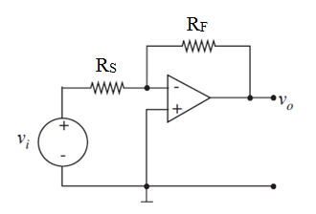

Output Resistance of Inverting Op-Amp
On board (using resistive model of op-amp)
Output Resistance
Tells us how small our load can be before we start losing signal fidelity
$$R_{out}≅\frac{R_{t}}{A\frac{R_{s}}{R_{s}+R_{f}}}$$

Slide 13
Input Resistance
Resistance at the input terminals of a device
Tells us how much current will be generated for a fixed input voltage
Useful, for example, to find power needed to power a device (at that input)
$$R_{in}=R_{s}$$

Slide 14
Input Resistance of Inverting Amplifier
What is the input resistance of an inverting amplifier using ideal op-amp model?
$$R_{in}=R_{s}$$
What is the input resistance of an inverting amplifier using resistive op-amp model?
(See sec 15.42 in book)
$$R_{in}≅R_{s}$$

Slide 15
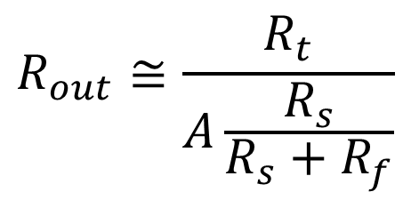
Why are these quantities useful?
$$R_{in}≅R_{s}$$
$$R_{out}≅\frac{R_{t}}{A\frac{R_{s}}{R_{s}+R_{f}}}$$
Input resistance tells us how much current (power) our input signal needs to provide
Output resistance says how small of a load we can drive

Slide 16
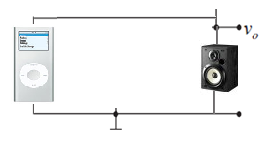
Why are these quantities useful?
An iPod provides roughly 1V signal output with 20Ω internal resistance
Speakers might be 4Ω resistance
Connect iPod directly to such speakers
Internal resistance dominates
$$V_{speaker}=\frac{4}{20+4}×1V=0.17V$$
$$P_{speaker}={0.17}^{2}/4Ω=0.0072 Watts$$

Slide 17
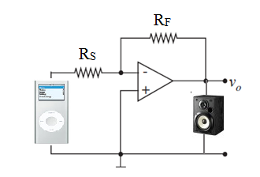
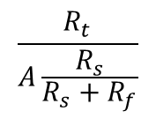
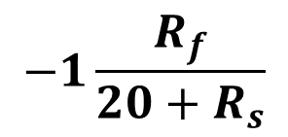
Why are these quantities useful?
$$R_{in}≅R_{s}$$
$$R_{out}≅\frac{R_{t}}{A\frac{R_{s}}{R_{s}+R_{f}}}$$
$$\frac{R_{t}}{A\frac{R_{s}}{R_{s}+R_{f}}}$$
20Ω
1V
–
+
R_{s}
$$−1\frac{R_{f}}{{20+R}_{s}}$$
–
+
4Ω
iPod
Speakers

Slide 18
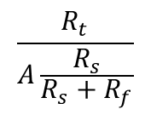
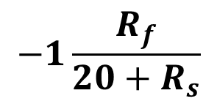
Bad Amplifier (Small R_{s})
$$\frac{R_{t}}{A\frac{R_{s}}{R_{s}+R_{f}}}$$
20Ω
1V
–
+
R_{s}
$$−1\frac{R_{f}}{{20+R}_{s}}$$
–
+
4Ω
iPod
Speakers
Very small R_{s}
iPod must supply 50mW
Output resistance is large (can’t drive speakers)

Slide 19
Good Amplifier
$$\frac{R_{t}}{A\frac{R_{s}}{R_{s}+R_{f}}}$$
20Ω
0.00133Ω
1V
–
+
R_{s}
$$−1\frac{R_{f}}{{20+R}_{s}}$$
–
+
4Ω
2.93V
iPod
Speakers
Must provide 1 mW
R_{s}=1000, R_{f}=3000, A=10⁶, R_{t}=1000

Slide 20
Op-Amp Saturation
Remember those power ports we’ve been ignoring?
They specify the maximum and minimum voltage that our op-amp can deliver
If $v_{min}<A\left(v^{+}−v^{−}\right)<v_{max}$
Op-Amp output is $A\left(v^{+}−v^{−}\right)$
If $A>v_{max}$,
Op-Amp output is $v_{max}$
If $A<v_{min}$,
Op-Amp output is $v_{min}$

Slide 21
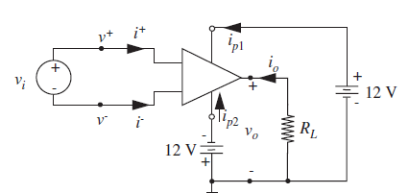
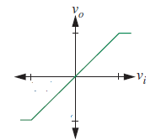
Op-Amp Saturation Example
$v_{max}=12V$, $v_{min}=−12V$
If A=3:
V_{in} | V_{o}
-5 V | -12V
-1V | -3V
2V | 6V
1,512,312V | 12V
12V
4V
-4V
-12V

Slide 22
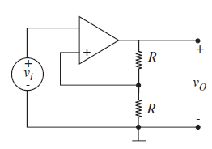
Positive Feedback
On the board

Slide 23
That’s all forOp-Ampsks
No class Monday
Enjoy weekend (doing op-amp problems)

