Slide 1
EE40 Lecture 5 Josh Hug
6/30/2010

Slide 2
General Info
Lab #2 today
HW1 grades up on bspace
Make up lab next week
Date TBA
Discussions going back to 2 hours
HW2 still due Friday at 5 PM
It is long, you should be half done
Get started tonight if you haven’t started yet
Don’t forget about the discussion board
Don’t forget there are other human beings who are also working on this homework

Slide 3
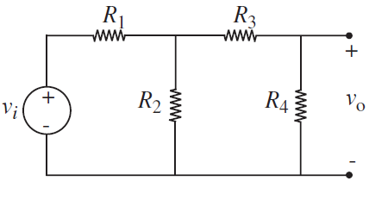
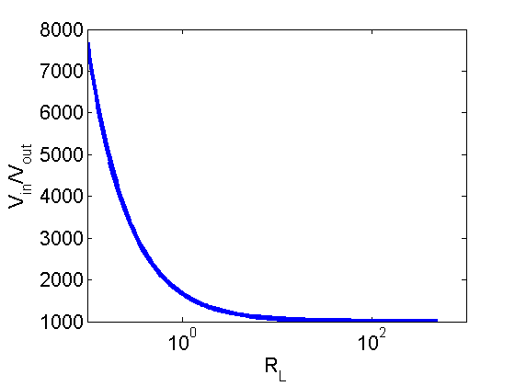
The Need for Dependent Sources
Suppose you build a circuit such that v_{o}=v_{i}/1000, to be used as a power supply
E.g. R₁=332.667Ω, R₂=R₃=R₄=1Ω
Consider what happens when you
attach a load to the power supply,
for example, a resistor
$V_{out}=\frac{R_{L}}{666.333+1000R_{L}}V_{in}$
V_{out}
V_{in}
R_{L}

Slide 4
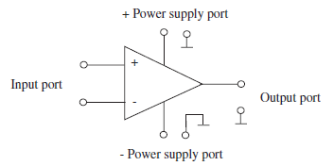
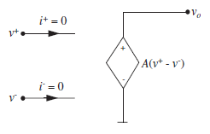
Operational Amplifiers
Dependent Sources are handy
Allows for decoupling
Only one problem:
They don’t exist
The “Operational Amplifier” approximates an ideal voltage dependent voltage source
Very very cool circuits
Analog IC design is hard

Slide 5
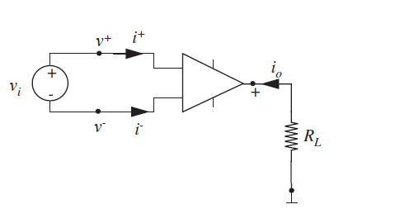
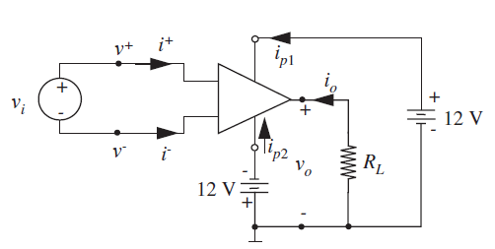
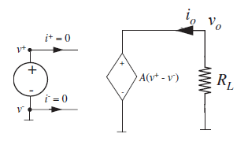
Most Obvious Op-Amp Circuit
We’ll ignore power supply ports for now
$$v_{o}=Av_{i}$$
e.g. A=1/1000

Slide 6
One Problem
The “open loop gain” A is:
Hard to reliably control during manufacturing
Typically very large (A > 1,000,000)
Fixed for a single device
Negative feedback helps us overcome these issues
$$v_{o}=Av_{i}$$

Slide 7
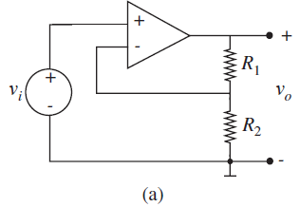
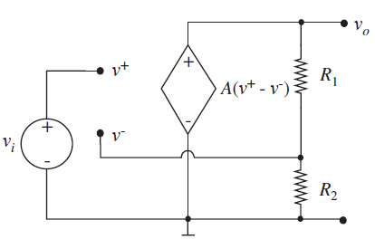
Simple Op-Amp Circuit with Negative Feedback
On the board:
b

Slide 8
Negative Feedback Op-Amp Circuit
Assuming A is very big…
$$v_{o}=\frac{Av_{i}}{A\frac{R_{2}}{R_{1}+R_{2}}}$$
$$v_{o}=\frac{v_{i}}{\frac{R_{2}}{R_{1}+R_{2}}}$$
$$v_{o}=v_{i}\frac{R_{1}+R_{2}}{R_{2}}$$

Slide 9
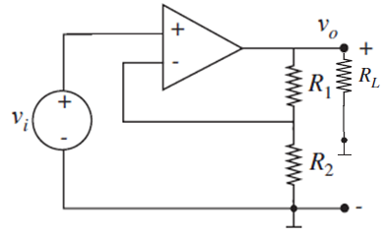
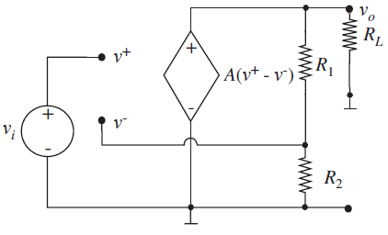
Op-Amp Circuit
Output voltage is independent of load!
One op-amp fits all, just tweak your resistors!
Output is independent of A!
$$v_{o}=v_{i}\frac{R_{1}+R_{2}}{R_{2}}$$

Slide 10
Wait, so whoa, how did that happen?
Let’s consider what happened to $v^{−}$:
$$v^{−}=\frac{Av_{i}}{1+A\frac{R_{2}}{R_{1}+R_{2}}}×\frac{R_{2}}{R_{1}+R_{2}}$$
$$v^{−}=v^{+}\frac{AR_{2}}{R_{1}+R_{2}+AR_{2}}$$
and for large A…
$$v^{−}=v^{+}(1−ε)$$
Where ε represents some tiny number
b

Slide 11
The Voodoo of Analog Circuit Design
For large A:
$$v_{o}=v_{i}\frac{R_{1}+R_{2}}{R_{2}}$$
$$v^{−}=v^{+}(1−ε)$$
The “negative feedback” forces $v^{−}$ to be extremely close to $v^{+}$
This very tiny difference between $v^{−}$ and $v^{+}$ gives us v_{o}

Slide 12
The Voodoo of Analog Circuit Design
For large A:
$$v_{o}=v_{i}\frac{R_{1}+R_{2}}{R_{2}}$$
For this circuit:
$$v^{−}=v^{+}(1−ε)$$
No longer focus on how op-amp drives the output, but instead on how it drives its own input!
The gain “A” disappears, since if it’s really big, the op-amp just forces $v^{−}=v^{+}$

Slide 13
Consequence of Negative Feedback
This input forcing property generalizes to all circuits with “negative feedback”
Specifically, in any circuit where v_{o} is connected back to $v^{−}$(and not to $v^{+}$), we have the property that $v^{−}=v^{+}(1−ε)$
We’ll approximate this by assuming that $v^{−}=v^{+}$
Not actually equal, otherwise the op-amp would not do anything
However with A>1,000,000, this approximation is incredibly accurate
Less error from this approximation than component variation, temperature variation, etc.

Slide 14
Approach to Op-Amp Circuits
An op-amp connected in a negative-feedback configuration does the following:
Forces ${ v}^{−}=v^{+}(1−ε)$
Can approximate by ${ v}^{−}=v^{+}$
Our prior approach was to replace the op-amp by dependent source and solve
This opens up a new approach
$$i^{+}$$
$$v^{+}$$
$$i^{−}$$
$$v^{−}$$

Slide 15
Approach to Op-Amp Circuits
If there’s only negative feedback:
Assume $v^{+}=v^{−}$
Assume $i^{+}=0$ and $i^{−}=0$
If there’s no feedback or positive feedback, replace the op-amp with equivalent dependent source and solve
“Summing-point constraint”
$$i^{+}$$
$$v^{+}$$
$$i^{−}$$
$$v^{−}$$

Slide 16
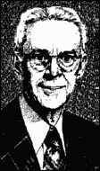
Negative Feedback Amplifiers
$$i^{+}$$
$$v^{+}$$
$$v^{+}=v^{−}$$
$$i^{−}$$
$i^{+}=0$ and $i^{−}=0$
$$v^{−}$$
Concept was invented on a ferry to Manhattan by Harold Stephan Black during his morning commute to Bell Labs in Manhattan in 1927, originally sketched out on a blank spot of his New York Times
The idea is bizarre, but really epic
Completely revolutionized electronics
9 years before patent office believed it

Slide 17
If you’re a little lost
Don’t fret, the idea is weird
At first, just keep in mind the important thing:
An op-amp with negative feedback has the properties that
$v^{+}=v^{−}$
$i^{+}=0$ and $i^{−}=0$
Later, if you want to show that this really works, do an op-amp circuit from scratch by replacing the op-amp with a voltage source, and you’ll get the same answer

Slide 18
Example using the Summing-Point Constraint
$$v^{−}=v^{+}=v_{i}$$
$$i^{−}=0, i^{+}=0$$
$${i_{R}}_{2}=\frac{v^{−}}{R_{2}}=\frac{v_{i}}{R_{2}}$$
$$i_{R_{1}} =i^{−}+{i_{R}}_{2}$$
$$={i_{R}}_{2}$$
$$=\frac{v_{i}}{R_{2}}$$
$$v_{o}=v_{i}+i_{R_{1}}R_{1}$$
$$=v_{i}+v_{i}R_{1}/R_{2}$$
$$=v_{i}\frac{R_{1}+R_{2}}{R_{2}}$$
b

Slide 19
Summing-Point Constraint
You don’t have to use the summing-point constraint
However, it is much faster, albeit less familiar and thus a little tricky at first

Slide 20
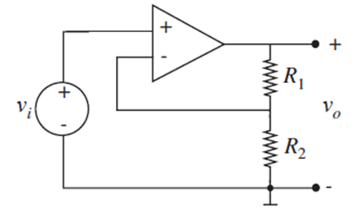
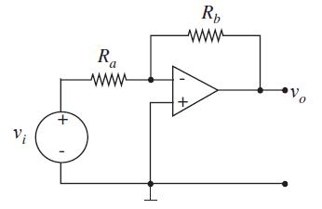
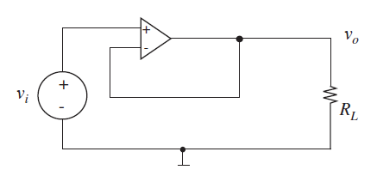
Op-Amp Circuits
There are a bunch of archetypical circuits, the one we’ve studied so far is the “non-inverting amplifier”
Inverting amplifier
$$v_{o}=v_{i}\frac{R_{1}+R_{2}}{R_{2}}$$
Voltage follower
$$v_{o}=−\frac{R_{b}}{R_{a}}v_{i}$$
$$v_{o}=v_{i}$$

Slide 21
Board Problems Time
Let’s go through some problems on the board

Slide 22
And then we were done…
We did some op-amp problems in class and then called it a day here, next slides will appear on Friday

Slide 23
Op-Amps – How Good Are They Exactly?
Of course, Op-Amps aren’t perfect
You can’t drive every device in the universe from one op-amp
How do we measure how good a voltage source is?
Looking at its Thevenin equivalent
Lower Thevenin resistance is better

Slide 24
Measuring the Quality of a Source
If you attach a resistive load, then the output voltage is:
$V_{out}=\frac{R_{L}}{R_{L}+R_{TH}}V_{TH}$
If you want V_{out} to be 99% of V_{TH}, then:
$\frac{99}{100}V_{TH}=V_{TH}\frac{R_{L}}{R_{L}+R_{TH}}$
$R_{L}=99R_{TH}$
So basically, for loads which are more than 99 times the Thevenin resistance, you get >99% of the Thevenin voltage
R_{TH}
+
V_{TH}
–
+
R_{L}
V_{out}
–
Lower R_{TH} is better, can handle
smaller loads

Slide 25
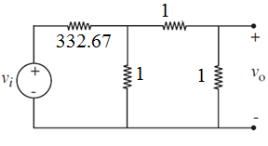
Source Quality Example
Suppose you build a circuit such that v_{o}=v_{i}/1000, to be used as a power supply
$V_{out}=\frac{R_{L}}{666.333+1000R_{L}}V_{in}$
V_{out}
V_{in}
R_{L}
2/3Ω
a
_{1/1000V}
–
+
R_{L}=99*2/3Ω=66Ω
66Ω load gets 99% of V_{TH}
b

Slide 26
Thevenin Equivalents of Op-Amp circuits
Can look at Thevenin equivalent of an op-amp circuit at its output terminals:
Just like converting a simple resistor based voltage attenuator:
R_{TH}
v_{o}
V_{TH}
–
+
2/3Ω
a
_{1/1000V}
–
+

