Slide 1
EE40 Lecture 4 Josh Hug
6/28/2010

Slide 2
For those of you watching the webcast…
We started today with a bunch of blackboard problems
Hopefully they are legible online, let me know if they’re not
Scanned copies of my notes will be available online within a day or so

Slide 3
iClicker Logistics
Everyone should go register their iClicker at iClicker.com
Directions will be posted on the website, but it’s pretty easy
Your student ID is just the first letter of your first name, and then your entire last name, example:
John Quincy Onahal-Menchura would have ID “JONAHAL-MENCHURA”
Just to be safe, enter your ID in all capital letters

Slide 4
Late HW Logistics
Reminder: You get 1 late homework with no penalty, and 1 dropped homework
If you want to turn in a HW late, you must email the readers (CC the email to me as well)
Make sure “Late Homework” is in the title
This will help us with book keeping of who has turned in a late homework
Late homeworks are due by the next homework deadline
If you don’t email us, no late credit!

Slide 5
Midterm
We still have 11 days until the first midterm (July 9th)
Will cover everything up to and including what we do this Friday (July 2nd)
You will be allowed one 8.5” x 11” sheet of paper with anything you want to write on it
Must be handwritten
You can keep it after the exam
Each midterm you will be allowed to augment your equation collection by 1 additional sheet of paper

Slide 6
Lunch and Webcasts
If you signed up for lunch, just come up at the end of class and we’ll head out together after the post-lecture question battery
A couple of lunch spots left if you didn’t sign up
Webcasts now available for lectures 1-3, should be linked in the same directory as the actual lectures
Lecture 2 debugging (“in parallel” vs. “in parallel”) coming after class

Slide 7
Important Dates this Week
Lab #1 on Tuesday
Do pre-lab before lab (available on line)
Submit prelab in lab
Lab #2 on Wednesday
Make up lab to be scheduled if there is a need, most likely on Thursday
HW2 posted, due Friday at 5 PM
It is long, get started early

Slide 8
Secret Office Hours
By request, holding an extra office hour today
477 Cory, 3:15PM-4:15 PM
If you’re behind and you can come, please do

Slide 9
iClicker HW1
For those that turned in HW1, approximately how much time did you spend on homework 1?
0-3 hours
3-6 hours
6-9 hours
9-12 hours
More than 12 hours

Slide 10
iClicker HW1
Did you guys work on the homework solo or with others?
I did the homework completely solo
I had some, but not much, interaction with others
Mostly alone, but then worked in Cory 240 with the impromptu last minute study group
Did homework solo, but then went over homework with a group that I’ll probably work with again
Worked with a group that I’ll probably work with again (this is ok!)

Slide 11
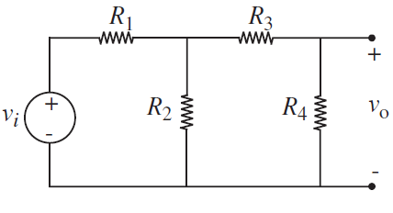
The Need for Dependent Sources
Suppose you build a circuit such that v_{o}=v_{i}/1000, to be used as a power supply
E.g. R₁=332.667Ω, R₂=R₃=R₄=1Ω
Consider what happens when you attach a load to the power supply, say a resistor
$V_{out}=\frac{R_{L}}{666.333+1000R_{L}}V_{in}$
V_{out}
V_{in}
R_{L}
Doesn’t work for:
Very high R_{L}
Very low R_{L}
Very high or low R_{L}

Slide 12
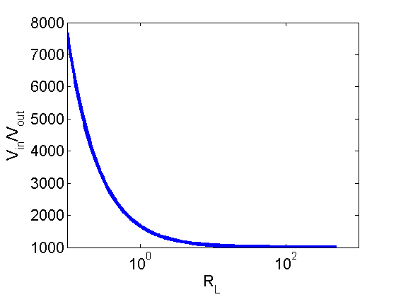
:
R₁=332.667 Ω, R₂=R₃=R₄=1Ω
V_{out}
V_{in}
R_{L}
For R_{L} < 10Ω or so, we have distortion
Can mitigate this distortion with different resistor values, but there’s a better way

Slide 13
Building a Better Attenuator
Using any ideal basic circuit element that we’ve discussed, what’s the best possible circuit we can design so that V_{out}=v_{in}/1000?

Slide 14
Dependent Sources
Dependent sources are great for decoupling circuits!
Only one problem:
They don’t exist

Slide 15
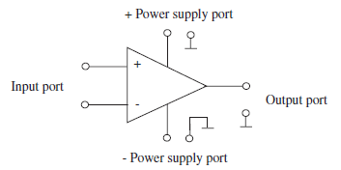
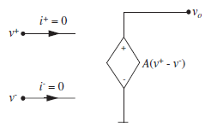
Operational Amplifiers
Dependent Sources are handy
Allows for decoupling
Only one problem:
They don’t exist
The “Operational Amplifier” approximates an ideal voltage dependent voltage source
Very very cool circuits
Analog IC design is hard

Slide 16
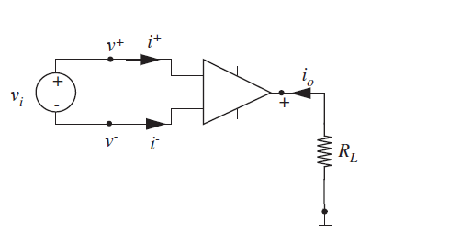
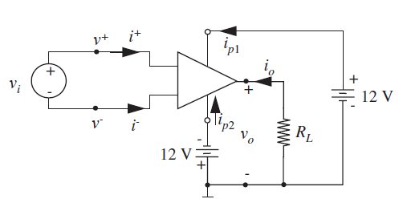
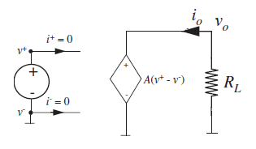
Most Obvious Op-Amp Circuit
$$v_{o}=Av_{i}$$

Slide 17
One Problem
The “open loop gain” A is:
Hard to reliably control during manufacturing
Typically very large (A > 1,000,000)
Fixed for a single device
For example, if you needed V_{o}=V_{in}/1000 within 2%, you’d need a high quality op-amp with A=1/1000
Could spend a lot of time and money addressing these, but there is a better way
$$v_{o}=Av_{i}$$

Slide 18
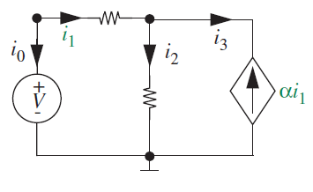
Feedback
Recall before that I mentioned that dependent sources can provide feedback to their controlling input, e.g.:
Remember also that these can be a little tricky to analyze

Slide 19
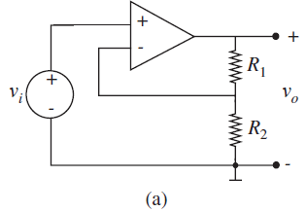
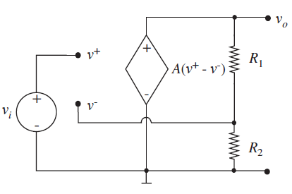
Simple Op-Amp Circuit with Negative Feedback
On the board:
b

Slide 20
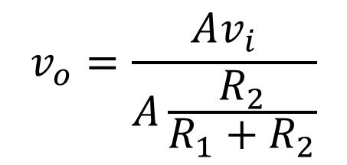
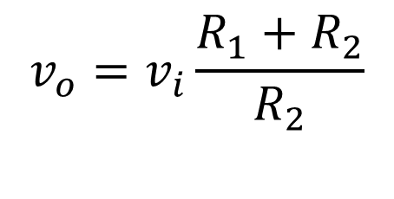
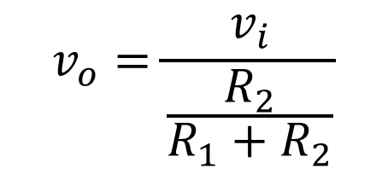
Negative Feedback Op-Amp Circuit
Assuming A is very big…
$$v_{o}=\frac{Av_{i}}{A\frac{R_{2}}{R_{1}+R_{2}}}$$
$$v_{o}=\frac{v_{i}}{\frac{R_{2}}{R_{1}+R_{2}}}$$
$$v_{o}=v_{i}\frac{R_{1}+R_{2}}{R_{2}}$$

Slide 21
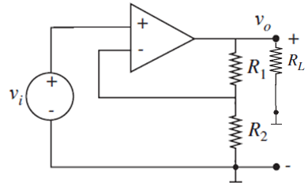
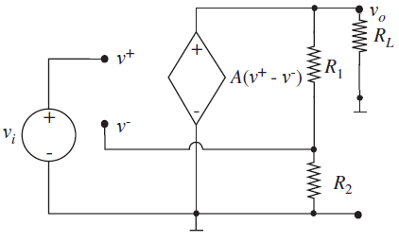

Op-Amp Circuit
Output voltage is independent of load!
One op-amp fits all, just tweak your resistors!
Output is independent of A!
$$v_{o}=v_{i}\frac{R_{1}+R_{2}}{R_{2}}$$

Slide 22
Wait, so whoa, how did that happen?
Let’s consider what happened to $v^{−}$:
$$v^{−}=\frac{Av_{i}}{1+A\frac{R_{2}}{R_{1}+R_{2}}}×\frac{R_{2}}{R_{1}+R_{2}}$$
$$v^{−}=v^{+}\frac{AR_{2}}{R_{1}+R_{2}+AR_{2}}$$
and for large A…
$$v^{−}=v^{+}(1+ε)$$
Where ε represents some tiny number
b

Slide 23
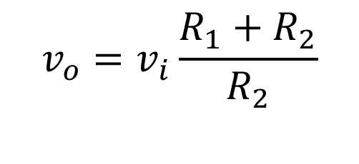
The Voodoo of Analog Circuit Design
For large A:
$$v_{o}=v_{i}\frac{R_{1}+R_{2}}{R_{2}}$$
$$v^{−}=v^{+}(1+ε)$$
The “negative feedback” forces $v^{−}$ to be extremely close to $v^{+}$
This very tiny difference between $v^{−}$ and $v^{+}$ gives us v_{o}

Slide 24
Consequence of Negative Feedback
In any circuit where v_{o} is connected back to $v^{−}$(and not to $v^{+}$), we have the property that $v^{−}=v^{+}(1+ε)$
We’ll approximate this by assuming that $v^{−}=v^{+}$
Of course it’s not actually equal, otherwise the op-amp would not do anything
However with A>1,000,000, this approximation is incredibly acscurate
Less error from this approximation than component variation, temperature variation, etc.

Slide 25
Approach to Op-Amp Circuits
If there’s only negative feedback:
Assume $v^{+}=v^{−}$
Assume $i^{+}=0$ and $i^{−}=0$
If there’s no feedback or positive feedback, replace the op-amp with equivalent dependent source and solve
“Summing-point constraint”
$$i^{+}$$
$$v^{+}$$
$$i^{−}$$
$$v^{−}$$

Slide 26
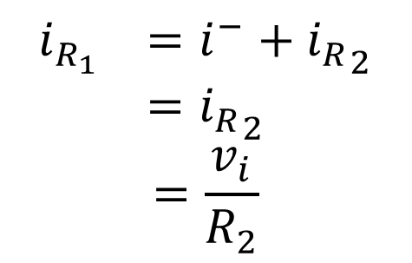
Example using the Summing-Point Constraint
$$v^{−}=v^{+}=v_{i}$$
$$i^{−}=0, i^{+}=0$$
$${i_{R}}_{2}=\frac{v^{−}}{R_{2}}=\frac{v_{i}}{R_{2}}$$
$$i_{R_{1}} =i^{−}+{i_{R}}_{2}$$
$$={i_{R}}_{2}$$
$$=\frac{v_{i}}{R_{2}}$$
$$v_{o}=v_{i}+i_{R_{1}}R_{1}$$
$$=v_{i}+v_{i}R_{1}/R_{2}$$
$$=v_{i}\frac{R_{1}+R_{2}}{R_{2}}$$
b

Slide 27
Summing-Point Constraint
You don’t have to use the summing-point constraint
However, it is much faster, albeit trickier
This is where building your intuition helps, so you can see where to go next

Slide 28
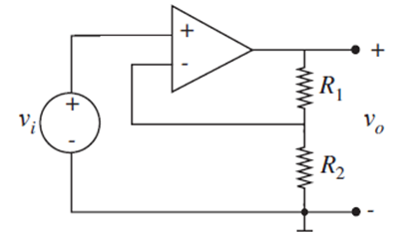
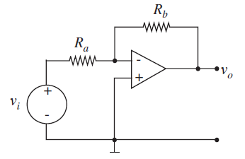
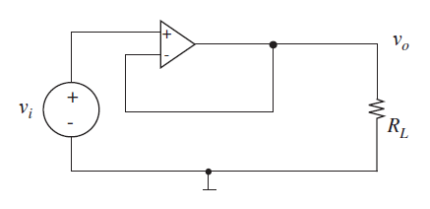
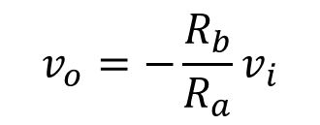

Op-Amp Circuits
There are a bunch of archetypical circuits, the one we’ve studied today is the “non-inverting amplifier”
Inverting amplifier
$$v_{o}=v_{i}\frac{R_{1}+R_{2}}{R_{2}}$$
Voltage follower
$$v_{o}=−\frac{R_{b}}{R_{a}}v_{i}$$
$$v_{o}=v_{i}$$

Slide 29
For Next Time
Lots more op-amp circuits
Useful for abstractions for analyzing and designing op-amp circuits
Before we go, a couple of questions

Slide 30
Pacing
Class Pacing
Way too slow
Too slow
Just right
Too fast
Way too fast

Slide 31
Blackboard
PowerPoint vs. chalkboard
Almost always prefer PowerPoint
PowerPoint is slightly preferable
Whatever is fine
Chalkboard is a bit better
I’d prefer little to no PowerPoint

Slide 32
Extra Slides

Slide 33
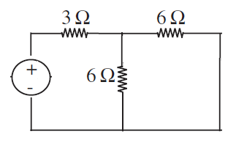
Voltage Sources and the Node Voltage Method
I didn’t point this out explicitly, but whenever you have a voltage source that connects two nodes, and neither of those nodes are ground, e.g.
Then you have to write KCL for the surface enclosing the two nodes (the book calls these surfaces “supernodes”)
If a node has N voltage sources, the surface will include N nodes
3V

Slide 34
Supernode Example
v_{a}
$$v_{a}=v_{b}+3$$
3V
Treat a and b together as one node, giving KCL:
v_{b}
$$\frac{v_{a}}{3}+\frac{v_{b}}{6}+\frac{v_{a}}{6}=0$$
If you try to write KCL for node a or b alone, you’ll get stuck when you try to write the current from a to b.

Slide 35
Note to Non-Native Speakers
I try my hardest to make sure the language on homework problems and on tests is clear
Please don’t hesitate to ask me if something seems confusing

