Slide 1
EE40
Lecture 18 Josh Hug
8/06/2010

Slide 2
Logistics
HW8 due today @5PM – short but tough
Mini-midterm 3 next Wednesday
  80/160 points will be a take-home set of design problems which will utilize techniques we’ve covered in class
    Posted online
  Other 80/160 will be an in class midterm covering HW7 and HW8
Final will include Friday and Monday lecture, Midterm won’t
  Design problems will provide practice

Slide 3
Project 2
Project 2 demos next Wednesday (after midterm), need two things to be “done”:
  Check-off: Verifying that your circuit works - can optionally be done before Wednesday if you’re worried about circuit breaking before presentation
  Presentation: Asking you questions about why your circuit works
  No lab report
Presentation will be Wednesday in lab
  1:15 PM until we’re done (~3:00 PM?)
  Cooper, Onur, and I will walk around asking questions
  Bring your circuit even if function is checked-off

Slide 4
Project 2
Booster lab actually due next week
  For Booster lab, ignore circuit simulation, though it may be instructive to try the Falstad simulator
Project 2 demos next Wednesday (after midterm)

Slide 5
EE40 this Summer
We’ve covered a terrifyingly large number of things for only 7 weeks
By this time last semester, they had just finished RC and RL circuits and hadn’t started phasors yet, we’ve done all that and:
  Phasors
  Transfer Functions and Filtering
  Real and Reactive Power
  Bode Plots
  Qualitatively: Integrated Circuits Manufacturing
  Defining Digital Systems
  MOSFET structure and 3 models of the MOSFET
  Discussed analysis and design of transistor circuits
    Function
    Delay
    Power Dissipation
  Diode circuit analysis
You’ll pardon me if we have a little fun…

Slide 6
Rewatching Lectures
As you remember in lecture this week, I realized I like saying “kind of” and “sort of” a lot
  I rewatched some of my lectures, and it is worse than I had feared
  Annihilates any residual professorial gravitas remaining to a short grad student with long hair
As expected, youtube comments are less than friendly
Let’s set the record straight, iClicker style

Slide 7


BYMYSYD – we’ll start easy
How terrible is my handwriting?
  A. Often illegible
  B. Readable, but painful to behold
  C. It’s fine
  D. It’s great, also I am a liar
  $4$

Slide 8

YTISubZero
Do I seem to be high in class?
  A. Never
  B. Sometimes
  C. I am basically watching Cheech and Chong give a lecture on electrical engineering [if you are too young, substitute “Harold and Kumar”]

Slide 9

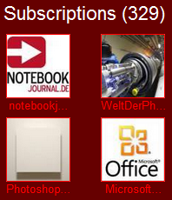
Yokombo – Lecture on RC and RL circuits
How freakish am I?
  A. Seem pretty normal
  B. Normal, except the weird walk
  C. Eccentric, in a safely professorish way
  D. I have on occasion been afraid to come to class

Slide 10

hivedrone83
This one was pretty funny.

Slide 11
Today
Intro to semiconductor physics
Diodes and PN-Junctions

Slide 12
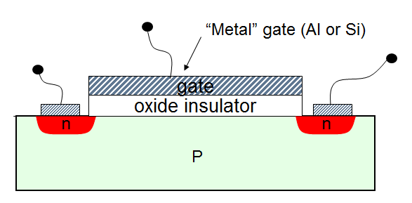
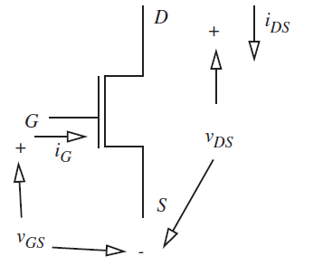


Semiconductor Devices
Physical Device
Symbol
I
N
P
I
−
+
−
$$V_{D}$$
+
$$V_{D}$$
What are “P” and “N”?
  Magic?
  Alchemy?

Slide 13
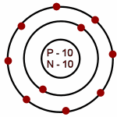
Atomic Structure
Electrons are organized into DISCRETE orbitals, basically a nested set of shells
If you rememeber high school chemistry:
  Neon’s electronic subshells: 1s²2s²2p⁶
The existence of these shells plays a key role in conductivity. It is hard to give an electron to someone with no room to hold it.
http://www.iq.poquoson.org/6sci/atoms/neonA.gif

Slide 14
Valence Shells
Differently put: When you apply an electric field, the electrons want to speed up
They’re close to nuclei, so they have to follow the rules: Only discrete energy levels (even when transiting across the material)
Can’t go up to the next level, because the electric field can’t get them that high

Slide 15
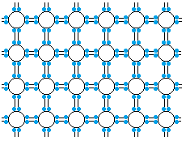
Classification of Materials: Insulators
Solids in which all electrons are tightly bound to atoms are insulators.
  e.g. Neon: applying an electric field will tend to do little, because it is hard for an electron to move in to your neighbors valence shell.

Slide 16
Electrons in Conductors and Insulators
Solids with “free electrons” – that is electrons not directly involved in the inter-atomic bonding- are the familiar metals (Cu, Al, Fe, Au, etc)
  Often 1 free electron per atom
Solids with no free electrons are the familiar insulators (glass, quartz crystals, ceramics, etc.)

Slide 17
Resistance of a Metal vs. Temperature
How does the resistance of a metal vary with temperature?
  A. Resistance increases as temperature goes up
  B. Resistance decreases as temperature goes up

Slide 18
Why?
In a hot metal everything is moving around a lot more
Electrons trying to get from point a to point b are constantly running into this big disorderly surface fluctuating around them
A very cold metal, by contrast, sits relatively still, so electrons can zoom along the lattice unhindered

Slide 19
Electrons in Semiconductors
Silicon is an insulator, but at higher temperatures some of the bonding electrons can get free and make it a little conducting – hence the term “semiconductor”
Pure silicon is a poor conductor (and a poor insulator). It has 4 valence electrons, all of which are needed to bond with nearest neighbors. No free electrons.

Slide 20
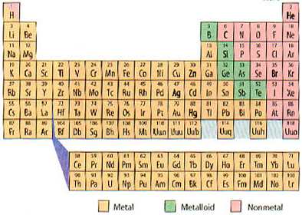
The Periodic Table
III IV V

Slide 21
Electronic Bonds in Silicon
2-D picture of perfect crystal of pure silicon; double line is a Si-Si bond with each line representing an electron
Essentially no free electrons, and no conduction - insulator
Actual structure is 3-dimensional tetrahedral- just like carbon bonding in organic and inorganic materials.

Slide 22
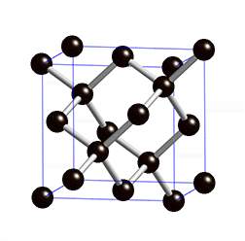
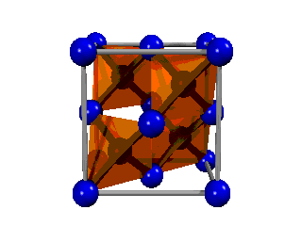
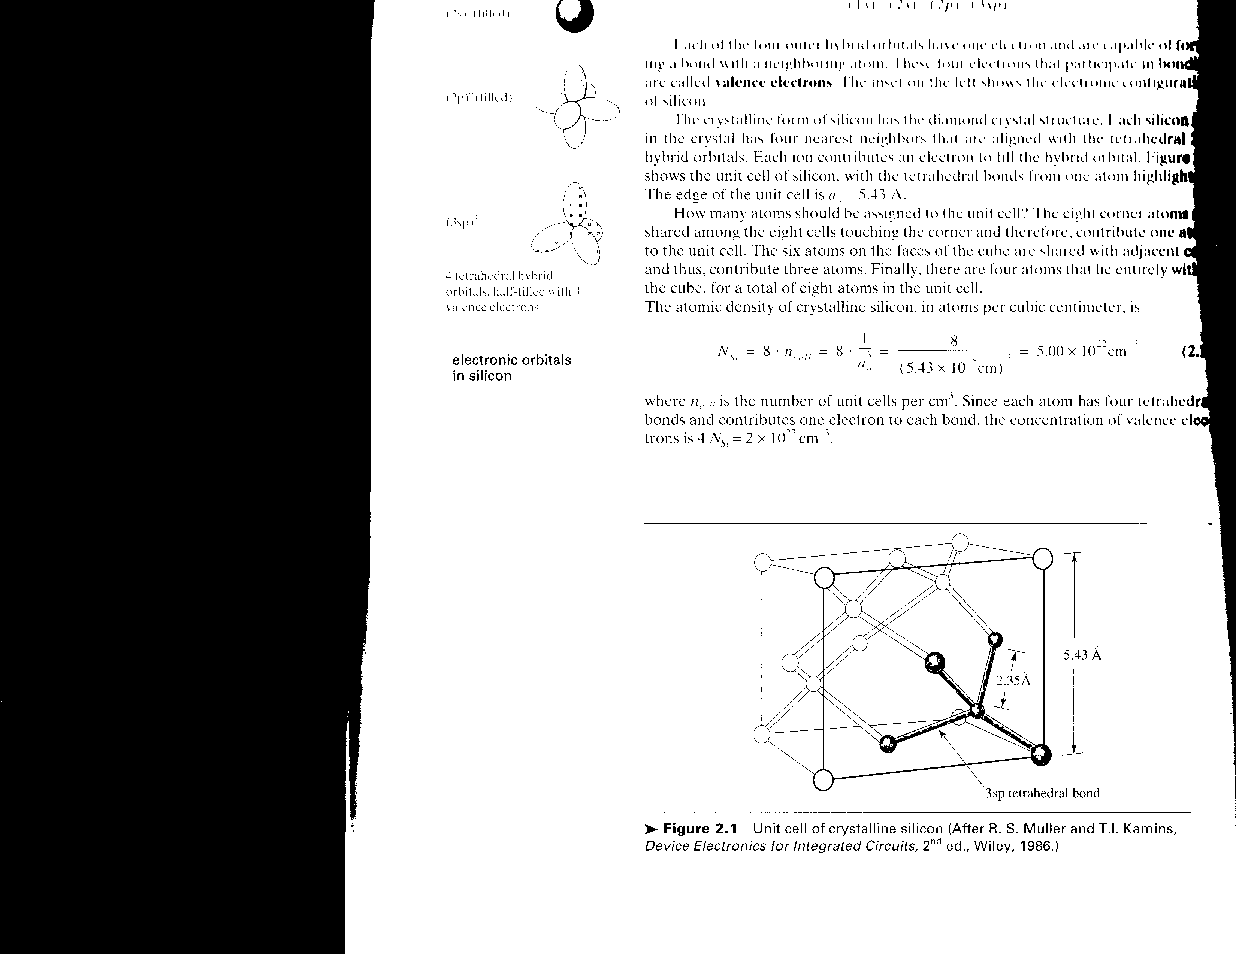



Crystal Structure of Silicon
How dense?
$$≈5×{10}^{22}/cm^{3}$$
Animated Movies from wikipedia

Slide 23
Bandgap
Electrons are mobile in the “conduction band”, but in the “valence band”, they are locked in (because valence band is full)
The excited electrons move from the valence band into the conduction band
  When there is an extremely strong electric field
  Or when the crystal is illuminated with photons whose energy is larger than the bandgap energy
  Or when the crystal is sufficiently heated

Slide 24
Semiconductors
Resistance DECREASES with temperature
  Yes, everything is jostling around more!
    More electrons can be shaken free to move around
    While traveling, these electrons endure scattering as they repeatedly run into the jostling landscape. Heat exacerbates this
  You can’t win if you don’t play
    More players
    Worse odds
    Still get more absolute number of successes

Slide 25
Bandgap
If an electron is excited into the conduction band, it can move
Interestingly, the “hole” left behind at the bottom can also move.
  No actual hole particle, but the ensemble of electrons can move as a whole [no pun intended]

Slide 26
Shockley’s Parking Garage Analogy for Conduction in Si
Two-story parking garage on a hill:
  If the lower floor is full and top one is empty, no traffic is possible. Analog of an insulator or a non-excited semiconductor. All electrons are locked up.

Slide 27
Shockley’s Parking Garage Analogy for Conduction in Si
Two-story parking garage on a hill:
  If one car is moved upstairs, it can move AND THE HOLE ON THE LOWER FLOOR CAN MOVE. Conduction is possible. Analog to warmed-up semiconductor. Some electrons get free (and leave “holes” behind).

Slide 28
Shockley’s Parking Garage Analogy for Conduction in Si
Two-story parking garage on a hill:
  If an extra car is “donated” to the upper floor, it can move. Conduction is possible. Analog to N-type semiconductor. (An electron donor is added to the crystal, creating free electrons).

Slide 29
Shockley’s Parking Garage Analogy for Conduction in Si
Two-story parking garage on a hill:
  If a car is removed from the lower floor, it leaves a HOLE which can move. Conduction is possible. Analog to P-type semiconductor. (Acceptors are added to the crystal, “consuming” bonding electrons,creating free holes).

Slide 30
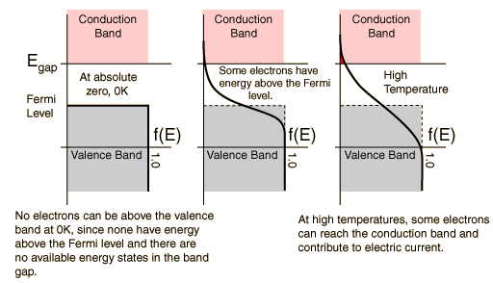
Fermi-Dirac Distribution
Fermi-Dirac function provides the probability that an energy level is occupied by a fermion which is under thermal equilibrium. Electrons as well as holes are Fermions and hence obey Fermi-Dirac statistics.
Fig. 5. Fermi function plots at absolute zero, mid-range, and high temperature.

Slide 31
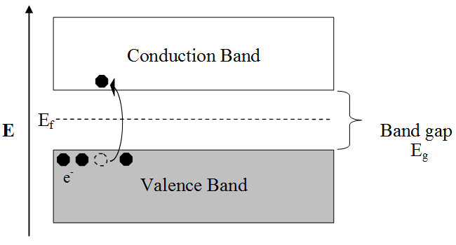
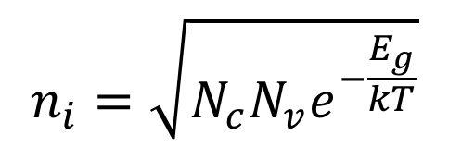

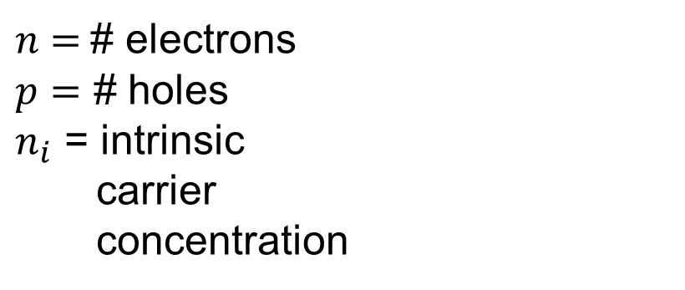


Fermi-Dirac Distribution of Electrons and Holes
$n$ $=$# electrons
$p=$ # holes
$n_{i}$ = intrinsic
carrier
concentration
$$n=p$$
$$n×p=n_{i}^{2}$$
$N_{C}=$# states in conduction band
$N_{V}=$# states in valence band
$E_{g} =$Energy gap between bands
$k =$Boltzman constant
$T =$Temperature
$$n_{i}=\sqrt{N_{c}N_{v}e^{−\frac{E_{g}}{kT}}}$$
@ Room temperature:
$$n_{i}≈{10}^{10}/cm^{3}$$

Slide 32
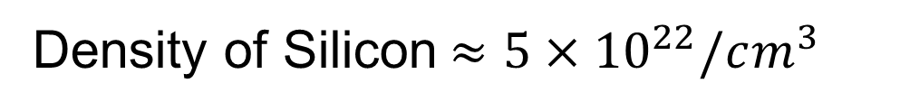
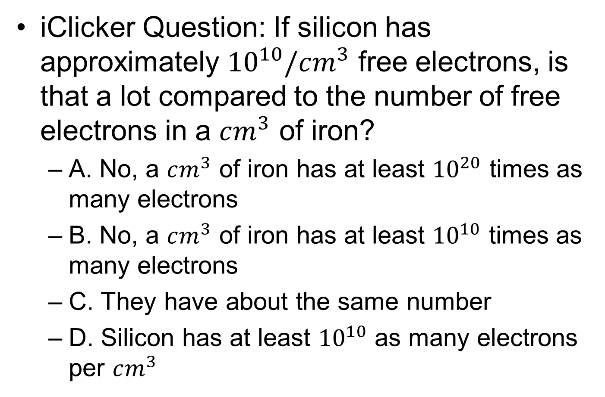
10 billion electrons seems like a lot to me
iClicker Question: If silicon has approximately ${10}^{10}/cm^{3}$ free electrons, is that a lot compared to the number of free electrons in a $cm^{3}$ of iron?
  A. No, a $cm^{3}$ of iron has at least ${10}^{20}$ times as many electrons
  B. No, a $cm^{3}$ of iron has at least ${10}^{10}$ times as many electrons
  C. They have about the same number
  D. Silicon has at least ${10}^{10}$ as many electrons per $cm^{3}$
Density of Silicon$≈5×{10}^{22}/cm^{3}$

Slide 33
How to get conduction in Si?
We must either:
1) Chemically modify the Si to produce free carriers (permanent) or
2) Transiently “induce” them by electric fields, photons, or temperature (temporary)
For the first approach, controlled impurities, “dopants”, are added to Si:
  Add group V elements (5 bonding electrons vs four for Si), such as phosphorus or arsenic
(Extra electrons produce “free electrons” for conduction.)
    or
Add group III elements (3 bonding electrons), such as boron
Deficiency of electrons results in “free holes”

Slide 34
The Periodic Table
III IV V

Slide 35
Doping Silicon with Donors (n-type)
Donors donate mobile electrons (and thus “n-type” silicon)
Example: add arsenic (As) to the silicon crystal:
The extra electron with As, “breaks free” and becomes a free electron for conduction

Slide 36
Doping with Acceptors (p-type)
Group III element (boron, typically) is added to the crystal
The “hole” which is a missing bonding electron, breaks free from the B acceptor and becomes a roaming positive charge, free to carry current in the semiconductor. It is positively charged.

Slide 37
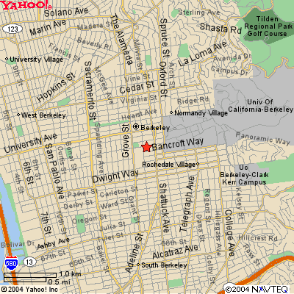
Doping
Typical doping densities: 10¹⁶~10¹⁹ cm⁻³
Atomic density for Si: 5 x 10²² atoms/cm³
Dopant concentration of 10¹⁸ cm⁻³ is 1 in 50,000
Doping is like
    Two people in all of Berkeley wearing a green hat

Slide 38




Electron and Hole Densities in Doped Si
Instrinsic (undoped) Si
N-doped Si
  Assume each dopant atom contributes one electron
p-doped Si
  Assume each dopant atom contributes one hole
$$n=N_{d}$$
$$p=n_{i}^{2}/N_{d}$$
$$p=N_{a}$$
$$n=n_{i}^{2}/N_{a}$$

Slide 39

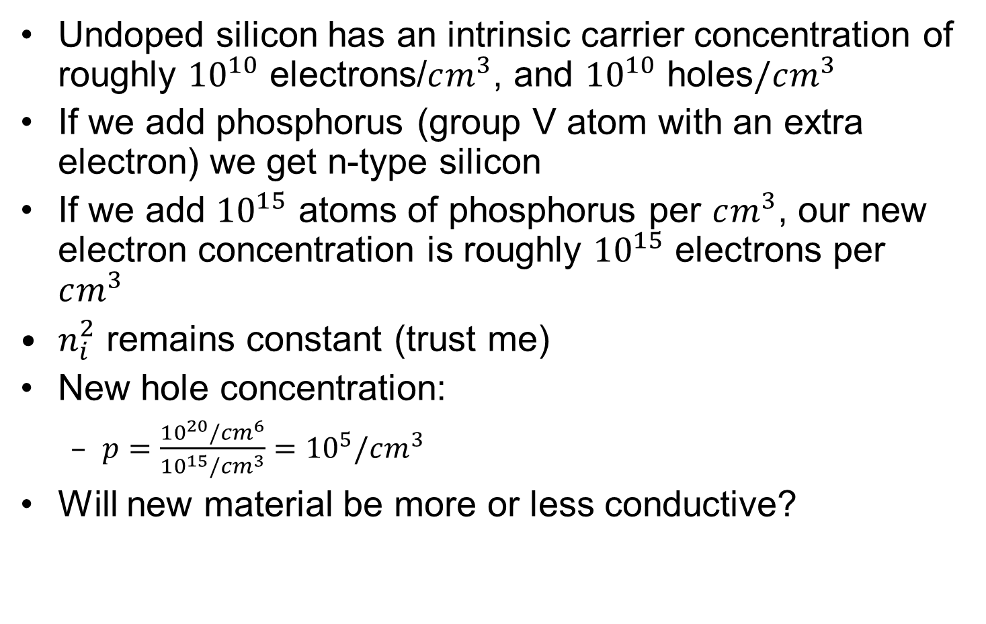


Doping Example
Undoped silicon has an intrinsic carrier concentration of roughly ${10}^{10}$ electrons/$cm^{3}$, and ${10}^{10}$ holes$/cm^{3}$
If we add phosphorus (group V atom with an extra electron) we get n-type silicon
If we add ${10}^{15}$ atoms of phosphorus per $cm^{3}$, our new electron concentration is roughly ${10}^{15}$ electrons per $cm^{3}$
$n_{i}^{2}$ remains constant (trust me)
New hole concentration:
  $p=\frac{{10}^{20}/cm^{6}}{{10}^{15}/cm^{3}}={10}^{5}/cm^{3}$
Will new material be more or less conductive?
$$n=N_{d}$$
$$n_{i}=np={10}^{10}/cm^{3}$$
$$p=n_{i}^{2}/N_{d}$$

Slide 40
Summary of n- and p-type silicon
Pure silicon is an insulator. At high temperatures it conducts weakly.
If we add an impurity with extra electrons (e.g. arsenic, phosphorus) these extra electrons are set free and we have a pretty good conductor (n-type silicon).
If we add an impurity with a deficit of electrons (e.g. boron) then bonding electrons are missing (holes), and the resulting holes can move around … again a pretty good conductor (p-type silicon)
Now what is really interesting is when we join n-type and p-type silicon, that is make a pn junction. It has interesting electrical properties.

Slide 41
Junctions of n- and p-type Regions
p-n junctions form the essential basis of all semiconductor devices.
A silicon chip may have 10⁸ to 10⁹ p-n junctions today.
How do they behave? What happens to the electrons and holes?
What is the electrical circuit model for such junctions?
n and p regions are brought into contact :

Slide 42
Junctions of n- and p-type Regions
n and p regions are brought into contact :
Electron are running around randomly on the n side, and holes on the p side [diffusion]
Before the regions are touching, they are in a homogeneous box just rearranging themselves meaninglessly
Once regions touch, electrons and holes mix

Slide 43
Depletion Region Approximation – Aha!
When the junction is first formed, mobile carriers diffuse across the junction (due to the concentration gradients)
  Holes diffuse from the p side to the n side, leaving behind negatively charged immobile acceptor ions
  Electrons diffuse from the n side to the p side, leaving behind positively charged immobile donor ions
→A region depleted of mobile carriers is formed at the junction.
The space charge due to immobile ions in the depletion region establishes an electric field that opposes carrier diffusion.
acceptor ions
donor ions
–
+
–
+
p n
–
+
–
+
–
+

Slide 44
Charge Density Distribution
Charge is stored in the depletion region.
acceptor ions
donor ions
–
+
–
+
p n
–
+
–
+
–
+
quasi-neutral p region
depletion region
quasi-neutral n region
charge density (C/cm³)
Area must match
distance

Slide 45
Two Governing Laws
Gauss’s Law describes the relationship of charge (density) and electric field: Electric field is integral of charge density
Poisson’s Equation describes the relationship between electric field distribution and electric potential: Potential is integral of negative electric field.

Slide 46
Electric Field from Electric Charge
p
n
Gauss’s Law
p
n

Slide 47
Why do we care about electric field?
Tells us how a free charge will behave
acceptor ions
donor ions
–
+
–
+
p n
–
+
–
+
–
+
quasi-neutral p region
depletion region
quasi-neutral n region
p
n

Slide 48
Electric Potential from Electric Field
p
E₀(x)
n
-x_{po}
x_{no}
x
−
qN
x
−
qN
x
Poisson’s Equation
E
(
0
)
=
a
po
=
d
no
0
ε
ε
s
s
φ₀(x)
qN
qN
d
x
2
+
a
x
2
2
ε
no
2
ε
po
s
s
n=10¹⁷
p=10⁵
P=10¹⁸
n=10⁴
-x_{po}
x_{no}
x

Slide 49
Why do we care about potential?
Another view of free charge movement
acceptor ions
donor ions
–
+
–
+
p n
–
+
–
+
–
+
quasi-neutral p region
depletion region
quasi-neutral n region
φ₀(x)
n=10¹⁷
p=10⁵
p=10¹⁸
n=10⁴
-x_{po}
x_{no}
x
Holes roll downhill Electrons roll uphill

Slide 50
Diffusion vs. Drift
Free holes on the p-side will randomly wander (diffuse throughout) the flat part of the plane
On the p-side, holes are the majority carrier
A very small number of them will get lucky and will roll up the hill
This is the “hole diffusion current”
φ₀(x)
n=10¹⁷
p=10⁵
p=10¹⁸
n=10⁴
-x_{po}
x_{no}
x

Slide 51
Diffusion vs. Drift
Free holes on the will randomly wander (diffuse throughout) the flat part of the plane
On the n-side, holes are the minority carrier
  If they happen to hit the sloping part of the hill, they will DRIFT down the hill because of the electric field
This is the “hole drift current”
n-side
φ₀(x)
n=10¹⁷
p=10⁵
p=10¹⁸
n=10⁴
-x_{po}
x_{no}
x

Slide 52
Diffusion vs. Drift
acceptor ions
donor ions
–
+
–
+
p n
–
+
–
+
–
+
quasi-neutral p region
depletion region
quasi-neutral n region
Holes on the right are “drifters”, aimless wanderers coasting along who find themselves being moved by forces of the universe beyond their control
Holes on the left are “diffusers”, a rare breed so aimless that they defy physical obstacles

Slide 53
One last analogy
acceptor ions
donor ions
–
+
–
+
p n
–
+
–
+
–
+
quasi-neutral p region
depletion region
quasi-neutral n region
φ₀(x)
n=10¹⁷
p=10⁵
p=10¹⁸
n=10⁴
-x_{po}
x_{no}
x
Billions of hobos at the base of Mount Everest and a few at the top, all randomly wandering

Slide 54
Hole Drift and Hole Diffusion Current
acceptor ions
donor ions
–
+
–
+
p n
–
+
–
+
–
+
quasi-neutral p region
depletion region
quasi-neutral n region
Hole drift current:
Hole diffusion current:

Slide 55
iClicker Time
If electrons roll uphill, what direction is the net movement of electron drift? What direction is the net movement of electron diffusion?
Drift
Diffusion
Left Left
Left Right
Right Left
Right Right
φ₀(x)
n=10¹⁷
p=10⁵
p=10¹⁸
n=10⁴
-x_{po}
x_{no}
x

Slide 56
iClicker Time
If electrons drift right and diffuse left, which directions are electron drift CURRENT and electron diffusion CURRENT?
Drift
Diffusion
Left Left
Left Right
Right Left
Right Right
φ₀(x)
n=10¹⁷
p=10⁵
p=10¹⁸
n=10⁴
-x_{po}
x_{no}
x

Slide 57
Hole Drift and Hole Diffusion Current
acceptor ions
donor ions
–
+
–
+
p n
–
+
–
+
–
+
quasi-neutral p region
depletion region
quasi-neutral n region
Hole drift current:
Hole diffusion current:
Electron drift current:
Electron diffusion current:

Slide 58
Effect of Applied Voltage
–
+
–
+
p n
–
+
–
+
V_{D}
–
+
+
-
The quasi-neutral p and n regions have low resistivity, whereas the depletion region has high resistivity. Thus, when an external voltage V_{D} is applied across the diode, almost all of this voltage is dropped across the depletion region. (Think of a voltage divider circuit.)
If V_{D} > 0 (forward bias), the potential barrier to carrier diffusion is reduced by the applied voltage.
If V_{D} < 0 (reverse bias), the potential barrier to carrier diffusion is increased by the applied voltage.

Slide 59
Depletion Approx. – with V_{D}<0 reverse bias
p
E₀(x)
n
-x_{p}
-x_{po}
x_{no}
x_{n}
x
−
qN
x
−
qN
x
E
(
0
)
=
a
po
=
d
no
0
ε
ε
Higher barrier and few holes in n-type lead to little current!
s
s
p=10⁵
φ₀(x)
qN
qN
φ_{bi}-qV_{D}
Built-in potential φ_{bi}=
d
x
2
+
a
x
2
2
ε
no
2
ε
po
n=10¹⁷
s
s
P=10¹⁸
φ_{bi}
n=10⁴
-x_{p}
-x_{po}
x_{no}
x_{n}
x

Slide 60
Hobonalogy
–
+
–
+
p n
–
+
–
+
V_{D}
–
+
+
-
If V_{D} < 0 (reverse bias), Mount Everest becomes steeper
Hordes of hobos at the bottom have a smaller chance of making it
The few hobos at the top plummet like stones

Slide 61
Depletion Approx. – with V_{D}>0 forward bias
p
E₀(x)
n
-x_{po}
-x_{p}
x_{no}
x_{n}
x
−
qN
x
−
qN
x
Poisson’s Equation
E
(
0
)
=
a
po
=
d
no
0
ε
ε
s
s
Lower barrier and large hole (electron) density at the right places lead to large current!
φ₀(x)
qN
qN
Built-in potential φ_{bi}=
d
x
2
+
a
x
2
P=10¹⁸
2
ε
no
2
ε
po
s
s
n=10¹⁷
p=10⁵
φ_{bi}
n=10⁴
φ_{bi}-qV_{D}
-x_{po}
-x_{p}
x_{n}
x_{no}
x

Slide 62
Hobonalogy
–
+
–
+
p n
–
+
–
+
V_{D}
–
+
+
-
If V_{D} < 0 (reverse bias), Mount Everest becomes a mere hillock
Hordes of hobos at the bottom have a much better chance of accidentally ascending
The few hobos at the top don’t fall quite so rapidly

Slide 63
Forward Bias
As V_{D} increases, the potential barrier to carrier diffusion across the junction decreases*, and current increases exponentially.
The carriers that diffuse across the
junction become minority carriers in
the quasi-neutral regions; they then
recombine with majority carriers,
“dying out” with distance.
V_{D} > 0
–
+
–
+
p n
–
+
–
+
–
+
I_{D} (Amperes)
V_{D} (Volts)

Slide 64
Reverse Bias
As |V_{D}| increases, the potential barrier to carrier diffusion across the junction increases*; thus, no carriers diffuse across the junction.
A very small amount of reverse
current (I_{D} < 0) does flow, due to
minority carriers diffusing from the
quasi-neutral regions into the depletion
region and drifting across the junction.
V_{D} < 0
–
+
–
+
p n
–
+
–
+
–
+
I_{D} (Amperes)
V_{D} (Volts)

Slide 65
Summary: pn-Junction Diode I-V
Under forward bias, the potential barrier is reduced, so that carriers flow (by diffusion) across the junction
  Current increases exponentially with increasing forward bias
  The carriers become minority carriers once they cross the junction; as they diffuse in the quasi-neutral regions, they recombine with majority carriers (supplied by the metal contacts)
    “injection” of minority carriers
Under reverse bias, the potential barrier is increased, so that negligible carriers flow across the junction
  If a minority carrier enters the depletion region (by thermal generation or diffusion from the quasi-neutral regions), it will be swept across the junction by the built-in electric field
    “collection” of minority carriers → reverse current
I_{D} (A)
V_{D} (V)

Slide 66
Making a pn Junction Diode
Schematic diagram
Circuit symbol
I_{D}
p-type n-type
net acceptor
concentration N_{A}
net donor
concentration N_{D}
+ V_{D} –
cross-sectional area A_{D}
Physical structure:
(an example)
I_{D}
+
V_{D}
–
metal
SiO₂
SiO₂
p-type Si
For simplicity, assume that
the doping profile changes
abruptly at the junction.
n-type Si
metal

Slide 67
More than one way to get current flowing
Or there’s more than one way to move hobos around mountains
Electric field is the obvious way
Can also create electron/hole pairs, for example, with light

Slide 68
Optoelectronic Diodes
Light incident on a pn junction generates electron-hole pairs
Carriers are generated in the depletion region as well as n-doped and p-doped quasi-neutral regions.
Electron hole-pairs generated on the n and p sides will happen at about the same frequency, and therefore will cancel out
Electron-hole pairs formed at the junction will:
  A. Result in no net current
  B. Result in a net current to the left
  C. Result in a net current to the right
–
+
–
+
p n
–
+
–
+
–
+

Slide 69
Optoelectronic Diodes
Electron-hole pairs formed at the junction will:
  Result in a net current to the p-side
Solar cells are nothing but big photodiodes!
Directly converts light into electricity
–
+
–
+
p n
–
+
–
+
–
+

Slide 70
Open Photodiode
If we leave our photocell open circuited, what happens?
Voltage is generated
–
+
–
+
p n
–
+
–
+
–
+

Slide 71
I-V Characteristic of Optoelectronic Diodes
–
+
–
+
p n
–
+
–
+
V_{D}
–
+
+
-
I_{D} (A)
in the dark
operating point
V_{D} (V)
with incident light

Slide 72
Photodiodes as Voltage Source and Current Source
If we leave attach a very small resistor, does the solar cell act like a voltage source or a current source?
  A. Voltage source
  B. Current source
I_{D} (A)
in the dark
operating point
V_{D} (V)
with incident light

Slide 73
Photodiodes as Voltage Source and Current Source
If we leave attach a very large resistor, the solar cell acts like a voltage source
I_{D} (A)
in the dark
operating point
V_{D} (V)
with incident light

Slide 74
That’s all for today
Next time
  Brief tiny look at MOSFET semiconductor physics (for ~5 minutes)
  Course overview
  Open Q&A: Send me questions beforehand for better answers
  If somehow we aren’t done at this point, I’ll do a quick diode problem

Slide 75
Extra Slides

Slide 76
Design Problems
ALL WORK MUST BE DONE COMPLETELY SOLO!
Maximum allowed time will be 5 hours
  Will be written so that it can be completed in approximately 2 hours
Allowed resources:
  May use any textbook (incl. Google Books)
  Anything posted on the EE40 website
  Only allowed websites are Google Books, wikipedia, and EE40 websites
  Not allowed to use other websites like facebook answers, yahoo answers, etc. even if you are reading other people’s responses
  When in doubt, email me or text me
  We will be very serious about cheating on this!

Slide 77
Example: Photodiode
An intrinsic region is placed between the p-type and n-type regions
  Goal is so that most of the electron-hole pairs are generated in the depletion region

Slide 78
Depletion Approximation 3

Slide 79
Depletion Approximation 1
p
n
Gauss’s Law
p
n

