Slide 1
EE40 Lecture 14 Josh Hug
7/26/2010

Slide 2
Logisticals
Midterm Wednesday
Study guide online
Study room on Monday
Cory 531, 2:00
Cooper, Tony, and I will be there 3:00-5:10
Study room on Tuesday
Cory 521, 2:30 and on
Completed homeworks that have not been picked up have been moved into the lab cabinet
If you have custom Project 2 parts, I’ve emailed you with details about how to pick them up

Slide 3
Lab
Lab will be open on Tuesday if you want to work on Project 2 or the Booster Lab or something else
Not required to start Project 2 tomorrow
No lab on Wednesday (won’t be open)

Slide 4
Power in AC Circuits
One last thing to discuss for Unit 2 is power in AC circuits
Let’s start by considering the power dissipated in a resistor:
+
-
$$5Ω$$
$$10cos(50t)$$
$$=10\cos\left(50t\right)×\frac{10}{5}cos⁡(50t)$$
$$P\left(t\right)=$$
$$v\left(t\right)i(t)$$
$$=20\cos^{2}\left(50t\right)$$

Slide 5
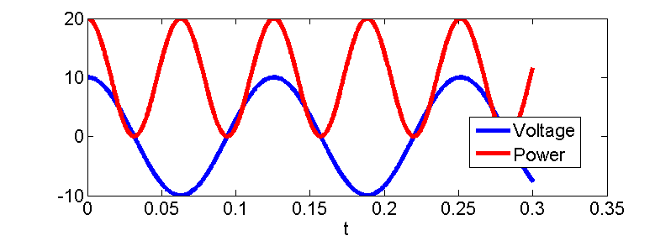
Or graphically
+
-
$$5Ω$$
$$10cos(50t)$$
$$=10\cos\left(50t\right)×\frac{10}{5}cos⁡(50t)$$
$$P\left(t\right)=$$
$$v\left(t\right)i(t)$$
$$=20\cos^{2}\left(50t\right)$$

Slide 6
Average Power
20W
Peak Power:
0W
+
-
Min Power:
$$5Ω$$
Avg Power:
$$10cos(50t)$$
10W

Slide 7
Capacitor example
Find p(t)
+
-
$$1mF$$
$$10cos(50t)$$
$i\left(t\right)={10}^{−3}×\left(−500\sin\left(50t\right)\right)=−0.5\sin\left(50t\right)$
$p\left(t\right)=−5\sin\left(50t\right)cos⁡(50t)$

Slide 8
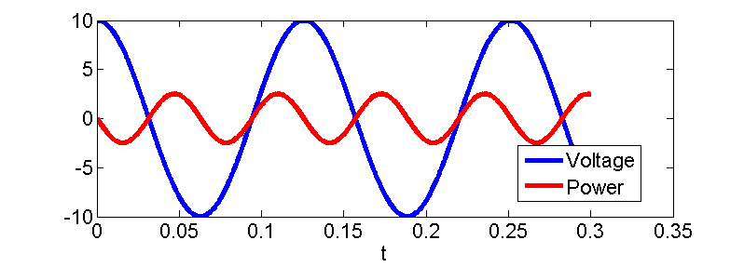
Graphically
$$5/2W$$
Peak Power:
+
-
$$1mF$$
$$−5/2W$$
Min Power:
$$10cos(50t)$$
Avg Power:
0W
$$p\left(t\right)=−5\sin\left(50t\right)cos⁡(50t)$$

Slide 9
Is there some easier way of calculating power?
Like maybe with… phasors?
Phasors are:
$\hat{V}=10∠0$
$\hat{I}=0.5∠\frac{π}{2}$
How about $\hat{P}=\hat{V}\hat{I}$?
+
-
$$1mF$$
$$i\left(t\right)=0.5\cos\left(50t+\frac{π}{2}\right)$$
$$10cos(50t)$$
$p\left(t\right)=5cos⁡(50t)$ $cos⁡(50t+\frac{π}{2})$

Slide 10
Is there some easier way of measuring power?
Phasors are:
$\hat{V}=10∠0$
$\hat{I}=0.5∠\frac{π}{2}$
Does $\hat{P}=\hat{V}\hat{I}$?
$\hat{V}\hat{I}=5∠\frac{π}{2}$
$p\left(t\right)=5cos⁡(50t)$ $cos⁡(50t+\frac{π}{2})$
Yes, $\hat{V}\hat{I}$ matches p(t)
No, wrong magnitude
No, wrong phase
No, wrong frequency

Slide 11
It gets worse
For the resistor, there is no phasor which represents the power (never goes negative)

Slide 12
Average Power
Tracking the time function of power with some sort of phasor-like quantity is annoying
Frequency changes
Sometimes have an offset (e.g. with resistor)
Often, the thing we care about is the average power, useful for e.g.
Battery drain
Heat dissipation
Useful to define a measure of “average” other than the handwavy thing we did before
Average power given periodic power is:
$$\overline{p}=\int_{0}^{T}{\frac{1}{T}p\left(t\right)dt}$$
T is time for 1 period

Slide 13
Power in terms of phasors
We’ve seen that we cannot use phasors to find an expression for p(t)
Average power given periodic power is:
We’ll use this definition of average power to derive an expression for average power in terms of phasors
$$\overline{p}=\int_{0}^{T}{\frac{1}{T}p\left(t\right)dt}$$
T is time for 1 period

Slide 14
Average Power
$\overline{p\left(t\right)}=\overline{v\left(t\right)i\left(t\right)}$
Note: $\overline{a}\overline{b}≠\overline{ab}$
e.g. $a=5\cos\left(t\right), b=4\cos\left(t\right)$
Average of each cosine is
Average of their product is
Our goal will be to get the average power $\overline{p\left(t\right)}$ from phasors $\hat{V}$ and $\hat{I}$
We’ll utilize $\overline{Re\left[a\right]Re\left[b\right]}=\frac{1}{2}Re[ab^{∗}]$
* denotes complex conjugate
See extra slides for proof of this identity
zero
10

Slide 15
Power from Phasors
$\overline{Re\left[a\right]Re\left[b\right]}=\frac{1}{2}Re\left[ab^{∗}\right]$
$\overline{p\left(t\right)}=\overline{v\left(t\right)i\left(t\right)}$
$v\left(t\right)=Re\left[V_{o}e^{j\left(ωt+θ\right)}\right]$
$i\left(t\right)=Re\left[I_{o}e^{j\left(ωt+φ\right)}\right]$
$\overline{p\left(t\right)}=\overline{Re\left[Re\left[V_{o}e^{j\left(ωt+θ\right)}\right]\right]Re\left[Re\left[I_{o}e^{j\left(ωt+φ\right)}\right]\right]}$
$=\frac{1}{2}Re\left[V_{o}e^{j\left(ωt+θ\right)}I_{o}e^{−j\left(ωt+φ\right)}\right]$
$=\frac{1}{2}Re[V_{o}I_{o}e^{j\left(θ−φ\right)}]$
$=\frac{1}{2}Re[\hat{V}{\hat{I}}^{∗}]$

Slide 16
Power from Phasors
Thus, given a voltage phasor $\hat{V}$ and a current phasor $\hat{I}$, the average power absorbed is
$$p\left(t\right)=\frac{1}{2}Re\left[\hat{V}{\hat{I}}^{∗}\right]$$

Slide 17
Capacitor Example
Phasors are:
$\hat{V}\left(t\right)=10∠0$
$\hat{I}\left(t\right)=0.5∠\frac{π}{2}$
$\overline{p\left(t\right)}=\frac{1}{2}Re\left[10∠0×0.5∠−\frac{π}{2}\right]$
$=\frac{1}{2}Re\left[5∠−\frac{π}{2}\right]=0$
+
-
$$1mF$$
$$i\left(t\right)=−0.5\cos\left(50t+\frac{π}{2}\right)$$
$$10cos(50t)$$
$p\left(t\right)=5cos⁡(50t)$ $cos⁡(50t+\frac{π}{2})$

Slide 18
Resistor Example
$\hat{V}=10∠0$
$\hat{I}=2∠0$
$\overline{\left(p\left(t\right)\right)}=\frac{1}{2}Re\left[20\right]=10$
$$p\left(t\right)=\frac{1}{2}Re\left[\hat{V}{\hat{I}}^{∗}\right]$$
+
-
$$5Ω$$
$$10cos(50t)$$
Find avg power across resistor
0 Watts
10 Watts
20 Watts

Slide 19
Resistor Example
$$1mF$$
$Z_{eq}=5−20j$
$\hat{V}=10∠0$
$\hat{I}=\hat{V}/Z_{eq}$
$\overline{\left(p\left(t\right)\right)}=\frac{1}{2}Re\left[\hat{V}{\hat{I}}^{∗}\right]$
+
-
$$5Ω$$
$$10cos(50t)$$
Find avg power from source
$$=\frac{1}{2}Re\left[\frac{\hat{V}{\hat{V}}^{∗}}{Z_{eq}^{∗}}\right]$$
$$=\frac{1}{2}Re\left[\frac{100}{5+20j}\right]$$
$=\frac{1}{2}Re\left[\frac{100}{20.6155∠1.3258}\right]$
$$=\frac{1}{2}Re\left[1.17−4.7j\right]$$
$$=0.58W$$

Slide 20
Reactive Power
So if power dissipated is $\frac{1}{2}Re\left[\hat{V}{\hat{I}}^{∗}\right]$, then what is $\frac{1}{2}Im\left[\hat{V}{\hat{I}}^{∗}\right]$?
Imaginary part is called “reactive power”
Physical intuition is that it’s power that you put into an element with memory, but which the element eventually gives back

Slide 21
Capacitor Reactive Power Example
Phasors are:
$\hat{V}\left(t\right)=10∠0$
$\hat{I}\left(t\right)=0.5∠\frac{π}{2}$
$\overline{p\left(t\right)}=\frac{1}{2}Im\left[10∠0×0.5∠−\frac{π}{2}\right]$
+
-
$$1mF$$
$$i\left(t\right)=−0.5\cos\left(50t+\frac{π}{2}\right)$$
$$10cos(50t)$$
$p\left(t\right)=5cos⁡(50t)$ $cos⁡(50t+\frac{π}{2})$
$=\frac{1}{2}Im\left[5∠−\frac{π}{2}\right]=−\frac{5}{2}W$

Slide 22
Graphically
$$5/2W$$
Peak Power:
$$−5/2W$$
+
-
$$1mF$$
Min Power:
$$10cos(50t)$$
Avg Power:
0W
Avg Reactive Power: -5/2W
Like a frictionless car with perfect regenerative brakes, starting and stopping again and again and again

Slide 23
Note on Reactive Power
“Providing” reactive power and “consuming” reactive power are physically the same thing
Usually we say capacitors “provide” reactive power, which comes from our definition, whereas inductors “consume” reactive power
$p_{reactive}=\frac{1}{2}Im\left[\hat{V}{\hat{I}}^{∗}\right]$?
As you’ll see on HW7, capacitors and inductors can be chosen to get rid of reactive power

Slide 24
And that rounds out Unit 2
We’ve covered all that needs to be covered on capacitors and inductors, so it’s time to (continue) moving on to the next big thing

Slide 25
Back to Unit 3 – Integrated Circuits
Last Friday, we started talking about integrated circuits
Analog integrated circuits
Behave mostly like our discrete circuits in lab, can reuse old analysis
Digital integrated circuits
We haven’t discussed discrete digital circuits, so in order to understand digital ICs, we will first have to do a bunch of new definitions

Slide 26
Digital Representations of Logical Functions
Digital signals offer an easy way to perform logical functions, using Boolean algebra
Example: Hot tub controller with the following algorithm
Turn on heating element if
A: Temperature is less than desired (T < Tset)
and B: The motor is on
and C: The hot tub key is turned to “on”
OR
T: Test heater button is pressed

Slide 27
Hot Tub Controller Example
Example: Hot tub controller with the following algorithm
Turn on heating element if
A: Temperature is less than desired (T < Tset)
and B: The motor is on
and C: The hot tub key is turned to “on”
OR
T: Test heater button is pressed
C
B
A
110V
T
Heater

Slide 28
Hot Tub Controller Example
Example: Hot tub controller with the following algorithm
A: Temperature is less than desired (T < Tset)
B: The motor is on
C: The hot tub key is turned to “on”
T: Test heater button is pressed
Or more briefly: ON=(A and B and C) or T
C
B
A
110V
T
Heater

Slide 29
Boolean Algebra and Truth Tables
We’ll next formalize some useful mathematical expressions for dealing with logical functions
These will be useful in understanding the function of digital circuits

Slide 30
Boolean Logic Functions
Example: ON=(A and B and C) or T
Boolean logic functions are like algebraic equations
Domain of variables is 0 and 1
Operations are “AND”, “OR”, and “NOT”
In contrast to our usual algebra on real numbers
Domain of variables is the real numbers
Operations are addition, multiplication, exponentiation, etc

Slide 31
Examples
In normal algebra, we can have
3+5=8
A+B=C
In Boolean algebra, we’ll have
1 and 0=0
A and B=C

Slide 32
Have you seen boolean algebra before?
A. Yes
B. No

Slide 33
Formal Definitions
“not” is a unary operator (takes 1 argument)
Returns 1 if its argument is 0, and 0 if its argument is 1, e.g.
not 0=1
There exist many shorthand ways of writing the not operation e.g.
$$\overline{0}=1$$
$$0^{′}=1$$
$$¬0=1$$
I will use bar notation for consistency with the book.

Slide 34
Formal Definitions
“and” is a binary operator [takes 2 arguments] which returns 1 if both if its arguments are 1, and 0 otherwise
Many ways to write “A and B” in shorthand:
$$AB$$
$$A∙B$$
$$A∧B$$
As a table, if $Z=AB$, then:
A | B | Z
0 | 0 | 0
0 | 1 | 0
1 | 0 | 0
1 | 1 | 1

Slide 35
Formal Definitions
“or” is a binary operator [takes 2 arguments] which returns 0 if either of its arguments are 1, and 0 otherwise
Common ways to write “A and B” in shorthand:
$$A+B$$
$$A∨B$$
As a table, if $Z=A+B$, then:
A | B | Z
0 | 0 | 0
0 | 1 | 1
1 | 0 | 1
1 | 1 | 1

Slide 36
Boolean Algebra and Truth Tables
Just as in normal algebra, boolean algebra operations can be applied recursively, giving rise to complex boolean functions
Z=AB+C
A | B | C | Z
0 | 0 | 0 | 0
0 | 0 | 1 | 1
0 | 1 | 0 | 0
0 | 1 | 1 | 1
1 | 0 | 0 | 0
1 | 0 | 1 | 1
1 | 1 | 0 | 1
1 | 1 | 1 | 1
Any boolean function can be represented by one of these tables, called a truth table

Slide 37
Boolean Algebra
Originally developed by George Boole as a way to write logical propositions as equations
Now, a very handy tool for specification and simplification of logical systems

Slide 38
Simplification Example
$Z$: Shine the bat signal
$C:$ Crime in progress
$B:$Want to meet Batman
$T$: Test bat signal
$Z=C+\overline{C}B+\overline{C}\overline{B}T$
Simpler expression:
$Z=C+B+T$
C | B | T | Z
0 | 0 | 0 | 0
0 | 0 | 1 | 1
0 | 1 | 0 | 1
0 | 1 | 1 | 1
1 | 0 | 0 | 1
1 | 0 | 1 | 1
1 | 1 | 0 | 1
1 | 1 | 1 | 1

Slide 39
Logic Simplification
In CS61C and optionally CS150, you will learn a more thorough systematic way to simplify logic expression
All digital arithmetic can be expressed in terms of logical functions
Logic simplification is crucial to making such functions efficient
You will also learn how to make logical adders, multipliers, and all the other good stuff inside of CPUs

Slide 40
Quick Arithmetic-as-Logic Example
Assuming we have boolean input variables $A_{1}, A_{2}, B_{2}, B_{2}$ and boolean output variables $Z_{1},Z_{2}$
Let’s say that each variable represent one digit of a binary number, we have 16 possibilities

Slide 41
Logic Gates
Logic gates are the schematic equivalent of our boolean logic functions
Example, the AND gate:
If we’re thinking about real circuits, this is a device where the output voltage is high if and only if both of the input voltages are high
A | B | F
0 | 0 | 0
0 | 1 | 0
1 | 0 | 0
1 | 1 | 1
A
F
F = A•B
B

Slide 42
Logic Functions, Symbols, & Notation
TRUTH
NAME SYMBOL NOTATION TABLE
A | F
0 | 1
1 | 0
“NOT”
A
F
F = A
A | B | F
0 | 0 | 0
0 | 1 | 1
1 | 0 | 1
1 | 1 | 1
A
“OR”
F
F = A+B
B
A | B | F
0 | 0 | 0
0 | 1 | 0
1 | 0 | 0
1 | 1 | 1
A
“AND”
F
F = A•B
B

Slide 43
Multi Input Gates
AND and OR gates can also have many inputs, e.g.
Can also define new gates which are composites of basic boolean operations, for example NAND:
A
F
F = ABC
B
C
A
F
$$F=\overline{ABC}$$
B
C

Slide 44
Logic Gates
Can think of logic gates as a technology independent way of representing logical circuits
The exact voltages that we’ll get will depend on what types of components we use to implement our gates
Useful when designing logical systems
Better to think in terms of logical operations instead of circuit elements and all the accompanying messy math

Slide 45
Hot Tub Controller Example
Example: Hot tub controller with the following algorithm
A: Temperature is less than desired (T < Tset)
B: The motor is on
C: The hot tub key is turned to “on”
T: Test heater button is pressed
Or more briefly: ON=(A and B and C) or T
C
B
A
110V
T
Heater

Slide 46
Hot Tub Controller Example
Example: Hot tub controller with the following algorithm
A: Temperature is less than desired (T < Tset)
B: The motor is on
C: The hot tub key is turned to “on”
T: Test heater button is pressed
Or more briefly: ON=(A and B and C) or T
A
T
110V
B
ON
Heater
C

Slide 47
How does this all relate to circuits?
A digital circuit is simply any circuit where every voltage in the circuit is one of two values
$V_{low}$ (typically ground) will represent boolean 0
$V_{high}$ (in modern CPUs, approximately 1V, though you can set this on your computer) will represent boolean 1
In truth, of course, values will vary continuously, but entire design is conceptualized as simply 1s and 0s

Slide 48
The “Static Discipline”
We can think of the whole circuit as obeying a contract to always provide output voltages $V_{low}$ and $V_{high}$ at all outputs as long as the inputs follow these same rules
Up to the circuit designer to ensure this specification is met
In truth, voltages may be a little lower or higher than these contractual values
However, as long as the output values are close enough, the deviations are unimportant

Slide 49
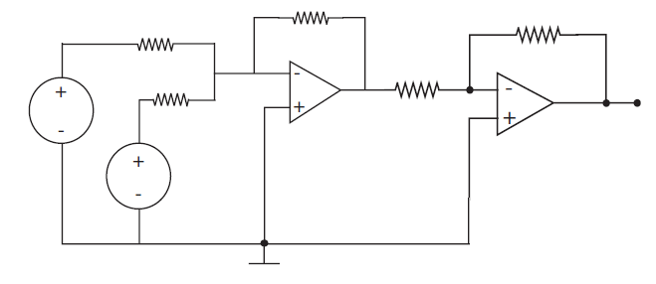
Many Possible Ways to Realize Logic Gates
There are many ways to build logic gates, for example, we can build gates with op-amps
Far from optimal
5 resistors
Dozens of transistors
$$1Ω$$
$$1Ω$$
$$1Ω$$
-5V
-5V
$$1Ω$$
$$1Ω$$
A
5V
5V
Z
$$Z=f(A,B)$$
B
Is this a(n):
AND gate
OR gate
NOT gate
Something else

Slide 50
Switches as Gates
Example: Hot tub controller
ON=(A and B and C) or T
Switches are the most natural implementation for logic gates
C
B
A
A
T
B
Heater
110V
110V
T
ON
Heater
C

Slide 51
Relays, Tubes, and Transistors as Switches
Electromechnical relays are ways to make a controllable switch:
Zuse’s Z3 computer (1941) was entirely electromechnical
Later vacuum tubes adopted:
Colossus (1943) – 1500 tubes
ENIAC (1946) – 17,468 tubes
Then transistors:
IBM 608 was first commercially available (1957), 3000 transistors

Slide 52
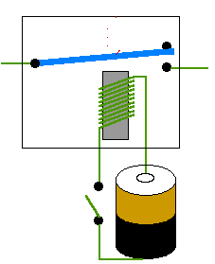
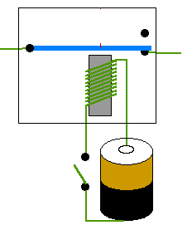
Electromechanical Relay
Inductor generates a magnetic field that physically pulls a switch down
When current stops flowing through inductor, a spring resets the switch to the off position
Three Terminals:
+ : Plus
– : Minus
C : Control
+
–
+
–
C
C

Slide 53
Electromechnical Relay Summary
“Switchiness” due to physically manipulation of a metal connector using a magnetic field
Very large
Moving parts
No longer widely used in computational systems as logic gates
Occasional use in failsafe systems

Slide 54
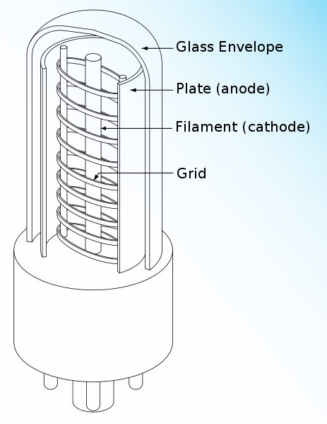
Vacuum Tube
Inside the glass, there is a hard vacuum
Current cannot flow
If you apply a current to the minus terminal (filament), it gets hot
This creates a gas of electrons that can travel to the positively charged plate from the hot filament
When control port is used, grid becomes charged
Acts to increase or decrease ability of current to flow from – to +
C
+
–
(Wikipedia)

Slide 55
Vacuum Tube Demo

Slide 56
Vacuum Tube Summary
“Switchiness” is due to a charged cage which can block the flow of free electrons from a central electron emitter and a receiving plate
No moving parts
Inherently power inefficient due to requirement for hot filament to release electrons
No longer used in computational systems
Still used in:
CRTs
Very high power applications
Audio amplification (due to nicer saturation behavior relative to transistors)

Slide 57
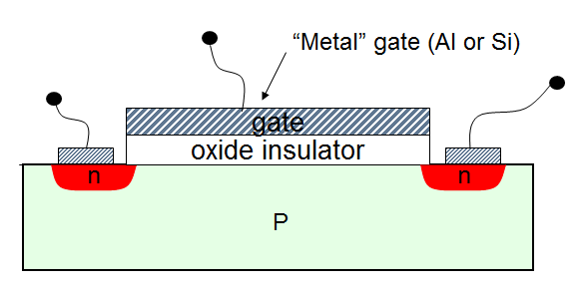
Field Effect Transistor
(Gate)
+
-
(Drain)
C
(Source)
+
–
- - - - - - - - - - - - -
P is (effectively) a high resistance block of material, so current can barely flow from + to –
The n region is a reservoir of extra electrons (we will discuss the role of the n region later)
When C is “on”, i.e. $V_{c}$ is relatively positive, then electrons from inside the P region collect at bottom of insulator, forming a “channel”

Slide 58
Field Effect Transistor
(Gate)
+
-
(Drain)
C
(Source)
+
–
- - - - - - - - - - - - -
When the channel is present, then effective resistance of P region dramatically decreases
Thus:
When C is “off”, switch is open
When C is “on”, switch is closed

Slide 59
Field Effect Transistor
(Gate)
+
-
C
(Source)
(Drain)
+
–
+
-
- - - - - -
If we apply a positive voltage to the plus side
Current begins to flow from + to –
Channel on the + side is weakened
If we applied a different positive voltage to both sides?

Slide 60
Field Effect Transistor Summary
“Switchiness” is due to a controlling voltage which induces a channel of free electrons
Extremely easy to make in unbelievable numbers
Ubiquitous in all computational technology everywhere

Slide 61
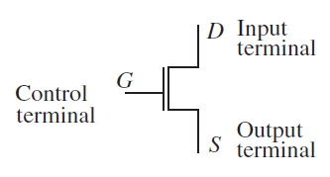
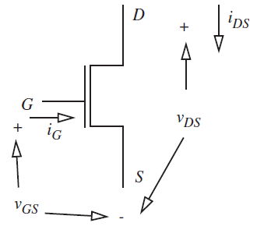
MOSFET Model
Schematically, we represent the MOSFET as a three terminal device
Can represent all the voltages and currents between terminals as shown to the right

Slide 62
MOSFET Model
What do you expect $i_{G}$ to be?
(Gate)
C
(Drain)
(Source)
+
–

Slide 63
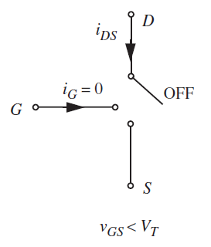
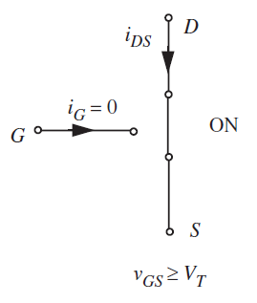
S Model of the MOSFET
The simplest model basically says that the MOSFET is:
Open for $V_{GS}<V_{T}$
Closed for $V_{GS}>V_{T}$

Slide 64
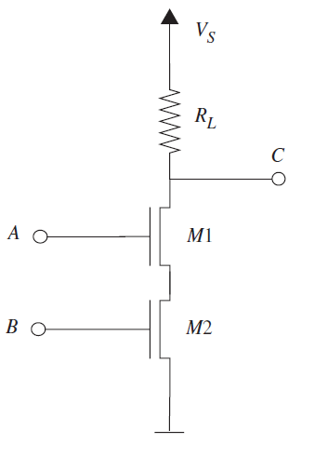
Building a NAND gate using MOSFETs
Consider the circuit to the right where $V_{S}$
On the board, we’ll show that $C=\overline{AB}$
Demonstration also on page 294 of the book

Slide 65
That’s it for today
Next time, we’ll discuss:
Building arbitrarily complex logic functions
Sequential logic
The resistive model of a MOSFET
Until then, study

