Slide 1
EE40 Lecture 10 Josh Hug
7/17/2010

Slide 2
Logistics and Lab Reminder
If you have not submitted a spec and want to do a custom Project 2, talk to me right after class
HW4 due today at 5
HW5 due Tuesday at 2PM (it will be short, and up by 5 PM today)
As requested, all reading assignments for next week will be posted tonight
We expect you to understand lab concepts. For example, the Schmitt Trigger:
Do you know what they are and what they do?

Slide 3
HW Clarification
There are a bunch of hints on the bspace forums
“Zero state response” and “zero input response” are terms that I haven’t used in lecture, but they’re really easy and they’re in the book
Zero input response: The response you get with f(t)=0 [same as homogeneous solution]
Zero state response: The response you get with y(0)=0 [complete response with initial condition equal to zero]

Slide 4
To the board…
For LC and RLC circuits

Slide 5
RLC Circuits
They are important, but not so much for digital integrated circuit design
They do play a role in the world of analog circuits, but that’s a bit specialized for us to spend a great deal of time
Usually care more about “frequency response” than the actual shape of the response in time
If you want to learn more about analog circuit design (it is hard and probably awesome), see EE

Slide 6
Let’s step back a second
Earlier this week, I said capacitors are good for
Storing energy
Filtering
Modeling unwanted capacitances in digital circuits
We’ve discussed the first case pretty heavily now, and filtering will come in great detail next week
For now, let’s talk about delay modeling

Slide 7
Application to Digital Integrated Circuits (ICs)
When we perform a sequence of computations using a digital circuit, we switch the input voltages between logic 0 (e.g. 0 Volts) and logic 1 (e.g. 5 Volts).
The output of the digital circuit changes between logic 0 and logic 1 as computations are performed.

Slide 8
Digital Signals
We compute with pulses.
We send beautiful pulses in:
voltage
time
But we receive lousy-looking pulses at the output:
voltage
time
Capacitor charging effects are responsible!
Every node in a real circuit has capacitance; it’s the charging of these capacitances that limits circuit performance (speed)

Slide 9
Circuit Model for a Logic Gate
As we’ll discuss in a couple of weeks, electronic building blocks referred to as “logic gates” are used to implement logical functions (NAND, NOR, NOT) in digital ICs
Any logical function can be implemented using these gates.
A logic gate can be modeled as a simple RC circuit:
R
+
V_{out}
–
V_{in}(t)
+
−
C
switches between “low” (logic 0)
and “high” (logic 1) voltage states

Slide 10
Logic Level Transitions
Transition from “0” to “1”
(capacitor charging)
Transition from “1” to “0”
(capacitor discharging)
V_{out}
V_{out}
V_{high}
V_{high}
0.63V_{high}
0.37V_{high}
time
time
0
RC
0
RC
(V_{high} is the logic 1 voltage level)

Slide 11
Sequential Switching
What if we step up the input,
wait for the output to respond,
then bring the input back down?
Vin
0
0
time
Vin
Vout
0
0
time
Vin
Vout
0
0
time

Slide 12
Pulse Distortion
R
The input voltage pulse width must be long enough; otherwise the output pulse doesn’t make it.
(We need to wait for the output to reach a recognizable logic level, before changing the input again.)
+
V_{out}
–
+
–
V_{in}(t)
C
Pulse width = 0.1RC
Pulse width = RC
Pulse width = 10RC
6
6
6
5
5
5
4
4
4
Vout
Vout
Vout
3
3
3
2
2
2
1
1
1
0
0
0
0
1
2
3
4
5
0
1
2
3
4
5
0
5
10
15
20
25
Time
Time
Time

Slide 13
Example
Suppose a voltage pulse of width
5 μs and height 4 V is applied to the
input of this circuit beginning at t = 0:
R
V
V
in
out
R = 2.5 kΩ
C = 1 nF
C
τ = RC = 2.5 μs
First, V_{out} will increase exponentially toward 4 V.
When V_{in} goes back down, V_{out} will decrease exponentially
back down to 0 V.
What is the peak value of V_{out}?
The output increases for 5 μs, or 2 time constants.
→ It reaches 1-e⁻² or 86% of the final value.
0.86 x 4 V = 3.44 V is the peak value

Slide 14
4
3.5
3
2.5
2
1.5
1
0.5
0
0
2
4
6
8
10
{
4-4e^{-t/2.5μs} for 0 ≤ t ≤ 5 μs
3.44e^{-(t-5μs)/2.5μs} for t > 5 μs
V_{out}(t) =

Slide 15
Parasitic Capacitances
We’ll discuss these parasitic capacitances in the context of digital integrated circuits right after midterm 2

Slide 16
AC Inputs
We’ve discussed to this point how we deal with constant and weird mathematically ideal inputs $(e.g. V\left(t\right)=t^{2})$
Next we’ll discuss sinusoidal inputs or AC inputs, useful for, in order of increasing generality:
Finding 60 Hz wall voltage response
Finding response to inputs that can be approximated by a sum of sinusoids (e.g. square waves)
Finding “frequency response”

Slide 17
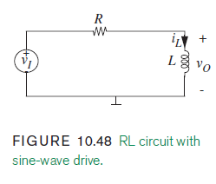
Solving Circuits with AC Sources
In principle, we can use the MPHS to solve the circuit below:
Will finding the homogeneous solution be difficult?

Slide 18
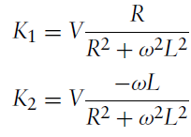
Solving Circuits with AC Sources
Will finding the particular solution be difficult?

Slide 19
Solving Circuits with AC Sources
Will finding the particular solution be difficult?
$$i_{L}=Ae^{−\frac{R}{L}t}+\sqrt{2}V\frac{ωL}{R^{2}+ω^{2}L^{2}}cos⁡(ωt+\frac{5π}{4})$$

Slide 20
Phasors
Solving simple resistive circuits
Hard way (kitchen sink method)
Easy way (node voltage)
Op-amp circuits
Hard way (taking limits as $A→∞$)
Easy way (summing point constraint)
Requires negative feedback, which can be hard to identify
Circuits with memory
Hard way (solving ODE)
Easy way (intuitive method)
Requires DC sources
Next will come an easy method for AC sources

Slide 21
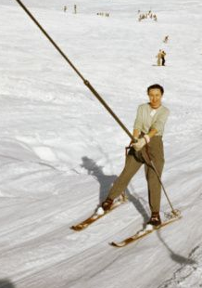
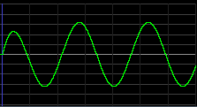
Two Paths
Using Impedances and Phasors
Solving ODEs
MPHS Limited
Trigonometry
Hell
Particular Solution Connector Route
Solution Town

Slide 22
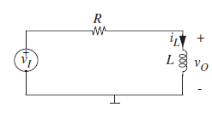
Basic Idea and Derivation of Impedances
$$v_{I}=V_{i}cos\left(ωt\right), t>0$$
$$V_{O}^{′}=−\frac{V_{O}}{RC}+\frac{V_{i}cos(ωt)}{RC}$$
Naïve way is to pick a particular solution which looks like ${v_{o,p}=K}_{1}\cos\left(wt+Φ\right)$
Unnecessary algebra and trigonometry
Instead, we’ll just replace the source by a new source $\tilde{v}=V_{i}e^{jwt}$ and solve this new problem
Waitttttttttttt, what?
Ok this may seem a little weird, we’re replacing the voltage source with a new one that we just made up, and sure it is also complex valued, but just trust me.

Slide 23
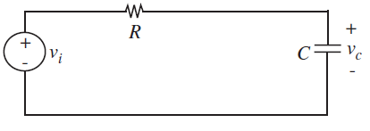
New Voltage Source Problem
$$v_{I}=V_{i}e^{jwt} t>0$$
$$V_{O}^{′}=−\frac{V_{O}}{RC}+V_{i}\frac{e^{jωt}}{RC}$$
Homogeneous solution is just $Ae^{−t/RC}$
Pick particular solution $V_{O,P}=k_{1}e^{jwt}$, plug in:
$$k_{1}jωe^{jωt}=−k_{1}\frac{e^{jωt}}{RC}+V_{i}\frac{e^{jωt}}{RC}$$
Divide by $e^{jwt}$
$$k_{1}jω=−k_{1}\frac{1}{RC}+V_{i}\frac{1}{RC}$$

Slide 24
New Voltage Source Problem
$$v_{I}=V_{i}e^{jwt} t>0$$
$$V_{O}^{′}=−\frac{V_{O}}{RC}+V_{i}\frac{e^{jωt}}{RC}$$
Divide by $e^{jwt}$
Solve for $k_{1}$
Particular solution is
$$k_{1}jω=−k_{1}\frac{1}{RC}+V_{i}\frac{1}{RC}$$
$$k_{1}=V_{i}\frac{1}{1+jωRC}$$
$$V_{O,P}\left(t\right)=V_{i}\frac{1}{1+jωRC}e^{jwt}$$

Slide 25
To Recap
AC source made it hard to find particular solution:
$$v_{I}=V_{i}cos\left(ωt\right), t>0$$
$$V_{O}^{′}=−\frac{V_{O}}{RC}+\frac{V_{i}cos(ωt)}{RC}$$
So we just replaced the annoying source, giving us:
$$v_{I}=V_{i}e^{jwt} t>0$$
$$V_{O}^{′}=−\frac{V_{O}}{RC}+V_{i}\frac{e^{jωt}}{RC}$$
This gave us the particular solution:
$$V_{O,P}\left(t\right)=V_{i}\frac{1}{1+jωRC}e^{jwt}$$

Slide 26
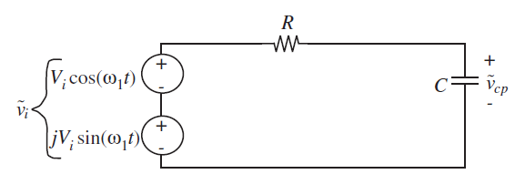
The Inverse Superposition Trick
Our complex exponential source is actually useful
$$v_{I}=V_{i}e^{jwt} t>0$$
$$Ae^{jωt}=Acos\left(ωt\right)+jsin(ωt)$$
Superposition tells us that our output $V_{O,P}\left(t\right)$ will just be the sum of the effect of these two sources

Slide 27
Inverse Superposition
Superposition tells us that our output $V_{O,P}\left(t\right)$ will just be the sum of the effect of these two sources
$$V_{O,P}\left(t\right)=V_{i}\frac{1}{1+jωRC}e^{jwt}$$
Luckily for us, all complex numbers are the sum of their real and imaginary parts $x=a+jb$
Just find real part and we’re done!

Slide 28
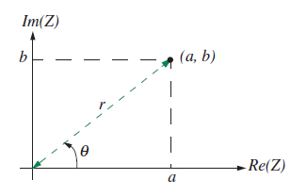
Real Part of Expression
Finding the real part of the expression is easy, it just involves some old school math that you’ve probably forgotten (HW5 will have complex number exercises)
$$V_{O,P}\left(t\right)=\frac{1}{1+jωRC}V_{i}e^{jwt}$$
Key thing to remember is that complex numbers have two representations
Rectangular form: $a+jb$
Polar form: $re^{jθ}$
$$r=\sqrt{a^{2}+b^{2}}$$
$$θ=\arctan\left(\frac{b}{a}\right)$$

Slide 29
Real Part of Expression
What we have is basically the product of two complex numbers
Let’s convert the left one to polar form
$$V_{O,P}\left(t\right)=\frac{1}{1+jωRC}V_{i}e^{jwt}$$
$$r=\sqrt{a^{2}+b^{2}}$$
Rectangular form: $a+jb$
Polar form: $re^{jθ}$
$$θ=\arctan\left(\frac{b}{a}\right)$$
$$V_{O,P}\left(t\right)=\frac{1}{Re^{jφ}}V_{i}e^{jwt}=V_{i}\frac{1}{1+{\left(wRC\right)}^{2}}e^{φj}e^{jwt}$$
$$φ=arctan⁡(ωRC)$$

Slide 30
Real Part of Expression
$$V_{i}\frac{1}{1+{\left(wRC\right)}^{2}}e^{jφ}e^{jwt}$$
$$\frac{V_{i}}{{\left(1+ωRC\right)}^{2}}e^{j(φ+ωt)}$$
$$\frac{V_{i}}{{\left(1+ωRC\right)}^{2}}(cos\left(ωt+φ\right)+jsin(ωt+φ))$$

Slide 31
Real Part of Expression
$$V_{i}\frac{1}{1+{\left(wRC\right)}^{2}}e^{jφ}e^{jwt}$$
Superposition tells us that our output $V_{O,P}\left(t\right)$ will just be the sum of the effect of these two sources
$$V_{O,P}\left(t\right)=\frac{V_{i}}{{\left(1+ωRC\right)}^{2}}(cos\left(ωt+φ\right)+jsin(ωt+φ))$$
Thus, particular solution (forced response) of original cosine source is just the real part
$$V_{O,P}\left(t\right)=\frac{V_{i}}{{\left(1+ωRC\right)}^{2}}cos\left(ωt+φ\right)$$

Slide 32
Wait…. That was easier?
$$V_{i}\frac{1}{1+{\left(wRC\right)}^{2}}e^{jφ}e^{jwt}$$
What we just did was mostly a derivation
Only have to do the hard math one time
Sort of like intuitive method for DC sources
What’s the “easy way” to find a particular solution, now that we did the hard math one time?

Slide 33
Impedance
For a complex exponential source:
$$V_{C,P}\left(t\right)=\frac{1}{1+jωRC}v_{I}(t)$$
Rewrite as:
$$V_{C,P}\left(t\right)=\frac{1/jwC}{1/jwC+R}v_{I}(t)$$
Let $Z_{c}=1/jwC$
$$V_{C,P}\left(t\right)=\frac{Z_{c}}{Z_{c}+R}v_{I}(t)$$
voltage divider
Looks a lot like…

Slide 34
Impedance Method for Solving AC Circuits
With a little more derivation, we can unveil a very powerful technique: impedance analysis:
Replace capacitors by $Z_{C}=\frac{1}{jωC}$
Replace inductors by $Z_{L}=jωL$
Replace resistors with $Z_{R}=R$
Replace source(s) with constant source with same magnitude (phasor representation)
Then treat the whole thing like a resistive circuit to get “phasor” version of particular solution
Optionally, convert back into time variable

Slide 35
Impedance Analysis
Requires sinusoidal source
Reduces any network of capacitors, inductors, and resistors into a big set of algebraic equations
Much easier to deal with than ODEs
Only gives you the particular solution, but we usually don’t care about the homogeneous solution

Slide 36
Impedance Analysis Example
On board

Slide 37
Extra Slides
Impedance example to help you on HW#5

