Slide 1
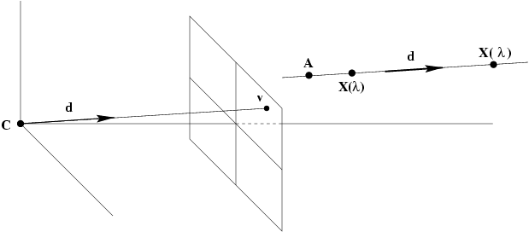
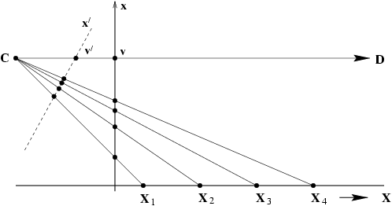
Vanishing points

Slide 2
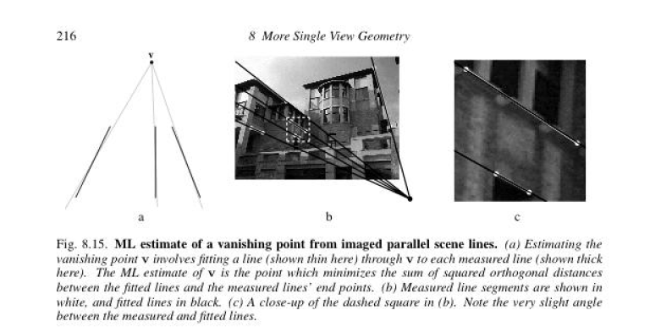
ML estimate of a vanishing point from imaged parallel scene lines
Estimate the VP and fitted lines simultaneously by solving a nonlinear
Levenson Marquardt optimization algorithm;
One option:
find pariwise intersection, then compute centrod of that intersection

Slide 3
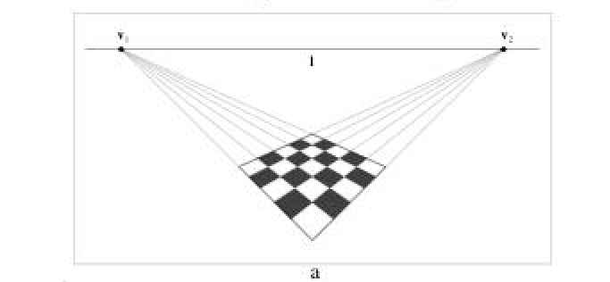
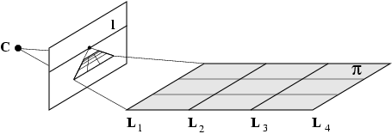
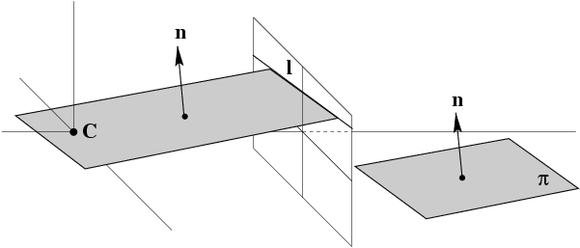
Vanishing lines

Slide 4
If K is known, then plane vanishing line may be used to find information about the plane
Can show that plane with vanishing Line l has orientation
n = K^{T} l
in camera’s Euclidean coordinate frame ; n is normal of plane
Plane can be metrically rectified given only its vanishing line:
compute normal from vanishing line,
then synthetically rotate camera by homography so that the plane is fronto parallel, ie. parallel to the image plane
If l₁ and l₂ are vanishing lines for two Planes, then the angle between the planes Is given by :
θ
ω
ω
ω

Slide 5
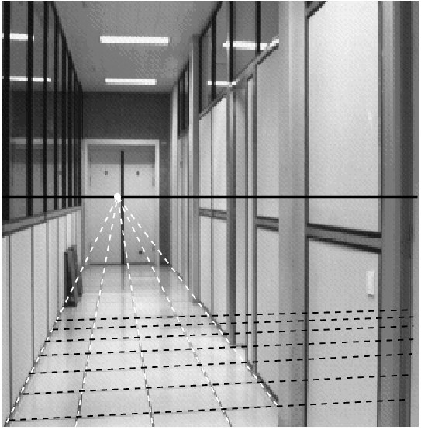
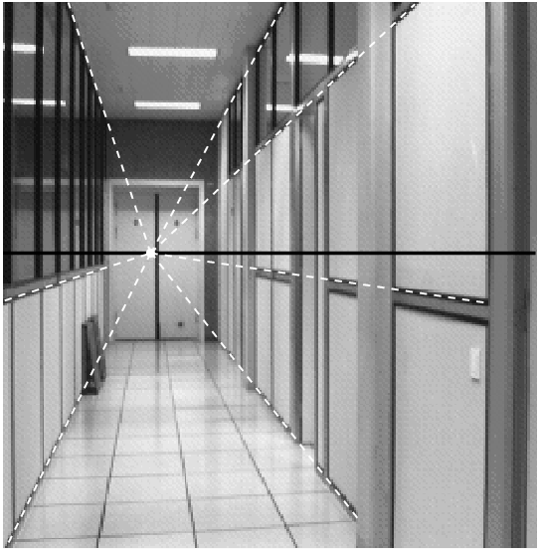
B c
a
Vanishing point of a line parallel to a plane lies on the vanishing line of the plane

Slide 6
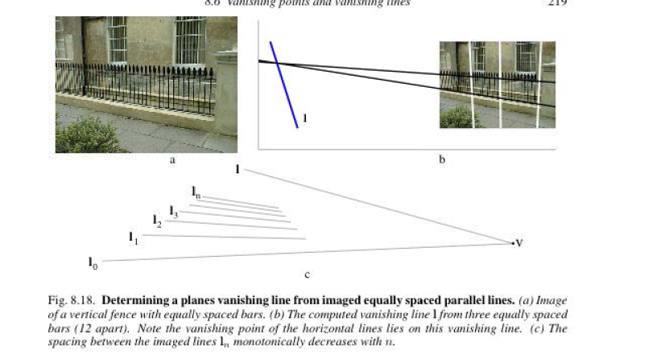

Slide 7
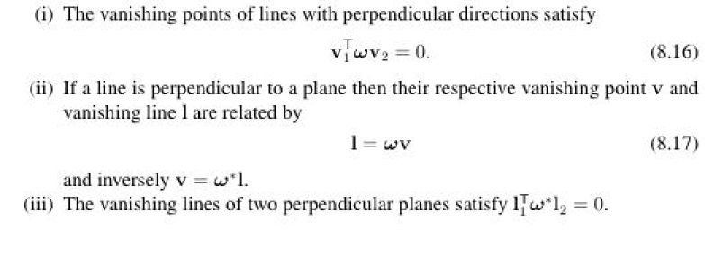
Orthogonality relation: can help find ω and K
ω
θ

Slide 8
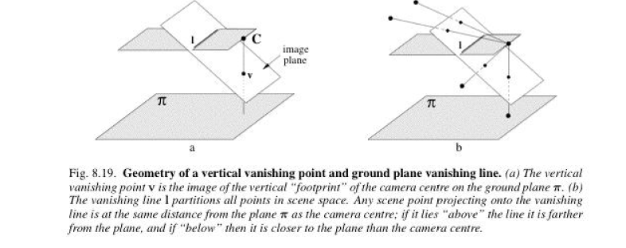
Affine properties can be measured only from vanishing line of a plane and vanishing point of a direction not parallel to the plane
Convenient to think of scene plane π as the horizontal ground plane; vanishing line is l is the horizon.
Convenient to think of the direction orthogonal to the scene plane as vertical; v is the vertical vanishing point
Given l and v, we can measure the relative length of two line segments in the vertical direction;
No need to know K
In general direction v need not be orthogonal to plane π

Slide 9
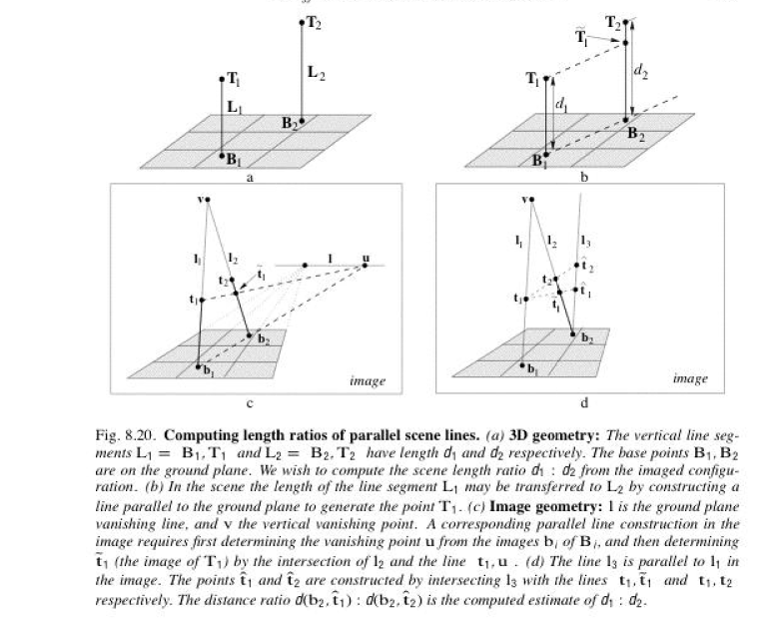

Slide 10
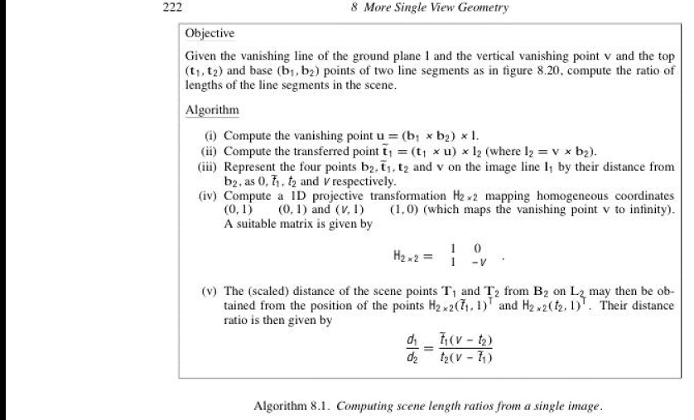

Slide 11
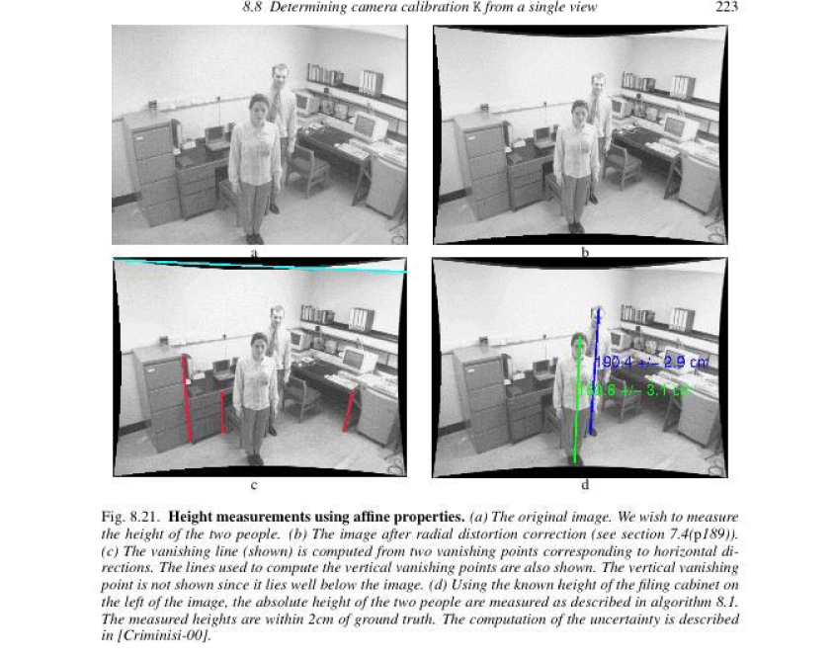
π
Use the tiles on the floor (horizontal plane) to find the vanishing line of the plane. Use the vertical lines in the scene
To determine the vertical vanishing point.

Slide 12
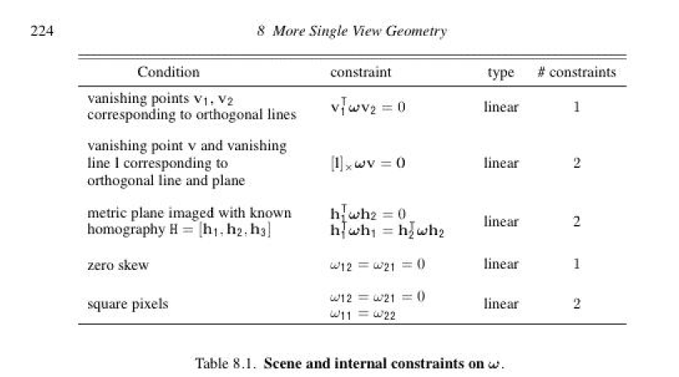
Five constraints gives us five equations and can determine w

Slide 13
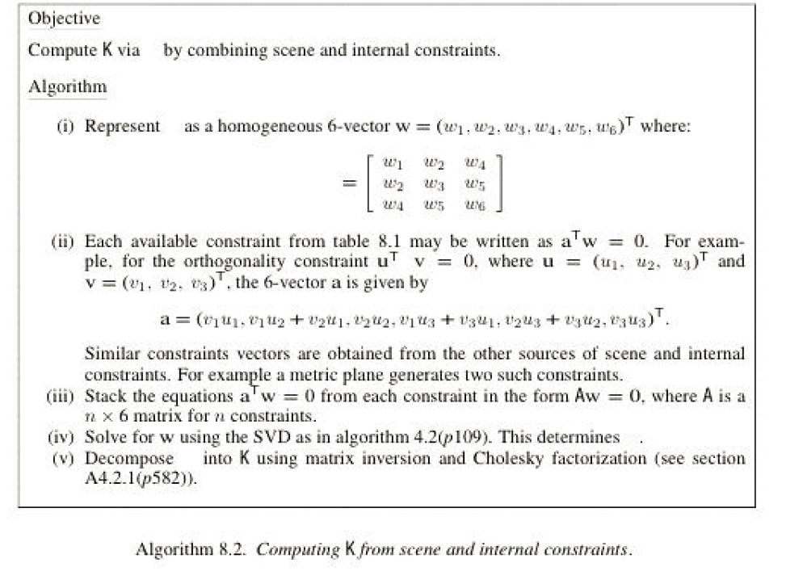
Computing K from scene and internal constraints

Slide 14
Single view calibration - example
[Eq. 28]
v^{T}ω v
_{cosθ =} 1 2
v^{T}ω v
v^{T}ω v
1 1
2
2
v₂
v₁
θ = 90º
[Eq. 29]
v^{T}ω v = 0
1 2
Do we have enough constraints to estimate K?
K has 5 degrees of freedom and Eq.29 is a scalar equation ☹
ω = (K K )
T −1

Slide 15
Single view calibration - example
[Eq. 28]
v^{T}ω v
_{cosθ =} 1 2
v^{T}ω v
v^{T}ω v
1 1
2
2
v₂
v₁
v₃
v^{T}ω v = 0
1 2
[Eqs. 31]
v ω v = 0
T
1 3
v^{T}ω v = 0
2
3

Slide 16
Single view calibration - example
⎡ω₁ ω₂ ω₄ ⎤
_{ω} ⎥
ω = ⎢ω ω
5 ⎥
^{ω}6 ⎥⎦
⎢
2 3
⎢⎣^{ω}4
ω₅
v₂
Square pixels
No skew
v
ω = 0
1
v₃
→
2
ω₁ = ω₃
v^{T}ω v = 0
1 2
[Eqs. 31]
v ω v = 0
T
1 3
v^{T}ω v = 0
2
3

Slide 17
Single view calibration - example
⎡ω₁ ω₂ ω₄ ⎤
_{ω} ⎥
ω = ⎢ω ω
5 ⎥
^{ω}6 ⎥⎦
⎢
2 3
⎢⎣^{ω}4
ω₅
v₂
Square pixels
No skew
v
ω = 0
1
v₃
→
2
ω₁ = ω₃
v^{T}ω v = 0
1 2
[Eqs. 31]
v ω v = 0
T
1 3
→ Compute ω !
v^{T}ω v = 0
2
3

Slide 18
Single view calibration - example
⎡ω₁ ω₂ ω₄ ⎤
_{ω} ⎥
ω = ⎢ω ω
5 ⎥
^{ω}6 ⎥⎦
⎢
2 3
⎢⎣^{ω}4
ω₅
v₂
Square pixels
No skew
v
ω = 0
1
v₃
→
2
ω₁ = ω₃
v^{T}ω v = 0
1 2
[Eqs. 31]
v ω v = 0
v ω v = 0
T
Once ω is calculated, we get K:
1
3
ω = (K K^{T} )⁻¹
K
T
2
3
(Cholesky factorization; HZ pag 582)

Slide 19
Single view reconstruction - example
l_{h}
[Eq. 27]
K known
→ n = K^{T}l
= Scene plane orientation in
the camera reference system
horiz
Select orientation discontinuities

Slide 20
Single view reconstruction - example
C
Recover the structure within the camera reference system
Notice: the actual scale of the scene is NOT recovered
Recognition helps reconstruction!
Humans have learnt this

Slide 21
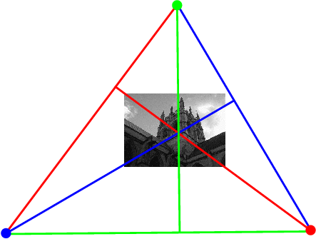
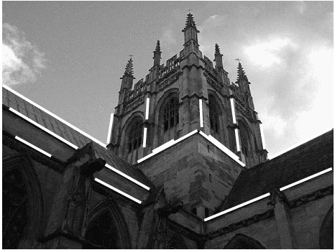
Calibration from vanishing points and lines
Principal point is the orthocenter of the trinagle made of 3 orthogonol vanishing lines
Assumes zero skew, square pixels and 3 orthogonal vanishing points

Slide 22
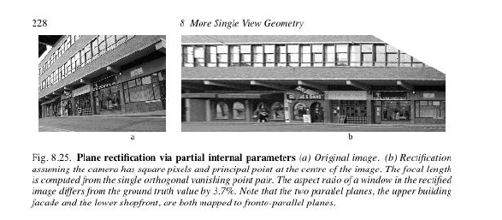
Assume zero skew , square pixels, and principal point is at the image center
Then ω is diagonal{1/f^2, 1/f^2,1) i.e. one degree of freedom➔ need one more
Constraint to determine f, the focal length ➔ two vanishing points corresponding
To orthogonal directions.
From two vanishing point, can also find vanishing line of the building façade;
Given K and vanishing line l, synthetically rotate the camera so that façade is
Fronto parallel: map the image with a homography

Slide 23
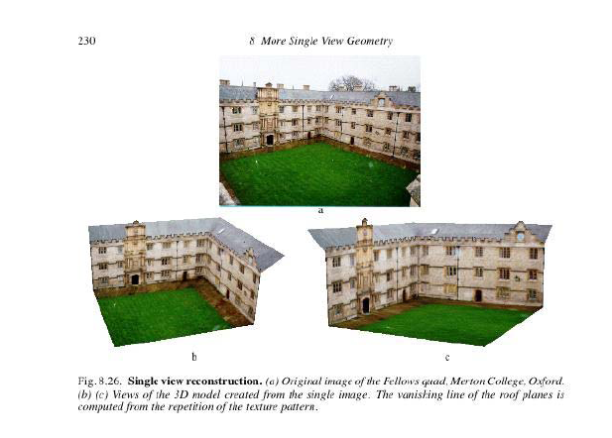
Scene consists of three dominant and mutually orthogonal planes: building façade on the right; on the left, and ground plane
Parallels line sets in three orthogonal directions define three vanishing points and together with the constraint of square pixels of
camera , calibration can be performed.
From vanishing points find three vanishing lines for the 3 planes.
Vanishing lines and ω can be used to find homography for each plane
Use homography to texture map the appropriate image regions onto the orthogonal planes of the model

