Slide 1
Robot Mapping
A Short Introduction to the Bayes Filter and Related Models
Cyrill Stachniss
1

Slide 2
State Estimation
▪▪ Estimate the state of a system given observations and controls
▪▪ Goal:
2

Slide 3
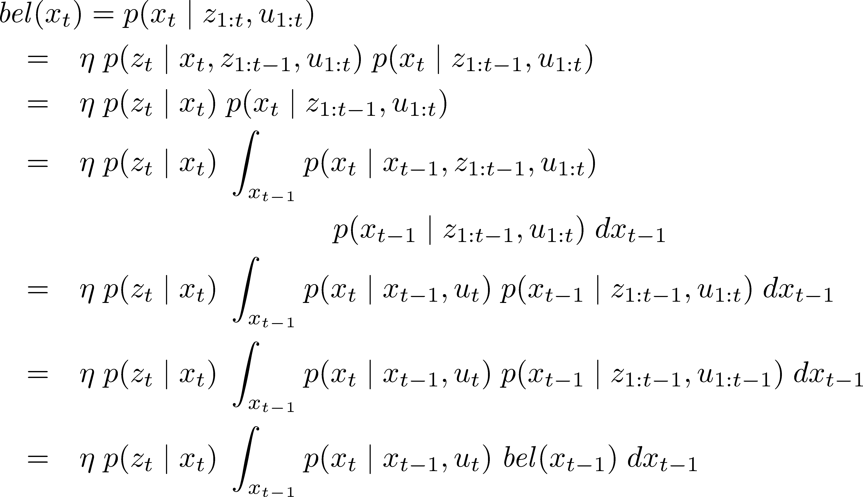
Recursive Bayes Filter 1
Definition of the belief
3

Slide 4
Recursive Bayes Filter 2
Bayes’ rule
4

Slide 5
Recursive Bayes Filter 3
Markov assumption
5

Slide 6
Recursive Bayes Filter 4
Law of total probability
6

Slide 7
Recursive Bayes Filter 5
Markov assumption
7

Slide 8
Recursive Bayes Filter 6
Markov assumption
8

Slide 9
Recursive Bayes Filter 7
Recursive term
9

Slide 10
Definition of Belief

Slide 11
More Definitions

Slide 12
Prediction and Correction Step
▪▪ Bayes filter can be written as a two step process
▪▪ Prediction step
▪▪ Correction step

Slide 13
Motion and Observation Model
▪▪ Prediction step
motion model
▪▪ Correction step
sensor or observation model

Slide 14
Different Realizations
▪▪ The Bayes filter is a framework for recursive state estimation
▪▪ There are different realizations
▪▪ Different properties
▪▪ Linear vs. non-linear models for motion and observation models
▪▪ Gaussian distributions only?
▪▪ Parametric vs. non-parametric filters
▪▪ …

Slide 15
In this Course
▪▪ Kalman filter & friends
▪▪ Gaussians
▪▪ Linear or linearized models
▪▪ Particle filter
▪▪ Non-parametric
▪▪ Arbitrary models (sampling required)

Slide 16
Motion Model

Slide 17
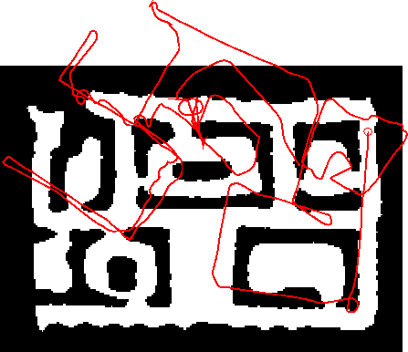
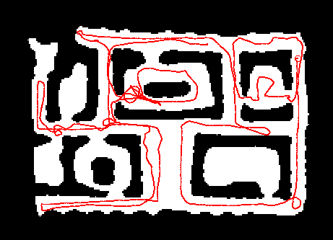
Robot Motion Models
▪▪ Robot motion is inherently uncertain
▪▪ How can we model this uncertainty?

Slide 18
Probabilistic Motion Models
▪▪ Specifies a posterior probability that action u carries the robot from x to x’.

Slide 19
Typical Motion Models
▪▪ In practice, one often finds two types of motion models:
▪▪ Odometry-based
▪▪ Velocity-based
▪▪ Odometry-based models for systems that are equipped with wheel encoders
▪▪ Velocity-based when no wheel encoders are available

Slide 20
Odometry Model
▪▪ Robot moves from
▪▪ Odometry information
to
.

Slide 21
Probability Distribution
▪▪ Noise in odometry
▪▪ Example: Gaussian noise

Slide 22
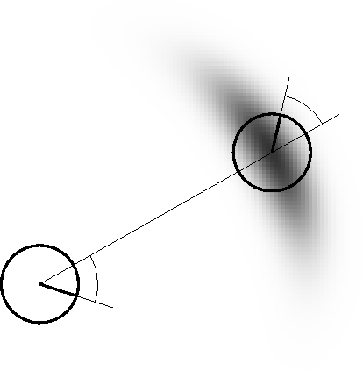
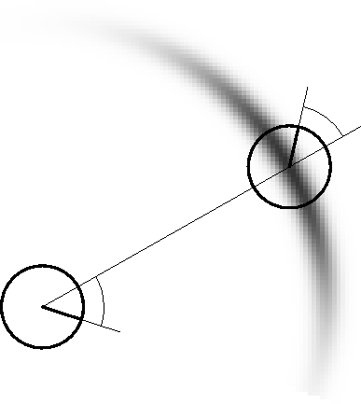
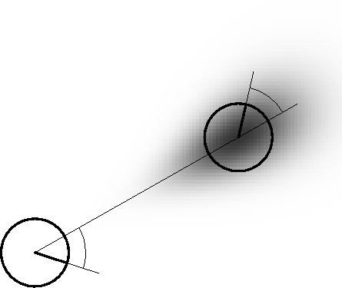
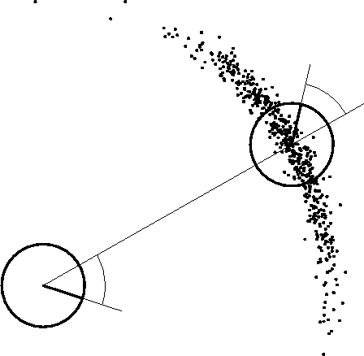
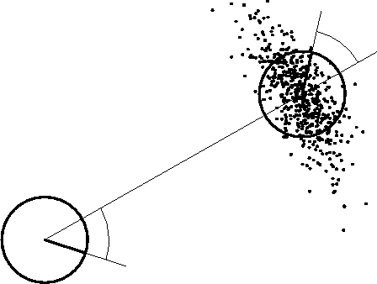
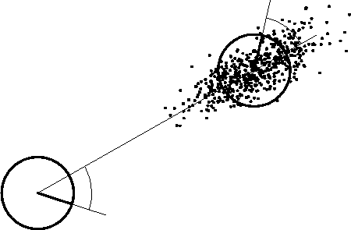
Examples (Odometry-Based)

Slide 23
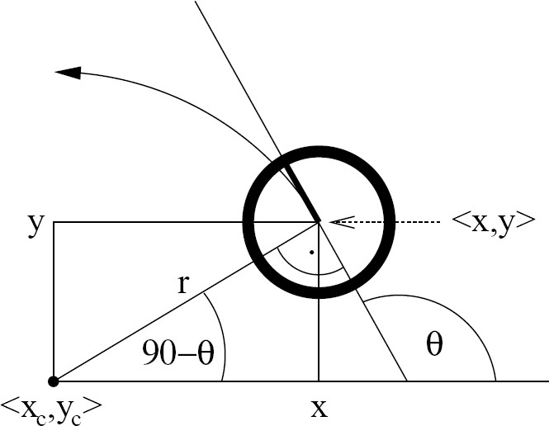
Velocity-Based Model
θ-90

Slide 24
Motion Equation
▪▪ Robot moves from
▪▪ Velocity information
to
.

Slide 25
Problem of the Velocity-Based Model
▪▪ Robot moves on a circle
▪▪ The circle constrains the final orientation
▪▪ Fix: introduce an additional noise term on the final orientation

Slide 26
Motion Including 3rd Parameter
Term to account for the final rotation

Slide 27
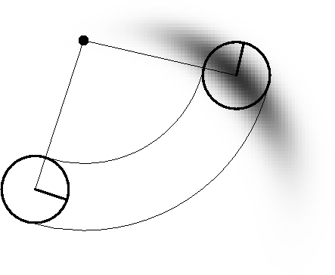
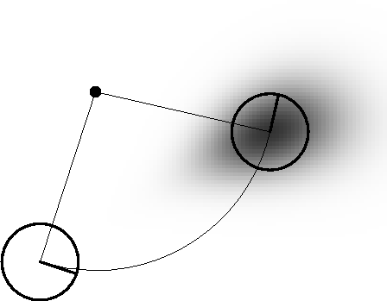
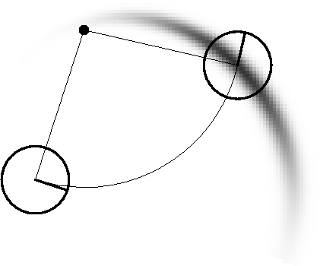
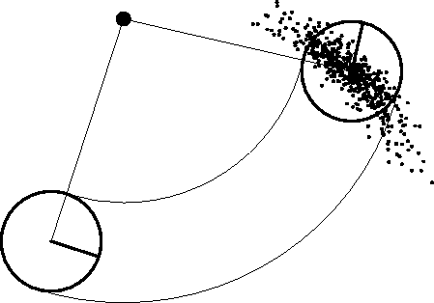
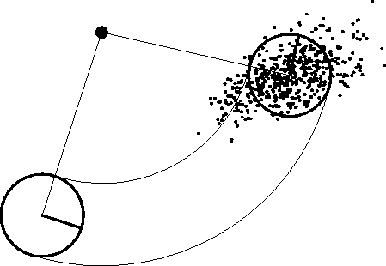
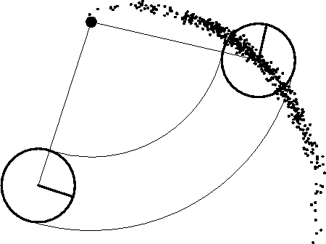
Examples (Velocity-Based)

Slide 28
Sensor Model

Slide 29
Model for Laser Scanners
▪▪ Scan z consists of K measurements.
▪▪ Individual measurements are independent given the robot position

Slide 30
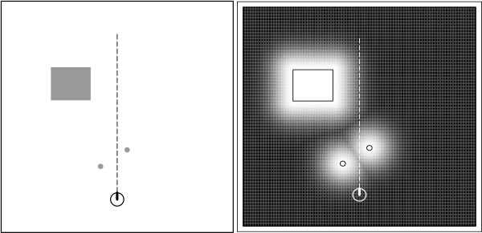
Beam-Endpoint Model

Slide 31
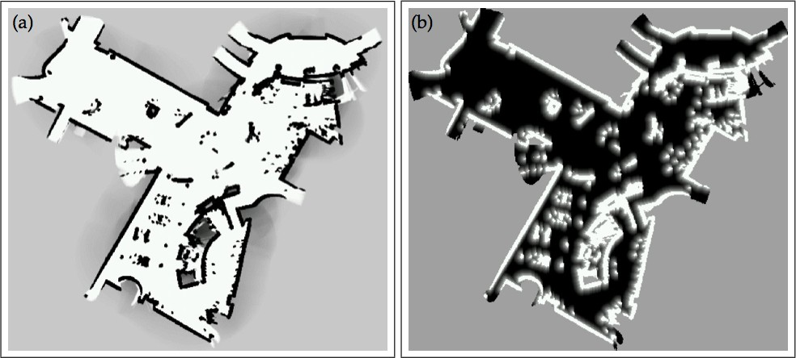
Beam-Endpoint Model
map
likelihood field

Slide 32
Ray-cast Model
▪▪ Ray-cast model considers the first obstacle long the line of sight
▪▪ Mixture of four models

Slide 33
Model for Perceiving Landmarks with Range-Bearing Sensors
▪▪ Range-bearing
▪▪ Robot’s pose
▪▪ Observation of feature j at location

Slide 34
Summary
▪▪ Bayes filter is a framework for state estimation
▪▪ Motion and sensor model are the central models in the Bayes filter
▪▪ Standard models for robot motion and laser-based range sensing

Slide 35
Literature
On the Bayes filter
▪▪ Thrun et al. “Probabilistic Robotics”, Chapter 2
▪▪ Course: Introduction to Mobile Robotics, Chapter 5
On motion and observation models
▪▪ Thrun et al. “Probabilistic Robotics”, Chapters 5 & 6
▪▪ Course: Introduction to Mobile Robotics, Chapters 6 & 7

