Slide 1
Deep Learning Tutorial
Courtesy of Hung-yi Lee
Notes:
Not memtion
DT v.s. Deep!!!!!

Slide 2
Machine Learning Basics
Machine learning is a field of computer science that gives computers the ability to learn without being explicitly programmed
Labeled Data
Machine Learning algorithm
Training
Prediction
Data
Learned model
Prediction
Methods that can learn from and make predictions on data

Slide 3
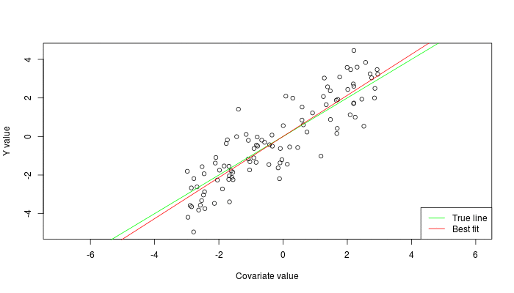
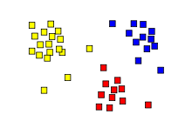
Types of Learning
Supervised: Learning with a labeled training set
Example: email classification with already labeled emails
Unsupervised: Discover patterns in unlabeled data
Example: cluster similar documents based on text
Reinforcement learning: learn to act based on feedback/reward
Example: learn to play Go, reward: win or lose
class A
class A
Classification
Regression
Clustering
Anomaly Detection
Sequence labeling
…
http://mbjoseph.github.io/2013/11/27/measure.html

Slide 4
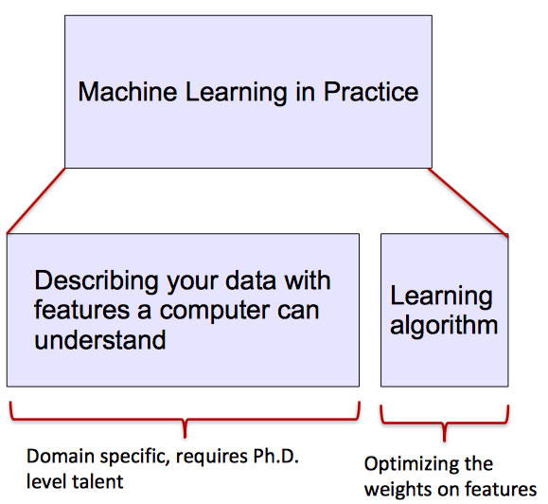
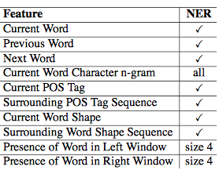
ML vs. Deep Learning
Most machine learning methods work well because of human-designed representations and input features
ML becomes just optimizing weights to best make a final prediction

Slide 5
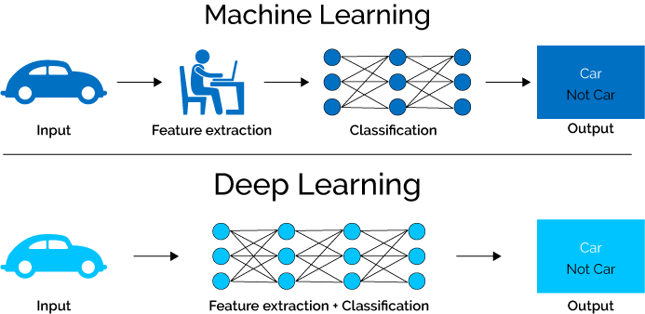
What is Deep Learning (DL) ?
A machine learning subfield of learning representations of data. Exceptional effective at learning patterns.
Deep learning algorithms attempt to learn (multiple levels of) representation by using a hierarchy of multiple layers
If you provide the system tons of information, it begins to understand it and respond in useful ways.
https://www.xenonstack.com/blog/static/public/uploads/media/machine-learning-vs-deep-learning.png

Slide 6
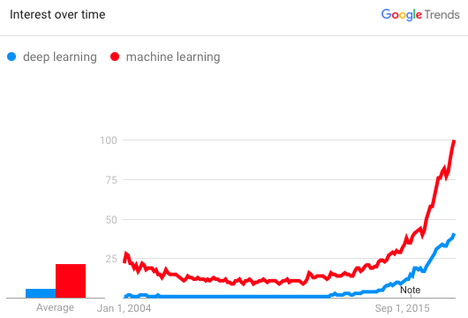
Why is DL useful?
Manually designed features are often over-specified, incomplete and take a long time to design and validate
Learned Features are easy to adapt, fast to learn
Deep learning provides a very flexible, (almost?) universal, learnable framework for representing world, visual and linguistic information.
Can learn both unsupervised and supervised
Effective end-to-end joint system learning
Utilize large amounts of training data
In ~2010 DL started outperforming other ML techniques
first in speech and vision, then NLP

Slide 7
Image Classification: A core task in Computer Vision
(assume given set of discrete labels)
{dog, cat, truck, plane, ...}
cat
This image by Nikita is licensed under CC-BY 2.0
Lecture 2 -
7

Slide 8
The Problem: Semantic Gap
What the computer sees
An image is just a big grid of numbers between [0, 255]:
e.g. 800 x 600 x 3 (3 channels RGB)
This image by Nikita is licensed under CC-BY 2.0
Lecture 2 -
8

Slide 9
Challenges: Viewpoint variation
All pixels change when the camera moves!
This image by Nikita is licensed under CC-BY 2.0
Lecture 2 -
9

Slide 10
Challenges: Illumination
This image is CC0 1.0 public domain
This image is CC0 1.0 public domain
This image is CC0 1.0 public domain
This image is CC0 1.0 public domain
Lecture 2 -

Slide 11
Challenges: Deformation
This image by Umberto Salvagnin is licensed under CC-BY 2.0
This image by Umberto Salvagnin is licensed under CC-BY 2.0
This image by sare bear is licensed under CC-BY 2.0
This image by Tom Thai is licensed under CC-BY 2.0
Lecture 2 -

Slide 12
Challenges: Occlusion
This image is CC0 1.0 public domain
This image is CC0 1.0 public domain
This image by jonsson is licensed under CC-BY 2.0
Lecture 2 -

Slide 13
Challenges: Background Clutter
This image is CC0 1.0 public domain
This image is CC0 1.0 public domain
Lecture 2 -

Slide 14
Challenges: Intraclass variation
This image is CC0 1.0 public domain
Lecture 2 -

Slide 15
Linear Classification
Lecture 2 -

Slide 16
Recall CIFAR10
50,000 training images each image is 32x32x3
10,000 test images.
Lecture 2 -

Slide 17
Parametric Approach
Image
f(x,W)
10 numbers giving class scores
Array of 32x32x3 numbers (3072 numbers total)
W
parameters
or weights
Lecture 2 -

Slide 18
f(x,W) = Wx
Parametric Approach: Linear Classifier
Image
f(x,W)
10 numbers giving class scores
Array of 32x32x3 numbers (3072 numbers total)
W
parameters
or weights
Lecture 2 -

Slide 19
Parametric Approach: Linear Classifier
3072x1
f(x,W) = Wx
10x1 10x3072
f(x,W)
Image
10 numbers giving class scores
Array of 32x32x3 numbers (3072 numbers total)
W
parameters
or weights
Lecture 2 -

Slide 20
Parametric Approach: Linear Classifier
3072x1
f(x,W) = Wx +
b
10x1
Image
10x1 10x3072
f(x,W)
10 numbers giving class scores
Array of 32x32x3 numbers (3072 numbers total)
W
parameters
or weights
Lecture 2 -

Slide 21
Example with an image with 4 pixels, and 3 classes (cat/dog/ship)
Stretch pixels into column
56
231
24
2
0.2 | -0.5 | 0.1 | 2.0
1.5 | 1.3 | 2.1 | 0.0
0 | 0.25 | 0.2 | -0.3
1.1
3.2
-1.2
-96.8
437.9
61.95
56 | 231
24 | 2
Cat score
+ =
Dog score
Ship score
Input image
W
b
Lecture 2 -

Slide 22
Example with an image with 4 pixels, and 3 classes (cat/dog/ship)
Algebraic Viewpoint
f(x,W) = Wx
Lecture 2 -

Slide 23
Example with an image with 4 pixels, and 3 classes (cat/dog/ship)
Input image
Algebraic Viewpoint
f(x,W) = Wx
W
0.2 | -0.5
0.1 | 2.0
1.5 | 1.3
2.1 | 0.0
0 | .25
0.2 | -0.3
b
1.1
3.2
-1.2
Score
-96.8
437.9
61.95
Lecture 2 -

Slide 24
Interpreting a Linear Classifier
Lecture 2 -

Slide 25
Interpreting a Linear Classifier: Geometric Viewpoint
f(x,W) = Wx + b
Array of 32x32x3 numbers (3072 numbers total)
Plot created using Wolfram Cloud
Cat image by Nikita is licensed under CC-BY 2.0
Lecture 2 -

Slide 26
Hard cases for a linear classifier
Class 1:
First and third quadrants
Class 1:
1 <= L2 norm <= 2
Class 2: Everything else
Class 1: Three modes
Class 2: Everything else
Class 2:
Second and fourth quadrants
Lecture 2 -

Slide 27
Linear Classifier: Three Viewpoints
Algebraic Viewpoint
Visual Viewpoint
Geometric Viewpoint
f(x,W) = Wx
One template per class
Hyperplanes cutting up space
Lecture 2 -

Slide 28
Deep learning attracts lots of attention.
Google Trends
2007
2009
2011
2013
2015

Slide 29
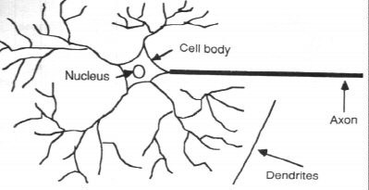
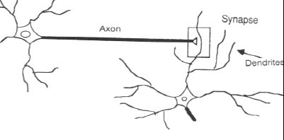
How the Human Brain learns
In the human brain, a typical neuron collects signals from others through a host of fine structures called dendrites.
The neuron sends out spikes of electrical activity through a long, thin stand known as an axon, which splits into thousands of branches.
At the end of each branch, a structure called a synapse converts the activity from the axon into electrical effects that inhibit or excite activity in the connected neurons.

Slide 30
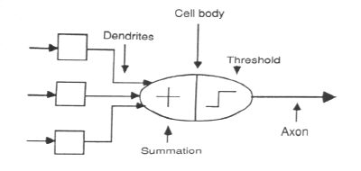
A Neuron Model
When a neuron receives excitatory input that is sufficiently large compared with its inhibitory input, it sends a spike of electrical activity down its axon. Learning occurs by changing the effectiveness of the synapses so that the influence of one neuron on another changes.
We conduct these neural networks by first trying to deduce the essential features of neurons and their interconnections.
We then typically program a computer to simulate these features.

Slide 31
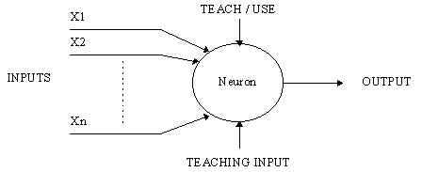
A Simple Neuron
An artificial neuron is a device with many inputs and one output.
The neuron has two modes of operation;
the training mode and
the using mode.

Slide 32
A Simple Neuron (Cont.)
In the training mode, the neuron can be trained to fire (or not), for particular input patterns.
In the using mode, when a taught input pattern is detected at the input, its associated output becomes the current output. If the input pattern does not belong in the taught list of input patterns, the firing rule is used to determine whether to fire or not.
The firing rule is an important concept in neural networks and accounts for their high flexibility. A firing rule determines how one calculates whether a neuron should fire for any input pattern. It relates to all the input patterns, not only the ones on which the node was trained on previously.

Slide 33
Part I: Introduction of Deep Learning
What people already knew in 1980s
Notes:
Three questions:
Model
Cost
Train

Slide 34
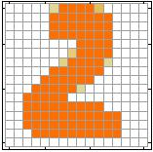
Example Application
Handwriting Digit Recognition
Machine
“2”
Notes:
“Hello world” for deep learning
Data: http://yann.lecun.com/exdb/mnist/

Slide 35
Handwriting Digit Recognition
Input
Output
y₁
is 1
0.1
y₂
is 2
0.7
The image is “2”
……
……
……
y₁₀
0.2
is 0
16 x 16 = 256
Ink → 1
No ink → 0
Each dimension represents the confidence of a digit.
Notes:
The same for even more complex tasks.

Slide 36
Example Application
Handwriting Digit Recognition
y₁
Machine
y₂
“2”
……
……
y₁₀
$$f:R^{256}→R^{10}$$
In deep learning, the function $f$ is represented by neural network

Slide 37
Element of Neural Network
Neuron
$$f:R^{K}→R$$
…
Activation function
weights
bias
Notes:
sigmoid

Slide 38
Neural Network
neuron
Input
Layer 1
Layer 2
Layer L
Output
……
y₁
……
y₂
……
……
……
……
……
……
y_{M}
Input Layer
Output Layer
Hidden Layers
Deep means many hidden layers
Notes:
Fully Connected Feedforward Network
You can always connect the neurons in your own way.
“+” is ignored
Each dimension corresponds to a digit (10 dimension is needed)

Slide 39
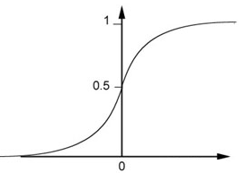
Example of Neural Network
1
4
0.98
1
-2
1
-1
-2
0.12
-1
1
0
Sigmoid Function
Notes:
Ignore +

Slide 40
Example of Neural Network
1
4
0.98
2
0.86
3
0.62
1
-2
-1
-1
1
0
-2
-1
-2
0.12
-2
0.11
-1
0.83
-1
1
-1
4
0
0
2

Slide 41
Example of Neural Network
1
0.73
2
0.72
3
0.51
0
-2
-1
-1
1
0
-2
-1
0.5
-2
0.12
-1
0.85
0
1
-1
4
0
0
2
$$f:R^{2}→R^{2}$$
$$f\left(\left[\begin{matrix}1 \\ −1\end{matrix}\right]\right)=\left[\begin{matrix}0.62 \\ 0.83\end{matrix}\right]$$
$$f\left(\left[\begin{matrix}0 \\ 0\end{matrix}\right]\right)=\left[\begin{matrix}0.51 \\ 0.85\end{matrix}\right]$$
Different parameters define different function
Notes:
For example, if we modify “1” to “2”, then we have another function

Slide 42
Matrix Operation
1
4
0.98
1
-2
1
-1
-2
0.12
-1
1
0
$$\left[\begin{matrix}1 & −2 \\ −1 & 1\end{matrix}\right]$$
$$\left[\begin{matrix}1 \\ −1\end{matrix}\right]$$
$$\left[\begin{matrix}1 \\ 0\end{matrix}\right]$$
$$=$$
$$\left[\begin{matrix}0.98 \\ 0.12\end{matrix}\right]$$
$$σ\left( \right)$$
$$+$$
$$\left[\begin{matrix}4 \\ −2\end{matrix}\right]$$
Notes:
Make sure you know how to do it
author: Adam Coates, Baidu, Inc.
Deep Learning (hopefully faster)
http://videolectures.net/deeplearning2015_coates_deep_learning/

Slide 43
Neural Network
……
y₁
W¹
W²
W^{L}
……
y₂
b¹
b²
b^{L}
……
……
……
……
……
x
a¹
a²
y
……
y_{M}
W¹
x
b¹
+
$$σ\left( \right)$$
a¹
b²
W²
+
$$σ\left( \right)$$
W^{L}
b^{L}
a^{L-1}
+
$$σ\left( \right)$$
Notes:
Draw it?

Slide 44
Neural Network
……
y₁
W¹
W²
W^{L}
……
y₂
b¹
b²
b^{L}
……
……
……
……
……
x
a¹
a²
y
……
y_{M}
y
x
Using parallel computing techniques to speed up matrix operation
$$=f\left( \right)$$
W^{L}
…
W²
W¹
x
b¹
b²
…
b^{L}
+
+
+
$$σ\left( \right)$$
$$=σ\left( \right)$$
$$σ\left( \right)$$
x
Notes:
Draw it?

Slide 45
Softmax
Softmax layer as the output layer
Ordinary Layer
In general, the output of network can be any value.
May not be easy to interpret
Notes:
Original output layer is local

Slide 46
Softmax
Probability:
$1>y_{i}>0$
$\sum_{i}{y_{i}=1}$
Softmax layer as the output layer
Softmax Layer
3
20
0.88
1
2.7
0.12
-3
0.05
≈0
Notes:
Why it is name soft max?
Monotonicity of softmax
Non-locality of softmax

Slide 47
How to set network parameters
$$θ=\left\{W^{1},b^{1},W^{2},b^{2},⋯W^{L},b^{L}\right\}$$
……
y₁
is 1
0.1
……
y₂
0.7
is 2
Softmax
……
……
……
……
y₁₀
is 0
0.2
16 x 16 = 256
Ink → 1
No ink → 0
Set the network parameters $θ$ such that ……
Input:
How to let the neural network achieve this
y₁ has the maximum value
Input:
y₂ has the maximum value

Slide 48
Training Data
Preparing training data: images and their labels
“5”
“0”
“4”
“1”
“9”
“2”
“1”
“3”
Using the training data to find the network parameters.

Slide 49
Cost
Given a set of network parameters $θ$, each example has a cost value.
“1”
……
y₁
0.2
1
……
y₂
0
0.3
……
……
……
Cost
……
……
……
y₁₀
$$L(θ)$$
0
0.5
target
Cost can be Euclidean distance or cross entropy of the network output and target
Notes:
With softmax, the summation of all the ouputs would be one.
Can be considered as probability if you want ……

Slide 50
Total Cost
For all training data …
Total Cost:
NN
$$C\left(θ\right)=\sum_{r=1}^{R}{L^{r}\left(θ\right)}$$
x¹
y¹
$${\hat{y}}^{1}$$
$$L^{1}\left(θ\right)$$
x²
NN
y²
$${\hat{y}}^{2}$$
How bad the network parameters $θ$ is on this task
$$L^{2}\left(θ\right)$$
x³
NN
y³
$${\hat{y}}^{3}$$
$$L^{3}\left(θ\right)$$
……
……
……
……
Find the network parameters $θ^{∗}$ that minimize this value
x^{R}
NN
y^{R}
$${\hat{y}}^{R}$$
$$L^{R}\left(θ\right)$$
Notes:
Randomly picked one
Two approaches update the parameters towards the same direction, but stochastic is faster!
Better!

Slide 51
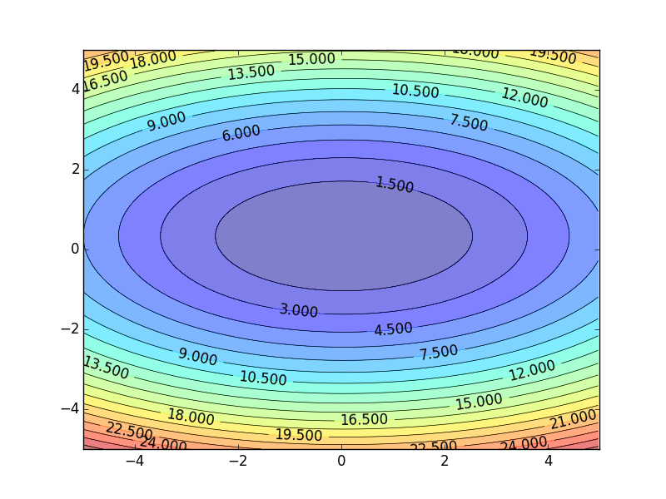
Gradient Descent
Assume there are only two parameters w₁ and w₂ in a network.
Error Surface
$$θ=\left\{w_{1},w_{2}\right\}$$
The colors represent the value of C.
Randomly pick a starting point $θ^{0}$
Compute the negative gradient at $θ^{0}$
$$w_{2}$$
$$θ^{∗}$$
$$−η∇C\left(θ^{0}\right)$$
$$−∇C\left(θ^{0}\right)$$
$$−∇C\left(θ^{0}\right)$$
Times the learning rate $η$
$$∇C\left(θ^{0}\right)=\left[\begin{matrix}∂C\left(θ^{0}\right)/∂w_{1} \\ ∂C\left(θ^{0}\right)/∂w_{2}\end{matrix}\right]$$
$$θ^{0}$$
$$−η∇C\left(θ^{0}\right)$$
$$w_{1}$$
Notes:
Eta
人站在 ｔｈｅｔａ０ 環顧四周 看看哪裡最低，那個方向就是 ｇｒａｄｉｅｎｔ

Slide 52
Gradient Descent
Eventually, we would reach a minima …..
Randomly pick a starting point $θ^{0}$
Compute the negative gradient at $θ^{0}$
$$θ^{2}$$
$$−η∇C\left(θ^{2}\right)$$
$$−η∇C\left(θ^{1}\right)$$
$$w_{2}$$
$$−∇C\left(θ^{2}\right)$$
$$−∇C\left(θ^{1}\right)$$
$$θ^{1}$$
$$−∇C\left(θ^{0}\right)$$
Times the learning rate $η$
$$θ^{0}$$
$$−η∇C\left(θ^{0}\right)$$
$$w_{1}$$

Slide 53
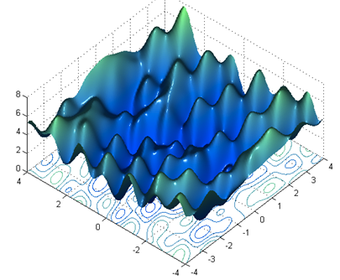
Local Minima
Gradient descent never guarantee global minima
Different initial point $θ^{0}$
Reach different minima, so different results
$$C$$
Who is Afraid of Non-Convex Loss Functions?
http://videolectures.net/eml07_lecun_wia/
$$w_{1}$$
$$w_{2}$$

Slide 54
Besides local minima ……
cost
Very slow at the plateau
Stuck at saddle point
Stuck at local minima
$$∇C\left(θ\right)≈0$$
$$∇C\left(θ\right)=0$$
$$∇C\left(θ\right)=0$$
parameter space

Slide 55
Mini-batch
Randomly initialize $θ^{0}$
x¹
NN
y¹
Pick the 1st batch
$${\hat{y}}^{1}$$
$$C^{1}$$
$$C=C^{1}+C^{31}+⋯$$
Mini-batch
NN
x³¹
y³¹
$${\hat{y}}^{31}$$
$$θ^{1}←θ^{0}−η∇C\left(θ^{0}\right)$$
$$C^{31}$$
Pick the 2nd batch
……
$$C=C^{2}+C^{16}+⋯$$
NN
$$θ^{2}←θ^{1}−η∇C\left(θ^{1}\right)$$
x²
y²
$${\hat{y}}^{2}$$
$$C^{2}$$
…
Until all mini-batches have been picked
Mini-batch
x¹⁶
NN
y¹⁶
$${\hat{y}}^{16}$$
$$C^{16}$$
one epoch
……
Repeat the above process
Notes:
Ｉｎ ｏｐｅｎ ｅｐｏｃｈ， ｕｐｄａｔｅ ｍａｎｙ ｔｉｍｅｓ
Shuffle data, and repeat above process

Slide 56
Backpropagation
A network can have millions of parameters.
Backpropagation is the way to compute the gradients efficiently (not today)
Ref: http://speech.ee.ntu.edu.tw/~tlkagk/courses/MLDS_2015_2/Lecture/DNN%20backprop.ecm.mp4/index.html
Many toolkits can compute the gradients automatically
Ref: http://speech.ee.ntu.edu.tw/~tlkagk/courses/MLDS_2015_2/Lecture/Theano%20DNN.ecm.mp4/index.html
Notes:
Just a function

Slide 57
Size of Training Data
Rule of thumb:
the number of training examples should be at least five to ten times the number of weights of the network.
Other rule:
|W|= number of weights
a = expected accuracy on test set

Slide 58
Training: Backprop algorithm
The Backprop algorithm searches for weight values that minimize the total error of the network over the set of training examples (training set).
Backprop consists of the repeated application of the following two passes:
Forward pass: in this step the network is activated on one example and the error of (each neuron of) the output layer is computed.
Backward pass: in this step the network error is used for updating the weights. Starting at the output layer, the error is propagated backwards through the network, layer by layer. This is done by recursively computing the local gradient of each neuron.

Slide 59
Back Propagation
Back-propagation training algorithm
Backprop adjusts the weights of the NN in order to minimize the network total mean squared error.
Network activation
Forward Step
Error propagation
Backward Step

Slide 60
Part II: Why Deep?

Slide 61
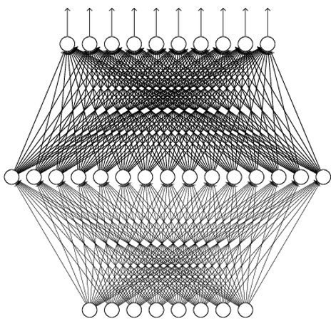
Universality Theorem
Any continuous function f
Can be realized by a network with one hidden layer
(given enough hidden neurons)
Reference for the reason: http://neuralnetworksanddeeplearning.com/chap4.html
Why “Deep” neural network not “Fat” neural network?

Slide 62
Fat + Short v.s. Thin + Tall
The same number of parameters
Which one is better?
……
……
……
Shallow
Deep

Slide 63
Recipe for Learning
http://www.gizmodo.com.au/2015/04/the-basic-recipe-for-machine-learning-explained-in-a-single-powerpoint-slide/
Notes:
今年四月的 GTC

Slide 64
Recipe for Learning
Don’t forget!
overfitting
Modify the Network
Preventing
Overfitting
Better optimization Strategy
http://www.gizmodo.com.au/2015/04/the-basic-recipe-for-machine-learning-explained-in-a-single-powerpoint-slide/
Notes:
Last one is on training set
Sometimes students ask

Slide 65
Neural networks re-visited

Slide 66
Neural networks: without the brain stuff
(Before) Linear score function:

Slide 67
Neural networks: without the brain stuff
(Before) Linear score function: (Now) 2-layer Neural Network

Slide 68
Neural networks: without the brain stuff
(Before) Linear score function: (Now) 2-layer Neural Network
x
h
W1
W2
s
3072
100
10

Slide 69
Neural networks: without the brain stuff
(Before) Linear score function: (Now) 2-layer Neural Network
x
h
W1
W2
s
3072
100
10

Slide 70
Neural networks: without the brain stuff
(Before) Linear score function: (Now) 2-layer Neural Network
or 3-layer Neural Network

Slide 71
Activation functions
Sigmoid
tanh
Leaky ReLU
Maxout
ReLU
ELU

Slide 72
Neural networks: Architectures
“3-layer Neural Net”, or
“2-hidden-layer Neural Net”
“Fully-connected” layers
“2-layer Neural Net”, or
“1-hidden-layer Neural Net”

Slide 73
Next: Convolutional Neural Networks
Illustration of LeCun et al. 1998 from CS231n 2017 Lecture 1
Lecture 5 -
73
April 17, 2018₄

Slide 74
A bit of history:
Gradient-based learning applied to document recognition
[LeCun, Bottou, Bengio, Haffner 1998]
LeNet-5
Lecture 5 -
1144

Slide 75
A bit of history:
ImageNet Classification with Deep Convolutional Neural Networks [Krizhevsky, Sutskever, Hinton, 2012]
“AlexNet”
Lecture 5 -
1155

Slide 76
Fast-forward to today: ConvNets are everywhere
NVIDIA Tesla line
(these are the GPUs on rye01.stanford.edu)
Note that for embedded systems a typical setup would involve NVIDIA Tegras, with integrated GPU and ARM-based CPU cores.
self-driving cars
Fei-Fei Li & Justin Johnson & Serena Yeung Lecture 5 - April 17, 2018

Slide 77
Convolutional Neural Networks
(First without the brain stuff)
Fei-Fei Li & Justin Johnson & Serena Yeung Lecture 5 - April 17, 2018

Slide 78
Fully Connected Layer
32x32x3 image -> stretch to 3072 x 1
input
activation
1
1
3072
10 x 3072
weights
10
Fei-Fei Li & Justin Johnson & Serena Yeung Lecture 5 - April 17, 2018

Slide 79
Fully Connected Layer
32x32x3 image -> stretch to 3072 x 1
input
activation
1
1
3072
10 x 3072
weights
10
1 number:
the result of taking a dot product between a row of W and the input (a 3072-dimensional dot product)
Fei-Fei Li & Justin Johnson & Serena Yeung Lecture 5 - April 17, 2018

Slide 80
Convolution Layer
32x32x3 image -> preserve spatial structure
32
height
32
depth
width
3
Fei-Fei Li & Justin Johnson & Serena Yeung Lecture 5 - April 17, 2018

Slide 81
Convolution Layer
32x32x3 image
5x5x3 filter
32
Convolve the filter with the image
i.e. “slide over the image spatially, computing dot products”
32
3
Fei-Fei Li & Justin Johnson & Serena Yeung Lecture 5 - April 17, 2018

Slide 82
Convolution Layer
Filters always extend the full depth of the input volume
32x32x3 image
5x5x3 filter
32
Convolve the filter with the image
i.e. “slide over the image spatially, computing dot products”
32
3
Fei-Fei Li & Justin Johnson & Serena Yeung Lecture 5 - April 17, 2018

Slide 83
Convolution Layer
32x32x3 image 5x5x3 filter
32
1 number:
the result of taking a dot product between the filter and a small 5x5x3 chunk of the image
(i.e. 5*5*3 = 75-dimensional dot product + bias)
32
3
Fei-Fei Li & Justin Johnson & Serena Yeung Lecture 5 - April 17, 2018

Slide 84
Convolution Layer
activation map
32x32x3 image 5x5x3 filter
32
28
convolve (slide) over all spatial locations
32
28
3
1
Fei-Fei Li & Justin Johnson & Serena Yeung Lecture 5 - April 17, 2018

Slide 85
consider a second, green filter
Convolution Layer
32x32x3 image 5x5x3 filter
activation maps
32
28
convolve (slide) over all spatial locations
32
28
3
1
Lecture 5 - 33
Fei-Fei Li & Justin Johnson & Serena Yeung Lecture 5 - April 17, 2018

Slide 86
For example, if we had 6 5x5 filters, we’ll get 6 separate activation maps:
activation maps
32
28
Convolution Layer
32
28
3
6
We stack these up to get a “new image” of size 28x28x6!
Fei-Fei Li & Justin Johnson & Serena Yeung Lecture 5 - April 17, 2018

Slide 87
Preview: ConvNet is a sequence of Convolution Layers, interspersed with activation functions
32
28
CONV, ReLU
e.g. 6 5x5x3 filters
32
28
3
6
Fei-Fei Li & Justin Johnson & Serena Yeung Lecture 5 - April 17, 2018

Slide 88
Preview: ConvNet is a sequence of Convolution Layers, interspersed with activation functions
32
28
24
….
CONV, ReLU
e.g. 6 5x5x3 filters
CONV, ReLU
e.g. 10 5x5x6 filters
CONV, ReLU
32
28
24
3
6
10
Fei-Fei Li & Justin Johnson & Serena Yeung Lecture 5 - April 17, 2018

Slide 89
Preview
[Zeiler and Fergus 2013]
Fei-Fei Li & Justin Johnson & Serena Yeung Lecture 5 - April 17, 2018

Slide 90
Preview
Fei-Fei Li & Justin Johnson & Serena Yeung Lecture 5 - April 17, 2018

Slide 91
one filter =>
one activation map
example 5x5 filters
(32 total)
We call the layer convolutional because it is related to convolution of two signals:
elementwise multiplication and sum of a filter and the signal (image)
Fei-Fei Li & Justin Johnson & Serena Yeung Lecture 5 - April 17, 2018

Slide 92
preview:
Fei-Fei Li & Justin Johnson & Serena Yeung Lecture 5 - April 17, 2018

Slide 93
The brain/neuron view of CONV Layer
32x32x3 image 5x5x3 filter
32
1 number:
the result of taking a dot product between the filter and this part of the image
(i.e. 5*5*3 = 75-dimensional dot product)
32
3
Fei-Fei Li & Justin Johnson & Serena Yeung Lecture 5 - April 17, 2018

Slide 94
The brain/neuron view of CONV Layer
32x32x3 image 5x5x3 filter
32
It’s just a neuron with local connectivity...
1 number:
the result of taking a dot product between the filter and this part of the image
(i.e. 5*5*3 = 75-dimensional dot product)
32
3
Fei-Fei Li & Justin Johnson & Serena Yeung Lecture 5 - April 17, 2018

Slide 95
The brain/neuron view of CONV Layer
32
28
An activation map is a 28x28 sheet of neuron outputs:
Each is connected to a small region in the input
All of them share parameters
32
28
“5x5 filter” -> “5x5 receptive field for each neuron”
3
Fei-Fei Li & Justin Johnson & Serena Yeung Lecture 5 - April 17, 2018

Slide 96
The brain/neuron view of CONV Layer
32
28
E.g. with 5 filters,
CONV layer consists of neurons arranged in a 3D grid (28x28x5)
There will be 5 different neurons all looking at the same region in the input volume
32
28
3
5
Fei-Fei Li & Justin Johnson & Serena Yeung Lecture 5 - April 17, 2018

Slide 97
Each neuron looks at the full input volume
32x32x3 image -> stretch to 3072 x 1
input
activation
1
1
3072
10 x 3072
weights
10
1 number:
the result of taking a dot product between a row of W and the input (a 3072-dimensional dot product)
Fei-Fei Li & Justin Johnson & Serena Yeung Lecture 5 - April 17, 2018

Slide 98
two more layers to go: POOL/FC
Fei-Fei Li & Justin Johnson & Serena Yeung Lecture 5 - April 17, 2018

Slide 99
Pooling layer
makes the representations smaller and more manageable
operates over each activation map independently:
Fei-Fei Li & Justin Johnson & Serena Yeung Lecture 5 - April 17, 2018

Slide 100
MAX POOLING
Single depth slice
1 | 1 | 2 | 4
5 | 6 | 7 | 8
3 | 2 | 1 | 0
1 | 2 | 3 | 4
x
max pool with 2x2 filters and stride 2
6 | 8
3 | 4
y
Fei-Fei Li & Justin Johnson & Serena Yeung Lecture 5 - April 17, 2018

Slide 101
Fully Connected Layer (FC layer)
- Contains neurons that connect to the entire input volume, as in ordinary Neural Networks
Fei-Fei Li & Justin Johnson & Serena Yeung Lecture 5 - April 17, 2018

Slide 102
Summary
ConvNets stack CONV,POOL,FC layers
Trend towards smaller filters and deeper architectures
Trend towards getting rid of POOL/FC layers (just CONV)
Typical architectures look like
[(CONV-RELU)*N-POOL?]*M-(FC-RELU)*K,SOFTMAX
where N is usually up to ~5, M is large, 0 <= K <= 2.
- but recent advances such as ResNet/GoogLeNet challenge this paradigm
Fei-Fei Li & Justin Johnson & Serena Yeung Lecture 5 - April 17, 2018

