Slide 1
Plane Projective transformation
Definition:
A projectivity is an invertible mapping h from P² to itself such that three points x₁,x₂,x₃ lie on the same line if and only if h(x₁),h(x₂),h(x₃) do. ( i.e. maps lines to lines in P²⁾
Theorem:
A mapping h:P²→P² is a projectivity if and only if there exist a non-singular 3x3 matrix H such that for any point in P² reprented by a vector x it is true that h(x)=Hx
Definition: Planar Projective transformation: linear transformation on homogeneous 3 vectors represented by a non singular matrix H
or
8DOF
projectivity=collineation=projective transformation=homography
Projectivity form a group: inverse of projectivity is also a projectivity; so is a composition of two projectivities.

Slide 2
Homography
A: Projective – mapping between any two PPs with the same center of projection
  rectangle should map to arbitrary quadrilateral
  parallel lines aren’t
  but must preserve straight lines
  same as: unproject, rotate, reproject
called Homography
PP2
p’
H
p
PP1
To apply a homography H
  Compute p’ = Hp (regular matrix multiply)
  Convert p’ from homogeneous to image coordinates

Slide 3
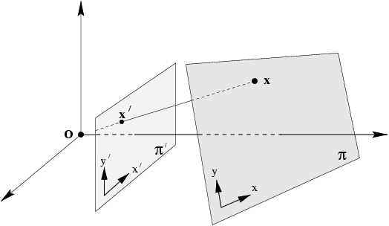
Projection along rays through a common point, (center of projection) defines a mapping from one plane to another
Central projection maps points on one plane to points on another plane
Projection also maps lines to lines : consider a plane through projection
center that intersects the two planes ➔ lines mapped onto lines ➔
Central projection is a projectivity ➔
central projection may be expressed by x’=Hx
(application of theorem)

Slide 4
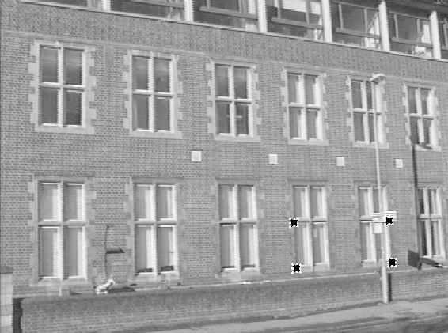
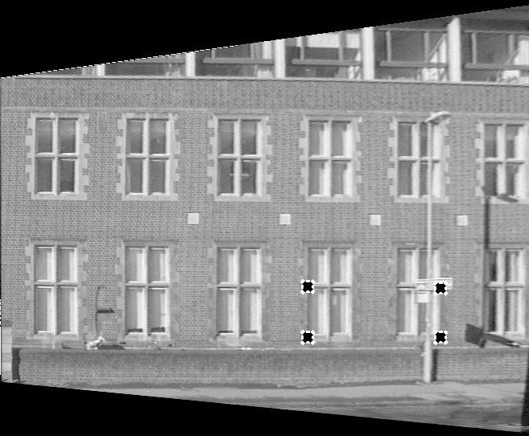
Removing projective distortion
Central projection image of a plane is related to the originial plane
via a projective transformation ➔ undo it by applying the inverse transformation
Let (x,y) and (x’,y’) be
inhomogeneous
Coordinates of a pair
of matching points
x and x’ in world and
image plane
select four points in a plane with known coordinates
(linear in h_{ij})
(2 constraints/point, 8DOF ⇒ 4 points needed)
Remark: no calibration at all necessary, better ways to compute (see later)
Sections of the image of the ground are subject to another projective distortion ➔
need another projective transformation to correct that.

Slide 5
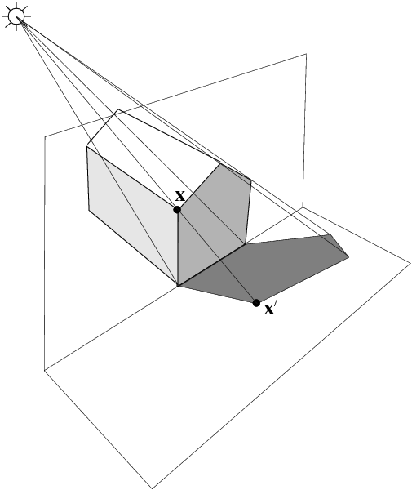
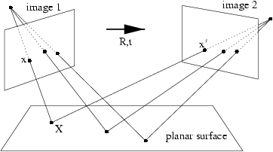
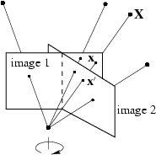
More examples
Projective transformation between two images
Induced by a world plane ➔ concatenation of two
Pojective transformations is also a proj. trans.
Proj. trans. Between the image of a plane
(end of the building) and the image of its
Shadow onto another plane (ground plane)
Proj. trans. Between two images with the same camera center
e.g. a camera rotating about its center

Slide 6
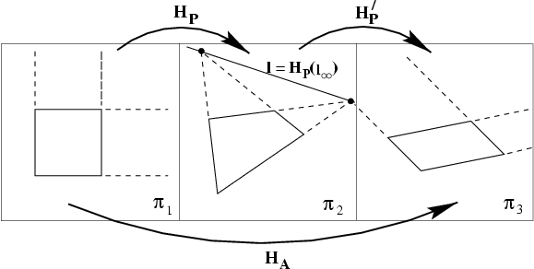
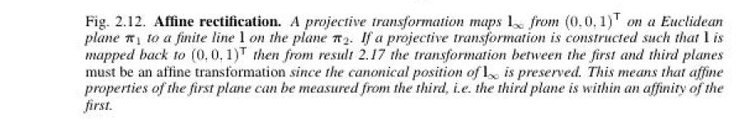
Affine properties from images
projection
rectification
Euclidean plane
Two step process:
1.Find l the image of line
at infinity in plane 2
2. Transform l to its
canonical position
(0,0,1) ^{T} by plugging into
H’p and applying it to
the entire image to get a
“rectified” image
3. Make affine measurements
on the rectified image
H’p =

Slide 7
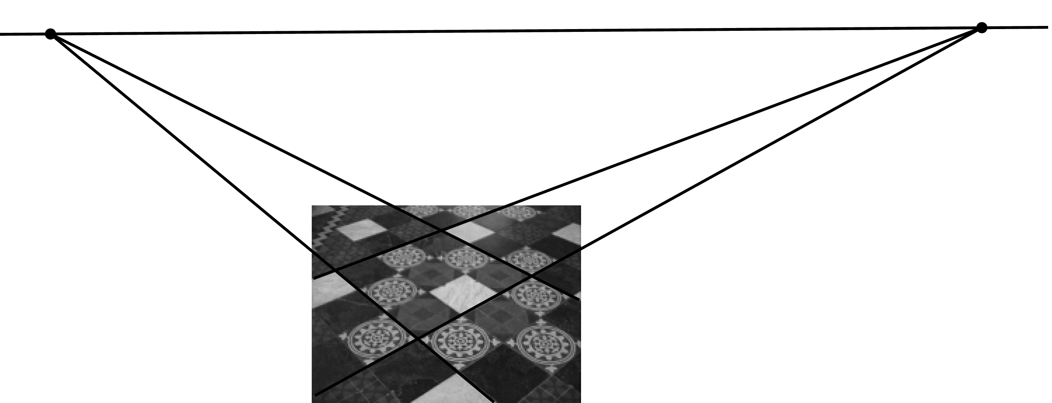
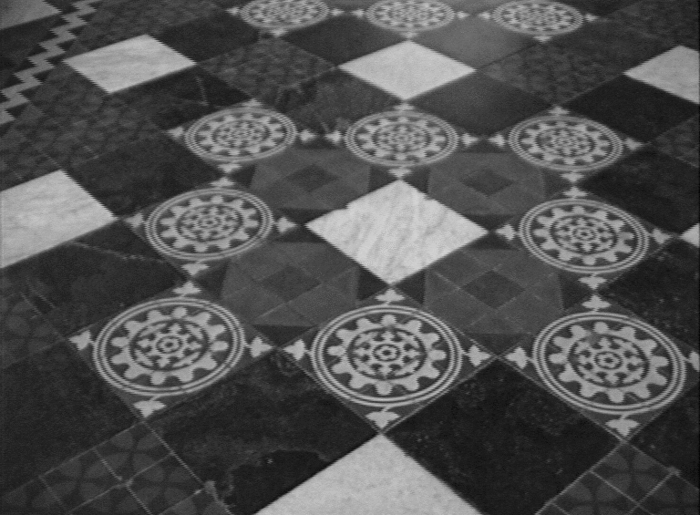
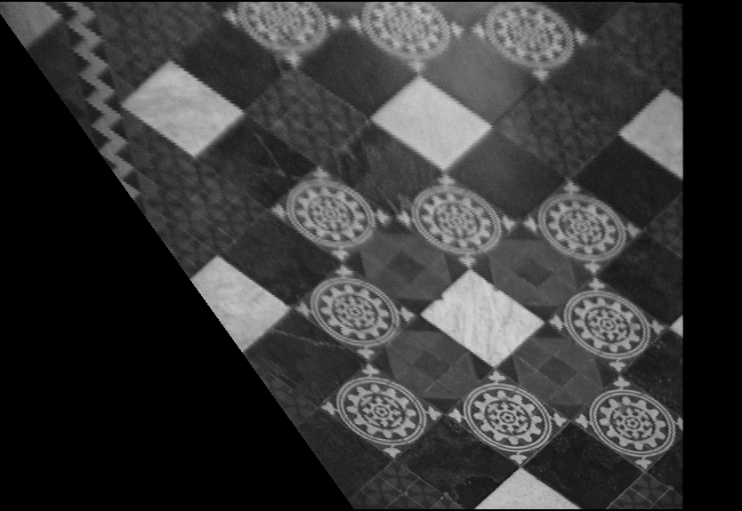
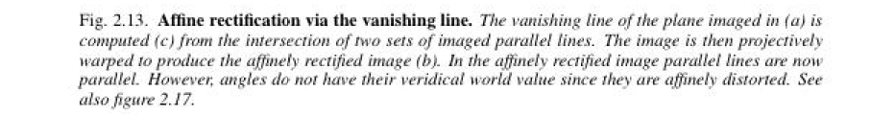
Affine rectification
v₁
l∞
v₂
l₁
l₃
l₂
l₄
c
a b

Slide 8
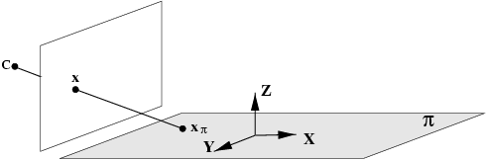

Action of projective camera on planes
Choose the world coordinate frome so that X-Y plane corresponds to a plane π in the scene such that points
In the scene plane have zero Z coordinate.
The map between the point on plane π and its image is a general planar homography: x = H x_{π} ; H is 3x3
The most general transformation that can occur between
a scene plane and an image plane under perspective
imaging is a plane projective transformation

Slide 9
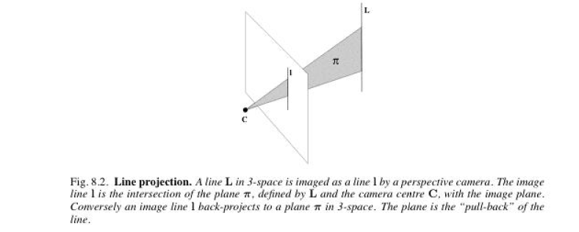
Action of projective camera on lines
forward projection
A line in 3D space projects to a line in the image.
Suppose A and B are points in space with their projections being a, and b under P; Then a point on a line that joins A and B i.e. X(μ) = A + μ B
Is the point:
Which is on the line joining a and b.
Set of points in space mapping to line l via the camera matrix P is plane P^{T} l
Line and camera center define a plane; image of the line is
the intersection of this plane with image plane.
back-projection: Plane

Slide 10
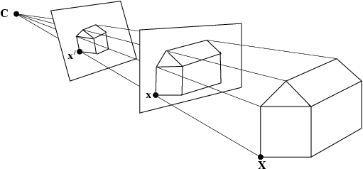
The importance of the camera center
Object in 3 space and camera center define “set of rays”
An image is obtained by intersecting these rays with a plane
Images obtained with the same camera center may be mapped to one another by a plane projective transformation
Assume two cameras
Same camera center
This is the 3x3 planar
Homography relating x and x’

Slide 11
Moving the image plane (zooming)
Changing the focal length, can be approximated as displacement of image plane along principal axis
x and x’ are images of a point X before and after zooming respectively
x’ = H x where
Assume only focal length
Is different between K and K’
Conclusion: the effect of zooming by a factor of k is to multiply the Calibration matrix
K on the right by diag(k,k,1)
Inhomogeneous
principal point

Slide 12
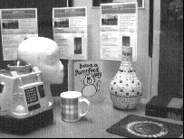
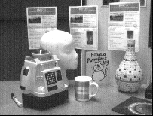
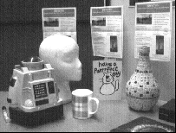
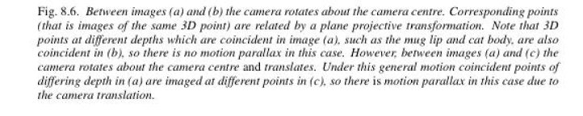
Camera rotation
Pure rotation about camera center.
x and x’ image of a point X before and after rotation.
^{x’= H x where:}
H is called conjugate rotation: same eigen values, up to a scale factor, μ, of the rotation
Matrix: ; So, phase of complex eigenvalues of H can be used to find rotation.
Can also be shown that the eigenvector of H corresponding to the real eignenvalue is the vanishing point of the rotation axis
click on 4 sets of correspondence
between A and B to determine H;
theta = 4.66 degrees.
vanishing point of rotation axis
is (0,1,0)^{T} , i.e. virtually at infinity in
the y direction; so rotation axis is
parallel to y direction
B A C

Slide 13
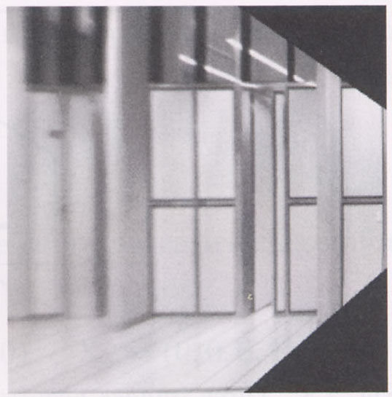


Image warping with homographies
image plane in front
image plane below
black area
where no pixel
maps to

Slide 14
Image rectification
p’
p
To unwarp (rectify) an image
  Find the homography H given a set of p and p’ pairs
  How many correspondences are needed?
  Tricky to write H analytically, but we can solve for it!
    Find such H that “best” transforms points p into p’
    Use least-squares!

Slide 15
Solving for homographies
p’ = Hp
Can set scale factor i=1. So, there are 8 unkowns.
Set up a system of linear equations:
Ah = b
where vector of unknowns h = [a,b,c,d,e,f,g,h]^{T}
Need at least 8 eqs, but the more the better…
Solve for h. If overconstrained, solve using least-squares:
Can be done in Matlab using “\” command
  see “help lmdivide”

Slide 16

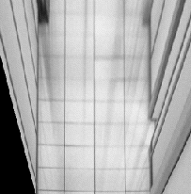
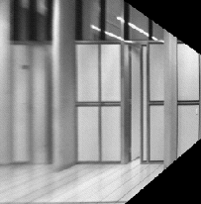

Application: generate synthetic view
In fronto parallel view (1): a rectangle is imaged as a rectangle; (2) world and image rectangle have same aspect ratio.
Approach: synthesize fronto parallel view by warping an image with the homography that maps a rectangle imaged as a quadrilateral to a rectangle with the correct aspect ratio.
Compute the homography H that warps the image quadrilateral to a rectangle with the known aspect ratio
Projectively warp the source image with this homography

Slide 17

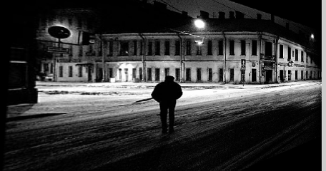
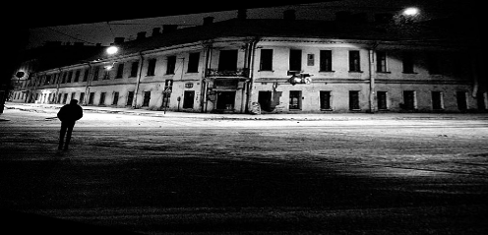
Fun with homographies
Original image
St.Petersburg
photo by A. Tikhonov
Virtual camera rotations

Slide 18

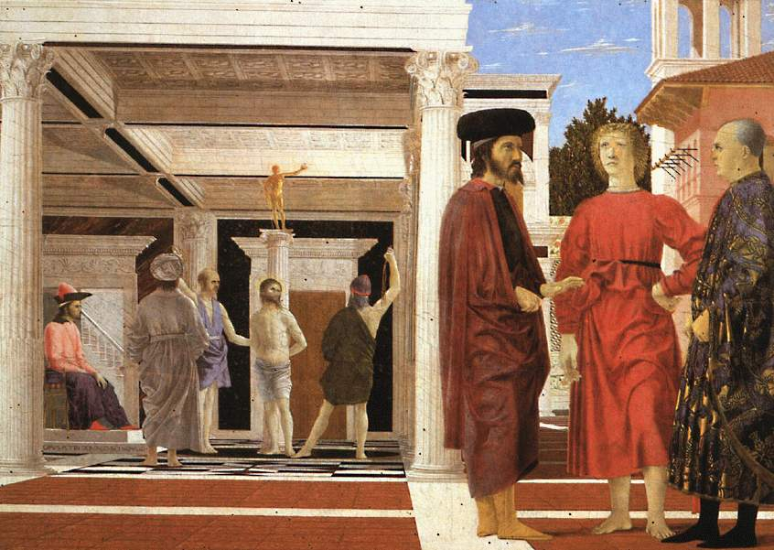

Analysing patterns and shapes
What is the shape of the b/w floor pattern?
Homography
The floor (enlarged)
Automatically
rectified floor
Slide from Criminisi

Slide 19
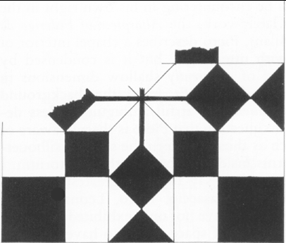
Analysing patterns and shapes
Automatic rectification
From Martin Kemp The Science of Art
(manual reconstruction)
2 patterns have been discovered !
Slide from Criminisi

Slide 20
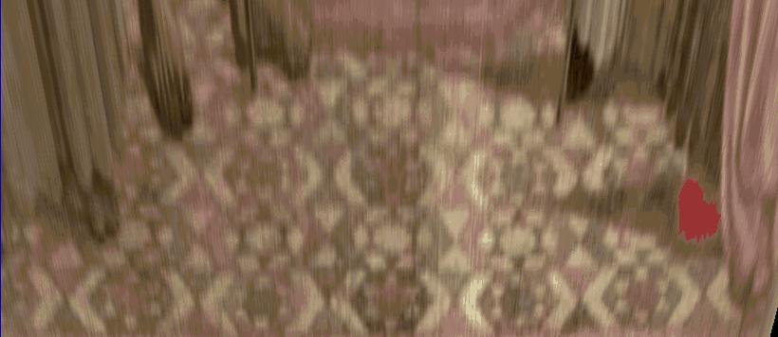
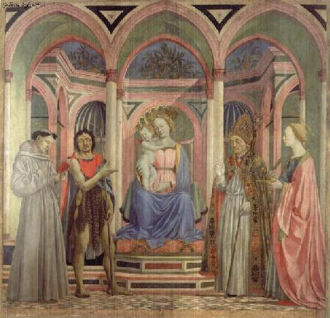
Analysing patterns and shapes
What is the (complicated)
shape of the floor pattern?
Automatically rectified floor
St. Lucy Altarpiece, D. Veneziano
Slide from Criminisi

Slide 21
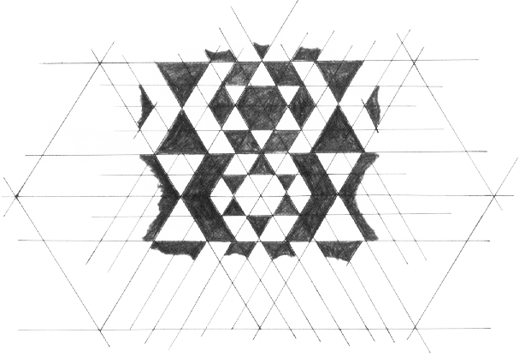
Analysing patterns and shapes
Automatic
rectification
From Martin Kemp, The Science of Art
(manual reconstruction)
Slide from Criminisi

Slide 22

Panoramas
Pick one image (red)
Warp the other images towards it (usually, one by one)
blend

Slide 23
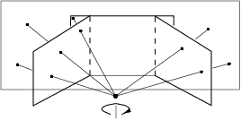
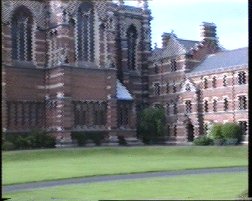
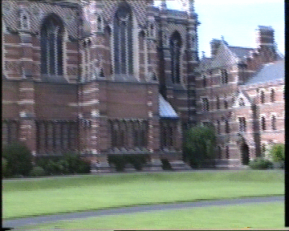
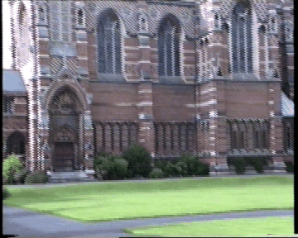


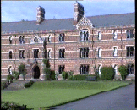
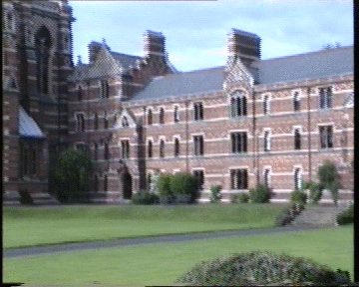



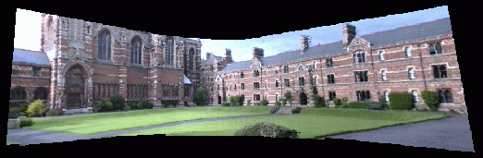
Planar homography mosaicing

Slide 24
close-up: interlacing
can be important problem!

Slide 25
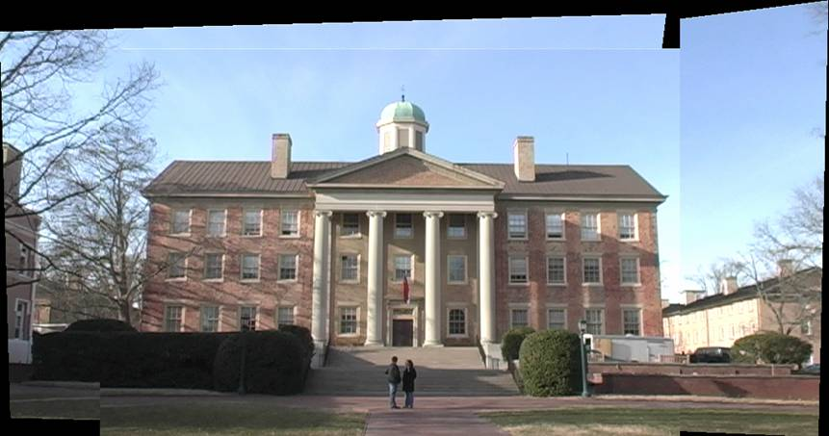
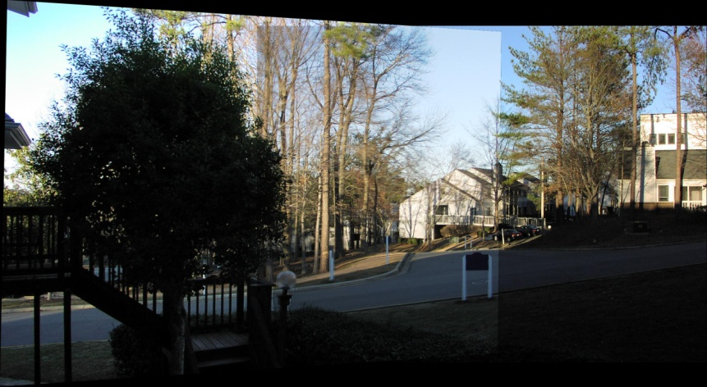
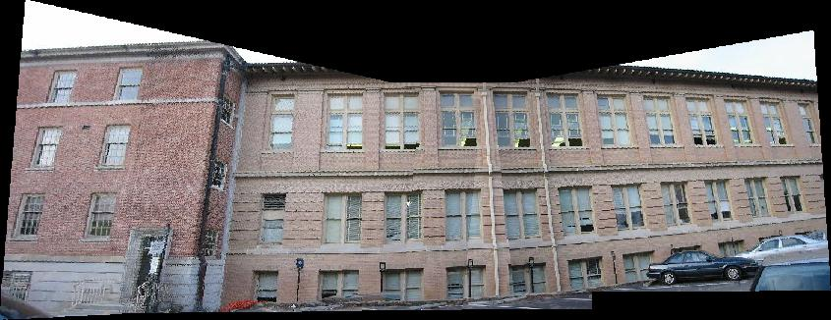
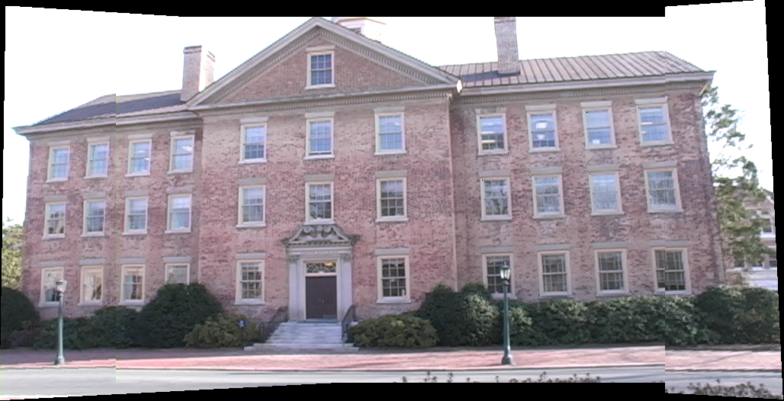
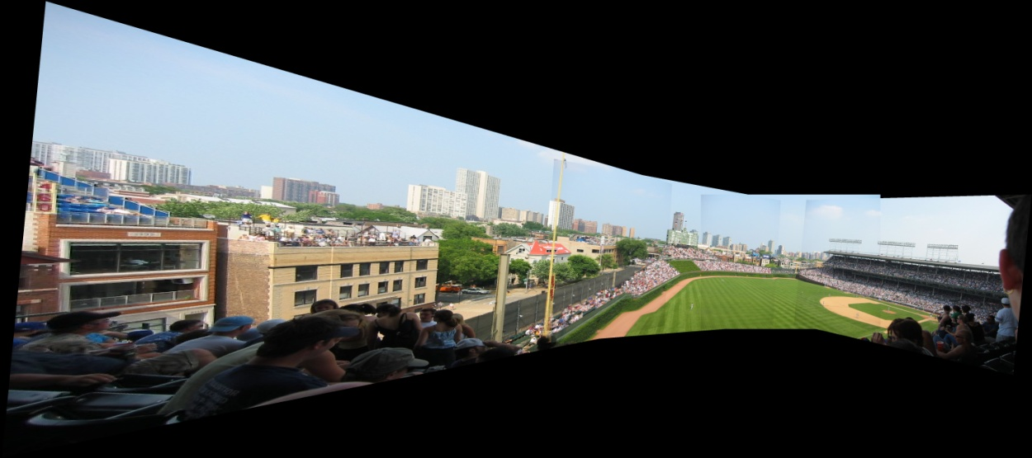
Planar homography mosaicing
more examples

Slide 26
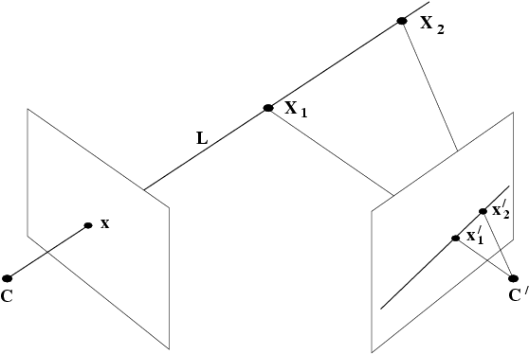
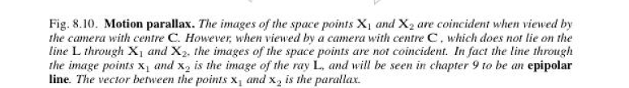
Moving the camera center
If C is fixed, but camera rotates or zooms, transformation of image only depends on the image plane motion NOT on 3D space structure
If C moves, map between images depends on 3 space structure it is looking at:
Important special case of 3-space structure: all scene points are co-planar:
2 images with motion parallax (camera center moving) are still related by planar homography
motion parallax
epipolar line

Slide 27
changing camera center
Does it still work?
synthetic PP
PP1
PP2

Slide 28

Planar scene (or far away)
PP3
PP1
PP2
PP3 is a projection plane of both centers of projection, so we are OK!
This is how big aerial photographs are made

Slide 29
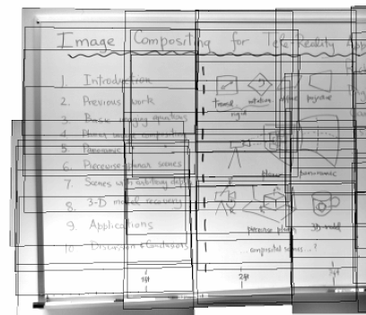
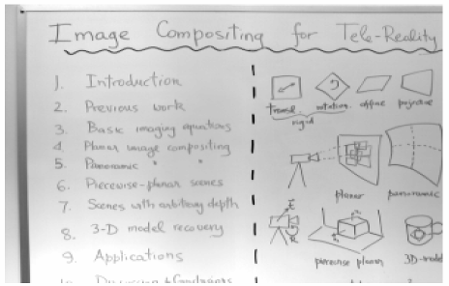
Planar mosaic

Slide 30
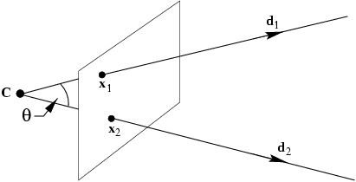


What does calibration give?
Image point x backprojects to a ray defined by x and camera center ➔ calibration relates image point to the ray’s direction
Points on a ray X = λ d with d being a direction, map to a point on the image plane x given by:
Get d from x by :
Angle between two rays with directions d₁ and d₂ corresponding to x₁ and x₂
if K is known, can measure angle between rays from their image points.
A camera for which K is known is called calibrated;
A calibrated camera is a direction sensor able to measure the direction of rays like a 2D protractor
θ
An image line l defines a plane through the camera center with normal n=K^{T}l measured in the camera’s Euclidean frame

