Slide 1

6.869 Advances in Computer Vision
Spring 2010
http://people.csail.mit.edu/torralba/courses/6.869/6.869. computervision.htm
Lecture 14
3D

Slide 2
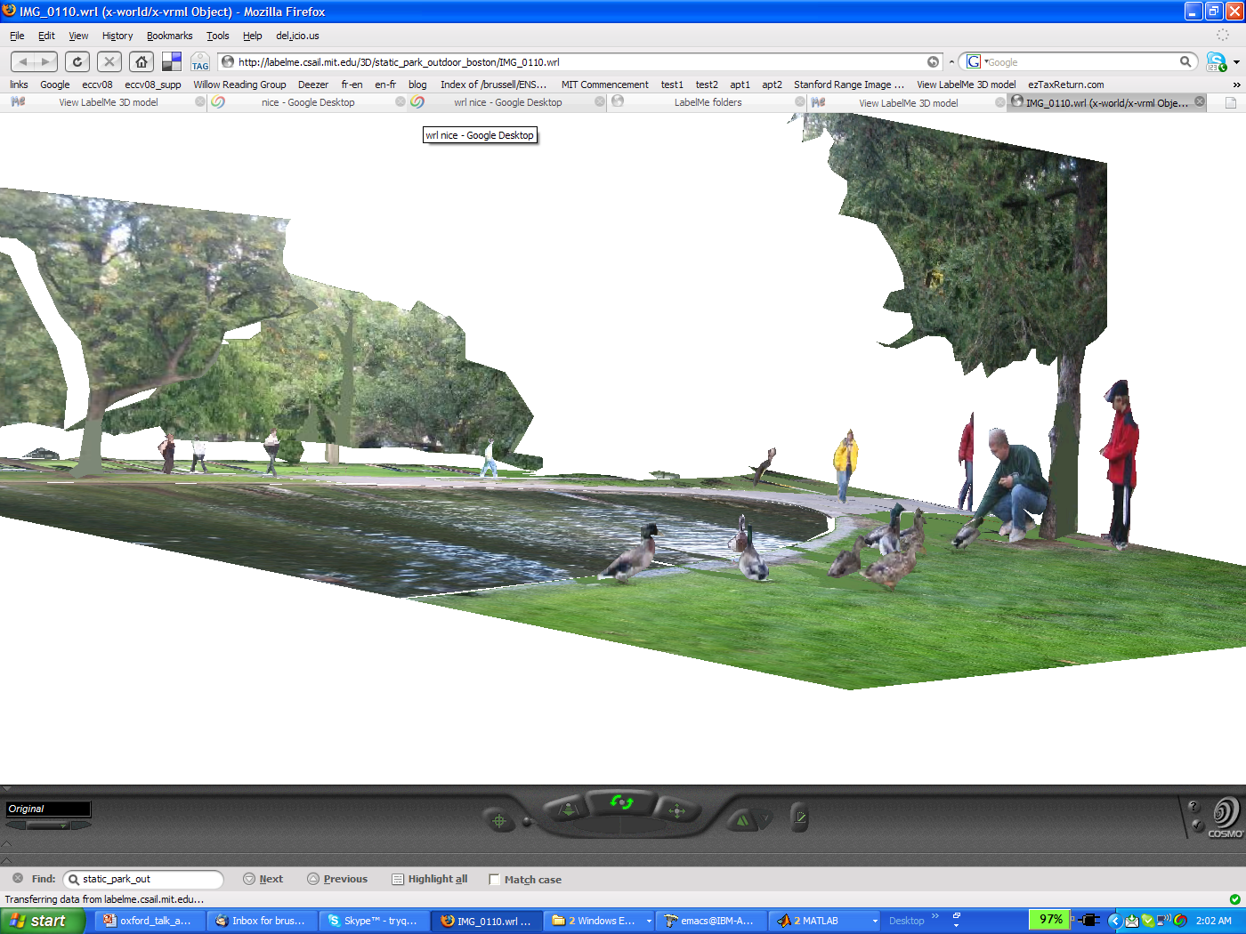
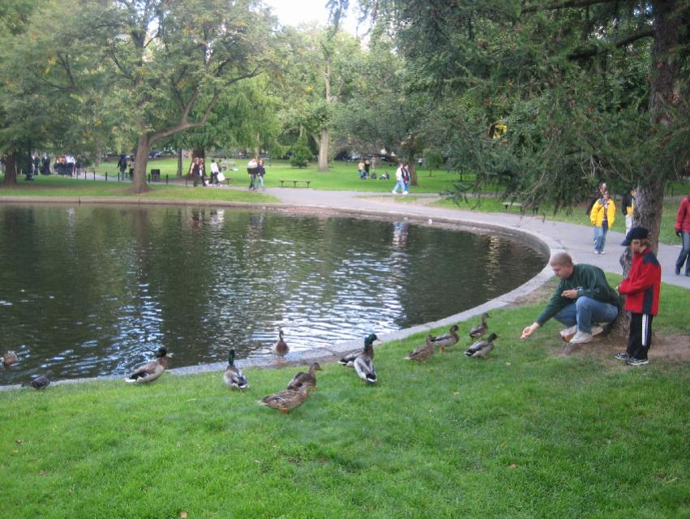
Depth Perception:
The inverse problem

Slide 3
Objects and Scenes
Most of these properties make reference to the 3D scene structure
Biederman’s violations (1981):

Slide 4


Stereo vision
~6cm
~50cm
After 30 feet (10 meters) disparity is quite small and depth from stereo is unreliable…

Slide 5
Monocular cues to depth
Absolute depth cues: (assuming known camera parameters) these cues provide information about the absolute depth between the observer and elements of the scene
Relative depth cues: provide relative information about depth between elements in the scene (this point is twice as far at that point, …)

Slide 6
Relative depth cues
Simple and powerful cue, but hard to make it work in practice…

Slide 7
Interposition / occlusion

Slide 8
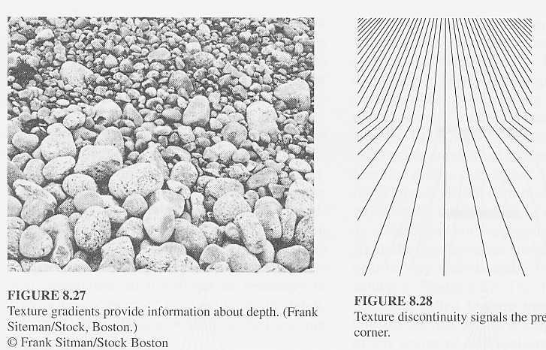
Texture Gradient
A Witkin. Recovering Surface Shape and Orientation from Texture (1981)

Slide 9

Texture Gradient
Shape from Texture from a Multi-Scale Perspective. Tony Lindeberg and Jonas Garding. ICCV 93

Slide 10
Illumination
Shading
Shadows
Inter-reflections

Slide 11
Shading
Based on 3 dimensional modeling of objects in light, shade and shadows.
Perception of depth through shading alone is always subject to the concave/convex inversion. The pattern shown can be perceived as stairsteps receding towards the top and lighted from above, or as an overhanging structure lighted from below.

Slide 12
Shadows
Slide by Steve Marschner
http://www.cs.cornell.edu/courses/cs569/2008sp/schedule.stm

Slide 13

Shadows
http://vision.psych.umn.edu/users/kersten/kersten-lab/shadows.html

Slide 14
Linear Perspective
Based on the apparent convergence of parallel lines to common vanishing points with increasing distance from the observer.
(Gibson : “perspective order”)
In Gibson’s term, perspective is a characteristic of the visual field rather than the visual world. It approximates how we see (the retinal image) rather than what we see, the objects in the world.
Perspective : a representation that is specific to one individual, in one position in space and one moment in time (a powerful immediacy).
Is perspective a universal fact of the visual retinal image ? Or is perspective something that is learned ?
Simple and powerful cue, and easy to make it work in practice…

Slide 15
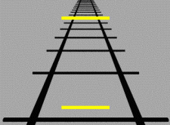
Linear Perspective
Ponzo’s illusion

Slide 16
Linear Perspective
Muller-Lyer
1889

Slide 17
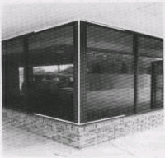
Linear Perspective
Muller-Lyer
1889

Slide 18
Linear Perspective
Muller-Lyer
1889

Slide 19
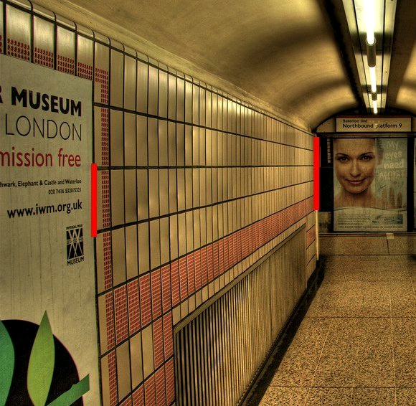
Linear Perspective
(c) 2006 Walt Anthony

Slide 20
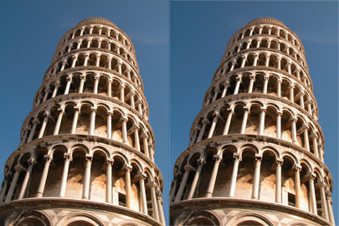
3D drives perception of important object attributes
The two Towers of Pisa
Frederick Kingdom, Ali Yoonessi and Elena Gheorghiu of McGill Vision Research unit.

Slide 21
Atmospheric perspective
Based on the effect of air on the color and visual acuity of objects at various distances from the observer.
Consequences:
  Distant objects appear bluer
  Distant objects have lower contrast.

Slide 22

Atmospheric perspective
http://encarta.msn.com/medias_761571997/Perception_(psychology).html

Slide 23
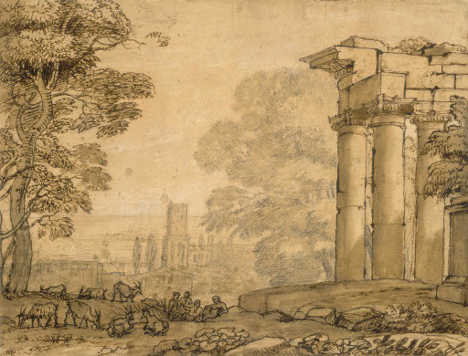
Claude Lorrain (artist)
French, 1600 - 1682
Landscape with Ruins, Pastoral Figures, and Trees, 1643/1655

Slide 24
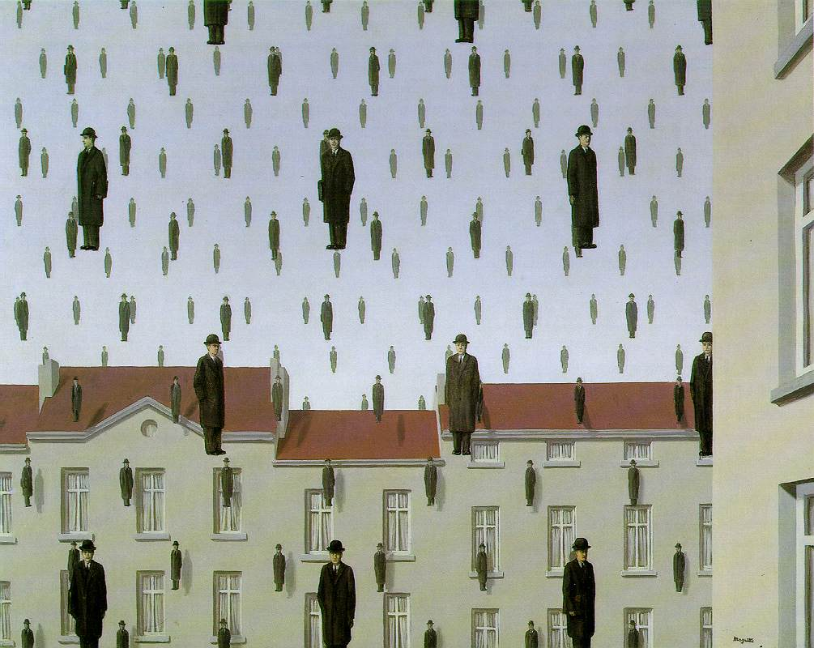
[Golconde Rene Magritte]

Slide 25
Absolute (monocular) depth cues
Are there any monocular cues that can give us absolute depth from a single image?

Slide 26


Familiar size
Which “object” is closer to the camera?
How close?

Slide 27
Familiar size
Apparent reduction in size of objects at a greater distance from the observer
Size perspective is thought to be conditional, requiring knowledge of the objects.
But, material textures also get smaller with distance, so possibly, no need of perceptual learning ?

Slide 28
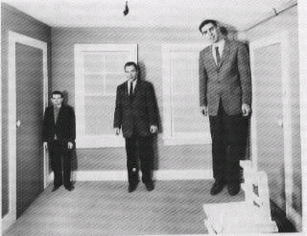
Perspective vs. familiar size
3D percept is driven by the scene, which imposes its ruling to the objects

Slide 29
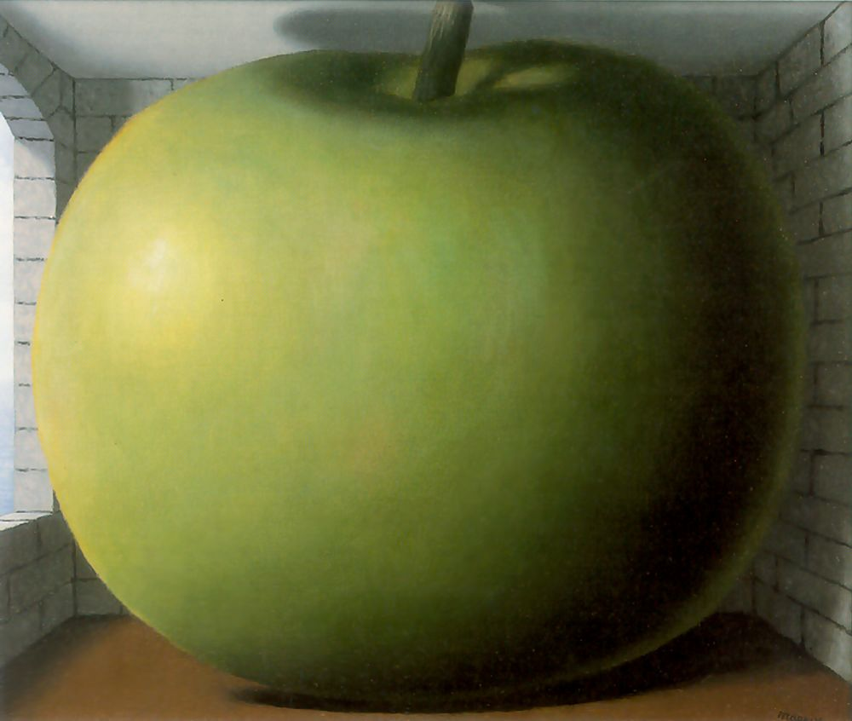
Scene vs. objects
What do you see? A big apple or a small room?
I see a big apple and a normal room
The scene seems to win again?
[The Listening Room Rene Magritte]

Slide 30

Scene vs. objects
[Personal Values Rene Magritte]

Slide 31
The importance of the horizon line

Slide 32
Distance from the horizon line
Based on the tendency of objects to appear nearer the horizon line with greater distance to the horizon.
Objects approach the horizon line with greater distance from the viewer. The base of a nearer column will appear lower against its background floor and further from the horizon line. Conversely, the base of a more distant column will appear higher against the same floor, and thus nearer to the horizon line.

Slide 33
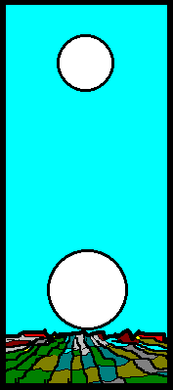
Moon illusion

Slide 34
Relative height
the object closer to the horizon is perceived as farther away, and the object further from the horizon is perceived as closer
If you know camera parameters: height of the camera, then we know real depth

Slide 35
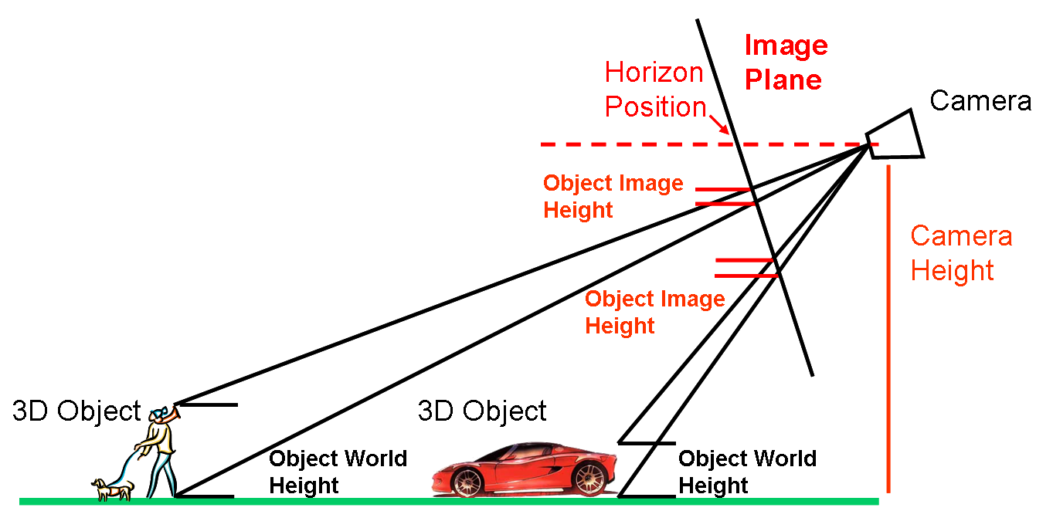
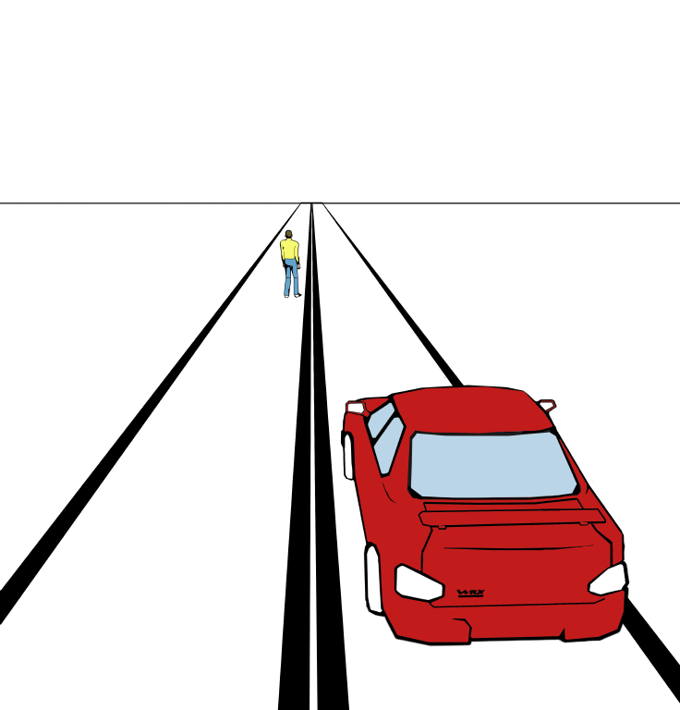
Object Size in the Image
Image
World
Slide by Derek Hoiem

Slide 36
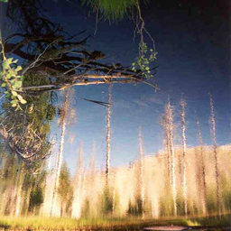
Slide by Aude Oliva

Slide 38

Slide by Aude Oliva

Slide 40
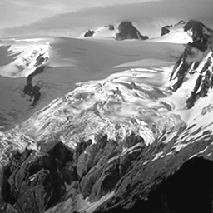

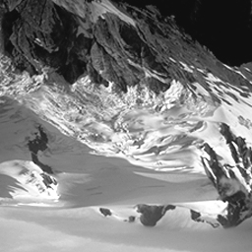

Textured surface layout influences depth perception
Torralba & Oliva (2002, 2003)
Slide by Aude Oliva
Notes:
The segmentation and regions are the same, the percept is totally different: by exposures to a lot of images, we learnt that a specific distribution of features is correlated with a volume.
The interpretation of objects is different: sky and water, reflection and trees, bracnhes, rocks

Slide 41


Depth Perception from Image Structure
We got wrong:
3D shape (mainly due to assumption of light from above)
The absolute scale (due to the wrong recognition).

Slide 42
Depth Perception from Image Structure
Mean depth refers to a global measurement of the mean distance
between the observer and the main objects and structures that
compose the scene.
Stimulus ambiguity: the three cubes produce the same retinal image.
Monocular information cannot give absolute depth measurements.
Only relative depth information such as shape from shading and
junctions (occlusions) can be obtained.

Slide 43
Depth Perception from Image Structure
However, nature (and man) do not build in the same way
at different scales.
d3
d2
d1
If d1>>d2>>d3 the structures of each view strongly differ. Structure provides monocular information about the scale (mean depth) of the space in front of the observer.

Slide 44
Statistical Regularities of Scene Volume
When increasing the size of the space, natural environment structures become larger and smoother.
Evolution of the slope of the global magnitude spectrum
For man-made environments, the clutter of the scene increases with increasing distance: close-up views on objects have large and homogeneous regions. When increasing the size of the space, the scene “surface” breaks down in smaller pieces (objects, walls, windows, etc).
Torralba & Oliva. (2002). Depth estimation from image structure. IEEE Pattern Analysis and Machine Intelligence
Slide by Aude Oliva

Slide 45

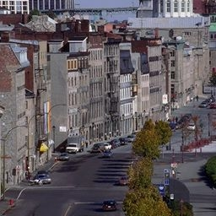

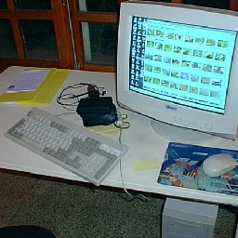
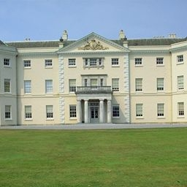
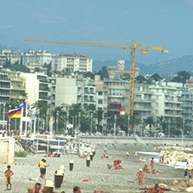

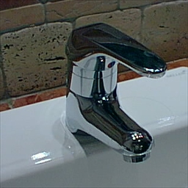

Image Statistics and Scene Scale
Close-up views
Large scenes
On average, low clutter
On average, highly cluttered
Point view is unconstrained
Point view is strongly constrained

Slide 46
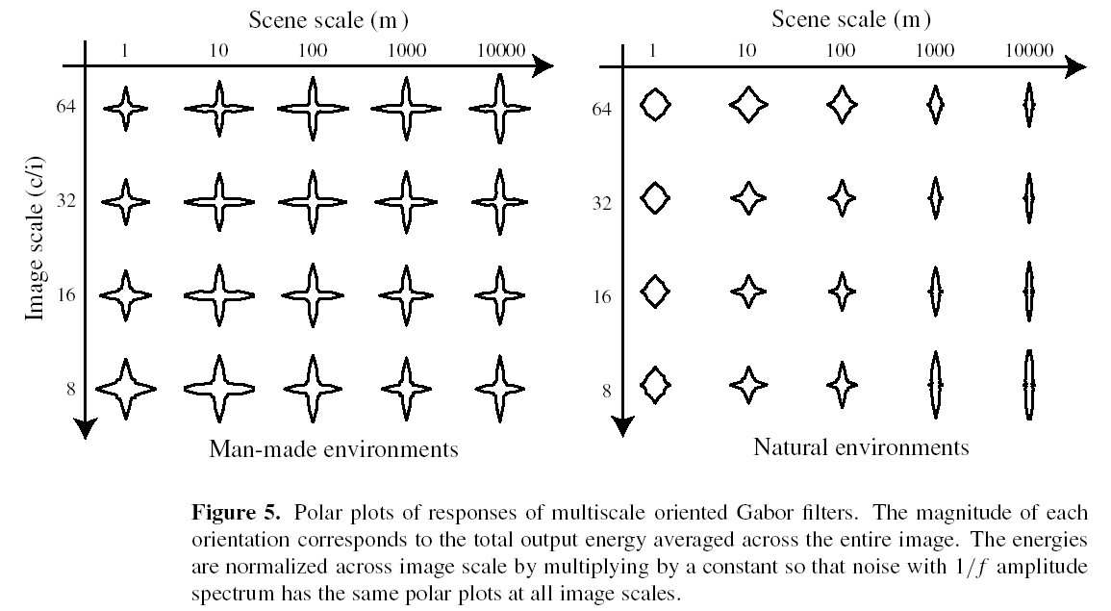
Image Scale vs. Scene Scale

Slide 47
It is not all about objects
3D percept is driven by the scene, which imposes its ruling to the objects

Slide 48
Class experiment

Slide 49
Class experiment
Experiment 1: draw a horse (the entire body, not just the head) in a white piece of paper.
Do not look at your neighbor! You already know how a horse looks like… no need to cheat.

Slide 50
Class experiment
Experiment 2: draw a horse (the entire body, not just the head) but this time chose a viewpoint as weird as possible.

Slide 51
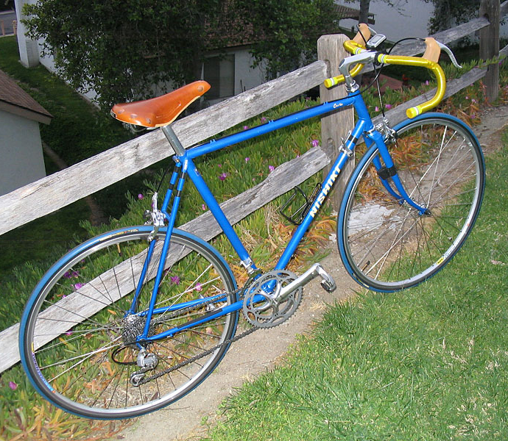
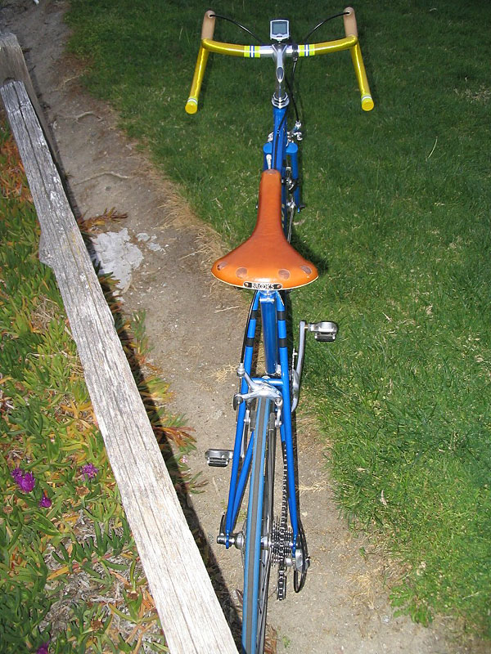
3D object categorization
Wait: object categorization in humans is not invariant to 3D pose

Slide 52

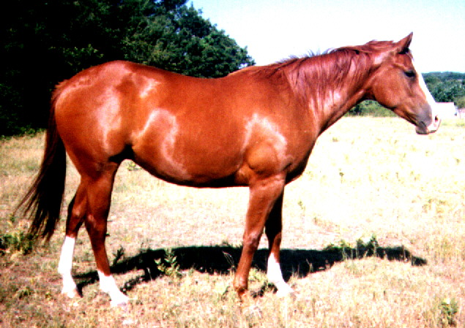

3D object categorization
Despite we can categorize all three pictures as being views of a horse, the three pictures do not look as being equally typical views of horses. And they do not seem to be recognizable with the same easiness.
by Greg Robbins

Slide 53
Observations about pose invariance in humans
Two main families of effects have been observed:
Canonical perspective
Priming effects

Slide 54
Canonical Perspective
Experiment (Palmer, Rosch & Chase 81): participants are shown views of an object and are asked to rate “how much each one looked like the objects they depict”
(scale; 1=very much like, 7=very unlike)
5
2
From Vision Science, Palmer

Slide 55
Canonical Perspective
Examples of canonical perspective:
In a recognition task, reaction time correlated with the ratings.
Canonical views are recognized faster at the entry level.
Why?
From Vision Science, Palmer

Slide 56
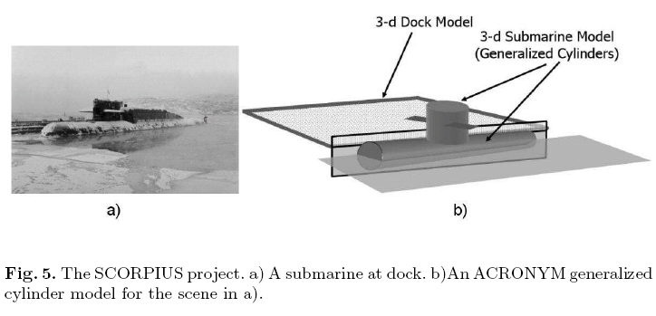
Explicit 3D model
Object Recognition in the Geometric Era: a Retrospective, Joseph L. Mundy

Slide 57
Image formation
3D world
2D image
Figures © Stephen E. Palmer, 2002

Slide 58
Cameras, lenses, and calibration
Camera models
Projection equations
Images are projections of the 3-D world onto a 2-D plane…

Slide 59

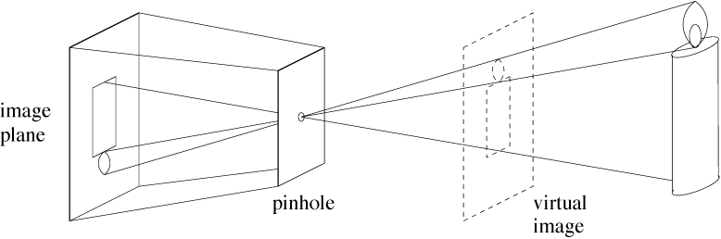
Light rays from many different parts of the scene strike the same point on the paper.
Pinhole camera only allows rays from one point in the scene to strike each point of the paper.
Forsyth&Ponce
Notes:
The point to make here is that each point on the image plane sees light from only
one direction, the one that passes through the pinhole.

Slide 60
Pinhole camera geometry:
Distant objects are smaller

Slide 61
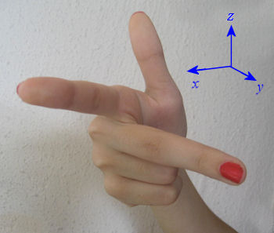
Right - handed system
y
y
left
top
far
z
x
right
bottom
near
x
z
y
z
x
x
z
y

Slide 62
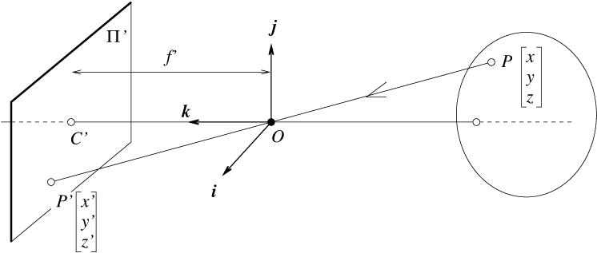
Perspective projection
camera
world
f
y
z
y’
Cartesian coordinates:
  We have, by similar triangles, that (x, y, z) -> (f x/z, f y/z, -f)
  Ignore the third coordinate, and get

Slide 63
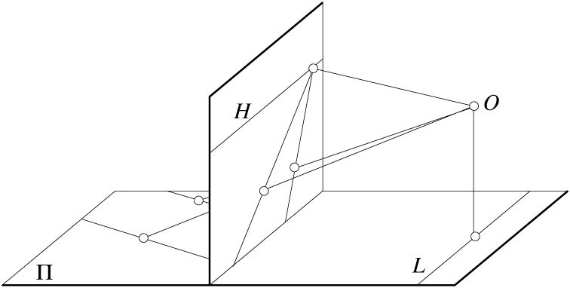
Geometric properties of projection
Points go to points
Lines go to lines
Planes go to whole image or half-planes.
Polygons go to polygons
Degenerate cases
  line through focal point to point
  plane through focal point to line

Slide 64
Perspective projection of that line
Line in 3-space
In the limit as
we have (for ):
This tells us that any set of parallel lines (same a, b, c parameters) project to the same point (called the vanishing point).

Slide 65
Vanishing point
y
camera
z

Slide 66
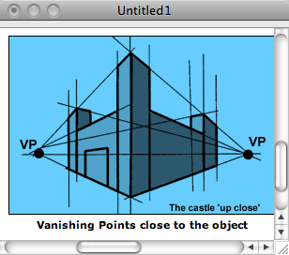
http://www.ider.herts.ac.uk/school/courseware/graphics/two_point_perspective.html

Slide 67
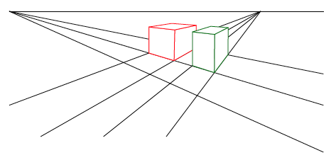
Vanishing points
Each set of parallel lines (=direction) meets at a different point
  The vanishing point for this direction
Sets of parallel lines on the same plane lead to collinear vanishing points.
  The line is called the horizon for that plane

Slide 68
What if you photograph a brick wall head-on?
y
x

Slide 69
Brick wall line in 3-space
Perspective projection of that line
All bricks have same z₀. Those in same row have same y₀
Thus, a brick wall, photographed head-on, gets rendered as set of parallel lines in the image plane.

Slide 70
Other projection models: Orthographic projection

Slide 71
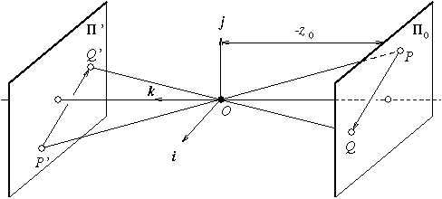
Other projection models:
Weak perspective
Issue
  perspective effects, but not over the scale of individual objects
  collect points into a group at about the same depth, then divide each point by the depth of its group
  Adv: easy
  Disadv: only approximate

Slide 72
Three camera projections
3-d point 2-d image position
(1) Perspective:
(2) Weak perspective:
(3) Orthographic:

Slide 73




Homogeneous coordinates
Is this a linear transformation?
Trick: add one more coordinate:
  no—division by z is nonlinear
homogeneous image
coordinates
homogeneous scene
coordinates
Converting from homogeneous coordinates
Slide by Steve Seitz

Slide 74
Perspective Projection
Projection is a matrix multiply using homogeneous coordinates:
This is known as perspective projection
  The matrix is the projection matrix
Slide by Steve Seitz

Slide 75
Perspective Projection
How does scaling the projection matrix change the transformation?
Slide by Steve Seitz

Slide 76
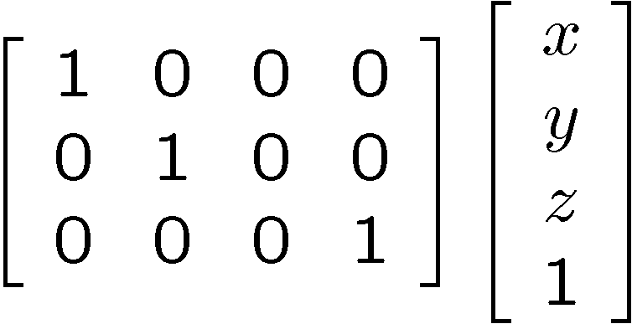
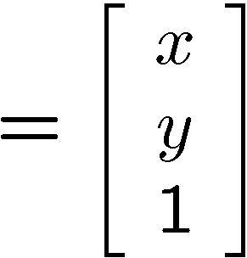

Orthographic Projection
Special case of perspective projection
  Distance from the COP to the PP is infinite
  Also called “parallel projection”
  What’s the projection matrix?
Image
World
?
Slide by Steve Seitz

Slide 77
Orthographic Projection
Special case of perspective projection
  Distance from the COP to the PP is infinite
  Also called “parallel projection”
  What’s the projection matrix?
Image
World
Slide by Steve Seitz

Slide 78
Homogeneous coordinates
2D Points:
2D Lines:
(n_{x}, n_{y})
d

Slide 79
Homogeneous coordinates
Intersection between two lines:

Slide 80
Homogeneous coordinates
Line joining two points:

Slide 81
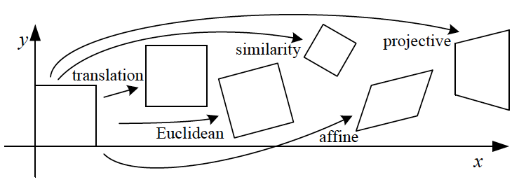
2D Transformations

Slide 82

2D Transformations
Example: translation
tx
ty
=
+

Slide 83

2D Transformations
Example: translation
tx
ty
1 | 0 | tx
0 | 1 | ty
1
=
+
=
.

Slide 84
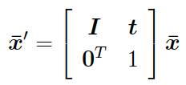
2D Transformations
Example: translation
tx
ty
1 | 0 | tx
0 | 1 | ty
1
=
+
=
.
1 | 0 | tx
0 | 1 | ty
0 | 0 | 1
.
=
Now we can chain transformations

Slide 85
Translation and rotation, written in each set of coordinates
Non-homogeneous coordinates
Homogeneous coordinates
where

Slide 86
Translation and rotation
“as described in the coordinates of frame B”
Let’s write
as a single matrix equation:

Slide 87
Camera calibration
Use the camera to tell you things about the world:
  Relationship between coordinates in the world and coordinates in the image: geometric camera calibration, see Szeliski, section 5.2, 5.3 for references
  (Relationship between intensities in the world and intensities in the image: photometric image formation, see Szeliski, sect. 2.2.)

Slide 88
Intrinsic parameters: from idealized world coordinates to pixel values
Forsyth&Ponce
Perspective projection

Slide 89
Intrinsic parameters
But “pixels” are in some arbitrary spatial units

Slide 90
Intrinsic parameters
Maybe pixels are not square

Slide 91
Intrinsic parameters
We don’t know the origin of our camera pixel coordinates

Slide 92
Intrinsic parameters
May be skew between camera pixel axes

Slide 93
Intrinsic parameters, homogeneous coordinates
Using homogenous coordinates,
we can write this as:
or:
In pixels
In camera-based coords

Slide 94
Extrinsic parameters: translation and rotation of camera frame
Non-homogeneous coordinates
Homogeneous coordinates

Slide 95
Combining extrinsic and intrinsic calibration parameters, in homogeneous coordinates
pixels
Intrinsic
World coordinates
Camera coordinates
Extrinsic
Forsyth&Ponce

Slide 96
Other ways to write the same equation
pixel coordinates
world coordinates
Conversion back from homogeneous coordinates leads to:

Slide 97

Camera parameters
A camera is described by several parameters
  Translation T of the optical center from the origin of world coords
  Rotation R of the image plane
  focal length f, principle point (x’_{c}, y’_{c}), pixel size (s_{x}, s_{y})
  blue parameters are called “extrinsics,” red are “intrinsics”
Projection equation
  The projection matrix models the cumulative effect of all parameters
  Useful to decompose into a series of operations
identity matrix
intrinsics
projection
rotation
translation
  The definitions of these parameters are not completely standardized
    especially intrinsics—varies from one book to another

