Slide 1
CS 61C: Great Ideas in Computer Architecture
Multilevel Caches,
Cache Questions
Instructor: Justin Hsia

Slide 2
Question: Heap management in Task 2 was new! Did you find it interesting and/or useful?
(A) Finished – was fun!
(B) Finished – found it interesting/useful
(C) Finished – not so interesting/useful
(D) Finished – hated it
(E) Still working on it!

Slide 3
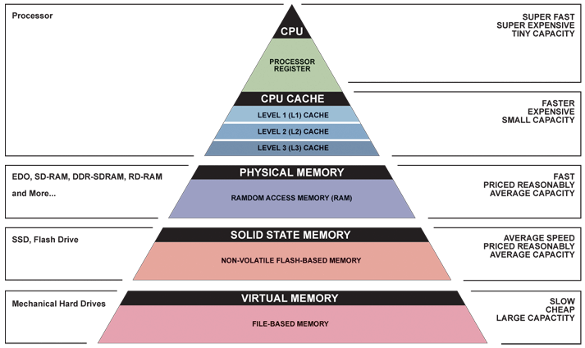
Great Idea #3: Principle of Locality/ Memory Hierarchy

Slide 4
Review of Last Lecture (1/2)
Direct-Mapped Caches:
Use hash function to determine location for block
Each block maps into a single row
(block address) modulo (# of slots in the cache)
N-way Set Associative Caches:
Split slots into sets of size N, map into set
(block address) modulo (# of sets in the cache)
TIO breakdown of memory address
Index field is result of hash function (which set)
Tag field is identifier (which block is currently in slot)
Offset field indexes into block

Slide 5
Review of Last Lecture (2/2)
Cache performance measured in CPI_{stall} and AMAT
Parameters that matter: HT, MR, MP
The 3 Cs of cache misses
Compulsory, capacity, and conflict

Slide 6
Question: How many total bits are stored in the following cache?
4-way SA cache, random replacement
Cache size 1 KiB, Block size 16 B
Write-back
16-bit address space
(A)
2⁶ × (2⁷ + 2³ + 2¹) = 8.625 Kib
(B)
2⁴ × (2⁷ + 2³ + 2⁰) = 2.140625 Kib
(C)
2⁴ × (2⁷ + 2³ + 2¹) = 2.15625 Kib
(D)
2⁴ × (2⁷ + 6 + 2¹) = 2.125 Kib

Slide 7
Agenda
Multilevel Caches
Administrivia
Improving Cache Performance
Anatomy of a Cache Question
Example Cache Questions
Bonus: Contemporary Cache Specs

Slide 8
Multiple Cache Levels
With advancing technology, have more room on die for bigger L1 caches and for L2 (and in some cases even L3) cache
Normally lower-level caches are unified (i.e. holds both instructions and data)
Multilevel caching is a way to reduce miss penalty
So what does this look like?

Slide 9
Multilevel Cache Diagram
Legend:
Request for data
Return of data
Main Memory
L2$
L1$
CPU
Memory
Access
Miss
Miss
.
.
.
Return
Hit
Hit
Store
Store
Path of data back to CPU
Notes:
The stores back in higher-level caches depends on your write-miss policy (write allocate or no-write allocate).

Slide 10
Multilevel Cache AMAT
AMAT = L1 HT + L1 MR × L1 MP
Now L1 MP depends on other cache levels
L1 MP = L2 HT + L2 MR × L2 MP
If more levels, then continue this chain (i.e. MP_{i} = HT_{i+1} + MR_{i+1} × MP_{i+1})
Final MP is main memory access time
For two levels:
AMAT = L1 HT + L1 MR × (L2 HT + L2 MR × L2 MP)

Slide 11
Multilevel Cache AMAT Example
Processor specs: 1 cycle L1 HT, 2% L1 MR, 5 cycle L2 HT, 5% L2 MR, 100 cycle main memory HT
Here assuming unified L1$
Without L2$:
AMAT₁ = 1 + 0.02 × 100 = 3
With L2$:
AMAT₂ = 1 + 0.02 × (5 + 0.05 × 100) = 1.2

Slide 12
Local vs. Global Miss Rates
Local miss rate: Fraction of references to one level of a cache that miss
e.g. L2$ local MR = L2$ misses/L1$ misses
Specific to level of caching (as used in AMAT)
Global miss rate: Fraction of all references that miss in all levels of a multilevel cache
Property of the overall memory hierarchy
Global MR is the product of all local MRs
Start at Global MR = L_{n} misses/L₁ accesses and expand
So by definition, global MR ≤ any local MR
Notes:
L1$ misses are the only requests that reach L2$

Slide 13
Memory Hierarchy with Two Cache Levels
1000 mem refs
40 mem refs
20 mem refs
CPU
L1$
L2$
MM
1 cycle
10 cycles
100 cycles
For every 1000 CPU to memory references
40 will miss in L1$; what is the local MR?
20 will miss in L2$; what is the local MR?
Global miss rate?
0.04
0.5
0.02

Slide 14
Rewriting Performance
For a two level cache, we know: MR_{global} = L1 MR × L2 MR
AMAT:
AMAT = L1 HT + L1 MR × (L2 HT + L2 MR × L2 MP)
AMAT = L1 HT + L1 MR × L2 HT + MR_{global} × L2 MP
CPI:
CPI_{stall} = CPI_{base} + (L1 MR × L1 MP + MR_{global} × L2 MP)
Accesses
Instr
Notes:
AMAT and CPI calculated differently.
AMAT is a direct substitution, where L1 MP = L2 HT + L2 MR * L2 MP.
CPI_{stall} calculates memory-stall cycles, so is additive (HT is hidden away in CPI_{base}).

Slide 15
Design Considerations
L1$ focuses on low hit time (fast access)
minimize HT to achieve shorter clock cycle
L1 MP significantly reduced by presence of L2$, so can be smaller/faster even with higher MR
e.g. smaller $ (fewer rows)
L2$, L3$ focus on low miss rate
As much as possible avoid reaching to main memory (heavy penalty)
e.g. larger $ with larger block sizes (same # rows)

Slide 16
Multilevel Cache Practice (1/3)
Processor specs:
CPI_{base} of 2
100 cycle miss penalty to main memory
25 cycle miss penalty to unified L2$
36% of instructions are load/stores
2% L1 I$ miss rate; 4% L1 D$ miss rate
0.5% global U(nified)L2$ miss rate
What is CPI_{stall} with and without the L2$?

Slide 17
Multilevel Cache Practice (2/3)
Notes:
Both L1 I$ and L1 D$ send misses to L2$
What does the global L2$ MR mean?
MR to main memory
Since there are 2 L1$s, implies L2$ has 2 different local MRs depending on source of access
Use CPI_{stall} formula shown at bottom of slide 13
Remember that CPI is cumulative

Slide 18
Multilevel Cache Practice (3/3)
Without L2$:
CPI_{stall} = 2 + 1×0.02×100 + 0.36×0.04×100
CPI_{stall} = 5.44
With L2$:
CPI_{stall} = 2 + 1x.02×25 + .36×.04×25 + 1x.005×100 + .36×.005×100 CPI_{stall} = 3.54
Instr Fetch
Load/Store
L1
L2

Slide 19
Agenda
Multilevel Caches
Administrivia
Improving Cache Performance
Anatomy of a Cache Question
Example Cache Questions
Bonus: Contemporary Cache Specs

Slide 20
Administrivia
HW4 due Sunday
Due after midterm, but on midterm material
Midterm: Fri 7/19 9am-12pm, 1 Pimentel
Take old exams for practice (see Piazza post @366)
Double-sided sheet of handwritten notes
MIPS Green Sheet provided; no calculators
Will cover up through caches
Mid-Semester Survey
Short survey to complete as part of Lab 6

Slide 21
Agenda
Multilevel Caches
Administrivia
Improving Cache Performance
Anatomy of a Cache Question
Example Cache Questions
Bonus: Contemporary Cache Specs

Slide 22
Improving Cache Performance (1/2)
Reduce the Hit Time of the cache
Smaller cache (less to search/check)
Smaller blocks (faster to return selected data)
Reduce the Miss Rate
Bigger cache (capacity)
Larger blocks (compulsory & spatial locality)
Increased associativity (conflict)

Slide 23
Improving Cache Performance (2/2)
Reduce the Miss Penalty
Smaller blocks (less to move)
Use multiple cache levels
Use a write buffer
Can also check on read miss (may get lucky)

Slide 24
The Cache Design Space
Several interacting dimensions
Cache parameters:
Cache size, Block size, Associativity
Policy choices:
Write-through vs. write-back
Write allocation vs. no-write allocation
Replacement policy
Optimal choice is a compromise
Depends on access characteristics
Workload and use (I$, D$)
Depends on technology / cost
Simplicity often wins
Cache Size
(Associativity)
Block Size
Bad
Good
Factor A
Factor B
Less
More
Notes:
No fancy replacement policy is needed for the direct mapped cache.
As a matter of fact, that is what cause direct mapped trouble to begin with: only one place to go in the cache--causes conflict misses.
No fancy replacement policy is needed for the direct mapped cache.
As a matter of fact, that is what cause direct mapped trouble to begin with: only one place to go in the cache--causes conflict misses.
Besides working at Sun, I also teach people how to fly whenever I have time.
Statistic have shown that if a pilot crashed after an engine failure, he or she is more likely to get killed in a multi-engine light airplane than a single engine airplane.
The joke among us flight instructors is that: sure, when the engine quit in a single engine stops, you have one option: sooner or later, you land. Probably sooner.
But in a multi-engine airplane with one engine stops, you have a lot of options. It is the need to make a decision that kills those people.

Slide 25
Effect of Block and Cache Sizes on Miss Rate
Miss rate goes up if the block size becomes a significant fraction of the cache size because the number of blocks that can be held in the same size cache is smaller (increasing capacity misses)
Notes:
Increasing the block size usually decreases the miss rate.
A more serious problem is that the miss penalty goes up since it is primarily determined by the time to fetch the block from the next lower level of the hierarchy and load it into the cache.

Slide 26
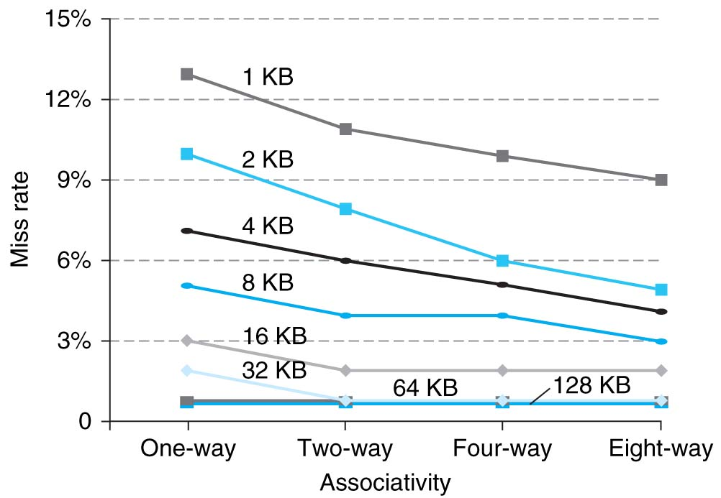
Benefits of Set-Associative Caches
Consider cost of a miss vs. cost of implementation
Largest gains are in going from direct mapped to 2-way (20%+ reduction in miss rate)
Notes:
As cache sizes grow, the relative improvement from associativity increases only slightly; since the overall miss rate of a larger cache is lower, the opportunity for improving the miss rate decreases and the absolute improvement in miss rate from associativity shrinks significantly.

Slide 27
Agenda
Multilevel Caches
Administrivia
Improving Cache Performance
Anatomy of a Cache Question
Example Cache Questions
Bonus: Contemporary Cache Specs

Slide 28
Anatomy of a Cache Question
Cache questions come in a few flavors:
TIO Breakdown
For fixed cache parameters, analyze the performance of the given code/sequence
For fixed cache parameters, find best/worst case scenarios
For given code/sequence, how does changing your cache parameters affect performance?
AMAT/CPI

Slide 29
The Cache
What are the important cache parameters?
Must figure these out from problem description
Address size, cache size, block size, associativity, replacement policy
Solve for TIO breakdown, # of sets, set size
Are there multiple levels?
Mostly applies to AMAT/CPI questions
What starts in the cache?
Not always specified (best/worst case)

Slide 30
Code: Arrays
Elements stored sequentially in memory
Ideal for spatial locality
Different arrays not necessarily next to each other
Remember to account for data size!
char is 1 byte, int is 4 bytes
Pay attention to access pattern
Touch all elements (e.g. shift, sum)
Touch some elements (e.g. histogram, stride)
How many times do we touch each element?

Slide 31
Code: Linked Lists/Structs
Nodes stored separately in memory
Addresses of nodes may be very different
Type and ordering of linking is important
Remember to account for size/ordering of struct elements
Pay attention to access pattern
Generally must start from “head”
How many struct elements are touched?

Slide 32
Access Patterns
How many hits within a single block once it is loaded into cache?
Will block still be in cache when you revisit its elements?
Are there special/edge cases to consider?
Usually edge of block boundary or edge of cache size boundary

Slide 33
Best/Worst Case
Set Associative (including Fully Associative)
Best: All accessed blocks fit into cache/set
Worst: Block is replaced before you access again
Direct-Mapped
Best: Accessed blocks go into different slots
Worst: Constant conflict misses

Slide 34
Get To Know Your Staff
Category: Food

Slide 35
Agenda
Multilevel Caches
Administrivia
Improving Cache Performance
Anatomy of a Cache Question
Example Cache Questions
Bonus: Contemporary Cache Specs

Slide 36
Example 1 (Sp07 Final)
1 GiB address space, 100 cycles to go to memory. Fill in the following table:
 | L1 | L2
Cache Size | 32 KiB | 512 KiB
Block Size | 8 B | 32 B
Associativity | 4-way | Direct-mapped
Hit Time | 1 cycle | 33 cycles
Miss Rate | 10% | 2%
Write Policy | Write-through | Write-through
Replacement Policy | LRU | n/a
Tag
Index
Offset
AMAT
17 | 11
10 | 14
3 | 5
AMAT L1 = 1 + 0.1 * 35 = 4.5
AMAT L2 = 33 + 0.02 * 100 = 35

Slide 37
Example 1 (Sp07 Final)
Only use L1$: C = 32 KiB, K = 8 B, N = 4, LRU, write-through
char A[] is block aligned and SIZE = 32 MiB
char *A = (char *) malloc (SIZE*sizeof(char));
/* number of STRETCHes */
for (i = 0; i < (SIZE/STRETCH); i++) {
/* go up to STRETCH */
for(j=0;j<STRETCH;j++) sum += A[i*STRETCH+j];
/* down from STRETCH */
for(j=STRETCH-1;j>=0;j--) prod += A[i*STRETCH+j];
}
2nd inner for loop hits same indices as 1st inner for loop, but in reverse order
Always traverse full SIZE, regardless of STRETCH

Slide 38
Example 1 (Sp07 Final)
Only use L1$: C = 32 KiB, K = 8 B, N = 4, LRU, write-through
char A[] is block aligned and SIZE = 32 MiB
char *A = (char *) malloc (SIZE*sizeof(char));
for (i = 0; i < (SIZE/STRETCH); i++) {
for(j=0;j<STRETCH;j++) sum += A[i*STRETCH+j];
for(j=STRETCH-1;j>=0;j++) prod += A[i*STRETCH+j];
}
As we double our STRETCH from 1 to 2 to 4 (…etc), we notice the number of cache misses doesn’t change! What is the largest value of STRETCH before cache misses changes? (Use IEC)
32 KiB, when STRETCH exactly equals C

Slide 39
Example 1 (Sp07 Final)
Only use L1$: C = 32 KiB, K = 8 B, N = 4, LRU, write-through
char A[] is block aligned and SIZE = 32 MiB
char *A = (char *) malloc (SIZE*sizeof(char));
for (i = 0; i < (SIZE/STRETCH); i++) {
for(j=0;j<STRETCH;j++) sum += A[i*STRETCH+j];
for(j=STRETCH-1;j>=0;j++) prod += A[i*STRETCH+j];
}
If we double our STRETCH from (b), what is the ratio of cache hits to misses?
Now STRETCH = 64 KiB. Moving sequentially by byte, so each block for entire 1st inner loop has 1 miss and 7 hits (7:1). Upper half of STRETCH lives in cache, so first half of 2nd inner loop is 8 hits/block (8:0). Second half is as before (7:1).

Slide 40
Example 1 (Sp07 Final)
Only use L1$: C = 32 KiB, K = 8 B, N = 4, LRU, write-through
char A[] is block aligned and SIZE = 32 MiB
char *A = (char *) malloc (SIZE*sizeof(char));
for (i = 0; i < (SIZE/STRETCH); i++) {
for(j=0;j<STRETCH;j++) sum += A[i*STRETCH+j];
for(j=STRETCH-1;j>=0;j++) prod += A[i*STRETCH+j];
}
If we double our STRETCH from (b), what is the ratio of cache hits to misses?
Considering the equal-sized chunks of half of each inner for loop, we have loop 1 1st (7:1), loop 1 2nd (7:1), loop 2 1st (8:0), and loop 2 2nd (7:1).
7+7+8+7:1+1+0+1 = 29:3

Slide 41
Questions?

Slide 42
Example 2 (Sp13 Final)
32-bit MIPS, 4 GiB memory, single L1$ of size C with block size K (C ≥ K and a power of 2).
A, B are arrays in different places of memory of equal size n (power of 2 and a [natural #] multiple of C), block aligned.
// sizeof(uint8_t) = 1
SwapLeft(uint8_t *A, uint8_t *B, int n) {
uint8_t tmp;
for (int i = 0; i < n; i++) {
tmp = A[i];
A[i] = B[i];
B[i] = tmp;
}
}
Array data size is 1 byte
Do n times:
Read A[i]
Read B[i], Write A[i]
Write B[i]

Slide 43
Example 2 (Sp13 Final)
32-bit MIPS, 4 GiB memory, single L1$ of size C with block size K (C ≥ K and a power of 2).
A, B are arrays in different places of memory of equal size n (power of 2 and a [natural #] multiple of C), block aligned.
If the cache is direct-mapped and the best hit:miss ratio is “H:1”, what is the block size in bytes?
Best case is A[i] and B[i] DON’T map to same slot.
Use every value of i ϵ [0,n) only once.
Rd A, Rd B, Wr A, Wr B → Miss, Miss, Hit, Hit (1st time)
→ Hit, Hit, Hit, Hit (K-1 times in block)
Per block:
4*(K-1)+2:2 = 4K-2:2 = 2K-1:1 = H:1 → K = (H+1)/2

Slide 44
Example 2 (Sp13 Final)
32-bit MIPS, 4 GiB memory, single L1$ of size C with block size K (C ≥ K and a power of 2).
A, B are arrays in different places of memory of equal size n (power of 2 and a [natural #] multiple of C), block aligned.
What is the worst hit:miss ratio?
Worst case is A[i] and B[i] map to same slot (conflict).
Rd A, Rd B, Wr A, Wr B → Miss, Miss, Miss, Miss (all times)
because blocks keep replacing each other
0:1 (or 0:<anything>)

Slide 45
Example 2 (Sp13 Final)
Fill in code for SwapRight so that it does the same thing as SwapLeft but improves the (b) hit:miss ratio.
SwapRight(uint8_t *A, uint8_t *B, int n) {
uint8_t tmpA, tmpB;
for (int i = 0; i < n; i++) {
______________________
______________________
______________________
______________________
}
}
tmpA = A[i];
tmpB = B[i];
B[i] = tmpA;
A[i] = tmpB;
Read A[i]
Read B[i]
Write B[i]
Write A[i]
Notes:
Could also do Rd B, Rd A, Wr A, Wr B.

Slide 46
Example 2 (Sp13 Final)
32-bit MIPS, 4 GiB memory, single L1$ of size C with block size K (C ≥ K and a power of 2).
A, B are arrays in different places of memory of equal size n (power of 2 and a [natural #] multiple of C), block aligned.
What is the worst hit:miss ratio for SwapRight?
Worst case is A[i] and B[i] map to same slot (conflict).
Rd A, Rd B, Wr B, Wr A → Miss, Miss, Hit, Miss (1st time)
→ Hit, Miss, Hit, Miss (K-1 times)
Per block:
(K-1)*2+1:(K-1)*2+3 = 2K-1:2K+1

Slide 47
Example 2 (Sp13 Final)
Change the cache to be 2-way set-associative. Cache size C, block size K. What is the worst hit:miss ratio for SwapLeft with the following replacement policies?
LRU and an empty cache
Even if A[i] and B[i] map to same set, they can both co-exist.
Rd A, Rd B, Wr A, Wr B → Miss, Miss, Hit, Hit (1st time)
→ Hit, Hit, Hit, Hit (K-1 times in block)
So 2K-1:1 (from part (a))
MRU and a full cache
Because cache is full, acts just like direct-mapped.
So 0:<anything> (same as part (b))

Slide 48
Summary
Multilevel caches reduce miss penalty
Local vs. global miss rate
Optimize first level to be fast (low HT)
Optimize lower levels to not miss (minimize MP)
Cache performance depends heavily on cache design (there are many choices)
Effects of parameters and policies
Cost vs. effectiveness
Cache problems are hard!

Slide 49
BONUS SLIDES
You are responsible for the material contained on the following slides, though we may not have enough time to get to them in lecture.
They have been prepared in a way that should be easily readable and the material will be touched upon in the following lecture.

Slide 50
Agenda
Multilevel Caches
Administrivia
Improving Cache Performance
Anatomy of a Cache Question
Example Cache Questions
Bonus: Contemporary Cache Specs

Slide 51
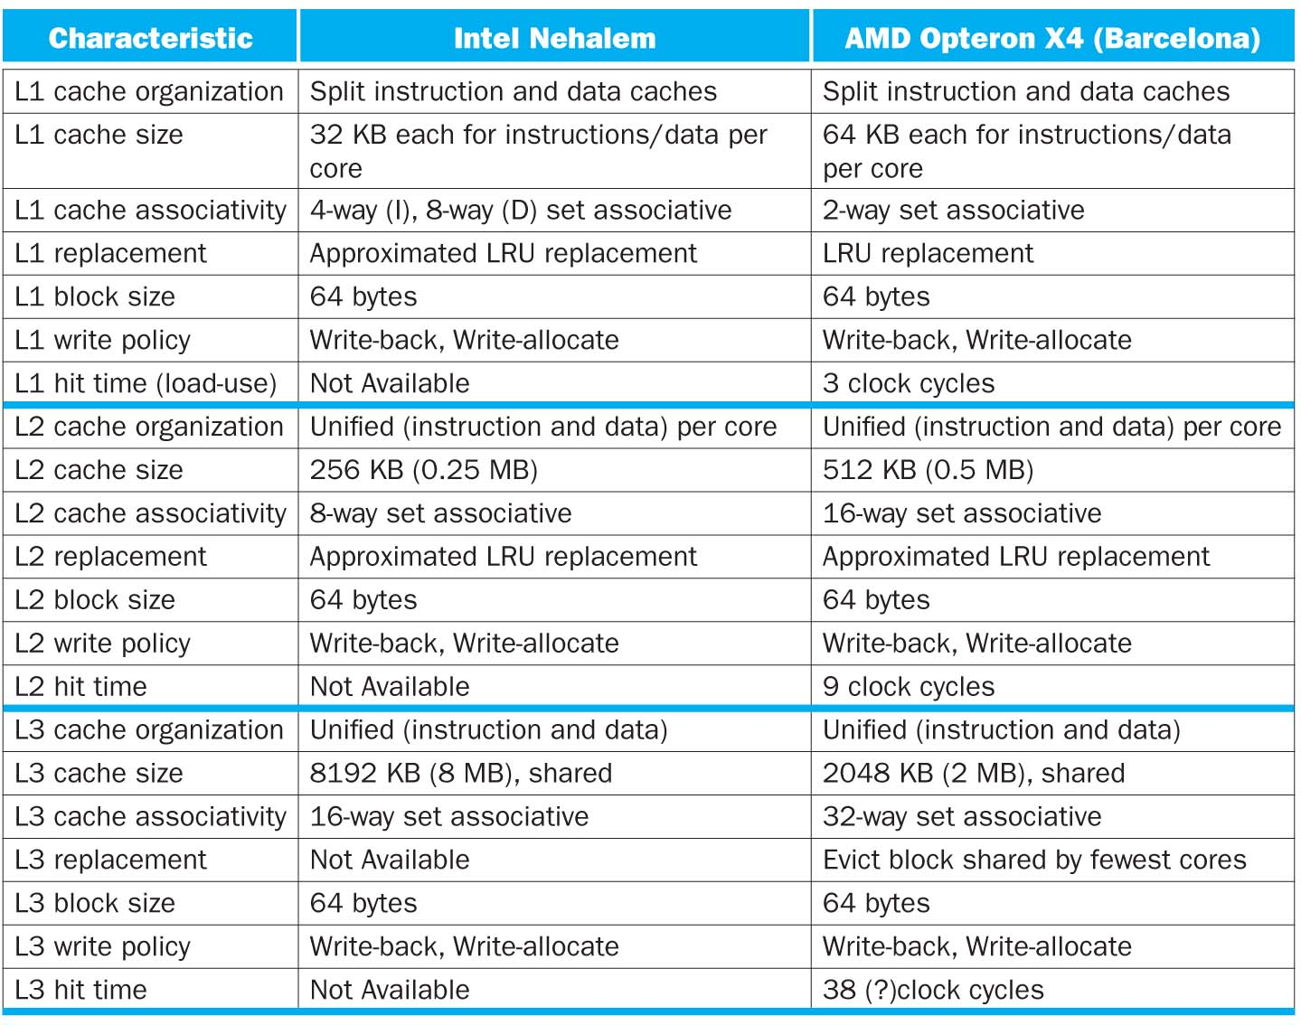

Slide 52
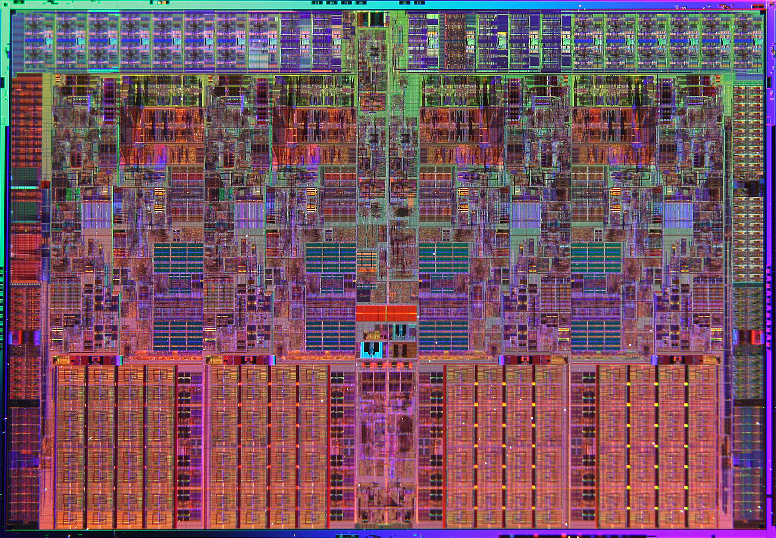
Intel Nehalem Die Photo
Memory Controller
Misc
IO
Misc
IO
13.6 mm (0.54 inch)
Core
Core
Core
Core
Memory
Queue
QPI
0
QPI
1
Shared L3 Cache
18.9 mm (0.75 inch)
Notes:
QPI – QuickPath Interconnect (for floating point)

Slide 53
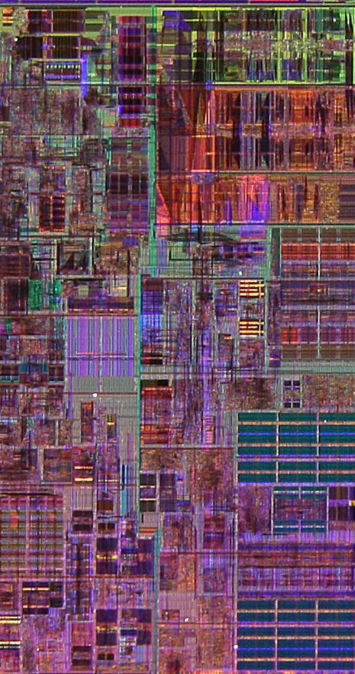
Core Area Breakdown
Memory Controller
Execution Units
32KiB I$ per core
32KiB D$ per core
512KiB L2$ per core
Share one 8-MiB L3$
L1 Data cache
L2 Cache & Interrupt Servicing
L1 Inst cache & Inst Fetch
L3 Cache
Load Store Queue

