Slide 1
CS 61C: Great Ideas in Computer Architecture
Direct-Mapped Caches,
Set Associative Caches,
Cache Performance
Instructor: Justin Hsia

Slide 2
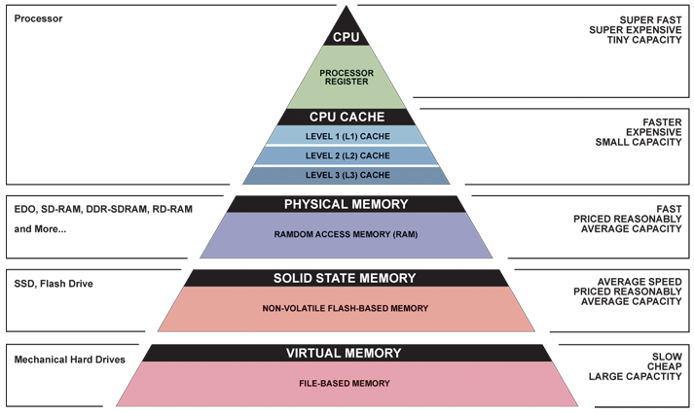
Great Idea #3: Principle of Locality/ Memory Hierarchy

Slide 3
Extended Review of Last Lecture
Why have caches?
Intermediate level between CPU and memory
In-between in size, cost, and speed
Memory (hierarchy, organization, structures) set up to exploit temporal and spatial locality
Temporal: If accessed, will access again soon
Spatial: If accessed, will access others around it
Caches hold a subset of memory (in blocks)
We are studying how they are designed for fast and efficient operation (lookup, access, storage)

Slide 4
Extended Review of Last Lecture
Fully Associative Caches:
Every block can go in any slot
Use random or LRU replacement policy when cache full
Memory address breakdown (on request)
Tag field is identifier (which block is currently in slot)
Offset field indexes into block
Each cache slot holds block data, tag, valid bit, and dirty bit (dirty bit is only for write-back)
The whole cache maintains LRU bits

Slide 5
Extended Review of Last Lecture
Cache read and write policies:
Affect consistency of data between cache and memory
Write-back vs. write-through
Write allocate vs. no-write allocate
On memory access (read or write):
Look at ALL cache slots in parallel
If Valid bit is 0, then ignore
If Valid bit is 1 and Tag matches, then use that data
On write, set Dirty bit if write-back

Slide 6
Extended Review of Last Lecture
256 B address space
cache size (C)
block size (K)
Fully associative cache layout
8-bit address space, 32-byte cache with 8-byte blocks
LRU replacement (2 bits), write-back and write allocate
Offset – 3 bits, Tag – 5 bits
Each slot has 71 bits; cache has 4*71+2 = 286 bits
LRU bits
Need dirty bit
Offset
0
1
2
3
V | D | Tag | 000 | 001 | 010 | 011 | 100 | 101 | 110 | 111
X | X | XXXXX | 0x?? | 0x?? | 0x?? | 0x?? | 0x?? | 0x?? | 0x?? | 0x??
X | X | XXXXX | 0x?? | 0x?? | 0x?? | 0x?? | 0x?? | 0x?? | 0x?? | 0x??
X | X | XXXXX | 0x?? | 0x?? | 0x?? | 0x?? | 0x?? | 0x?? | 0x?? | 0x??
X | X | XXXXX | 0x?? | 0x?? | 0x?? | 0x?? | 0x?? | 0x?? | 0x?? | 0x??
Slot
LRU
XX

Slide 7
Agenda
Direct-Mapped Caches
Administrivia
Set Associative Caches
Cache Performance

Slide 8
Direct-Mapped Caches (1/3)
Each memory block is mapped to exactly one slot in the cache (direct-mapped)
Every block has only one “home”
Use hash function to determine which slot
Comparison with fully associative
Check just one slot for a block (faster!)
No replacement policy necessary
Access pattern may leave empty slots in cache
Notes:
Check just one location to see if block is in cache.

Slide 9
Direct-Mapped Caches (2/3)
Offset field remains the same as before
Recall: blocks consist of adjacent bytes
Do we want adjacent blocks to map to same slot?
Index field: Apply hash function to block address to determine which slot the block goes in
(block address) modulo (# of blocks in the cache)
Tag field maintains same function (identifier), but is now shorter

Slide 10
TIO Address Breakdown
Memory address fields:
Meaning of the field sizes:
O bits ↔ 2^{O} bytes/block = 2^{O-2} words/block
I bits ↔ 2^{I} slots in cache = cache size / block size
T bits = A – I – O, where A = # of address bits (A = 32 here)
31
0
Tag
Index
Offset
T bits
I bits
O bits

Slide 11
Direct-Mapped Caches (3/3)
What’s actually in the cache?
Block of data (8 × K = 8 × 2^{O} bits)
Tag field of address as identifier (T bits)
Valid bit (1 bit)
Dirty bit (1 bit if write-back)
No replacement management bits!
Total bits in cache = # slots × (8×K + T + 1 + 1) = 2^{I} × (8×2^{O} + T + 1 + 1) bits

Slide 12
DM Cache Example (1/5)
Cache parameters:
Direct-mapped, address space of 64B, block size of 1 word, cache size of 4 words, write-through
TIO Breakdown:
1 word = 4 bytes, so O = log₂(4) = 2
Cache size / block size = 4, so I = log₂(4) = 2
A = log₂(64) = 6 bits, so T = 6 – 2 – 2 = 2
Bits in cache = 2² × (8×2² + 2 + 1) = 140 bits
Memory Addresses:
XX
XX
XX
Block address
Notes:
Compare with fully associative example from last lecture. This takes 140 bits to implement instead of 150 bits because of shorter Tag and no LRU bits.

Slide 13
DM Cache Example (2/5)
Cache parameters:
Direct-mapped, address space of 64B, block size of 1 word, cache size of 4 words, write-through
Offset – 2 bits, Index – 2 bits, Tag – 2 bits
35 bits per index/slot, 140 bits to implement
Offset
00
01
10
11
V | Tag | 00 | 01 | 10 | 11
X | XX | 0x?? | 0x?? | 0x?? | 0x??
X | XX | 0x?? | 0x?? | 0x?? | 0x??
X | XX | 0x?? | 0x?? | 0x?? | 0x??
X | XX | 0x?? | 0x?? | 0x?? | 0x??
Index

Slide 14
DM Cache Example (3/5)
Main Memory:
0000xx
0001xx
0010xx
0011xx
0100xx
0101xx
0110xx
0111xx
1000xx
1001xx
1010xx
1011xx
1100xx
1101xx
1110xx
1111xx
Which blocks map to each row of the cache?
(see colors)
On a memory request: (let’s say 001011_{two})
1) Take Index field (10)
2) Check if Valid bit is true in that row of cache
3) If valid, then check if Tag matches
Which blocks map to each row of the cache?
(see colors)
Cache:
Index
Valid
Tag
Data
00
01
10
11
Cache slots exactly match the Index field
Main Memory shown in blocks, so offset bits not shown (x’s)

Slide 15
DM Cache Example (4/5)
Consider the sequence of memory address accesses
0 2 4 8 20 16 0 2
Starting with a cold cache:
0
miss
2
hit
00
01
10
11
0 | 00 | 0x?? | 0x?? | 0x?? | 0x??
0 | 00 | 0x?? | 0x?? | 0x?? | 0x??
0 | 00 | 0x?? | 0x?? | 0x?? | 0x??
0 | 00 | 0x?? | 0x?? | 0x?? | 0x??
1 | 00 | M[0] | M[1] | M[2] | M[3]
0 | 00 | 0x?? | 0x?? | 0x?? | 0x??
0 | 00 | 0x?? | 0x?? | 0x?? | 0x??
0 | 00 | 0x?? | 0x?? | 0x?? | 0x??
00
01
10
11
1 | 00 | M[0] | M[1] | M[2] | M[3]
0 | 00 | 0x?? | 0x?? | 0x?? | 0x??
0 | 00 | 0x?? | 0x?? | 0x?? | 0x??
0 | 00 | 0x?? | 0x?? | 0x?? | 0x??
4
miss
8
miss
00
01
10
11
1 | 00 | M[0] | M[1] | M[2] | M[3]
0 | 00 | 0x?? | 0x?? | 0x?? | 0x??
0 | 00 | 0x?? | 0x?? | 0x?? | 0x??
0 | 00 | 0x?? | 0x?? | 0x?? | 0x??
1 | 00 | M[0] | M[1] | M[2] | M[3]
1 | 00 | M[4] | M[5] | M[6] | M[7]
0 | 00 | 0x?? | 0x?? | 0x?? | 0x??
0 | 00 | 0x?? | 0x?? | 0x?? | 0x??
00
01
10
11
1 | 00 | M[0] | M[1] | M[2] | M[3]
1 | 00 | M[4] | M[5] | M[6] | M[7]
0 | 00 | 0x?? | 0x?? | 0x?? | 0x??
0 | 00 | 0x?? | 0x?? | 0x?? | 0x??
1 | 00 | M[0] | M[1] | M[2] | M[3]
1 | 00 | M[4] | M[5] | M[6] | M[7]
1 | 00 | M[8] | M[9] | M[10] | M[11]
0 | 00 | 0x?? | 0x?? | 0x?? | 0x??

Slide 16
DM Cache Example (5/5)
Consider the sequence of memory address accesses
0 2 4 8 20 16 0 2
Starting with a cold cache:
20
miss
16
miss
00
01
10
11
1 | 00 | M[0] | M[1] | M[2] | M[3]
1 | 00 | M[4] | M[5] | M[6] | M[7]
1 | 00 | M[8] | M[9] | M[10] | M[11]
0 | 00 | 0x?? | 0x?? | 0x?? | 0x??
00
01
10
11
1 | 00 | M[0] | M[1] | M[2] | M[3]
1 | 01 | M[20] | M[21] | M[22] | M[23]
1 | 00 | M[8] | M[9] | M[10] | M[11]
0 | 00 | 0x?? | 0x?? | 0x?? | 0x??
0
miss
2
hit
00
01
10
11
1 | 01 | M[16] | M[17] | M[18] | M[19]
1 | 01 | M[20] | M[21] | M[22] | M[23]
1 | 00 | M[8] | M[9] | M[10] | M[11]
0 | 00 | 0x?? | 0x?? | 0x?? | 0x??
00
01
10
11
1 | 00 | M[0] | M[1] | M[2] | M[3]
1 | 01 | M[20] | M[21] | M[22] | M[23]
1 | 00 | M[8] | M[9] | M[10] | M[11]
0 | 00 | 0x?? | 0x?? | 0x?? | 0x??
8 requests, 6 misses – last slot was never used!

Slide 17
Worst-Case for Direct-Mapped
Cold DM $ that holds 4 1-word blocks
Consider the memory accesses: 0, 16, 0, 16,...
HR of 0%
Ping pong effect: alternating requests that map into the same cache slot
Does fully associative have this problem?
0
Miss
16
Miss
0
Miss
00 M[0-3]
00 M[0-3]
01 M[16-19]
. . .

Slide 18
Comparison So Far
Fully associative
Block can go into any slot
Must check ALL cache slots on request (“slow”)
TO breakdown (i.e. I = 0 bits)
“Worst case” still fills cache (more efficient)
Direct-mapped
Block goes into one specific slot (set by Index field)
Only check ONE cache slot on request (“fast”)
TIO breakdown
“Worst case” may only use 1 slot (less efficient)

Slide 19
Agenda
Direct-Mapped Caches
Administrivia
Set Associative Caches
Cache Performance

Slide 20
Administrivia
Proj1 due Sunday
Shaun extra OH Saturday 4-7pm
HW4 released Friday, due next Sunday
Midterm:
Please keep Sat 7/20 open just in case
Take old exams for practice
Doubled-sided sheet of handwritten notes
MIPS Green Sheet provided; no calculators
Will cover up through caches

Slide 21
Agenda
Direct-Mapped Caches
Administrivia
Set Associative Caches
Cache Performance

Slide 22
Set Associative Caches
Compromise!
More flexible than DM, more structured than FA
N-way set-associative: Divide $ into sets, each of which consists of N slots
Memory block maps to a set determined by Index field and is placed in any of the N slots of that set
Call N the associativity
New hash function: (block address) modulo (# sets in the cache)
Replacement policy applies to every set
Notes:
All of the tags of all of the elements of the set must be searched for a match.

Slide 23
Effect of Associativity on TIO (1/2)
Here we assume a cache of fixed size (C)
Offset: # of bytes in a block (same as before)
Index: Instead of pointing to a slot, now points to a set, so I = log₂(C/K/N)
Fully associative (1 set): 0 Index bits!
Direct-mapped (N = 1): max Index bits
Set associative: somewhere in-between
Tag: Remaining identifier bits (T = A – I – O)
Notes:
C = cache size, B = block size

Slide 24
Effect of Associativity on TIO (2/2)
For a fixed-size cache, each increase by a factor of two in associativity doubles the number of blocks per set (i.e. the number of slots) and halves the number of sets – decreasing the size of the Index by 1 bit and increasing the size of the Tag by 1 bit
Used for tag comparison
Selects the set
Selects the word in the block
Tag
Index
Block offset
Byte offset
Increasing associativity
Decreasing associativity
Fully associative
(only one set)
Direct mapped
(only one way)
Notes:
For lecture
In 2008, the greater size and power consumption of CAMs generally leads to 2-way and 4-way set associativity being built from standard SRAMs with comparators with 8-way and above being built using CAMs

Slide 25
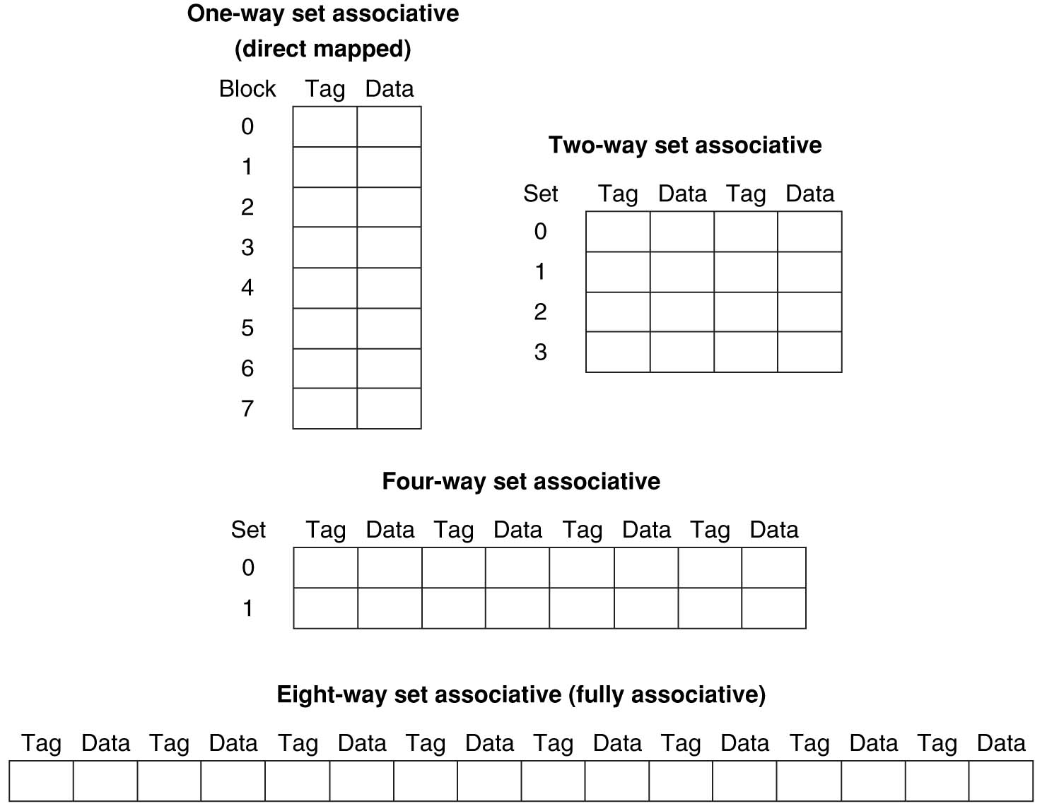
Example: Eight-Block Cache Configs
Total size of $ = # sets × associativity
For fixed $ size, associativity ↑ means # sets ↓ and slots per set ↑
With 8 blocks, an 8-way set associative $ is same as a fully associative $

Slide 26
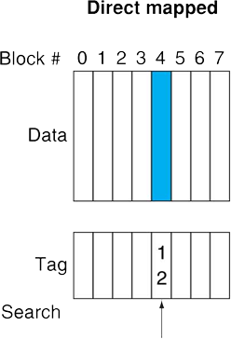
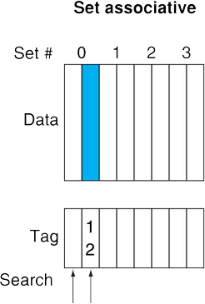
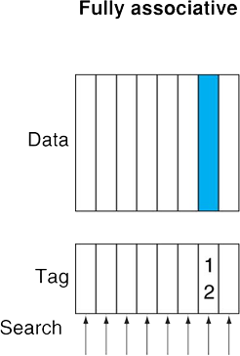
Block Placement Schemes
Place memory block 12 in a cache that holds 8 blocks
Fully associative: Can go in any of the slots (all 1 set)
Direct-mapped: Can only go in slot (12 mod 8) = 4
2-way set associative: Can go in either slot of set (12 mod 4) = 0

Slide 27
SA Cache Example (1/5)
Cache parameters:
2-way set associative, 6-bit addresses, 1-word blocks, 4-word cache, write-through
How many sets?
C/K/N = 4/1/2 = 2 sets
TIO Breakdown:
O = log₂(4) = 2, I = log₂(2) = 1, T = 6 – 1 – 2 = 3
Memory Addresses:
XXX
X
XX
Block address

Slide 28
SA Cache Example (2/5)
Cache parameters:
2-way set associative, 6-bit addresses, 1-word blocks, 4-word cache, write-through
Offset – 2 bits, Index – 1 bit, Tag – 3 bits
36 bits per slot, 36*2+1 = 73 bits per set, 2*73 = 146 bits to implement
Offset
0
1
 | 0
 | 1
 | 0
 | 1
V | Tag | 00 | 01 | 10 | 11
X | XXX | 0x?? | 0x?? | 0x?? | 0x??
X | XXX | 0x?? | 0x?? | 0x?? | 0x??
X | XXX | 0x?? | 0x?? | 0x?? | 0x??
X | XXX | 0x?? | 0x?? | 0x?? | 0x??
LRU
X
Index
LRU
X

Slide 29
SA Cache Example (3/5)
Main Memory:
0000xx
0001xx
0010xx
0011xx
0100xx
0101xx
0110xx
0111xx
1000xx
1001xx
1010xx
1011xx
1100xx
1101xx
1110xx
1111xx
Each block maps into one set (either slot)
(see colors)
Cache:
Set
Slot
V
Tag
Data
0
0
1
On a memory request: (let’s say 001011_{two})
1) Take Index field (0)
2) For EACH slot in set,
check valid bit,
then compare Tag
0
1
1
Set numbers exactly match the Index field
Main Memory shown in blocks, so offset bits not shown (x’s)

Slide 30
SA Cache Example (4/5)
Consider the sequence of memory address accesses
0 2 4 8 20 16 0 2
Starting with a cold cache:
0
miss
2
hit
0
1
0
1
0
1
0 | 000 | 0x?? | 0x?? | 0x?? | 0x??
0 | 000 | 0x?? | 0x?? | 0x?? | 0x??
0 | 000 | 0x?? | 0x?? | 0x?? | 0x??
0 | 000 | 0x?? | 0x?? | 0x?? | 0x??
1 | 000 | M[0] | M[1] | M[2] | M[3]
0 | 000 | 0x?? | 0x?? | 0x?? | 0x??
0 | 000 | 0x?? | 0x?? | 0x?? | 0x??
0 | 000 | 0x?? | 0x?? | 0x?? | 0x??
0
1
0
1
0
1
1 | 000 | M[0] | M[1] | M[2] | M[3]
0 | 000 | 0x?? | 0x?? | 0x?? | 0x??
0 | 000 | 0x?? | 0x?? | 0x?? | 0x??
0 | 000 | 0x?? | 0x?? | 0x?? | 0x??
4
miss
8
miss
0
1
0
1
0
1
1 | 000 | M[0] | M[1] | M[2] | M[3]
0 | 000 | 0x?? | 0x?? | 0x?? | 0x??
0 | 000 | 0x?? | 0x?? | 0x?? | 0x??
0 | 000 | 0x?? | 0x?? | 0x?? | 0x??
1 | 000 | M[0] | M[1] | M[2] | M[3]
0 | 000 | 0x?? | 0x?? | 0x?? | 0x??
1 | 000 | M[4] | M[5] | M[6] | M[7]
0 | 000 | 0x?? | 0x?? | 0x?? | 0x??
0
1
0
1
0
1
1 | 000 | M[0] | M[1] | M[2] | M[3]
0 | 000 | 0x?? | 0x?? | 0x?? | 0x??
1 | 000 | M[4] | M[5] | M[6] | M[7]
0 | 000 | 0x?? | 0x?? | 0x?? | 0x??
1 | 000 | M[0] | M[1] | M[2] | M[3]
1 | 001 | M[8] | M[9] | M[10] | M[11]
1 | 000 | M[4] | M[5] | M[6] | M[7]
0 | 000 | 0x?? | 0x?? | 0x?? | 0x??

Slide 31
SA Cache Example (5/5)
Consider the sequence of memory address accesses
0 2 4 8 20 16 0 2
Starting with a cold cache:
M H M M
20
miss
16
miss
0
1
0
1
0
1
1 | 000 | M[0] | M[1] | M[2] | M[3]
1 | 001 | M[8] | M[9] | M[10] | M[11]
1 | 000 | M[4] | M[5] | M[6] | M[7]
0 | 000 | 0x?? | 0x?? | 0x?? | 0x??
1 | 000 | M[0] | M[1] | M[2] | M[3]
1 | 001 | M[8] | M[9] | M[10] | M[11]
1 | 000 | M[4] | M[5] | M[6] | M[7]
1 | 010 | M[20] | M[21] | M[22] | M[23]
0
1
0
1
0
1
1 | 000 | M[0] | M[1] | M[2] | M[3]
1 | 001 | M[8] | M[9] | M[10] | M[11]
1 | 000 | M[4] | M[5] | M[6] | M[7]
1 | 010 | M[20] | M[21] | M[22] | M[23]
0
miss
2
hit
0
1
0
1
0
1
1 | 010 | M[16] | M[17] | M[18] | M[19]
1 | 001 | M[8] | M[9] | M[10] | M[11]
1 | 000 | M[4] | M[5] | M[6] | M[7]
1 | 010 | M[20] | M[21] | M[22] | M[23]
0
1
0
1
0
1
1 | 010 | M[16] | M[17] | M[18] | M[19]
1 | 000 | M[0] | M[1] | M[2] | M[3]
1 | 000 | M[4] | M[5] | M[6] | M[7]
1 | 010 | M[20] | M[21] | M[22] | M[23]
8 requests, 6 misses

Slide 32
Worst Case for Set Associative
Worst case for DM was repeating pattern of 2 into same cache slot (HR = 0/n)
Set associative for N > 1: HR = (n-2)/n
Worst case for N-way SA with LRU?
Repeating pattern of at least N+1 that maps into same set
Back to HR = 0:
0, 8, 16, 0, 8, …
M
M
M
M
M
001 M[8-11]
010 M[16-19]
000 M[0-3]
001 M[8-11]
000 M[0-3]
Notes:
For lecture
Another sample string to try 0 1 2 3 0 8 11 0 3

Slide 33
Question: What is the TIO breakdown for the following cache?
32-bit address space
32 KiB 4-way set associative cache
8 word blocks
T I O
(A)
21 8 3
(B)
19 8 5
(C)
19 10 3
(D)
17 10 5

Slide 34
Get To Know Your Instructor

Slide 35
Agenda
Direct-Mapped Caches
Administrivia
Set Associative Caches
Cache Performance

Slide 36
Cache Performance
Two things hurt the performance of a cache:
Miss rate and miss penalty
Average Memory Access Time (AMAT): average time to access memory considering both hits and misses
AMAT = Hit time + Miss rate × Miss penalty
(abbreviated AMAT = HT + MR × MP)
Goal 1: Examine how changing the different cache parameters affects our AMAT (Lec 12)
Goal 2: Examine how to optimize your code for better cache performance (Lec 14, Proj 2)

Slide 37
AMAT Example
Processor specs: 200 ps clock, MP of 50 clock cycles, MR of 0.02 misses/instruction, and HT of 1 clock cycle
AMAT = ???
Which improvement would be best?
190 ps clock
MP of 40 clock cycles
MR of 0.015 misses/instruction
1 + 0.02 × 50 = 2 clock cycles = 400 ps
380 ps
360 ps
350 ps

Slide 38
Cache Parameter Example
What is the potential impact of much larger cache on AMAT? (same block size)
Increase HR
Longer HT: smaller is faster
At some point, increase in hit time for a larger cache may overcome the improvement in hit rate, yielding a decrease in performance
Effect on TIO? Bits in cache? Cost?

Slide 39
Effect of Cache Performance on CPI
Recall: CPU Performance
CPU Time = Instructions × CPI × Clock Cycle Time
Include memory accesses in CPI:
CPI_{stall} = CPI_{base} + Average Memory-stall Cycles
CPU Time = IC × CPI_{stall} × CC
Simplified model for memory-stall cycles:
Memory-stall cycles
Will discuss more complicated models next lecture
(IC)
(CC)
Notes:
Memory-stall clock cycles = Read-stall cycles + Write-stall cycles.
Reasonable write buffer depth (e.g., four or more words) and a memory capable of accepting writes at a rate that significantly exceeds the average write frequency means write buffer stalls are small.
Here we are assuming same MR and MP for reads and writes.

Slide 40
CPI Example
Processor specs: CPI_{base} of 2, a 100 cycle MP, 36% load/store instructions, and 2% I$ and 4% D$ MRs
How many times per instruction do we access the I$? The D$?
MP is assumed the same for both I$ and D$
Memory-stall cycles will be sum of stall cycles for both I$ and D$
Notes:
I$ accessed at EVERY instruction (need to fetch from Code portion of memory!).
D$ is accessed only on loads and stores.
Naturally, you expect the I$ MR < D$ MR.

Slide 41
CPI Example
Processor specs: CPI_{base} of 2, a 100 cycle MP, 36% load/store instructions, and 2% I$ and 4% D$ MRs
Memory-stall cycles = (100% × 2% + 36% × 4%) × 100 = 3.44
CPI_{stall} = 2 + 3.44 = 5.44 (more than 2 x CPI_{base}!)
What if the CPI_{base} is reduced to 1?
What if the D$ miss rate went up by 1%?
I$
D$
Notes:
If CPI_{base} = 1, CPI_{stall} = 4.44, with memory-stall cycles accounting for 77.5% as opposed to 63.2%.
If D$ MR = 0.05, then memory-stall cycles = 3.8 and CPI_{stall} = 5.8. Memory-stall cycles now account for 65.5% of CPI_{stall}.

Slide 42
Impacts of Cache Performance
CPI_{stall} = CPI_{base} + Memory-stall Cycles
Relative penalty of cache performance increases as processor performance improves (faster clock rate and/or lower CPI_{base})
Relative contribution of CPI_{base} and memory-stall cycles to CPI_{stall}
Memory speed unlikely to improve as fast as processor cycle time
What can we do to improve cache performance?
Notes:
For CPI_{base} = 1, then CPI_{stall} = 4.44 and the amount of execution time spent on memory stalls would have risen from 3.44/5.44 = 63% to 3.44/4.44 = 77%
For miss penalty of 200, memory stall cycles = 2% 200 + 36% x 4% x 200 = 6.88 so that CPIstall = 8.88
This assumes that hit time (so hit time is 1 cycle) is not a factor in determining cache performance. A larger cache would have a longer access time (if a lower miss rate), meaning either a slower clock cycle or more stages in the pipeline for memory access.

Slide 43
Sources of Cache Misses: The 3Cs
Compulsory: (cold start or process migration, 1st reference)
First access to block impossible to avoid; Effect is small for long running programs
Capacity:
Cache cannot contain all blocks accessed by the program
Conflict: (collision)
Multiple memory locations mapped to the same cache location

Slide 44
The 3Cs: Design Solutions
Compulsory:
Increase block size (increases MP; too large blocks could increase MR)
Capacity:
Increase cache size (may increase HT)
Conflict:
Increase cache size
Increase associativity (may increase HT)

Slide 45
Summary
Set associativity determines flexibility of block placement
Fully associative: blocks can go anywhere
Direct-mapped: blocks go in one specific location
N-way: cache split into sets, each of which have n slots to place memory blocks
Cache Performance
AMAT = HT + MR × MP
CPU time = IC × CPI_{stall} × CC = IC × (CPI_{base} + Memory-stall cycles) × CC

