Slide 1
CS 61C: Great Ideas in Computer Architecture
Course Introduction,
Number Representation
Instructor: Justin Hsia

Slide 2
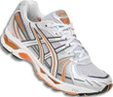
Introducing Your Instructor
I’m not a professor – call me Justin
Upbringing: Born and raised in the Bay
Education: I bleed Blue and Gold (Go Bears!)
B.S. ME, B.S. EECS, M.S. EECS
Ph.D. EECS (expected 2014)
Research: Synthetic Biology
Teaching: EE128, EE40, CS61C (Su11, Su12, Sp13)
Interests:

Slide 3
Agenda
Course Overview
Six Great Ideas in Computer Architecture
Administrivia
Number Representation
Number Bases
Signed Representations
Overflow
Sign Extension

Slide 4
What is CS 61C about?
It is about the hardware-software interface
What does the programmer need to know to achieve the highest possible performance?
Use low-level programming languages (closer to underlying hardware)
Allows us to talk about key hardware features in higher-level terms
Allows programmers to harness underlying hardware parallelism for high performance

Slide 5
Machine Structures
Application (ex: browser)
Operating
CS 61C
Compiler
System
(Mac OSX)
Software
Assembler
Instruction Set
Architecture
Hardware
Processor
Memory
I/O system
Datapath & Control
Digital Design
Circuit Design
Transistors

Slide 6
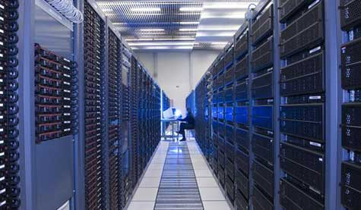
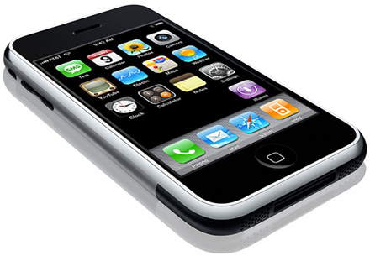
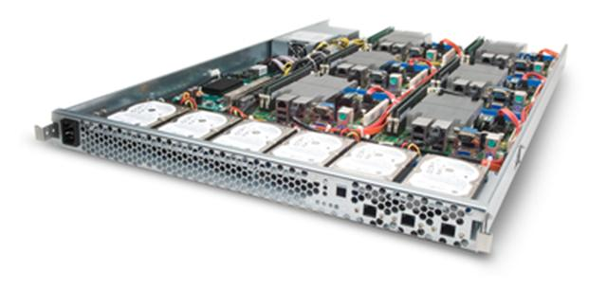
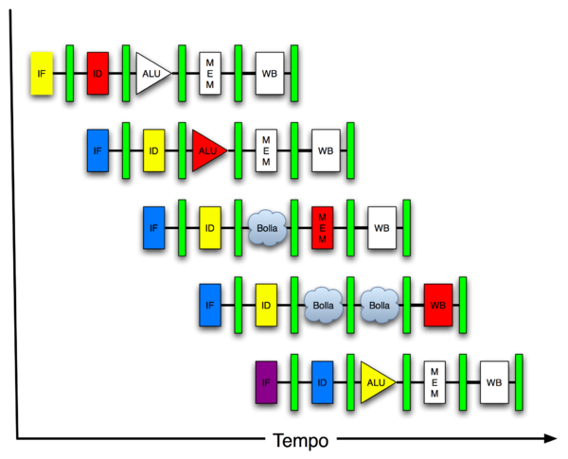
New-School: Parallelism
Software Hardware
Parallel Requests
Assigned to computer
e.g. search “Garcia”
Parallel Threads
Assigned to core
e.g. lookup, ads
Parallel Instructions
> 1 instruction @ one time
e.g. 5 pipelined instructions
Parallel Data
> 1 data item @ one time
e.g. add of 4 pairs of words
Hardware descriptions
All gates functioning in parallel at same time
Warehouse Scale Computer
Smart Phone
Leverage Parallelism &
Achieve High Performance
Computer
Core
…
Core
Memory
Input/Output
Core
Instruction Unit(s)
Functional
Unit(s)
A₀+B₀
A₁+B₁
A₂+B₂
A₃+B₃
Cache Memory
Logic Gates

Slide 7
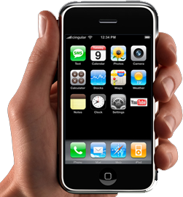
Post-PC Era: Late 2000s - ???
Personal Mobile
Devices (PMD):
Enabling Tech: Wireless networking, smartphones
Big Players: Apple, Nokia, …
Cost: $500, Target: Consumers on the go
Using: Objective C, Android OS

Slide 8
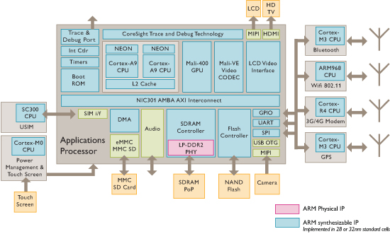
iPhone Innards
I/O
Processor
I/O
I/O
Memory
You will learn about multiple processors, the memory hierarchy, and I/O in 61C

Slide 9
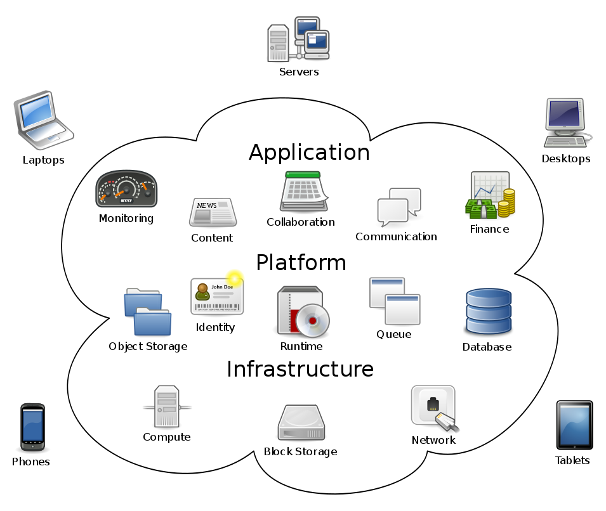
Post-PC Era: Late 2000s - ???
Cloud
Computing:
Enabling Tech: Local Area Networks, broadband Internet
Big Players: Amazon, Google, …
Target: Transient users or users who cannot afford high-end equipment

Slide 10
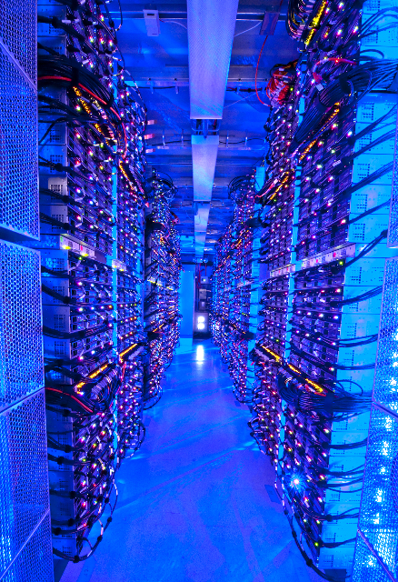
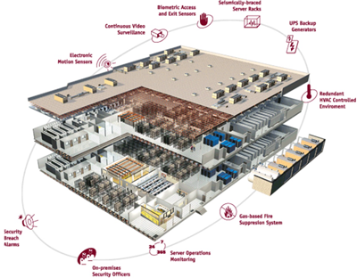
Post-PC Era: Late 2000s - ???
Datacenters and
Warehouse Scale
Computers (WSC):
Enabling Tech: Local Area Networks, cheap servers
Cost: $200M clusters + maintenance costs
Target: Internet services and PMDs
Usages: MapReduce, Ruby on Rails

Slide 11
Six Great Ideas in Computer Architecture
Layers of Representation/Interpretation
Technology Trends
Principle of Locality/Memory Hierarchy
Parallelism
Performance Measurement & Improvement
Dependability via Redundancy

Slide 12
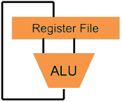
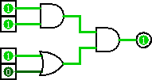
Great Idea #1: Levels of Representation/Interpretation
Higher-Level Language Program (e.g. C)
temp = v[k];
v[k] = v[k+1];
v[k+1] = temp;
Compiler
Anything can be represented as a number!
e.g. words, colors, data, logic,
code, even other numbers
lw $t0, 0($2)
lw $t1, 4($2)
sw $t1, 0($2)
sw $t0, 4($2)
Assembly Language Program (e.g. MIPS)
Assembler
0000 1001 1100 0110 1010 1111 0101 1000
1010 1111 0101 1000 0000 1001 1100 0110
1100 0110 1010 1111 0101 1000 0000 1001
0101 1000 0000 1001 1100 0110 1010 1111
Machine Language Program (MIPS)
Machine Interpretation
Hardware Architecture Description (e.g. block diagrams)
Architecture Implementation
Logic Circuit Description (Circuit Schematic Diagrams)

Slide 13
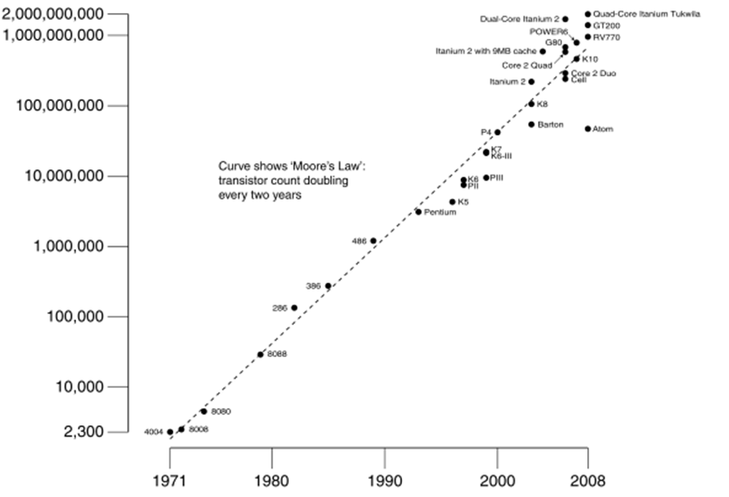
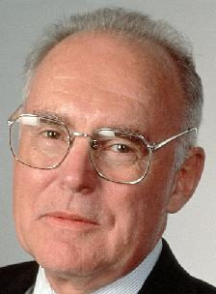
Great Idea #2: Technology Trends
Predicts: Transistor count
per chip doubles
every 2 years
# of transistors on an integrated circuit (IC)
Gordon Moore
Intel Cofounder B.S. Cal 1950
Year:

Slide 14
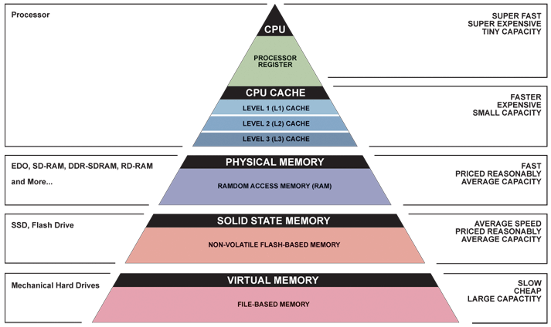
Great Idea #3: Principle of Locality/ Memory Hierarchy
Increasing distance from application/user
Trade-off in speed and cost vs. capacity!

Slide 15
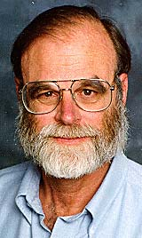
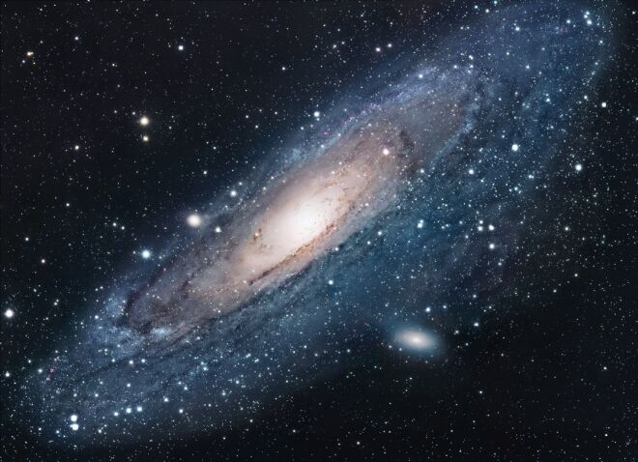
Storage Latency Analogy: How Far Away is the Data?
Andromeda
9
10
Tape /Optical
2,000 Years
Robot
Jim Gray Turing Award
B.S. Cal 1966
Ph.D. Cal 1969!
10
6
Disk
Pluto
2 Years
Sacramento
1.5 hr
100
Memory
10
On Board Cache
This Campus
10 min
2
On Chip Cache
This Room
1
Registers
My Head
1 min
(ns)

Slide 16
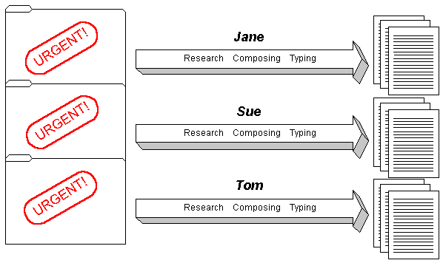
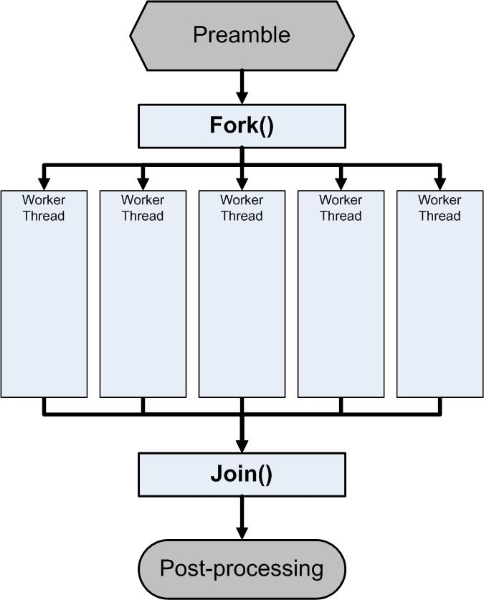
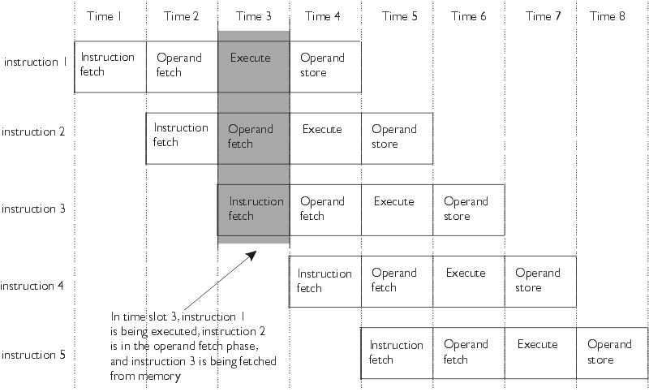
Great Idea #4: Parallelism

Slide 17
Great Idea #5: Performance Measurement and Improvement
Allows direct comparisons of architectures and quantification of improvements
Most common measures are time to finish (latency) and rate of execution (throughput)
Latency includes both setup and execution time
Match application and hardware to exploit:
Locality, parallelism, special hardware features
Notes:
Special hardware features could be specialized instructions.

Slide 18
Great Idea #6: Dependability via Redundancy
Redundancy so that a failing piece doesn’t make the whole system fail
1+1=2
2 of 3 agree
1+1=2
1+1=2
1+1=1
FAIL!

Slide 19
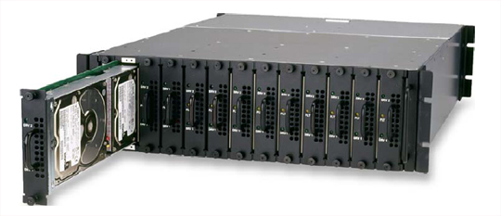
Great Idea #6: Dependability via Redundancy
Applies to everything from datacenters to storage to memory
Redundant datacenters so that can lose 1 datacenter but Internet service stays online
Redundant disks so that can lose 1 disk but not lose data (Redundant Arrays of Independent Disks/RAID)
Redundant memory bits of so that can lose 1 bit but no data (Error Correcting Code/ECC Memory)
Increasing transistor density reduces the cost of redundancy

Slide 20
Agenda
Course Overview
Six Great Ideas in Computer Architecture
Administrivia
Number Representation
Number Bases
Overflow
Signed Representations
Sign Extension

Slide 21
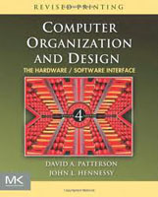
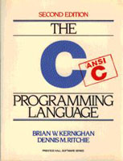
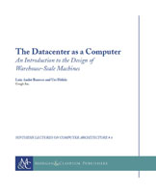
Course Information
This information can also be found on the course syllabus
Website: http://inst.eecs.berkeley.edu/~cs61c/su13
Instructor: Justin Hsia
Teaching Assistants: Albert Magyar, Jeffrey Dong, Justin Fu, Kevin Yeun, Sagar Karandikar, Shaun Benjamin
Textbooks: average 15 pages of reading/week
Patterson & Hennessey, Computer Organization and Design, Revised 4th Edition (not ≤ 3rd Edition, not Asian 4th Edition)
Kernighan & Ritchie, The C Programming Language, 2nd Edition
Barroso & Holzle, The Datacenter as a Computer, 1st Edition (free!)
Piazza (http://piazza.com/class#summer2013/cs61c) is the class forum
Every announcement, discussion, clarification happens there

Slide 22
Course Assignments and Grading
Homework (15%) – 5 total, weighted by difficulty
Labs (6%) – 12 total, weighted equally
Done in partners, good learning environment
Projects (24%) – 3 total, weighted equally
MIPS Instruction Set Simulator
Performance Tuning of a Parallel Application
Computer Processor Pipelined Design
Midterm (24%): Friday, July 19 @ 9am
Final (26%): Friday, August 16 @ 9am
Participation and Altruism (5%)

Slide 23
Projects
MapReduce
Software Hardware
Parallel Requests
Assigned to computer
e.g. search “Garcia”
Parallel Threads
Assigned to core
e.g. lookup, ads
Parallel Instructions
>1 instruction @ one time
e.g. 5 pipelined instructions
Parallel Data
> 1 data item @ one time
e.g. add of 4 pairs of words
Hardware descriptions
All gates functioning in parallel at same time
Warehouse Scale Computer
Smart Phone
Leverage Parallelism &
Achieve High Performance
Computer
Core
…
Core
Project 1: MIPS Emulator
Memory
Input/Output
Core
Project 2:
Matrix Multiply
Instruction Unit(s)
Functional
Unit(s)
A₀+B₀
A₁+B₁
A₂+B₂
A₃+B₃
Cache Memory
Logic Gates
Project 3:
CPU Design

Slide 24
Participation and Altruism
Participation
Asking great questions in discussion and lecture and making it more interactive
Attending office hours, completing all assignments
Peer instruction voting (more on this next)
Altruism
Helping others in lab, discussion, and on Piazza
This is a subjective score (internal)
Reward for helping, not a penalty for not helping
The point is to encourage class-wide learning!

Slide 25
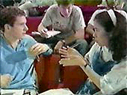
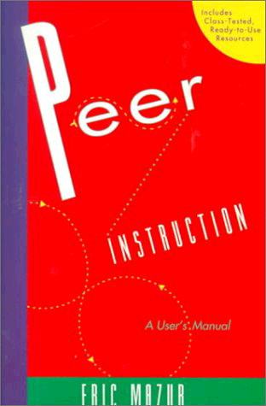
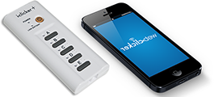
Peer Instruction
Increase real-time learning in lecture, test understanding of concepts vs. details mazur-www.harvard.edu/education/pi.phtml
Multiple choice question at end of a “segment”
1 minute to decide yourself
2 minutes in pairs to reach consensus
Learn by teaching!
Vote using i>clicker remote
Can buy from bookstore or online
Will start using tomorrow
Counts towards P&A grade

Slide 26
Question: Which statement is FALSE about Great Ideas in Computer Architecture?
(A)
To offer a dependable system, you must use components that almost never fail
(B)
Memory hierarchy goal is to look as fast as most expensive memory, as big as cheapest
(C)
Moore’s Law means computers will continue to get put twice as many transistors/chip every ≈2 years without fail
(D)
The levels of interpretation/representation mean that we can represent anything as 0’s and 1’s

Slide 27
Late Policy – Slip Days
Assignments due at 11:59:59pm (time-stamped)
You have 3 slip day tokens
Token used for every day your project or homework is late (even by a second)
Keep in mind how much each assignment is worth
After tokens, it’s 33% deducted per day
No credit if more than 2 days late
Cannot retroactively “reassign” slip days

Slide 28
Policy on Assignments and Independent Work
With the exception of Project 2, all homework and projects are to be YOUR work and your work ALONE.
You are encouraged to discuss your assignments with other students (ideas), but we expect that what you hand in is yours.
It is NOT acceptable to copy solutions from other students.
It is NOT acceptable to copy (or start your) solutions from the Web.

Slide 29
Policy on Assignments and Independent Work
We have tools and methods, developed over many years, for detecting this. You WILL be caught, and the penalties WILL be severe.
Both the cheater and the enabler receive –100% for the assignment. Letter to your university record documenting the incidence of cheating.
Possible automatic F in the course
People are caught every semester of 61C

Slide 30
Comments on Summer Version
Summer is EXTREMELY hectic!
Double the standard pace
Less time to synthesize material
Falling behind just a little can be fatal
No MapReduce project
Starts deceptively slowly (first two weeks)
If the course begins to overwhelm you, don’t wait, contact me or your TA immediately!

Slide 31
Pedagogic Comments
Deep learning does not happen in lecture
Learn by doing: labs, discussions, and assignments
Engaging the material outside of class and lab is critical to your success
Study groups, testing out your own questions
Talking with others helps solidify your own understanding
You learn best from your mistakes
Don’t be afraid to be wrong; only you lose if you remain silent

Slide 32
Architecture of a Lecture
Full
Administrivia
+ stretch break
Tech break
+ GTKYS
Summary
+ Bonus
Attention
0
20
25
50
53
78
80
Time (minutes)

Slide 33
Last Things…
Discussions, labs, and OHs start immediately
Yes, that means today!
Switching sections: if you find another 61C student willing to swap lab, talk to your TAs
Attend whichever discussion you want, as long as there is enough physical room
HW0 due this Tuesday, June 25th
Find a small digital image of yourself
HW1 due this Sunday, June 30th

Slide 34
Get To Know Your Staff
Category: Cal

Slide 35
Agenda
Course Overview
Six Great Ideas in Computer Architecture
Administrivia
Number Representation
Number Bases
Signed Representations
Overflow
Sign Extension

Slide 36
Number Representation
Numbers are an abstract concept!
Recognize that these are arbitrary symbols
Inside a computer, everything stored as a sequence of 0’s and 1’s (bits)
Even this is an abstraction!
How do we represent numbers in this format?
Let’s start with integers

Slide 37
Number Bases
Key terminology: digit (d) and base (B)
Value of i-th digit is d×B^{i} where i starts at 0 and increases from right to left
n digit number d_{n-1}d_{n-2} ... d₁d₀
value = d_{n-1}×B^{n-1} + d_{n-2}×B^{n-2} + ... + d₁×B¹ + d₀×B⁰
In base B, each digit is one of B possible symbols
Base is indicated using either a prefix or a subscript

Slide 38
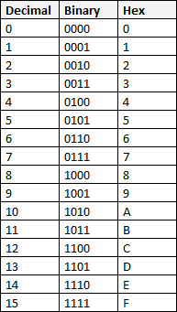
Commonly Used Number Bases
Decimal (base 10)
Symbols: 0, 1, 2, 3, 4, 5, 6, 7, 8, 9
Notation: 9472_{ten} = 9472
Binary (base 2)
Symbols: 0, 1
Notation: 101011_{two} = 0b101011
Hexadecimal (base 16)
Symbols: 0, 1, 2, 3, 4, 5, 6, 7, 8, 9, A, B, C, D, E, F
Notation: 2A5D_{hex} = 0x2A5D
Notes:
You will want to memorize this table!

Slide 39
Number Base Examples
Examples:
9472_{ten} = 9000 + 400 + 70 + 2
9x1000 + 4x100 + 7x10 + 2x1
9x10³ + 4x10² + 7x10¹ + 2x10⁰
9472_{ten} = 2x16³ + 5x16² + 0x16¹ + 0x16⁰
9472_{ten} = 2500_{hex}
0xA15 = 0b 1010 0001 0101
3 2 1 0
Notes:
Decomposition of base
Converting between bases
Skipping base 10 intermediate step

Slide 40
Bits Can Represent Anything
n digits in base B can represent at most B^{n} things!
Each of the n digits is one of B possible symbols
Have more things? Add more digits!
Example: Logical values (1 bit) – 0 is False, 1 is True
Example: Characters
26 letters require 5 bits (2⁵ = 32 > 26)
Example: Students in this class (8 bits)
For convenience, can group into nibbles (4 bits) and bytes (8 bits)

Slide 41
So What Number Is It Anyway?
Here we are using binary bit patterns to represent numbers
Strictly speaking they are called numerals and have no meaning until you interpret them
Is CAB a word (taxi) or a number (3243_{ten})?
Is 0x999999 a number or a color (RGB)?
Keep in mind that the same bit pattern will mean different things depending on how you choose to interpret it

Slide 42
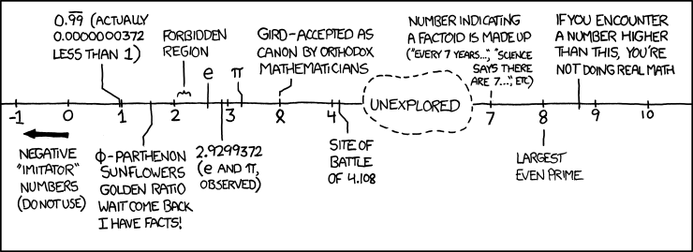
Numbers in a Computer (1/2)
The number line:
Alt text: The Wikipedia page "List of Numbers" opens with "This list is incomplete; you can help by expanding it.“
(Source: http://xkcd.com/899)
What do we choose to represent?
Notes:
Alt text is now inaccurate: “This is an incomplete list, which may never be able to satisfy particular standards for completeness. You can help by expanding it with reliably sourced entries.”

Slide 43
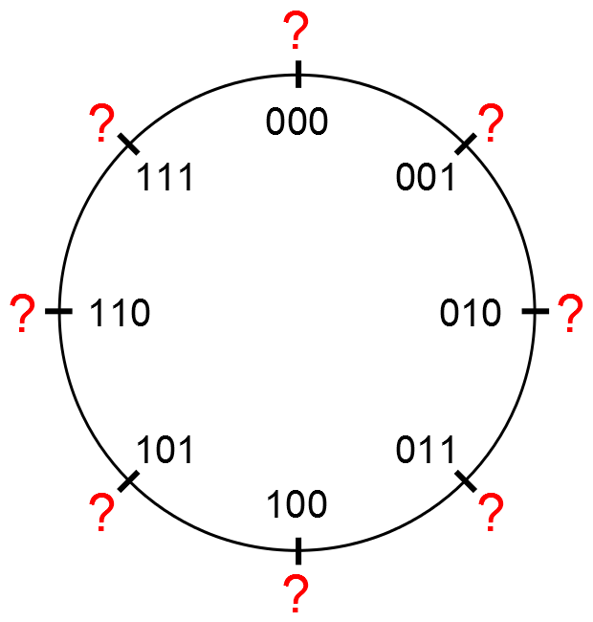
Numbers in a Computer (2/2)
Numbers really have ∞ digits, but hardware can only store a finite number of them (fixed)
Usually ignore leading zeros
Leftmost is most significant bit (MSB)
Rightmost is least significant bit (LSB)
“Circle” of binary numerals: (3-bit example)

Slide 44
Unsigned Integers
Represent only non-negative (unsigned) integers:
0000_{two} = 0_{ten}
0001_{two} = 1_{ten}
. . .
0110_{two} = 6_{ten}
0111_{two} = 7_{ten}
1000_{two} = 8_{ten}
1001_{two} = 9_{ten}
. . .
1110_{two} = 14_{ten}
1111_{two} = 15_{ten}
Zero?
0…0_{two} = 0_{ten}
Most neg number?
0…0_{two} = 0_{ten}
Most pos number?
1…1_{two} = (2^{n}-1)_{ten}
Increment?
Notes:
Notice that adding one to an unsigned integer ALWAYS results in a larger (more positive) number, with the exception of overflow.

Slide 45
Signed Integers
n bits can represent 2^{n} different things
Ideally, want the range evenly split between positive and negative
How do we want to encode zero?
Can we encode them in such a way that we can use the same hardware regardless of whether the numbers are signed or unsigned?
e.g. incrementing pos/neg numbers

Slide 46
Sign and Magnitude
MSB gives sign, rest treated as unsigned (magnitude):
0000_{two} = +0_{ten}
0001_{two} = +1_{ten}
. . .
0110_{two} = +6_{ten}
0111_{two} = +7_{ten}
1000_{two} = -0_{ten}
1001_{two} = -1_{ten}
. . .
1110_{two} = -6_{ten}
1111_{two} = -7_{ten}
Zero?
0…0_{two} and 10…0_{two} = ±0_{ten}
Most neg number?
1…1_{two} = -(2^{(n-1)}-1)_{ten}
Most pos number?
01…1_{two} = (2^{(n-1)}-1)_{ten}
Increment?
Notes:
Two zeros! Incrementing negative numerals results in decrementing numbers.

Slide 47
Biased Notation
Like unsigned, but “shifted” so zero is in the middle:
0000_{two} = -7_{ten}
0001_{two} = -6_{ten}
. . .
0110_{two} = -1_{ten}
0111_{two} = 0_{ten}
1000_{two} = +1_{ten}
1001_{two} = +2_{ten}
. . .
1110_{two} = +7_{ten}
1111_{two} = +8_{ten}
Zero?
01…1_{two} = 0_{ten}
Most neg number?
0…0_{two} = -(2^{(n-1)}-1)_{ten}
Most pos number?
1…1_{two} = 2^{(n-1)}_{ten}
Increment?
Notes:
How do you find the number zero? Choice of 1 extra pos or neg # is arbitrary. Same as reading as unsigned but subtracting a bias of 2^(n-1)-1.

Slide 48
One’s Complement
New negation procedure – complement the bits:
0000_{two} = +0_{ten}
0001_{two} = +1_{ten}
. . .
0110_{two} = +6_{ten}
0111_{two} = +7_{ten}
1000_{two} = -7_{ten}
1001_{two} = -6_{ten}
. . .
1110_{two} = -1_{ten}
1111_{two} = -0_{ten}
Zero?
0…0_{two} and 1…1_{two} = ±0_{ten}
Most neg number?
10…0_{two} = -(2^{(n-1)}-1)_{ten}
Most pos number?
01…1_{two} = (2^{(n-1)}-1)_{ten}
Increment?
Notes:
One’s complement is NOT a verb. Can still use MSB as sign bit.

Slide 49
Two’s Complement
Like One’s Complement, but “shift” negative #s by 1:
0000_{two} = 0_{ten}
0001_{two} = +1_{ten}
. . .
0110_{two} = +6_{ten}
0111_{two} = +7_{ten}
1000_{two} = -8_{ten}
1001_{two} = -7_{ten}
. . .
1110_{two} = -2_{ten}
1111_{two} = -1_{ten}
Zero?
0…0_{two} = 0_{ten}
Most neg number?
10…0_{two} = -2^{(n-1)}_{ten}
Most pos number?
01…1_{two} = (2^{(n-1)}-1)_{ten}
Increment?
Notes:
One’s complement is NOT a verb. Can still use MSB as sign bit.

Slide 50
Two’s Complement Summary
Used by all modern hardware
Roughly evenly split between positive and negative
One more negative # because positive side has 0
Can still use MSB as sign bit
To negate: Flip the bits and add one
Example: +7 = 0b 0000 0111, -7 = 0b 1111 1001

Slide 51
Two’s Complement Review
← need 6 bits
← one’s complement
← unsigned
← two’s complement
← need 6 bits
Suppose we had 5 bits. What integers can be represented in two’s complement?
(A) -31 to +31
(B) -15_to +15
(C) -0_to +31
(D) -16_to +15
(E) -32 to +31

Slide 52
Overflow
Overflow is when the result of an arithmetic operation can’t be represented by the hardware bits
i.e. the result is mathematically incorrect
Examples:
Unsigned: 0b1…1 + 1₁₀ = 0b0…0 = 0?
Two’s: 0b01…1 + 1₁₀ = 0b10…0 = -2^{(n-1)}_{ten}?
0b 0000
0001
0010
1110
1111
unsigned
Notes:
Notice that the examples for unsigned and 2’s DON’T work in the other representation!

Slide 53
Sign Extension
Want to represent the same number using more bits than before
Easy for positive #s (add leading 0’s), more complicated for negative #s
Sign and magnitude: add 0’s after the sign bit
One’s complement: copy MSB
Two’s complement: copy MSB
Example:
Sign and magnitude: 0b 11 = 0b 1001
One’s/Two’s complement: 0b 11 = 0b 1111
Notes:
Why this is useful will become apparent later in the course.

Slide 54
Summary (1/2)
CS61C: Learn 6 Great Ideas in Computer Architecture to enable high performance programming via parallelism
Layers of Representation/Interpretation
Technology Trends
Principle of Locality/Memory Hierarchy
Parallelism
Performance Measurement and Improvement
Dependability via Redundancy

Slide 55
Summary (2/2)
Number Representation: How to represent positive and negative integers using binary
Unsigned: Interpret numeral in base 2
Signed: Two’s Complement
Biased: Subtract bias
Sign extension must preserve signed number

