Slide 1
CS 61C: Great Ideas in Computer Architecture
Cache Performance,
Set Associative Caches
Instructor: Justin Hsia

Slide 2
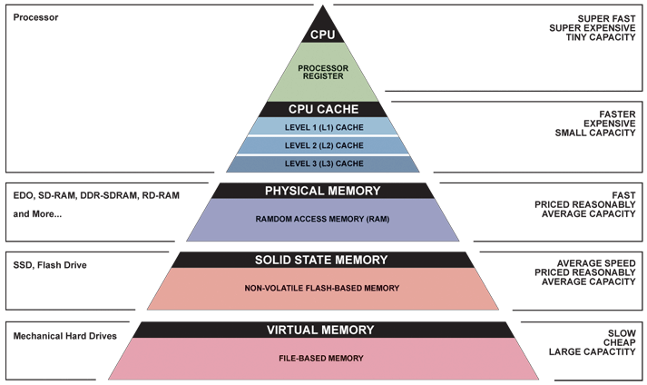
Great Idea #3: Principle of Locality/ Memory Hierarchy

Slide 3
Extended Review of Last Lecture
Why have caches?
Intermediate level between CPU and memory
In-between in size, cost, and speed
Memory (hierarchy, organization, structures) set up to exploit temporal and spatial locality
Temporal: If accessed, will access again soon
Spatial: If accessed, will access others around it
Caches hold a subset of memory (in blocks)
We are studying how they are designed for fast and efficient operation (lookup, access, storage)

Slide 4
Extended Review of Last Lecture
Direct-Mapped Caches:
Use hash function to determine location for block
Each block maps into a single row
(block address) modulo (# of blocks in the cache)
TIO breakdown of memory address
Index field is result of hash function (which row)
Tag field is identifier (which block is currently in row)
Offset field indexes into block
Each cache row holds block data, tag, valid bit, and dirty bit (dirty bit is only for write-back)

Slide 5
Extended Review of Last Lecture
Cache design considerations
Affect hit rate/miss rate (HR/MR), hit time (HT), and miss penalty (MP)
So far introduced cache size and block size
Cache read and write policies:
Affect consistency of data between cache and memory
Write-back vs. write-through
Write allocate vs. no-write allocate

Slide 6
Direct-Mapped Cache Layout
256 B address space
cache size
block size
8-bit address space, 32-byte cache with 8-byte (2 word) blocks, write-back and write allocate
Offset – 3 bits, Index – 2 bits, Tag – 3 bits
Each row has 69 bits; cache has 4*69 = 276 bits
Need dirty bit
Offset
00
01
10
11
V | D | Tag | 000 | 001 | 010 | 011 | 100 | 101 | 110 | 111
X | X | XXX | 0x?? | 0x?? | 0x?? | 0x?? | 0x?? | 0x?? | 0x?? | 0x??
X | X | XXX | 0x?? | 0x?? | 0x?? | 0x?? | 0x?? | 0x?? | 0x?? | 0x??
X | X | XXX | 0x?? | 0x?? | 0x?? | 0x?? | 0x?? | 0x?? | 0x?? | 0x??
X | X | XXX | 0x?? | 0x?? | 0x?? | 0x?? | 0x?? | 0x?? | 0x?? | 0x??
Index

Slide 7
Direct-Mapped Cache Request
On memory request (read or write):
Extract Index field and find corresponding row
Check Valid bit (otherwise cache miss)
Extract Tag field and compare to Tag in row (otherwise cache miss with replacement)
Use Offset to select correct byte/word from block (cache hit)
On write, set Dirty bit if write-back

Slide 8
Agenda
Cache Performance
Administrivia
Multilevel Caches
Set Associative Caches
Improving Cache Performance
Bonus: Multilevel Cache Performance Practice
Bonus: Contemporary Cache Specs

Slide 9
Cache Performance
Two things hurt the performance of a cache:
Miss rate and miss penalty
Average Memory Access Time (AMAT): average time to access memory considering both hits and misses
AMAT = Hit time + Miss rate × Miss penalty
(abbreviated AMAT = HT + MR × MP)
Goal 1: Examine how changing the different cache parameters affects our AMAT (Lec 12)
Goal 2: Examine how to optimize your code for better cache performance (Lec 13, Proj 2)

Slide 10
AMAT Example Usage
Processor specs: 200 ps clock, MP of 50 clock cycles, MR of 0.02 misses/instruction, and HT of 1 clock cycle
AMAT = ???
Which improvement would be best?
190 ps clock
MP of 40 clock cycles
MR of 0.015 misses/instruction
1 + 0.02 × 50 = 2 clock cycles = 400 ps
380 ps
360 ps
350 ps

Slide 11
Cache Parameter Example
What is the potential impact of much larger cache on AMAT? (same block size)
Increase HR
Longer HT: smaller is faster
At some point, increase in hit time for a larger cache may overcome the improvement in hit rate, yielding a decrease in performance
Effect on TIO? Bits in cache? Cost?

Slide 12
Effect of Cache Performance on CPI
Recall: CPU Performance
CPU Time = Instructions × CPI × Clock Cycle Time
Include memory accesses in CPI:
CPI_{stall} = CPI_{base} + Average Memory-stall Cycles
CPU Time = IC × CPI_{stall} × CC
Simplified model for memory-stall cycles:
Memory-stall cycles
We will discuss more complicated models soon
(IC)
(CC)
Notes:
Memory-stall clock cycles = Read-stall cycles + Write-stall cycles.
Reasonable write buffer depth (e.g., four or more words) and a memory capable of accepting writes at a rate that significantly exceeds the average write frequency means write buffer stalls are small.
Here we are assuming same MR and MP for reads and writes.

Slide 13
CPI Example
Processor specs: CPI_{base} of 2, a 100 cycle MP, 36% load/store instructions, and 2% I$ and 4% D$ MRs
How many times per instruction do we access the I$? The D$?
MP is assumed the same for both I$ and D$
Memory-stall cycles will be sum of stall cycles for both I$ and D$
Notes:
I$ accessed at EVERY instruction (need to fetch from Code portion of memory!).
D$ is accessed only on loads and stores.
Naturally, you expect the I$ MR < D$ MR.

Slide 14
CPI Example
Processor specs: CPI_{base} of 2, a 100 cycle MP, 36% load/store instructions, and 2% I$ and 4% D$ MRs
Memory-stall cycles = (100% × 2% + 36% × 4%) × 100 = 3.44
CPI_{stall} = 2 + 3.44 = 5.44 (more than 2x CPI_{base}!)
What if the CPI_{base} is reduced to 1?
What if the D$ miss rate went up by 1%?
I$
D$
Notes:
If CPI_{base} = 1, CPI_{stall} = 4.44, with memory-stall cycles accounting for 77.5% as opposed to 63.2%.
If D$ MR = 0.05, then memory-stall cycles = 3.8 and CPI_{stall} = 5.8. Memory-stall cycles now account for 65.5% of CPI_{stall}.

Slide 15
Impacts of Cache Performance
CPI_{stall} = CPI_{base} + Memory-stall Cycles
Relative penalty of cache performance increases as processor performance improves (faster clock rate and/or lower CPI_{base})
Relative contribution of CPI_{base} and memory-stall cycles to CPI_{stall}
Memory speed unlikely to improve as fast as processor cycle time
What can we do to improve cache performance?
Notes:
For CPI_{base} = 1, then CPI_{stall} = 4.44 and the amount of execution time spent on memory stalls would have risen from 3.44/5.44 = 63% to 3.44/4.44 = 77%
For miss penalty of 200, memory stall cycles = 2% 200 + 36% x 4% x 200 = 6.88 so that CPIstall = 8.88
This assumes that hit time (so hit time is 1 cycle) is not a factor in determining cache performance. A larger cache would have a longer access time (if a lower miss rate), meaning either a slower clock cycle or more stages in the pipeline for memory access.

Slide 16
The 3Cs Revisited: Design Solutions
Compulsory:
Increase block size (increases MP; too large blocks could increase MR)
Capacity:
Increase cache size (may increase HT)
Conflict:
Increase cache size
Increase associativity (may increase HT)
Notes:
We will talk about associativity later in this lecture.

Slide 17
Agenda
Cache Performance
Administrivia
Multilevel Caches
Set Associative Caches
Improving Cache Performance
Bonus: Multilevel Cache Performance Practice
Bonus: Contemporary Cache Specs

Slide 18
Administrivia
HW3 due Wednesday
Midterm: Friday @ 9am in 245 Li Ka Shing
Take old exams for practice (see Piazza post @209)
One-sided sheet of handwritten notes
MIPS Green Sheet provided; no calculators
Will cover up through caches
Mid-Semester Survey
Short survey to complete as part of Lab 7
Found some copied code already; don’t do it!

Slide 19
Agenda
Cache Performance
Administrivia
Multilevel Caches
Set Associative Caches
Improving Cache Performance
Bonus: Multilevel Cache Performance Practice
Bonus: Contemporary Cache Specs

Slide 20
Multiple Cache Levels
With advancing technology, have more room on die for bigger L1 caches and for L2 (and in some cases even L3) cache
Normally lower-level caches are unified (i.e. holds both instructions and data)
Multilevel caching is a way to reduce miss penalty
So what does this look like?

Slide 21
Multilevel Cache Diagram
Legend:
Request for data
Return of data
Main Memory
L2$
L1$
CPU
Memory
Access
Miss
Miss
.
.
.
Return
Hit
Hit
Store
Store
Path of data back to CPU
Notes:
The stores back in higher-level caches depends on your write-miss policy (write allocate or no-write allocate).

Slide 22
Multilevel Cache AMAT
AMAT = L1 HT + L1 MR × L1 MP
Now L1 MP depends on other cache levels
L1 MP = L2 HT + L2 MR × L2 MP
If more levels, then continue this chain (i.e. MP_{i} = HT_{i+1} + MR_{i+1} × MP_{i+1})
Final MP is main memory access time
For two levels:
AMAT = L1 HT + L1 MR × (L2 HT + L2 MR × L2 MP)

Slide 23
Multilevel Cache AMAT Example
Processor specs: 1 cycle L1 HT, 2% L1 MR, 5 cycle L2 HT, 5% L2 MR, 100 cycle main memory HT
Here assuming unified L1$
Without L2$:
AMAT₁ = 1 + 0.02 × 100 = 3
With L2$:
AMAT₂ = 1 + 0.02 × (5 + 0.05 × 100) = 1.2

Slide 24
Local vs. Global Miss Rates
Local miss rate: Fraction of references to one level of a cache that miss
e.g. L2$ local MR = L2$ misses/L1$ misses
Specific to level of caching (as used in AMAT)
Global miss rate: Fraction of all references that miss in all levels of a multilevel cache
Property of the overall memory hierarchy
Global MR is the product of all local MRs
Start at Global MR = L_{n} misses/L₁ accesses and expand
So by definition, global MR ≤ any local MR
Notes:
L1$ misses are the only requests that reach L2$

Slide 25
Memory Hierarchy with Two Cache Levels
1000 mem refs
40 mem refs
20 mem refs
CPU
L1$
L2$
MM
1 cycle
10 cycles
100 cycles
For every 1000 CPU to memory references
40 will miss in L1$; what is the local MR?
20 will miss in L2$; what is the local MR?
Global miss rate?
0.04
0.5
0.02

Slide 26
Rewriting Performance
For a two level cache, we know: MR_{global} = L1 MR × L2 MR
AMAT:
AMAT = L1 HT + L1 MR × (L2 HT + L2 MR × L2 MP)
AMAT = L1 HT + L1 MR × L2 HT + MR_{global} × L2 MP
CPI:
CPI_{stall} = CPI_{base} + × L1 MR × (L1 MP + L2 MR × L2 MP)
CPI_{stall} = CPI_{base} + (L1 MR × L1 MP + MR_{global} × L2 MP)
Accesses
Instr
Accesses
Instr

Slide 27
Design Considerations
L1$ focuses on low hit time (fast access)
minimize HT to achieve shorter clock cycle
L1 MP significantly reduced by presence of L2$, so can be smaller/faster even with higher MR
e.g. smaller $ (fewer rows)
L2$, L3$ focus on low miss rate
As much as possible avoid reaching to main memory (heavy penalty)
e.g. larger $ with larger block sizes (same # rows)

Slide 28
Agenda
Cache Performance
Administrivia
Multilevel Caches
Set Associative Caches (Part 1)
Improving Cache Performance
Bonus: Multilevel Cache Performance Practice
Bonus: Contemporary Cache Specs

Slide 29
Reducing Cache Misses
Allow more flexible block placement in cache:
Direct-mapped: Memory block maps to exactly one cache block
Fully associative: Memory block can go in any slot
N-way set-associative: Divide $ into sets, each of which consists of n slots to place memory block
Memory block maps to a set determined by Index field and is placed in any of the n slots of that set
Hash function: (block address) modulo (# sets in the cache)
Notes:
All of the tags of all of the elements of the set must be searched for a match.

Slide 30
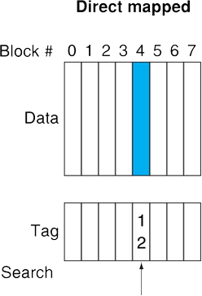
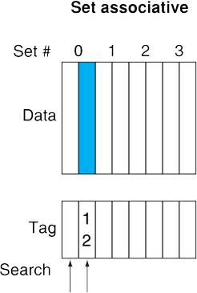
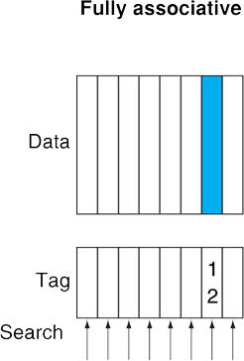
Block Placement Schemes
Place memory block 12 in a cache that holds 8 blocks
Direct-mapped: Can only go in row (12 mod 8) = 4
Fully associative: Can go in any of the slots (1 set/row)
2-way set associative: Can go in either slot of set (12 mod 4) = 0

Slide 31
Effect of Associativity on TIO (1/2)
Here we assume a cache of fixed size (C)
Offset: # of bytes in a block (same as before)
Index: Instead of pointing to a row, now points to a set, so I = C/B/associativity
Fully associative (1 set): 0 Index bits!
Direct-mapped (associativity of 1): max Index bits
Set associative: somewhere in-between
Tag: Remaining identifier bits (T = A – I – O)
Notes:
C = cache size, B = block size

Slide 32
Effect of Associativity on TIO (2/2)
For a fixed-size cache, each increase by a factor of two in associativity doubles the number of blocks per set (i.e. the number of slots) and halves the number of sets – decreasing the size of the Index by 1 bit and increases the size of the Tag by 1 bit
Used for tag comparison
Selects the set
Selects the word in the block
Tag
Index
Block offset
Byte offset
Increasing associativity
Decreasing associativity
Fully associative
(only one set)
Direct mapped
(only one way)
Notes:
For lecture
In 2008, the greater size and power consumption of CAMs generally leads to 2-way and 4-way set associativity being built from standard SRAMs with comparators with 8-way and above being built using CAMs

Slide 33
Set Associative Example (1/2)
Cache parameters:
6-bit addresses, block size of 1 word, cache size of 4 words, 2-way set associative
How many sets?
C/B/associativity = 4/1/2 = 2 sets
TIO Breakdown:
O = log₂(4) = 2, I = log₂(2) = 1, T = 6 – 1 – 2 = 3
Memory Addresses:
XXX
X
XX
Block address

Slide 34
Set Associative Example (2/2)
Main Memory:
0000xx
0001xx
0010xx
0011xx
0100xx
0101xx
0110xx
0111xx
1000xx
1001xx
1010xx
1011xx
1100xx
1101xx
1110xx
1111xx
Each block maps into one set (either slot)
(see colors)
Cache:
Set
Slot
V
Tag
Data
0
0
1
On a memory request: (let’s say 001011_{two})
1) Take Index field (0)
2) For EACH slot in set,
check valid bit,
then compare Tag
0
1
1
Set numbers exactly match the Index field
Main Memory shown in blocks, so offset bits not shown (x’s)

Slide 35
Question: What is the TIO breakdown for the following cache?
32-bit address space
32 KiB 4-way set associative cache
8 word blocks
T I O
☐
21 8 3
☐
19 8 5
☐
19 10 3
☐
17 10 5

Slide 36
Get To Know Your Staff
Category: Food

Slide 37
Agenda
Cache Performance
Administrivia
Multilevel Caches
Set Associative Caches (Part 2)
Improving Cache Performance
Bonus: Multilevel Cache Performance Practice
Bonus: Contemporary Cache Specs

Slide 38
Worst-Case for Direct-Mapped
Example: direct-mapped $ that holds 4 blocks
Starts empty (all initially not valid)
Consider the memory accesses: 0, 4, 0, 4, ...
HR of 0%
Ping pong effect: alternating requests that map into the same cache row
0
Miss
01
4
Miss
4
00
0
Miss
0
00 Mem(0)
00 Mem(0)
01 Mem(4)
. . .

Slide 39
Set Associative Benefits
Example: 2-way associative $ holds 4 blocks
Starts empty (all initially not valid)
Consider the memory accesses: 0, 4, 0, 4, ...
HR of (n-2)/n – big improvement!
Reduced conflict misses because memory locations that map into the same set can co-exist
0
Miss
4
Miss
0
Hit
4
Hit
000 Mem(0)
000 Mem(0)
000 Mem(0)
000 Mem(0)
010 Mem(4)
010 Mem(4)
010 Mem(4)
Notes:
For lecture
Another sample string to try 0 1 2 3 0 8 11 0 3

Slide 40
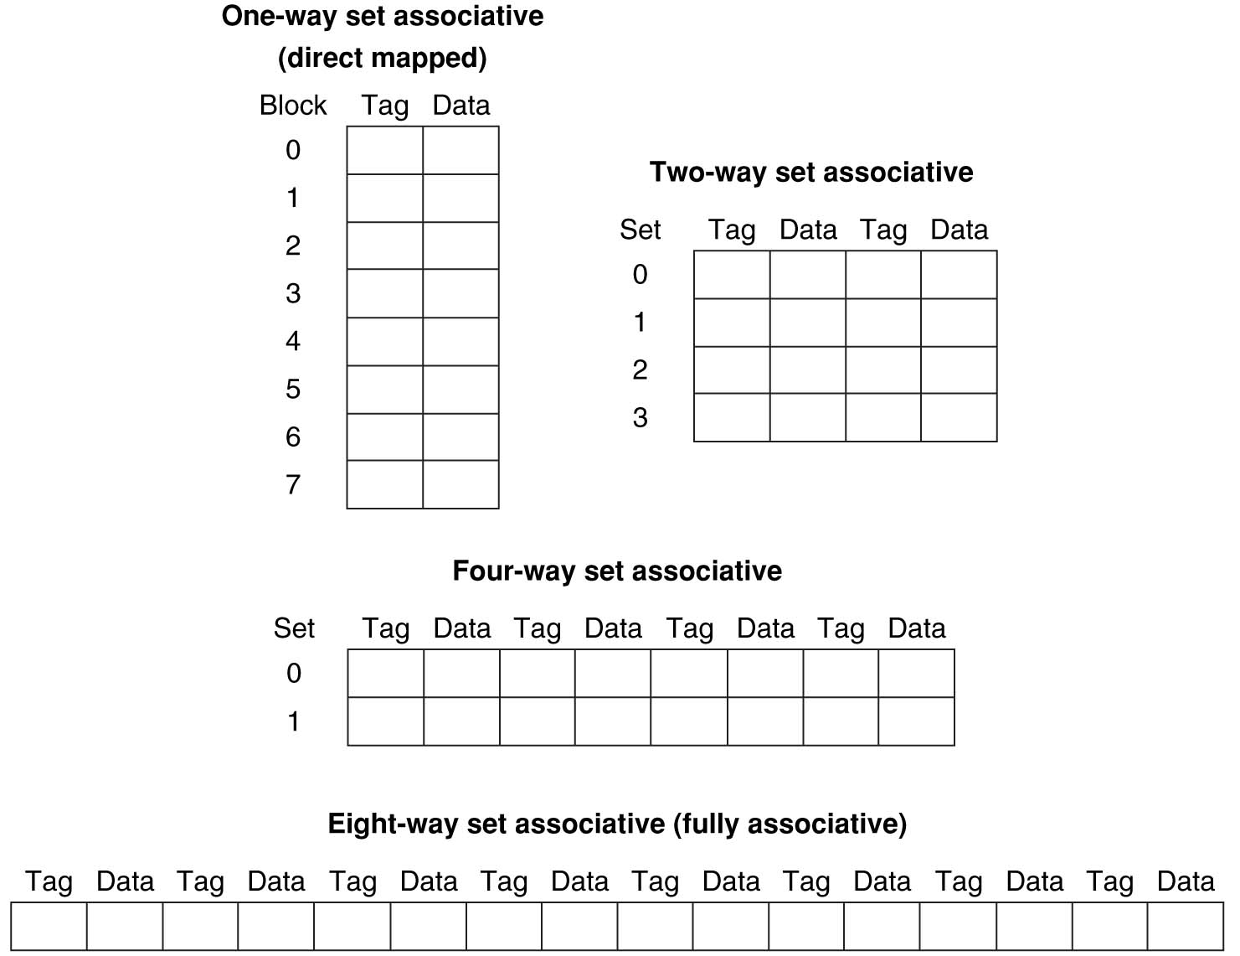
Example: Eight-Block Cache Configs
Total size of $ = # sets × associativity
For fixed $ size, associativity ↑ means # sets ↓ and slots per set ↑
With 8 blocks, an 8-way set associative $ is same as a fully associative $

Slide 41
4-Way Set Associative Cache
2⁸ = 256 sets each with four slots for blocks
31 30 . . . 13 12 11 . . . 2 1 0
Byte offset
Tag
22
8
Index
Index
V
Tag
Data
V
Tag
Data
V
Tag
Data
V
Tag
Data
0
1
2
.
.
.
253
254
255
0
1
2
.
.
.
253
254
255
0
1
2
.
.
.
253
254
255
0
1
2
.
.
.
253
254
255
Slot 0
Slot 1
Slot 2
Slot 3
32
4x1 select
Hit
Data
Notes:
This is called a 4-way set associative cache because there are four cache entries for each cache index. Essentially, you have four direct mapped cache working in parallel.
This is how it works: the cache index selects a set from the cache. The four tags in the set are compared in parallel with the upper bits of the memory address.
If no tags match the incoming address tag, we have a cache miss.
Otherwise, we have a cache hit and we will select the data from the slot where the tag match occurred.

Slide 42
Costs of Set-Associative Caches
For n-way set associative cache:
Need n comparators for Tag comparisons
Must choose data from correct slot (multiplexer)
On cache miss, which block do you replace in the set?
Use a cache block replacement policy
There are many (most are intuitively named), but we will just cover a few in this class
http://en.wikipedia.org/wiki/Cache_algorithms#Examples
Notes:
First of all, a N-way set associative cache will need N comparators instead of just one comparator (use the right side of the diagram for direct mapped cache).
A N-way set associative cache will also be slower than a direct mapped cache because of this extra multiplexer delay.
Finally, for a N-way set associative cache, the data will be available AFTER the hit/miss signal becomes valid because the hit/mis is needed to control the data MUX.
For a direct mapped cache, that is everything before the MUX on the right or left side, the cache block will be available BEFORE the hit/miss signal (AND gate output) because the data does not have to go through the comparator.
This can be an important consideration because the processor can now go ahead and use the data without knowing if it is a Hit or Miss. Just assume it is a hit.
Since cache hit rate is in the upper 90% range, you will be ahead of the game 90% of the time and for those 10% of the time that you are wrong, just make sure you can recover.
You cannot play this speculation game with a N-way set-associative cache because as I said earlier, the data will not be available to you until the hit/miss signal is valid.
+2 = 38 min. (Y:18)

Slide 43
Block Replacement Policies (1/2)
Random Replacement:
Hardware randomly selects a cache block in set
Least Recently Used (LRU):
Hardware keeps track of access history and replaces the entry that has not been used for the longest time
For 2-way set associative cache, can get away with just one bit per set
Example of a Simple “Pseudo” LRU Implementation:
For each set, store a hardware replacement pointer that points to one slot
Takes just log₂(associativity) bits
Whenever that slot is accessed, move pointer to next slot
That slot is the most recently used and cannot be the LRU

Slide 44
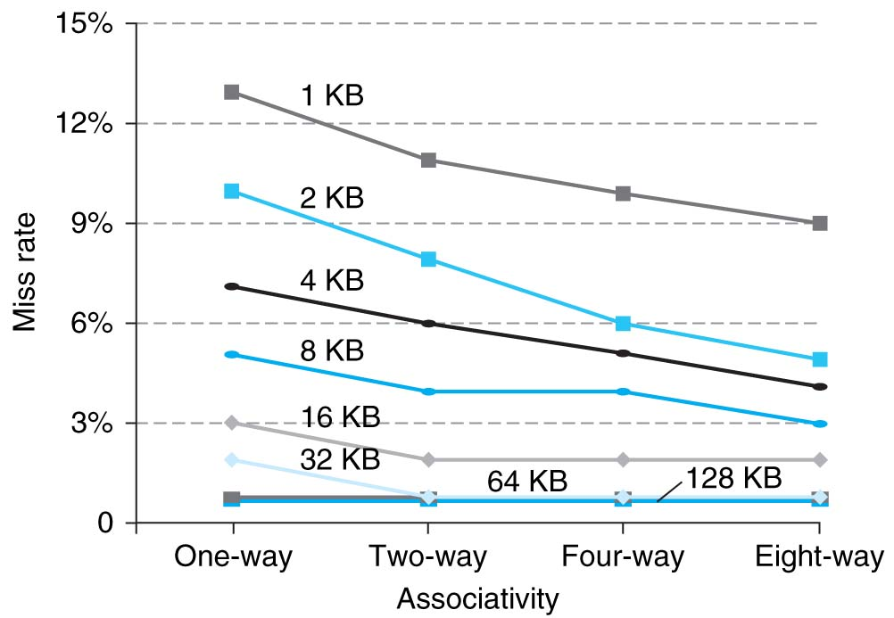
Benefits of Set-Associative Caches
Consider cost of a miss vs. cost of implementation
Largest gains are in going from direct mapped to 2-way (20%+ reduction in miss rate)
Notes:
As cache sizes grow, the relative improvement from associativity increases only slightly; since the overall miss rate of a larger cache is lower, the opportunity for improving the miss rate decreases and the absolute improvement in miss rate from associativity shrinks significantly.

Slide 45
Agenda
Cache Performance
Administrivia
Multilevel Caches
Set Associative Caches
Improving Cache Performance
Bonus: Multilevel Cache Performance Practice
Bonus: Contemporary Cache Specs

Slide 46
Improving Cache Performance (1/2)
Reduce the Hit Time of the cache
Smaller cache (less to search/check)
1 word blocks (no MUX/selector to pick word)
Reduce the Miss Rate
Bigger cache (capacity)
Larger blocks (compulsory & spatial locality)
Increased associativity (conflict)

Slide 47
Improving Cache Performance (2/2)
Reduce the Miss Penalty
Smaller blocks (less to move)
Use multiple cache levels
Use a write buffer
Can also check on read miss (may get lucky)

Slide 48
The Cache Design Space
Several interacting dimensions
Cache parameters:
Cache size, Block size, Associativity
Policy choices:
Write-through vs. write-back
Write allocation vs. no-write allocation
Replacement policy
Optimal choice is a compromise
Depends on access characteristics
Workload and use (I$, D$)
Depends on technology / cost
Simplicity often wins
Cache Size
(Associativity)
Block Size
Bad
Good
Factor A
Factor B
Less
More
Notes:
No fancy replacement policy is needed for the direct mapped cache.
As a matter of fact, that is what cause direct mapped trouble to begin with: only one place to go in the cache--causes conflict misses.
No fancy replacement policy is needed for the direct mapped cache.
As a matter of fact, that is what cause direct mapped trouble to begin with: only one place to go in the cache--causes conflict misses.
Besides working at Sun, I also teach people how to fly whenever I have time.
Statistic have shown that if a pilot crashed after an engine failure, he or she is more likely to get killed in a multi-engine light airplane than a single engine airplane.
The joke among us flight instructors is that: sure, when the engine quit in a single engine stops, you have one option: sooner or later, you land. Probably sooner.
But in a multi-engine airplane with one engine stops, you have a lot of options. It is the need to make a decision that kills those people.

Slide 49
Summary (1/2)
Cache Performance
AMAT = HT + MR × MP
CPU time = IC × CPI_{stall} × CC = IC × (CPI_{base} + Memory-stall cycles) × CC
Multilevel caches reduce miss penalty
Local vs. global miss rate
Optimize first level to be fast (low HT)
Optimize lower levels to not miss (minimize MP)

Slide 50
Summary (2/2)
Set associativity reduces miss rate
N-way: cache split into sets, each of which have n slots to place memory blocks
Fully associative: blocks can go anywhere
Memory block maps into more than one slot, reducing conflict misses
Cache performance depends heavily on cache design (there are many choices)
Effects of parameters and policies
Cost vs. effectiveness

Slide 51
BONUS SLIDES
You are responsible for the material contained on the following slides, though we may not have enough time to get to them in lecture.
They have been prepared in a way that should be easily readable and the material will be touched upon in the following lecture.

Slide 52
Agenda
Cache Performance
Administrivia
Multilevel Caches
Set-associative Caches
Improving Cache Performance
Bonus: Multilevel Cache Performance Practice
Bonus: Contemporary Cache Specs

Slide 53
Multilevel Cache Practice (1/3)
Processor specs:
CPI_{base} of 2
100 cycle miss penalty to main memory
25 cycle miss penalty to unified L2$
36% of instructions are load/stores
2% L1 I$ miss rate; 4% L1 D$ miss rate
0.5% global U(nified)L2$ miss rate
What is CPI_{stall} with and without the L2$?

Slide 54
Multilevel Cache Practice (2/3)
Notes:
Both L1 I$ and L1 D$ send misses to L2$
What does the global L2$ MR mean?
MR to main memory
Since there are 2 L1$s, implies L2$ has 2 different local MRs depending on source of access
Use formula shown at bottom of slide 26

Slide 55
Multilevel Cache Practice (3/3)
Without L2$:
CPI_{stall} = 2 + 1×0.02×100 + 0.36×0.04×100
CPI_{stall} = 5.44
With L2$:
CPI_{stall} = 2 + 1x.02×25 + .36×.04×25 + 1x.005×100 + .36×.005×100 CPI_{stall} = 3.54
Instr Fetch
Load/Store
L1
L2

Slide 56
Agenda
Cache Performance
Administrivia
Multilevel Caches
Set-associative Caches
Improving Cache Performance
Bonus: Multilevel Cache Performance Practice
Bonus: Contemporary Cache Specs

Slide 57
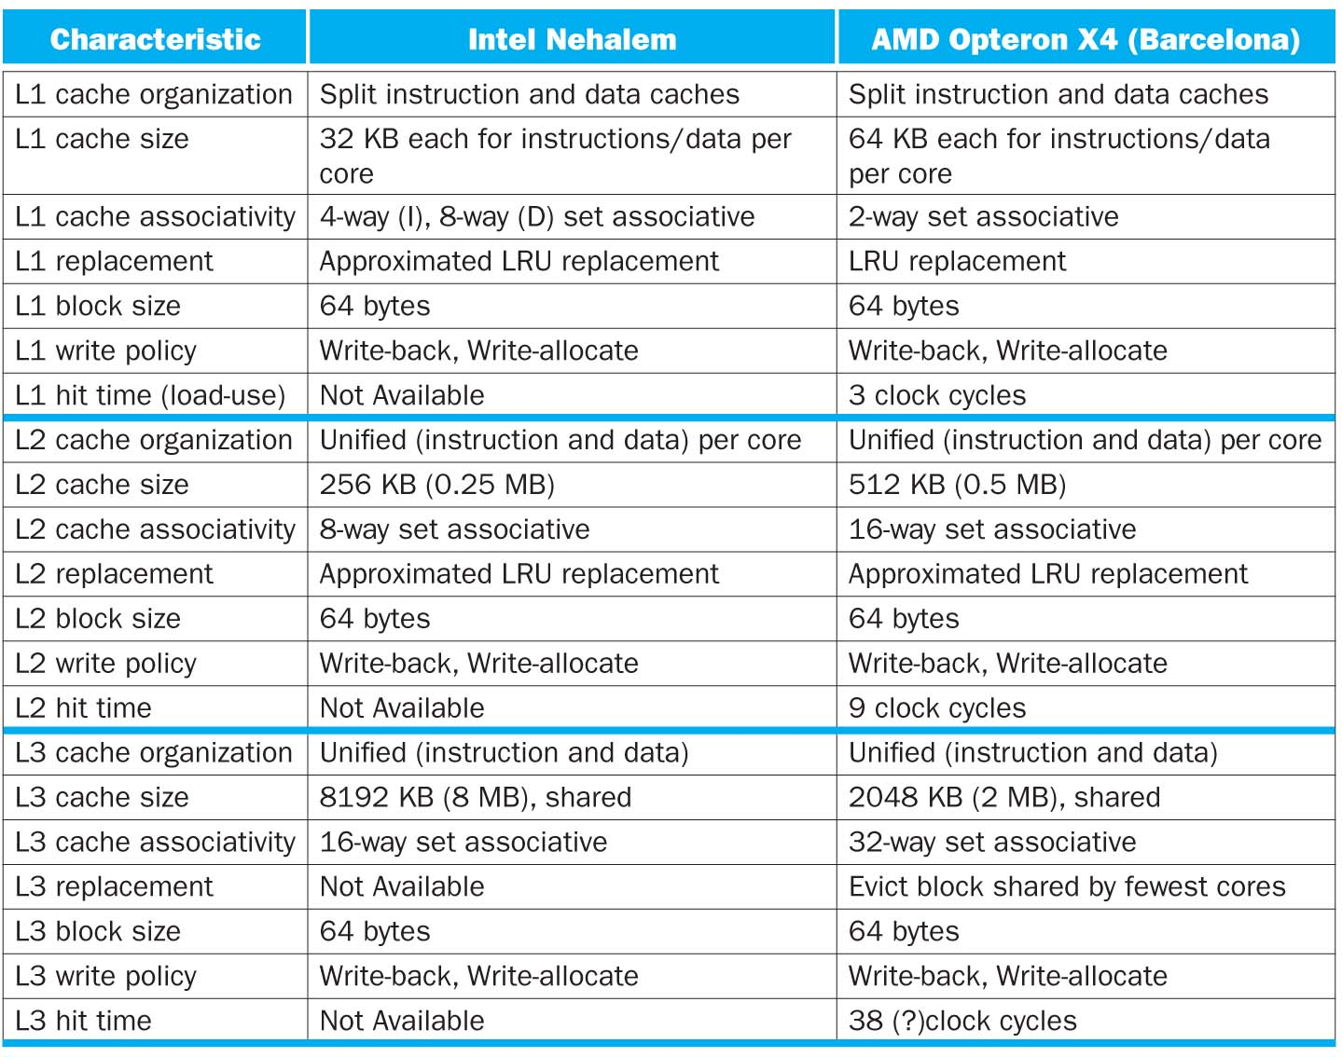

Slide 58
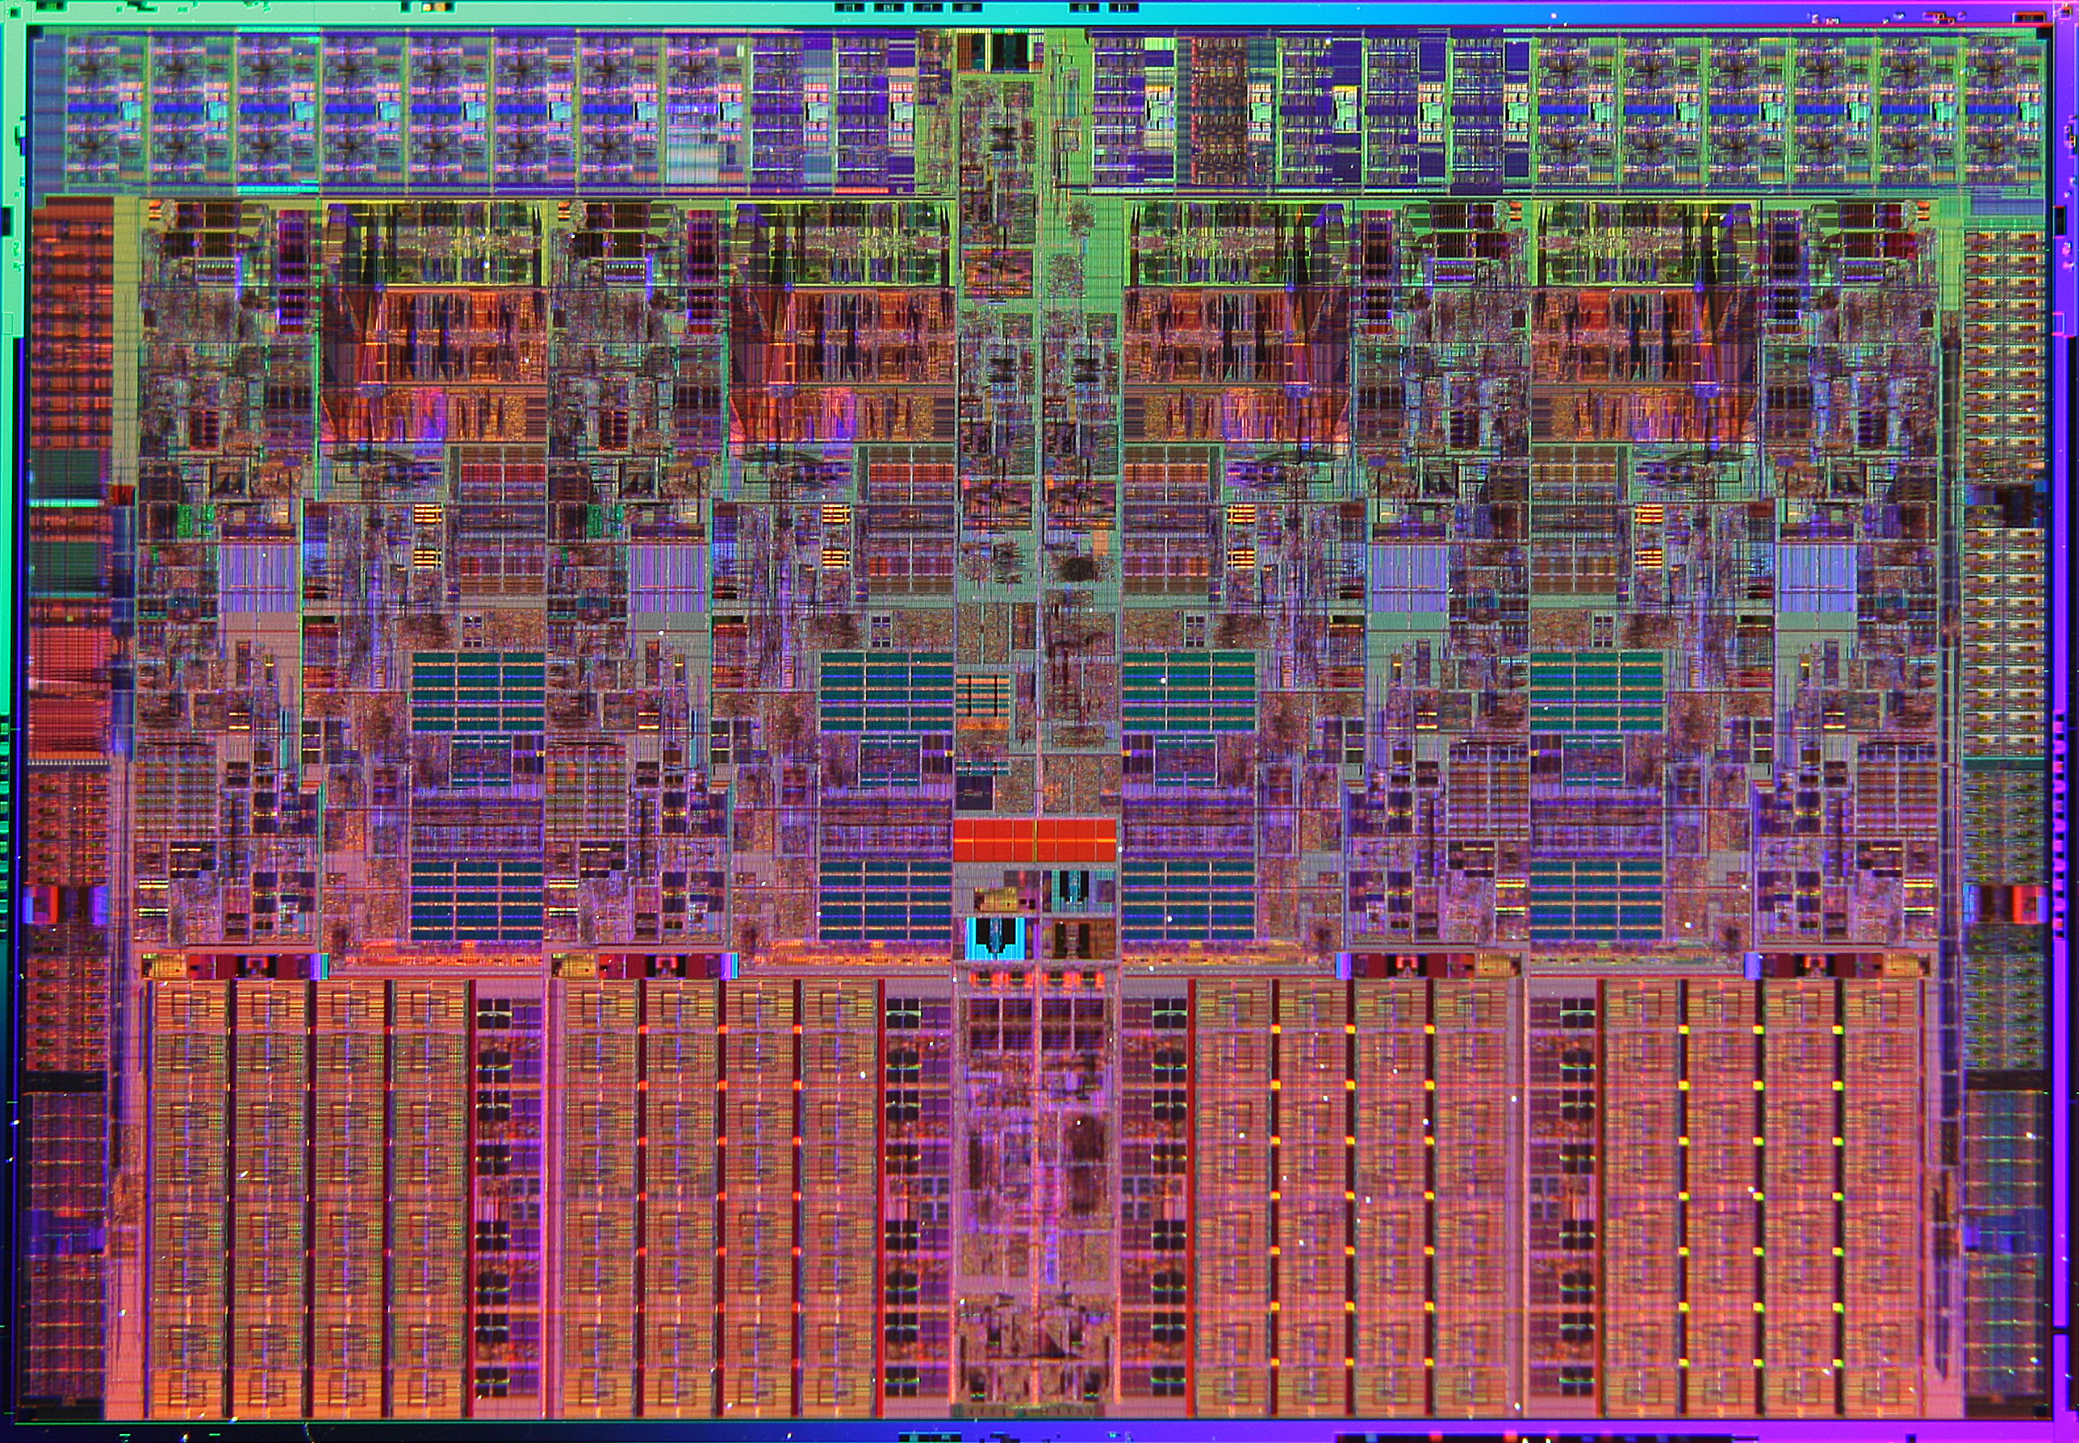
Intel Nehalem Die Photo
Memory Controller
Misc
IO
Misc
IO
13.6 mm (0.54 inch)
Core
Core
Core
Core
Memory
Queue
QPI
0
QPI
1
Shared L3 Cache
18.9 mm (0.75 inch)
Notes:
QPI – QuickPath Interconnect (for floating point)

Slide 59
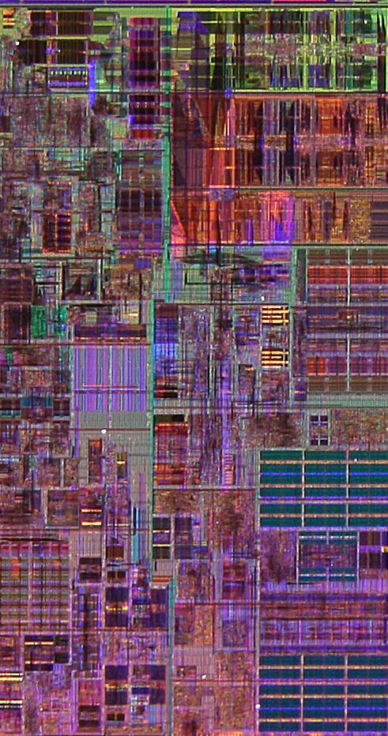
Core Area Breakdown
Memory Controller
Execution Units
32KiB I$ per core
32KiB D$ per core
512KiB L2$ per core
Share one 8-MiB L3$
L1 Data cache
L2 Cache & Interrupt Servicing
L1 Inst cache & Inst Fetch
L3 Cache
Load Store Queue

