Slide 1
CS 61C: Great Ideas in Computer Architecture (Machine Structures)
Course Summary
Instructor:
Michael Greenbaum

Slide 2
Agenda
Course Summary
Administrivia/Project 2 Results
What’s Next?
Acknowledgements

Slide 3
Review: RISC vs. CISC
RISC fundamentally changed processor design strategy.
Lots of man-hours/development funds/transistors - CISC can work
  Builds off of important RISC concepts (execution engine of CISC processor operates on RISC-like micro-ops)
You need to understand RISC before you can build CISC!
RISC still important for mobile/embedded devices.

Slide 4
Old School View of
Software-Hardware Interface
Application (ex: browser)
CS61C
Operating
Compiler
System
(Mac OSX)
Software
Assembler
Instruction Set
Architecture
Hardware
Processor
Memory
I/O system
Datapath & Control
Digital Design
Circuit Design
transistors

Slide 5

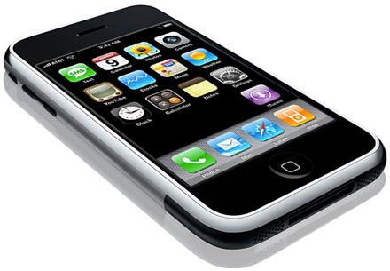


New-School Machine Structures
Today’s
Lecture
Software Hardware
Parallel Requests
  Assigned to computer
  e.g., Search “Katz”
Parallel Threads
  Assigned to core
  e.g., Lookup, Ads
Parallel Instructions
  >1 instruction @ one time
  e.g., 5 pipelined instructions
Parallel Data
  >1 data item @ one time
  e.g., Add of 4 pairs of words
Hardware descriptions
  All gates @ one time
Warehouse Scale Computer
Smart
Phone
Harness
Parallelism &
Achieve High
Performance
Computer
Core
…
Core
Memory (Cache)
Input/Output
Core
Instruction Unit(s)
Functional
Unit(s)
A₀+B₀
A₁+B₁
A₂+B₂
A₃+B₃
Main Memory
Logic Gates

Slide 6
6 Great Ideas in Computer Architecture
Layers of Representation/Interpretation
Moore’s Law
Principle of Locality/Memory Hierarchy
Parallelism
Performance Measurement & Improvement
Dependability via Redundancy

Slide 7

#1: Levels of Representation/Interpretation
High Level Language
Program (e.g., C)
temp = v[k];
v[k] = v[k+1];
v[k+1] = temp;
Compiler
Anything can be represented
as a number,
i.e., data or instructions
lw $t0, 0($2)
lw $t1, 4($2)
sw $t1, 0($2)
sw $t0, 4($2)
Assembly Language Program (e.g., MIPS)
Assembler
0000 1001 1100 0110 1010 1111 0101 1000
1010 1111 0101 1000 0000 1001 1100 0110
1100 0110 1010 1111 0101 1000 0000 1001
0101 1000 0000 1001 1100 0110 1010 1111
Machine Language Program (MIPS)
Machine Interpretation
Hardware Architecture Description
(e.g., block diagrams)
Architecture Implementation
Logic Circuit Description
(Circuit Schematic Diagrams)

Slide 8
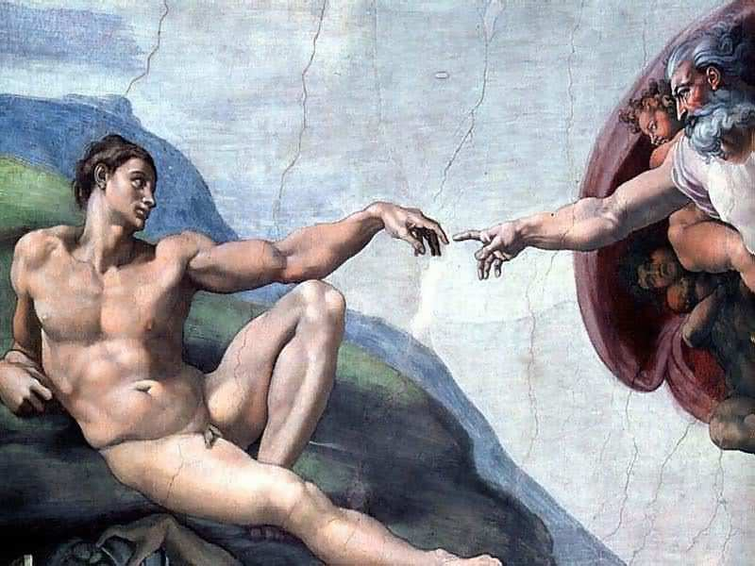
Call home, we’ve made HW/SW contact!
High Level Language
Program (e.g., C)
temp = v[k];
v[k] = v[k+1];
v[k+1] = temp;
Compiler
Anything can be represented
as a number,
i.e., data or instructions
lw $t0, 0($2)
lw $t1, 4($2)
sw $t1, 0($2)
sw $t0, 4($2)
Assembly Language Program (e.g., MIPS)
Assembler
0000 1001 1100 0110 1010 1111 0101 1000
1010 1111 0101 1000 0000 1001 1100 0110
1100 0110 1010 1111 0101 1000 0000 1001
0101 1000 0000 1001 1100 0110 1010 1111
Machine Language Program (MIPS)
Machine Interpretation
Hardware Architecture Description
(e.g., block diagrams)
Architecture Implementation
Logic Circuit Description
(Circuit Schematic Diagrams)

Slide 9
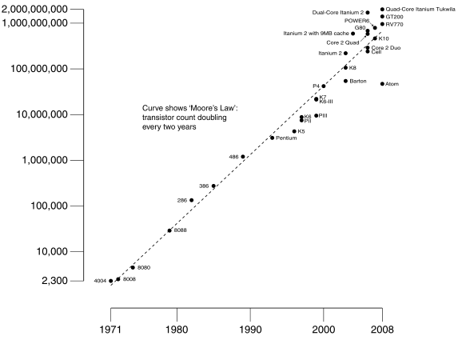
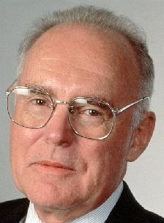
Moore’s Law
Predicts: 2X Transistors / chip every 2 years
#2:
# of transistors on an integrated circuit (IC)
Gordon Moore
Intel Cofounder
B.S. Cal 1950!
Year

Slide 10
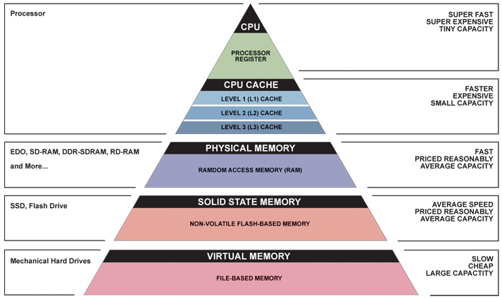
#3: Principle of Locality/
Memory Hierarchy

Slide 11
Typical Memory Hierarchy
Take advantage of the principle of locality to present the user with as much memory as is available in the cheapest technology at the speed offered by the fastest technology
On-Chip Components
Control
Instr
Cache
Second
Level
Cache
(SRAM)
Secondary
Memory
(Disk)
ITLB
Main
Memory
(DRAM)
Datapath
DTLB
Data
Cache
RegFile
Speed (%cycles): ½’s 1’s 10’s 100’s 10,000’s
Size (bytes): 100’s 10K’s M’s G’s T’s
Cost: highest lowest
Notes:
Instead, the memory system of a modern computer consists of a series of black boxes ranging from the fastest to the slowest.
Besides variation in speed, these boxes also varies in size (smallest to biggest) and cost.
What makes this kind of arrangement work is one of the most important principle in computer design. The principle of locality. The principle of locality states that programs access a relatively small portion of the address space at any instant of time.
The design goal is to present the user with as much memory as is available in the cheapest technology (points to the disk).
While by taking advantage of the principle of locality, we like to provide the user an average access speed that is very close to the speed that is offered by the fastest technology.
(We will go over this slide in detail in the next lectures on caches).

Slide 12
Memory Hierarchy
Caches
  3Cs: Compulsory/Capacity/Conflict misses
  Direct-mapped vs. Set-associative
  Multi-level caches for fast clock + low miss rate
Virtual Memory
  Originally small physical memory that appears to be very large
  Modern: provide isolation through separated address spaces

Slide 13
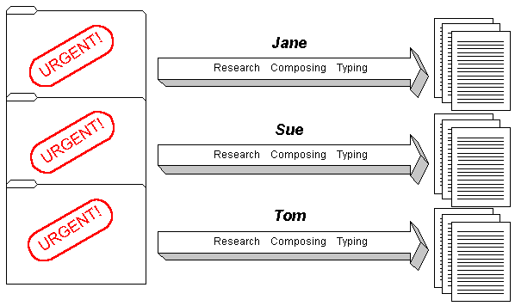
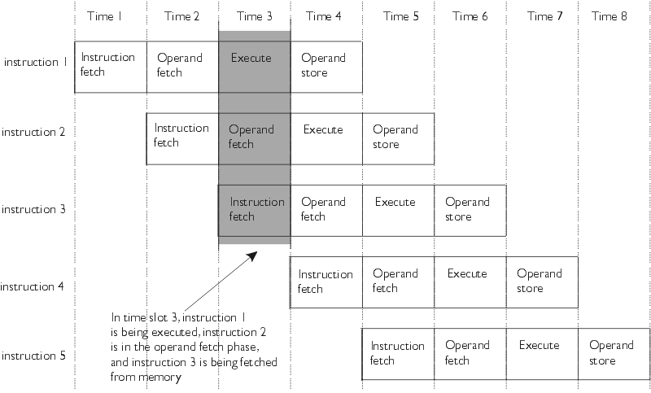
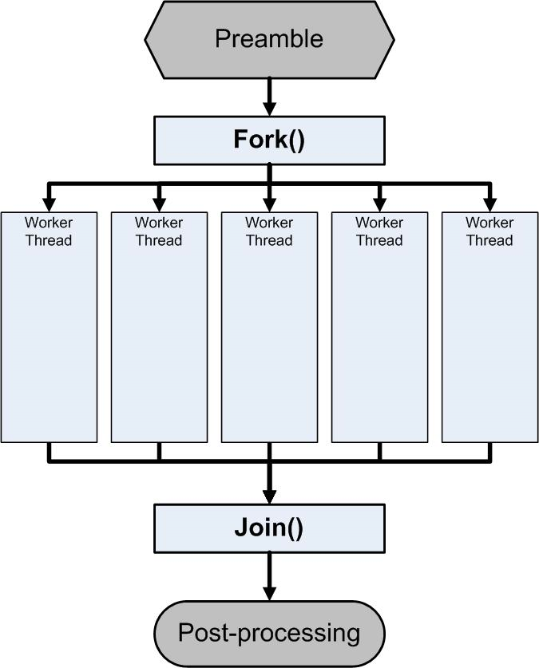
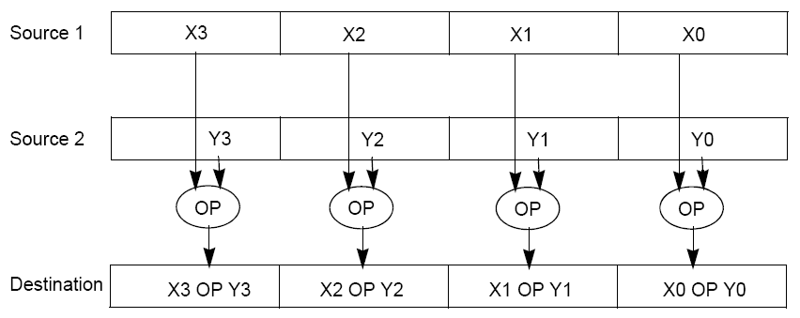
#4: Parallelism

Slide 14
Forms of Parallelism
Instruction Parallelism
  Processor pipeline: multiple instructions in execution at the same time
Task Parallelism
  Synchronization primitives, openMP
  Modern web services
Data Parallelism
  Map-Reduce, SIMD instruction set
  Data and numerically intensive processing

Slide 15
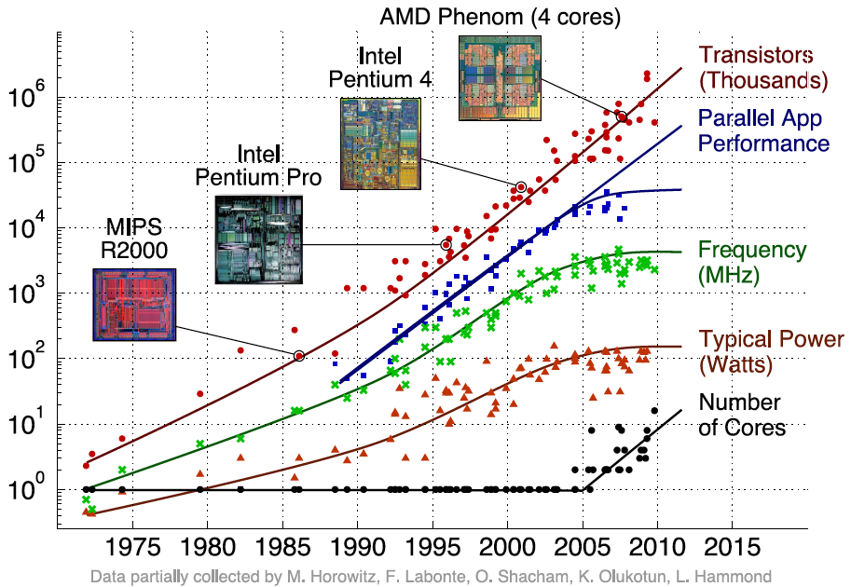
Transition to Multicore
Sequential App Performance

Slide 16
Parallelism - The Challenge
Only path to performance is parallelism
  Clock rates flat or declining
Key challenge is to craft parallel programs that have high performance on multiprocessors as the number of processors increase – i.e., that scale
  Scheduling, load balancing, time for synchronization, overhead for communication
Project #2: fastest matrix multiply code on 8 processor (8 cores) computers
  2 chips (or sockets)/computer, 4 cores/chip

Slide 17
Great Idea #5: Performance Measurement and Improvement
Matching application to underlying hardware to exploit:
  Memory system
  SIMD, hardware features
Parallel speedup
  Amdahl’s law
Measuring hardware performance
  AMAT, CPI, performance and power benchmarks.

Slide 18
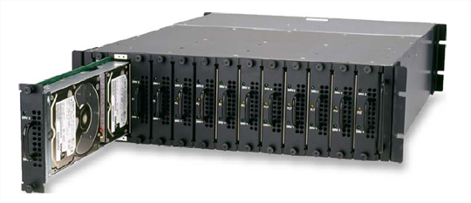
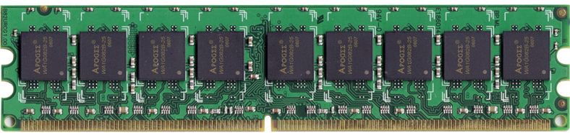
Great Idea #6:
Dependability via Redundancy
Applies to everything from datacenters to storage to memory
  Redundant datacenters so that can lose 1 datacenter but Internet service stays online
  Redundant disks so that can lose 1 disk but not lose data (Redundant Arrays of Independent Disks/RAID)
  Redundant memory bits of so that can lose 1 bit but no data (Error Correcting Code/ECC Memory)

Slide 19
Course Summary
As the field changes, cs61c has to change too!
It is still about the software-hardware interface
  Programming for performance!
  Understanding the memory hierarchy and its impact on application performance
  Unlocking the capabilities of the architecture for performance
    Multicore programming and task parallelism
    Special instructions
    Special instruction sequences

Slide 20
Agenda
Course Summary
Administrivia/Project 2 Results
What’s Next?
Acknowledgements

Slide 21
Administrivia
Extra OH
  Come into the SD lab today wherever there’s a blank sign-up time.
  Sean: After 8pm in the SD lab...
Project 3 Face-to-Face grading today 200 SD lab. Don’t forget to show up!
Final Exam - Tomorrow! 9am - 12pm 2050 VLSB
  Two-sided handwritten cheat sheet. Green sheet provided.
    Use the back side of your midterm cheat sheet!
  Final is long. Planning for 190 minutes, might give extra time if enough people don’t finish. Show up at 9 am sharp!

Slide 22
Administrivia
CS61c Final Feedback Survey
  Chance to give feedback on this “new” 61c
    First time it’s been offered during the summer
  What worked and what didn’t?
  I’ll send out the link after the final…

Slide 23
Project 2 Results: sgemm-small

Slide 24
Project 2 Results: sgemm-all

Slide 25
Project 2 Results: sgemm-openmp

Slide 26
Project 2 EC Winners
Only 3 extra credit submissions…
  (EC due at same time as part 2, sorry about that…)
Serial Winners:
1. 11.4 Gflop/s Jonathan Dinu, Elan Frenkel
1. 11.4 Gflop/s Julien Freche, Simon Relet
3. 11.2 Gflop/s Nils Adiceam, Thibault Hartmann, Victor Degliame
Didn’t submit, but still fast:
11.9 Gflop/s Jiajun Wu, Terence Yuen
11.3 Gflop/s Albert Magyar
11.2 Gflop/s Edmond Lo, Jiasi Shen

Slide 27
Project 2 EC Winners
Parallel Winners:
1. 79.8Gflop/s Jonathan Dinu, Elan Frenkel
2. 74.9Gflop/s Julien Freche, Simon Relet
3. 69.2Gflop/s Nils Adiceam, Thibault Hartmann, Victor Degliame
Didn’t submit, but still fast:
78.9 Gflop/s John Song, Trung Nguyen

Slide 28
Agenda
Course Summary
Administrivia/Project 2 Results
What’s Next?
Acknowledgements

Slide 29
What’s Next?
What classes should I take (now)?
Take classes from great teachers! (teacher > class)
  Distinguished Teaching Award (very hard to get)
  HKN Course evaluations (≥6 is very good)
  EECS web site has plan for year (up in late spring)
If have choice of multiple great teachers
  CS152 Computer Architecture & Engin. (Sp12)
  CS162 Operating Systems and Systems Programming
  CS164 Programming Languages and Compilers
  CS267 Applications of Parallel Computers (Sp12)

Slide 30
What’s Next?
If you did well in CS3 or 61[ABC]
(A- or above) and want to be on staff?
  Usual path: Lab Assistant => Reader => TA
  Also: Self-Paced Center Tutor
  Apply as Lab Assistant by emailing instructor before course
  Reader/TA Applications available on EECS website

Slide 31
Taking advantage of Cal Opportunities
Why we are a top university in the WORLD?
  Research, research, research!
  Whether you want to go to grad school or industry, you need someone to vouch for you!
Techniques
  Find out what you like, do lots of web research (read published papers), hit OH of Prof, show enthusiasm & initiative

Slide 32
Dan’s Opportunities
GamesCrafters (Game Theory R & D)
  Develop SW, analysis on 2-person games of no chance. (e.g., go, chess, connect-4, nim, etc.)
  Req: ≥ A- in CS61C, Game Theory / SW Interest
UCBUGG (Recreational Graphics)
  Develop computer-generated images, animations.
  Req: 3D interest
  Taught as a DeCal by UCBUGG veterans

Slide 33
Agenda
Course Summary
Administrivia/Project 2 Results
What’s Next?
Acknowledgements

Slide 34
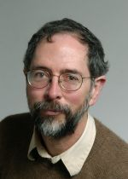
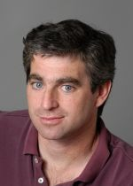
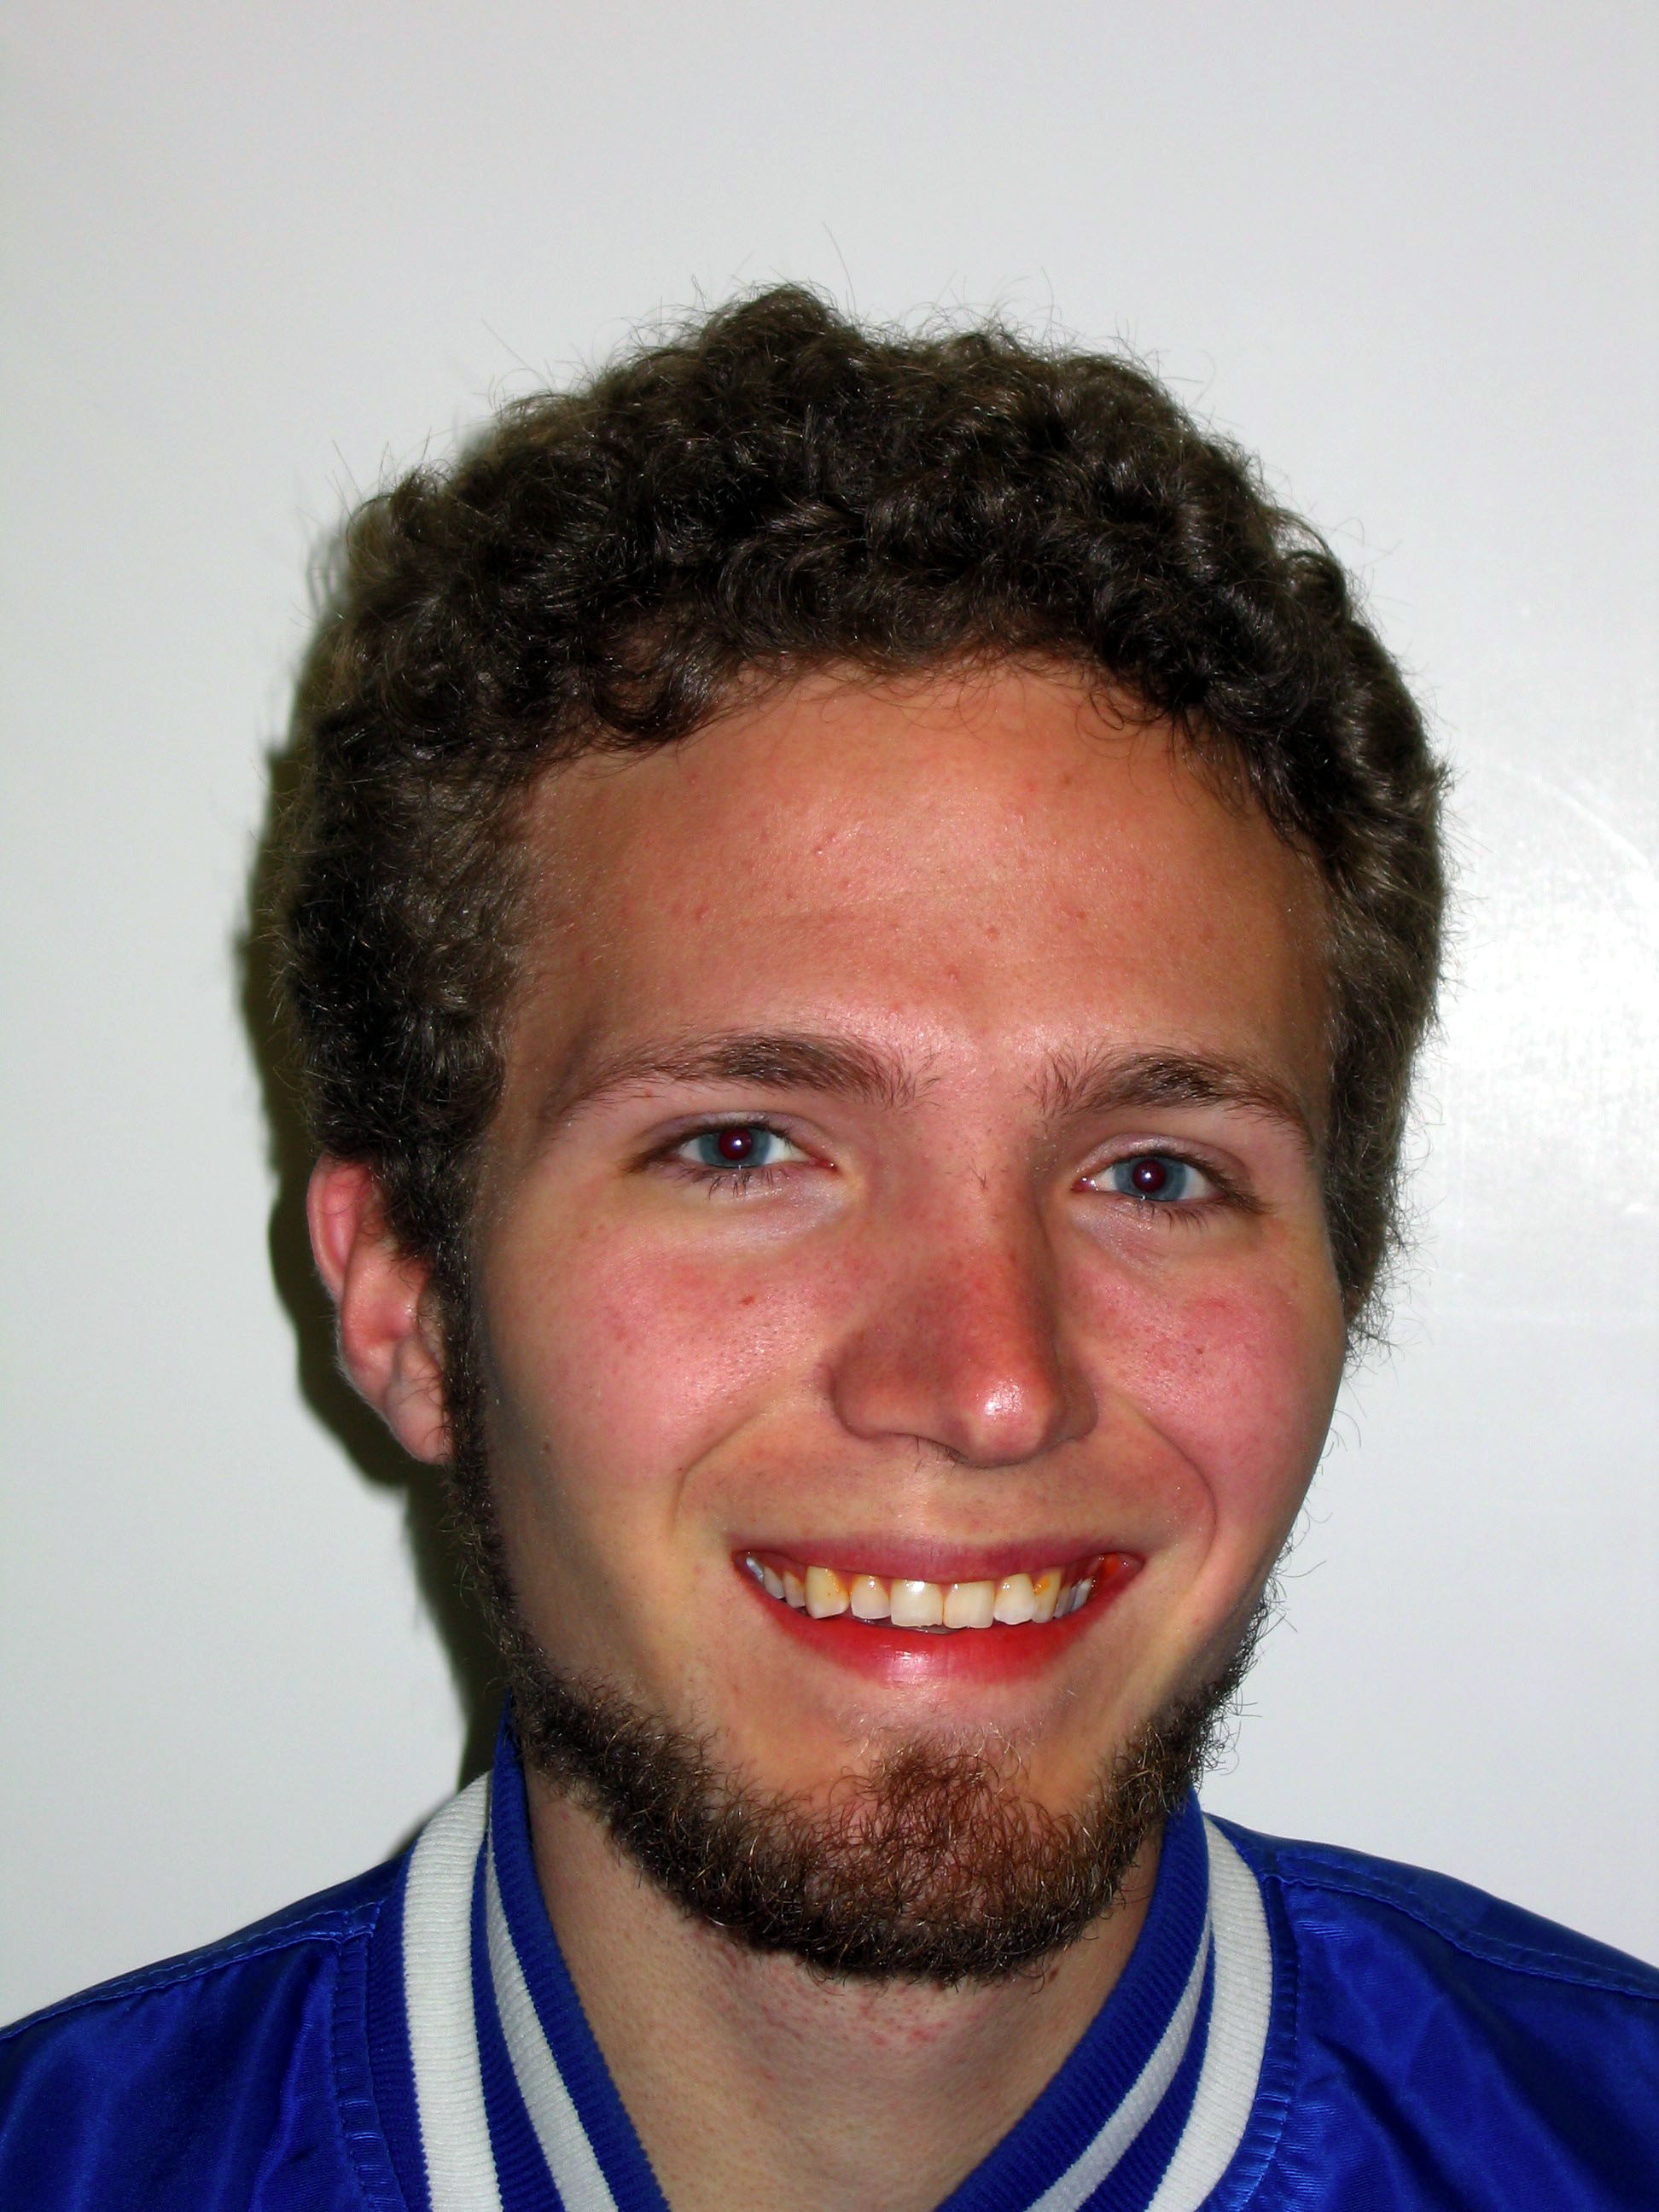
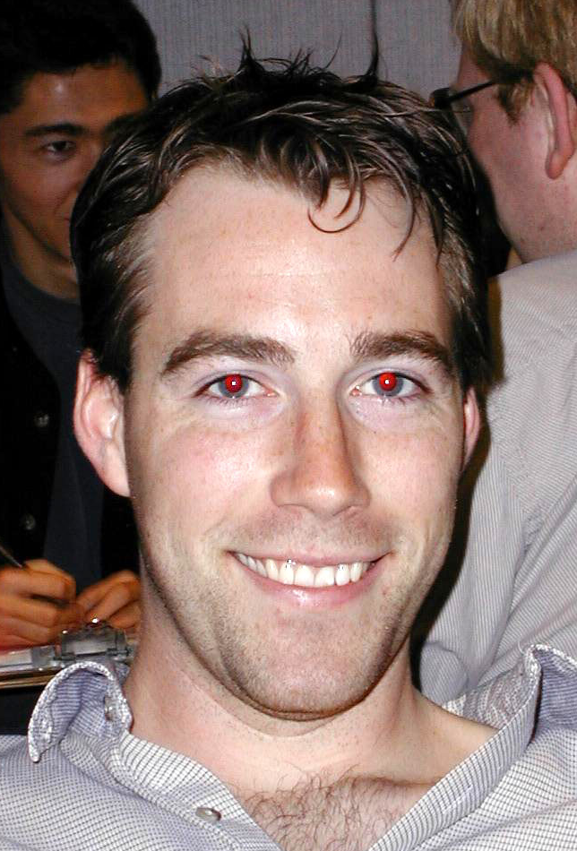
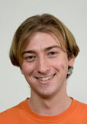
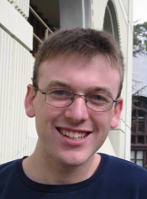
“I stand on the shoulders of giants…”
Lecturer SOE
Mike Clancy
Prof
David Culler
TA
Andy Carle
TA
Kurt Meinz
TA
David Jacobs
TA
Jeremy Huddleston
Thanks to these talented folks (& many others) whose contributions have helped make CS61C a really tremendous course!

Slide 35
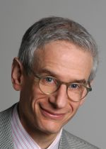
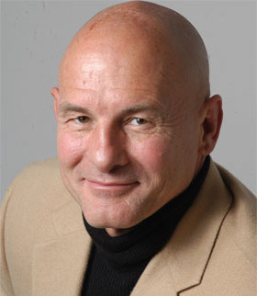
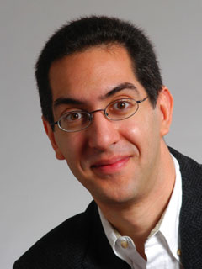
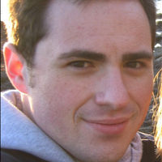
Extra Special Thanks
Prof
Randy Katz
Prof
David Patterson
2010 Summer Instructor
Paul Pearce
Lecturer SOE
Dan Garcia

Slide 36
Special Thanks to the Staff:
TAs:
Justin Hsia
Sean Soleyman
Alvin Yuan
Readers:
Ken Cheng, Leah Dorner, Amanda Ren
Lab Assistants:
Kevin Shih, Edwin Liao

Slide 37
The Future for Future Cal Alumni
What’s The Future?
New Century, Many New Opportunities: Parallelism, Cloud, Statistics + CS, Bio + CS, Society (Health Care, 3rd world) + CS
Cal heritage as future alumni
  Hard Working / Can do attitude
  Never Give Up (“Don’t fall with the ball!” - cf. The Play)
“The best way to predict the future is to invent it” – Alan Kay (inventor of personal computing vision)
The Future is up to you!

