Slide 1
CS 61C: Great Ideas in Computer Architecture (Machine Structures)
Warehouse-Scale Computers and the Cloud
Instructor:
Michael Greenbaum

Slide 2
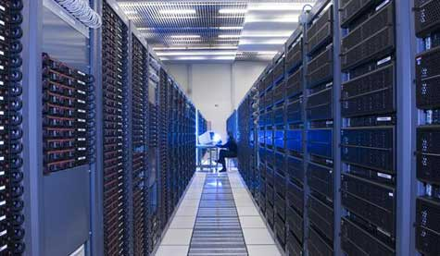



New-School Machine Structures
(It’s a bit more complicated!)
Today’s Lecture
Software Hardware
Parallel Requests
  Assigned to computer
  e.g., Search “Katz”
Parallel Threads
  Assigned to core
  e.g., Lookup, Ads
Parallel Instructions
  >1 instruction @ one time
  e.g., 5 pipelined instructions
Parallel Data
  >1 data item @ one time
  e.g., Add of 4 pairs of words
Hardware descriptions
  All gates @ one time
Warehouse Scale Computer
Smart
Phone
Harness
Parallelism &
Achieve High
Performance
Computer
Core
…
Core
Memory (Cache)
Input/Output
Core
Instruction Unit(s)
Functional
Unit(s)
A₀+B₀
A₁+B₁
A₂+B₂
A₃+B₃
Main Memory
Logic Gates

Slide 3
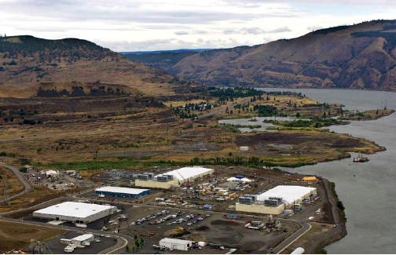
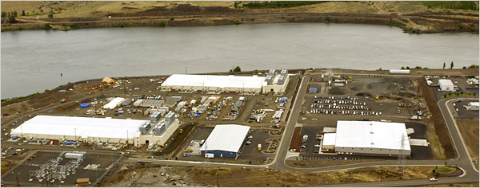
Google’s Oregon
Warehouse-Scale Computer

Slide 4
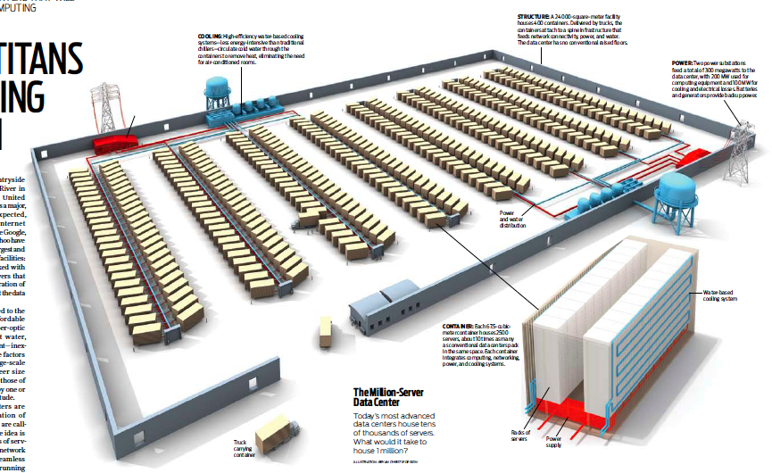
One Million Servers:
400 Containers x 2500 Nodes
Notes:
24000 sq. m housing 400 containers
Each container contains 2500 servers
Integrated computing, networking, power, cooling systems
300 MW supplied from two power substations situated on opposite sides of the datacenter
Dual water-based cooling systems circulate cold water to containers, eliminating need for air conditioned rooms

Slide 5
Agenda
Cloud Computing
Administrivia
Warehouse Scale Computers
Break
Power Usage Effectiveness
WSC Costs
Request Level Parallelism (If time)

Slide 6

The Big Switch: Utility Computing
“A hundred years ago, companies stopped generating their own power with steam engines and dynamos and plugged into the newly built electric grid. The cheap power pumped out by electric utilities didn’t just change how businesses operate. It set off a chain reaction of economic and social transformations that brought the modern world into existence. Today, a similar revolution is under way. Hooked up to the Internet’s global computing grid, massive information-processing plants have begun pumping data and software code into our homes and businesses. This time, it’s computing that’s turning into a utility.”

Slide 7
Cloud Computing
“Delivery of computer services from vast warehouses of shared machines—enables cutting of costs by handing over the running of applications and services to a third party, then accessed over the internet. There are advantages for customers (lower cost, less complexity) and service providers (economies of scale). But customers risk losing control, in particular over their data, as they migrate into the cloud. Moving from one service provider to another could be even more difficult than switching between software packages in the old days.”—The Economist, May 28, 2009

Slide 8
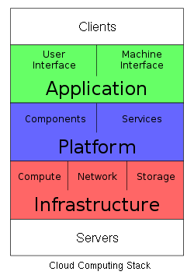
Cloud Services
SaaS: deliver apps over Internet, eliminating need to install/run on customer's computers, simplifying maintenance and support
  E.g., Google Docs, Win Apps in the Cloud
PaaS: deliver computing “stack” as a service, using cloud infrastructure to implement apps. Deploy apps without cost/complexity of buying and managing underlying layers
  E.g., Hadoop on EC2, Google App Engine
IaaS: Rather than purchasing servers, sw, DC space or net equipment, clients buy resources as an outsourced service. Billed on utility basis. Amount of resources consumed/cost reflect level of activity
  E.g., EC2

Slide 9
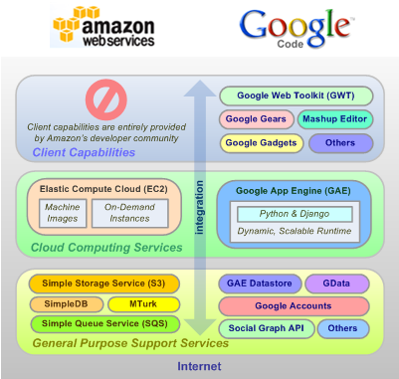
Alternate Service Stacks

Slide 10
Cloud Distinguished by …
Shared platform with illusion of isolation
  Collocation with other tenants
  Exploits technology of VMs and hypervisors
  At best “fair” allocation of resources, but not true isolation
Attraction of low-cost cycles
  Economies of scale driving move to consolidation
  Multiplexing of resources to achieve high utilization/efficiency
Elastic service
  Pay for what you need, get more when you need it
  But no performance guarantees: assumes uncorrelated demand for resources
  Amazon EC2 - Elastic Compute Cluster.

Slide 11
Economics For Cloud Users
Pay by use instead of provisioning for peak
Capacity
Resources
Resources
Demand
Capacity
Demand
Time
Time
Static data center
Data center in the cloud
Unused resources

Slide 12
Economics For Cloud Users
Risk of over-provisioning: underutilization
Capacity
Unused resources
Resources
Demand
Time
Static data center

Slide 13

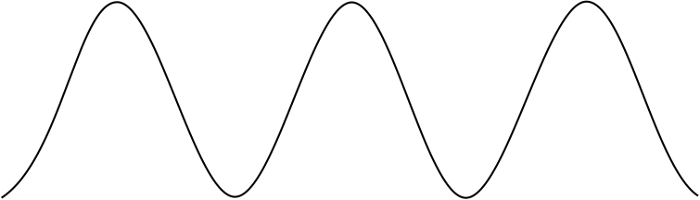
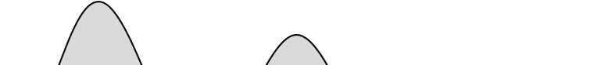

Economics For Cloud Users
Heavy penalty for under-provisioning
Resources
Capacity
Demand
Resources
Capacity
1
2
3
Time (days)
Demand
Lost revenue
1
2
3
Time (days)
Resources
Capacity
Demand
1
2
3
Time (days)
Lost users

Slide 14
Scale Economics For Cloud Providers
5-7x economies of scale
Extra benefits
  Amazon: utilize off-peak capacity
  Microsoft: sell .NET tools
  Google: reuse existing infrastructure
Resource | Cost in Medium DC | Cost in Very Large DC | Ratio
Network | $95 / Mbps / month | $13 / Mbps / month | 7.1x
Storage | $2.20 / GB / month | $0.40 / GB / month | 5.7x
Administration | ≈140 servers/admin | >1000 servers/admin | 7.1x

Slide 15
Agenda
Cloud Computing
Administrivia
Warehouse Scale Computers
Power Usage Effectiveness
WSC Costs
Request Level Parallelism (If time)

Slide 16
Warehouse Scale Computers
Massive scale datacenters: 10,000 to 100,000 servers + networks to connect them together
Very highly available: <1 hour down/year
  Must cope with failures common at scale
Differ from classic Datacenter because of:
  Homogeneous hardware/software, infrastructure
  Offer small number of very large applications (Internet services): search, social networking, video sharing

Slide 17
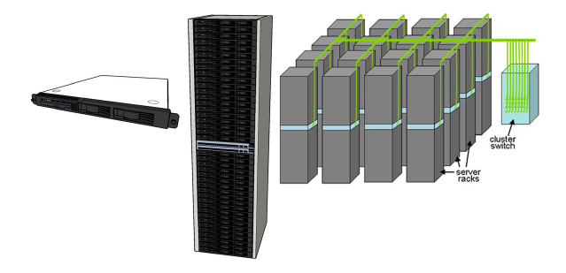
Equipment Inside a WSC
Server (in rack format):
1 ¾ inches high “1U”,
x 19 inches x 16-20 inches: 8 cores, 16 GB DRAM, 4x1 TB disk
Array (aka cluster):
16-32 server racks + larger local area network switch (“array switch”)
7 foot Rack: 40-80 servers + Ethernet local area network (1-10 Gbps) switch in middle (“rack switch”)

Slide 18
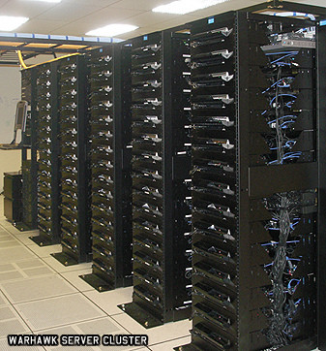
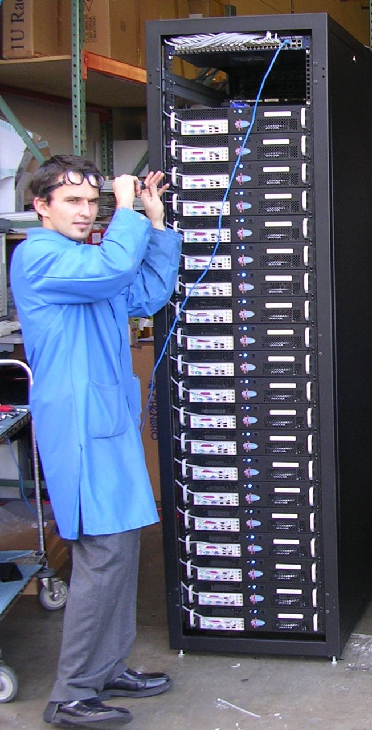
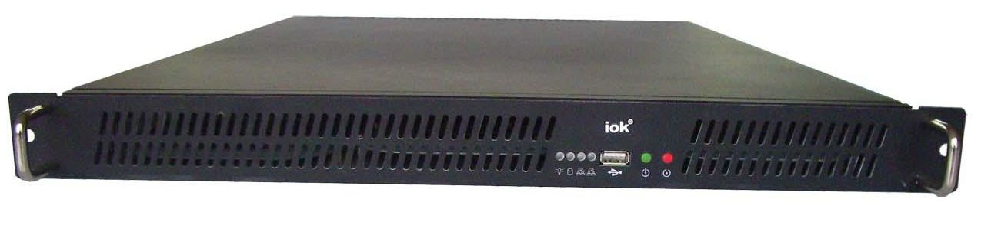
Server, Rack, Array

Slide 19
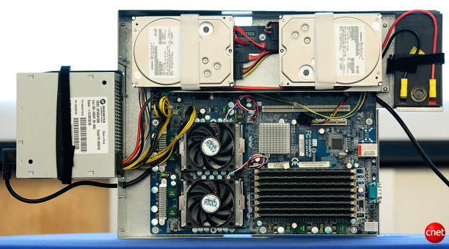
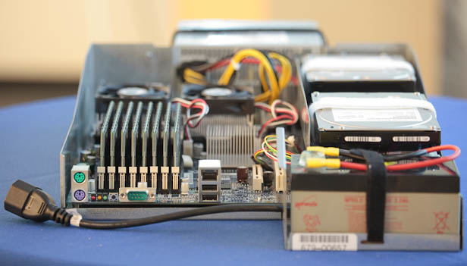
Google Server Internals
Google Server
Notes:
Most companies buy servers from the likes of Dell, Hewlett-Packard, IBM, or Sun Microsystems. But Google, which has hundreds of thousands of servers and considers running them part of its core expertise, designs and builds its own. Ben Jai, who designed many of Google's servers, unveiled a modern Google server before the hungry eyes of a technically sophisticated audience.
Google's big surprise: each server has its own 12-volt battery to supply power if there's a problem with the main source of electricity. The company also revealed for the first time that since 2005, its data centers have been composed of standard shipping containers--each with 1,160 servers and a power consumption that can reach 250 kilowatts.
It may sound geeky, but a number of attendees--the kind of folks who run data centers packed with thousands of servers for a living--were surprised not only by Google's built-in battery approach, but by the fact that the company has kept it secret for years. Jai said in an interview that Google has been using the design since 2005 and now is in its sixth or seventh generation of design.
Read more: http://news.cnet.com/8301-1001_3-10209580-92.html#ixzz0yo8bhTOH

Slide 20
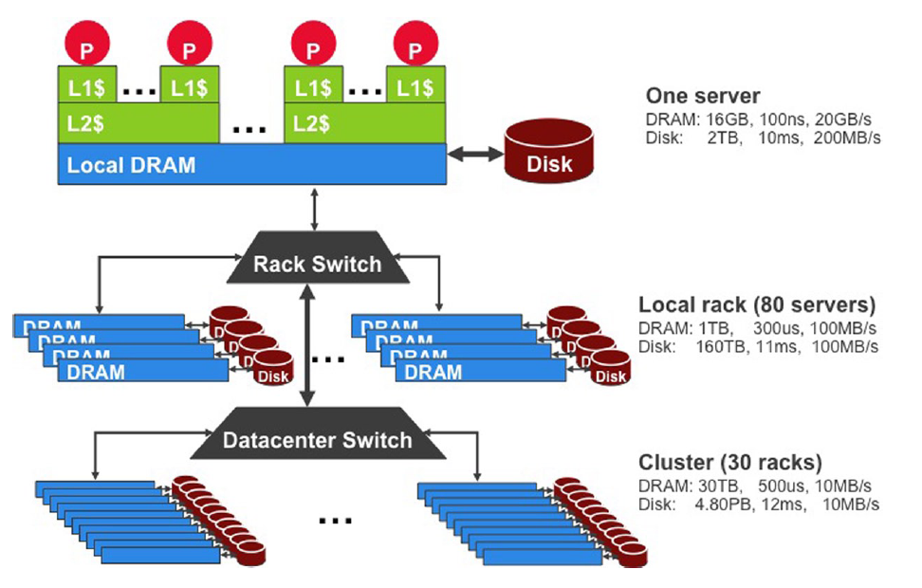
Processing Infrastructure

Slide 21
Coping with Performance in Array
Lower latency to DRAM in another server than local disk
Higher bandwidth to local disk than to DRAM in another server
 | Local | Rack | Array
Racks | -- | 1 | 30
Servers | 1 | 80 | 2400
Cores (Processors) | 8 | 640 | 19,200
DRAM Capacity (GB) | 16 | 1,280 | 38,400
Disk Capacity (GB) | 4,000 | 320,000 | 9,600,000
DRAM Latency (microseconds) | 0.1 | 100 | 300
Disk Latency (microseconds) | 10,000 | 11,000 | 12,000
DRAM Bandwidth (MB/sec) | 20,000 | 100 | 10
Disk Bandwidth (MB/sec) | 200 | 100 | 10

Slide 22
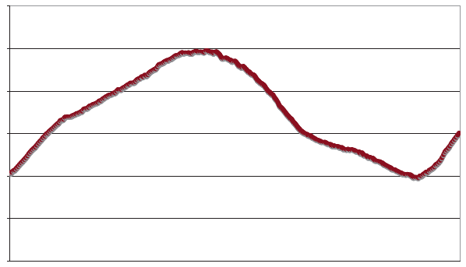
Coping with Workload Variation
Workload
2X
Midnight
Noon
Midnight
Online service: Peak usage 2X off-peak

Slide 23
Impact of latency, bandwidth, failure, varying workload on WSC software?
WSC Software must take care where it places data within an Array to get good performance
WSC Software must cope with failures gracefully
WSC Software must scale up and down gracefully in response to varying demand
More elaborate hierarchy of memories, failure tolerance, workload accommodation makes
WSC software development more challenging than software for single computer

Slide 24
Administrivia
No lab today- Work on project, study for final, etc. TAs will be there.
  Lab 12 due during this lab!
Sign up for project 3 face-to-face grading.
  In 200 SD, Wednesday, 8/10.
Final Review - Monday, 8/8, 4pm-6pm, 277 Cory.
Final Exam - Thursday, 8/11, 9am - 12pm 2050 VLSB
  Two-sided handwritten cheat sheet. Green sheet provided.
    Use the back side of your midterm cheat sheet!

Slide 25
Agenda
Cloud Computing
Administrivia
Power Usage / Efficiency
Break
Power Usage Effectiveness
WSC Costs
Request Level Parallelism (If time)

Slide 26
Emphasis on Cost Efficiency
WSCs must scale to increasing customer demand, increasing complexity of problems to solve.
More computing power usually => better product.
Focus on cost efficiency to afford as much computation as possible.
  Power consumption is a dominant cost.

Slide 27
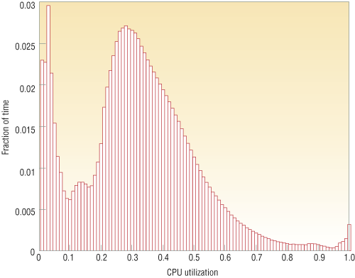
Energy Proportional Computing
“The Case for
Energy-Proportional
Computing,”
Luiz André Barroso,
Urs Hölzle,
IEEE Computer
December 2007
It is surprisingly hard
to achieve high levels
of utilization of typical
servers (and your home
PC or laptop is even
worse)
Figure 1. Average CPU utilization of more than 5,000 servers during a six-month period. Servers
are rarely completely idle and seldom operate near their maximum utilization, instead operating
most of the time at between 10 and 50 percent of their maximum

Slide 28
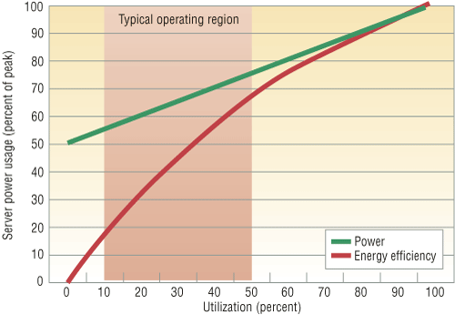
Energy Proportional Computing
“The Case for
Energy-Proportional
Computing,”
Luiz André Barroso,
Urs Hölzle,
IEEE Computer
December 2007
Doing nothing well …
NOT!
Energy Efficiency =
Utilization/Power
Figure 2. Server power usage and energy efficiency at varying utilization levels, from idle to
peak performance. Even an energy-efficient server still consumes about half its full power
when doing virtually no work.

Slide 29
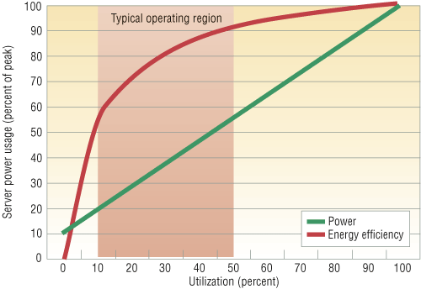
Energy Proportional Computing
“The Case for
Energy-Proportional
Computing,”
Luiz André Barroso,
Urs Hölzle,
IEEE Computer
December 2007
Doing nothing
VERY well
Design for
wide dynamic
power range and
active low power
modes
Energy Efficiency =
Utilization/Power
Figure 4. Power usage and energy efficiency in a more energy-proportional server. This
server has a power efficiency of more than 80 percent of its peak value for utilizations of
30 percent and above, with efficiency remaining above 50 percent for utilization levels as
low as 10 percent.

Slide 30
Server Power Consumption
Peak
Power %

Slide 31
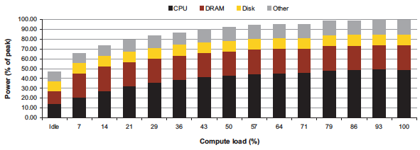
Power vs. Server Utilization by Component

Slide 32
Agenda
Cloud Computing
Administrivia
Warehouse Scale Computers
Break
Power Usage Effectiveness
WSC Costs
Request Level Parallelism (If time)

Slide 33
Agenda
Cloud Computing
Administrivia
Warehouse Scale Computers
Break
Power Usage Effectiveness
WSC Costs
Request Level Parallelism (If time)

Slide 34
Power Usage Effectiveness
Overall WSC Energy Efficiency: amount of computational work performed divided by the total energy used in the process
Power Usage Effectiveness (PUE):
Total building power / IT equipment power
  An power efficiency measure for WSC, not including efficiency of servers, networking gear
  1.0 => perfection
  e.g. 2.0 => half of WSC energy spent on infrastructure overhead.

Slide 35
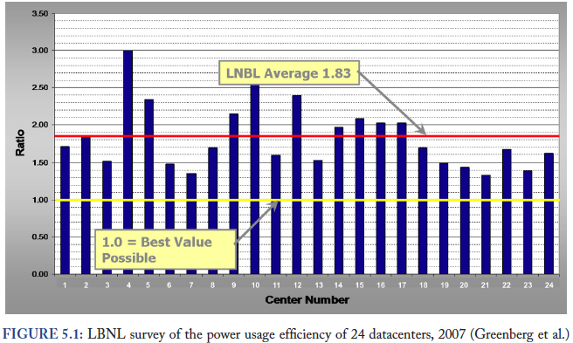
PUE in the Wild (2007)

Slide 36
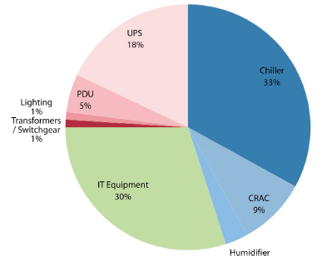
High PUE: Where Does Power Go?
Uninterruptable
Power Supply
(battery)
Chiller cools warm
water from Air
Conditioner
Power
Distribution
Unit
Computer
Room
Air
Conditioner
Servers +
Networking

Slide 37
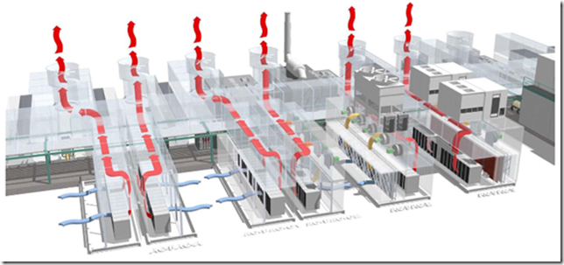
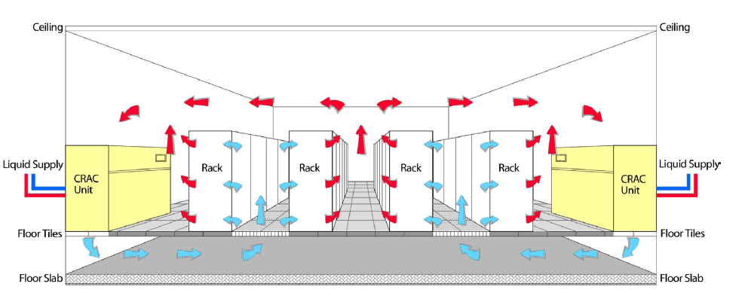
DC Infrastructure Energy Efficiencies
Cooling (Air + Water movement) + Power Distribution

Slide 38
Google WSC A PUE: 1.24
Careful air flow handling
Don’t mix server hot air exhaust with cold air (separate warm aisle from cold aisle)
Short path to cooling so little energy spent moving cold or hot air long distances
Keeping servers inside containers helps control air flow

Slide 39
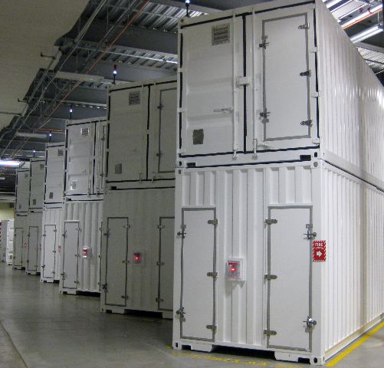
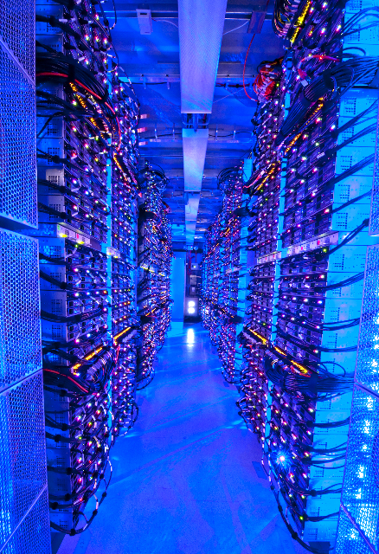
Containers in WSCs
Inside WSC
Inside Container

Slide 40
Google WSC A PUE: 1.24
Elevated cold aisle temperatures
81°F instead of traditional 65°- 68°F
Found reliability OK if run servers hotter
Use of free cooling
Cool warm water outside by evaporation in cooling towers
Locate WSC in moderate climate so not too hot or too cold

Slide 41
Google WSC A PUE: 1.24
Per-server 12-V DC UPS
Rather than WSC wide UPS, place single battery per server board
Increases WSC efficiency from 90% to 99%
Measure vs. estimate PUE, publish PUE, and improve operation

Slide 42
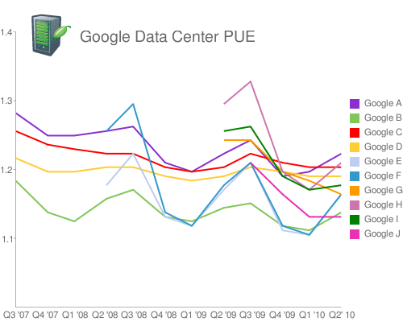
Google WSC PUE: Quarterly Avg
PUE
www.google.com/corporate/green/datacenters/measuring.htm

Slide 43
Agenda
Cloud Computing
Administrivia
Warehouse Scale Computers
Break
Power Usage Effectiveness
WSC Costs
Request Level Parallelism (If time)

Slide 44
Design Goals of a WSC
Unique to Warehouse-scale
  Ample parallelism:
    Lots of independent requests. Request-Level Parallelism
    Large data sets with processing that can be done on each element independently. Data-Level Parallelism
  Scale and its Opportunities/Problems
    Price breaks are possible from purchases of very large numbers of commodity servers
    Must also prepare for high component failures
  Operational Costs Count:
    Cost of equipment purchases << cost of ownership

Slide 45
WSC Case Study
Server Provisioning
WSC Power Capacity |  | 8.00 | MW
Power Usage Effectiveness (PUE) | 1.50
IT Equipment Power Share | 0.67 | 5.36 | MW
Power/Cooling Infrastructure | 0.33 | 2.64 | MW
IT Equipment Measured Peak (W) | 145.00
Assume Average Pwr @ 0.8 Peak | 116.00
# of Servers |  | 46000
# of Servers per Rack | 40.00
# of Racks |  | 1150
Top of Rack Switches |  | 1150
# of TOR Switch per L2 Switch | 16.00
# of L2 Switches |  | 72
# of L2 Switches per L3 Switch | 24.00
# of L3 Switches |  | 3
Internet
L3 Switch
L2 Switch
…
TOR Switch
Server
Rack …

Slide 46
WSC Case Study
Capital Expenditure (Capex)
Facility cost and total IT cost about the same
Facility Cost |  | $88,000,000
Total Server Cost | $1,450 | $66,700,000
TOR Switch Cost | $1,400 | $1,610,000
L2 Switch Cost | $140,000 | $10,080,000
L3 Switch Cost | $280,000 | $840,000
Total Network Cost |  | $12,530,000
Total Cost |  | $167,230,000

Slide 47
Cost of WSC
US account practice allow converting Capital Expenditure (CAPEX) into Operational Expenditure (OPEX) by amortizing costs over time period
  Servers 3 years
  Networking gear 4 years
  Facility 10 years

Slide 48
WSC Case Study
Operational Expense (Opex)
Years
Amortization
Monthly Cost
Amortized
Capital
Expense
Server | 3 | $66,700,000 | $2,000,000 | 55%
Network | 4 | $12,530,000 | $295,000 | 8%
Facility |  | $88,000,000
Pwr&Cooling | 10 | $72,160,000 | $625,000 | 17%
Other | 10 | $15,840,000 | $140,000 | 4%
Amortized Cost |  |  | $3,060,000
Power (8MW) |  | $0.07 | $475,000 | 13%
People (3) |  |  | $85,000 | 2%
Total Monthly |  |  | $3,620,000 | 100%
Operational
Expense
$/kWh
  Monthly Power costs
    $475k for electricity
    $625k + $140k to amortize facility power distribution and cooling

Slide 49
How much does a watt cost in a WSC?
8 MW facility
Amortized facility, including power distribution and cooling is $625k + $140k = $765k
Monthly Power Usage = $475k
$/Year = ($765k+$475k)*12/8M = $1.86 or about $2 per year
To save a watt, if spend more than $2 a year, lose money

Slide 50
Replace Rotating Disks with Flash?
Flash is non-volatile semiconductor memory
  Costs about $20 / GB, Capacity about 10 GB
  Power about 0.01 Watts
Disk is non-volatile rotating storage
  Costs about $0.1 / GB, Capacity about 1000 GB
  Power about 10 Watts
Should replace Disk with Flash to save money?
A red) No: Capex Costs are 100:1 of OpEx savings!
B orange) Don’t have enough information to answer question
C green) Yes: Return investment in a single year!

Slide 51
Replace Rotating Disks with Flash?
Flash is non-volatile semiconductor memory
  Costs about $20 / GB, Capacity about 10 GB
  Power about 0.01 Watts
Disk is non-volatile rotating storage
  Costs about $0.1 / GB, Capacity about 1000 GB
  Power about 10 Watts
Should replace Disk with Flash to save money?
A red) No: Capex Costs are 100:1 of OpEx savings!
B orange) Don’t have enough information to answer question
C green) Yes: Return investment in a single year!

Slide 52
WSC Case Study
Operational Expense (Opex)
Years
Amortization
Monthly Cost
Amortized
Capital
Expense
Server | 3 | $66,700,000 | $2,000,000 | 55%
Network | 4 | $12,530,000 | $295,000 | 8%
Facility |  | $88,000,000
Pwr&Cooling | 10 | $72,160,000 | $625,000 | 17%
Other | 10 | $15,840,000 | $140,000 | 4%
Amortized Cost |  |  | $3,060,000
Power (8MW) |  | $0.07 | $475,000 | 13%
People (3) |  |  | $85,000 | 2%
Total Monthly |  |  | $3,620,000 | 100%
Operational
Expense
$/kWh
$3.8M/46000 servers = ~$80 per month per server in revenue to break even
~$80/720 hours per month = $0.11 per hour
So how does Amazon EC2 make money???

Slide 53
January 2011 AWS Instances & Prices
Instance | Per Hour | Ratio to Small | Compute Units | Virtual Cores | Compute Unit/ Core | Memory (GB) | Disk (GB) | Address
Standard Small | $0.085 | 1.0 | 1.0 | 1 | 1.00 | 1.7 | 160 | 32 bit
Standard Large | $0.340 | 4.0 | 4.0 | 2 | 2.00 | 7.5 | 850 | 64 bit
Standard Extra Large | $0.680 | 8.0 | 8.0 | 4 | 2.00 | 15.0 | 1690 | 64 bit
High-Memory Extra Large | $0.500 | 5.9 | 6.5 | 2 | 3.25 | 17.1 | 420 | 64 bit
High-Memory Double Extra Large | $1.000 | 11.8 | 13.0 | 4 | 3.25 | 34.2 | 850 | 64 bit
High-Memory Quadruple Extra Large | $2.000 | 23.5 | 26.0 | 8 | 3.25 | 68.4 | 1690 | 64 bit
High-CPU Medium | $0.170 | 2.0 | 5.0 | 2 | 2.50 | 1.7 | 350 | 32 bit
High-CPU Extra Large | $0.680 | 8.0 | 20.0 | 8 | 2.50 | 7.0 | 1690 | 64 bit
Cluster Quadruple Extra Large | $1.600 | 18.8 | 33.5 | 8 | 4.20 | 23.0 | 1690 | 64 bit
Closest computer in WSC example is Standard Extra Large
@$0.11/hr, Amazon EC2 can make money!
  even if used only 50% of time

Slide 54
Agenda
Cloud Computing
Administrivia
Warehouse Scale Computers
Break
Power Usage Effectiveness
WSC Costs
Request Level Parallelism

Slide 55
Request-Level Parallelism (RLP)
Hundreds or thousands of requests per second
  Internet services like Google search
  Such requests are largely independent
    Mostly involve read-only databases
    Little read-write (aka “producer-consumer”) sharing
    Rarely involve read–write data sharing or synchronization across requests
Computation easily partitioned within a request and across different requests

Slide 56
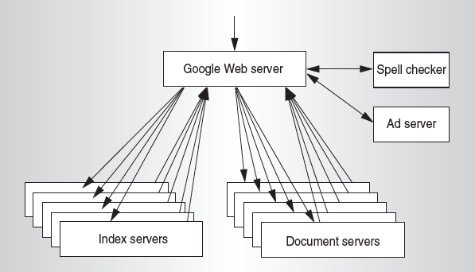
Google Query-Serving Architecture

Slide 57
Anatomy of a Web Search
Google “Randy H. Katz”
  Direct request to “closest” Google Warehouse Scale Computer
  Front-end load balancer directs request to one of many arrays (cluster of servers) within WSC
  Within array, select one of many Google Web Servers (GWS) to handle the request and compose the response pages
  GWS communicates with Index Servers to find documents that contain the search words, “Randy”, “Katz”, uses location of search as well
  Return document list with associated relevance score

Slide 58
Anatomy of a Web Search
In parallel,
  Ad system: books by Katz at Amazon.com
  Images of Randy Katz
Use docids (document IDs) to access indexed documents
Compose the page
  Result document extracts (with keyword in context) ordered by relevance score
  Sponsored links (along the top) and advertisements (along the sides)

Slide 59
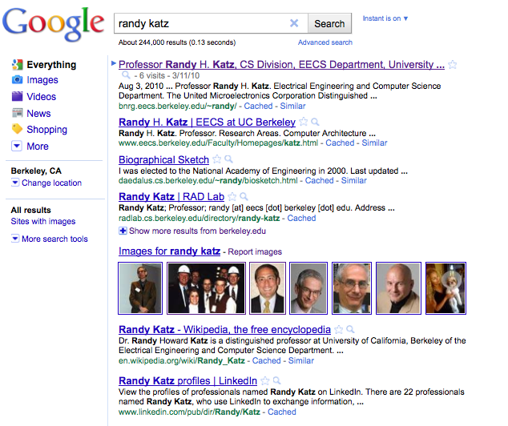

Slide 60
Anatomy of a Web Search
Implementation strategy
  Randomly distribute the entries
  Make many copies of data (aka “replicas”)
  Load balance requests across replicas
Redundant copies of indices and documents
  Breaks up hot spots, e.g., “Justin Bieber”
  Increases opportunities for request-level parallelism
  Makes the system more tolerant of failures

Slide 61
Summary
Cloud Computing
  Benefits of WSC computing for third parties
  “Elastic” pay as you go resource allocation
  Amazon demonstrates that you can make money by selling cycles and storage
Warehouse-Scale Computers (WSCs)
  Power ultra large-scale Internet applications
  Emphasis on cost, power efficiency
  PUE - Ratio of total power consumed over power used for computing.

