Slide 1
CS 61C: Great Ideas in Computer Architecture (Machine Structures) Instruction Level Parallelism— Pipelining
Instructor: Michael Greenbaum

Slide 2
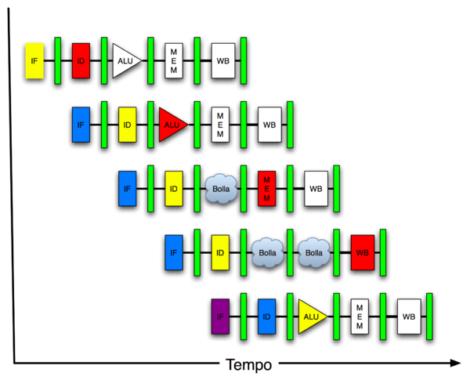
You Are Here!
Software Hardware
Parallel Requests
Assigned to computer
e.g., Search “Katz”
Parallel Threads
Assigned to core
e.g., Lookup, Ads
Parallel Instructions
>1 instruction @ one time
e.g., 5 pipelined instructions
Parallel Data
>1 data item @ one time
e.g., Add of 4 pairs of words
Hardware descriptions
All gates functioning in parallel at same time
Warehouse Scale Computer
Smart Phone
Harness Parallelism &
Achieve High Performance
Computer
Core
…
Core
Memory (Cache)
Input/Output
Core
Today’s Lecture
Instruction Unit(s)
Functional
Unit(s)
A₀+B₀
A₁+B₁
A₂+B₂
A₃+B₃
Cache
Logic Gates

Slide 3
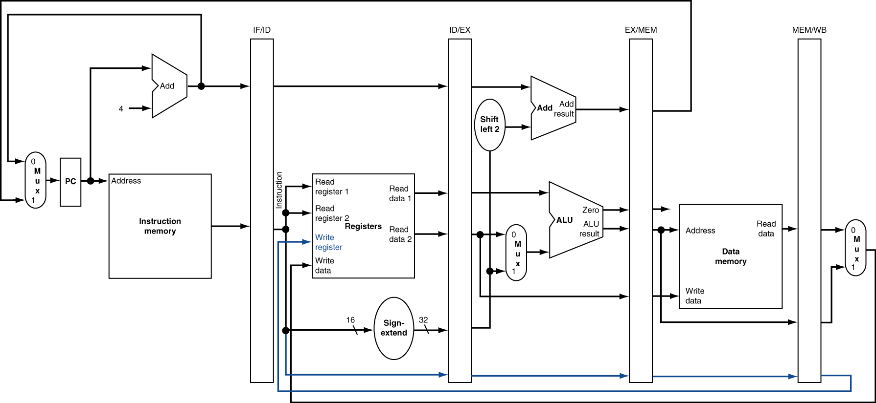
Review: Pipelined Datapath

Slide 4
Graphical Pipeline Representation
(In Reg, right half highlight read, left half write)
Time (clock cycles)
I
n
s
t
r.
O
r
d
e
r
Load
I$
Reg
ALU
D$
Reg
Add
I$
Reg
ALU
D$
Reg
Store
I$
Reg
ALU
D$
Reg
Sub
I$
Reg
ALU
D$
Reg
Or
I$
Reg
ALU
D$
Reg

Slide 5
Agenda
Pipelining Performance
Pipelining Hazards
Administrivia
Pipelining Hazards (cont’d)
Break
Multiple Instruction Issue

Slide 6
Pipeline Performance
Assume time for stages is
100ps for register read or write
200ps for other stages
What is pipelined clock rate?
Compare pipelined datapath with single-cycle datapath
Instr | Instr fetch | Register read | ALU op | Memory access | Register write | Total time
lw | 200ps | 100 ps | 200ps | 200ps | 100 ps | 800ps
sw | 200ps | 100 ps | 200ps | 200ps |  | 700ps
R-format | 200ps | 100 ps | 200ps |  | 100 ps | 600ps
beq | 200ps | 100 ps | 200ps |  |  | 500ps

Slide 7
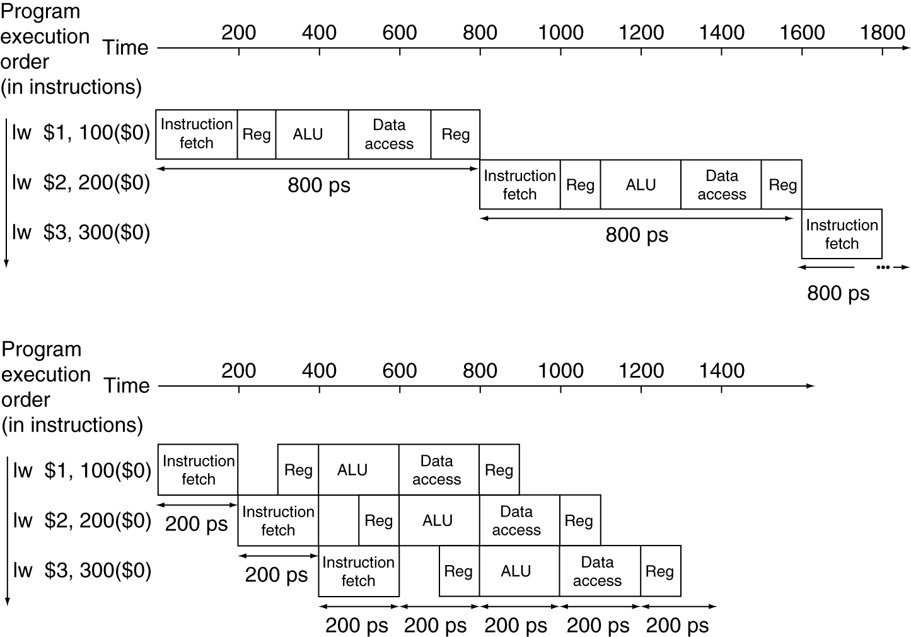
Pipeline Performance
Single-cycle (T_{c}= 800ps)
Pipelined (T_{c}= 200ps)

Slide 8
Pipeline Speedup
If all stages are balanced
i.e., all take the same time
Time between instructions_{pipelined} = Time between instructions_{nonpipelined} Number of stages
If not balanced, speedup is less
Speedup due to increased throughput
Latency (time for each instruction) does not decrease

Slide 9
Agenda
Pipelining Performance
Pipelining Hazards
Administrivia
Pipelining Hazards (cont’d)
Break
Multiple Instruction Issue

Slide 10
Hazards
Situations that prevent starting the next instruction in the next clock cycle
Structural hazards
A required resource is busy (e.g., needed in multiple stages)
Data hazard
Data dependency between instructions.
Need to wait for previous instruction to complete its data read/write
Control hazard
Flow of execution depends on previous instruction

Slide 11
1. Structural Hazards
Conflict for use of a resource
In MIPS pipeline with a single memory
Load/Store requires memory access for data
Instruction fetch would have to stall for that cycle
Causes a pipeline “bubble”
Hence, pipelined datapaths require separate instruction/data memories
Separate L1 I$ and L1 D$ take care of this.

Slide 12
Structural Hazard #1: Single Memory
Time (clock cycles)
I
n
s
t
r.
O
r
d
e
r
Load
I$
Reg
ALU
D$
Reg
Instr 1
I$
Reg
ALU
D$
Reg
Instr 2
I$
Reg
ALU
D$
Reg
Instr 3
I$
Reg
ALU
D$
Reg
Instr 4
I$
Reg
ALU
D$
Reg

Slide 13
Structural Hazard #2: Registers (1/2)
I
n
s
t
r.
O
r
d
e
r
Time (clock cycles)
sw
I$
Reg
ALU
D$
Reg
Instr 1
I$
Reg
ALU
D$
Reg
Instr 2
I$
Reg
ALU
D$
Reg
Instr 3
I$
Reg
ALU
D$
Reg
Instr 4
I$
Reg
ALU
D$
Reg
Can we read and write to registers simultaneously?

Slide 14
1. Structural Hazard #2: Registers (2/2)
Two different solutions have been used:
1) RegFile access is VERY fast: takes less than half the time of ALU stage
Write to Registers during first half of each clock cycle
Read from Registers during second half of each clock cycle
2) Build RegFile with independent read and write ports
Result: can perform Read and Write during same clock cycle

Slide 15
Data Hazards (1/2)
Consider the following sequence of instructions
add $t0, $t1, $t2
sub $t4, $t0 ,$t3
and $t5, $t0 ,$t6
or $t7, $t0 ,$t8
xor $t9, $t0 ,$t10

Slide 16
Data Hazards (2/2)
Data-flow backward in time are hazards
I
n
s
t
r.
O
r
d
e
r
Time (clock cycles)
IF
ID/RF
EX
MEM
WB
add $t0,$t1,$t2
I$
Reg
ALU
D$
Reg
sub $t4,$t0,$t3
I$
Reg
ALU
D$
Reg
and $t5,$t0,$t6
I$
Reg
ALU
D$
Reg
or $t7,$t0,$t8
I$
Reg
ALU
D$
Reg
xor $t9,$t0,$t10
I$
Reg
ALU
D$
Reg

Slide 17
Data Hazard Solution: Forwarding
Forward result from one stage to another
IF
ID/RF
EX
MEM
WB
add $t0,$t1,$t2
I$
Reg
ALU
D$
Reg
sub $t4,$t0,$t3
I$
Reg
ALU
D$
Reg
and $t5,$t0,$t6
I$
Reg
ALU
D$
Reg
or $t7,$t0,$t8
I$
Reg
ALU
D$
Reg
xor $t9,$t0,$t10
I$
Reg
ALU
D$
Reg
(“or” hazard solved by register hardware)

Slide 18
Corrected Datapath for Forwarding?

Slide 19
Data Hazard: Loads (1/4)
Dataflow backwards in time are hazards
Can’t solve all cases with forwarding
Must stall instruction dependent on load, then forward (more hardware)
IF
ID/RF
EX
MEM
WB
lw $t0,0($t1)
I$
Reg
ALU
D$
Reg
sub $t3,$t0,$t2
I$
Reg
ALU
D$
Reg

Slide 20
Data Hazard: Loads (2/4)
Hardware stalls pipeline
Called “interlock”
IF
ID/RF
EX
MEM
WB
lw $t0, 0($t1)
I$
Reg
ALU
D$
Reg
sub $t3,$t0,$t2
bubble
I$
Reg
ALU
D$
Reg
and $t5,$t0,$t4
I$
bubble
Reg
ALU
D$
Reg
or $t7,$t0,$t6
bubble
I$
D$
Reg
ALU

Slide 21
Data Hazard: Loads (3/4)
Instruction slot after a load is called “load delay slot”
If that instruction uses the result of the load, then the hardware interlock will stall it for one cycle.
If the compiler puts an unrelated instruction in that slot, then no stall
Letting the hardware stall the instruction in the delay slot is equivalent to putting a nop in the slot (except the latter uses more code space)

Slide 22
Data Hazard: Loads (4/4)
Stall is equivalent to nop
lw $t0, 0($t1)
I$
Reg
ALU
D$
Reg
nop
bubble
bubble
bubble
bubble
bubble
sub $t3,$t0,$t2
I$
Reg
ALU
D$
Reg
and $t5,$t0,$t4
I$
Reg
ALU
Reg
D$
or $t7,$t0,$t6
I$
Reg
ALU
D$

Slide 23
Administrivia
I’ll be gone for tomorrow, Justin (TA) will be giving a guest lecture.
Project 2 Part 2 due Sunday.
Slides at end of July 12 lecture contain useful info.
Lab 12 cancelled!
Replaced with free study session where you can catch up on labs / work on project 2.
The TA’s will still be there.

Slide 24
Agenda
Pipelining Performance
Pipelining Hazards
Administrivia
Pipelining Hazards (cont’d)
Break
Multiple Instruction Issue

Slide 25
Pipelining and ISA Design
MIPS Instruction Set designed for pipelining
MIPS originally stood for Microprocessor without Interlocked Pipeline Stages.
All instructions are 32-bits
Easier to fetch and decode in one cycle
x86: 1- to 17-byte instructions
(x86 HW actually translates to internal RISC instructions!)
Few and regular instruction formats, 2 source register fields always in same place
Can decode and read registers in one step
Memory operands only in Loads and Stores
Can calculate address 3rd stage, access memory 4th stage
Alignment of memory operands
Memory access takes only one cycle

Slide 26
3. Control Hazards
Branch determines flow of control
Fetching next instruction depends on branch outcome
Pipeline can’t always fetch correct instruction
Still working on Decode stage of branch
BEQ, BNE in MIPS pipeline
Simple solution Option 1: Stall on every branch until have new PC value
Would add 2 bubbles/clock cycles for every Branch! (~ 20% of instructions executed)

Slide 27
Stall => 2 Bubbles/Clocks
Time (clock cycles)
I
n
s
t
r.
O
r
d
e
r
beq
I$
Reg
ALU
D$
Reg
Instr 1
I$
Reg
ALU
D$
Reg
Instr 2
I$
Reg
ALU
D$
Reg
Instr 3
I$
Reg
ALU
D$
Reg
Instr 4
I$
Reg
ALU
D$
Reg
Where do we do the compare for the branch?

Slide 28
3. Control Hazard: Branching
Optimization #1:
Insert special branch comparator in Stage 2
As soon as instruction is decoded (Opcode identifies it as a branch), immediately make a decision and set the new value of the PC
Benefit: since branch is complete in Stage 2, only one unnecessary instruction is fetched, so only one no-op is needed
Side Note: means that branches are idle in Stages 3, 4 and 5

Slide 29
Corrected Datapath for BEQ/BNE?

Slide 30
One Clock Cycle Stall
Time (clock cycles)
I
n
s
t
r.
O
r
d
e
r
beq
I$
Reg
ALU
D$
Reg
Instr 1
I$
Reg
ALU
D$
Reg
Instr 2
I$
Reg
ALU
D$
Reg
Instr 3
I$
Reg
ALU
D$
Reg
Instr 4
I$
Reg
ALU
D$
Reg
Branch comparator moved to Decode stage.

Slide 31
3. Control Hazards
Option 2: Predict outcome of a branch, fix up if guess wrong
Must cancel all instructions in pipeline that depended on guess that was wrong
Simplest hardware if we predict that all branches are NOT taken
Why?
Student Roulette?

Slide 32
3. Control Hazard: Branching
Option #3: Redefine branches
Old definition: if we take the branch, none of the instructions after the branch get executed by accident
New definition: whether or not we take the branch, the single instruction immediately following the branch gets executed (the branch-delay slot)
Delayed Branch means we always execute inst after branch
This optimization is used with MIPS

Slide 33
3. Control Hazard: Branching
Notes on Branch-Delay Slot
Worst-Case Scenario: put a no-op in the branch-delay slot
Better Case: place some instruction preceding the branch in the branch-delay slot—as long as the changed doesn’t affect the logic of program
Re-ordering instructions is common way to speed up programs
Compiler usually finds such an instruction 50% of time
Jumps also have a delay slot …

Slide 34
Example: Nondelayed vs. Delayed Branch
Nondelayed Branch
Delayed Branch
or $8, $9, $10
add $1, $2,$3
add $1, $2, $3
sub $4, $5, $6
sub $4, $5, $6
beq $1, $4, Exit
beq $1, $4, Exit
or $8, $9, $10
xor $10, $1, $11
xor $10, $1, $11
Exit:
Exit:

Slide 35
Delayed Branch/Jump and MIPS ISA?
Why does JAL put PC+8 in register 31?
JAL executes following instruction (PC+4) so should return to PC+8

Slide 36
Code Scheduling to Avoid Stalls
Reorder code to avoid use of load result in the next instruction
C code for A = B + E; C = B + F;
lw $t1, 0($t0)
lw $t2, 4($t0)
add $t3, $t1, $t2
sw $t3, 12($t0)
lw $t4, 8($t0)
add $t5, $t1, $t4
sw $t5, 16($t0)
lw $t1, 0($t0)
lw $t2, 4($t0)
lw $t4, 8($t0)
add $t3, $t1, $t2
sw $t3, 12($t0)
add $t5, $t1, $t4
sw $t5, 16($t0)
stall
stall
13 cycles
11 cycles

Slide 37
Peer Instruction
Thanks to pipelining, I have reduced the time it took me to wash my one shirt.
Longer pipelines are always a win (since less work per stage & a faster clock).
A)(red) I is True and II is True
B)(blue) I is False and II is True
C)(green) I is True and II is False
D)(yellow) I is False and II is False

Slide 38
Peer Instruction Answer
Throughput better, not latency!
“…longer pipelines do usually mean faster clock rate, but hazards can cause problems!”
F A L S E
Thanks to pipelining, I have reduced the time it took me to wash my one shirt.
Longer pipelines are always a win (since less work per stage & a faster clock).
12
a) FF
b) FT
c) TF
d) TT
F A L S E

Slide 39
Peer Question: Stall, Forward, OK?
For each code sequence, chose whether I. It must stall II. It can avoid stalls using only forwarding III. It can execute without stalling or forwarding
1: lw $t0,0($t0) add $t1,$t0,$t0 | 2: add $t1,$t0,$t0 addi $t2,$t0,5 addi $t4,$t1,5 | 3: addi $t1,$t0,1 addi $t2,$t0,2 addi $t3,$t0,2 addi $t3,$t0,4 addi $t5,$t1,5
 | Red: 1 II, 2 II, 3 III
White: 1 I, 2 I, 3 II | Blue: 1 II, 2 III, 3 III
Green: 1 I, 2 I, 3 III | Purple: All II (must forward)
Yellow: 1 I, 2 II, 3 III
Notes:
D, 1 must stall due to load-use; 2 must forward on t1 since result not written for a few stages; 3 no dependencies

Slide 40
Sequence 1
Time (clock cycles)
I
n
s
t
r.
O
r
d
e
r
lw
I$
Reg
ALU
D$
Reg
add
I$
Reg
ALU
D$
Reg
instr
I$
Reg
ALU
D$
Reg
instr
I$
Reg
ALU
D$
Reg
instr
I$
Reg
ALU
D$
Reg

Slide 41
Sequence 2
Time (clock cycles)
I
n
s
t
r.
O
r
d
e
r
forwarding
no forwarding
add
I$
Reg
ALU
D$
Reg
addi
I$
Reg
ALU
D$
Reg
addi
I$
Reg
ALU
D$
Reg
instr
I$
Reg
ALU
D$
Reg
instr
I$
Reg
ALU
D$
Reg

Slide 42
Sequence 3
Time (clock cycles)
I
n
s
t
r.
O
r
d
e
r
addi
I$
Reg
ALU
D$
Reg
addi
I$
Reg
ALU
D$
Reg
addi
I$
Reg
ALU
D$
Reg
addi
I$
Reg
ALU
D$
Reg
addi
I$
Reg
ALU
D$
Reg

Slide 43
Peer Question: Stall, Forward, OK?
For each code sequence, chose whether I. It must stall II. It can avoid stalls using only forwarding III. It can execute without stalling or forwarding
1: lw $t0,0($t0) add $t1,$t0,$t0 | 2: add $t1,$t0,$t0 addi $t2,$t0,#5 addi $t4,$t1,#5 | 3: addi $t1,$t0,#1 addi $t2,$t0,#2 addi $t3,$t0,#2 addi $t3,$t0,#4 addi $t5,$t1,#5
 | Red: 1 II, 2 II, 3 III
White: 1 I, 2 I, 3 II | Blue: 1 II, 2 III, 3 III
Green: 1 I, 2 I, 3 III | Purple: All II (must forward)
Yellow: 1 I, 2 II, 3 III
Notes:
D, 1 must stall due to load-use; 2 must forward on t1 since result not written for a few stages; 3 no dependencies

Slide 44
Agenda
Pipelining Performance
Pipelining Hazards
Administrivia
Pipelining Hazards (cont’d)
Break
Multiple Instruction Issue

Slide 45
Greater Instruction-Level Parallelism (ILP)
Deeper pipeline (5 => 10 => 15 stages)
Less work per stage ⇒ shorter clock cycle
Multiple issue (superscalar)
Replicate pipeline stages ⇒ multiple pipelines
Start multiple instructions per clock cycle
CPI < 1, so use Instructions Per Cycle (IPC)
E.g., 4 GHz 4-way multiple-issue
16 BIPS, peak CPI = 0.25, peak IPC = 4
But dependencies reduce this in practice
§4.10 Parallelism and Advanced Instruction Level Parallelism

Slide 46
Multiple Issue
Static multiple issue
Compiler groups instructions to be issued together
Packages them into “issue slots”
Compiler detects and avoids hazards
Dynamic multiple issue
CPU examines instruction stream and chooses instructions to issue each cycle
Compiler can help by reordering instructions
CPU resolves hazards using advanced techniques at runtime

Slide 47
Superscalar Laundry: Parallel per stage
6 PM
7
8
9
10
11
12
1
2 AM
More resources, HW to match mix of parallel tasks?
30
30
30
30
30
Time
T
a
s
k
O
r
d
e
r
A
(light clothing)
(dark clothing)
B
(very dirty clothing)
C
D
(light clothing)
(dark clothing)
E
(very dirty clothing)
F

Slide 48
Pipeline Depth and Issue Width
Intel Processors over Time
Microprocessor | Year | Clock Rate | Pipeline Stages | Issue width | Cores | Power
i486 | 1989 | 25 MHz | 5 | 1 | 1 | 5W
Pentium | 1993 | 66 MHz | 5 | 2 | 1 | 10W
Pentium Pro | 1997 | 200 MHz | 10 | 3 | 1 | 29W
P4 Willamette | 2001 | 2000 MHz | 22 | 3 | 1 | 75W
P4 Prescott | 2004 | 3600 MHz | 31 | 3 | 1 | 103W
Core 2 Conroe | 2006 | 2930 MHz | 14 | 4 | 2 | 75W
Core 2 Yorkfield | 2008 | 2930 MHz | 16 | 4 | 4 | 95W
Core i7 Gulftown | 2010 | 3460 MHz | 16 | 4 | 6 | 130W

Slide 49
Pipeline Depth and Issue Width

Slide 50
Static Multiple Issue
Compiler groups instructions into issue packets
Group of instructions that can be issued on a single cycle
Determined by pipeline resources required
Think of an issue packet as a very long instruction
Specifies multiple concurrent operations

Slide 51
Scheduling Static Multiple Issue
Compiler must remove some/all hazards
Reorder instructions into issue packets
No dependencies with a packet
Possibly some dependencies between packets
Varies between ISAs; compiler must know!
Pad with nop if necessary

Slide 52
MIPS with Static Dual Issue
Dual-issue packets
One ALU/branch instruction
One load/store instruction
64-bit aligned
ALU/branch, then load/store
Pad an unused instruction with nop
Address | Instruction type | Pipeline Stages
n | ALU/branch | IF | ID | EX | MEM | WB
n + 4 | Load/store | IF | ID | EX | MEM | WB
n + 8 | ALU/branch |  | IF | ID | EX | MEM | WB
n + 12 | Load/store |  | IF | ID | EX | MEM | WB
n + 16 | ALU/branch |  |  | IF | ID | EX | MEM | WB
n + 20 | Load/store |  |  | IF | ID | EX | MEM | WB

Slide 53
Hazards in the Dual-Issue MIPS
More instructions executing in parallel
EXECUTE stage data hazard
Forwarding avoided stalls with single-issue
Now can’t use ALU result in load/store in same packet
add $t0, $s0, $s1 load $s2, 0($t0)
Split into two packets, effectively a stall
Load-use hazard
Still one cycle use latency, but now two instructions
More aggressive scheduling required

Slide 54
Scheduling Example
Schedule this for dual-issue MIPS
Loop: lw $t0, 0($s1) # $t0=array element addu $t0, $t0, $s2 # add scalar in $s2 sw $t0, 0($s1) # store result addi $s1, $s1,–4 # decrement pointer bne $s1, $zero, Loop # branch $s1!=0
 | ALU/branch | Load/store | cycle
Loop: | nop | lw $t0, 0($s1) | 1
 | addi $s1, $s1,–4 | nop | 2
 | addu $t0, $t0, $s2 | nop | 3
 | bne $s1, $zero, Loop | sw $t0, 4($s1) | 4
IPC = 5/4 = 1.25 (c.f. peak IPC = 2)

Slide 55
Loop Unrolling
Replicate loop body to expose more parallelism
Use different registers per replication
Called register renaming
Avoid loop-carried anti-dependencies
Store followed by a load of the same register
Aka “name dependence”
Reuse of a register name

Slide 56
Loop Unrolling Example
 | ALU/branch | Load/store | cycle
Loop: | addi $s1, $s1,–16 | lw $t0, 0($s1) | 1
 | nop | lw $t1, 12($s1) | 2
 | addu $t0, $t0, $s2 | lw $t2, 8($s1) | 3
 | addu $t1, $t1, $s2 | lw $t3, 4($s1) | 4
 | addu $t2, $t2, $s2 | sw $t0, 16($s1) | 5
 | addu $t3, $t4, $s2 | sw $t1, 12($s1) | 6
 | nop | sw $t2, 8($s1) | 7
 | bne $s1, $zero, Loop | sw $t3, 4($s1) | 8
IPC = 14/8 = 1.75
Closer to 2, but at cost of registers and code size

Slide 57
“And in Conclusion, …”
Instruction Level Parallelism (ILP)
Achieved by Pipelining, Multiple Instruction Issue
Hazards are the enemy of ILP
Structural Hazards
Data Hazards
Control Hazards

