Slide 1
CS 61C: Great Ideas in Computer Architecture (Machine Structures) MIPS CPU Datapath
Instructor: Michael Greenbaum

Slide 2
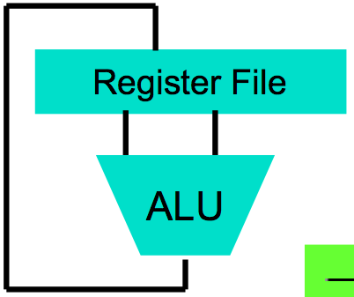
Levels of Representation/Interpretation
High Level Language Program (e.g., C)
temp = v[k];
v[k] = v[k+1];
v[k+1] = temp;
Compiler
Anything can be represented as a number, i.e., data or instructions
lw $t0, 0($2)
lw $t1, 4($2)
sw $t1, 0($2)
sw $t0, 4($2)
Assembly Language Program (e.g., MIPS)
Assembler
0000 1001 1100 0110 1010 1111 0101 1000
1010 1111 0101 1000 0000 1001 1100 0110
1100 0110 1010 1111 0101 1000 0000 1001
0101 1000 0000 1001 1100 0110 1010 1111
Machine Language Program (MIPS)
Machine Interpretation
Hardware Architecture Description (e.g., block diagrams)
Architecture Implementation
Logic Circuit Description (Circuit Schematic Diagrams)

Slide 3
Review
D-Flip-Flops update output at rising edge of clock
Setup and Hold times important
Critical Path constrains clock rate.
Finite State Machines extremely useful
Use muxes to select among input
S input bits selects 2^{S} inputs
Each input can be n-bits wide, independent of S
Build n-bit adder out of chained 1-bit adders.

Slide 4
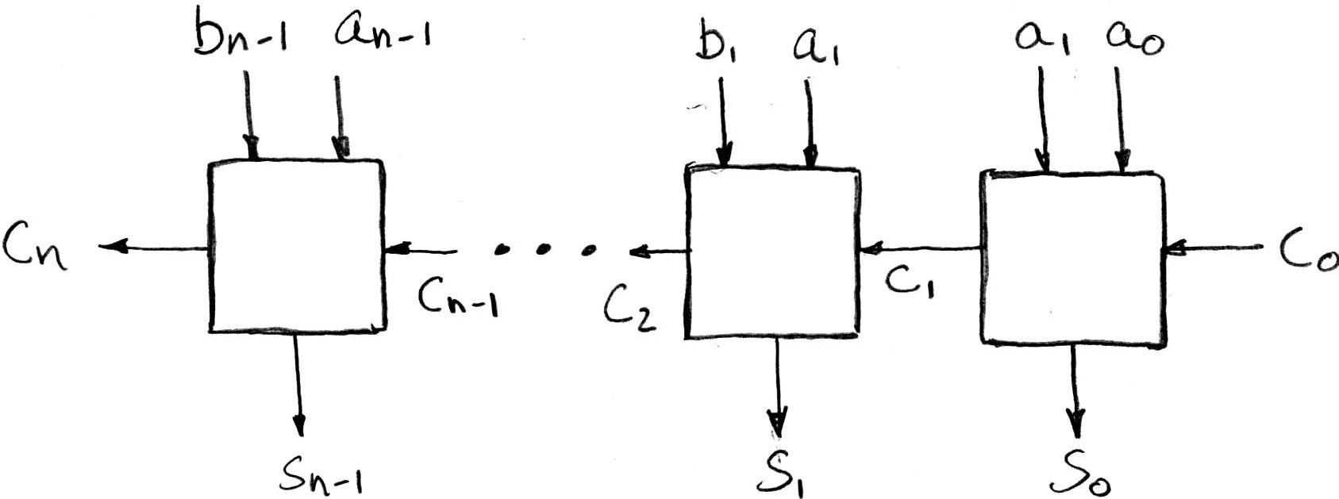
Review: N x 1-bit Adders ⇒ 1 N-bit Adder
Connect Carry Out i-1 to Carry in i:
b₀
+
+
+

Slide 5
What about detecting overflow?
Unsigned overflow - The carry out from the most significant bit.
Signed overflow - A bit more complicated, two cases:
Overflow from adding “big” positive numbers.
Overflow from adding “big” negative numbers.

Slide 6
Detecting Signed Overflow (4-bit examples)
From two positive numbers:
0111 + 0111, 0111 + 0001, 0100 + 0100.
What do these have in common? Carry-out from the second highest bit (but not highest bit)
From two negative numbers:
1000 + 1000, 1000 + 1111, 1011 + 1011.
These have carry-out from the highest bit (but not second highest bit)
Expression for signed overflow: C_{n} XOR C_{n-1}

Slide 7
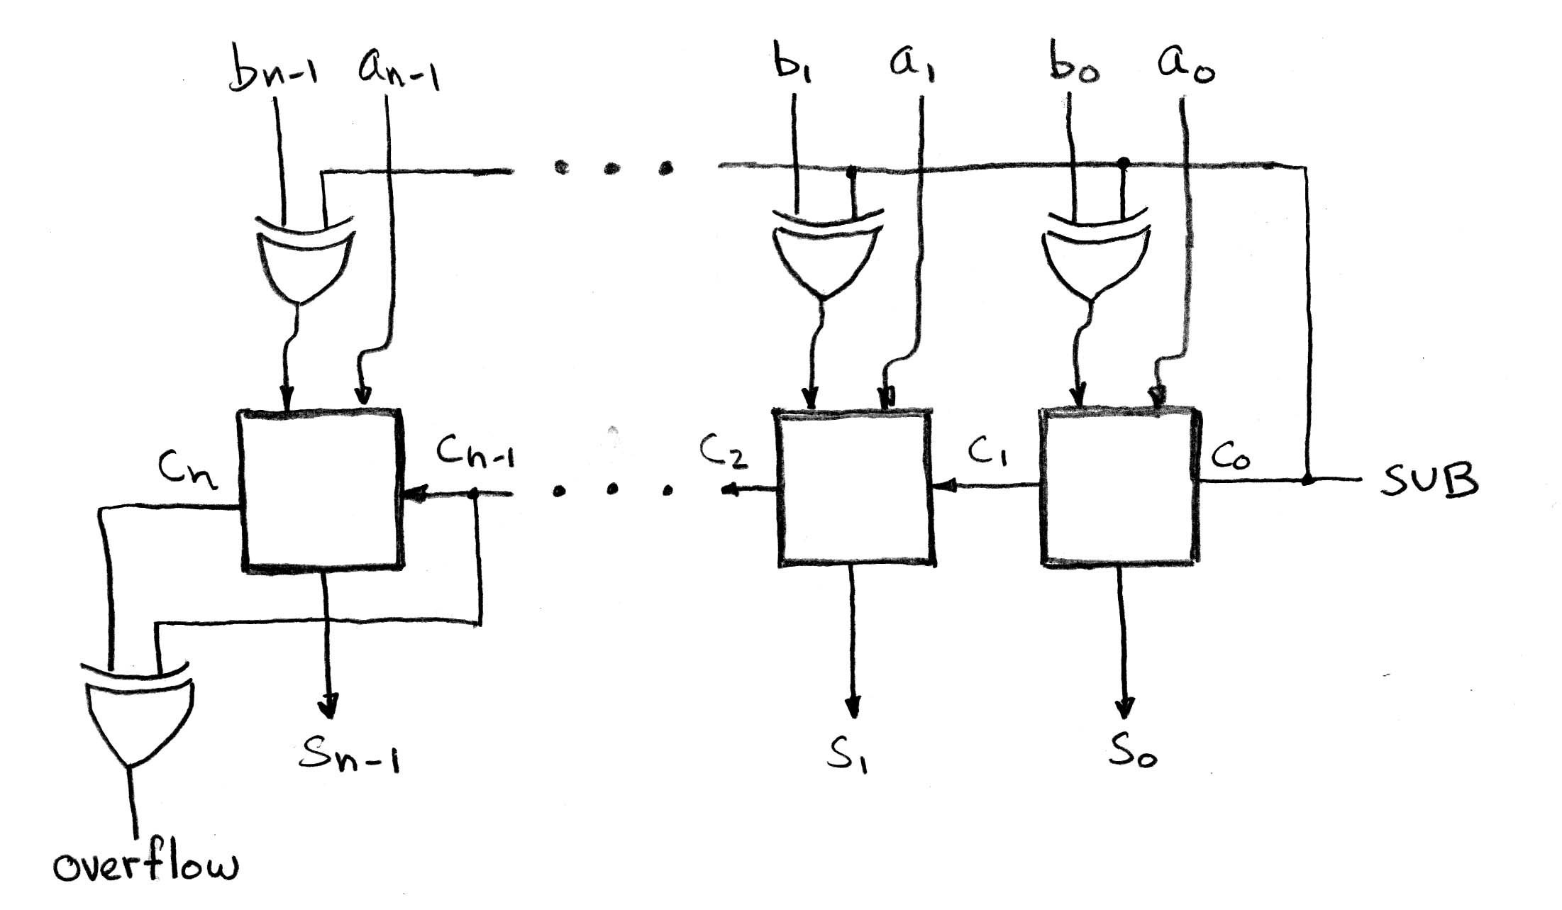
Twos Complement Adder/Subtractor
Can subtract by adding the negative of the second number. To negate:
Flip the bits
And add one!

Slide 8
Agenda
5 Stages of the Datapath
Administrivia
Quick Datapath Walkthrough
Processor Design Process
Determine datapath requirements based on instruction set
Select datapath components
Assemble the datapath

Slide 9
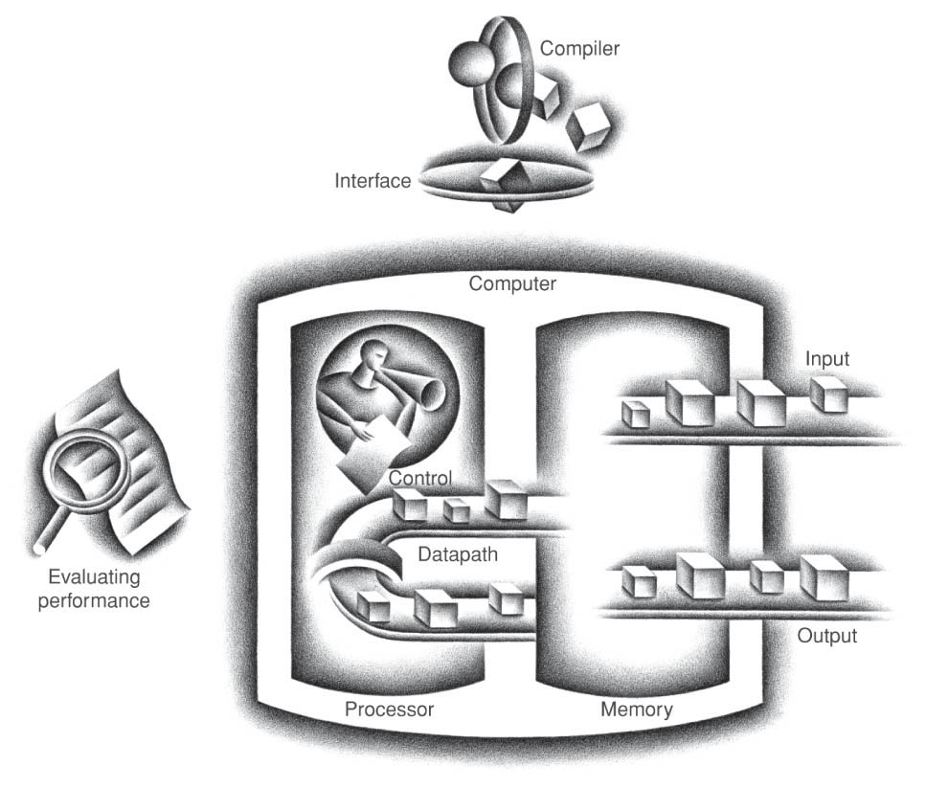
Five Components of a Computer
Control
Datapath
Memory
Input
Output
Notes:
That is, any computer, no matter how primitive or advance, can be divided into five parts:
1. The input devices bring the data from the outside world into the computer.
2. These data are kept in the computer’s memory until ...
3. The datapath request and process them.
4. The operation of the datapath is controlled by the computer’s controller.
All the work done by the computer will NOT do us any good unless we can get the data back to the outside world.
5. Getting the data back to the outside world is the job of the output devices.
The most COMMON way to connect these 5 components together is to use a network of busses.

Slide 10
The Processor
Processor (CPU): Implements the instructions of the Instruction Set Architecture (ISA)
Datapath: portion of the processor which contains hardware necessary to perform operations required by the processor (the brawn)
Control: portion of the processor (also in hardware) which tells the datapath what needs to be done (the brain)

Slide 11
Stages of the Datapath : Overview
Break up the process of “executing an instruction” into stages or phases, and then connect the phases to create the whole datapath
Smaller phases are easier to design
Easy to optimize (change) one phase without touching the others
Project 1 had 3 phases: Fetch, Decode, Execute. Here, we expand Execute into ALU, Memory Access, and Register Write.

Slide 12
Phases of the Datapath (1/5)
Phase 1: Instruction Fetch
No matter what the instruction, the 32-bit instruction word must first be fetched from memory (the cache-memory hierarchy)
Also, this is where we Increment PC (that is, PC = PC + 4, to point to the next instruction: byte addressing so + 4)

Slide 13
Phases of the Datapath (2/5)
31
26
21
16
11
6
0
op
rs
rt
rd
shamt
funct
Phase 2: Instruction Decode
Upon fetching the instruction, we next gather data from the fields (decode all necessary instruction data)
Read the opcode and each of the possible fields from the 32 bits of the instruction.
Read data from all necessary registers (This differs from Project 1)
For add, read two registers
For addi, read one register
For jal, no reads necessary
6 bits
5 bits
5 bits
5 bits
5 bits
6 bits

Slide 14
Phases of the Datapath (3/5)
Phase 3: ALU (Arithmetic-Logic Unit)
Real work of most instructions is done here: arithmetic (+, -, *, /), shifting, logic (&, |), comparisons (slt)
What about loads and stores?
eg, lw $t0, 40($t1)
Memory Address = Offset + Value in $t1
We perform this addition in this stage.

Slide 15
Phases of the Datapath (4/5)
Phase 4: Memory Access
Only the load and store instructions do anything during this phase; the others remain idle or skip this phase all together
Since these instructions have a unique step, we need this extra phase to account for them
As a result of the cache system, this phase is expected to be fast

Slide 16
Phases of the Datapath (5/5)
Phase 5: Register Write
Most instructions write the result of some computation into a register
E.g.,: arithmetic, logical, shifts, loads, slt, jal(!)
What about stores, branches, jumps?
Don’t write anything into a register at the end
These remain idle during this fifth phase or skip it all together

Slide 17
Why Five Stages?
Could we have a different number of stages?
Yes, and other architectures do
So why does MIPS have five if instructions tend to idle for at least one stage?
The five stages are the union of all the operations needed by all the instructions.
There is one instruction that uses all five stages: the load

Slide 18
Generic Steps of Datapath
rd
PC
instruction
memory
registers
rs
Data
memory
rt
ALU
+4
imm
2. Decode/
Register
Read
1. Instruction
Fetch
5. Reg.
Write
3. Execute
4. Memory

Slide 19
Agenda
5 Stages of the Datapath
Administrivia
Quick Datapath Walkthrough
Processor Design Process
Determine datapath requirements based on instruction set
Select datapath components
Assemble the datapath

Slide 20
Administrivia
HW3 Due Wednesday at midnight
Should be able to answer last two questions after today’s lecture.
Project 2 Part 2 due Sunday.
Lab 11 posted.
Lab 12 cancelled!
Replaced with free study session where you can catch up on labs / work on project 2.
The TA’s will still be there.

Slide 21
cs61c in…Minecraft!
Person builds 16-bit ALU in Minecraft.
Let’s check out the video…

Slide 22
Agenda
5 Stages of the Datapath
Administrivia
Quick Datapath Walkthrough
Processor Design Process
Determine datapath requirements based on instruction set
Select datapath components
Assemble the datapath

Slide 23
Datapath Walkthroughs (1/3)
add $3,$1,$2 # R[3] = R[1]+R[2]
Stage 1: fetch this instruction, inc. PC
Stage 2: decode to find it’s an add, then read registers $1 and $2
Stage 3: add the two values retrieved in Stage 2
Stage 4: idle (nothing to write to memory)
Stage 5: write result of Stage 3 into register $3

Slide 24
Example: add Instruction
reg[1]+reg[2]
reg[1]
3
PC
instruction
memory
registers
1
Data
memory
reg[2]
ALU
2
+4
imm
add $3, $1, $2

Slide 25
Datapath Walkthroughs (2/3)
slti $3,$1,17
Stage 1: fetch this instruction, inc. PC
Stage 2: decode to find it’s an slti, then read register $1
Stage 3: compare value retrieved in Stage 2 with the integer 17
Stage 4: idle
Stage 5: write the result of Stage 3 in register $3

Slide 26
Example: slti Instruction
reg[1]<17?
reg[1]
x
PC
instruction
memory
registers
1
Data
memory
ALU
3
+4
imm
17
slti $3, $1, 17

Slide 27
Datapath Walkthroughs (3/3)
sw $3, 17($1)
Stage 1: fetch this instruction, inc. PC
Stage 2: decode to find it’s a sw, then read registers $1 and $3
Stage 3: add 17 to value in register $1 (retrieved in Stage 2)
Stage 4: write value in register $3 (retrieved in Stage 2) into memory address computed in Stage 3
Stage 5: idle (nothing to write into a register)

Slide 28
Example: sw Instruction
reg[1]+17
reg[1]
x
PC
instruction
memory
registers
1
Data
memory
reg[3]
ALU
3
+4
imm
17
MEM[$1+17]=$3
SW $3, 17($1)

Slide 29
Agenda
5 Stages of the Datapath
Administrivia
Quick Datapath Walkthrough
Processor Design Process
Determine datapath requirements based on instruction set
Select datapath components
Assemble the datapath

Slide 30
Processor Design Process
Five steps to design a processor:
Step 1: Analyze instruction set to determine datapath requirements
Step 2: Select set of datapath components & establish clocking methodology
Step 3: Assemble datapath components to meet the requirements
Step 4: Analyze implementation of each instruction to determine setting of control points that realizes the register transfer
Step 5: Assemble the control logic

Slide 31
Processor Design Process
Five steps to design a processor:
Step 1: Analyze instruction set to determine datapath requirements
Step 2: Select set of datapath components & establish clocking methodology
Step 3: Assemble datapath components to meet the requirements
Step 4: Analyze implementation of each instruction to determine setting of control points that realizes the register transfer
Step 5: Assemble the control logic

Slide 32
Step 1a: The MIPS-lite Subset for today
ADDU and SUBU
addu rd,rs,rt
subu rd,rs,rt
OR Immediate:
ori rt,rs,imm16
LOAD and STORE Word
lw rt,rs,imm16
sw rt,rs,imm16
BRANCH:
beq rs,rt,imm16
31
26
21
16
11
6
0
op
rs
rt
rd
shamt
funct
6 bits
5 bits
5 bits
5 bits
5 bits
6 bits
31
26
21
16
0
op
rs
rt
immediate
6 bits
5 bits
5 bits
16 bits
31
26
21
16
0
op
rs
rt
immediate
6 bits
5 bits
5 bits
16 bits
31
26
21
16
0
op
rs
rt
immediate
6 bits
5 bits
5 bits
16 bits
Notes:
In today’s lecture, I will show you how to implement the following subset of MIPS instructions: add, subtract, or immediate, load, store, branch, and the jump instruction.
The Add and Subtract instructions use the R format. The Op together with the Func fields together specified all the different kinds of add and subtract instructions.
Rs and Rt specifies the source registers. And the Rd field specifies the destination register.
The Or immediate instruction uses the I format. It only uses one source register, Rs. The other operand comes from the immediate field. The Rt field is used to specified the destination register. (Note that dest is the Rt field!)
Both the load and store instructions use the I format and both add the Rs and the immediate filed together to from the memory address.
The difference is that the load instruction will load the data from memory into Rt while the store instruction will store the data in Rt into the memory.
The branch on equal instruction also uses the I format. Here Rs and Rt are used to specified the registers we need to compare.
If these two registers are equal, we will branch to a location offset by the immediate field.
Finally, the jump instruction uses the J format and always causes the program to jump to a memory location specified in the address field.
I know I went over this rather quickly and you may have missed something. But don’t worry, this is just an overview. You will keep seeing these (point to the format) all day today.
+3 = 13 min. (X:53)

Slide 33
Register Transfer Language (RTL)
RTL gives the meaning of the instructions
{op , rs , rt , rd , shamt , funct} ← MEM[ PC ]
{op , rs , rt , Imm16} ← MEM[ PC ]
Inst Register Transfers
ADDU R[rd] ← R[rs] + R[rt]; PC ← PC + 4
SUBU R[rd] ← R[rs] – R[rt]; PC ← PC + 4
ORI R[rt] ← R[rs] | zero_ext(Imm16); PC ← PC + 4
LOAD R[rt] ← MEM[ R[rs] + sign_ext(Imm16)]; PC ← PC + 4
STORE MEM[ R[rs] + sign_ext(Imm16) ] ← R[rt]; PC ← PC + 4
BEQ if ( R[rs] == R[rt] ) then PC ← PC + 4 + (sign_ext(Imm16) || 00) else PC ← PC + 4
Instruction Fetches

Slide 34
Step 1b: Requirements of the Instruction Set
Memory (MEM)
Instructions & data (will use one for each: really caches)
Registers (R: 32 x 32)
Read rs
Read rt
Write rt or rd
PC
Extender (sign/zero extend)
Add/Sub/OR unit for operation on register(s) or extended immediate
Add 4 (+ maybe extended immediate) to PC
Compare if registers equal?

Slide 35
Step 2: Components of the Datapath
Combinational Elements
Storage Elements (Registers, Memory)
OP
CarryIn
Select
A
A
32
A
32
Adder
Sum
32
Result
32
MUX
Y
ALU
32
32
B
CarryOut
B
B
32
32
32
Adder
Multiplexer
ALU

Slide 36
Required ALU Operations
Addition, subtraction, logical OR, ==:
ADDU R[rd] = R[rs] + R[rt]; ...
SUBU R[rd] = R[rs] – R[rt]; ...
ORI R[rt] = R[rs] | zero_ext(Imm16)...
BEQ if ( R[rs] == R[rt] )...
Test to see if output == 0 for any ALU operation gives == test. How?
Full MIPS also adds AND, Set Less Than (1 if A < B, 0 otherwise)
ALU from Appendix C, section C.5

Slide 37
Storage Element: Idealized Memory
Write Enable
Address
Memory (idealized)
One input bus: Data In
One output bus: Data Out
Memory word is found by:
Address selects the word to put on Data Out
Write Enable = 1: address selects the memory word to be written via the Data In bus
Clock input (CLK)
CLK input is a factor ONLY during write operation
During read operation, behaves as a combinational logic block:
Address valid ⇒ Data Out valid after “access time”
Data In
DataOut
32
32
Clk
Notes:
The last storage element you will need for the datapath is the idealized memory to store your data and instructions.
This idealized memory block has just one input bus (DataIn) and one output bus (DataOut).
When Write Enable is 0, the address selects the memory word to put on the Data Out bus.
When Write Enable is 1, the address selects the memory word to be written via the DataIn bus at the next clock tick.
Once again, the clock input is a factor ONLY during the write operation.
During read operation, it behaves as a combinational logic block.
That is if you put a valid value on the address lines, the output bus DataOut will become valid after the access time of the memory.
+2 = 35 min. (Y:15)

Slide 38
Storage Element: Register (Building Block)
Write Enable
Similar to D Flip Flop except
N-bit input and output
Write Enable input
Write Enable:
Negated (or deasserted) (0): Data Out will not change
Asserted (1): Data Out will become Data In on rising edge of clock
Data In
Data Out
N
N
clk
Notes:
As far as storage elements are concerned, we will need a N-bit register that is similar to the D flip-flop I showed you in class.
The significant difference here is that the register will have a Write Enable input.
That is the content of the register will NOT be updated if Write Enable is not asserted (0).
The content is updated at the clock tick ONLY if the Write Enable signal is asserted (1).
+1 = 31 min. (Y:11)

Slide 39
Storage Element: Register File
RW
RA
RB
Write Enable
5
5
5
Register File consists of 32 registers:
Two 32-bit output busses:
busA and busB
One 32-bit input bus: busW
Register is selected by:
RA (number) selects the register to put on busA (data)
RB (number) selects the register to put on busB (data)
RW (number) selects the register to be written via busW (data) when Write Enable is 1
Clock input (clk)
Clk input is a factor ONLY during write operation
During read operation, behaves as a combinational logic block:
RA or RB valid ⇒ busA or busB valid after “access time.”
busA
busW
32 x 32-bit
Registers
32
32
busB
Clk
32
Notes:
We will also need a register file that consists of 32 32-bit registers with two output busses (busA and busB) and one input bus.
The register specifiers Ra and Rb select the registers to put on busA and busB respectively.
When Write Enable is 1, the register specifier Rw selects the register to be written via busW.
In our simplified version of the register file, the write operation will occurs at the clock tick.
Keep in mind that the clock input is a factor ONLY during the write operation.
During read operation, the register file behaves as a combinational logic block.
That is if you put a valid value on Ra, then bus A will become valid after the register file’s access time.
Similarly if you put a valid value on Rb, bus B will become valid after the register file’s access time. In both cases (Ra and Rb), the clock input is not a factor.
+2 = 33 min. (Y:13)

Slide 40
Clocking Methodology (1/2)
Single Cycle CPU: All stages of an instruction are completed within one long clock cycle.
The clock cycle is made sufficient long to allow each instruction to complete all stages without interruption and within one cycle.
2. Decode/
Register
Read
1. Instruction
Fetch
5. Reg.
Write
3. Execute
4. Memory
This is what we’ll talk about today.

Slide 41
Clocking Methodology (2/2)
Multiple-cycle CPU: Only one stage of instruction per clock cycle.
The clock is made as long as the slowest stage.
Several significant advantages over single cycle execution: Unused stages in a particular instruction can be skipped OR instructions can be pipelined (overlapped).
2. Decode/
Register
Read
1. Instruction
Fetch
5. Reg.
Write
3. Execute
4. Memory

Slide 42
Step 3: Assemble Datapath Meeting Requirements
Register Transfer Requirements ⇒ Assembly of Datapath
In common between all instructions:
Fetch the Instruction: mem[PC]
Update the program counter:
Sequential Code: PC ← PC + 4
Branch and Jump: PC ← “something else”
clk
PC
Next Address
Logic
Address
Instruction Word
Instruction
Memory
32

Slide 43
Add & Subtract
R[rd] = R[rs] op R[rt] (addu rd,rs,rt)
Ra, Rb, and Rw come from instruction’s Rs, Rt, and Rd fields
ALUctr and RegWr: control logic after decoding the instruction
… Already defined the register file & ALU
31
26
21
16
11
6
0
op
rs
rt
rd
shamt
funct
6 bits
5 bits
5 bits
5 bits
5 bits
6 bits
rd
rs
rt
RegWr
ALUctr
5
5
5
busA
Rw
Ra
Rb
busW
32
Result
32
32 x 32-bit
Registers
ALU
busB
32
clk
32
Notes:
And here is the datapath that can do the trick.
First of all, we connect the register file’s Ra, Rb, and Rw input to the Rd, Rs, and Rt fields of the instruction bus (points to the format diagram).
Then we need to connect busA and busB of the register file to the ALU.
Finally, we need to connect the output of the ALU to the input bus of the register file.
Conceptually, this is how it works.
The instruction bus coming out of the Instruction memory will set the Ra and Rb to the register specifiers Rs and Rt.
This causes the register file to put the value of register Rs onto busA and the value of register Rt onto busB, respectively.
By setting the ALUctr appropriately, the ALU will perform either the Add and Subtract for us.
The result is then fed back to the register file where the register specifier Rw should already be set to the instruction bus’s Rd field.
Since the control, which we will design in our next lecture, should have already set the RegWr signal to 1, the result will be written back to the register file at the next clock tick (points to the Clk input).
+3 = 42 min. (Y:22)

Slide 44
Logical Operations with Immediate
R[rt] = R[rs] op ZeroExt[imm16]
31
26
21
16
15
0
op
rs
rt
immediate
31
6 bits
5 bits
5 bits
16
15
16 bits
0
0 0 0 0 0 0 0 0 0 0 0 0 0 0 0 0
immediate
16 bits
16 bits
But we’re writing to Rt register??
RegWr
Rd
Rs
Rt
ALUctr
5
5
5
Rw
Ra
Rb
busA
32
busW
32
RegFile
busB
ALU
clk
32
Notes:
Here is the datapath for the Or immediate instructions.
We cannot use the Rd field here (Rw) because in this instruction format, we don’t have a Rd field. The Rd field in the R-type is used here as part of the immediate field.
For this instruction type, Rw input of the register file, that is the address of the register to be written, comes from the Rt field of the instruction.
Recalled from earlier slide that for R-type instruction, the Rw comes from the Rd field.
That’s why we need a MUX here to put Rd onto Rw for R-type instructions and to put Rt onto Rw for the I-type instruction.
Since the second operation of this instruction will be the immediate field zero extended to 32 bits, we also need a MUX here to block off bus B from the register file.
Since bus B is blocked off by the MUX, the value on bus B is don’t care. Therefore we do not have to worry about what ends up on the register file’s Rb register specifier.
To keep things simple, we may just as well keep it the same as the R-type instruction and put the Rt field here.
So to summarize, this is how this datapath works. With Rs on Register File’s Ra input, bus A will get the value of Rs as the first ALU operand.
The second operand will come from the immediate field of the instruction.
Once the ALU complete the OR operation, the result will be written into the register specified by the instruction’s Rt field.
+3 = 50 min. (Y:30)

Slide 45
Logical Operations with Immediate
R[rt] = R[rs] op ZeroExt[imm16]
31
26
21
16
0
op
rs
rt
immediate
31
6 bits
5 bits
5 bits
16
15
16 bits
0
RegDst
immediate
0 0 0 0 0 0 0 0 0 0 0 0 0 0 0 0
rd
rt
16 bits
16 bits
1
0
RegWr
rs
rt
ALUctr
5
5
5
Rw
Ra
Rb
busA
32
32
32
RegFile
busB
ALU
Already defined 32-bit MUX; Zero Ext?
0
clk
32
imm16
ZeroExt
1
16
32
ALUSrc
Notes:
Here is the datapath for the Or immediate instructions.
We cannot use the Rd field here (Rw) because in this instruction format, we don’t have a Rd field. The Rd field in the R-type is used here as part of the immediate field.
For this instruction type, Rw input of the register file, that is the address of the register to be written, comes from the Rt field of the instruction.
Recalled from earlier slide that for R-type instruction, the Rw comes from the Rd field.
That’s why we need a MUX here to put Rd onto Rw for R-type instructions and to put Rt onto Rw for the I-type instruction.
Since the second operation of this instruction will be the immediate field zero extended to 32 bits, we also need a MUX here to block off bus B from the register file.
Since bus B is blocked off by the MUX, the value on bus B is don’t care. Therefore we do not have to worry about what ends up on the register file’s Rb register specifier.
To keep things simple, we may just as well keep it the same as the R-type instruction and put the Rt field here.
So to summarize, this is how this datapath works. With Rs on Register File’s Ra input, bus A will get the value of Rs as the first ALU operand.
The second operand will come from the immediate field of the instruction.
Once the ALU complete the OR operation, the result will be written into the register specified by the instruction’s Rt field.
+3 = 50 min. (Y:30)

Slide 46
Load Operations
R[rt] = Mem[R[rs] + SignExt[imm16]] Example: lw rt,rs,imm16
31
26
21
16
0
op
rs
rt
immediate
6 bits
5 bits
5 bits
16 bits
RegDst
rd
rt
1
0
RegWr
rs
rt
ALUctr
5
5
5
Rw
Ra
Rb
busA
32
32
32
RegFile
busB
ALU
0
clk
32
What sign extending??
imm16
ZeroExt
1
16
32
ALUSrc
Notes:
Once again we cannot use the instruction’s Rd field for the Register File’s Rw input because load is a I-type instruction and there is no such thing as the Rd field in the I format.
So instead of Rd, the Rt field is used to specify the destination register through this two to one multiplexor.
The first operand of the ALU comes from busA of the register file which contains the value of Register Rs (points to the Ra input of the register file).
The second operand, on the other hand, comes from the immediate field of the instruction.
Instead of using the Zero Extender I used in datapath for the or immediate datapath, I have to use a more general purpose Extender that can do both Sign Extend and Zero Extend.
The ALU then adds these two operands together to form the memory address.
Consequently, the output of the ALU has to go to two places:
(a) First the address input of the data memory.
(b) And secondly, also to the input of this two-to-one multiplexer.
The other input of this multiplexer comes from the output of the data memory so we can place the output of the data memory onto the register file’s input bus for the load instruction.
For Add, Subtract, and the Or immediate instructions, the output of the ALU will be selected to be placed on the input bus of the register file.
In either case, the control signal RegWr should be asserted so the register file will be written at the end of the cycle.
+3 = 60 min. (Y:40)

Slide 47
Load Operations
R[rt] = Mem[R[rs] + SignExt[imm16]] Example: lw rt,rs,imm16
31
26
21
16
0
op
rs
rt
immediate
6 bits
5 bits
5 bits
16 bits
RegDst
rd
rt
ALUctr
MemtoReg
1
0
MemWr
RegWr
rs
rt
5
5
5
Rw
Ra
Rb
busA
32
busW
32
32
RegFile
busB
ALU
0
0
clk
32
?
32
WrEn
Adr
imm16
Extender
1
Data In
1
16
32
Data
Memory
ALUSrc
clk
ExtOp
Notes:
Once again we cannot use the instruction’s Rd field for the Register File’s Rw input because load is a I-type instruction and there is no such thing as the Rd field in the I format.
So instead of Rd, the Rt field is used to specify the destination register through this two to one multiplexor.
The first operand of the ALU comes from busA of the register file which contains the value of Register Rs (points to the Ra input of the register file).
The second operand, on the other hand, comes from the immediate field of the instruction.
Instead of using the Zero Extender I used in datapath for the or immediate datapath, I have to use a more general purpose Extender that can do both Sign Extend and Zero Extend.
The ALU then adds these two operands together to form the memory address.
Consequently, the output of the ALU has to go to two places:
(a) First the address input of the data memory.
(b) And secondly, also to the input of this two-to-one multiplexer.
The other input of this multiplexer comes from the output of the data memory so we can place the output of the data memory onto the register file’s input bus for the load instruction.
For Add, Subtract, and the Or immediate instructions, the output of the ALU will be selected to be placed on the input bus of the register file.
In either case, the control signal RegWr should be asserted so the register file will be written at the end of the cycle.
+3 = 60 min. (Y:40)

Slide 48
Store Operations
Mem[ R[rs] + SignExt[imm16] ] = R[rt] Ex.: sw rt, rs, imm16
31
26
21
16
0
op
rs
rt
immediate
6 bits
5 bits
5 bits
16 bits
RegDst
Rd
Rt
ALUctr
MemtoReg
1
0
MemWr
RegWr
Rs
Rt
5
5
5
Rw
Ra
Rb
busA
32
busW
32
32
RegFile
busB
ALU
0
0
clk
32
32
WrEn
Adr
imm16
Extender
1
Data In
1
16
32
Data
Memory
ALUSrc
clk
ExtOp
Notes:
And here is the datapath for the store instruction.
The Register File, the ALU, and the Extender are the same as the datapath for the load instruction because the memory address has to be calculated the same exact way:
(a) Put the register selected by Rs onto bus A and sign extend the 16 bit immediate field.
(b) Then make the ALU (ALUctr) adds these two (busA and output of Extender) together.
The new thing we added here is busB extension (DataIn).
More specifically, in order to send the register selected by the Rt field (Rb of the register file) to data memory, we need to connect bus B to the data memory’s Data In bus.
Finally, the store instruction is the first instruction we encountered that does not do any register write at the end.
Therefore the control unit must make sure RegWr is zero for this instruction.
+2 = 64 min. (Y:44)

Slide 49
Store Operations
Mem[ R[rs] + SignExt[imm16] ] = R[rt] Ex.: sw rt, rs, imm16
31
26
21
16
0
op
rs
rt
immediate
6 bits
5 bits
5 bits
16 bits
RegDst
Rd
Rt
ALUctr
MemtoReg
1
0
MemWr
RegWr
Rs
Rt
5
5
5
Rw
Ra
Rb
busA
32
busW
32
32
RegFile
busB
ALU
0
0
clk
32
32
WrEn
Adr
imm16
Extender
1
Data In
1
16
32
Data
Memory
ALUSrc
clk
ExtOp
Notes:
And here is the datapath for the store instruction.
The Register File, the ALU, and the Extender are the same as the datapath for the load instruction because the memory address has to be calculated the same exact way:
(a) Put the register selected by Rs onto bus A and sign extend the 16 bit immediate field.
(b) Then make the ALU (ALUctr) adds these two (busA and output of Extender) together.
The new thing we added here is busB extension (DataIn).
More specifically, in order to send the register selected by the Rt field (Rb of the register file) to data memory, we need to connect bus B to the data memory’s Data In bus.
Finally, the store instruction is the first instruction we encountered that does not do any register write at the end.
Therefore the control unit must make sure RegWr is zero for this instruction.
+2 = 64 min. (Y:44)

Slide 50
The Branch Instruction
31
26
21
16
0
op
rs
rt
immediate
6 bits
5 bits
5 bits
16 bits
beq rs, rt, imm16
mem[PC] Fetch the instruction from memory
Zero = R[rs] - R[rt] Calculate branch condition
if (Zero) Calculate the next instruction’s address
PC = PC + 4 + ( SignExt(imm16) x 4 )
else
PC = PC + 4
Notes:
How does the branch on equal instruction work?
Well it calculates the branch condition by subtracting the register selected by the Rt field from the register selected by the Rs field.
If the result of the subtraction is zero, then these two registers are equal and we take a branch. Otherwise, we keep going down the sequential path (PC = PC +4).
+1 = 65 min. (Y:45)

Slide 51
Datapath for Branch Operations
beq rs, rt, imm16 Datapath generates condition (zero)
31
26
21
16
0
op
rs
rt
immediate
6 bits
5 bits
5 bits
16 bits
Inst Address
Zero
nPC_sel
4
RegWr
Rs
Rt
ALUctr
Adder
5
5
5
00
Rw
Ra
Rb
busA
32
z
busW
32
Mux
PC
RegFile
busB
ALU
Adder
32
clk
PC Ext
clk
Already have mux, adder, need special sign extender for PC, need equal compare (sub?)
imm16
Notes:
The datapath for calculating the branch condition is rather simple.
All we have to do is feed the Rs and Rt fields of the instruction into the Ra and Rb inputs of the register file.
Bus A will then contain the value from the register selected by Rs.
And bus B will contain the value from the register selected by Rt.
The next thing to do is to ask the ALU to perform a subtract operation and feed the output Zero to the next address logic.
How does the next address logic block look like?
Well, before I show you that, let’s take a look at the binary arithmetics behind the program counter (PC).
+2 = 67 min. (Y:47)

Slide 52
Putting it All Together: A Single Cycle Datapath
Inst
Memory
Instruction<31:0>
<21:25>
<16:20>
<0:15>
<11:15>
Adr
Rs
Rt
Rd
Imm16
nPC_sel
RegDst
Rd
Rt
Zero
ALUctr
MemtoReg
1
0
MemWr
4
RegWr
Rs
Rt
5
5
5
Adder
Rw
Ra
Rb
busA
32
00
busW
z
32
32
RegFile
busB
ALU
0
Mux
PC
0
clk
32
Adder
32
WrEn
Adr
PC Ext
clk
imm16
1
Data In
1
16
Extender
Data
Memory
32
clk
imm16
ExtOp
ALUSrc
Notes:
So here is the single cycle datapath we just built.
If you push into the Instruction Fetch Unit, you will see the last slide showing the PC, the next address logic, and the Instruction Memory.
Here I have shown how we can get the Rt, Rs, Rd, and Imm16 fields out of the 32-bit instruction word.
The Rt, Rs, and Rd fields will go to the register file as register specifiers while the Imm16 field will go to the Extender where it is either Zero and Sign extended to 32 bits.
The signals ExtOp, ALUSrc, ALUctr, MemWr, MemtoReg, RegDst, RegWr, Branch, and Jump are control signals.
And I will show you how to generate them on Friday.
+2 = 80 min. (Z:00)

Slide 53
An Abstract View of the Implementation
Control
Ideal
Instruction
Memory
Instruction
Control Signals
Conditions
Rd
Rs
Rt
Instruction
Address
5
5
5
A
Data
Addr
Rw
Ra
Rb
Data
Out
32
32
32
Ideal
Data
Memory
PC
Register
File
ALU
Next Address
B
Data In
clk
clk
32
clk
Datapath
Notes:
One thing you may noticed from our last slide is that almost all instructions, except Jump, require reading some registers, do some computation, and then do something else.
Therefore our datapath will look something like this.
For example, if we have an add instruction (points to the output of Instruction Memory), we will read the registers from the register file (Ra, Rb and then busA and busB).
Add the two numbers together (ALU) and then write the result back to the register file.
On the other hand, if we have a load instruction, we will first use the ALU to calculate the memory address.
Once the address is ready, we will use it to access the Data Memory.
And once the data is available on Data Memory’s output bus, we will write the data to the register file. Well, this is simple enough.
But if it is this simple, you probably won’t need to take this class.
So in today’s lecture, I will show you how to turn this abstract datapath into a real datapath by making it slightly (JUST slightly) more complicated so it can do real work for you.
But before we do that, let’s do a quick review of the clocking methodology
+3 = 16 (X:56)

