Slide 1
CS 61C: Great Ideas in Computer Architecture (Machine Structures) Functional Units, FSMs
Instructor: Michael Greenbaum

Slide 2
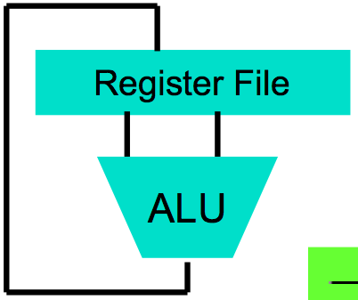
Levels of Representation/Interpretation
High Level Language Program (e.g., C)
temp = v[k];
v[k] = v[k+1];
v[k+1] = temp;
Compiler
Anything can be represented as a number, i.e., data or instructions
lw $t0, 0($2)
lw $t1, 4($2)
sw $t1, 0($2)
sw $t0, 4($2)
Assembly Language Program (e.g., MIPS)
Assembler
0000 1001 1100 0110 1010 1111 0101 1000
1010 1111 0101 1000 0000 1001 1100 0110
1100 0110 1010 1111 0101 1000 0000 1001
0101 1000 0000 1001 1100 0110 1010 1111
Machine Language Program (MIPS)
Machine Interpretation
Hardware Architecture Description (e.g., block diagrams)
Architecture Implementation
Logic Circuit Description (Circuit Schematic Diagrams)

Slide 3
Review
Synchronous Digital Systems
Synchronous - Pulse of a Clock controls flow of information
Digital - All signals are seen as either 0 (below a certain voltage) or 1.
SDS constructed from two types of elements:
Combinational Logic - Stateless, output only a function of immediate inputs
State Elements (Registers)
Truth table can be mapped to gates for combinational logic design
Boolean algebra allows minimization of gates
State registers implemented from Flip-flops

Slide 4
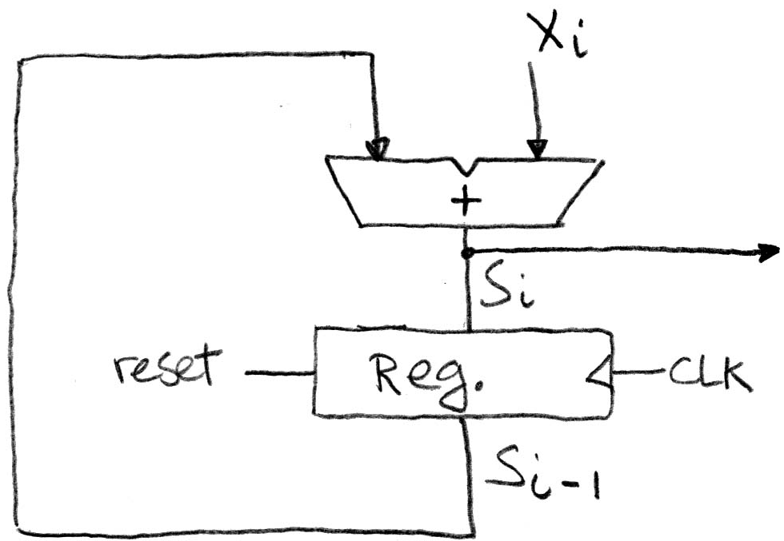
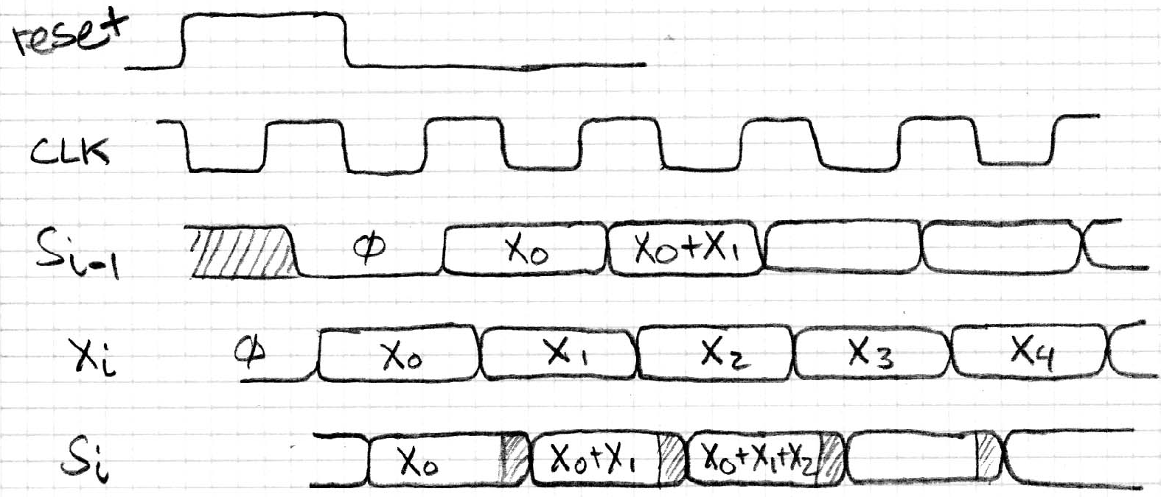
Accumulator Revisited ...Again
reset signal shown
In practice X might not arrive to the adder at the same time as S_{i-1}
S_{i} temporarily is wrong, but register always captures correct value
In good circuits, instability never happens around rising edge of clk

Slide 5
Agenda
State Elements
Finite State Machines
Administrivia / Break
Multiplexers
ALU Design
Adder/Subtracter

Slide 6
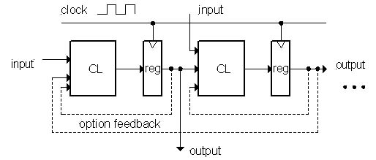
Model for Synchronous Systems
Collection of Combinational Logic blocks separated by registers
Feedback is optional
Clock signal(s) connects only to clock input of registers
Clock (CLK): steady square wave that synchronizes the system
Register: several bits of state that samples on rising edge of CLK (positive edge-triggered)

Slide 7
Timing Terms
Setup Time: when the input must be stable before the rising edge of the CLK
Hold Time: when the input must be stable after the rising edge of the CLK
“CLK-to-Q” Delay: how long it takes the output to change, measured from the rising edge of the CLK

Slide 8
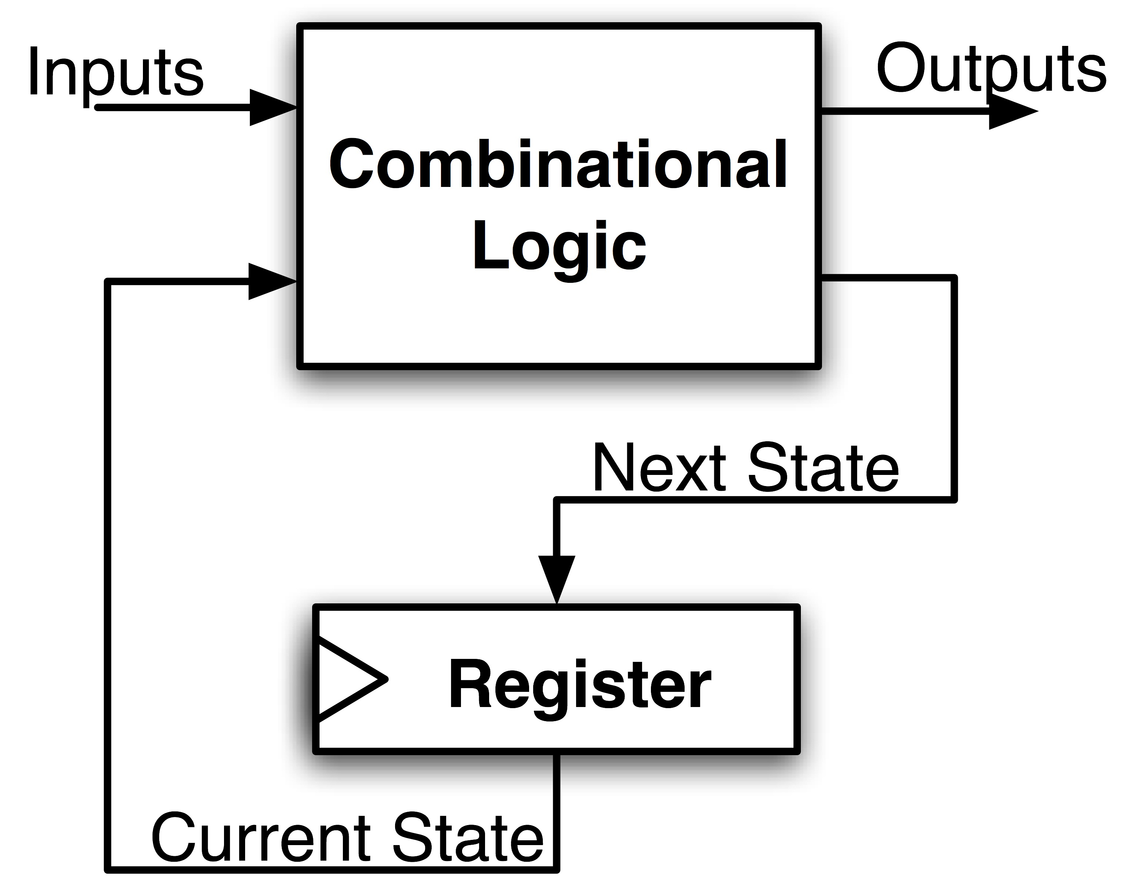
Maximum Clock Frequency
What is the maximum frequency of this circuit?
Hint:
Frequency = 1/Period
Max Delay = Setup Time + CLK-to-Q Delay + CL Delay

Slide 9
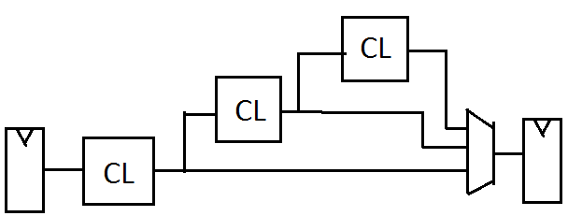
The Critical Path
The Critical Path is the longest delay between any two registers in a circuit.
The clock period must be longer than this critical path, or the signal will not propagate to that next register

Slide 10
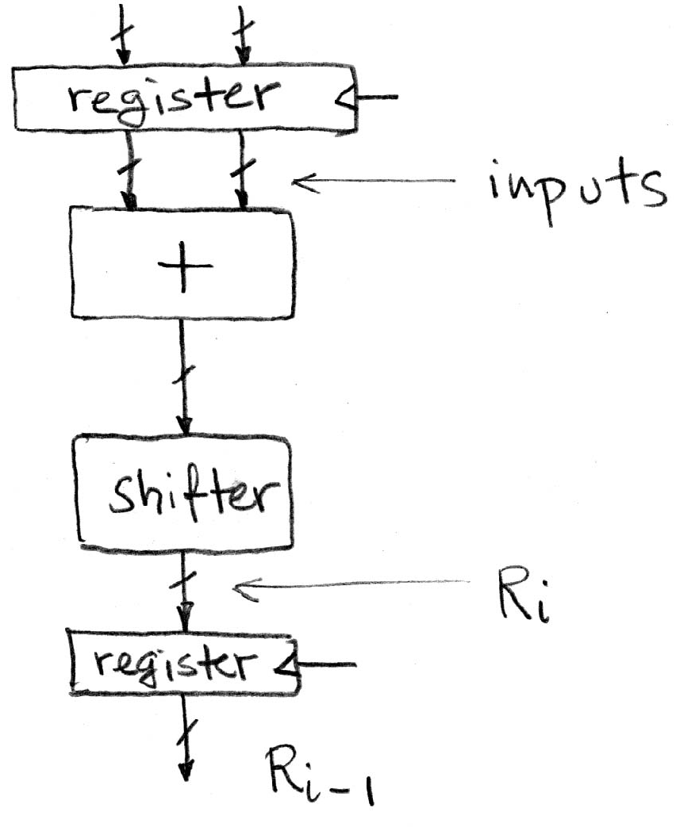
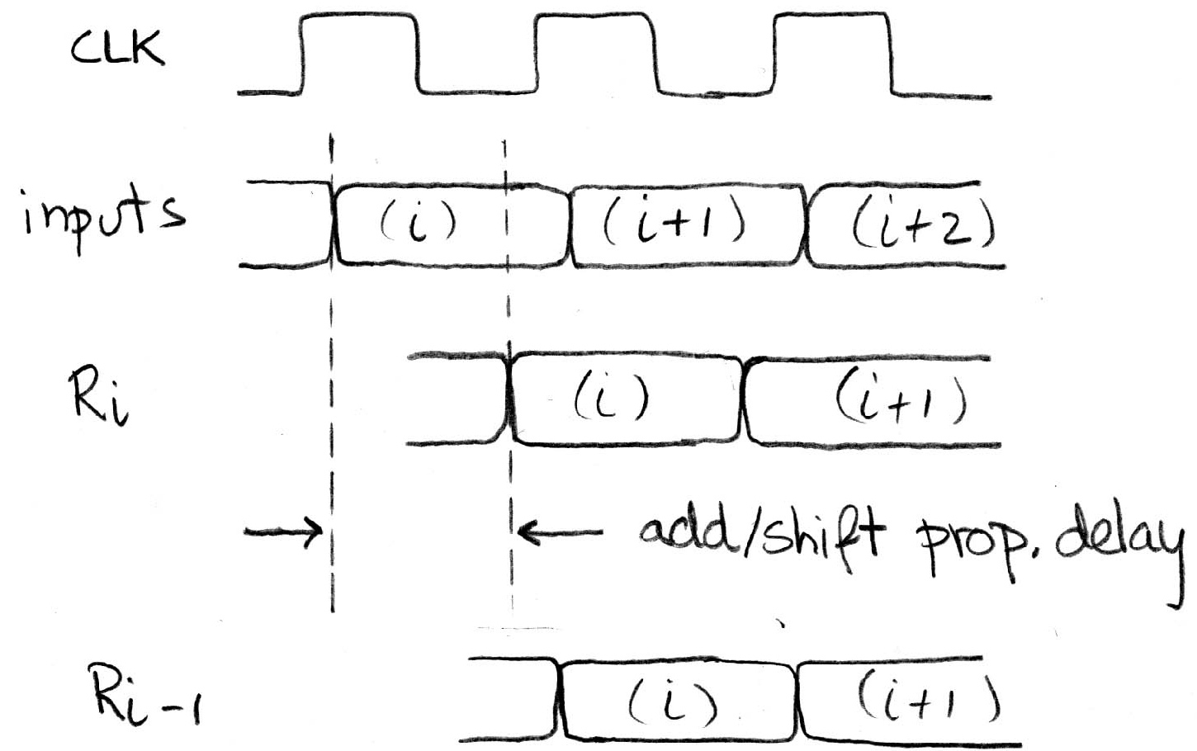
Pipelining to Improve Performance (1/2)
An extra register can be added to speed up the clock rate
Timing…
Note: delay of 1 clock cycle from input to output.
Clock period limited by propagation delay of adder/shifter

Slide 11
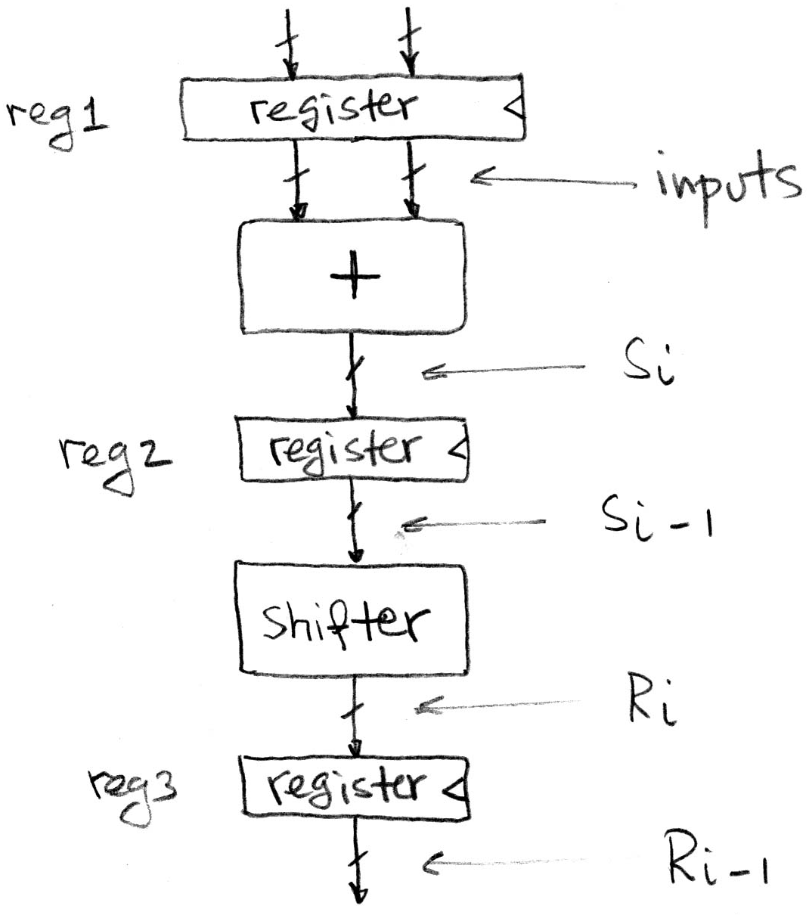
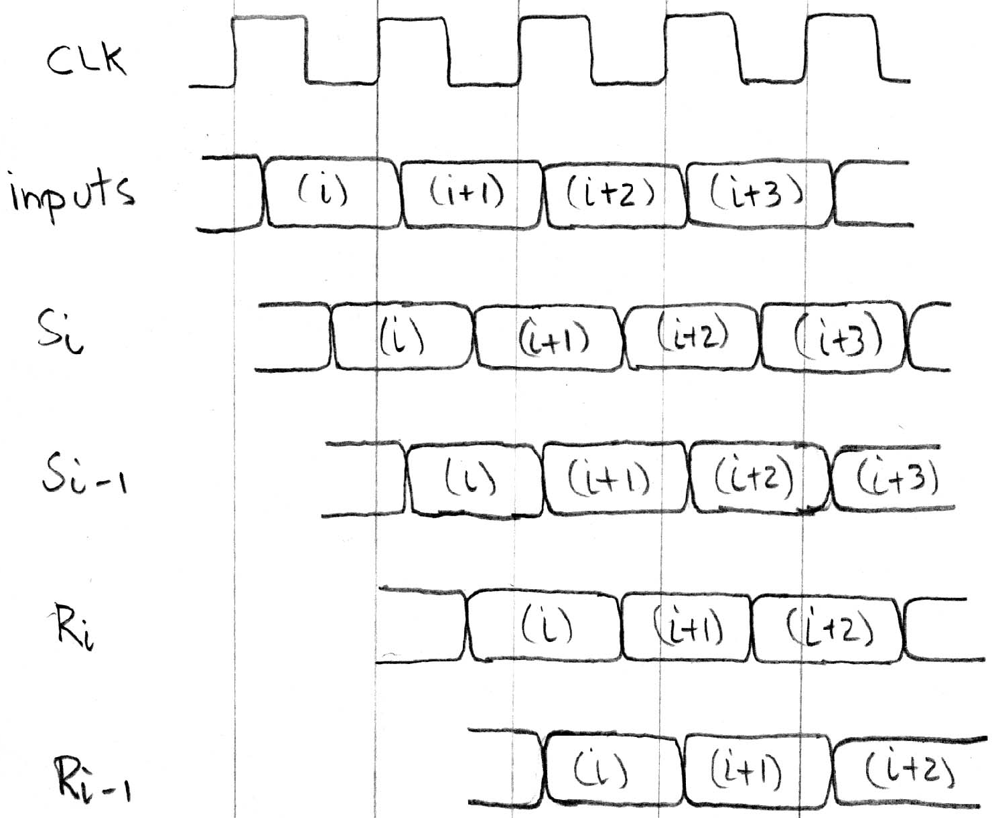
Pipelining to Improve Performance (2/2)
Insertion of register allows higher clock frequency
More outputs per second
However, 2 (shorter) clock cycles to produce first output. Higher latency!

Slide 12
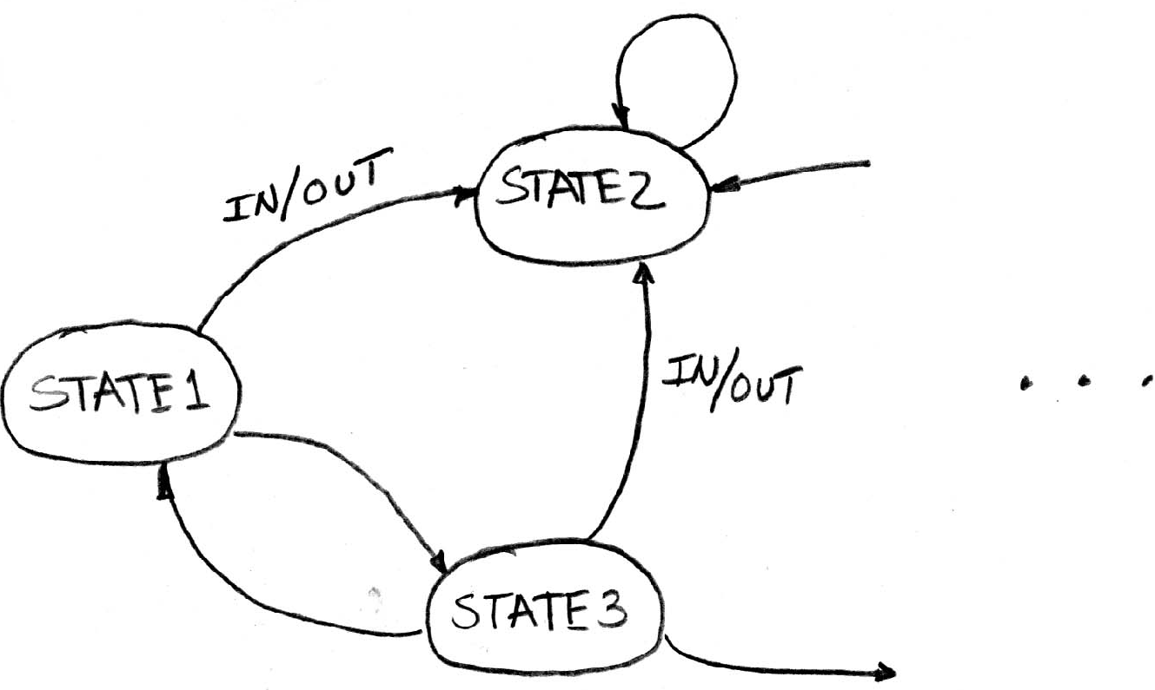
Another Great Idea: Finite State Machines (FSM)
You may have seen FSMs in other classes (have you?)
Function can be represented with a “state transition diagram”
With combinational logic and registers, any FSM can be implemented in hardware

Slide 13
FSM Overview
An FSM (in this class) is defined by:
A set of states S
A starting state s₀
A transition function that maps from Current Input and Current State to Current Output and Next State. (The arrows in the diagram)

Slide 14
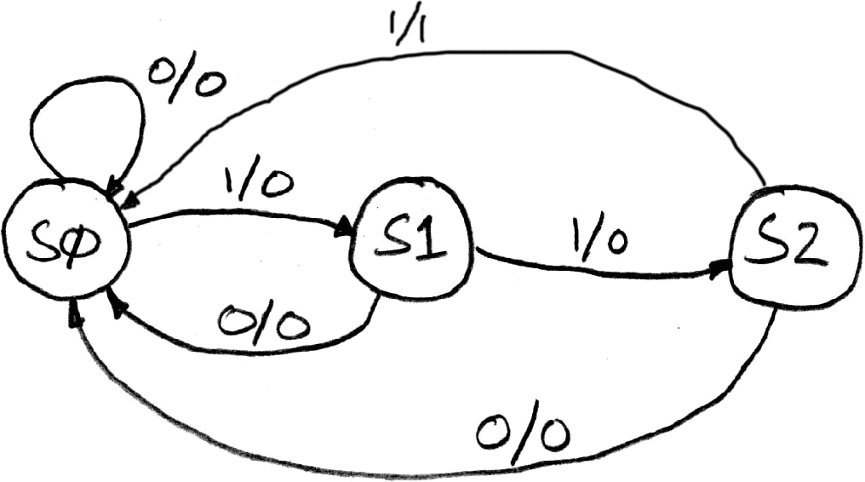
Example: 3 Ones FSM
FSM to detect the occurrence of 3 consecutive 1’s in the Input
Draw the FSM …
Assume state transitions are controlled by the clock: On each clock cycle the machine checks the inputs and moves to a new state and produces a new output …

Slide 15
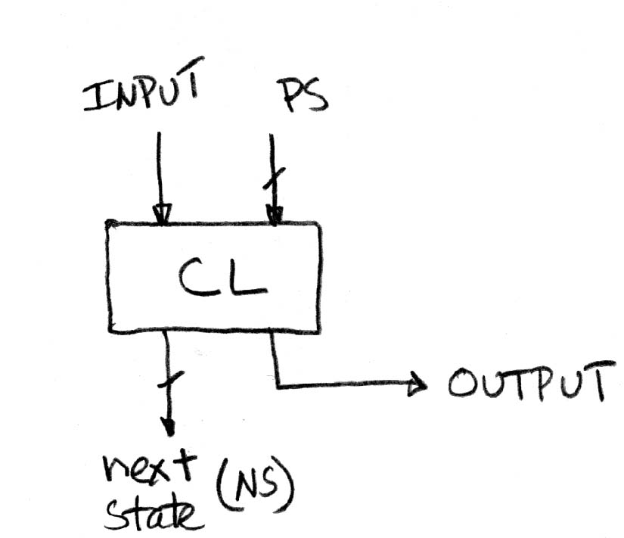
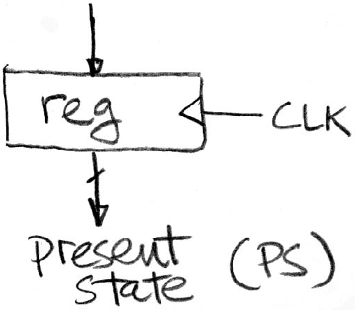
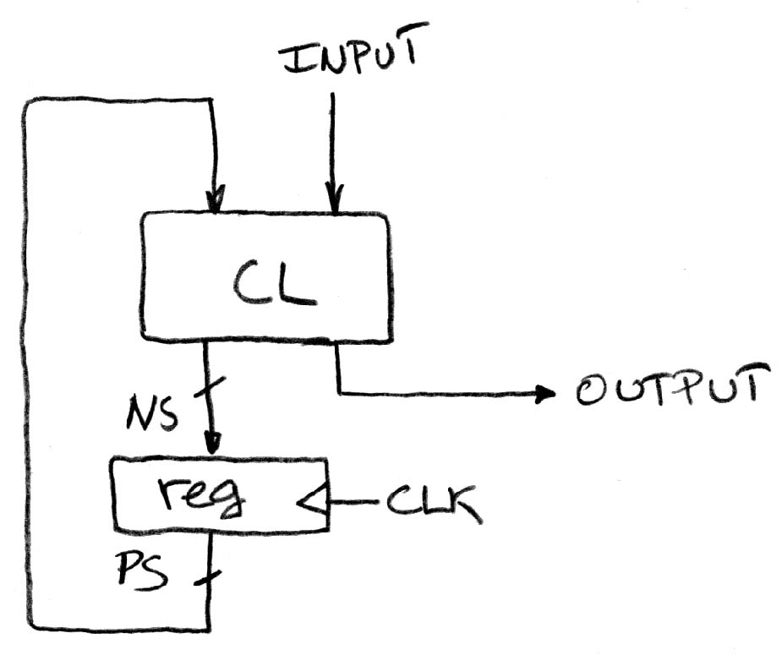
Hardware Implementation of FSM
Register needed to hold a representation of the machine’s state. Unique bit pattern for each state.
+
Combinational logic circuit is used to implement a function maps from present state and input to next state and output.
=
The register is used to break the feedback path between NS and PS, controlled by the clock

Slide 16
Hardware for FSM: Combinational Logic
Can look at its functional specification, truth table form
Truth table …
PS
Input
NS
Output
00
0
00
0
00
1
01
0
01
0
00
0
01
1
10
0
10
0
00
0
10
1
00
1

Slide 17
Administrivia
Midterm rubric is posted
Regrade deadline extended to next Thursday since I was late in getting this up.
“We will regrade the entire test”
HW3, Project 2 Part 2 will be posted today.

Slide 18
Agenda
State Elements
Finite State Machines
Administrivia / Break
Multiplexers
ALU Design
Adder/Subtracter

Slide 19
Data Multiplexer (e.g., 2-to-1 x n-bit-wide)
“mux”
Notes:
Go to Logisim and do design from mux

Slide 20
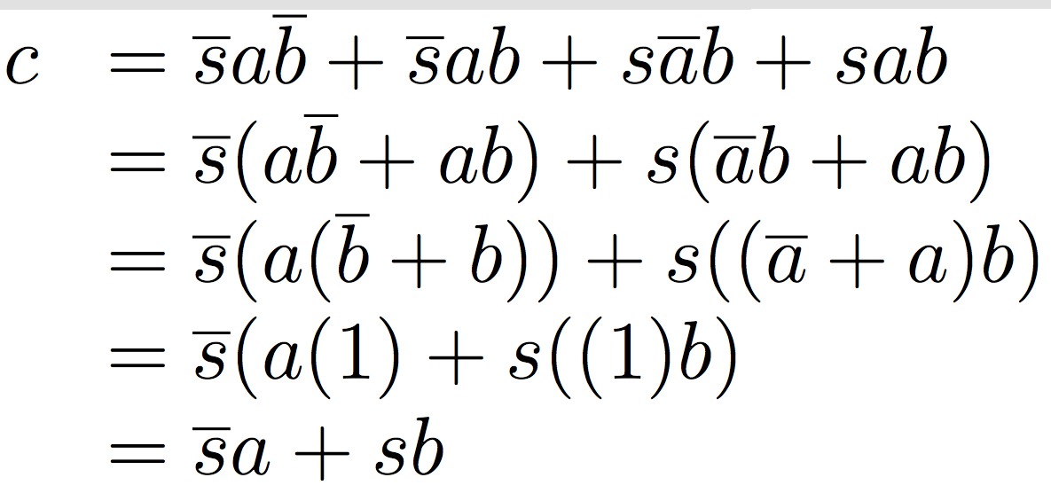
N Instances of 1-bit-Wide Mux
How many rows in TT?

Slide 21
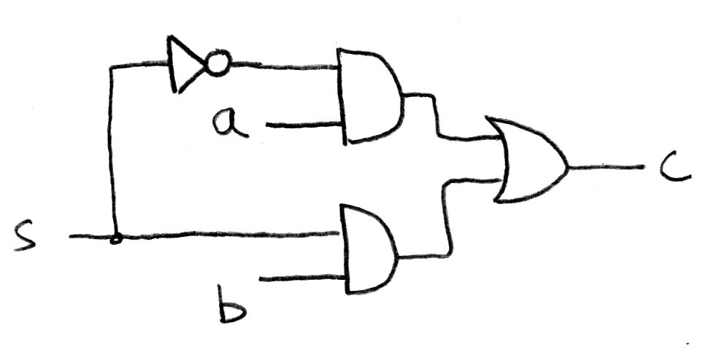
How Do We Build a 1-bit-Wide Mux?
Notes:
Draw on Board, Build in Logisim, create as subcircuit my mux
Make s north facing

Slide 22
4-to-1 Multiplexer
How many rows in TT?

Slide 23
Alternative Hierarchical Approach

Slide 24
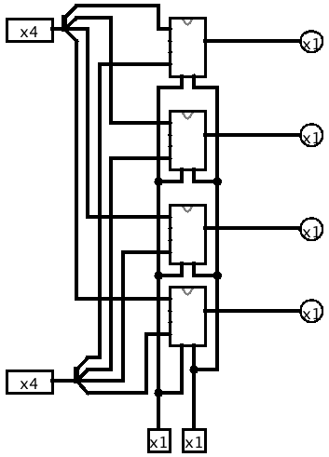
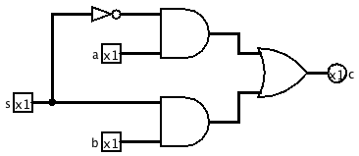
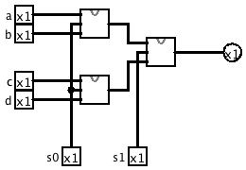
In Logisim
2 to 1, 1 bit mux
4 to 1, 1 bit mux
4 to 1, 4 bit mux

Slide 25
Common Mistakes in Logisim
Connecting wires together
Losing track of which input is which
Connecting to edge without connecting to actual input
Unexpected direction of input
Notes:
1. XOR Logic with Bug.circ
Works for 00, 10, 11, breaks for 01
(xor connected to input of gate – 2 wires with different values)
2. AndBug.circ
Works for 00, 10, 01, fails for 11
(its not unconnected inputs to And gate – change inputs to see)
(its using west facing input as an output)
3. counter without bug.circ
FSM not working as change input!
(facing wrong way)

Slide 26
Agenda
State Elements
Finite State Machines
Administrivia / Break
Multiplexers
ALU Design
Adder/Subtracter

Slide 27
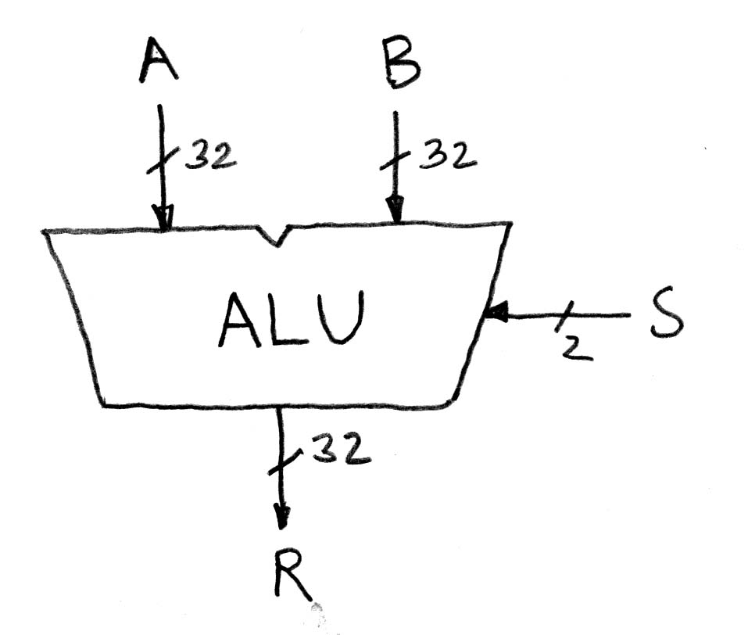
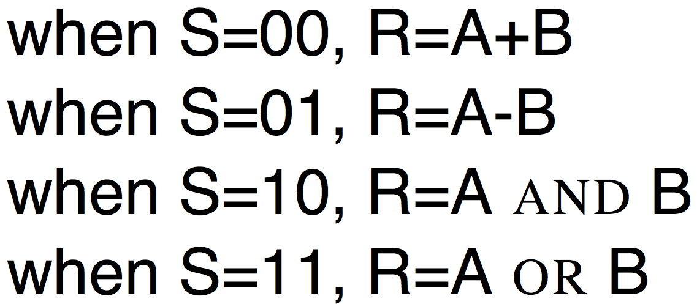
Arithmetic and Logic Unit
Most processors contain a special logic block called “Arithmetic and Logic Unit” (ALU)
We’ll show you an easy one that does ADD, SUB, bitwise AND, bitwise OR

Slide 28
Simple ALU

Slide 29
Agenda
State Elements
Finite State Machines
Administrivia / Break
Multiplexers
ALU Design
Adder/Subtracter

Slide 30
Adder/Subtractor: One-bit adder for Least Significant Bit

Slide 31
Adder/Subtractor: One-bit adder (1/2) …

Slide 32
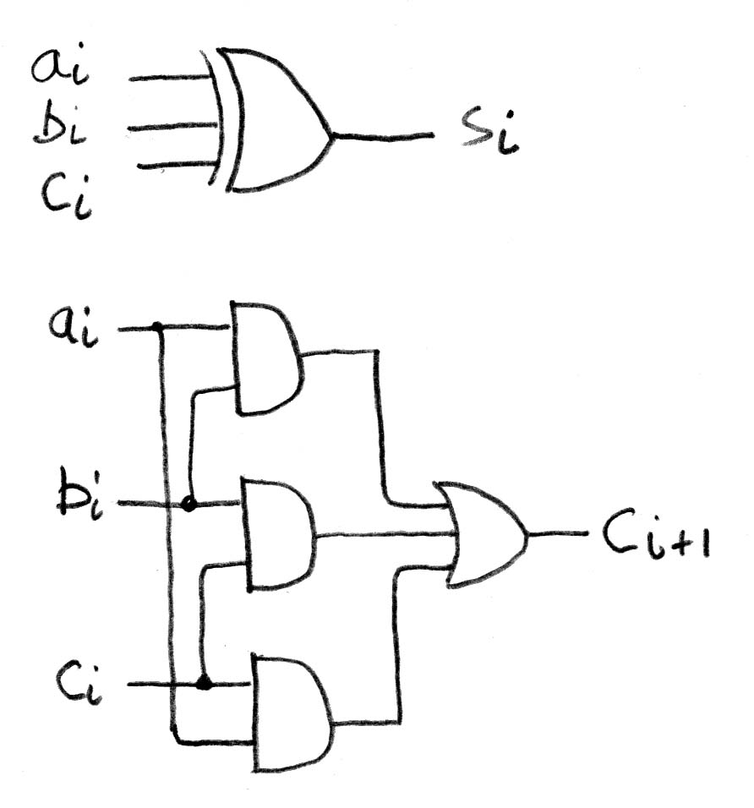
Adder/Subtractor: One-bit Adder (2/2) …

Slide 33
N x 1-bit Adders ⇒ 1 N-bit Adder
Connect Carry Out i-1 to Carry in i:
b₀
+
+
+

Slide 34
Twos Complement Adder/Subtractor

Slide 35
Summary
D-flip-flops update at rising edge of clock
Setup and Hold times important
Critical path constrains clock rate
Finite State Machines extremely useful
Use muxes to select among input
S input bits selects 2^{S} inputs
Each input can be n-bits wide, indep of S
Build n-bit adder out of chained 1-bit adders.

