Slide 1
CS 61C: Great Ideas in Computer Architecture (Machine Structures) Technology Trends and Data Level Parallelism
Instructor: Michael Greenbaum

Slide 2
Agenda
Caches - Replacement Policies, Review
Administrivia
Course Halfway Point!
Technology Trends and the Need for Parallelism
Break
The Flynn Taxonomy
SIMD Instructions

Slide 3
Review
Lots and lots of cache parameters!
Write-back vs. write through, write allocation, block size, cache size, associativity, etc.
Multi-level caches - Reduce Cache Miss Penalty
Optimize first level to be fast!
Optimize 2nd and 3rd levels to minimize the memory access penalty
Set-associativity - Reduce Cache Miss Rate
Memory block maps into more than 1 cache block
N-way: n possible places in cache to hold a memory block

Slide 4
Costs of Set-Associative Caches
When miss occurs, which block in set selected for replacement?
Least Recently Used (LRU): one that has been unused the longest
Must track when each block was used relative to other blocks in the set
For 2-way SA $, one bit per set → set to 1 when a block is referenced; reset the other way’s bit (i.e., “last used”)
N-way set-associative cache costs
N comparators for tag comparisons
Must choose appropriate set (multiplexer) before data is available
Notes:
First of all, a N-way set associative cache will need N comparators instead of just one comparator (use the right side of the diagram for direct mapped cache).
A N-way set associative cache will also be slower than a direct mapped cache because of this extra multiplexer delay.
Finally, for a N-way set associative cache, the data will be available AFTER the hit/miss signal becomes valid because the hit/mis is needed to control the data MUX.
For a direct mapped cache, that is everything before the MUX on the right or left side, the cache block will be available BEFORE the hit/miss signal (AND gate output) because the data does not have to go through the comparator.
This can be an important consideration because the processor can now go ahead and use the data without knowing if it is a Hit or Miss. Just assume it is a hit.
Since cache hit rate is in the upper 90% range, you will be ahead of the game 90% of the time and for those 10% of the time that you are wrong, just make sure you can recover.
You cannot play this speculation game with a N-way set-associative cache because as I said earlier, the data will not be available to you until the hit/miss signal is valid.
+2 = 38 min. (Y:18)

Slide 5
LRU Approximation
Difficult to keep track of LRU for large associativity (must update counter for every block, for example).
Example of a Simple “Pseudo” LRU Implementation
Assume 64 Fully Associative entries in a set.
Hardware replacement pointer points to one cache entry
Whenever access is made to the entry the pointer points to:
Move the pointer to the next entry
Otherwise: do not move the pointer
Entry 0
Entry 1
Replacement
:
Pointer
Entry 63

Slide 6
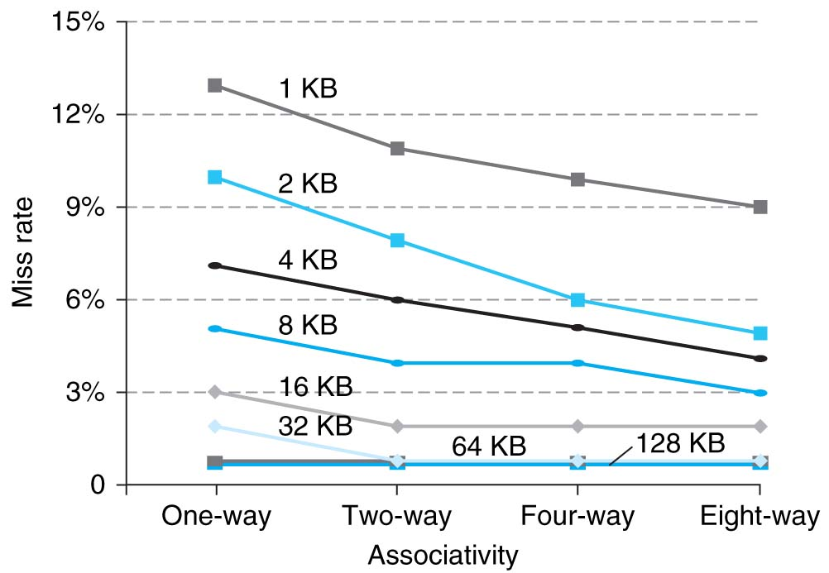
Benefits of Set-Associative Caches
Choice of DM $ or SA $ depends on the cost of a miss versus the cost of implementation
Largest gains are in going from direct mapped to 2-way (20%+ reduction in miss rate)
Notes:
As cache sizes grow, the relative improvement from associativity increases only slightly; since the overall miss rate of a larger cache is lower, the opportunity for improving the miss rate decreases and the absolute improvement in miss rate from associativity shrinks significantly.

Slide 7
How to Calculate 3C’s using Cache Simulator
Compulsory: set cache size to infinity and fully associative, and count number of misses
Capacity: Change cache size from infinity, usually in powers of 2, and count misses for each reduction in size
16 MB, 8 MB, 4 MB, … 128 KB, 64 KB, 16 KB
Conflict: Change from fully associative to n-way set associative while counting misses
Fully associative, 16-way, 8-way, 4-way, 2-way, 1-way

Slide 8
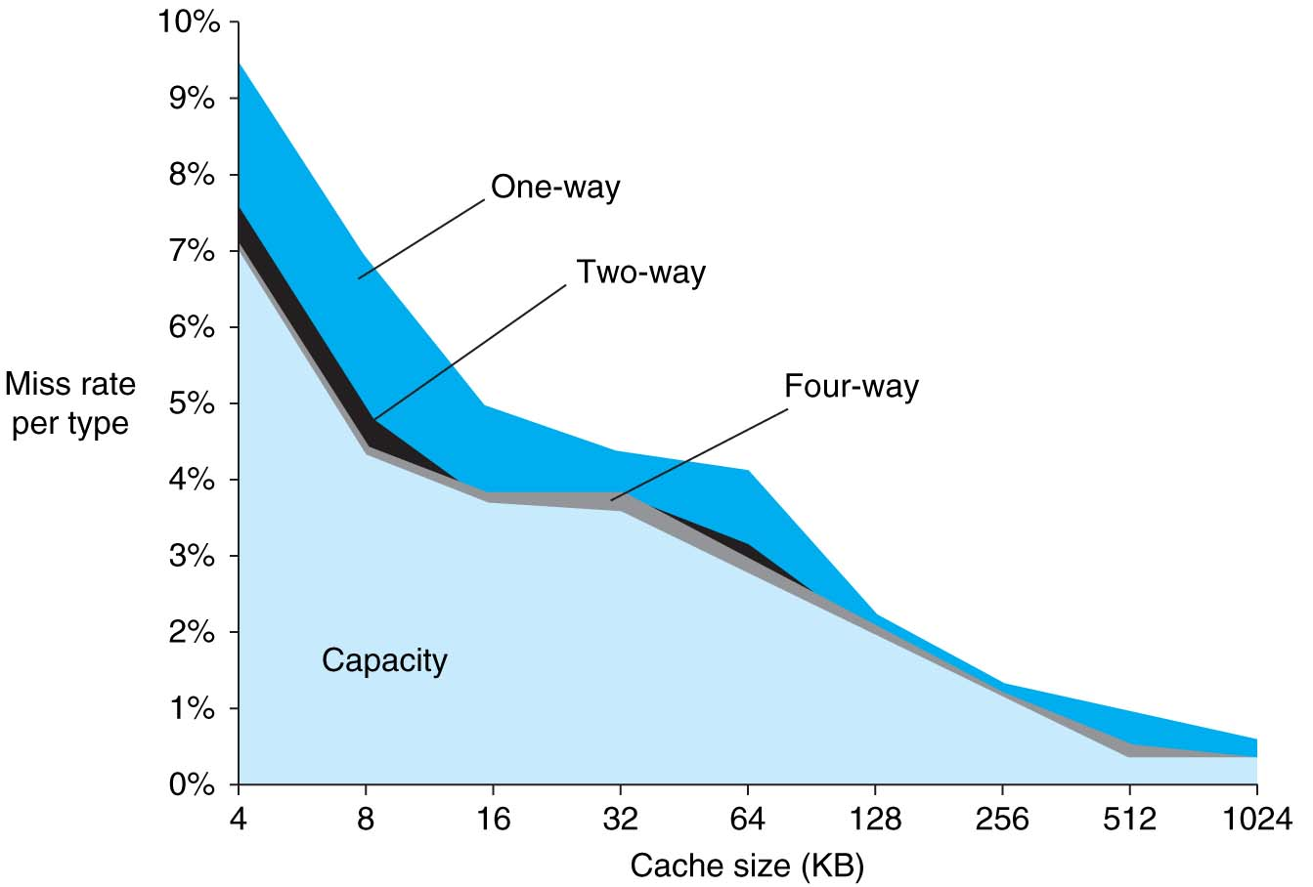
3Cs Revisted
Three sources of misses (SPEC2000 integer and floating-point benchmarks)
Compulsory misses 0.006%; not visible
Capacity misses, function of cache size
Conflict portion depends on associativity and cache size

Slide 9
Improving Cache Performance: Summary
1. Reduce the time to hit in the cache
Smaller cache
1 word blocks (no multiplexor/selector to pick word)
2. Reduce the miss rate
Bigger cache
Larger blocks (16 to 64 bytes typical)
Increasing Associativity

Slide 10
Improving Cache Performance: Summary
3. Reduce the miss penalty
Smaller blocks
Use multiple cache levels
Other tricks possible:
Use a write buffer to hold dirty blocks being replaced so don’t have to wait for the write to complete before reading .
Check write buffer on read miss – may get lucky

Slide 11
The Cache Design Space
Several interacting dimensions
Cache size
Block size
Write-through vs. write-back
Write allocation
Later Associativity
Replacement policy
Optimal choice is a compromise
Depends on access characteristics
Workload
Use (I-cache, D-cache)
Depends on technology / cost
Simplicity often wins
Cache Size
(Associativity)
Block Size
Bad
Good
Factor A
Factor B
Less
More
Notes:
No fancy replacement policy is needed for the direct mapped cache.
As a matter of fact, that is what cause direct mapped trouble to begin with: only one place to go in the cache--causes conflict misses.
No fancy replacement policy is needed for the direct mapped cache.
As a matter of fact, that is what cause direct mapped trouble to begin with: only one place to go in the cache--causes conflict misses.
Besides working at Sun, I also teach people how to fly whenever I have time.
Statistic have shown that if a pilot crashed after an engine failure, he or she is more likely to get killed in a multi-engine light airplane than a single engine airplane.
The joke among us flight instructors is that: sure, when the engine quit in a single engine stops, you have one option: sooner or later, you land. Probably sooner.
But in a multi-engine airplane with one engine stops, you have a lot of options. It is the need to make a decision that kills those people.

Slide 12
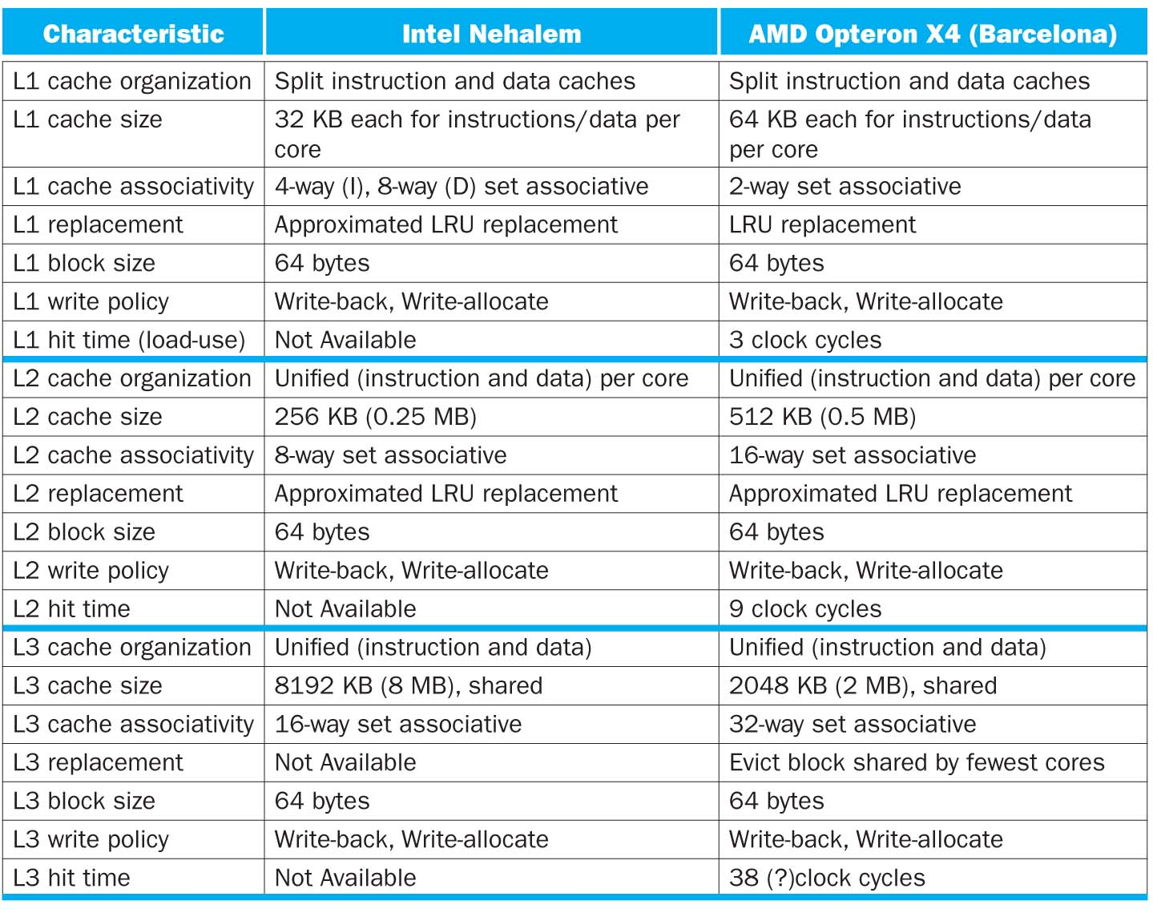

Slide 13
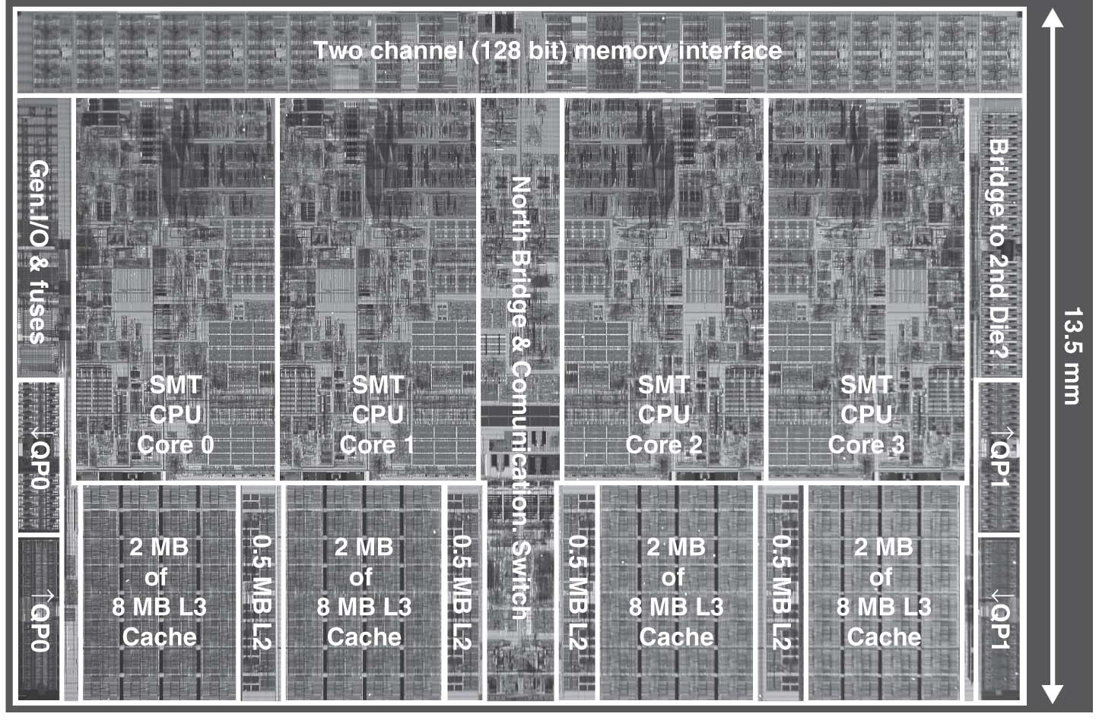
Intel Nehalem Die Photo
4 cores, 32KB I$/32-KB D$, 512KB L2$
Share one 8-MB L3$

Slide 14
Agenda
Caches - Replacement Policies, Review
Administrivia
Course Halfway Point!
Technology Trends and the Need for Parallelism
Break
The Flynn Taxonomy
SIMD Instructions

Slide 15
Administrivia
Midterm
Friday 7/15, 9am-12pm, 2050 VLSB
How to study:
Studying in groups can help.
Take old exams for practice (link at top of main webpage)
Look at lectures, section notes, projects, hw, labs, etc.
There are still a few OH left before the test…
Will cover up to yesterday’s material (+overlap into today).

Slide 16
Agenda
Caches - Replacement Policies, Review
Administrivia
Course Halfway Point!
Technology Trends and the Need for Parallelism
Break
The Flynn Taxonomy
SIMD Instructions

Slide 17
Course Halfway Point!
With the background knowledge we have, we can begin to discuss modern developments in computer architecture.
Focus on extracting more performance from existing technologies, continuing trends of accelerating computational power.
Lots of material now is “new 61c” exclusive. You’re the third class to ever see it.

Slide 18
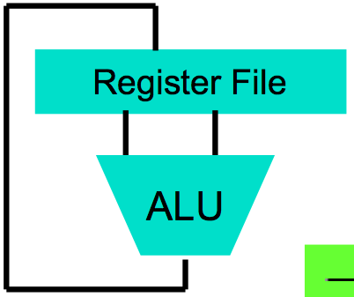
Great Idea #1: Levels of Representation/Interpretation
High Level Language Program (e.g., C)
temp = v[k];
v[k] = v[k+1];
v[k+1] = temp;
Compiler
Anything can be represented as a number, i.e., data or instructions
lw $t0, 0($2)
lw $t1, 4($2)
sw $t1, 0($2)
sw $t0, 4($2)
Assembly Language Program (e.g., MIPS)
Assembler
0000 1001 1100 0110 1010 1111 0101 1000
1010 1111 0101 1000 0000 1001 1100 0110
1100 0110 1010 1111 0101 1000 0000 1001
0101 1000 0000 1001 1100 0110 1010 1111
Machine Language Program (MIPS)
Machine Interpretation
Hardware Architecture Description (e.g., block diagrams)
Architecture Implementation
Logic Circuit Description (Circuit Schematic Diagrams)

Slide 19
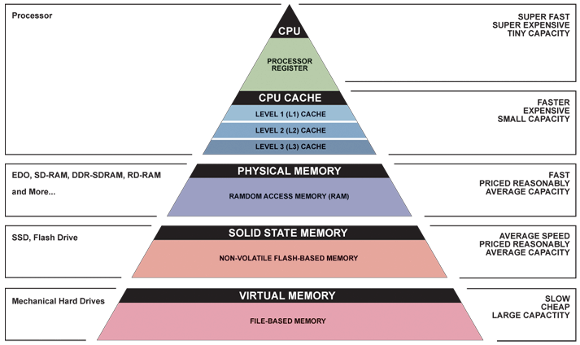
Great Idea #3: Principle of Locality/ Memory Hierarchy
First half 61C

Slide 20
Great Idea #5: Performance Measurement and Improvement
Matching application to underlying hardware to exploit:
Locality
Parallelism
Special hardware features, like specialized instructions (e.g., matrix manipulation)
Latency
How long to set the problem up
How much faster does it execute once it gets going
It is all about time to finish

Slide 21
Agenda
Caches - Replacement Policies, Review
Administrivia
Course Halfway Point!
Technology Trends and the Need for Parallelism
Break
The Flynn Taxonomy
SIMD Instructions

Slide 22
Technology Cost over Time: What does Improving Technology Look Like?
Cost
$
A
D
B
C
Time

Slide 23
Technology Cost over Time
Cost
$
C
Time

Slide 24
Technology Cost over Time Successive Generations
Cost
$
How Can Tech Gen 2 Replace Tech Gen 1?
Technology Generation 1
Technology Generation 2
Technology Generation 2
Technology Generation 3
Time

Slide 25
Technology Performance over Time
Performance
Time

Slide 26
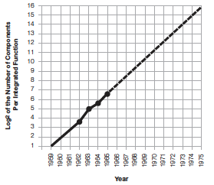
Moore’s Law
“The complexity for minimum component costs has increased at a rate of roughly a factor of two per year. …That means by 1975, the number of components per integrated circuit for minimum cost will be 65,000.” (from 50 in 1965)
Gordon Moore, “Cramming more components onto integrated circuits,” Electronics, Volume 38, Number 8, April 19, 1965
“Integrated circuits will lead to such wonders as home computers--or at least terminals connected to a central computer--automatic controls for automobiles, and personal portable communications equipment. The electronic wristwatch needs only a display to be feasible today.”

Slide 27
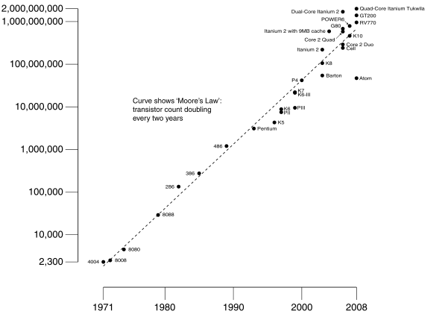
Moore’s Law
Predicts: 2X Transistors / chip every 2 years
# of transistors on an integrated circuit (IC)
Gordon Moore Intel Cofounder B.S. Cal 1950!
Year

Slide 28
End of Moore’s Law?
It’s also a law of investment in equipment as well as increasing volume of integrated circuits that need more transistors per chip
Exponential growth cannot last forever
More transistors/chip will end during your careers
2020? 2025?
(When) will something replace it?

Slide 29
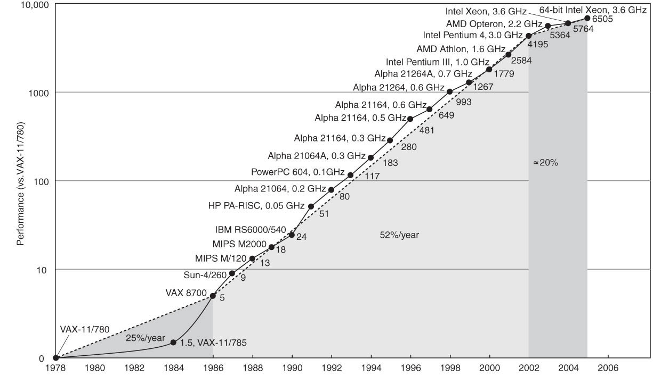
Technology Trends: Uniprocessor Performance (SPECint)
Improvements in processor performance have slowed
Why?

Slide 30
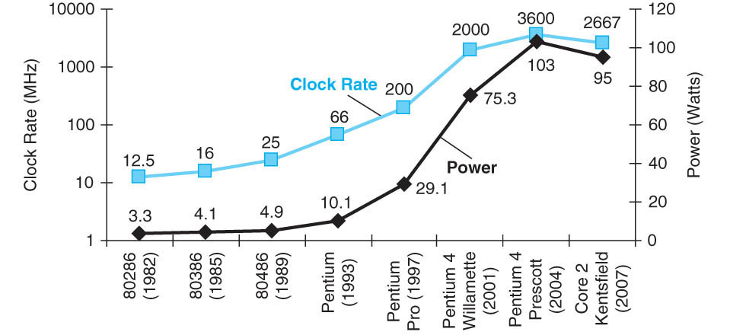
Limits to Performance: Faster Means More Power
P = CV²f

Slide 31
P = C V² f
Power is proportional to Capacitance * Voltage² * Frequency of switching
What is the effect on power consumption of:
“Simpler” implementation (fewer transistors)?
Smaller implementation (shrunk down design)?
Reduced voltage?
Increased clock frequency?

Slide 32
Multicore Helps Energy Efficiency
Power ~ CV²f
William Holt, HOT Chips 2005

Slide 33
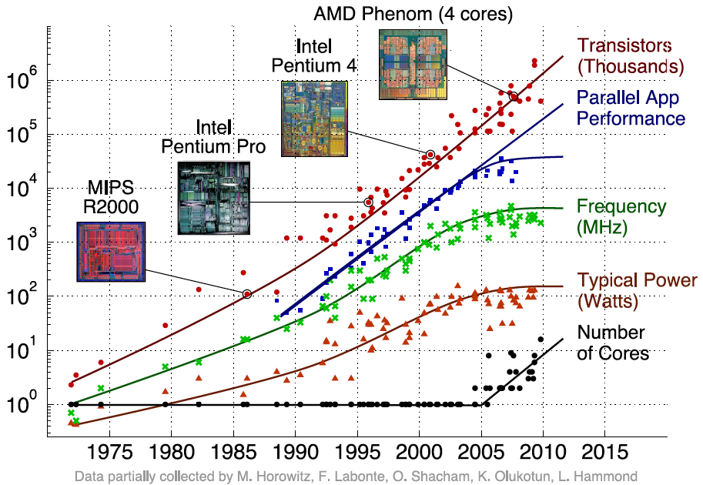
Transition to Multicore
Sequential App Performance

Slide 34
Parallelism - The Challenge
Only path to performance is parallelism
Clock rates flat or declining
Key challenge is to craft parallel programs that have high performance on multiprocessors as the number of processors increase – i.e., that scale
Scheduling, load balancing, time for synchronization, overhead for communication
Project #2: fastest matrix multiply code on 8 processor (8 cores) computers
2 chips (or sockets)/computer, 4 cores/chip

Slide 35
Agenda
Caches - Replacement Policies, Review
Administrivia
Course Halfway Point!
Technology Trends and the Need for Parallelism
Break
The Flynn Taxonomy
SIMD Instructions

Slide 36
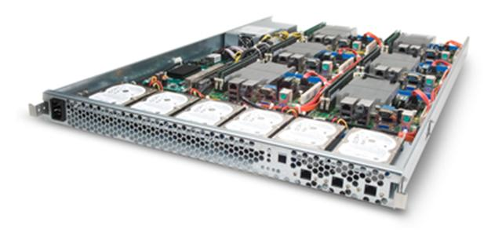
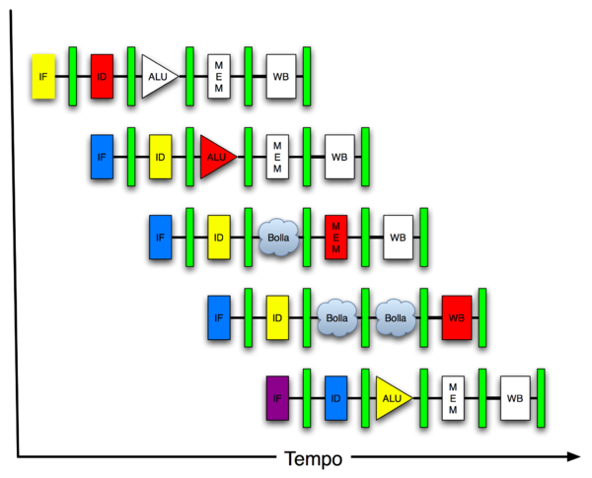
New-School Machine Structures (It’s a bit more complicated!)
Software Hardware
Parallel Requests
Assigned to computer
e.g., Search “Katz”
Parallel Threads
Assigned to core
e.g., Lookup, Ads
Parallel Instructions
>1 instruction @ one time
e.g., 5 pipelined instructions
Parallel Data
>1 data item @ one time
e.g., Add of 4 pairs of words
Hardware descriptions
All gates @ one time
Warehouse Scale Computer
Smart Phone
Harness Parallelism &
Achieve High Performance
Computer
Core
…
Core
Memory (Cache)
Input/Output
Core
Instruction Unit(s)
Functional
Unit(s)
A₀+B₀
A₁+B₁
A₂+B₂
A₃+B₃
Main Memory
Logic Gates

Slide 37
Kinds of Parallelism: The Programming Viewpoint
Job-level parallelism/process-level parallelism
Running independent programs on multiple processors simultaneously
Example?
Parallel processing program
Single program that runs on multiple processors simultaneously
Example?

Slide 38
Kinds of Parallelism: Hardware vs. Software
Concurrent software can also run on serial hardware
Sequential software can also run on parallel hardware
Focus is on parallel processing software: sequential or concurrent software running on parallel hardware

Slide 39
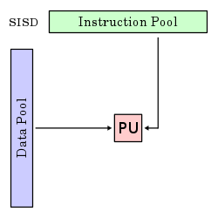
Kinds of Parallelism: Single Instruction/Single Data Stream
Single Instruction, Single Data stream (SISD)
Sequential computer that exploits no parallelism in either the instruction or data streams. Examples of SISD architecture are traditional uniprocessor machines
Processing Unit

Slide 40
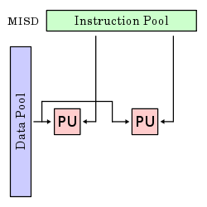
Kinds of Parallelism: Multiple Instruction/Single Data Stream
Multiple Instruction, Single Data streams (MISD)
Computer that exploits multiple instruction streams against a single data stream for data operations that can be naturally parallelized. For example, certain kinds of array processors.
No longer commonly encountered, mainly of historical interest only

Slide 41
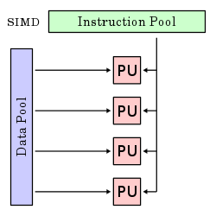
Kinds of Parallelism: Single Instruction/Multiple Data Stream
Single Instruction, Multiple Data streams (SIMD)
Computer that exploits multiple data streams against a single instruction stream to operations that may be naturally parallelized, e.g., SIMD instruction extensions or Graphics Processing Unit (GPU)

Slide 42
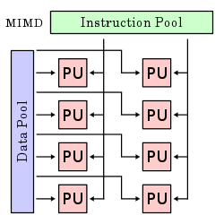
Kinds of Parallelism: Multiple Instruction/Multiple Data Streams
Multiple Instruction, Multiple Data streams (MIMD)
Multiple autonomous processors simultaneously executing different instructions on different data.
MIMD architectures include multicore and Warehouse Scale Computers

Slide 43
Flynn Taxonomy
In 2011, SIMD and MIMD most commonly encountered
SIMD : specialized function units, for handling lock-step calculations involving arrays. Essentially, vector processing instructions.
Scientific computing, signal processing, multimedia (audio/video processing)

Slide 44
Data-Level Parallelism (DLP)
2 kinds
Lots of data in memory that can be operated on in parallel (e.g., adding together 2 arrays)
Lots of data on many disks that can be operated on in parallel (e.g., searching for documents)
Rest of week and 2rd project do first type of DLP.
Later, will look at DLP across many disks or servers.

Slide 45
SIMD Architectures
Execute one operation on multiple data streams
Example to provide context:
Multiplying a coefficient vector by a data vector (e.g., in filtering)
y[i] := c[i] × x[i], 0 ≤ i < n
Sources of performance improvement:
One instruction is fetched & decoded for entire operation
Multiplications are independent, executed in parallel.
Concurrency in memory access as well

Slide 46
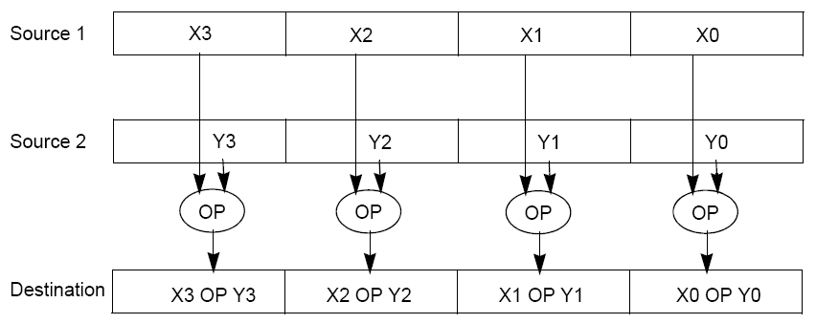
“Advanced Digital Media Boost”
To improve performance, Intel’s SIMD instructions
Fetch one instruction, do the work of multiple instructions
MMX (MultiMedia eXtension, Pentium II processor family)
SSE (Streaming SIMD Extension, Pentium III and beyond)

Slide 47
Example: SIMD Array Processing
for each f in array
f = sqrt(f)
for each f in array
{
load f to the floating-point register
calculate the square root
write the result from the register to memory
}
for each 4 members in array
{
load 4 members to the SSE register
calculate 4 square roots in one operation
write the result from the register to memory
}
pseudocode
SISD
SIMD

Slide 48
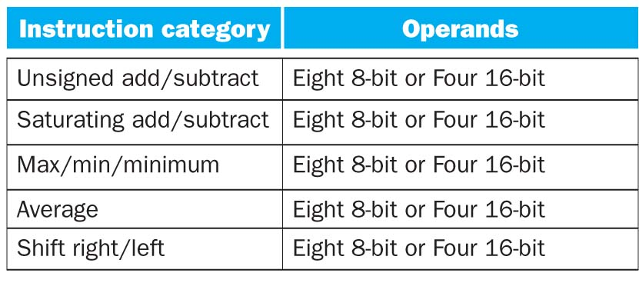
SSE Instruction Categories for Multimedia Support
SSE-2+ supports wider data types to allow 16 x 8-bit and 8 x 16-bit operands

Slide 49
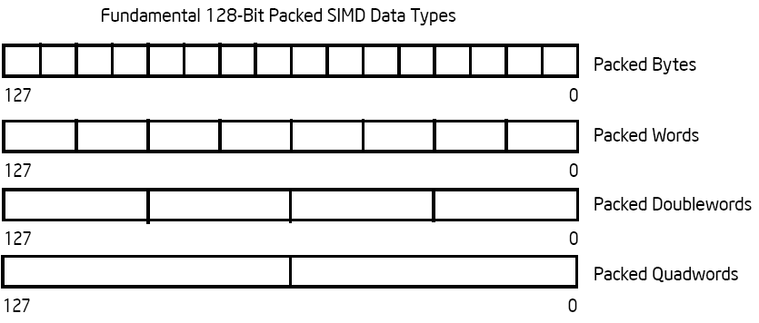
Intel Architecture 128-Bit SIMD Data Types
Note: in Intel Architecture (unlike MIPS) a word is 16 bits
Single precision FP: Double word (32 bits)
Double precision FP: Quad word (64 bits)

Slide 50
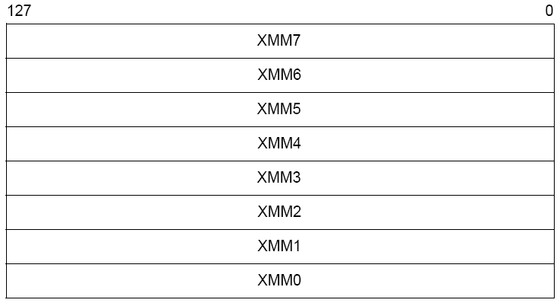
XMM Registers
Architecture extended with eight 128-bit data registers: XMM registers
IA 64-bit address architecture: available as 16 64-bit registers (XMM8 – XMM15)
E.g., 128-bit packed single-precision floating-point data type (doublewords), allows four single-precision operations to be performed simultaneously

Slide 51
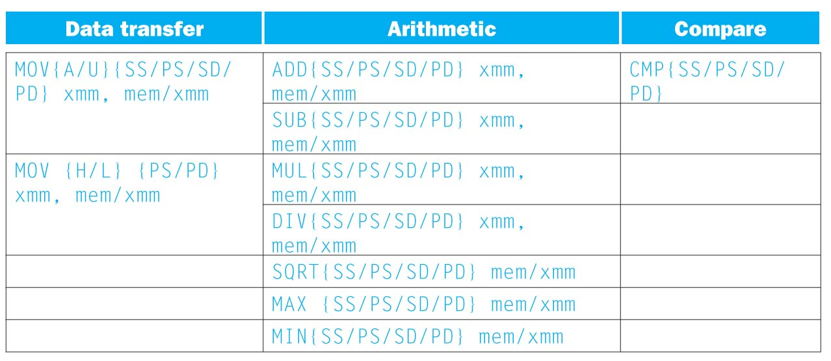
SSE/SSE2 Floating Point Instructions
xmm: one operand is a 128-bit SSE2 register
mem/xmm: other operand is in memory or an SSE2 register
{SS} Scalar Single precision FP: one 32-bit operand in a 128-bit register
{PS} Packed Single precision FP: four 32-bit operands in a 128-bit register
{SD} Scalar Double precision FP: one 64-bit operand in a 128-bit register
{PD} Packed Double precision FP, or two 64-bit operands in a 128-bit register
{A} 128-bit operand is aligned in memory
{U} means the 128-bit operand is unaligned in memory
{H} means move the high half of the 128-bit operand
{L} means move the low half of the 128-bit operand

Slide 52
Example: Add Two Single Precision FP Vectors
Computation to be performed:
vec_res.x = v1.x + v2.x;
vec_res.y = v1.y + v2.y;
vec_res.z = v1.z + v2.z;
vec_res.w = v1.w + v2.w;
SSE Instruction Sequence:
movaps xmm0,address-of-v1
;xmm0=v1.w | v1.z | v1.y | v1.x
addps xmm0,address-of-v2
;xmm0=v1.w+v2.w | v1.z+v2.z | v1.y+v2.y | v1.x+v2.x
movaps address-of-vec_res,xmm0
mov a ps : move from mem to XMM register, memory aligned, packed single precision
add ps : add from mem to XMM register, packed single precision
mov a ps : move from XMM register to mem, memory aligned, packed single precision

Slide 53
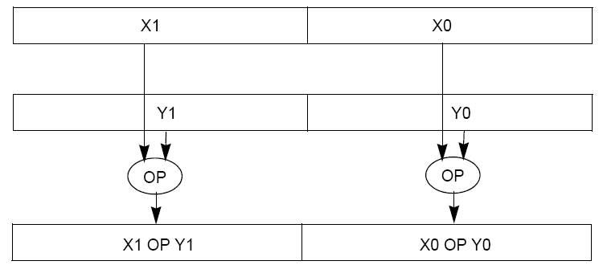
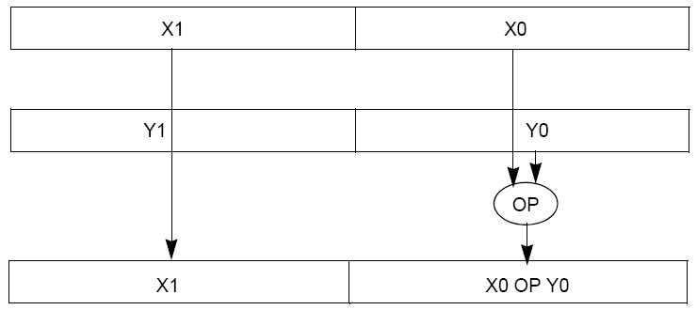
Packed and Scalar Double-Precision Floating-Point Operations

Slide 54
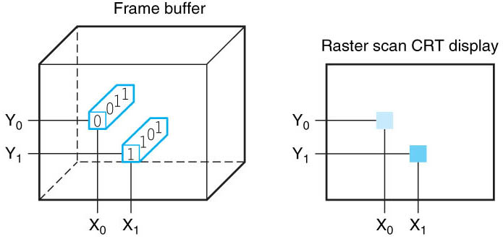
Displays and Pixels
Each coordinate in frame buffer on left determines shade of corresponding coordinate for the raster scan CRT display on right. Pixel (X0, Y0) contains bit pattern 0011, a lighter shade on the screen than the bit pattern 1101 in pixel (X1, Y1)

Slide 55
Example: Image Converter
Converts BMP image to a YUV image format:
Read individual pixels from the BMP image, convert pixels into YUV format
Can pack the pixels and operate on a set of pixels with a single instruction
E.g., bitmap image consists of 8 bit monochrome pixels
Pack these pixel values in a 128 bit register (8 bit * 16 pixels), can operate on 16 values at a time
Significant performance boost

Slide 56
Example: Image Converter
FMADDPS – Multiply and add packed single precision floating point instruction
One of the typical operations computed in transformations (e.g., DFT of FFT)
N
P = ∑ f(n) × x(n)
n = 1

Slide 57
Example: Image Converter
Floating point numbers f(n) and x(n) in src1 and src2; p in dest; C implementation for N = 4 (128 bits):
for (int i =0; i< 4; i++)
{
p = p + src1[i] * src2[i];
}
SSE2 instructions for the inner loop:
//xmm0 = p, xmm1 = src1, xmm2 = src2
mulps xmm1, xmm2
addps xmm0, xmm1
SSE5 instruction accomplishes same in one instruction:
//xmm0 = p, xmm1 = src1, xmm2 = src2
fmaddps xmm0, xmm1, xmm2, xmm0

Slide 58
“And In Conclusion..”
Moore’s Law still alive and well.
Processors have hit the power wall, the only option is to go parallel.
Instruction Level Parallelism (ILP)
Data Level Parallelism (DLP)
Thread Level Parallelism (TLP)
The major challenge is how to write programs that use our parallel architectures!

Slide 59
“And In Conclusion..”
Flynn Taxonomy of Parallel Architectures
SIMD: Single Instruction Multiple Data
MIMD: Multiple Instruction Multiple Data
SISD: Single Instruction Single Data
MISD: Multiple Instruction Single Data (unused)
Intel SSE SIMD Instructions
One instruction fetch that operates on multiple operands simultaneously
128/64 bit XMM registers

