Slide 1
CS 61C: Great Ideas in Computer Architecture (Machine Structures) Running a Program, Floating Point
Instructor: Michael Greenbaum

Slide 2
Agenda
Running a Program
Administrivia
Translation vs. Interpretation
Break
Floating Point

Slide 3
Steps to Running a Program
C program: foo.c
Compiler
Executable (mach lang pgm): a.out
Memory
Assembly program: foo.s
Assembler
Object (mach lang module): foo.o
Linker
Loader
lib.o

Slide 4
Review: Linking
.o file 1
text 1
a.out
data 1
Relocated text 1
info 1
Relocated text 2
Linker
.o file 2
Relocated data 1
text 2
Relocated data 2
data 2
info 2

Slide 5
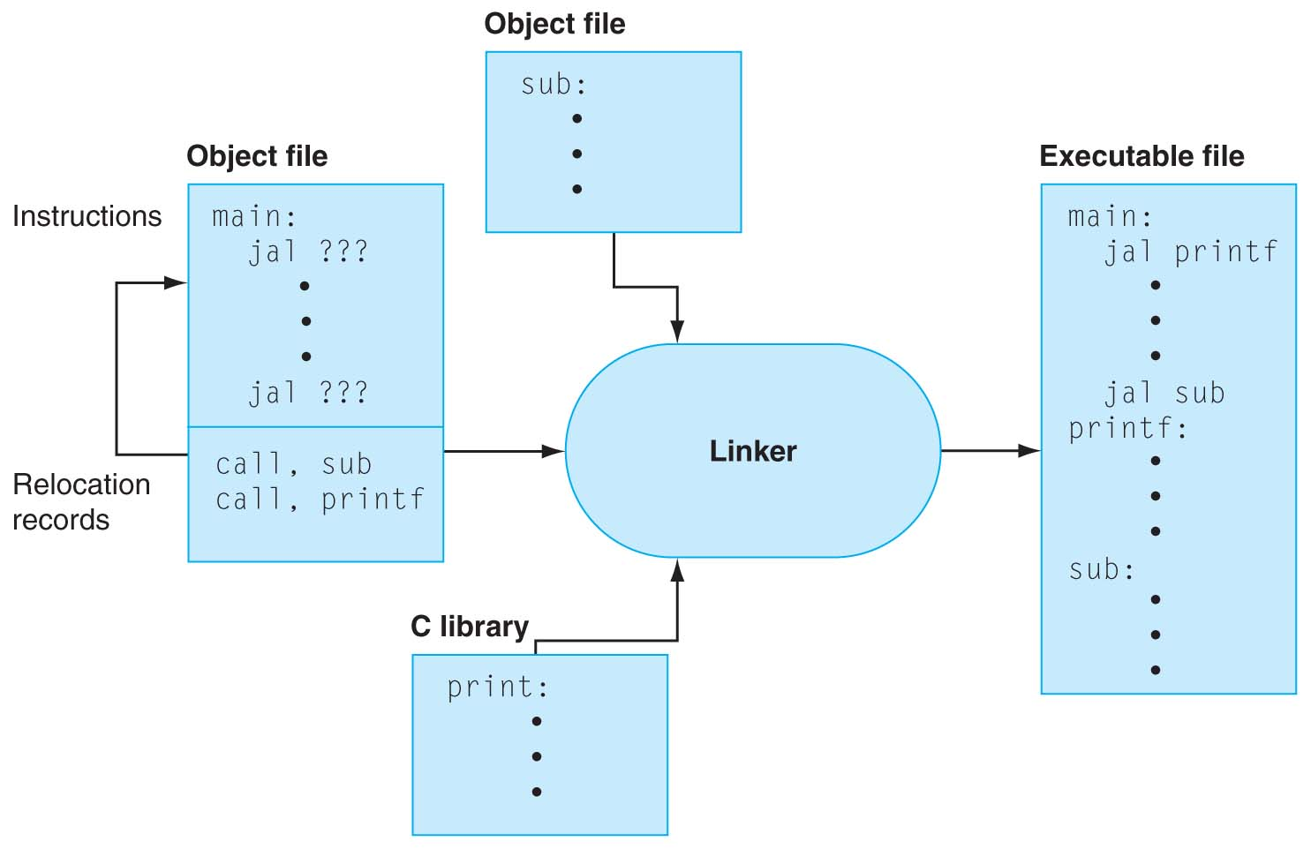
Linker Stitches Files Together
FIGURE B.3.1 The linker searches a collection of object files and program libraries to find nonlocal routines used in a program, combines them into a single executable file, and resolves references between routines in different files. Copyright © 2009 Elsevier, Inc. All rights reserved.

Slide 6
Static vs. Dynamic Linking
What we’ve described is the traditional way: statically-linked approach
The library is now part of the executable, so if the library updates, we don’t get the fix (have to recompile if we have source)
It includes the entire library even if not all of it will be used.
Executable is self-contained.
An alternative is dynamically linked libraries (DLL), common on Windows & UNIX platforms

Slide 7
Dynamic Linking
Only link/load library procedure when it is called
Automatically picks up new library versions
Requires procedure code to be relocatable
Avoids image bloat caused by static linking of all (transitively) referenced libraries
Dynamic linking is default on UNIX and Windows Systems

Slide 8
Dynamic Linking
1st time pay extra overhead of DLL (Dynamically Linked Library), subsequent times almost no cost
Compiler sets up code and data structures to find desired library first time
Linker fixes up address at runtime so fast call subsequent times
Note that return from library is fast every time

Slide 9
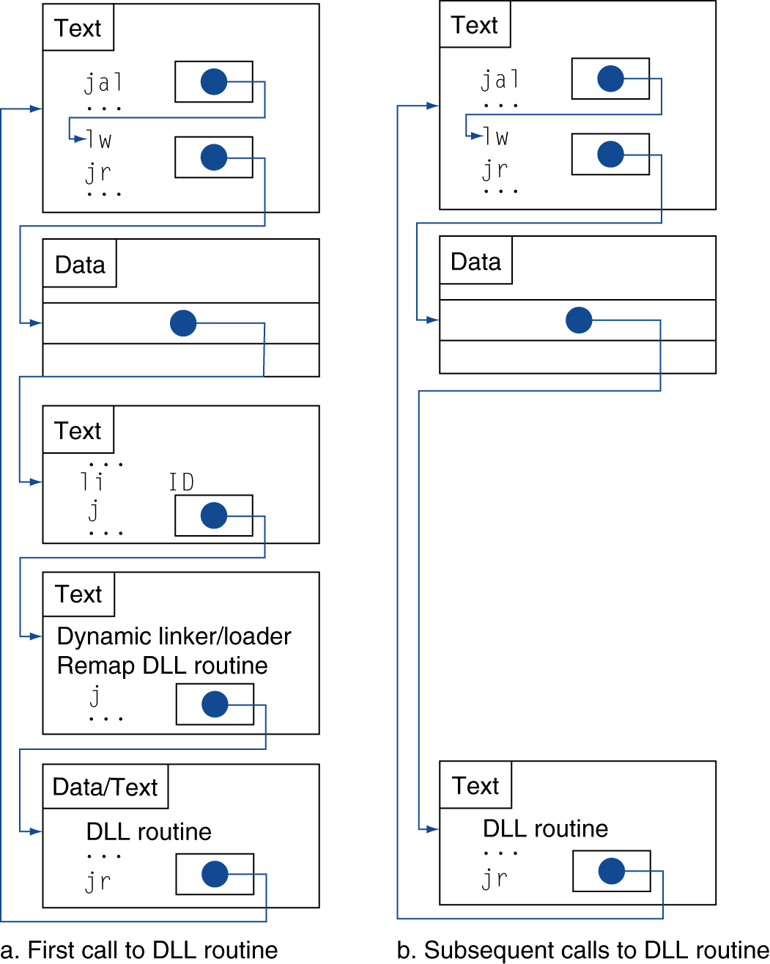
Dynamic Linkage
Call to DLL Library
Indirection table that initially
points to stub code
Stub: Loads routine ID so can find desired library, Jump to linker/loader
Indirection table now points to DLL
Linker/loader code finds desired library and edits jump address in indirection table, jumps to desired routine
Dynamically mapped code executes and returns
Notes:
Book has more detailed figure
At compile time these data structures to point into the linker
At run time the linker edits the file

Slide 10
Steps to Starting a Program
C program: foo.c
Compiler
Executable (mach lang pgm): a.out
Memory
Assembly program: foo.s
Assembler
Object (mach lang module): foo.o
Linker
Loader
lib.o

Slide 11
Loading a Program
Mostly the job of the operating system.
Load from image file on disk into memory
1. Read header to determine .text, .data segment sizes
2. Create virtual address space (cover later in semester)
Copy text and initialized data into memory
Set up arguments on stack
5. Initialize registers (including $sp, $fp, $gp)
6. Jump to startup routine
Copies arguments to $a0, … and calls main
When main returns, do “exit” systems call
Compare with Project 1’s InitComputer function!

Slide 12
Steps to Starting a Program
C program: foo.c
Compiler
Executable (mach lang pgm): a.out
Memory
Assembly program: foo.s
Assembler
Object (mach lang module): foo.o
Linker
Loader
lib.o

Slide 13
What’s a Compiler?
Compiler: a program that accepts as input a program text in a certain language and produces as output a program text in another language, while preserving the meaning of that text.
The text must comply with the syntax rules of whichever programming language it is written in.
A compiler's complexity depends on the syntax of the language and how much abstraction that programming language provides.
A C compiler is much simpler than C++ Compiler
Compiler executes before compiled program runs

Slide 14
Compilers are Non-Trivial
There’s a whole course about them – cs164
We won’t go into further detail in this course.
Some examples of the task’s complexity:
Operator precedence: 2 + 3 * 4
Operator associativity: a = b = c;
Can’t determine locally whether a program is valid
if (a) { if (b) { … /*long distance*/ … } } } //extra bracket

Slide 15
Compiler Optimization
gcc compiler options
-O1: the compiler tries to reduce code size and execution time, without performing any optimizations that take a great deal of compilation time
-O2: Optimize even more. GCC performs nearly all supported optimizations that do not involve a space-speed tradeoff. As compared to -O, this option increases both compilation time and the performance of the generated code
-O3: Optimize yet more. All -O2 optimizations and also turns on the -finline-functions, …

Slide 16
What is Typical Benefit of Compiler Optimization?
What is a typical program?
For now, try a toy program:
BubbleSort.c
#define ARRAY_SIZE 20000
int main() {
int iarray[ARRAY_SIZE], x, y, holder;
for(x = 0; x < ARRAY_SIZE; x++)
for(y = 0; y < ARRAY_SIZE-1; y++)
if(iarray[y] > iarray[y+1]) {
holder = iarray[y+1];
iarray[y+1] = iarray[y];
iarray[y] = holder;
}
}
Notes:
Login into lab computer and try gcc-mips
I tried to build gcc on a mac machine today, but failed even after applying Scott's patches. I think it will take more time to port the toolchain to snow leopard, but I can get it working before next week's lab. In the meantime you can login to nova.cs.berkeley.edu and use mips-gcc.
61C password
$ ssh cs61c@nova.cs.berkeley.edu
$ mips-gcc -S test.c (assuming you have test.c)
$ cat test.c

Slide 17
Unoptimized MIPS Code
$L3:
lw $2,80016($sp)
slt $3,$2,20000
bne $3,$0,$L6
j $L4
$L6:
.set noreorder
nop
.set reorder
sw $0,80020($sp)
$L7:
lw $2,80020($sp)
slt $3,$2,19999
bne $3,$0,$L10
j $L5
$L10:
lw $2,80020($sp)
move $3,$2
sll $2,$3,2
addu $3,$sp,16
addu $2,$3,$2
lw $4,80020($sp)
addu $3,$4,1
move $4,$3
sll $3,$4,2
addu $4,$sp,16
addu $3,$4,$3
lw $2,0($2)
lw $3,0($3)
slt $2,$3,$2
beq $2,$0,$L9
lw $3,80020($sp)
addu $2,$3,1
move $3,$2
sll $2,$3,2
addu $3,$sp,16
addu $2,$3,$2
lw $3,0($2)
sw $3,80024($sp
$L11:
$L9:
lw $2,80020($sp)
addu $3,$2,1
sw $3,80020($sp)
j $L7
$L8:
$L5:
lw $2,80016($sp)
addu $3,$2,1
sw $3,80016($sp)
j $L3
$L4:
$L2:
li $12,65536
ori $12,$12,0x38b0
addu $13,$12,$sp
addu $sp,$sp,$12
j $31
lw $3,80020($sp)
addu $2,$3,1
move $3,$2
sll $2,$3,2
addu $3,$sp,16
addu $2,$3,$2
lw $3,80020($sp)
move $4,$3
sll $3,$4,2
addu $4,$sp,16
addu $3,$4,$3
lw $4,0($3)
sw $4,0($2)
lw $2,80020($sp)
move $3,$2
sll $2,$3,2
addu $3,$sp,16
addu $2,$3,$2
lw $3,80024($sp)
sw $3,0($2)

Slide 18
-O2 optimized MIPS Code
li $13,65536
ori $13,$13,0x3890
addu $13,$13,$sp
sw $28,0($13)
move $4,$0
addu $8,$sp,16
$L6:
move $3,$0
addu $9,$4,1
.p2align 3
$L10:
sll $2,$3,2
addu $6,$8,$2
addu $7,$3,1
sll $2,$7,2
addu $5,$8,$2
lw $3,0($6)
lw $4,0($5)
slt $2,$4,$3
beq $2,$0,$L9
sw $3,0($5)
sw $4,0($6)
$L9:
move $3,$7
slt $2,$3,19999
bne $2,$0,$L10
move $4,$9
slt $2,$4,20000
bne $2,$0,$L6
li $12,65536
ori $12,$12,0x38a0
addu $13,$12,$sp
addu $sp,$sp,$12
j $31
.

Slide 19
Running a Program: Summary
Compiler converts a single HLL file into a single assembly language file.
Assembler removes pseudoinstructions, converts what it can to machine language, and creates a checklist for the linker (relocation table). A .s file becomes a .o file.
Does 2 passes to resolve addresses, handling internal forward references
Linker combines several .o files and resolves absolute addresses.
Enables separate compilation, libraries that need not be compiled, and resolves remaining addresses
Loader loads executable into memory and begins execution.

Slide 20
Running a Program: Summary
Stored Program concept is very powerful. It means that instructions can be treated just like data. Therefore we can use programs to manipulate other programs!
Enables the software pipeline we’ve just seen.

Slide 21
Agenda
Running a Program
Administrivia
Translation vs. Interpretation
Break
Floating Point

Slide 22
Administrivia
Project 1 posted.
Due Sunday at midnight.
Midterm, Friday 7/15.
Time and Location still TBD, will keep you updated
Closed book. We will supply you with a green sheet.
You can bring a one-sided, handwritten cheatsheet.
3 hours long.
Review Session next Monday

Slide 23
Agenda
Running a Program
Administrivia
Translation vs. Interpretation
Break
Floating Point

Slide 24
Translation vs. Interpretation
How do we run a program written in a source language?
Interpretion: Directly execute a program in the source language
Translation: Converts a program from the source language to an equivalent program in another language.
Translation is what we’ve seen so far – Start out in high level language, convert to machine language.
Not all translation is necessarily from HLL to machine code. We’ll see an example later…

Slide 25
What’s an Interpreter?
It reads and executes source statements executed one at a time
No linking
No machine code generation, so more portable
Start executing quicker, but run much more slowly than compiled code
Performing the actions straight from the text allows better error checking and reporting to be done
The interpreter stays around during execution
Unlike compiler, some work is done after program starts
Writing an interpreter is much less work than writing a compiler

Slide 26
Interpreted Languages: Edit-Run
Editor
Source
code
Interpreter
☺
Notes:
When you use an interpreted language, the program that is being executed is the interpreter; the text of your program serves as data for the interpreter.

Slide 27
(Machine code) Compilation vs. Interpretation Advantages
Compilation:
Faster Execution
Single file to execute
Compiler can do better diagnosis of syntax and semantic errors, since it has more info than an interpreter (Interpreter only sees one line at a time)
Can find syntax errors before run program
Compiler can optimize code
Interpretation:
Easier to debug program
Faster development time

Slide 28
(Machine code) Compilation vs. Interpretation Advantages
Compilation:
Harder to debug program
Takes longer to change source code, recompile, and relink
Interpretation:
Slower execution times
No optimization
Need all of source code available
Source code larger than executable for large systems
Interpreter must remain installed while the program is interpreted

Slide 29
Java’s Hybrid Approach: Compiler + Interpreter
A Java compiler converts Java source code into instructions for the Java Virtual Machine (JVM)
These instructions, called bytecodes, are same for any computer / OS
A CPU-specific Java interpreter interprets bytecodes on a particular computer
Notes:
Java Virtual Machine is an imaginary computer with a CPU instruction set that is “the least common denominator” for typical real CPUs.

Slide 30
Java’s Compiler + Interpreter
Editor
Compiler
:
:
7


K
Hello.java
Hello.class

Interpreter
Interpreter


Hello,
World!
Notes:
There is also JIT (Just-In-Time) compiler technology where the program is interpreted and compiled at the same time. On subsequent runs the compiled code is used; there is no need to reinterpret it.

Slide 31
Why Bytecodes?
Platform-independent
Load from the Internet faster than source code
Interpreter is faster and smaller than it would be for Java source
Source code is not revealed to end users
Interpreter performs additional security checks, screens out malicious code
Notes:
Java’s culture is pretty open, and many applets are available on the Internet with their source code. Still, software vendors may want to protect their source code.
For obvious reasons, the interpreter wouldn’t allow an applet to read or write files on your computer.
Hackers have peculiar ethics (or rather, a gap in ethics): they won’t go around checking locks on the doors of houses or cars or spread real disease germs (even if non-lethal ones), but they will break into your computer system (which may be much more harmful and expensive) and spread computer viruses.

Slide 32
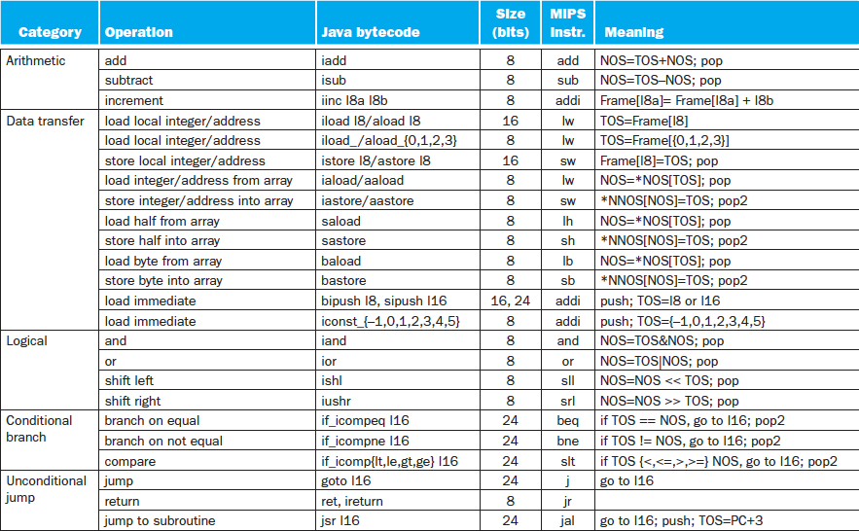
Java Bytecodes (Stack) vs. MIPS (Reg.)

Slide 33
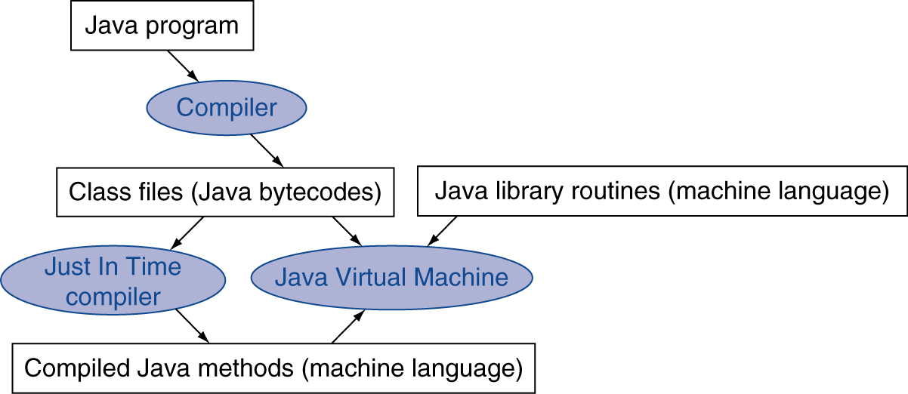
Starting Java Applications
Simple portable instruction set for the JVM
Compiles bytecodes of “hot” methods into native code for host machine
Interprets bytecodes
Just In Time (JIT) compiler translates bytecode into machine language just before execution

Slide 34
Agenda
Running a Program
Administrivia
Translation vs. Interpretation
Break
Floating Point

Slide 35
Agenda
Running a Program
Administrivia
Translation vs. Interpretation
Break
Floating Point

Slide 36
Floating Point
We’ve seen how integers, characters, and instructions are encoded as data in a computer.
How do we encode real numbers?
eg, 3.14159, -.0002384, etc.

Slide 37
Goals of Floating Point
Support a wide range of values
Both the very small (.000000003842) and the very large (6.022 x 10²³).
Keep as much precision as possible.
Help programmer with errors in real arithmetic
Support +∞, -∞, Not-A-Number (NaN), exponent overflow, exponent underflow
Keep encoding that is somewhat compatible with two’s complement
E.g., 0 in Fl. Pt. is 0 in two’s complement
Can compare two Fl. Pt. numbers in the same way as comparing two’

Slide 38
Scientific Notation (e.g., Base 10)
Normalized scientific notation (aka standard form or exponential notation):
Normalized => No leading 0s
61 is 6.10 x 10², 0.000061 is 6.10 x10⁻⁵
r x E^{i}, E where is exponent, i is a positive or negative integer, r is a real number ≥ 1.0, < 10

Slide 39
Which is Smaller? (i.e., closer to -∞)
0 vs. 1 x 10⁻¹²⁷?
1 x 10⁻¹²⁶ vs. 1 x 10⁻¹²⁷?
-1 x 10⁻¹²⁷ vs. 0?
-1 x 10⁻¹²⁶ vs. -1 x 10⁻¹²⁷?
Student Roulette?

Slide 40
Which is Smaller? (i.e., closer to -∞)
0 vs. 1 x 10⁻¹²⁷?
1 x 10⁻¹²⁶ vs. 1 x 10⁻¹²⁷?
-1 x 10⁻¹²⁷ vs. 0?
-1 x 10⁻¹²⁶ vs. -1 x 10⁻¹²⁷?

Slide 41
Translating To and From Scientific Notation
Consider the number 8.12 x 10⁴
To convert to ordinary number, shift the decimal to the right by 4.
Result: 81200
For negative exponents, shift decimal to the left
8.12 x 10⁻⁵ => .0000812
Can reverse this process to go from ordinary number to scientific notation
.00812 => 8.12 x 10⁻³

Slide 42
Scientific Notation in Base 2
How to write out fractional numbers in Base 2?
“Binary Point”
eg. 1101.001
Convert to Base 2 normalized scientific notation?
1101.001 => 1.101001 x 2³
Can also go the other way, as before.
This “floating” of the point is origin of Floating Point name
xx.yyyy
2¹
2⁻⁴
2⁰
2⁻¹
2⁻²
2⁻³

Slide 43
Floating Point Encoding
Use normalized, Base 2 scientific notation: +1.xxx…x_{two}*2^{yyy…y}two
Split a 32 bit word into 3 fields:
31
30
23
22
0
S
Exponent
Significand
1 bit
8 bits
23 bits
S represents Sign (1 is negative, 0 positive)
Exponent represents y’s
Significand represents x’s
Represent numbers as small as ~2.0 x 10⁻³⁸ to as large as ~2.0 x 10³⁸

Slide 44
The Exponent Field
Definitely want a signed exponent.
Use two’s compliment?
Smallest exponent looks like 1000000, largest exponent looks like 01111111.
Can reuse integer comparison hardware if exponents range from 00000000 for smallest to 11111111 for largest.

Slide 45
The Exponent Field
Use biased two’s compliment. Instead of -128 through 127 being 10000000 through 01111111, define -127 through 128 to be 00000000 through 11111111.
Corresponds with a bias of 127: the value 0 is represented as 01111111_{two} => 127_{ten}
To encode in biased two’s complement, add the bias to your number, then encode as usual:
1 => 128 => 10000000
127 => 254 => 11111110

Slide 46
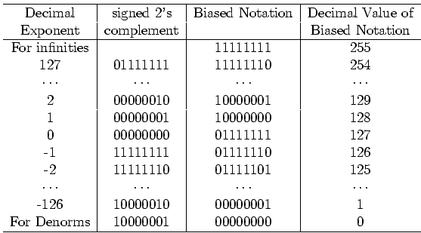
Bias Notation (+127)
How it is interpreted
How it is encoded
∞, NaN
Getting closer to zero
Zero

Slide 47
Floating Point Encoding
Note the implicit 1 in front of the Significand.
31
30
23
22
0
S
Exponent
Significand
1 bit
8 bits
23 bits
(-1)^{S} x (1 . Significand) x 2^{(Exponent-127)}

Slide 48
Double Precision Fl. Pt. Encoding
Next Multiple of Word Size (64 bits)
31
30
20
19
0
S
Exponent
Significand
1 bit
11 bits
20 bits
Significand (cont’d)
32 bits
Double Precision (vs. Single Precision)
C variable declared as double
Represent numbers almost as small as 2.0 x 10⁻³⁰⁸ to almost as large as 2.0 x 10³⁰⁸
But primary advantage is greater accuracy due to larger significand

Slide 49
Floating Point: Representing Very Small Numbers
Zero: Bit pattern of all 0s is encoding for 0.000
But 0 in exponent should mean most negative exponent (want 0 to be next to smallest real)
Can’t use two’s complement (1000 0000_{two})
Bias notation: subtract bias from exponent
Single precision uses bias of 127; DP uses 1023
0 uses 0000 0000_{two} => 0-127 = -127; ∞, NaN uses 1111 1111_{two} => 255-127 = +128
Smallest SP real can represent: 1.00…00 x 2⁻¹²⁶
Largest SP real can represent: 1.11…11 x 2⁺¹²⁷

Slide 50
“Father” of the Floating point standard
IEEE Standard 754 for Binary Floating-Point Arithmetic.
1989 ACM Turing Award Winner!
Prof. Kahan
www.cs.berkeley.edu/~wkahan/ieee754status/754story.html
Notes:
1:30 in

Slide 51
Example: Converting Binary FP to Decimal
0
0110 1000
101 0101 0100 0011 0100 0010
(-1)^{S} x (1 . Significand) x 2^{(Exponent-127)}
Sign: 0 ➔ positive
Exponent:
0110 1000_{two} = 104_{ten}
Bias adjustment: 104 - 127 = -23
Significand:
1 . 10101010100001101000010
1 + 1x2⁻¹+ 0x2⁻² + 1x2⁻³ + 0x2⁻⁴ + 1x2⁻⁵ +... =1+2⁻¹+2⁻³ +2⁻⁵ +2⁻⁷ +2⁻⁹ +2⁻¹⁴ +2⁻¹⁵ +2⁻¹⁷ +2⁻²² = 1.0 + 0.666115
Represents: 1.666115_{ten}*2⁻²³ ~ 1.986*10⁻⁷ (about 2/10,000,000)

Slide 52
Example: Converting Decimal to FP
-2.340625 x 10¹
Denormalize: -23.40625
Convert integer part:
23 = 16 + 4 + 2 + 1 = 10111₂
Convert fractional part:
.40625 = .25 + ( .15625 = .125 + ( .03125 ) ) = .01101₂
Put parts together and normalize:
10111.01101 = 1.011101101 x 2⁴
Convert exponent: 127 + 4 = 10000011₂
1
1000 0011
011 1011 0100 0000 0000 0000

Slide 53
Floating Point Features
What about 0?
Bit pattern all 0s means 0, so no implicit leading 1
What if divide 1 by 0?
Can get infinity symbols +∞, -∞
Sign bit 0 or 1, largest exponent, 0 in fraction
What if do something stupid? (∞ – ∞, 0 ÷ 0)
Can get special symbols NaN for Not-a-Number
Sign bit 0 or 1, largest exponent, not zero in fraction
What if result is too big? (2x10³⁰⁸ x 2x10²)
Get overflow in exponent, alert programmer!
What if result is too small? (2x10⁻³⁰⁸ ÷ 2x10²)
Get underflow in exponent, alert programmer!

Slide 54
Special Numbers Summary
Reserve exponents, significands:
Exponent | Significand | Meaning
0 | 0 | +/-0
0 | nonzero | Denorm
1-254 | Anything | +/- fl. Pt #
255 | 0 | +/- ∞
255 | nonzero | NaN

Slide 55
MIPS Floating Point Instructions
C, Java has single precision (float) and double precision (double) types
MIPS instructions: .s for single, .d for double
Fl. Pt. Addition single precision: Fl. Pt. Addition double precision:
Fl. Pt. Subtraction single precision: Fl. Pt. Subtraction double precision:
Fl. Pt. Multiplication single precision: Fl. Pt. Multiplication double precision:
Fl. Pt. Divide single precision: Fl. Pt. Divide double precision:
Student Roulette?

Slide 56
MIPS Floating Point Instructions
C, Java has single precision (float) and double precision (double) types
MIPS instructions: .s for single, .d for double
Fl. Pt. Addition single precision: add.s Fl. Pt. Addition double precision: add.d
Fl. Pt. Subtraction single precision: sub.s Fl. Pt. Subtraction double precision: sub.d
Fl. Pt. Multiplication single precision: mul.s Fl. Pt. Multiplication double precision: mul.d
Fl. Pt. Divide single precision: div.s Fl. Pt. Divide double precision: div.d

Slide 57
MIPS Floating Point Instructions
C, Java have single precision (float) and double precision (double) types
MIPS instructions: .s for single, .d for double
Fl. Pt. Comparison single precision: Fl. Pt. Comparison double precision:
Fl. Pt. branch:
Since rarely mix integers and Floating Point, MIPS has separate registers for floating-point operations: $f0, $f1, …, $f31
Double precision uses adjacent even-odd pairs of registers:
$f0 and $f1, $f2 and $f3, $f4 and $f5, …, $f30 and $f31
Need data transfer instructions for these new registers
lwc1 (load word), swc1 (store word)
Double precision uses two lwc1 instructions, two swc1 instructions
Notes:
Floating-point comparison, single (c.x.s) and comparison, double (c.x.d),
where x may be equal (eq), not equal (neq), less than (lt), less than or equal (le), greater than (gt), or greater than or equal (ge)
Floating-point branch, true (bc1t) and branch, false (bc1f)

Slide 58
Peer Instruction Question
Suppose Big, Tiny, and BigNegative are floats in C, with Big initialized to a big number (e.g., age of universe in seconds or 4.32 x 10¹⁷), Tiny to a small number (e.g., seconds/femtosecond or 1.0 x 10⁻¹⁵), BigNegative = - Big. Here are two conditionals:
(Big * Tiny) * BigNegative == (Big * BigNegative) * Tiny
(Big + Tiny) + BigNegative == (Big + BigNegative) + Tiny
Which statement about these is correct?
Red. I. is false and II. is false
Orange. I. is false and II. is true
Yellow. I. is true and II. is false
Green. I. is true and II. is true

Slide 59
Peer Instruction Answer
Suppose Big, Tiny, and BigNegative are floats in C, with Big initialized to a big number (e.g., age of universe in seconds or 4.32 x 10¹⁷), Tiny to a small number (e.g., seconds/femtosecond or 1.0 x 10⁻¹⁵), BigNegative = - Big. Here are two conditionals:
(Big * Tiny) * BigNegative == (Big * BigNegative) * Tiny
(Big + Tiny) + BigNegative == (Big + BigNegative) + Tiny
Which statement about these is correct?
Yellow. I. is true and II. is false (if we don’t consider overflow)—but there are cases where one side overflows while the other does not!
I. Works ok if no overflow, but because exponents add, if Big * BigNeg overflows, then result is overflow, not -1
II. Left hand side is 0, right hand side is tiny

Slide 60
Pitfalls
Floating point addition is NOT associative
Some optimizations can change order of floating point computations, which can change results
Need to ensure that floating point algorithm is correct even with optimizations

Slide 61
“And in Conclusion, …”
Steps for running a program
(C)ompilation
(A)ssembly
(L)inking
(L)oading
Interpretation another option.
Floating point encoding approximates real numbers
Also provides encoding for +∞, -∞, NaN

Slide 62
Bonus slides
These are extra slides that used to be included in lecture notes, but have been moved to this, the “bonus” area to serve as a supplement.
The slides will appear in the order they would have in the normal presentation
Bonus

Slide 63
Example: C ⇒ Asm ⇒ Obj ⇒ Exe ⇒ Run
C Program Source Code: prog.c
#include <stdio.h>
int main (int argc, char *argv[]) {
int i, sum = 0;
for (i = 0; i <= 100; i++) sum = sum + i * i;
printf ("The sum of sq from 0 .. 100 is %d\n", sum);
}
“printf” lives in “libc”

Slide 64
Compilation: MAL
.text
.align 2
.globl main
main:
subu $sp,$sp,32
sw $ra, 20($sp)
sd $a0, 32($sp)
sw $0, 24($sp)
sw $0, 28($sp)
loop:
lw $t6, 28($sp)
mul $t7, $t6,$t6
lw $t8, 24($sp)
addu $t9,$t8,$t7
sw $t9, 24($sp)
addu $t0, $t6, 1
sw $t0, 28($sp)
ble $t0,100, loop
la $a0, str
lw $a1, 24($sp)
jal printf
move $v0, $0
lw $ra, 20($sp)
addiu $sp,$sp,32
jr $ra
.data
.align 0
str:
.asciiz "The sum of sq from 0 .. 100 is %d\n"
Where are
7 pseudo- instructions?

Slide 65
Compilation: MAL
.text
.align 2
.globl main
main:
subu $sp,$sp,32
sw $ra, 20($sp)
sd $a0, 32($sp)
sw $0, 24($sp)
sw $0, 28($sp)
loop:
lw $t6, 28($sp)
mul $t7, $t6,$t6
lw $t8, 24($sp)
addu $t9,$t8,$t7
sw $t9, 24($sp)
addu $t0, $t6, 1
sw $t0, 28($sp)
ble $t0,100, loop
la $a0, str
lw $a1, 24($sp)
jal printf
move $v0, $0
lw $ra, 20($sp)
addiu $sp,$sp,32
jr $ra
.data
.align 0
str:
.asciiz "The sum of sq from 0 .. 100 is %d\n"
7 pseudo- instructions underlined

Slide 66
Assembly step 1:
Remove pseudoinstructions, assign addresses
00 addiu $29,$29,-32
04 sw $31,20($29)
08 sw $4, 32($29)
0c sw $5, 36($29)
10 sw $0, 24($29)
14 sw $0, 28($29)
18 lw $14, 28($29)
1c multu $14, $14
20 mflo $15
24 lw $24, 24($29)
28 addu $25,$24,$15
2c sw $25, 24($29)
30 addiu $8,$14, 1
34 sw $8,28($29)
38 slti $1,$8, 101
3c bne $1,$0, loop
40 lui $4, l.str
44 ori $4,$4,r.str
48 lw $5,24($29)
4c jal printf
50 add $2, $0, $0
54 lw $31,20($29)
58 addiu $29,$29,32
5c jr $31

Slide 67
Assembly step 2
Create relocation table and symbol table
Symbol Table
Label address (in module) type
main: 0x00000000 global text
loop: 0x00000018 local text
str: 0x00000000 local data
Relocation Information
Address Instr. type Dependency 0x00000040 lui l.str 0x00000044 ori r.str 0x0000004c jal printf

Slide 68
Assembly step 3
Resolve local PC-relative labels
00 addiu $29,$29,-32
04 sw $31,20($29)
08 sw $4, 32($29)
0c sw $5, 36($29)
10 sw $0, 24($29)
14 sw $0, 28($29)
18 lw $14, 28($29)
1c multu $14, $14
20 mflo $15
24 lw $24, 24($29)
28 addu $25,$24,$15
2c sw $25, 24($29)
30 addiu $8,$14, 1
34 sw $8,28($29)
38 slti $1,$8, 101
3c bne $1,$0, -10
40 lui $4, l.str
44 ori $4,$4,r.str
48 lw $5,24($29)
4c jal printf
50 add $2, $0, $0
54 lw $31,20($29)
58 addiu $29,$29,32
5c jr $31

Slide 69
Assembly step 4
Generate object (.o) file:
Output binary representation for
ext segment (instructions),
data segment (data),
symbol and relocation tables.
Using dummy “placeholders” for unresolved absolute and external references.

Slide 70
Text segment in object file
0x000000 00100111101111011111111111100000
0x000004 10101111101111110000000000010100
0x000008 10101111101001000000000000100000
0x00000c 10101111101001010000000000100100
0x000010 10101111101000000000000000011000
0x000014 10101111101000000000000000011100
0x000018 10001111101011100000000000011100
0x00001c 10001111101110000000000000011000
0x000020 00000001110011100000000000011001
0x000024 00100101110010000000000000000001
0x000028 00101001000000010000000001100101
0x00002c 10101111101010000000000000011100
0x000030 00000000000000000111100000010010
0x000034 00000011000011111100100000100001
0x000038 00010100001000001111111111110111
0x00003c 10101111101110010000000000011000
0x000040 00111100000001000000000000000000
0x000044 10001111101001010000000000000000
0x000048 00001100000100000000000011101100
0x00004c 00100100000000000000000000000000
0x000050 10001111101111110000000000010100
0x000054 00100111101111010000000000100000
0x000058 00000011111000000000000000001000
0x00005c 00000000000000000001000000100001

Slide 71
Link step 1: combine prog.o, libc.o
Merge text/data segments
Create absolute memory addresses
Modify & merge symbol and relocation tables
Symbol Table
Label Address
main: 0x00000000
loop: 0x00000018
str: 0x10000430
printf: 0x000003b0 …
Relocation Information
Address Instr. Type Dependency 0x00000040 lui l.str 0x00000044 ori r.str 0x0000004c jal printf …

Slide 72
Link step 2:
Edit Addresses in relocation table
(shown in TAL for clarity, but done in binary )
00 addiu $29,$29,-32
04 sw $31,20($29)
08 sw $4, 32($29)
0c sw $5, 36($29)
10 sw $0, 24($29)
14 sw $0, 28($29)
18 lw $14, 28($29)
1c multu $14, $14
20 mflo $15
24 lw $24, 24($29)
28 addu $25,$24,$15
2c sw $25, 24($29)
30 addiu $8,$14, 1
34 sw $8,28($29)
38 slti $1,$8, 101
3c bne $1,$0, -10
40 lui $4, 4096
44 ori $4,$4,1072
48 lw $5,24($29)
4c jal 812
50 add $2, $0, $0
54 lw $31,20($29)
58 addiu $29,$29,32
5c jr $31

Slide 73
Link step 3:
Output executable of merged modules.
Single text (instruction) segment
Single data segment
Header detailing size of each segment
NOTE:
The preceeding example was a much simplified version of how ELF and other standard formats work, meant only to demonstrate the basic principles.

