Slide 1
CS 61C: Great Ideas in Computer Architecture (Machine Structures) Course Introduction, Number Representation
Instructor:
Michael Greenbaum
http://inst.eecs.berkeley.edu/~cs61c/su11

Slide 2
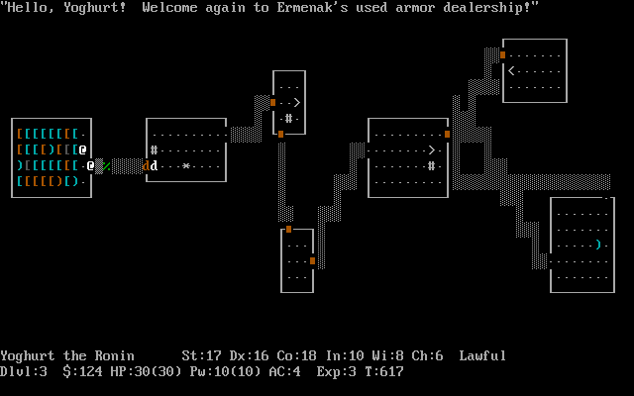
My HW0
Grew up in the San Fernando Valley (“The Valley”). Moved to nearby Agoura Hills during middle school.
BS, EECS – UC Berkeley, 2008. Entered PhD program studying AI.
TA’d 5 times. Cs61c twice.
Enjoy golfing, playing “roguelike”
computer games (nethack,
Dungeon Crawl).
I’m not a professor. Call me Michael.
Teaching this class will be consuming all my time this summer!

Slide 3
Agenda
Great Ideas in Computer Architecture
Administrivia
Break
Number Representation

Slide 4
Agenda
Great Ideas in Computer Architecture
Administrivia
Break
Number Representation

Slide 5
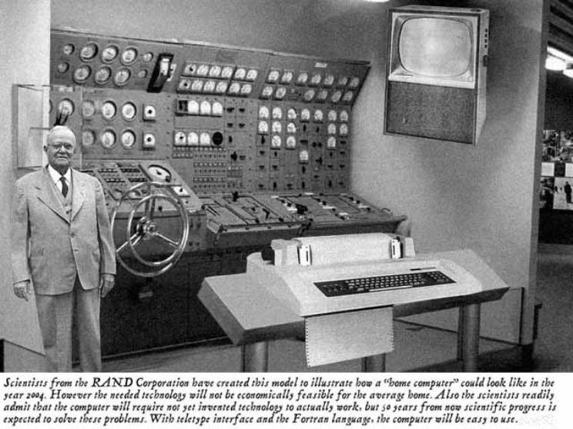
Old School CS61c

Slide 6
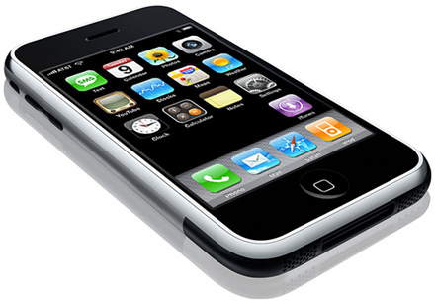
New School CS61c
Personal Mobile Devices

Slide 7
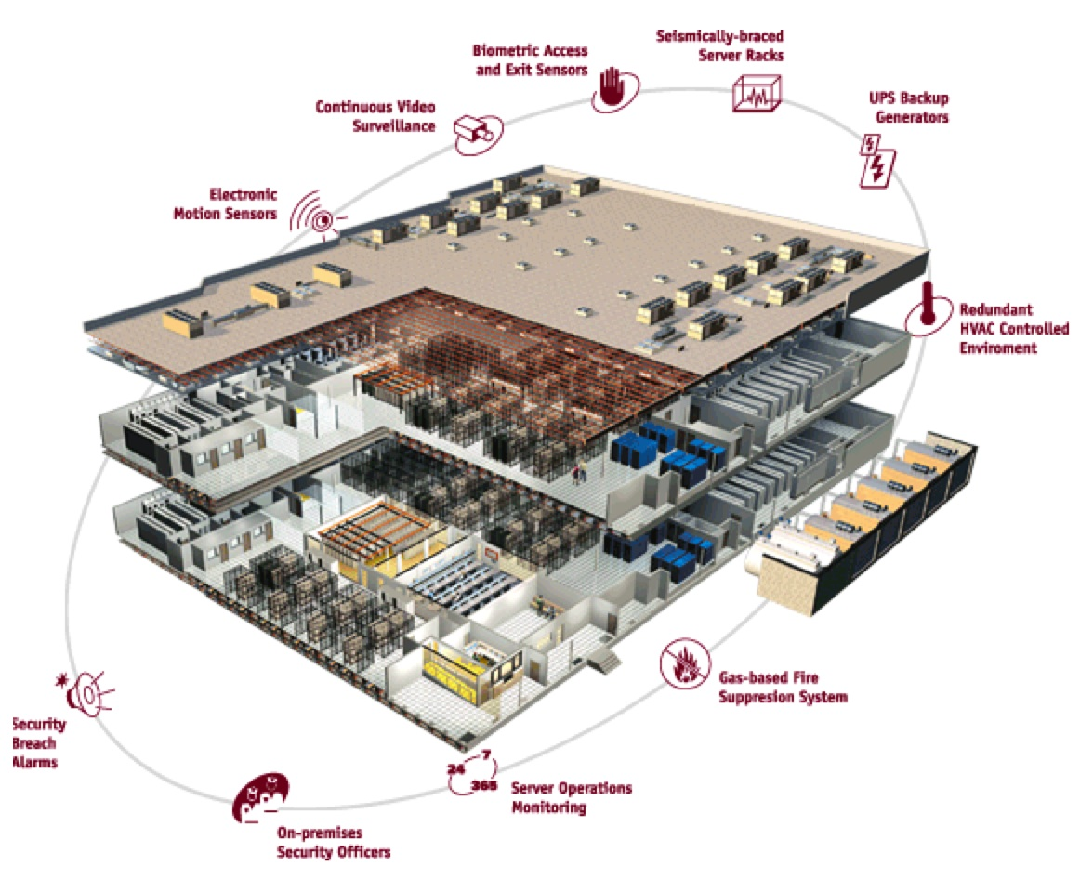
Warehouse
Scale
Computer

Slide 8
Old-School Machine Structures
Application (ex: browser)
CS61c
Operating
Compiler
System
(Mac OSX)
Software
Assembler
Instruction Set
Architecture
Hardware
Processor
Memory
I/O system
Datapath & Control
Digital Design
Circuit Design
transistors

Slide 9
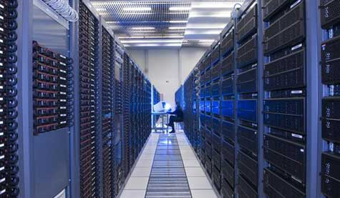
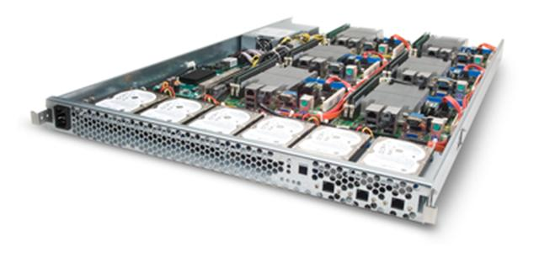
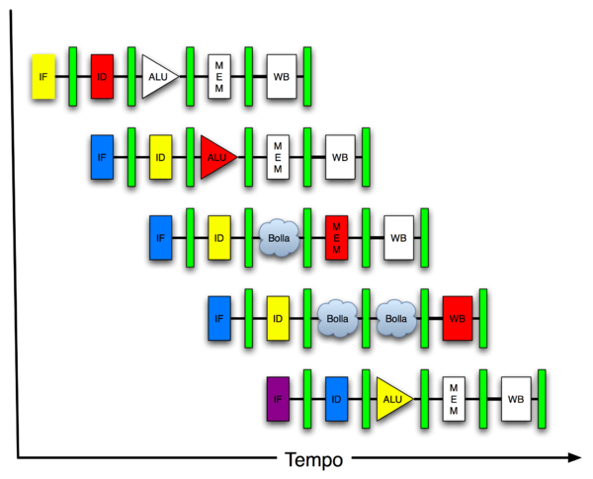
New-School Machine Structures (It’s a bit more complicated!)
Software Hardware
Parallel Requests
Assigned to computer
e.g., Search “Katz”
Parallel Threads
Assigned to core
e.g., Lookup, Ads
Parallel Instructions
>1 instruction @ one time
e.g., 5 pipelined instructions
Parallel Data
>1 data item @ one time
e.g., Add of 4 pairs of words
Hardware descriptions
All gates functioning in parallel at same time
Warehouse Scale Computer
Smart Phone
Harness Parallelism &
Achieve High Performance
Computer
Core
…
Core
Memory (Cache)
Input/Output
Core
Instruction Unit(s)
Functional
Unit(s)
A₀+B₀
A₁+B₁
A₂+B₂
A₃+B₃
Main Memory
Logic Gates

Slide 10
6 Great Ideas in Computer Architecture
Layers of Representation/Interpretation
Moore’s Law
Principle of Locality/Memory Hierarchy
Parallelism
Performance Measurement & Improvement
Dependability via Redundancy

Slide 11
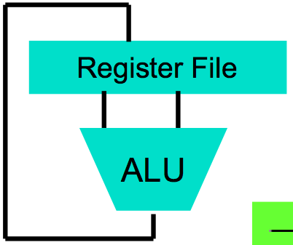
Great Idea #1: Levels of Representation/Interpretation
High Level Language Program (e.g., C)
temp = v[k];
v[k] = v[k+1];
v[k+1] = temp;
Compiler
Anything can be represented as a number, i.e., data or instructions
lw $t0, 0($2)
lw $t1, 4($2)
sw $t1, 0($2)
sw $t0, 4($2)
Assembly Language Program (e.g., MIPS)
Assembler
0000 1001 1100 0110 1010 1111 0101 1000
1010 1111 0101 1000 0000 1001 1100 0110
1100 0110 1010 1111 0101 1000 0000 1001
0101 1000 0000 1001 1100 0110 1010 1111
Machine Language Program (MIPS)
Machine Interpretation
Hardware Architecture Description (e.g., block diagrams)
Architecture Implementation
Logic Circuit Description (Circuit Schematic Diagrams)

Slide 12
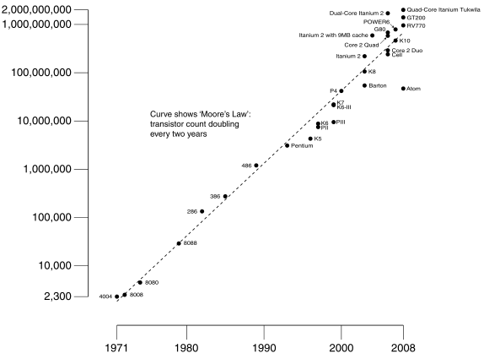
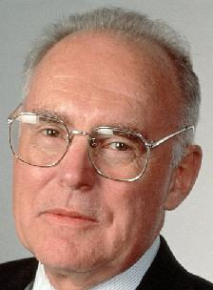
#2: Moore’s Law
Predicts: 2X Transistors / chip every 2 years
# of transistors on an integrated circuit (IC)
Gordon Moore Intel Cofounder B.S. Cal 1950!
Year

Slide 13
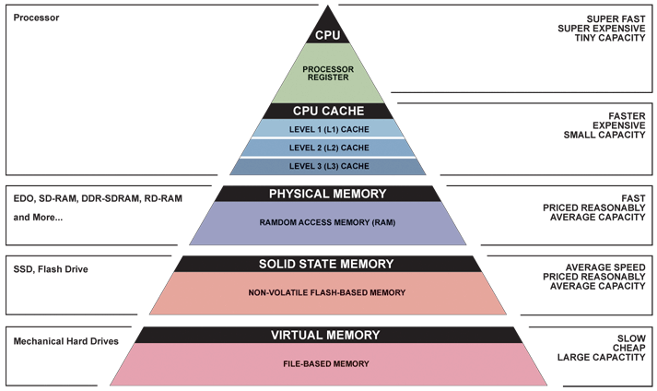
Great Idea #3: Principle of Locality/ Memory Hierarchy

Slide 14
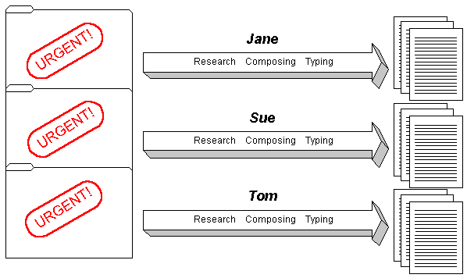
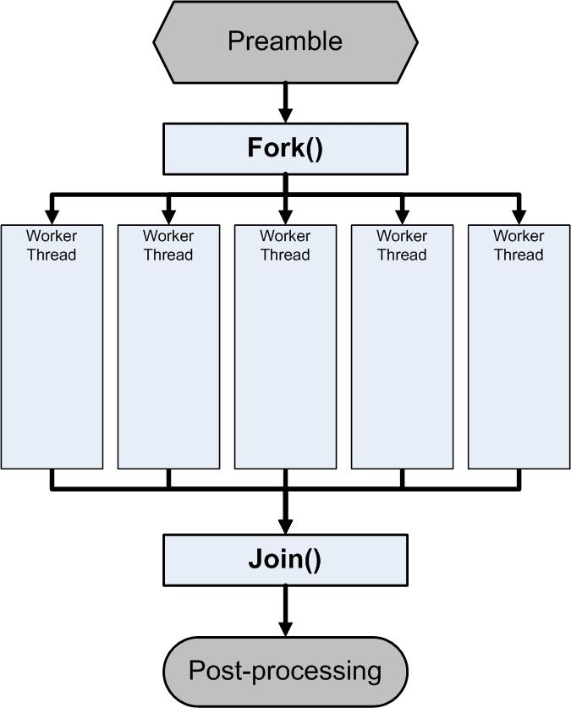
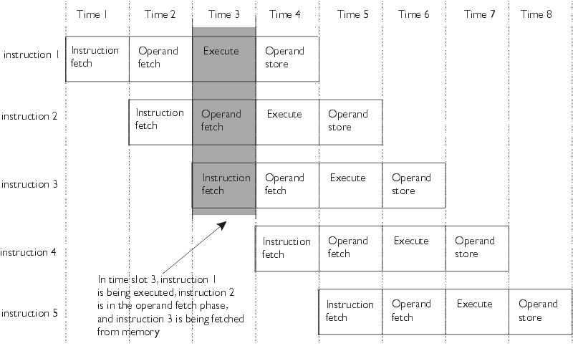
Great Idea #4: Parallelism

Slide 15
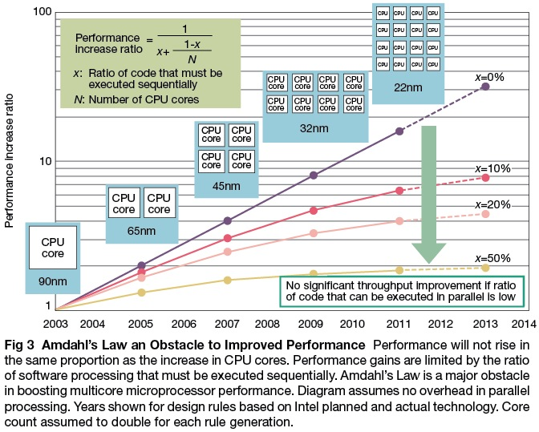

Slide 17
Great Idea #5: Performance Measurement and Improvement
Matching application to underlying hardware to exploit:
Locality
Parallelism
Special hardware features, like specialized instructions (e.g., matrix manipulation)
Latency
How long to set the problem up
How much faster does it execute once it gets going
It is all about time to finish

Slide 18
Great Idea #6: Dependability via Redundancy
Redundancy so that a failing piece doesn’t make the whole system fail
1+1=2
2 of 3 agree
1+1=2
1+1=2
1+1=1
FAIL!
Increasing transistor density reduces the cost of redundancy

Slide 19
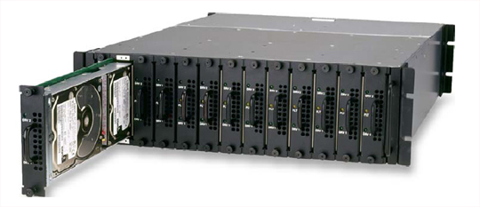
Great Idea #6: Dependability via Redundancy
Applies to everything from datacenters to storage to memory
Redundant datacenters so that can lose 1 datacenter but Internet service stays online
Redundant disks so that can lose 1 disk but not lose data (Redundant Arrays of Independent Disks/RAID)
Redundant memory bits of so that can lose 1 bit but no data (Error Correcting Code/ECC Memory)

Slide 20
Agenda
Great Ideas in Computer Architecture
Administrivia
Break
Number Representation

Slide 21
Course Information
Course Website: http://inst.eecs.berkeley.edu/~cs61c/su11
Textbooks: Average 15 pages of reading/week
Patterson & Hennessey, Computer Organization and Design, 4th Edition (not ≤3rd Edition, not International 4th edition)
Kernighan & Ritchie, The C Programming Language, 2nd Edition
Barroso & Holzle, The Datacenter as a Computer, 1st Edition
Piazzza for main discussion forum.

Slide 22
Your Course Staff
TAs
Justin Hsia
Sean Soleyman
Alvin Yuan
3 Readers
~5 Lab Assistants

Slide 23
Course Organization
Grading
Effort, Participation, Altruism (EPA) (5%)
Homework (5%)
Labs (15%)
Projects (30%)
Computer Instruction Set Simulator (C)
Performance Tuning of a Parallel Application/Matrix Multiply using cache blocking, SIMD, MIMD (OpenMP, due with partner)
Computer Processor Design (Logisim)
Midterm (20%): end of 4th week
Final (25%): last day of class

Slide 24
EPA
Effort
Attending Michael’s and TA’s office hours, completing all assignments, turning in HW0
Participation
Attending lecture and discussion sections.
Asking great questions in lecture and discussion and making it more interactive
Altruism
Helping others in lab or on piazzza
EPA! extra credit points have the potential to bump students up to the next grade level! (but actual EPA! scores are internal)

Slide 25
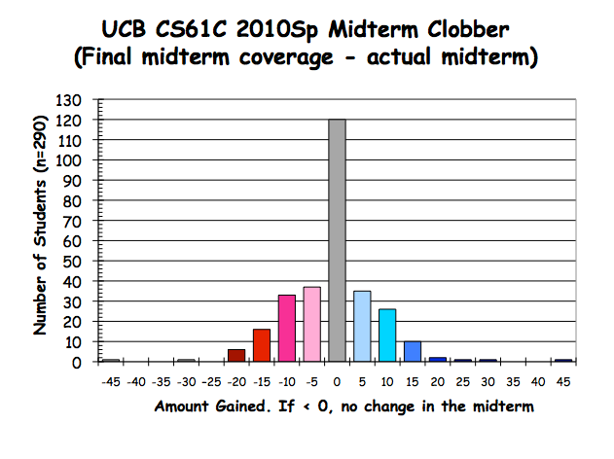
Exam Clobbering Policy
A higher score on the “midterm” portion of your final than on your midterm will replace your midterm score!
Note: The “midterm” portion of the final still counts toward your score on the final, regardless

Slide 26
Late Policy
Assignments mostly due Sundays at 11:59:59 PM
Late homeworks not accepted (100% penalty)
Late projects get 20% penalty, accepted up to two full days later.
No credit if more than 48 hours late
No “slip days”
Only three projects – Don’t want late projects to be the norm.

Slide 27
Policy on Assignments and Independent Work
With the exception of laboratories and assignments that explicitly permit you to work in groups, all homeworks and projects are to be YOUR work and your work ALONE.
You are encouraged to discuss your assignments with other students, and extra credit will be assigned to students who help others, particularly by answering questions on Piazzza, but we expect that what you hand is yours.
It is NOT acceptable to copy solutions from other students.
It is NOT acceptable to copy (or start your) solutions from the Web.
We have tools and methods, developed over many years, for detecting this. You WILL be caught, and the penalties WILL be severe.
At the minimum a ZERO for the assignment, possibly an F in the course, and a letter to your university record documenting the incidence of cheating.
(We caught people last semester!)

Slide 28
Comments on Summer Version
Summer is EXTREMELY hectic!
Double the standard pace.
Please stay on top of your reading and assignments
You won’t learn just from lecture. Engaging the material outside of class and lab is critical to your success
If the course begins to overwhelm you, don’t wait, contact me or your TA immediately!

Slide 29
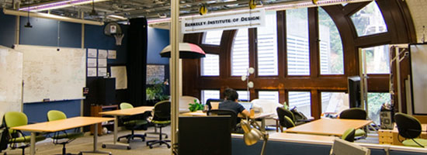
Discussion Sections Moved!
As part of a Berkeley Institute of Design research project, all sections will be held in 360 Heart Mining Building (at their usual times).
Your enrollment in CS61C and your class grades will NOT be affected by your decision to participate in the study (sections without full consent will be held in the location without any of the equipment or experiment proceedings)

Slide 30
Other notes
My OH will be held Monday, Wednesday from 1-2 pm in the Soda Alcoves.

Slide 31
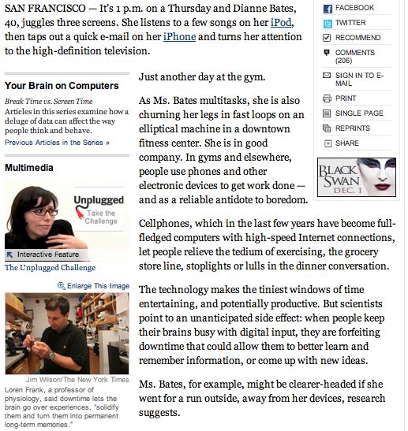
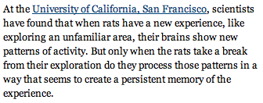

Slide 32
Architecture of a Lecture
Full
Administrivia
Break
“And in conclusion…”
Attention
0
20
25
50
55
78
80
Time (minutes)

Slide 33
Agenda
Great Ideas in Computer Architecture
Administrivia
Break
Number Representation

Slide 34
Number Representation
Inside a computer, everything stored as a fixed sequence of 0’s and 1’s.
How do we represent integers in this format?

Slide 35
Decimal Numbers: Base 10
Digits: 0, 1, 2, 3, 4, 5, 6, 7, 8, 9
Example:
9472 = 9000 + 400 + 70 + 2
3 2 1 0
(9x1000) + (4x100) + (7x10) + (2x1)
(9x10³) + (4x10²) + (7x10¹) + (2x10⁰)

Slide 36
Number Bases
Number Base B ⇒ B symbols per digit:
Base 10 (Decimal): 0, 1, 2, 3, 4, 5, 6, 7, 8, 9 Base 2 (Binary): 0, 1
Number representation:
d_{n-1}d_{n-2} ... d₁d₀ is an n digit number
value = d_{n-1} × B^{n-1} + d_{n-2} × B^{n-2} + ... + d₁ × B¹ + d₀ × B⁰

Slide 37
Number Bases
Commonly deal with base 2, base 10, base 16.
Will refer to these here as 01101_{two}, 12345_{ten}, and 12345_{hex} for clarity
Binary often signified with prefix 0b (eg 0b10101) and hex with 0x.
An n digit, base B number can represent B^{n} different things.

Slide 38
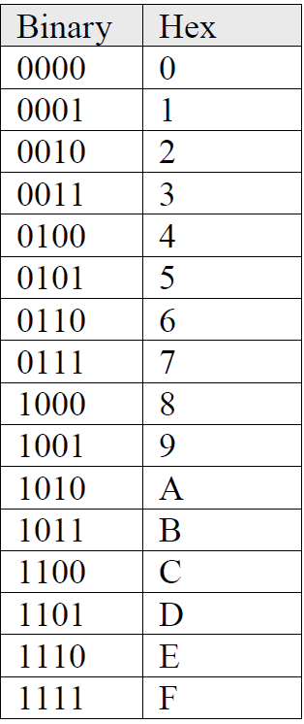
Hexadecimal
Base 16 (hexadecimal) digits: 0,1,2,3,4,5,6,7,8,9,A,B,C,D,E,F
FFE_{hex} = 15_{ten}x 16_{ten}² + 15_{ten}x 16_{ten}¹ + 14_{ten}x 16_{ten}⁰ = 3840_{ten} + 240_{ten} + 14_{ten} = 4094_{ten}
Why hex? Because four sequential bits map to one hex digit. Easier to read a long string of binary if converted to hex.
1111 1111 1110_{two} = FFE_{hex} = 4094_{ten}

Slide 39
Unsigned Integers
Represent non-negative (unsigned) integers using base 2!
0000 0000 0000 0000 0000 0000 0000 0000_{two} = 0_{ten}
0000 0000 0000 0000 0000 0000 0000 0001_{two} = 1_{ten}
0000 0000 0000 0000 0000 0000 0000 0010_{two} = 2_{ten}
... ...
0111 1111 1111 1111 1111 1111 1111 1101_{two} = 2,147,483,645_{ten}
0111 1111 1111 1111 1111 1111 1111 1110_{two} = 2,147,483,646_{ten}
0111 1111 1111 1111 1111 1111 1111 1111_{two} = 2,147,483,647_{ten}
1000 0000 0000 0000 0000 0000 0000 0000_{two} = 2,147,483,648_{ten}
1000 0000 0000 0000 0000 0000 0000 0001_{two} = 2,147,483,649_{ten}
1000 0000 0000 0000 0000 0000 0000 0010_{two} = 2,147,483,650_{ten}
... ...
1111 1111 1111 1111 1111 1111 1111 1101_{two} = 4,294,967,293_{ten}
1111 1111 1111 1111 1111 1111 1111 1110_{two} = 4,294,967,294_{ten}
1111 1111 1111 1111 1111 1111 1111 1111_{two} = 4,294,967,295_{ten}

Slide 40
What if too big?
Binary bit patterns above are simply representatives of numbers. Strictly speaking they are called “numerals”.
Numbers really have an ∞ number of digits
with almost all being same (00…0) except for a few of the rightmost digits
If result of add (or -, *, / ) cannot be represented by these rightmost hardware bits, overflow is said to have occurred.
00000
00001
00010
11110
11111
unsigned
Notes:
Subtract big from a small-> negative overflow. Be sure to point out

Slide 41
Signed Integers
Programs often need to deal with negative numbers.
How do we encode these?
A sequence of n bits can represent 2^{n} different things.
Ideally, want the range evenly split between positive and negative.
Can we encode them in such a way that we can use the same hardware regardless of whether the numbers are signed or unsigned?

Slide 42
Sign and Magnitude
Leading (leftmost) bit says whether positive or negative. 0 is positive, 1 is negative.
Rest of bits treated as usual.
8 bit examples:
1000 0010 = -2_{ten}
0000 0111 = 7_{ten}
What’s wrong with this?

Slide 43
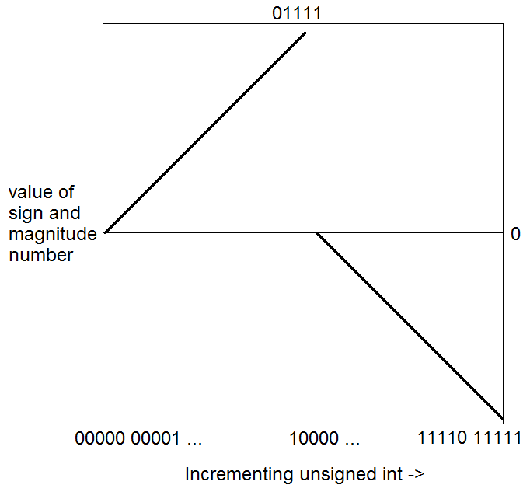
Sign and Magnitude
Two zeros! 000…0 and 100…0 are +0 and -0.
Cannot reuse unsigned hardware:

Slide 44
One’s Complement
To negate – complement the bits:
+7 => 0000 0111. -7 => 1111 1000.
Positive numbers always have leading 0’s, negative numbers always have leading 1’s
Increasing unsigned
00000
00001
...
01111
10000
...
11110
11111

Slide 45
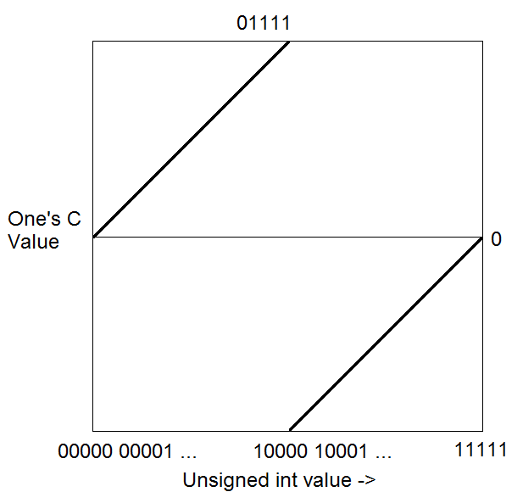
One’s Complement
Incrementing an unsigned int
nearly always increments a
One’s Complement int, with
one exception.
The two zeros: 00…000 and 11…111

Slide 46
Two’s Compliment
Minor modification of one’s compliment.
“Shift” representation of negative numbers down by one to remove duplicate zero
Using this representation, incrementing an unsigned int will always increment a signed int.
Increasing unsigned
00000
00001
...
01111
10000
...
11111
These “shifted” by one

Slide 47
Two’s Complement Integers
Sign Bit
0000 0000 0000 0000 0000 0000 0000 0000_{two} = 0_{ten}
0000 0000 0000 0000 0000 0000 0000 0001_{two} = 1_{ten}
0000 0000 0000 0000 0000 0000 0000 0010_{two} = 2_{ten}
... ...
0111 1111 1111 1111 1111 1111 1111 1101_{two} = 2,147,483,645_{ten}
0111 1111 1111 1111 1111 1111 1111 1110_{two} = 2,147,483,646_{ten}
0111 1111 1111 1111 1111 1111 1111 1111_{two} = 2,147,483,647_{ten}
1000 0000 0000 0000 0000 0000 0000 0000_{two} = –2,147,483,648_{ten}
1000 0000 0000 0000 0000 0000 0000 0001_{two} = –2,147,483,647_{ten}
1000 0000 0000 0000 0000 0000 0000 0010_{two} = –2,147,483,646_{ten}
... ...
1111 1111 1111 1111 1111 1111 1111 1101_{two} = –3_{ten}
1111 1111 1111 1111 1111 1111 1111 1110_{two} = –2_{ten}
1111 1111 1111 1111 1111 1111 1111 1111_{two} = –1_{ten}

Slide 48
Two’s Complement Summary
Used by all modern hardware.
Roughly evenly split between positive and negative.
There’s one more negative number than positive because the positive side also has zero.
To negate: Flip the bits and add one:
+3 => 0000 0011. Flip bits and add one: 1111 1101 => -3

Slide 49
In Conclusion…
CS61c: Learn 6 great ideas in computer architecture
Layers of Representation/Interpretation
Moore’s Law
Principle of Locality/Memory Hierarchy
Parallelism
Performance Measurement and Improvement
Dependability via Redundancy
Number Representation – how to represent positive and negative integers using binary.
Unsigned – Use straight up base 2.
Signed – Two’s Complement.

