Slide 1
inst.eecs.berkeley.edu/~cs61c UC Berkeley CS61C : Machine Structures Lecture 28 – Intra-machine Parallelism 2010-08-09
TA Tom Magrino
Parallel Programming Boot Camp with Par Lab next week!
You should be able to understand the basics of what they’ll be teaching after taking this course! It is free for UC Berkeley students, so take advantage of this amazing opportunity!
http://parlab.eecs.berkeley.edu/2010bootcamp
Notes:
Greet class

Slide 2
Review
Parallelism is necessary for performance
It looks like it’s It is the future of computing
It is unlikely that serial computing will ever catch up with parallel computing
Software Parallelism
Grids and clusters, networked computers
MPI & MapReduce – two common ways to program
Parallelism is often difficult
Speedup is limited by serial portion of the code and communication overhead

Slide 3
Today
Why we’re going parallel
Flynn’s Taxonomy of Parallel Architectures
Superscalars
Multithreading
Vector Processors
Multicore
Challenges for Parallelism

Slide 4
Disclaimers
Please don’t let today’s material confuse what you have already learned about CPU’s and pipelining
When programmer is mentioned today, it means whoever is generating the assembly code (so it is probably a compiler)
Many of the concepts described today are difficult to implement, so if it sounds easy, think of possible hazards

Slide 5
Scaling
Notes:
20 Years architects have been able to get performance rate to keep up with Moore’s law as far as SpecINT measures it.
Frequency has kept up, but not as much, because of techniques like Superscalar design.
Note leveling off recently, due to power limitations.

Slide 6
Conventional Wisdom (CW) in Computer Architecture
Old CW: Power is free, but transistors expensive
New CW: Power wall Power expensive, transistors “free”
Can put more transistors on a chip than have power to turn on
Old CW: Multiplies slow, but loads fast
New CW: Memory wall Loads slow, multiplies fast
200 clocks to DRAM, but even FP multiplies only 4 clocks
Old CW: More ILP via compiler / architecture innovation
Branch prediction, speculation, Out-of-order execution, VLIW, …
New CW: ILP wall Diminishing returns on more ILP
Old CW: 2X CPU Performance every 18 months
New CW is Power Wall + Memory Wall + ILP Wall = Brick Wall
Implication: We must go parallel!

Slide 7
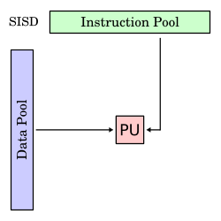
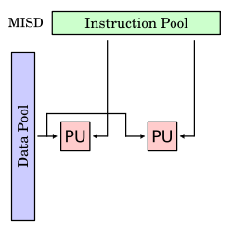
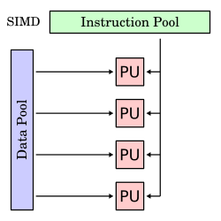
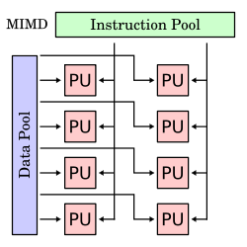
Flynn’s Taxonomy
Classification of Parallel Architectures
Single Instruction
Multiple Instruction
Single Data
Multiple Data
wwww.wikipedia.org

Slide 8
Superscalar
Add more functional units or pipelines to the CPU
Directly reduces CPI by doing more per cycle
Consider what if we:
Added another ALU
Added 2 more read ports to the RegFile
Added 1 more write port to the RegFile

Slide 9
Simple Superscalar MIPS CPU
Instruction
Memory
Can now do 2 instructions in 1 cycle!
Inst1
Inst0
Rd
Rs
Rt
Rd
Rs
Rt
Instruction
Address
5
5
5
5
5
5
A
Data
Addr
W0
Ra
Rb
W1
Rc
Rd
32
32
Data
Memory
PC
Register
File
ALU
Next Address
B
Data In
clk
clk
32
clk
32
C
32
32
ALU
D
Notes:
Ask students at this point to try and point out why it does not magically double performance.

Slide 10
Simple Superscalar MIPS CPU (cont.)
Considerations
We now have to figure out what will use the other functional unit
Forwarding for pipelining now harder
Limitations of our example
Improvement only if other instructions can fill slots
Doesn’t scale well
Who decides how to use the new slots?
Notes:
Scott seems to confuse VLIW and Superscalars at this point. I don’t think we need to bother introducing both terms but make a point of saying this could happen under the hood using very sophisticated hardware.

Slide 11
Superscalars in Practice
Modern superscalar processors usually hide behind a scalar ISA
Gives the illusion of a scalar processor
Dynamically schedules instructions
Tries to fill all slots with useful instructions
Detects hazards and avoids them
Instruction Level Parallelism (ILP)
Multiple instructions from same instruction stream in flight at the same time
Where in this course did we already make use of ILP? Pipelining

Slide 12
Multithreading
There’s only so much ILP we can get out of the same program
Why not try to have parallel tasks or threads running at the same time in the CPU?
No use in having the CPU time go to waste waiting on a single task
Let the programmer/OS figure out what tasks can happen in parallel
Now the CPU is able to just assume they’re independent.

Slide 13
Multithreading (cont.)
Idea is to have the processor try and have multiple threads working at the same time.
Less work on the CPU’s part to figure out conflicts
Programmer/OS already figured out what is independent!
All the CPU has to do is just make sure they don’t trample each other!

Slide 14
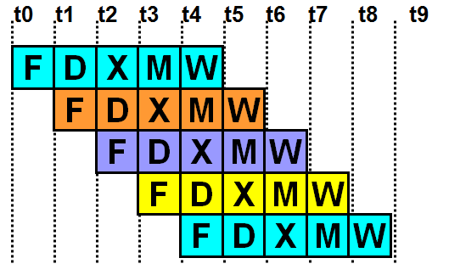
Static Multithreading
First attempt: Let’s just keep switching threads every N clock cycles!
We can probably do better…

Slide 15
Dynamic Multithreading
Well, let’s try to improve by determining while we run when to switch
That way we make even more use of the CPU despite some threads taking a long time on a single instruction.
This can be hard to do
You can have some threads “starve” if you aren’t “fair”
We can still do better! How?
Hint: Superscalars

Slide 16
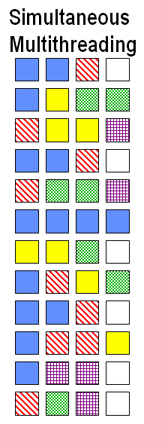
Simultaneous Multithreading
Let’s just have different threads active at the SAME time, every cycle.
Use the CPU’s resources as much as possible
We’ll probably still have some nops, but that’s okay.
Very complex hardware to do this!
Different Clock cycles
Functional Units

Slide 17
Administrivia
Proj3 and HW9 due tonight at 11:59pm
I know a few of you guys have found some of the questions vague/unclear, if you’re ever not sure just note what you’re assuming in your answer.
Final is Thursday 8–11am in 10 Evans
We’ll be having two review lectures between now and then.
We’re ending a bit early for course evaluations
Don’t forget: Paul has office hours today

Slide 18
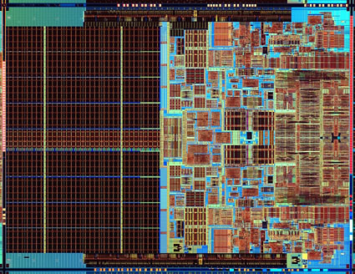
Multicore
Put multiple CPU’s on the same die
Cost of multicore: complexity and slower single-thread execution
Task/Thread Level Parallelism (TLP)
Multiple instructions streams in flight at the same time

Slide 19
Multicore Helps Energy Efficiency
Power ~ CV²f
Circuit delay is roughly linear with V
William Holt, HOT Chips 2005

Slide 20
Cache Coherence Problem
CPU0:
CPU0
CPU1
LW R2, 16(R0)
CPU1:
LW R2, 16(R0)
Cache
Addr | Value
Cache
Addr | Value
CPU1:
SW R0,16(R0)
16
5
16
5
0
View of memory no longer “coherent”.
Loads of location 16 from CPU0 and CPU1 see different values!
Shared Main Memory
Addr | Value
16
5
0
From: John Lazzaro

Slide 21
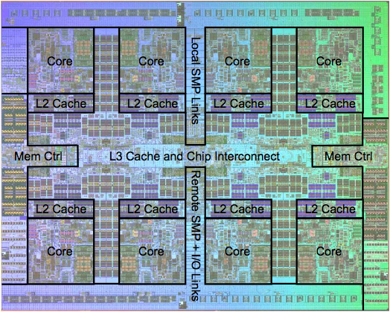
Real World Example: IBM POWER7
Notes:
Each core has 12 functional units, L1 built into each core.

Slide 22
Vector Processors
Vector Processors implement SIMD
One operation applied to whole vector
Not all program can easily fit into this
Can get high performance and energy efficiency by amortizing instruction fetch
Spends more silicon and power on ALUs
Data Level Parallelism (DLP)
Compute on multiple pieces of data with the same instruction stream

Slide 23
Vectors (continued)
Vector Extensions
Extra instructions added to a scalar ISA to provide short vectors
Examples: MMX, SSE, AltiVec
Graphics Processing Units (GPU)
Also leverage SIMD
Initially very fixed function for graphics, but now becoming more flexible to support general purpose computation

Slide 24
Parallelism at Different Levels
Intra-Processor (within the core)
Pipelining & superscalar (ILP)
Vector extensions & GPU (DLP)
Intra-System (within the box)
Multicore – multiple cores per socket (TLP)
Multisocket – multiple sockets per system
Intra-Cluster (within the room)
Multiple systems per rack and multiple racks per cluster

Slide 25
Peer Instruction
12
a) FF
b) FT
c) TF
d) TT
A GPU is an example of SIMD
With simultaneous multithreading, every part of the processor will be active, at all times.

Slide 26
Peer Instruction Answer
GPUs work on large batches of data at a time … TRUE
There is still a possibility that your threads are competing for a single part of the processor and nothing else … FALSE
12
a) FF
b) FT
c) TF
d) TT
A GPU is an example of SIMD
With simultaneous multithreading, every part of the processor will be active, at all times.
Notes:
False (explained above)
True

Slide 27
“And In conclusion…”
Modern processors are now focusing more and more about getting a lot done all at once.
Types of Parallelism: ILP, TLP, DLP
Parallelism already at many levels
Great opportunity for change
Please stick around for surveys

