Slide 1
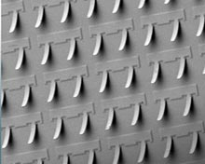
inst.eecs.berkeley.edu/~cs61c CS61C : Machine Structures Lecture 14 Introduction to Synchronous Digital Systems & State Elements 2010-07-14
Instructor Paul Pearce
Springs instead
of solder?⇒
Researchers in Palo Alto have devised a new way to integrate computer chips using springs and glue instead of solder. This technique leads to reversible integration, which reduces waste associated with a single broken component.
http://www.technologyreview.com/computing/25792/
Notes:
Greet class

Slide 2
In Review: Steps to Starting a Program

Slide 3
What are “Machine Structures”?
Application (Firefox)
61C
Operating
Compiler
System
(MacOS X)
Software
Assembler
Instruction Set
Architecture
Hardware
Processor
Memory
I/O system
Datapath & Control
Digital Design
Circuit Design
transistors
Coordination of many levels of abstraction
ISA is an important abstraction level: contract between HW & SW

Slide 4
Below the Program
High-level language program (in C)
swap int v[], int k){
int temp;
temp = v[k];
v[k] = v[k+1];
v[k+1] = temp;
}
Assembly language program (for MIPS)
swap: sll $2, $5, 2
add $2, $4,$2
lw $15, 0($2)
lw $16, 4($2)
sw $16, 0($2)
sw $15, 4($2)
jr $31
Machine (object) code (for MIPS)
000000 00000 00101 0001000010000000
000000 00100 00010 0001000000100000 . . .
C compiler
assembler
?
Notes:
For lecture
Computer only understands zeros and ones – instructions of 0’s and 1’s
Early programmers found representing machine instructions in a symbolic notation – assembly language
And developed programs that translate from assembler to machine code
Eventually, programmers found working even in assembler too tedious so migrated to higher-level languages and developed compilers that would translate from the higher-level languages to assembler

Slide 5
Synchronous Digital Systems
The hardware of a processor, such as the MIPS, is an example of a Synchronous Digital System
Synchronous:
Means all operations are coordinated by a central clock.
It keeps the “heartbeat” of the system!
Digital:
Mean all values are represented by discrete values
Electrical signals are treated as 1’s and 0’s and grouped together to form words.

Slide 6
Logic Design
Next ~2 weeks: we’ll study how a modern processor is built; starting with basic elements as building blocks.
Why study hardware design?
In order to understand the capabilities and limitations of hardware in general (and processors in particular).
What processors can do fast and what they can’t do fast (avoid slow things if you want your code to run fast!)
Background for more detailed hardware courses (Digital Design CS 150, Computer Architecture CS 152)
There is just so much you can do with processors. At some point you may need to design your own custom hardware.
Understanding how hardware works is understanding the consequences of the decisions you make when writing software.

Slide 7
PowerPC Die Photograph
Let’s look closer…

Slide 8
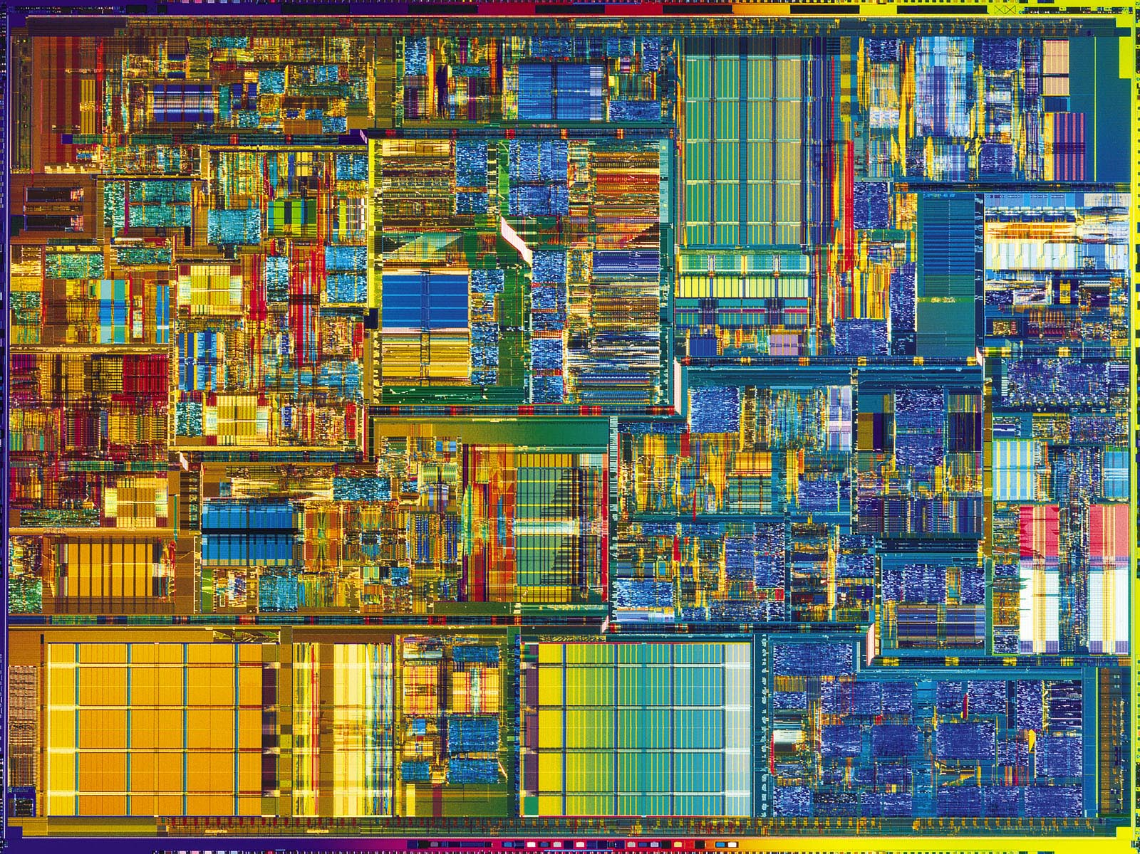
Intel Pentium 4 Die Photo

Slide 9
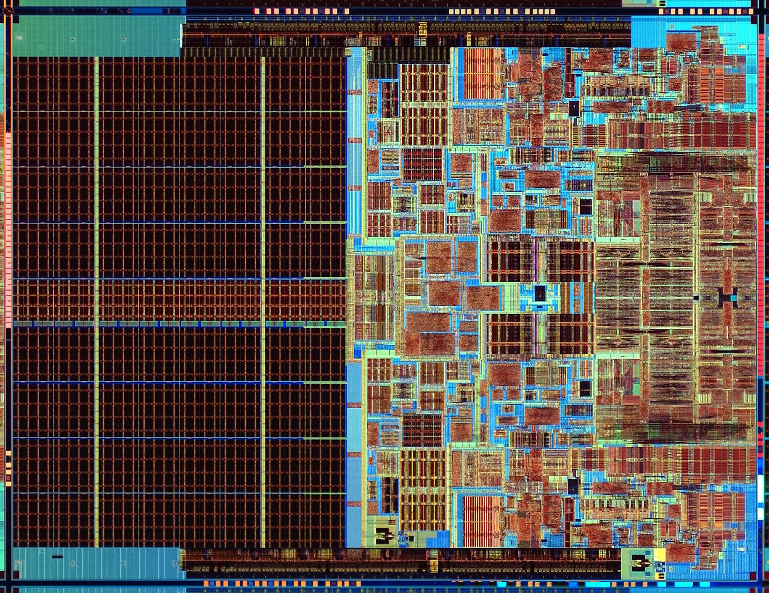
Intel Core 2 Duo Die Photo

Slide 10
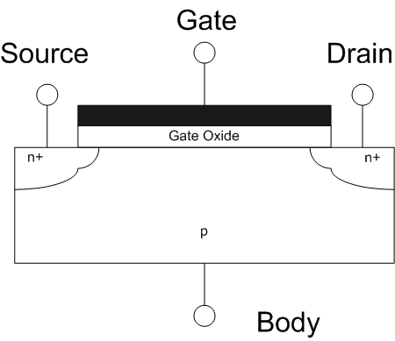
Transistors 101
D
S
MOSFET
Metal-Oxide-Semiconductor Field-Effect Transistor
Come in two types:
n-type NMOSFET
p-type PMOSFET
For n-type (p-type opposite)
If voltage not enough between G & S, transistor turns “off” (cut-off) and Drain-Source NOT connected
If the G & S voltage is high enough, transistor turns “on” (saturation) and Drain-Source ARE connected
G
G
S
D
n-type
p-type
Side view
www.wikipedia.org/wiki/Mosfet

Slide 11
Transistor Circuit Rep. vs. Block diagram
Chips is composed of nothing but transistors and wires.
Small groups of transistors form useful building blocks.
Block are organized in a hierarchy to build higher-level blocks: ex: adders.
“1” (voltage source)
a
b
c
0
0
1
0
1
1
1
0
1
1
1
0
“0” (ground)

Slide 12
Signals and Waveforms: Clocks
Signals
When digital is only treated as 1 or 0
Is transmitted over wires continuously
Transmission is effectively instant
Implies that any wire only contains 1 value at a time

Slide 13
Administrivia
Midterm Friday 9:30am-12:30pm in 100 Lewis
Remember to look at practice exams
Lecture tomorrow is review.
TA Eric will be leading.
Discussion Monday is midterm recap
This is a change to the posted schedule.
My OH are now officially MTh 12-2 (extended by 1 hour each day) in 511 Soda.
No Lab tomorrow. Instead, TA’s will be holding OH in the lab during that time.
You can go to any TA’s office hours. This is 8 hours of OH for the TA’s (11am-7pm), plus my 2 hours!

Slide 14
Signals and Waveforms

Slide 15
Signals and Waveforms: Grouping

Slide 16
Signals and Waveforms: Circuit Delay
2
3
4
5
3
10
0
1
5
13
4
6

Slide 17
Type of Circuits
Synchronous Digital Systems are made up of two basic types of circuits:
Combinational Logic (CL) circuits
Our previous adder circuit is an example.
Output is a function of the inputs only.
Similar to a pure function in mathematics, y = f(x). (No way to store information from one invocation to the next. No side effects)
State Elements: circuits that store information.

Slide 18
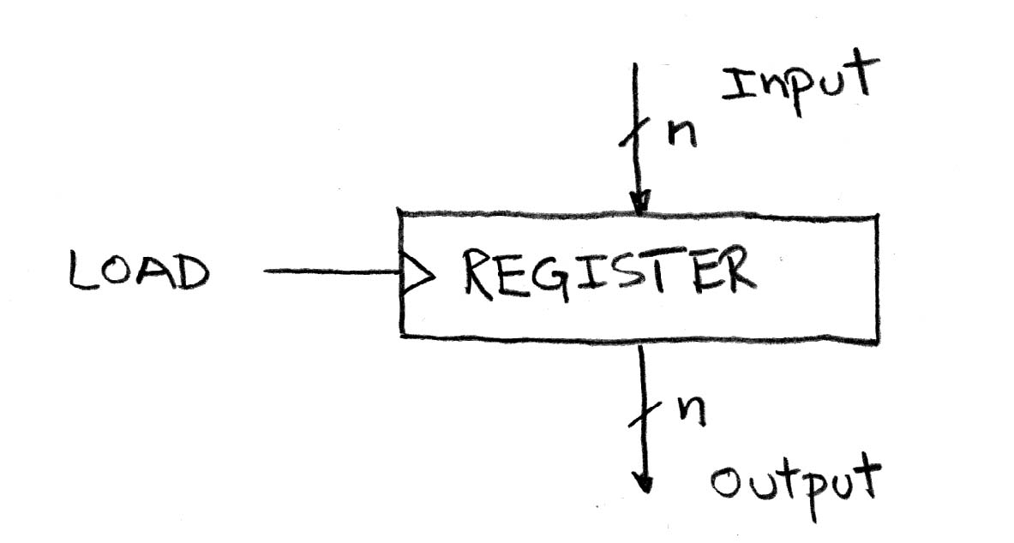
Circuits with STATE (e.g., register)

Slide 19
Uses for State Elements
As a place to store values for some indeterminate amount of time:
Register files (like $1-$31 on the MIPS)
Memory (caches, and main memory)
Help control the flow of information between combinational logic blocks.
State elements are used to hold up the movement of information at the inputs to combinational logic blocks and allow for orderly passage.

Slide 20
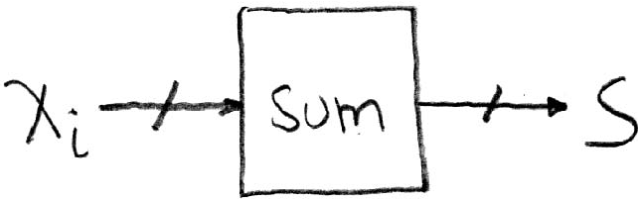
Accumulator Example
Why do we need to control the flow of information?
Want: S=0;
for (i=0;i<n;i++)
S = S + X_{i}
Assume:
Each X value is applied in succession, one per cycle.
After n cycles the sum is present on S.

Slide 21
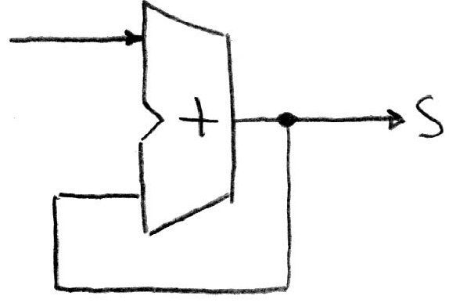
First try…Does this work?
X_{i}
Feedback
Nope!
Reason #1… What is there to control the next iteration of the ‘for’ loop?
Reason #2… How do we say: ‘S=0’?

Slide 22
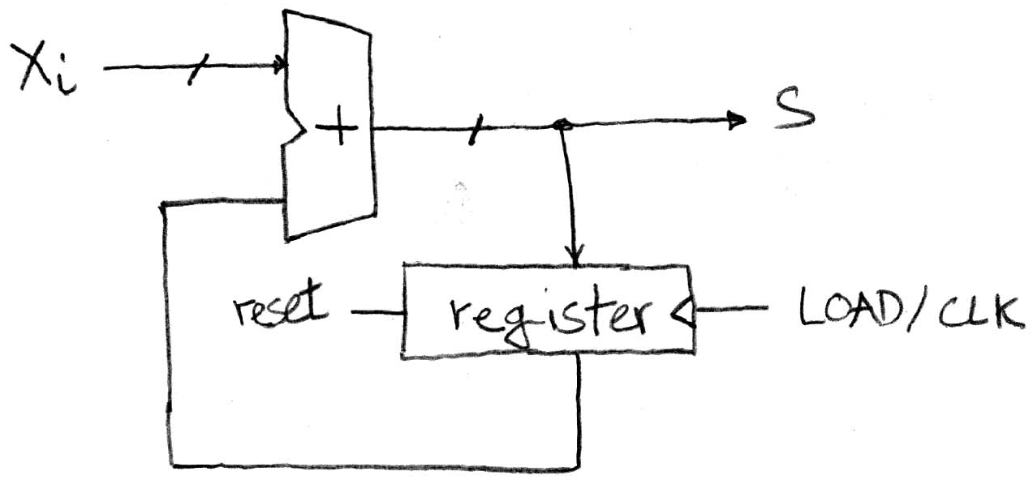
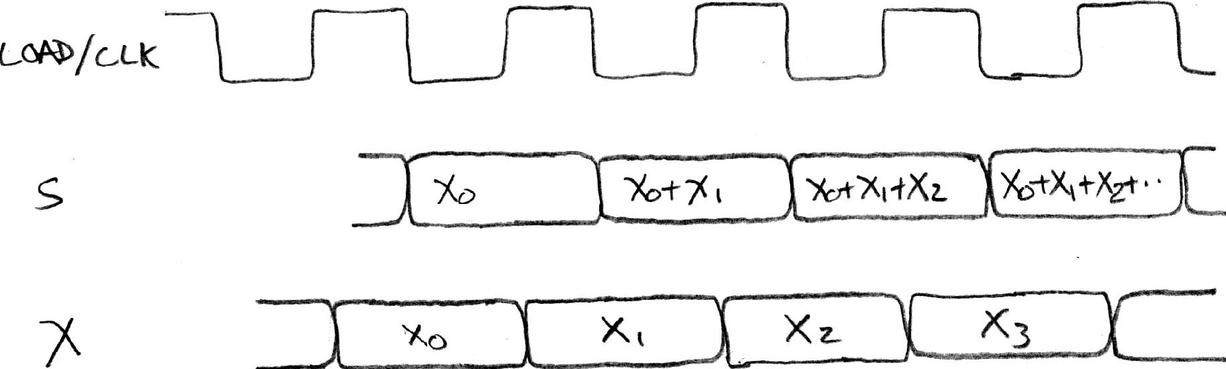
Second try…How about this?
Rough timing…
Register is used to hold up the transfer of data to adder.

Slide 23
Register Details…What’s inside?
n instances of a “Flip-Flop”
Flip-flop name because the output flips and flops between and 0,1
D is “data”, Q is “output”
Also called “d-type Flip-Flop”

Slide 24
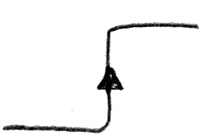
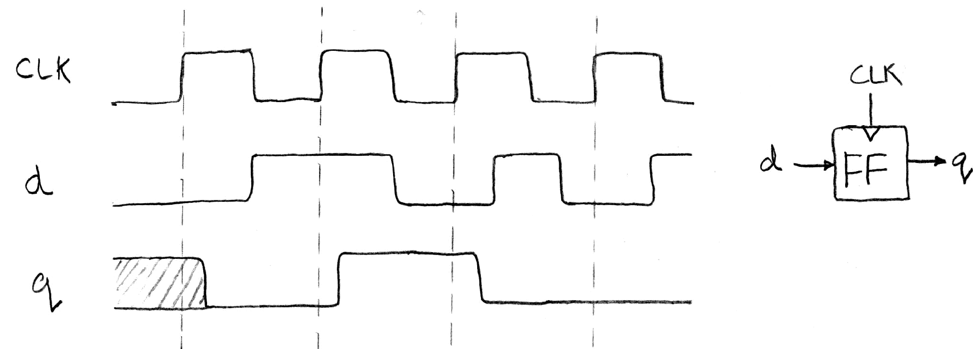
What’s the timing of a Flip-flop? (1/2)
Edge-triggered d-type flip-flop
This one is “positive edge-triggered”
“On the rising edge of the clock, the input d is sampled and transferred to the output. At all other times, the input d is ignored.”
Example waveforms:

Slide 25
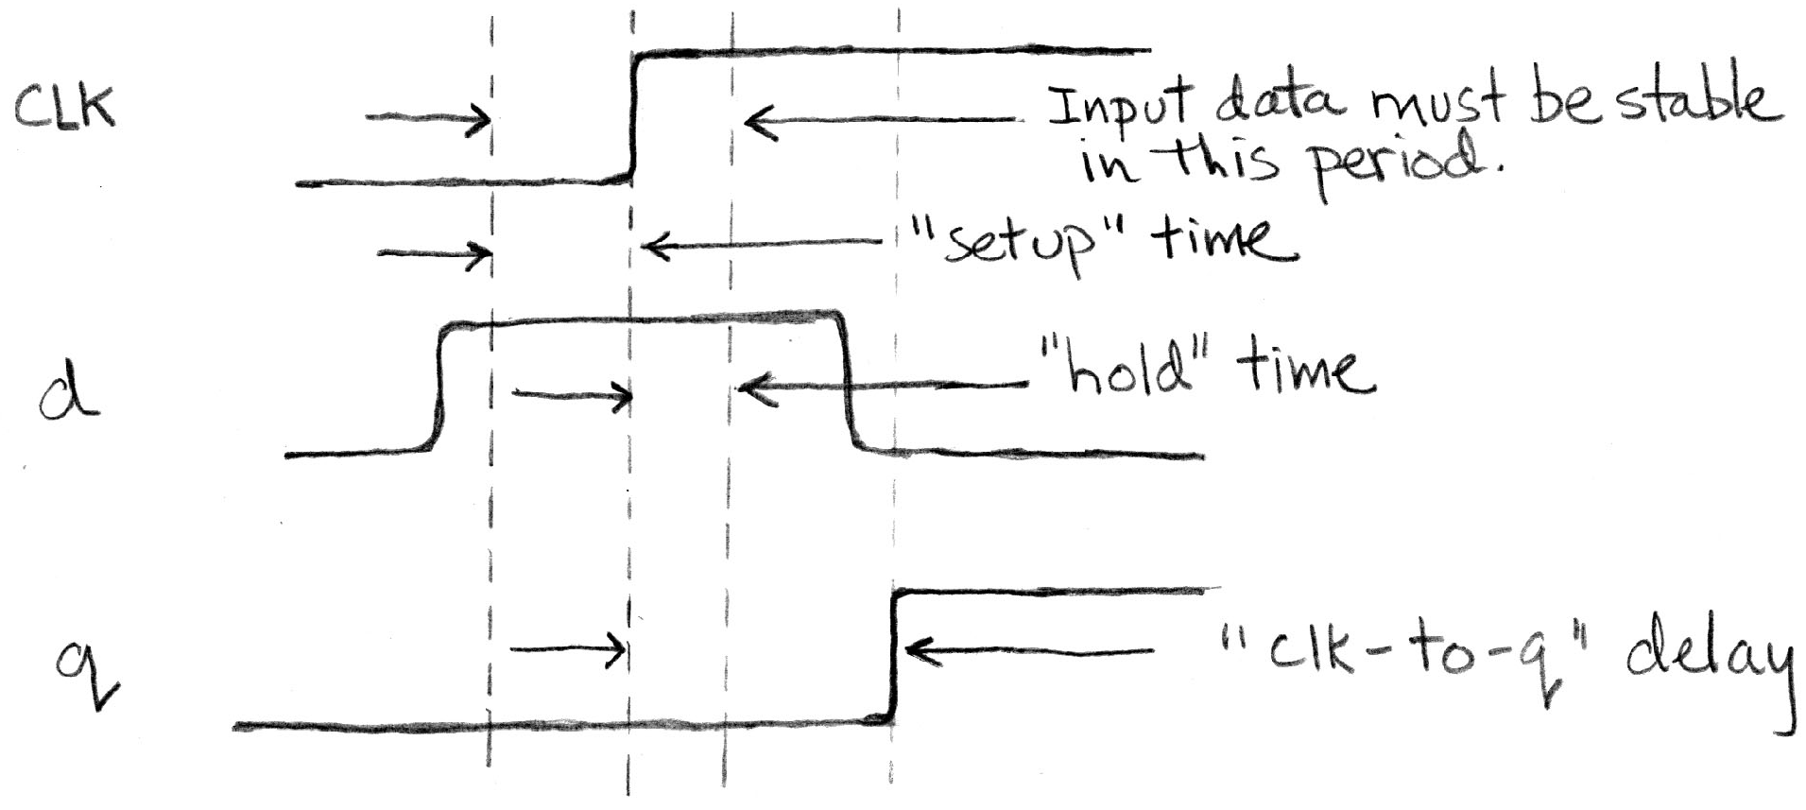
What’s the timing of a Flip-flop? (2/2)
Edge-triggered d-type flip-flop
This one is “positive edge-triggered”
“On the rising edge of the clock, the input d is sampled and transferred to the output. At all other times, the input d is ignored.”
Example waveforms (more detail):

Slide 26
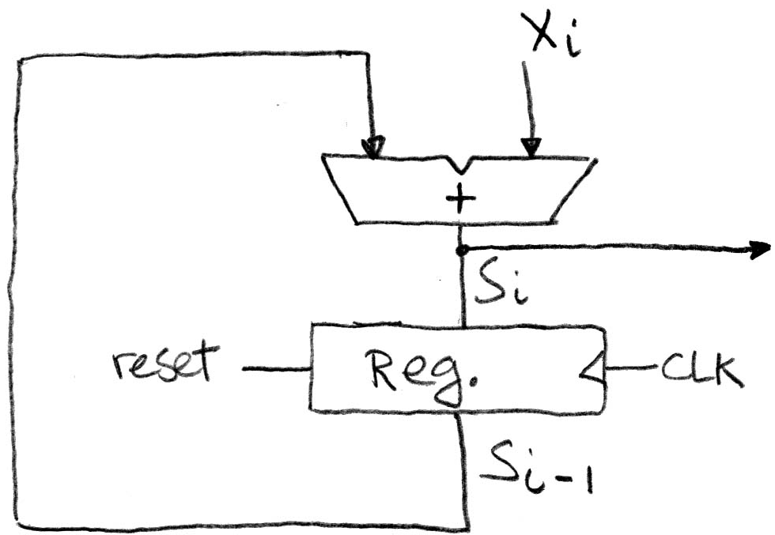
Accumulator Revisited (proper timing 1/2)
Reset input to register is used to force it to all zeros (takes priority over D input).
S_{i-1} holds the result of the i^{th}-1 iteration.
Analyze circuit timing starting at the output of the register.

Slide 27
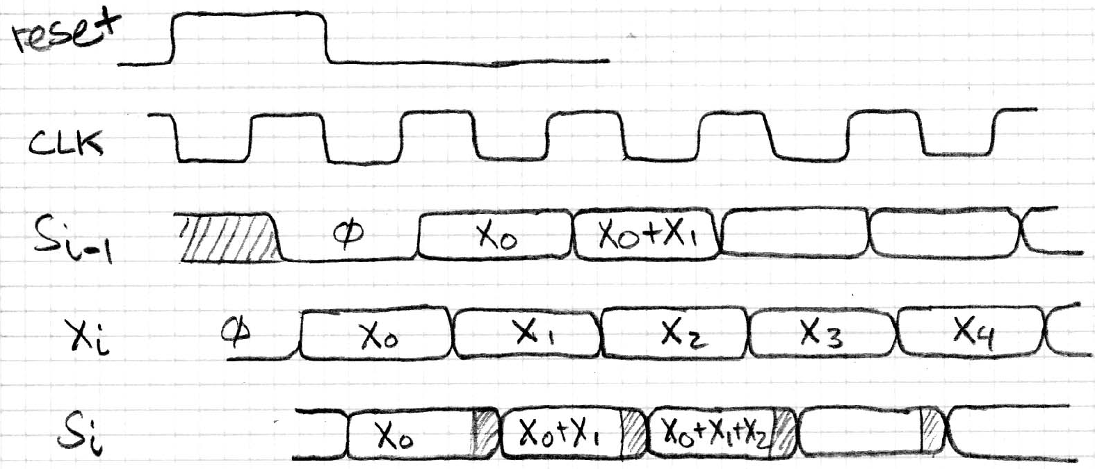
Accumulator Revisited (proper timing 2/2)
reset signal shown.
Also, in practice X might not arrive to the adder at the same time as S_{i-1}
S_{i} temporarily is wrong, but register always captures correct value.
In good circuits, instability never happens around rising edge of clk.

Slide 28
Peer Instruction
SW can peek at HW (past ISA abstraction boundary) for optimizations
SW can depend on particular HW implementation of ISA
HW feedback akin to SW recursion
123
A: FFF
B: FTF
C: TFF
D: TFT
E: TTT
ABC
A: FFF
B: FTF
C: TFF
D: TTF
E: TTT
Notes:
Answer: [correct=5, TFT]

Slide 29
Peer Instruction Answers
TRUE
SW can peek at HW (past ISA abstraction boundary) for optimizations
SW can depend on particular HW implementation of ISA
HW feedback akin to SW recursion
123
A: FFF
B: FTF
C: TFF
D: TFT
E: TTT
ABC
A: FFF
B: FTF
C: TFF
D: TTF
E: TTT
FALSE
TRUE
Notes:
Answer: [correct=5, TFT]

Slide 30
And in conclusion…
ISA is very important abstraction layer
Contract between HW and SW
Clocks control pulse of our circuits
Voltages are analog, quantized to 0/1
Circuit delays are fact of life
Two types of circuits:
Stateless Combinational Logic (&,|,~)
State circuits (e.g., registers)
State elements are used to:
Build memories
Control the flow of information between other state elements and combinational logic
D-flip-flops used to build registers
Clocks tell us when D-flip-flops change
Setup and Hold times important

Slide 31
Reference slides
You ARE responsible for the material on these slides (they’re just taken from the reading anyway) ; we’ve moved them to the end and off-stage to give more breathing room to lecture!

Slide 32
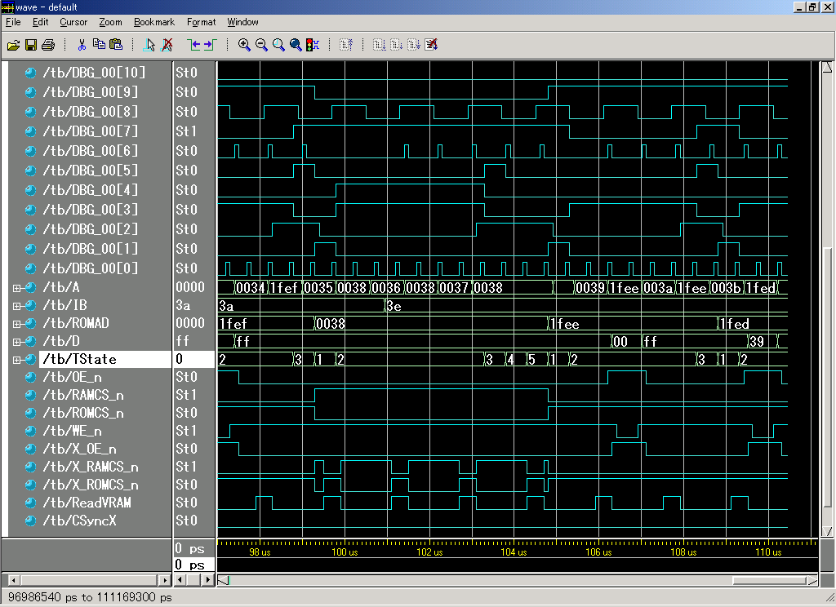
Sample Debugging Waveform

