Slide 1
inst.eecs.berkeley.edu/~cs61c CS61CL : Machine Structures Lecture #9 – Single Cycle CPU Design 2009-07-22
Jeremy Huddleston
Notes:
Greet class

Slide 2
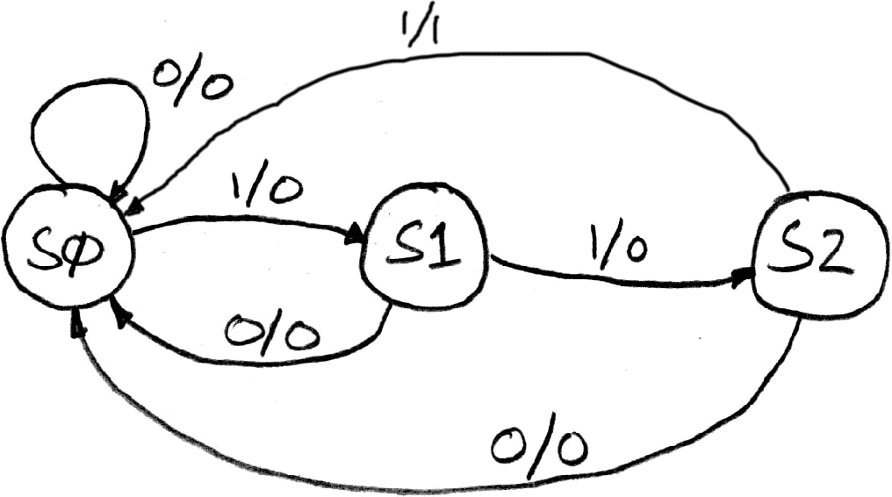
Finite State Machine Example: 3 ones…
FSM to detect the occurrence of 3 consecutive 1’s in the input.
Draw the FSM…
Assume state transitions are controlled by the clock:
on each clock cycle the machine checks the inputs and moves to a new state and produces a new output…

Slide 3
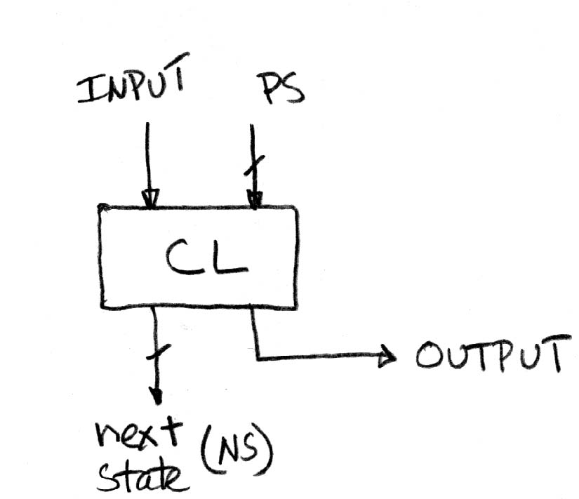
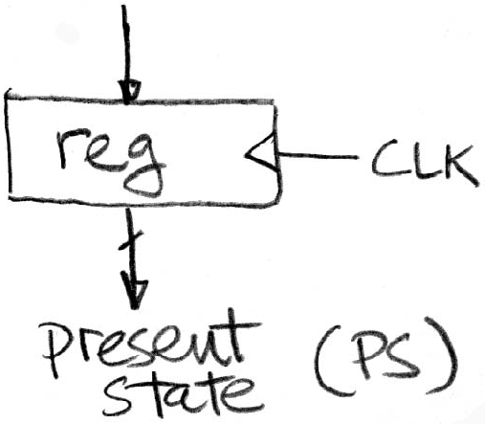
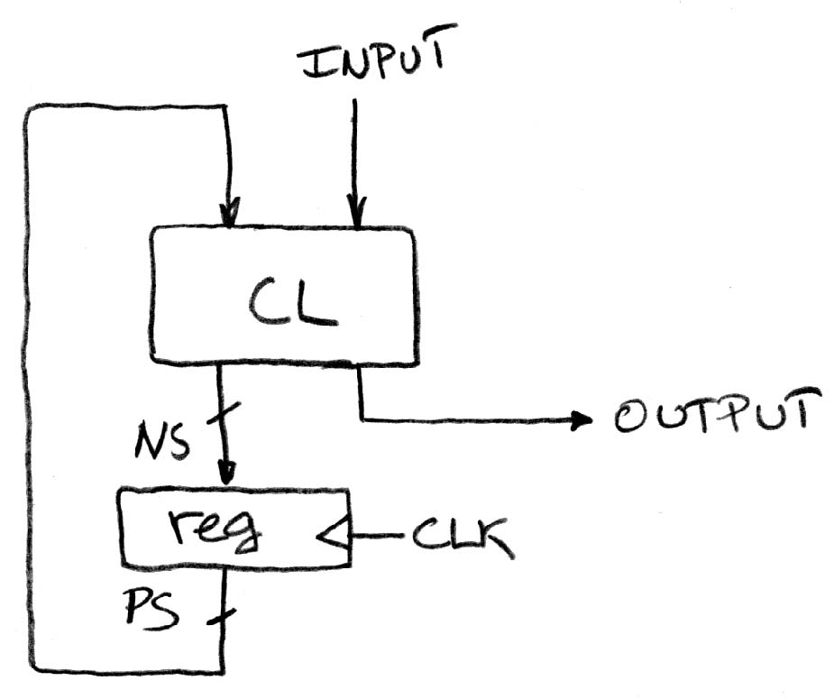
Hardware Implementation of FSM
… Therefore a register is needed to hold the a representation of which state the machine is in. Use a unique bit pattern for each state.
+
?
=
Combinational logic circuit is used to implement a function maps from present state and input to next state and output.

Slide 4
Register Details…What’s inside?
n instances of a “Flip-Flop”
Flip-flop name because the output flips and flops between and 0,1
D is “data”, Q is “output”
Also called “d-type Flip-Flop”

Slide 5
Adder/Subtracter – One-bit adder LSB…

Slide 6
Adder/Subtracter – One-bit adder (1/2)…

Slide 7
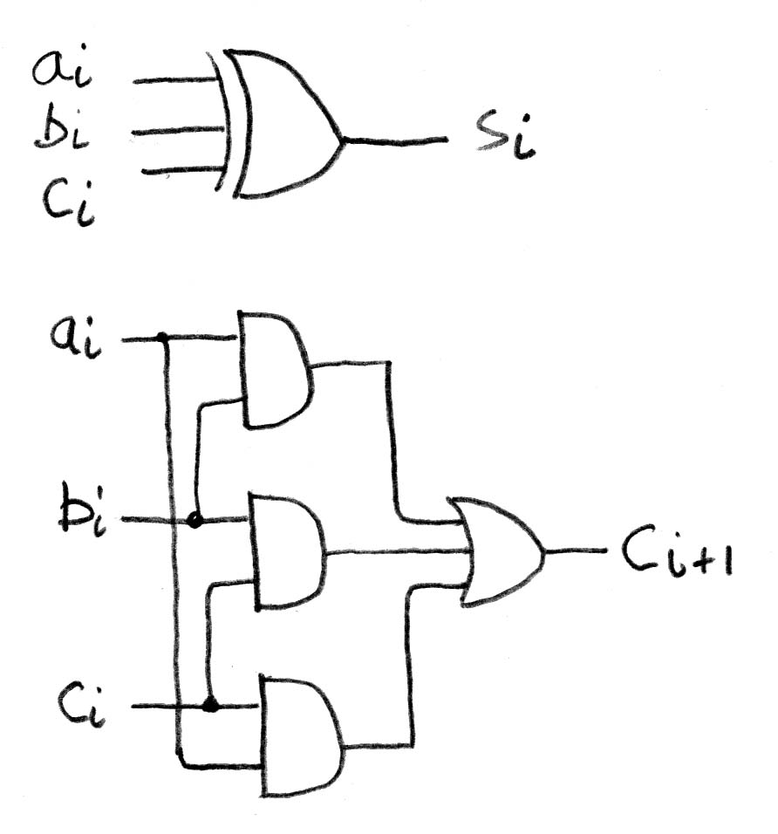
Adder/Subtracter – One-bit adder (2/2)…

Slide 8
N 1-bit adders ⇒ 1 N-bit adder
b₀
+
+
+

Slide 9
Administrivia
Midterm handed back today

Slide 10
Five Components of a Computer
Computer
Keyboard, Mouse
Devices
Processor
Memory
(passive)
(where
programs,
data live
when
running)
Disk (where
programs,
data live when not running)
Input
Control
Output
Datapath
Display, Printer

Slide 11
The CPU
Processor (CPU): the active part of the computer, which does all the work (data manipulation and decision-making)
Datapath: portion of the processor which contains hardware necessary to perform operations required by the processor (the brawn)
Control: portion of the processor (also in hardware) which tells the datapath what needs to be done (the brain)

Slide 12
Stages of the Datapath : Overview
Problem: a single, atomic block which “executes an instruction” (performs all necessary operations beginning with fetching the instruction) would be too bulky and inefficient
Solution: break up the process of “executing an instruction” into stages, and then connect the stages to create the whole datapath
smaller stages are easier to design
easy to optimize (change) one stage without touching the others

Slide 13
Stages of the Datapath (1/5)
There is a wide variety of MIPS instructions: so what general steps do they have in common?
Stage 1: Instruction Fetch
no matter what the instruction, the 32-bit instruction must first be fetched from memory (the cache-memory hierarchy)
also, this is where we Increment PC (that is, PC = PC + 4, to point to the next instruction: byte addressing so + 4)

Slide 14
Stages of the Datapath (2/5)
Stage 2: Instruction Decode
upon fetching the instruction, we next gather data from the fields (decode all necessary instruction data)
first, read the opcode to determine instruction type and field lengths
second, read in data from all necessary registers
for add, read two registers
for addi, read one register
for jal, no reads necessary

Slide 15
Stages of the Datapath (3/5)
Stage 3: ALU (Arithmetic-Logic Unit)
the real work of most instructions is done here: arithmetic (+, -, *, /), shifting, logic (&, |), comparisons (slt)
what about loads and stores?
lw $t0, 40($t1)
the address we are accessing in memory = the value in $t1 PLUS the value 40
so we do this addition in this stage

Slide 16
Stages of the Datapath (4/5)
Stage 4: Memory Access
actually only the load and store instructions do anything during this stage; the others remain idle during this stage or skip it all together
since these instructions have a unique step, we need this extra stage to account for them
as a result of the cache system, this stage is expected to be fast

Slide 17
Stages of the Datapath (5/5)
Stage 5: Register Write
most instructions write the result of some computation into a register
examples: arithmetic, logical, shifts, loads, slt
what about stores, branches, jumps?
don’t write anything into a register at the end
these remain idle during this fifth stage or skip it all together

Slide 18
Generic Steps of Datapath
rd
PC
instruction
memory
registers
rs
Data
memory
rt
ALU
+4
imm
2. Decode/
Register
Read
1. Instruction
Fetch
5. Reg.
Write
3. Execute
4. Memory

Slide 19
Datapath Walkthroughs (1/3)
add $r3,$r1,$r2 # r3 = r1+r2
Stage 1: fetch this instruction, inc. PC
Stage 2: decode to find it’s an add, then read registers $r1 and $r2
Stage 3: add the two values retrieved in Stage 2
Stage 4: idle (nothing to write to memory)
Stage 5: write result of Stage 3 into register $r3

Slide 20
Example: add Instruction
reg[1]
3
instruction
memory
reg[1]+reg[2]
PC
1
registers
Data
memory
reg[2]
ALU
2
+4
imm
add r3, r1, r2

Slide 21
Datapath Walkthroughs (3/3)
sw $r3, 17($r1)
Stage 1: fetch this instruction, inc. PC
Stage 2: decode to find it’s a sw, then read registers $r1 and $r3
Stage 3: add 17 to value in register $r1 (retrieved in Stage 2)
Stage 4: write value in register $r3 (retrieved in Stage 2) into memory address computed in Stage 3
Stage 5: idle (nothing to write into a register)

Slide 22
Example: sw Instruction
reg[1]
x
instruction
memory
reg[1]+17
PC
1
registers
Data
memory
reg[3]
ALU
3
+4
imm
17
MEM[r1+17]<=r3
SW r3, 17(r1)

Slide 23
Why Five Stages? (1/2)
Could we have a different number of stages?
Yes, and other architectures do
So why does MIPS have five if instructions tend to idle for at least one stage?
The five stages are the union of all the operations needed by all the instructions.
There is one type of instruction that uses all five stages: the load

Slide 24
Why Five Stages? (2/2)
lw $r3, 17($r1)
Stage 1: fetch this instruction, inc. PC
Stage 2: decode to find it’s a lw, then read register $r1
Stage 3: add 17 to value in register $r1 (retrieved in Stage 2)
Stage 4: read value from memory address compute in Stage 3
Stage 5: write value found in Stage 4 into register $r3

Slide 25
Example: lw Instruction
reg[1]
x
instruction
memory
reg[1]+17
PC
1
registers
Data
memory
ALU
3
MEM[r1+17]
+4
imm
17
LW r3, 17(r1)

Slide 26
Datapath Summary
The datapath based on data transfers required to perform instructions
A controller causes the right transfers to happen
rd
PC
instruction
memory
registers
rs
Data
memory
rt
ALU
+4
imm
opcode, funct
Controller

Slide 27
CPU clocking (1/2)
For each instruction, how do we control the flow of information though the datapath?
Single Cycle CPU: All stages of an instruction are completed within one long clock cycle.
The clock cycle is made sufficient long to allow each instruction to complete all stages without interruption and within one cycle.
2. Decode/
Register
Read
1. Instruction
Fetch
5. Reg.
Write
3. Execute
4. Memory

Slide 28
CPU clocking (2/2)
For each instruction, how do we control the flow of information though the datapath?
Multiple-cycle CPU: Only one stage of instruction per clock cycle.
The clock is made as long as the slowest stage.
Several significant advantages over single cycle execution: Unused stages in a particular instruction can be skipped OR instructions can be pipelined (overlapped).
2. Decode/
Register
Read
1. Instruction
Fetch
5. Reg.
Write
3. Execute
4. Memory

Slide 29
How to Design a Processor: step-by-step
1. Analyze instruction set architecture (ISA) ⇒ datapath requirements
meaning of each instruction is given by the register transfers
datapath must include storage element for ISA registers
datapath must support each register transfer
2. Select set of datapath components and establish clocking methodology
3. Assemble datapath meeting requirements
4. Analyze implementation of each instruction to determine setting of control points that effects the register transfer.
5. Assemble the control logic (hard part!)

Slide 30
Review: The MIPS Instruction Formats
All MIPS instructions are 32 bits long. 3 formats:
R-type
I-type
J-type
The different fields are:
op: operation (“opcode”) of the instruction
rs, rt, rd: the source and destination register specifiers
shamt: shift amount
funct: selects the variant of the operation in the “op” field
address / immediate: address offset or immediate value
target address: target address of jump instruction
31
26
21
16
11
6
0
op
rs
rt
rd
shamt
funct
6 bits
5 bits
5 bits
5 bits
5 bits
6 bits
31
26
21
16
0
op
rs
rt
address/immediate
6 bits
5 bits
5 bits
16 bits
31
26
0
op
target address
6 bits
26 bits
Notes:
One of the most important thing you need to know before you start designing a processor is how the instructions look like.
Or in more technical term, you need to know the instruction format. One good thing about the MIPS instruction set is that it is very simple.
First of all, all MIPS instructions are 32 bits long and there are only three instruction formats: (a) R-type, (b) I-type, and (c) J-type.
The different fields of the R-type instructions are:
(a) OP specifies the operation of the instruction.
(b) Rs, Rt, and Rd are the source and destination register specifiers.
(c) Shamt specifies the amount you need to shift for the shift instructions.
(d) Funct selects the variant of the operation specified in the “op” field.
For the I-type instruction, bits 0 to 15 are used as an immediate field. I will show you how this immediate field is used differently by different instructions.
Finally for the J-type instruction, bits 0 to 25 become the target address of the jump.
+3 = 10 min. (X:50)

Slide 31
The MIPS-lite Subset for today
ADDU and SUBU
addu rd,rs,rt
subu rd,rs,rt
OR Immediate:
ori rt,rs,imm16
LOAD and STORE Word
lw rt,rs,imm16
sw rt,rs,imm16
BRANCH:
beq rs,rt,imm16
31
26
21
16
11
6
0
op
rs
rt
rd
shamt
funct
6 bits
5 bits
5 bits
5 bits
5 bits
6 bits
31
26
21
16
0
op
rs
rt
immediate
6 bits
5 bits
5 bits
16 bits
31
26
21
16
0
op
rs
rt
immediate
6 bits
5 bits
5 bits
16 bits
31
26
21
16
0
op
rs
rt
immediate
6 bits
5 bits
5 bits
16 bits
Notes:
In today’s lecture, I will show you how to implement the following subset of MIPS instructions: add, subtract, or immediate, load, store, branch, and the jump instruction.
The Add and Subtract instructions use the R format. The Op together with the Func fields together specified all the different kinds of add and subtract instructions.
Rs and Rt specifies the source registers. And the Rd field specifies the destination register.
The Or immediate instruction uses the I format. It only uses one source register, Rs. The other operand comes from the immediate field. The Rt field is used to specified the destination register. (Note that dest is the Rt field!)
Both the load and store instructions use the I format and both add the Rs and the immediate filed together to from the memory address.
The difference is that the load instruction will load the data from memory into Rt while the store instruction will store the data in Rt into the memory.
The branch on equal instruction also uses the I format. Here Rs and Rt are used to specified the registers we need to compare.
If these two registers are equal, we will branch to a location offset by the immediate field.
Finally, the jump instruction uses the J format and always causes the program to jump to a memory location specified in the address field.
I know I went over this rather quickly and you may have missed something. But don’t worry, this is just an overview. You will keep seeing these (point to the format) all day today.
+3 = 13 min. (X:53)

Slide 32
ALU Needs for MIPS-lite + Rest of MIPS
Addition, subtraction, logical OR, ==:
ADDU R[rd] = R[rs] + R[rt]; ...
SUBU R[rd] = R[rs] – R[rt]; ...
ORI R[rt] = R[rs] | zero_ext(Imm16)...
BEQ if ( R[rs] == R[rt] )...
Test to see if output == 0 for any ALU operation gives == test. How?
P&H also adds AND, Set Less Than (1 if A < B, 0 otherwise)
ALU follows chap 5

Slide 33
How to Design a Processor: step-by-step
1. Analyze instruction set architecture (ISA) ⇒ datapath requirements
meaning of each instruction is given by the register transfers
datapath must include storage element for ISA registers
datapath must support each register transfer
2. Select set of datapath components and establish clocking methodology
3. Assemble datapath meeting requirements
4. Analyze implementation of each instruction to determine setting of control points that effects the register transfer.
5. Assemble the control logic (hard part!)

Slide 34
What Hardware Is Needed? (1/2)
PC: a register which keeps track of memory addr of the next instruction
General Purpose Registers
used in Stages 2 (Read) and 5 (Write)
MIPS has 32 of these
Memory
used in Stages 1 (Fetch) and 4 (R/W)
cache system makes these two stages as fast as the others, on average

Slide 35
What Hardware Is Needed? (2/2)
ALU
used in Stage 3
something that performs all necessary functions: arithmetic, logicals, etc.
we’ll design details later
Miscellaneous Registers
In implementations with only one stage per clock cycle, registers are inserted between stages to hold intermediate data and control signals as they travels from stage to stage.
Note: Register is a general purpose term meaning something that stores bits. Not all registers are in the “register file”.

Slide 36
Combinational Logic Elements (Building Blocks)
Adder
MUX
ALU
CarryIn
A
32
Adder
Sum
32
B
CarryOut
32
Select
A
32
MUX
Y
32
B
32
OP
A
32
ALU
Result
32
B
32
Notes:
Based on the Register Transfer Language examples we have so far, we know we will need the following combinational logic elements.
We will need an adder to update the program counter.
A MUX to select the results.
And finally, an ALU to do various arithmetic and logic operation.
+1 = 30 min. (Y:10)

Slide 37
Storage Element: Idealized Memory
Memory (idealized)
One input bus: Data In
One output bus: Data Out
Memory word is found by:
Address selects the word to put on Data Out
Write Enable = 1: address selects the memory word to be written via the Data In bus
Clock input (CLK)
The CLK input is a factor ONLY during write operation
During read operation, behaves as a combinational logic block:
Address valid ⇒ Data Out valid after “access time.”
Write Enable
Address
Data In
DataOut
32
32
Clk
Notes:
The last storage element you will need for the datapath is the idealized memory to store your data and instructions.
This idealized memory block has just one input bus (DataIn) and one output bus (DataOut).
When Write Enable is 0, the address selects the memory word to put on the Data Out bus.
When Write Enable is 1, the address selects the memory word to be written via the DataIn bus at the next clock tick.
Once again, the clock input is a factor ONLY during the write operation.
During read operation, it behaves as a combinational logic block.
That is if you put a valid value on the address lines, the output bus DataOut will become valid after the access time of the memory.
+2 = 35 min. (Y:15)

Slide 38
Storage Element: Register (Building Block)
Similar to D Flip Flop except
N-bit input and output
Write Enable input
Write Enable:
negated (or deasserted) (0): Data Out will not change
asserted (1): Data Out will become Data In on positive edge of clock
Write Enable
Data In
Data Out
N
N
clk
Notes:
As far as storage elements are concerned, we will need a N-bit register that is similar to the D flip-flop I showed you in class.
The significant difference here is that the register will have a Write Enable input.
That is the content of the register will NOT be updated if Write Enable is not asserted (0).
The content is updated at the clock tick ONLY if the Write Enable signal is asserted (1).
+1 = 31 min. (Y:11)

Slide 39
Storage Element: Register File
Register File consists of 32 registers:
Two 32-bit output busses:
busA and busB
One 32-bit input bus: busW
Register is selected by:
RA (number) selects the register to put on busA (data)
RB (number) selects the register to put on busB (data)
RW (number) selects the register to be written via busW (data) when Write Enable is 1
Clock input (clk)
The clk input is a factor ONLY during write operation
During read operation, behaves as a combinational logic block:
RA or RB valid ⇒ busA or busB valid after “access time.”
RW
RA
RB
Write Enable
5
5
5
busA
busW
32 32-bit
Registers
32
32
busB
Clk
32
Notes:
We will also need a register file that consists of 32 32-bit registers with two output busses (busA and busB) and one input bus.
The register specifiers Ra and Rb select the registers to put on busA and busB respectively.
When Write Enable is 1, the register specifier Rw selects the register to be written via busW.
In our simplified version of the register file, the write operation will occurs at the clock tick.
Keep in mind that the clock input is a factor ONLY during the write operation.
During read operation, the register file behaves as a combinational logic block.
That is if you put a valid value on Ra, then bus A will become valid after the register file’s access time.
Similarly if you put a valid value on Rb, bus B will become valid after the register file’s access time. In both cases (Ra and Rb), the clock input is not a factor.
+2 = 33 min. (Y:13)

Slide 40
How to Design a Processor: step-by-step
1. Analyze instruction set architecture (ISA) ⇒ datapath requirements
meaning of each instruction is given by the register transfers
datapath must include storage element for ISA registers
datapath must support each register transfer
2. Select set of datapath components and establish clocking methodology
3. Assemble datapath meeting requirements
4. Analyze implementation of each instruction to determine setting of control points that effects the register transfer.
5. Assemble the control logic (hard part!)

Slide 41
Overview of the Instruction Fetch Unit
The common RTL operations
Fetch the Instruction: mem[PC]
Update the program counter:
Sequential Code: PC ← PC + 4
Branch and Jump: PC ← “something else”
clk
PC
Next Address
Logic
Address
Instruction Word
Instruction
Memory
32
Notes:
Now let’s take a look at the first major component of the datapath: the instruction fetch unit.
The common RTL operations for all instructions are:
(a) Fetch the instruction using the Program Counter (PC) at the beginning of an
instruction’s execution (PC -> Instruction Memory -> Instruction Word).
(b) Then at the end of the instruction’s execution, you need to update the
Program Counter (PC -> Next Address Logic -> PC).
More specifically, you need to increment the PC by 4 if you are executing sequential code.
For Branch and Jump instructions, you need to update the program counter to “something else” other than plus 4.
I will show you what is inside this Next Address Logic block when we talked about the Branch and Jump instructions.
For now, let’s focus our attention to the Add and Subtract instructions.
+2 = 37 min. (Y:17)

Slide 42
Add & Subtract
R[rd] = R[rs] op R[rt] Ex.: addU rd,rs,rt
Ra, Rb, and Rw come from instruction’s Rs, Rt, and Rd fields
ALUctr and RegWr: control logic after decoding the instruction
… Already defined the register file & ALU
31
26
21
16
11
6
0
op
rs
rt
rd
shamt
funct
6 bits
5 bits
5 bits
5 bits
5 bits
6 bits
Rd
Rs
Rt
RegWr
ALUctr
5
5
5
busA
Rw
Ra
Rb
busW
32
32 32-bit
Registers
Result
32
ALU
busB
32
clk
32
Notes:
And here is the datapath that can do the trick.
First of all, we connect the register file’s Ra, Rb, and Rw input to the Rd, Rs, and Rt fields of the instruction bus (points to the format diagram).
Then we need to connect busA and busB of the register file to the ALU.
Finally, we need to connect the output of the ALU to the input bus of the register file.
Conceptually, this is how it works.
The instruction bus coming out of the Instruction memory will set the Ra and Rb to the register specifiers Rs and Rt.
This causes the register file to put the value of register Rs onto busA and the value of register Rt onto busB, respectively.
By setting the ALUctr appropriately, the ALU will perform either the Add and Subtract for us.
The result is then fed back to the register file where the register specifier Rw should already be set to the instruction bus’s Rd field.
Since the control, which we will design in our next lecture, should have already set the RegWr signal to 1, the result will be written back to the register file at the next clock tick (points to the Clk input).
+3 = 42 min. (Y:22)

Slide 43
Logical Operations with Immediate
R[rt] = R[rs] op ZeroExt[imm16]
31
26
21
16
0
op
rs
rt
immediate
31
6 bits
5 bits
5 bits
16
15
16 bits
0
0 0 0 0 0 0 0 0 0 0 0 0 0 0 0 0
immediate
16 bits
16 bits
But we’re writing to Rt register??
RegWr
Rd
Rs
Rt
ALUctr
5
5
5
Rw
Ra
Rb
busA
32
busW
32
RegFile
busB
ALU
clk
32
Notes:
Here is the datapath for the Or immediate instructions.
We cannot use the Rd field here (Rw) because in this instruction format, we don’t have a Rd field. The Rd field in the R-type is used here as part of the immediate field.
For this instruction type, Rw input of the register file, that is the address of the register to be written, comes from the Rt field of the instruction.
Recalled from earlier slide that for R-type instruction, the Rw comes from the Rd field.
That’s why we need a MUX here to put Rd onto Rw for R-type instructions and to put Rt onto Rw for the I-type instruction.
Since the second operation of this instruction will be the immediate field zero extended to 32 bits, we also need a MUX here to block off bus B from the register file.
Since bus B is blocked off by the MUX, the value on bus B is don’t care. Therefore we do not have to worry about what ends up on the register file’s Rb register specifier.
To keep things simple, we may just as well keep it the same as the R-type instruction and put the Rt field here.
So to summarize, this is how this datapath works. With Rs on Register File’s Ra input, bus A will get the value of Rs as the first ALU operand.
The second operand will come from the immediate field of the instruction.
Once the ALU complete the OR operation, the result will be written into the register specified by the instruction’s Rt field.
+3 = 50 min. (Y:30)

Slide 44
Logical Operations with Immediate
R[rt] = R[rs] op ZeroExt[imm16]
31
26
21
16
0
op
rs
rt
immediate
31
6 bits
5 bits
5 bits
16
15
16 bits
0
RegDst
0 0 0 0 0 0 0 0 0 0 0 0 0 0 0 0
immediate
Rd
Rt
16 bits
16 bits
What about Rt register read??
1
0
RegWr
Rs
Rt
ALUctr
5
5
5
Rw
Ra
Rb
busA
32
32
32
RegFile
busB
ALU
0
clk
32
imm16
ZeroExt
1
16
32
ALUSrc
Already defined 32-bit MUX; Zero Ext?
Notes:
Here is the datapath for the Or immediate instructions.
We cannot use the Rd field here (Rw) because in this instruction format, we don’t have a Rd field. The Rd field in the R-type is used here as part of the immediate field.
For this instruction type, Rw input of the register file, that is the address of the register to be written, comes from the Rt field of the instruction.
Recalled from earlier slide that for R-type instruction, the Rw comes from the Rd field.
That’s why we need a MUX here to put Rd onto Rw for R-type instructions and to put Rt onto Rw for the I-type instruction.
Since the second operation of this instruction will be the immediate field zero extended to 32 bits, we also need a MUX here to block off bus B from the register file.
Since bus B is blocked off by the MUX, the value on bus B is don’t care. Therefore we do not have to worry about what ends up on the register file’s Rb register specifier.
To keep things simple, we may just as well keep it the same as the R-type instruction and put the Rt field here.
So to summarize, this is how this datapath works. With Rs on Register File’s Ra input, bus A will get the value of Rs as the first ALU operand.
The second operand will come from the immediate field of the instruction.
Once the ALU complete the OR operation, the result will be written into the register specified by the instruction’s Rt field.
+3 = 50 min. (Y:30)

Slide 45
Load Operations
R[rt] = Mem[R[rs] + SignExt[imm16]] Example: lw rt,rs,imm16
31
26
21
16
0
op
rs
rt
immediate
6 bits
5 bits
5 bits
16 bits
RegDst
Rd
Rt
1
0
RegWr
Rs
Rt
ALUctr
5
5
5
Rw
Ra
Rb
busA
32
32
32
RegFile
busB
ALU
0
clk
32
imm16
ZeroExt
1
16
32
ALUSrc
Notes:
Once again we cannot use the instruction’s Rd field for the Register File’s Rw input because load is a I-type instruction and there is no such thing as the Rd field in the I format.
So instead of Rd, the Rt field is used to specify the destination register through this two to one multiplexor.
The first operand of the ALU comes from busA of the register file which contains the value of Register Rs (points to the Ra input of the register file).
The second operand, on the other hand, comes from the immediate field of the instruction.
Instead of using the Zero Extender I used in datapath for the or immediate datapath, I have to use a more general purpose Extender that can do both Sign Extend and Zero Extend.
The ALU then adds these two operands together to form the memory address.
Consequently, the output of the ALU has to go to two places:
(a) First the address input of the data memory.
(b) And secondly, also to the input of this two-to-one multiplexer.
The other input of this multiplexer comes from the output of the data memory so we can place the output of the data memory onto the register file’s input bus for the load instruction.
For Add, Subtract, and the Or immediate instructions, the output of the ALU will be selected to be placed on the input bus of the register file.
In either case, the control signal RegWr should be asserted so the register file will be written at the end of the cycle.
+3 = 60 min. (Y:40)

Slide 46
Load Operations
R[rt] = Mem[R[rs] + SignExt[imm16]] Example: lw rt,rs,imm16
31
26
21
16
0
op
rs
rt
immediate
6 bits
5 bits
5 bits
16 bits
RegDst
Rd
Rt
ALUctr
MemtoReg
1
0
MemWr
RegWr
Rs
Rt
5
5
5
Rw
Ra
Rb
busA
32
busW
32
32
RegFile
busB
ALU
0
0
clk
32
?
32
WrEn
Adr
imm16
Extender
1
Data In
1
16
32
Data
Memory
ALUSrc
clk
ExtOp
Notes:
Once again we cannot use the instruction’s Rd field for the Register File’s Rw input because load is a I-type instruction and there is no such thing as the Rd field in the I format.
So instead of Rd, the Rt field is used to specify the destination register through this two to one multiplexor.
The first operand of the ALU comes from busA of the register file which contains the value of Register Rs (points to the Ra input of the register file).
The second operand, on the other hand, comes from the immediate field of the instruction.
Instead of using the Zero Extender I used in datapath for the or immediate datapath, I have to use a more general purpose Extender that can do both Sign Extend and Zero Extend.
The ALU then adds these two operands together to form the memory address.
Consequently, the output of the ALU has to go to two places:
(a) First the address input of the data memory.
(b) And secondly, also to the input of this two-to-one multiplexer.
The other input of this multiplexer comes from the output of the data memory so we can place the output of the data memory onto the register file’s input bus for the load instruction.
For Add, Subtract, and the Or immediate instructions, the output of the ALU will be selected to be placed on the input bus of the register file.
In either case, the control signal RegWr should be asserted so the register file will be written at the end of the cycle.
+3 = 60 min. (Y:40)

Slide 47
Store Operations
Mem[ R[rs] + SignExt[imm16] ] = R[rt] Ex.: sw rt, rs, imm16
31
26
21
16
0
op
rs
rt
immediate
6 bits
5 bits
5 bits
16 bits
RegDst
Rd
Rt
ALUctr
MemtoReg
1
0
MemWr
RegWr
Rs
Rt
5
5
5
Rw
Ra
Rb
busA
32
busW
32
32
RegFile
busB
ALU
0
0
clk
32
32
WrEn
Adr
imm16
Extender
1
Data In
1
16
32
Data
Memory
ALUSrc
clk
ExtOp
Notes:
And here is the datapath for the store instruction.
The Register File, the ALU, and the Extender are the same as the datapath for the load instruction because the memory address has to be calculated the same exact way:
(a) Put the register selected by Rs onto bus A and sign extend the 16 bit immediate field.
(b) Then make the ALU (ALUctr) adds these two (busA and output of Extender) together.
The new thing we added here is busB extension (DataIn).
More specifically, in order to send the register selected by the Rt field (Rb of the register file) to data memory, we need to connect bus B to the data memory’s Data In bus.
Finally, the store instruction is the first instruction we encountered that does not do any register write at the end.
Therefore the control unit must make sure RegWr is zero for this instruction.
+2 = 64 min. (Y:44)

Slide 48
Store Operations
Mem[ R[rs] + SignExt[imm16] ] = R[rt] Ex.: sw rt, rs, imm16
31
26
21
16
0
op
rs
rt
immediate
6 bits
5 bits
5 bits
16 bits
RegDst
Rd
Rt
ALUctr
MemtoReg
1
0
MemWr
RegWr
Rs
Rt
5
5
5
Rw
Ra
Rb
busA
32
busW
32
32
RegFile
busB
ALU
0
0
clk
32
32
WrEn
Adr
imm16
Extender
1
Data In
1
16
32
Data
Memory
ALUSrc
clk
ExtOp
Notes:
And here is the datapath for the store instruction.
The Register File, the ALU, and the Extender are the same as the datapath for the load instruction because the memory address has to be calculated the same exact way:
(a) Put the register selected by Rs onto bus A and sign extend the 16 bit immediate field.
(b) Then make the ALU (ALUctr) adds these two (busA and output of Extender) together.
The new thing we added here is busB extension (DataIn).
More specifically, in order to send the register selected by the Rt field (Rb of the register file) to data memory, we need to connect bus B to the data memory’s Data In bus.
Finally, the store instruction is the first instruction we encountered that does not do any register write at the end.
Therefore the control unit must make sure RegWr is zero for this instruction.
+2 = 64 min. (Y:44)

Slide 49
The Branch Instruction
31
26
21
16
0
op
rs
rt
immediate
6 bits
5 bits
5 bits
16 bits
beq rs, rt, imm16
mem[PC] Fetch the instruction from memory
Equal = R[rs] == R[rt] Calculate branch condition
if (Equal) Calculate the next instruction’s address
PC = PC + 4 + ( SignExt(imm16) x 4 )
else
PC = PC + 4
Notes:
How does the branch on equal instruction work?
Well it calculates the branch condition by subtracting the register selected by the Rt field from the register selected by the Rs field.
If the result of the subtraction is zero, then these two registers are equal and we take a branch. Otherwise, we keep going down the sequential path (PC = PC +4).
+1 = 65 min. (Y:45)

Slide 50
Datapath for Branch Operations
beq rs, rt, imm16 Datapath generates condition (equal)
31
26
21
16
0
op
rs
rt
immediate
6 bits
5 bits
5 bits
16 bits
Inst Address
Equal
nPC_sel
4
RegWr
Rs
Rt
ALUctr
Adder
5
5
5
00
Rw
Ra
Rb
busA
32
=
busW
32
Mux
PC
RegFile
busB
ALU
Adder
32
clk
PC Ext
clk
Already have mux, adder, need special sign extender for PC, need equal compare (sub?)
imm16
Notes:
The datapath for calculating the branch condition is rather simple.
All we have to do is feed the Rs and Rt fields of the instruction into the Ra and Rb inputs of the register file.
Bus A will then contain the value from the register selected by Rs.
And bus B will contain the value from the register selected by Rt.
The next thing to do is to ask the ALU to perform a subtract operation and feed the output Zero to the next address logic.
How does the next address logic block look like?
Well, before I show you that, let’s take a look at the binary arithmetics behind the program counter (PC).
+2 = 67 min. (Y:47)

Slide 51
Putting it All Together:A Single Cycle Datapath
Inst
Memory
Instruction<31:0>
<21:25>
<16:20>
<0:15>
<11:15>
Adr
Rs
Rt
Rd
Imm16
nPC_sel
RegDst
Rd
Rt
Equal
ALUctr
MemtoReg
1
0
MemWr
4
RegWr
Rs
Rt
5
5
5
Adder
Rw
Ra
Rb
busA
32
00
busW
=
32
32
RegFile
busB
ALU
0
Mux
PC
0
clk
32
Adder
32
WrEn
Adr
PC Ext
clk
imm16
1
Data In
1
16
Extender
Data
Memory
32
clk
imm16
ExtOp
ALUSrc
Notes:
So here is the single cycle datapath we just built.
If you push into the Instruction Fetch Unit, you will see the last slide showing the PC, the next address logic, and the Instruction Memory.
Here I have shown how we can get the Rt, Rs, Rd, and Imm16 fields out of the 32-bit instruction word.
The Rt, Rs, and Rd fields will go to the register file as register specifiers while the Imm16 field will go to the Extender where it is either Zero and Sign extended to 32 bits.
The signals ExtOp, ALUSrc, ALUctr, MemWr, MemtoReg, RegDst, RegWr, Branch, and Jump are control signals.
And I will show you how to generate them on Friday.
+2 = 80 min. (Z:00)

Slide 52
An Abstract View of the Implementation
Control
Ideal
Instruction
Memory
Instruction
Control Signals
Conditions
Rd
Rs
Rt
Instruction
Address
5
5
5
A
Data
Addr
Rw
Ra
Rb
Data
Out
32
32
32
Ideal
Data
Memory
PC
Register
File
ALU
Next Address
B
Data In
clk
clk
32
clk
Datapath
Notes:
One thing you may noticed from our last slide is that almost all instructions, except Jump, require reading some registers, do some computation, and then do something else.
Therefore our datapath will look something like this.
For example, if we have an add instruction (points to the output of Instruction Memory), we will read the registers from the register file (Ra, Rb and then busA and busB).
Add the two numbers together (ALU) and then write the result back to the register file.
On the other hand, if we have a load instruction, we will first use the ALU to calculate the memory address.
Once the address is ready, we will use it to access the Data Memory.
And once the data is available on Data Memory’s output bus, we will write the data to the register file. Well, this is simple enough.
But if it is this simple, you probably won’t need to take this class.
So in today’s lecture, I will show you how to turn this abstract datapath into a real datapath by making it slightly (JUST slightly) more complicated so it can do real work for you.
But before we do that, let’s do a quick review of the clocking methodology
+3 = 16 (X:56)

Slide 53
Summary: A Single Cycle Datapath
We have everything except control signals
Instruction<31:0>
nPC_sel
instr
fetch
unit
<21:25>
<16:20>
<0:15>
clk
<11:15>
RegDst
Rd
Rt
Rs
Rt
Rd
Imm16
1
0
ALUctr
MemtoReg
RegWr
Rs
Rt
zero
5
5
5
MemWr
Rw
Ra
Rb
busA
32
=
busW
32
32
RegFile
busB
ALU
0
0
clk
32
32
WrEn
Adr
imm16
1
Data In
1
16
Extender
Data
Memory
32
clk
ExtOp
ALUSrc
Notes:
The result of the last lecture is this single-cycle datapath.
+1 = 6 min. (X:46)

Slide 54
“And In conclusion…”
N-bit adder-subtractor done using N 1-bit adders with XOR gates on input
XOR serves as conditional inverter
CPU design involves Datapath,Control
Datapath in MIPS involves 5 CPU stages
Instruction Fetch
Instruction Decode & Register Read
ALU (Execute)
Memory
Register Write

Slide 55
Bonus slides
These are extra slides that used to be included in lecture notes, but have been moved to this, the “bonus” area to serve as a supplement.
The slides will appear in the order they would have in the normal presentation
Bonus

Slide 56
Review of Timing Terms
Clock (CLK) - steady square wave that synchronizes system
Setup Time - when the input must be stable before the rising edge of the CLK
Hold Time - when the input must be stable after the rising edge of the CLK
“CLK-to-Q” Delay - how long it takes the output to change, measured from the rising edge
Flip-flop - one bit of state that samples every rising edge of the CLK
Register - several bits of state that samples on rising edge of CLK or on LOAD

Slide 57
What about overflow?
Consider a 2-bit signed # & overflow:
10 = -2 + -2 or -1
11 = -1 + -2 only
00 = 0 NOTHING!
01 = 1 + 1 only
Highest adder
C₁ = Carry-in = C_{in}, C₂ = Carry-out = C_{out}
No C_{out} or C_{in} ⇒ NO overflow!
C_{in} and C_{out} ⇒ NO overflow!
C_{in} but no C_{out} ⇒ A,B both > 0, overflow!
C_{out} but no C_{in} ⇒ A,B both < 0, overflow!
±
#
What op?

Slide 58
What about overflow?
Consider a 2-bit signed # & overflow:
10 = -2 + -2 or -1 11 = -1 + -2 only 00 = 0 NOTHING! 01 = 1 + 1 only
Overflows when…
C_{in}, but no C_{out} ⇒ A,B both > 0, overflow!
C_{out}, but no C_{in} ⇒ A,B both < 0, overflow!
±
#

Slide 59
Extremely Clever Subtractor

Slide 60
Datapath Walkthroughs (2/3)
slti $r3,$r1,17
Stage 1: fetch this instruction, inc. PC
Stage 2: decode to find it’s an slti, then read register $r1
Stage 3: compare value retrieved in Stage 2 with the integer 17
Stage 4: idle
Stage 5: write the result of Stage 3 in register $r3

Slide 61
Example: slti Instruction
reg[1]
x
instruction
memory
reg[1]<17?
PC
1
registers
Data
memory
ALU
3
+4
imm
17
slti r3, r1, 17

Slide 62
Clocking Methodology
Clk
.
.
.
.
.
.
.
.
.
.
.
.
Storage elements clocked by same edge
Being physical devices, flip-flops (FF) and combinational logic have some delays
Gates: delay from input change to output change
Signals at FF D input must be stable before active clock edge to allow signal to travel within the FF (set-up time), and we have the usual clock-to-Q delay
“Critical path” (longest path through logic) determines length of clock period
Notes:
Remember, we will be using a clocking methodology where all storage elements are clocked by the same clock edge.
Consequently, our cycle time will be the sum of:
(a) The Clock-to-Q time of the input registers.
(b) The longest delay path through the combinational logic block.
(c) The set up time of the output register.
(d) And finally the clock skew.
In order to avoid hold time violation, you have to make sure this inequality is fulfilled.
+2 = 18 min. (X:58)

Slide 63
An Abstract View of the Critical Path
Critical Path (Load Instruction) =
Delay clock through PC (FFs) +
Instruction Memory’s Access Time +
Register File’s Access Time, +
ALU to Perform a 32-bit Add +
Data Memory Access Time + Stable Time for Register File Write
Ideal
Instruction
Memory
Instruction
Rd
Rs
Rt
(Assumes a fast controller)
Instruction
Address
5
5
5
A
Data
Addr
Rw
Ra
Rb
32
32
32
Ideal
Data
Memory
PC
Register
File
ALU
Next Address
B
Data In
clk
clk
32
clk
Notes:
Now with the clocking methodology back in your mind, we can think about how the critical path of our “abstract” datapath may look like.
One thing to keep in mind about the Register File and Ideal Memory (points to both Instruction and Data) is that the Clock input is a factor ONLY during the write operation.
For read operation, the CLK input is not a factor. The register file and the ideal memory behave as if they are combinational logic.
That is you apply an address to the input, then after certain delay, which we called access time, the output is valid.
We will come back to these points (point to the “behave” bullets) later in this lecture.
But for now, let’s look at this “abstract” datapath’s critical path which occurs when the datapath tries to execute the Load instruction.
The time it takes to execute the load instruction are the sum of:
(a) The PC’s clock-to-Q time.
(b) The instruction memory access time.
(c) The time it takes to read the register file.
(d) The ALU delay in calculating the Data Memory Address.
(e) The time it takes to read the Data Memory.
(f) And finally, the setup time for the register file and clock skew.
+3 = 21 (Y:01)

