Slide 1
CS 61C:
Great Ideas in Computer Architecture
Dependability – More on ECC, RAID
Vladimir Stojanovic & Nicholas Weaver
http://inst.eecs.berkeley.edu/~cs61c/

Slide 2
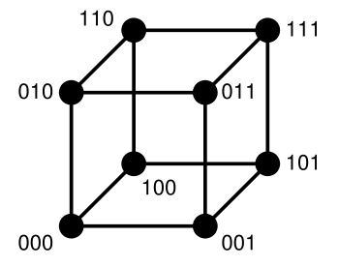
Hamming Distance: 8 code words

Slide 3
Hamming Distance 2: Detection
Detect Single Bit Errors
Invalid
Codewords
No 1 bit error goes to another valid codeword
½ codewords are valid

Slide 4
Hamming Distance 3: Correction
Correct Single Bit Errors, Detect Double Bit Errors
Nearest
111
(one 0)
Nearest
000
(one 1)
No 2 bit error goes to another valid codeword; 1 bit error near
1/4 codewords are valid

Slide 5
Hamming Error Correcting Code
Overhead involved in single error-correction code
Let p be total number of parity bits and d number of data bits in p + d bit word
If p error correction bits are to point to error bit (p + d cases) + indicate that no error exists (1 case), we need:
  2^{p} >= p + d + 1,
  thus p >= log₂(p + d + 1)
  for large d, p approaches log₂(d)
8 bits data => d = 8, 2^{p} >= p + 8 + 1 => p >= 4
16b data => 5b parity,
32b data => 6b parity,
64b data => 7b parity

Slide 6
Hamming Single-Error Correction,
Double-Error Detection (SEC/DED)
Adding extra parity bit covering the entire word provides double error detection as well as single error correction
1 2 3 4 5 6 7 8
p₁ p₂ d₁ p₃ d₂ d₃ d₄ p₄
Hamming parity bits H (p₁ p₂ p₃) are computed (even parity as usual) plus the even parity over the entire word, p₄:
H=0 p₄=0, no error
H≠0 p₄=1, correctable single error (odd parity if 1 error => p₄=1)
H≠0 p₄=0, double error occurred (even parity if 2 errors=> p₄=0)
H=0 p₄=1, single error occurred in p₄ bit, not in rest of word
Typical modern codes in DRAM memory systems:
64-bit data blocks (8 bytes) with 72-bit code words (9 bytes).

Slide 7
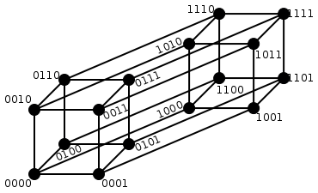
Hamming Single
Error Correction
+ Double
Error Detection
Hamming Distance = 4
1 bit error (one 0)
Nearest 1111
2 bit error
(two 0s, two 1s)
Halfway
Between Both
1 bit error (one 1)
Nearest 0000
Notes:
1 bit error from 0000, all numbers with one 1
1 bit error from 1111, all numbers with one 0
2 bit error from 0000, all numbers with two 1s and two 0s
2 bit error from 1111, all numbers with two 1s and two 0s

Slide 8
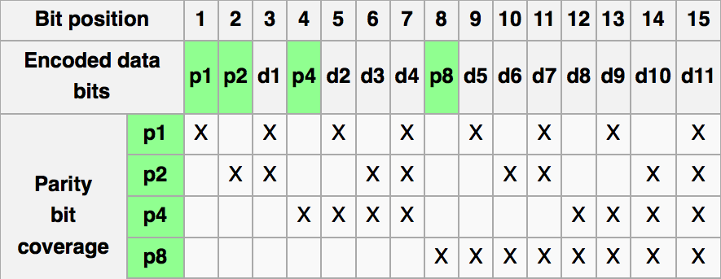
iClicker Question
The following word is received, encoded with Hamming code:
0 1 1 0 0 0 1
What is the corrected data bit sequence?
A. 1 1 1 1
B. 0 0 0 1
C. 1 1 0 1
D. 1 0 1 1
E. 1 0 0 0
Notes:
Ans: D
0 x 1 x 0 x 1 - check
p2 x 1 1 x x 0 1 – error in p2
x x x 0 0 0 1 - error in p4
Error in location 2+4 =6

Slide 9
What if More Than 2-Bit Errors?
Network transmissions, disks, distributed storage common failure mode is bursts of bit errors, not just one or two bit errors
  Contiguous sequence of B bits in which first, last and any number of intermediate bits are in error
  Caused by impulse noise or by fading in wireless
  Effect is greater at higher data rates
Solve with Cyclic Redundancy Check (CRC), interleaving or other more advanced codes

Slide 10
iClicker Question
The following word is received, encoded with Hamming code:
0 1 1 0 0 0 1
check p1: 0 x 1 x 0 x 1 – o.k.
check p2: x 1 1 x x 0 1 – error in p2
check p4: x x x 0 0 0 1 – error in p4
Error in location 2+4 =6
Correct data: 1 0 1 1 (answer D)
Notes:
Ans: D
0 x 1 x 0 x 1 - check
p2 x 1 1 x x 0 1 – error in p2
x x x 0 0 0 1 - error in p4
Error in location 2+4 =6

Slide 11
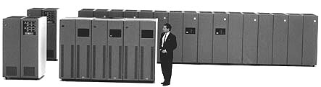
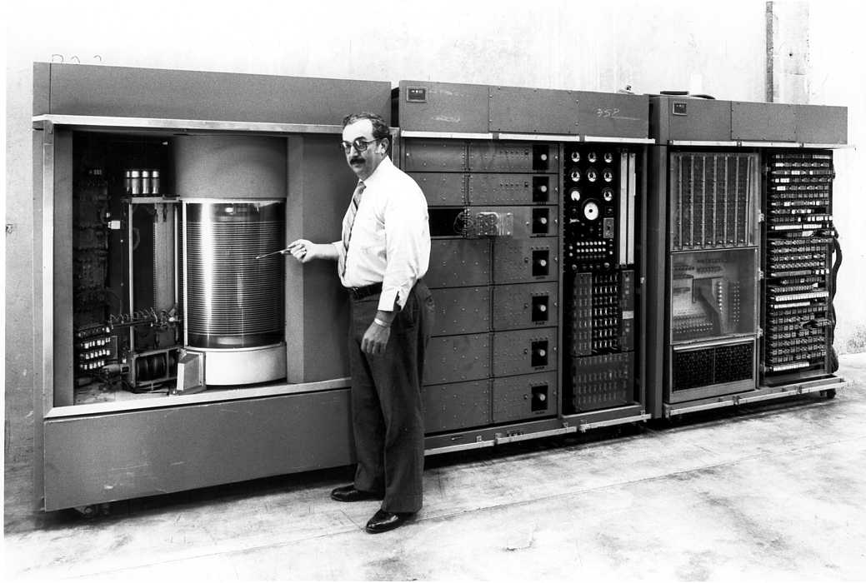
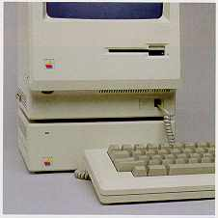
Evolution of the Disk Drive
IBM 3390K, 1986
IBM RAMAC 305, 1956
Apple SCSI, 1986

Slide 12
Arrays of Small Disks
  Can smaller disks be used to close gap in performance between disks and CPUs?
Conventional: 4 disk designs
3.5”
5.25”
10”
14”
Low End
High End
Disk Array:
1 disk design
3.5”

Slide 13
Replace Small Number of Large Disks with Large Number of Small Disks! (1988 Disks)
IBM 3390K
20 GBytes
97 cu. ft.
3 KW
15 MB/s
600 I/Os/s
250 KHrs
$250K
IBM 3.5" 0061
320 MBytes
0.1 cu. ft.
11 W
1.5 MB/s
55 I/Os/s
50 KHrs
$2K
x70
23 GBytes
11 cu. ft.
1 KW
120 MB/s
3900 IOs/s
??? Hrs
$150K
Capacity
Volume
Power
Data Rate
I/O Rate
MTTF
Cost
9X
3X
8X
6X
Disk Arrays have potential for large data and I/O rates, high MB per cu. ft., high MB per KW, but what about reliability?

Slide 14
RAID: Redundant Arrays of (Inexpensive) Disks
Files are "striped" across multiple disks
Redundancy yields high data availability
  Availability: service still provided to user, even if some components failed
Disks will still fail
Contents reconstructed from data redundantly stored in the array
  ⇒ Capacity penalty to store redundant info
  ⇒ Bandwidth penalty to update redundant info

Slide 15
Redundant Arrays of Inexpensive Disks
RAID 1: Disk Mirroring/Shadowing
recovery
group
• Each disk is fully duplicated onto its “mirror”
Very high availability can be achieved
• Writes limited by single-disk speed
• Reads may be optimized
Most expensive solution: 100% capacity overhead

Slide 16
Redundant Array of Inexpensive Disks RAID 3: Parity Disk
10010011
11001101
10010011
. . .
P
1
0
1
0
0
0
1
1
1
1
0
0
1
1
0
1
1
0
1
0
0
0
1
1
1
1
0
0
1
1
0
1
logical record
Striped physical
records
P contains sum of
other disks per stripe
mod 2 (“parity”)
If disk fails, subtract
P from sum of other
disks to find missing information

Slide 17
Redundant Arrays of Inexpensive Disks RAID 4: High I/O Rate Parity
D0
D1
D2
D3
Increasing
Logical
Disk
Address
P
Insides of 5 disks
D4
D5
D6
D7
P
D8
D9
D10
D11
P
Example: small read D0 & D5, large write D12-D15
D12
D13
D14
D15
P
Stripe
D16
D17
D18
D19
P
D20
D21
D22
D23
P
.
.
.
.
.
.
.
.
.
.
.
.
.
.
.
Disk Columns

Slide 18
Inspiration for RAID 5
RAID 4 works well for small reads
Small writes (write to one disk):
  Option 1: read other data disks, create new sum and write to Parity Disk
  Option 2: since P has old sum, compare old data to new data, add the difference to P
Small writes are limited by Parity Disk: Write to D0, D5 both also write to P disk
D0
D1
D2
D3
P
D4
D5
D6
D7
P

Slide 19
RAID 5: High I/O Rate Interleaved Parity
D0
D1
D2
D3
P
Increasing
Logical
Disk
Addresses
Independent writes
possible because of
interleaved parity
D4
D5
D6
P
D7
D8
D9
P
D10
D11
D12
P
D13
D14
D15
P
D16
D17
D18
D19
Example: write to D0, D5 uses disks 0, 1, 3, 4
D20
D21
D22
D23
P
.
.
.
.
.
.
.
.
.
.
.
.
.
.
.
Disk Columns

Slide 20
Problems of Disk Arrays: Small Writes
RAID-5: Small Write Algorithm
1 Logical Write = 2 Physical Reads + 2 Physical Writes
D0'
D0
D1
D2
D3
P
new
data
old
data
old
parity
(1. Read)
(2. Read)
+
XOR
+
XOR
(3. Write)
(4. Write)
D0'
D1
D2
D3
P'

Slide 21
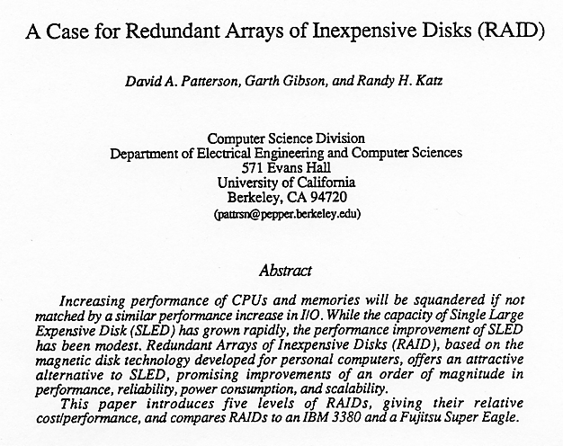
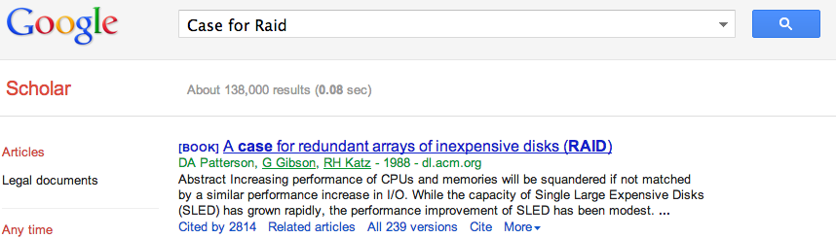
Tech Report Read ‘Round the World
(December 1987)

Slide 22
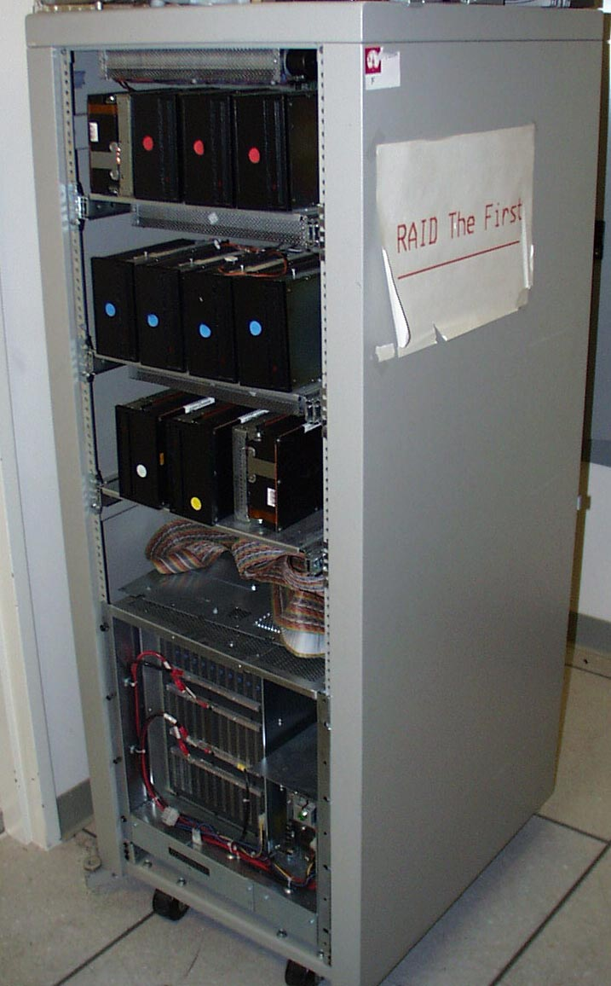
RAID-I
RAID-I (1989)
  Consisted of a Sun 4/280 workstation with 128 MB of DRAM, four dual-string SCSI controllers, 28 5.25-inch SCSI disks and specialized disk striping software

Slide 23
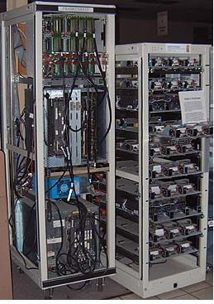
RAID II
1990-1993
Early Network Attached Storage (NAS) System running a Log Structured File System (LFS)
Impact:
  $25 Billion/year in 2002
  Over $150 Billion in RAID device sold since 1990-2002
  200+ RAID companies (at the peak)
  Software RAID a standard component of modern OSs

Slide 24
And, in Conclusion, …
Memory
  Hamming distance 2: Parity for Single Error Detect
  Hamming distance 3: Single Error Correction Code + encode bit position of error
Treat disks like memory, except you know when a disk has failed—erasure makes parity an Error Correcting Code
RAID-2, -3, -4, -5: Interleaved data and parity

