Slide 1
CS 61C: Great Ideas in Computer Architecture (Machine Structures)
Operating Systems, Interrupts
Instructors:
Nicholas Weaver & Vladimir Stojanovic
http://inst.eecs.berkeley.edu/~cs61c/

Slide 2
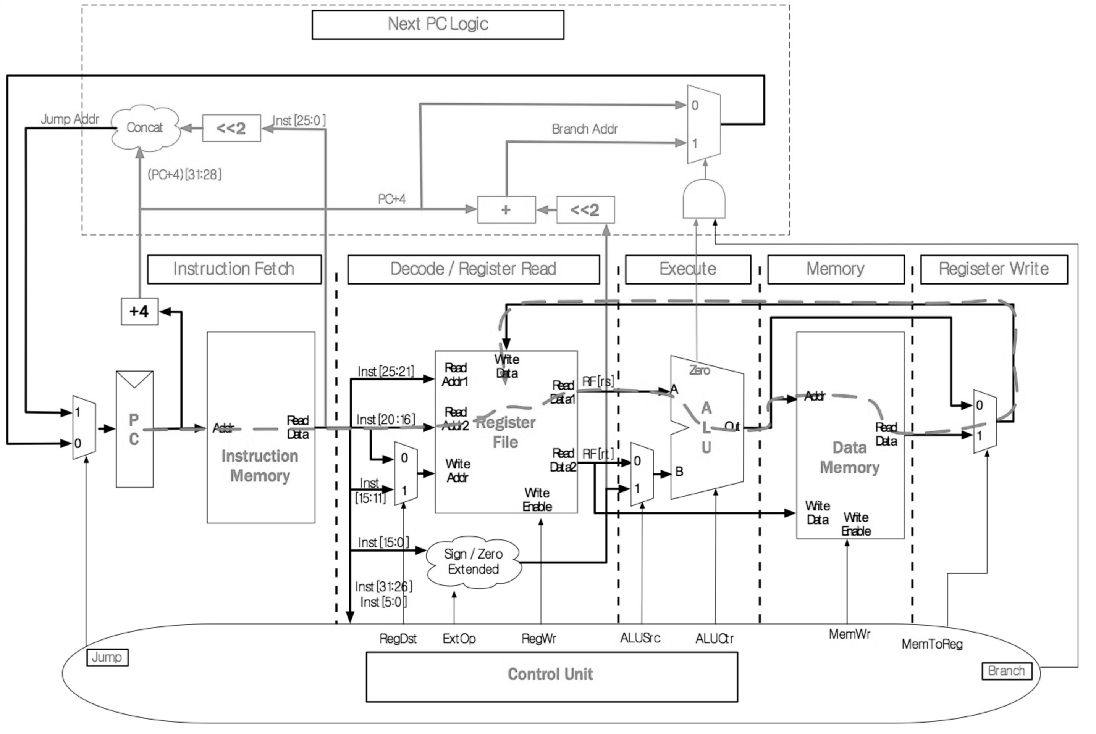
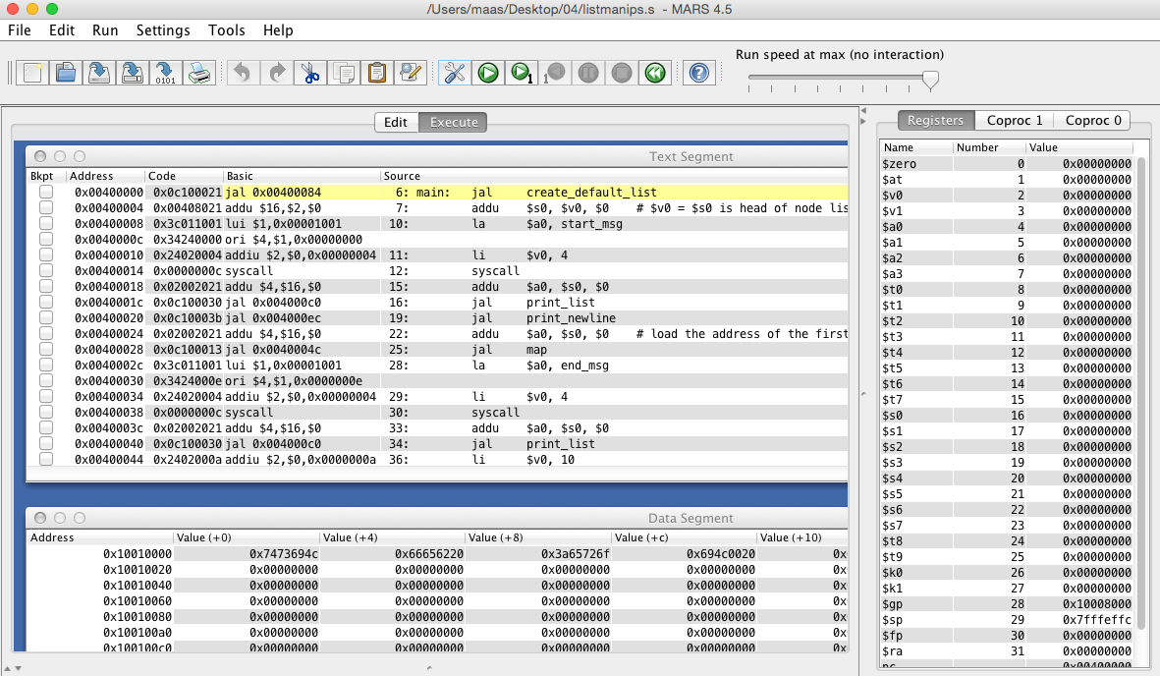
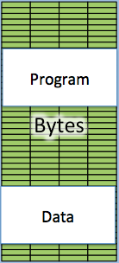
CS61C so far…
C Programs
MIPS Assembly
#include <stdlib.h>
int fib(int n) {
return
fib(n-1) +
fib(n-2);
}
Project 2
.foo
lw $t0, 4($r0)
addi $t1, $t0, 3
beq $t1, $t2, foo
nop
CPU
Project 1
Labs
Caches
Memory

Slide 3
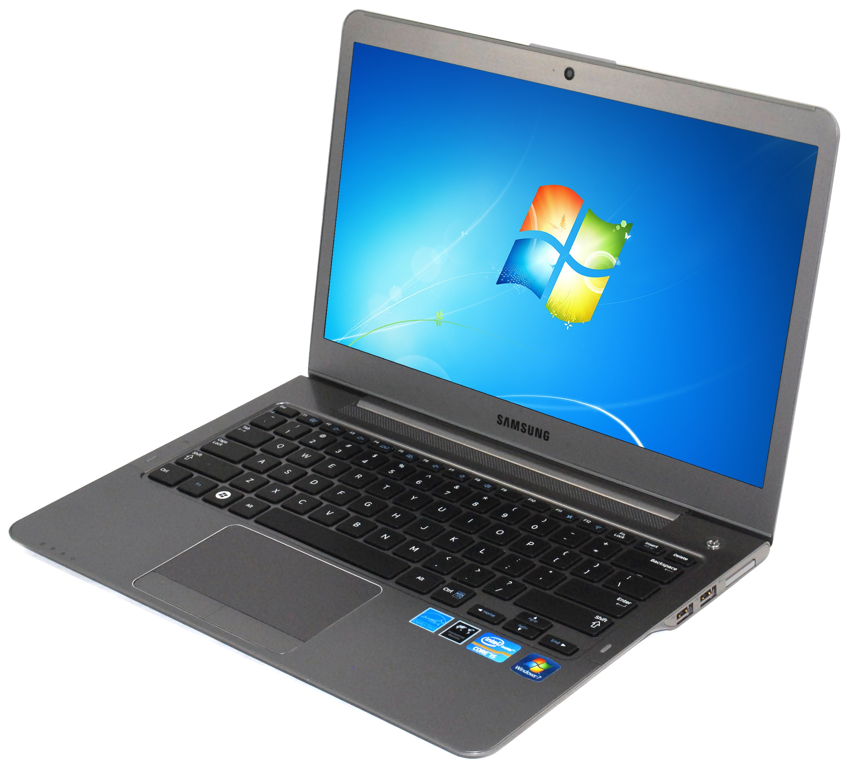
So how is this any different?
Screen
Keyboard
Storage

Slide 4
Adding I/O
C Programs
MIPS Assembly
#include <stdlib.h>
int fib(int n) {
return
fib(n-1) +
fib(n-2);
}
Project 2
.foo
lw $t0, 4($r0)
addi $t1, $t0, 3
beq $t1, $t2, foo
nop
CPU
Project 1
Screen
Keyboard
Storage
Caches
I/O (Input/Output)
Memory

Slide 5
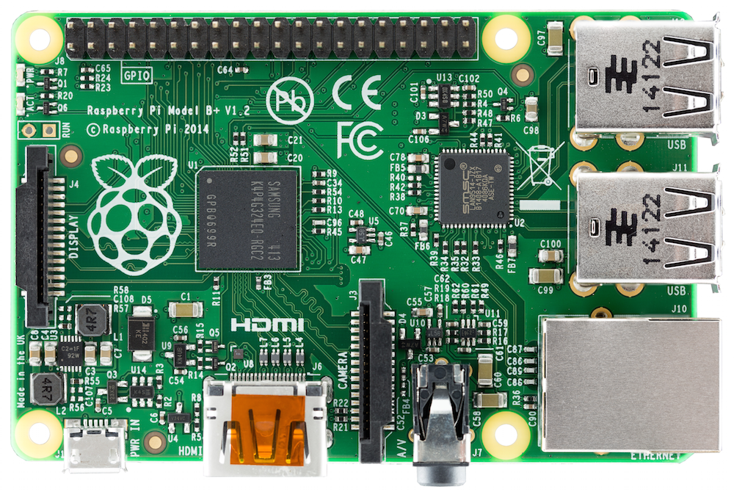
Raspberry Pi 3 ($35 on Amazon)
Serial I/O
(USB)
Storage I/O
(Micro SD Card)
CPU+$s, etc.
Memory
Network I/O
(Ethernet)
Screen I/O
(HDMI)

Slide 6
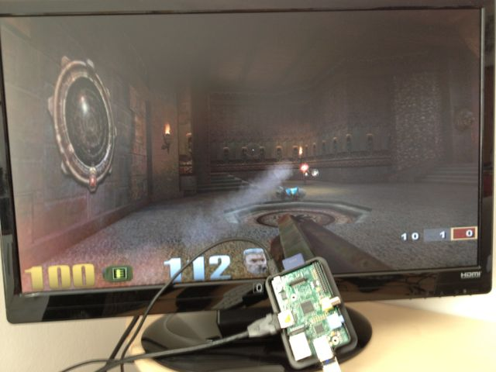
It’s a real computer!

Slide 7
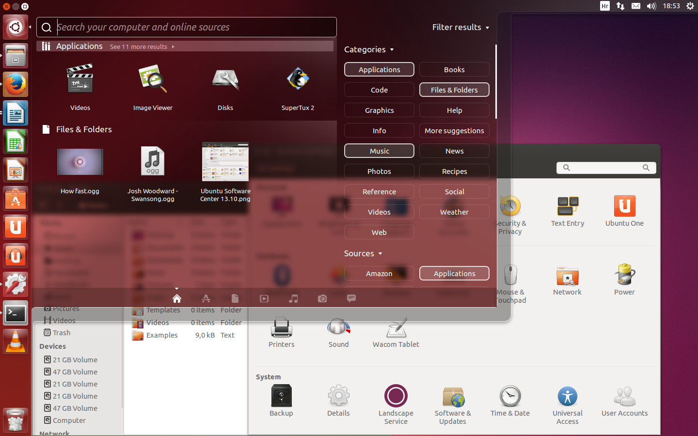
But wait…
That’s not the same! When we run MARS, it only executes one program and then stops.
When I switch on my computer, I get this:
Yes, but that’s just software! The Operating System (OS)

Slide 8
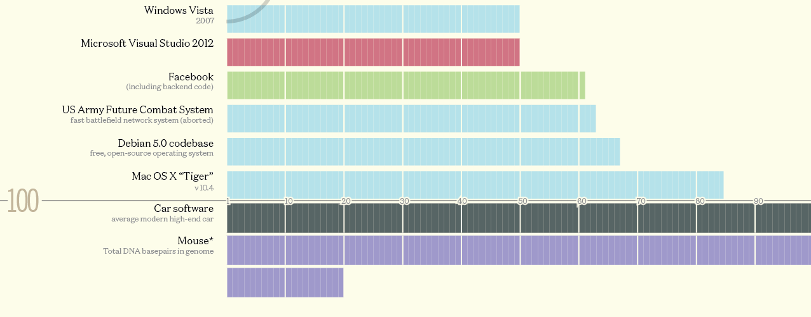
Well, “just software”
The biggest piece of software on your machine?
How many lines of code? These are guesstimates:
Codebases (in millions of lines of code). CC BY-NC 3.0 — David McCandless © 2013
http://www.informationisbeautiful.net/visualizations/million-lines-of-code/

Slide 9
What does the OS do?
One of the first things that runs when your computer starts (right after firmware/bootloader)
Loads, runs and manages programs:
  Multiple programs at the same time (time-sharing)
  Isolate programs from each other (isolation)
  Multiplex resources between applications (e.g., devices)
Services: File System, Network stack, etc.
Finds and controls all the devices in the machine in a general way (using “device drivers”)

Slide 10
Administrivia
Project 4 delayed due date to tomorrow
  But extra credit for turning it in today
Project 5 will be out ASAP
  I'm worried that we made it too easy, but eh…

Slide 11
Agenda
Devices and I/O
OS Boot Sequence and Operation
Multiprogramming/time-sharing
Introduction to Virtual Memory

Slide 12
Agenda
Devices and I/O
OS Boot Sequence and Operation
Multiprogramming/time-sharing
Introduction to Virtual Memory

Slide 13

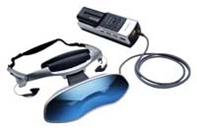




How to interact with devices?
Assume a program running on a CPU. How does it interact with the outside world?
Need I/O interface for Keyboards,
Network, Mouse, Screen, etc.
  Connect to many types of devices
  Control these devices, respond
  to them, and transfer data
  Present them to user
  programs so
  they are useful
Operating System
Proc
Mem
PCI Bus
SATA/USB Bus
cmd reg.
data reg.

Slide 14
Instruction Set Architecture for I/O
What must the processor do for I/O?
  Input: reads a sequence of bytes
  Output: writes a sequence of bytes
Some processors have special input and output instructions
Alternative model (used by MIPS):
  Use loads for input, stores for output (in small pieces)
  Called Memory Mapped Input/Output
  A portion of the address space dedicated to communication paths to Input or Output devices (no memory there)

Slide 15
Memory Mapped I/O
Certain addresses are not regular memory
Instead, they correspond to registers in I/O devices
address
0xFFFFFFFF
0xFFFF0000
cntrl reg.
data reg.
0

Slide 16
Processor-I/O Speed Mismatch
1GHz microprocessor can execute 1B load or store instructions per second, or 4,000,000 KB/s data rate
  I/O data rates range from 0.01 KB/s to 1,250,000 KB/s
Input: device may not be ready to send data as fast as the processor loads it
  Also, might be waiting for human to act
Output: device not be ready to accept data as fast as processor stores it
What to do?

Slide 17
Processor Checks Status before Acting
Path to a device generally has 2 registers:
  Control Register, says it’s OK to read/write (I/O ready) [think of a flagman on a road]
  Data Register, contains data
Processor reads from Control Register in loop, waiting for device to set Ready bit in Control reg
(0  1) to say it’s OK
Processor then loads from (input) or writes to (output) data register
  Load from or Store into Data Register resets Ready bit
  (1  0) of Control Register
This is called “Polling”

Slide 18
I/O Example (polling)
Input: Read from keyboard into $v0
lui $t0, 0xffff #ffff0000
Waitloop: lw $t1, 0($t0) #control
andi $t1,$t1,0x1
beq $t1,$zero, Waitloop
lw $v0, 4($t0) #data
Output: Write to display from $a0
lui $t0, 0xffff #ffff0000
Waitloop: lw $t1, 8($t0) #control
andi $t1,$t1,0x1
beq $t1,$zero, Waitloop
sw $a0, 12($t0) #data
“Ready” bit is from processor’s point of view!

Slide 19
Cost of Polling?
Assume for a processor with a 1GHz clock it takes 400 clock cycles for a polling operation (call polling routine, accessing the device, and returning). Determine % of processor time for polling
  Mouse: polled 30 times/sec so as not to miss user movement
  Hard disk: assume transfers data in 16-Byte chunks and can transfer at 16 MB/second. Again, no transfer can be missed. (we’ll come up with a better way to do this)

Slide 20
% Processor time to poll
Mouse Polling [clocks/sec]
  = 30 [polls/s] * 400 [clocks/poll] = 12K [clocks/s]
% Processor for polling:
  12*10³ [clocks/s] / 1*10⁹ [clocks/s] = 0.0012%
  ⇒ Polling mouse little impact on processor
Notes:
was p 677 in book (not current edition)

Slide 21
Clicker Time
  Hard disk: transfers data in 16-Byte chunks and can transfer at 16 MB/second. No transfer can be missed. What percentage of processor time is spent in polling (assume 1GHz clock)?
  A: 2%
  B: 4%
  C: 20%
  D: 40%
  E: 80%

Slide 22
% Processor time to poll hard disk
Frequency of Polling Disk
  = 16 [MB/s] / 16 [B/poll] = 1M [polls/s]
Disk Polling, Clocks/sec
= 1M [polls/s] * 400 [clocks/poll]
= 400M [clocks/s]
% Processor for polling:
  400*10⁶ [clocks/s] / 1*10⁹ [clocks/s] = 40%
  ⇒ Unacceptable
  (Polling is only part of the problem – main problem is that accessing in small chunks is inefficient)

Slide 23
What is the alternative to polling?
Wasteful to have processor spend most of its time “spin-waiting” for I/O to be ready
Would like an unplanned procedure call that would be invoked only when I/O device is ready
Solution: use exception mechanism to help
I/O. Interrupt program when I/O ready, return when done with data transfer
Allow to register (post) interrupt handlers: functions that are called when an interrupt is triggered

Slide 24
Interrupt-driven I/O
Handler Execution
Incoming interrupt suspends instruction stream
Looks up the vector (function address) of a handler in
an interrupt vector table stored within the CPU
Perform a jal to the handler (needs to store any state)
Handler run on current stack and returns on finish
(thread doesn’t notice that a handler was run)
Stack Frame
Stack Frame
handler: lui $t0, 0xffff
lw $t1, 0($t0)
andi $t1,$t1,0x1
    lw $v0, 4($t0)
    sw $t1, 8($t0)
    ret
Stack Frame
Label: sll $t1,$s3,2
addu $t1,$t1,$s5
lw $t1,0($t1)
add $s1,$s1,$t1
addu $s3,$s3,$s4
bne $s3,$s2,Label
CPU Interrupt Table
SPI0 | handler
… | …
Interrupt(SPI0)

Slide 25
Direct Memory Access
Complements interrupts:
  The device itself can directly read or write to a specified block of memory
Used to buffer transfers
  DMA write the data
  Then trigger an interrupt
Can even go to great extremes
  You can buy an FPGA-based network card which will directly write into process buffers
We will go into this in more detail later on

Slide 26
Agenda
Devices and I/O
OS Boot Sequence and Operation
Multiprogramming/time-sharing
Introduction to Virtual Memory

Slide 27
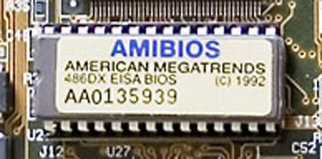
What happens at boot?
When the computer switches on, it does the same as MARS: the CPU executes instructions from some start address (stored in Flash ROM)
CPU
Memory mapped
0x2000:
addi $t0, $zero, 0x1000
lw $t0, 4($r0)
…
(Code to copy firmware into regular memory and jump into it)
PC = 0x2000 (some default value)
Address Space

Slide 28
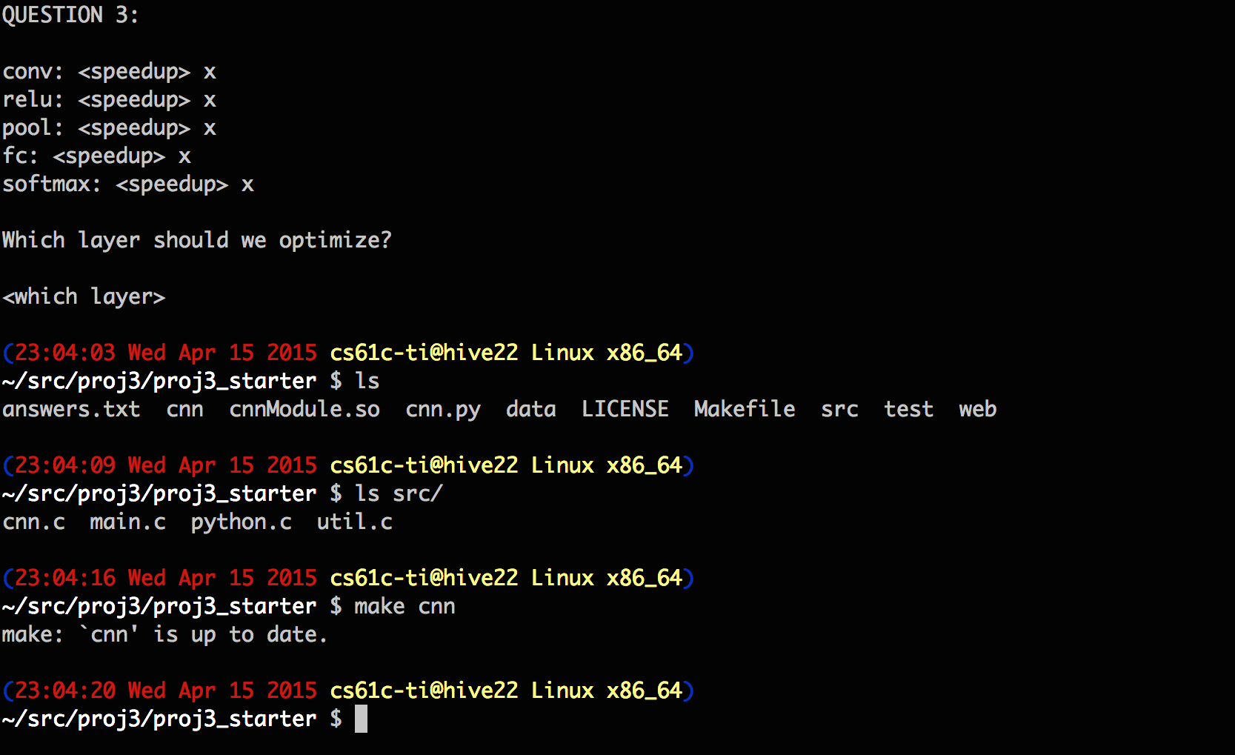
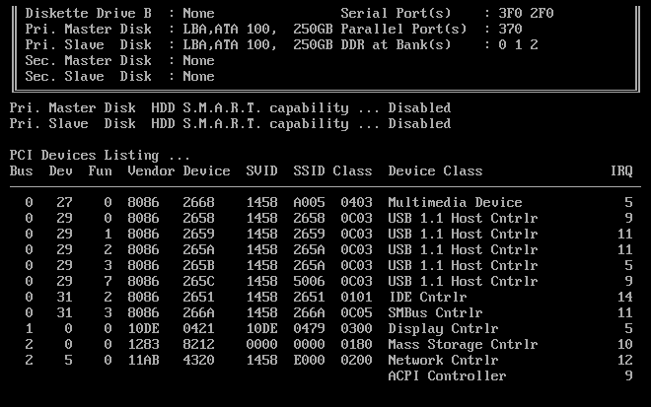
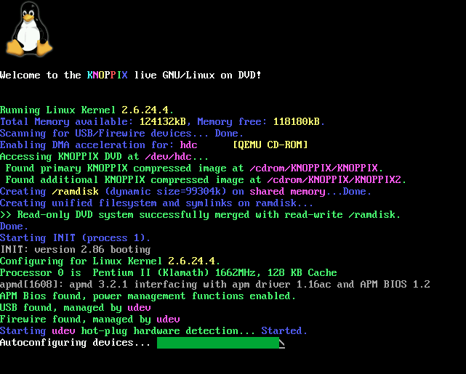
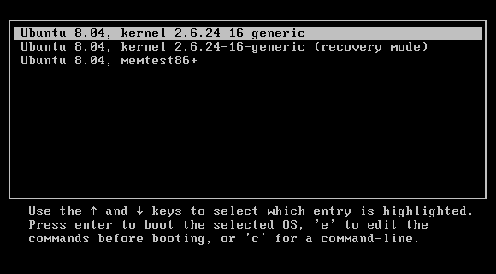
What happens at boot?
When the computer switches on, it does the same as MARS: the CPU executes instructions from some start address (stored in Flash ROM)
1. BIOS: Find a storage
device and load first sector (block of data)
4. Init: Launch an application that waits for input in loop (e.g., Terminal/Desktop/...
2. Bootloader (stored on, e.g., disk): Load the OS kernel from disk into a location in memory and jump into it.
3. OS Boot: Initialize services, drivers, etc.

Slide 29
Validated Boot…
The old-school BIOS (Basic Input/Output System) just started running whatever was in the boot sector
  Allowed all sorts of shenanigans
Modern firmware (UEFI (Universal Extensible Firmware Interface), iPhone, etc) performs validated boot
  Cryptographically verifies that the boot code is signed by a valid cryptographic signature
Essential to maintain a chain of trust
  Trust the hardware and EFI to validate the boot…
If you run Windows only, turn this on!

Slide 30
Launching Applications
Applications are called “processes” in most OSs.
Created by another process calling into an OS routine (using a “syscall”, more details later).
  Depends on OS, but Linux uses fork to create a new process, and execve to load application.
Loads executable file from disk (using the file system service: often just 'mapping' the file into memory to be loaded on demand, which we will get to when talking about virtual memory) and puts instructions & data into memory (.text, .data sections), prepare stack and heap.
Set argc and argv, jump into the main function.

Slide 31
Supervisor Mode
If something goes wrong in an application, it could crash the entire machine. And what about malware, etc.?
The OS may need to enforce resource constraints to applications (e.g., access to devices).
To help protect the OS from the application, CPUs have a supervisor mode bit.
  A process can only access a subset of instructions and (physical) memory when not in supervisor mode (user mode).
  Process can change out of supervisor mode using a special instruction, but not into it directly – only using an interrupt.

Slide 32
Syscalls
What if we want to call into an OS routine? (e.g., to read a file, launch a new process, send data, etc.)
  Need to perform a syscall: set up function arguments in registers, and then raise software interrupt
  OS will perform the operation and return to user mode
Also, OS uses interrupts for scheduling process execution:
  OS sets scheduler timer interrupt then drops to user mode and start executing a user task, when interrupts triggers, switch into supervisor mode, select next task to execute (& set timer) and drop back to user mode.
This way, the OS can mediate access to all resources, including devices and the CPU itself.

Slide 33
Traps/Interrupts/Execeptions: altering the normal flow of control
I_{i-1}
HI₁
trap
handler
program
I_{i}
HI₂
I_{i+1}
HI_{n}
An external or internal event that needs to be processed - by another program – the OS. The event is often unexpected from original program’s point of view.

Slide 34
Terminology
In CS61C (you’ll see other definitions in use elsewhere):
Interrupt – caused by an event external to current running program (e.g. key press, mouse activity)
  Asynchronous to current program, can handle interrupt on any convenient instruction
Exception – caused by some event during execution of one instruction of current running program
  Examples include integer overflow (add), lw/sw to invalid memory, not a valid opcode, etc…
  Or deliberate syscall operation
  Synchronous, must handle exception on instruction that causes exception
Trap – action of servicing interrupt or exception by hardware jump to “trap handler” code

Slide 35
Precise Traps
Trap handler’s view of machine state is that every instruction prior to the trapped one has completed, and no instruction after the trap has executed.
Implies that handler can return from an interrupt by restoring user registers and jumping back to interrupted instruction (EPC register will hold the instruction address)
  Interrupt handler software doesn’t need to understand the pipeline of the machine, or what program was doing!
  More complex to handle trap caused by an exception than interrupt
Providing precise traps is tricky in a pipelined superscalar out-of-order processor!
  But handling imprecise interrupts in software is even worse.

Slide 36
Trap Handling in 5-Stage Pipeline
PC
Inst. Mem
D
Decode
E
M
Data Mem
W
+
PC address Exception
Illegal Opcode
Data address Exceptions
Overflow
Asynchronous Interrupts
How to handle multiple simultaneous exceptions in different pipeline stages?
How and where to handle external asynchronous interrupts?

Slide 37
Save Exceptions Until Commit
Commit Point
PC
Inst. Mem
D
Decode
E
M
Data Mem
W
+
Illegal Opcode
Overflow
Data address Exceptions
PC address Exception
Exc
D
Exc
E
Exc
M
Cause
PC
D
PC
E
PC
M
EPC
Select Handler PC
Asynchronous
Interrupts
Kill F Stage
Kill D Stage
Kill E Stage
Kill Writeback

Slide 38
Handling Traps in In-Order Pipeline
Hold exception flags in pipeline until commit point (M stage)
Exceptions in earlier instructions override exceptions in later instructions
Exceptions in earlier pipe stages override later exceptions for a given instruction
Inject external interrupts at commit point (override others)
If exception/interrupt at commit: update Cause and EPC registers, kill all stages, inject handler PC into fetch stage

Slide 39
Trap Pipeline Diagram
      time
      t0 t1 t2 t3 t4 t5 t6 t7 . . . .
(I₁) 096: ADD IF₁ ID₁ EX₁ MA₁ - overflow!
(I₂) 100: XOR IF₂ ID₂ EX₂ - -
(I₃) 104: SUB IF₃ ID₃ - - -
(I₄) 108: ADD IF₄ - - - -
(I₅) Trap Handler code IF₅ ID₅ EX₅ MA₅ WB₅

Slide 40
In Conclusion
Once we have a basic machine, it’s mostly up to the OS to use it and define application interfaces.
Hardware helps by providing the right abstractions and features (e.g., Virtual Memory, I/O).
If you want to learn more about operating systems, you should take CS162!
What’s next in CS61C?
  More details on I/O
  More about Virtual Memory

