Slide 1
CS 61C: Great Ideas in Computer Architecture (Machine Structures) Warehouse-Scale Computing
Instructors:
Nicholas Weaver & Vladimir Stojanovic
http://inst.eecs.berkeley.edu/~cs61c/

Slide 2
Coherency Tracked by Cache Block
Block ping-pongs between two caches even though processors are accessing disjoint variables
Effect called false sharing
How can you prevent it?

Slide 3
Review: Understanding Cache Misses: The 3Cs
Compulsory (cold start or process migration, 1st reference):
First access to block, impossible to avoid; small effect for long-running programs
Solution: increase block size (increases miss penalty; very large blocks could increase miss rate)
Capacity (not compulsory and…)
Cache cannot contain all blocks accessed by the program even with perfect replacement policy in fully associative cache
Solution: increase cache size (may increase access time)
Conflict (not compulsory or capacity and…):
Multiple memory locations map to the same cache location
Solution 1: increase cache size
Solution 2: increase associativity (may increase access time)
Solution 3: improve replacement policy, e.g.. LRU
Notes:
(Capacity miss) That is the cache misses are due to the fact that the cache is simply not large enough to contain all the blocks that are accessed by the program.
The solution to reduce the Capacity miss rate is simple: increase the cache size.
Here is a summary of other types of cache miss we talked about.
First is the Compulsory misses. These are the misses that we cannot avoid. They are caused when we first start the program.
Then we talked about the conflict misses. They are the misses that caused by multiple memory locations being mapped to the same cache location.
There are two solutions to reduce conflict misses. The first one is, once again, increase the cache size. The second one is to increase the associativity.
For example, say using a 2-way set associative cache instead of directed mapped cache.
But keep in mind that cache miss rate is only one part of the equation. You also have to worry about cache access time and miss penalty. Do NOT optimize miss rate alone.
Finally, there is another source of cache miss we will not cover today. Those are referred to as invalidation misses caused by another process, such as IO , update the main memory so you have to flush the cache to avoid inconsistency between memory and cache.
+2 = 43 min. (Y:23)

Slide 4
Fourth “C” of Cache Misses: Coherence Misses
Misses caused by coherence traffic with other processor
Also known as communication misses because represents data moving between processors working together on a parallel program
For some parallel programs, coherence misses can dominate total misses
It gets even more complicated with multithreaded processors: You want separate threads on the same CPU to have common working set, otherwise you get what could be described as incoherence misses

Slide 5
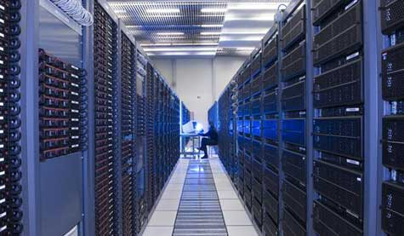
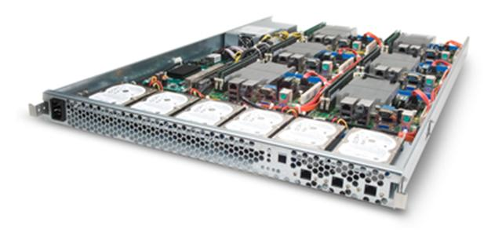
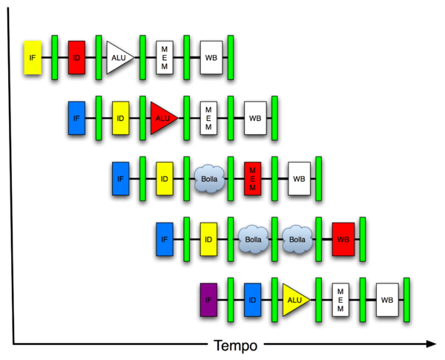
New-School Machine Structures (It’s a bit more complicated!)
Software Hardware
Parallel Requests
Assigned to computer
e.g., Search “cats”
Parallel Threads
Assigned to core
e.g., Lookup, Ads
Parallel Instructions
>1 instruction @ one time
e.g., 5 pipelined instructions
Parallel Data
>1 data item @ one time
e.g., Deep Learning for image classification
Hardware descriptions
All gates @ one time
Programming Languages
Warehouse Scale Computer
Smart Phone
Harness Parallelism &
Achieve High Performance
Computer
Core
…
Core
Memory (Cache)
Input/Output
Core
Instruction Unit(s)
Functional
Unit(s)
A₀+B₀
A₁+B₁
A₂+B₂
A₃+B₃
Cache Memory
Logic Gates

Slide 6
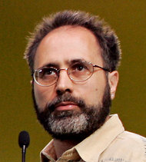
Back in 2011
Google disclosed that it continuously uses enough electricity to power 200,000 homes, but it says that in doing so, it also makes the planet greener.
Average energy use per typical user per month is same as running a 60-watt bulb for 3 hours (180 watt-hours).
Urs Hoelzle, Google SVP
Co-author of today’s reading
http://www.nytimes.com/2011/09/09/technology/google-details-and-defends-its-use-of-electricity.html

Slide 7
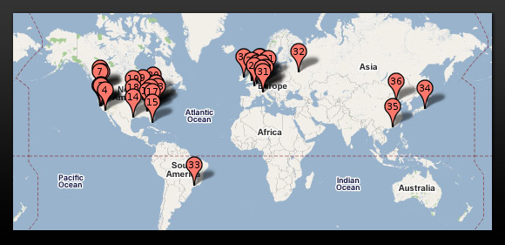
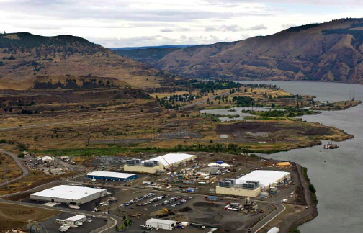
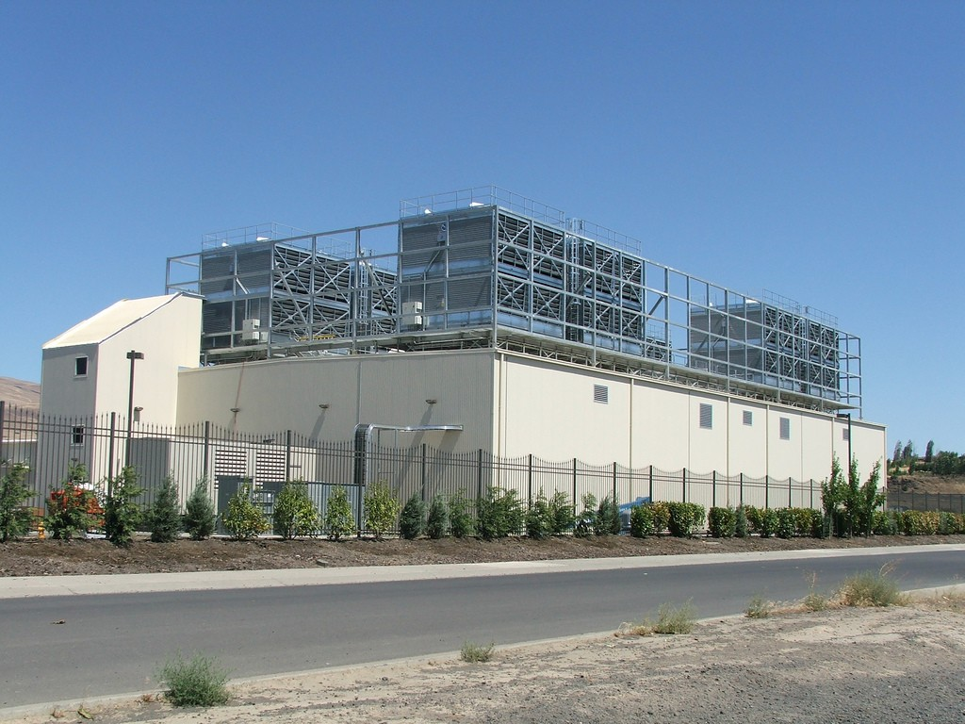
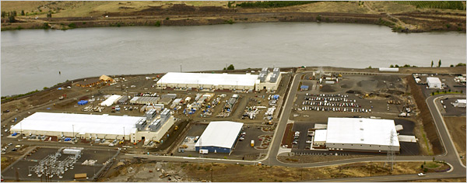
Google’s WSCs
Ex: In Oregon

Slide 8
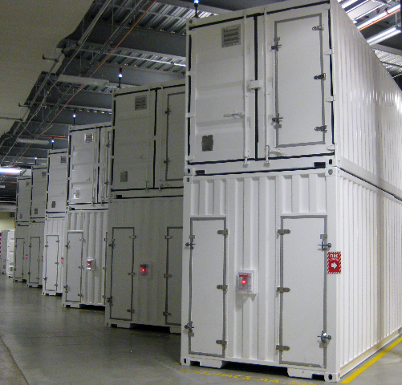
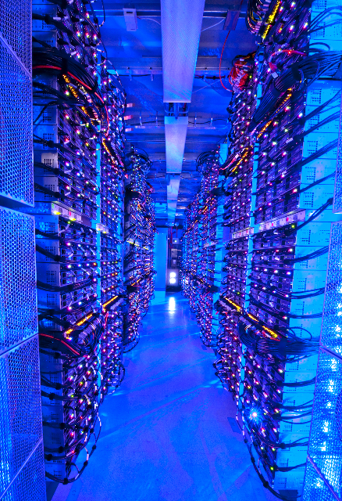
Containers in WSCs
Inside WSC
Inside Container

Slide 9
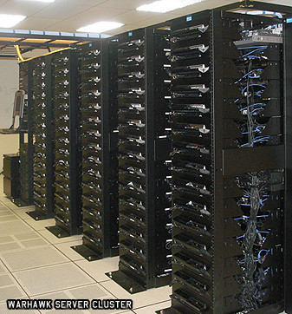
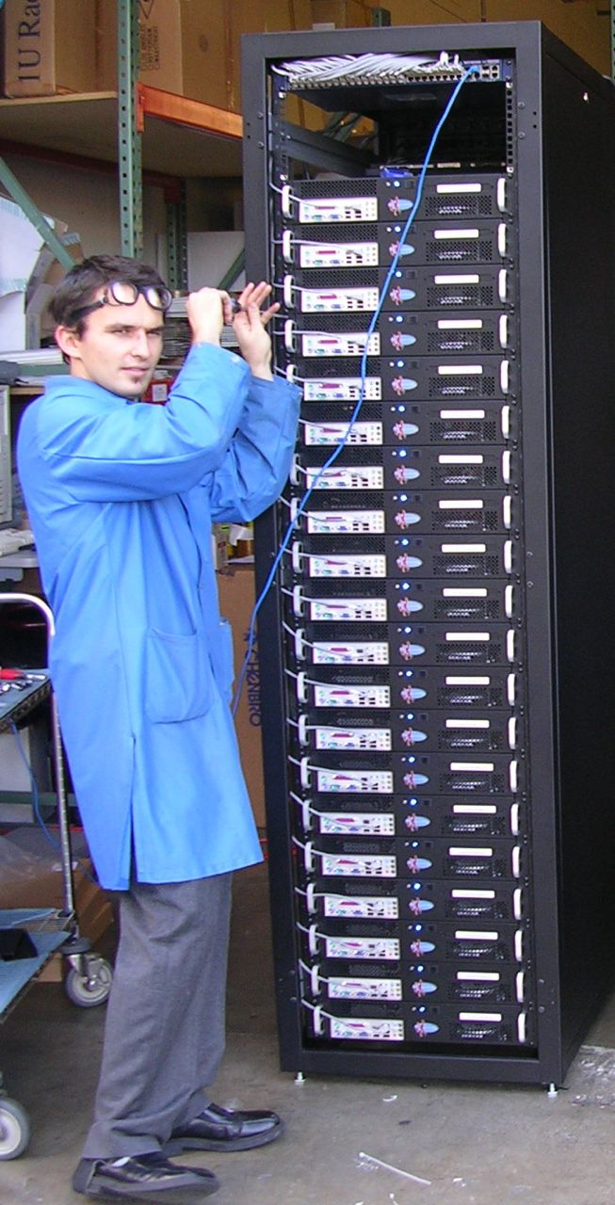
Server, Rack, Array

Slide 10
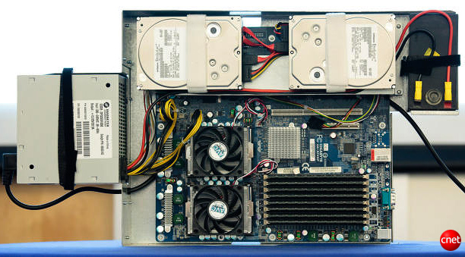
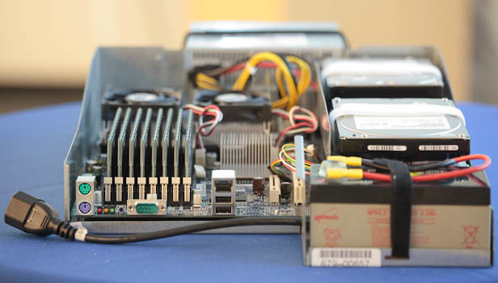
Google Server Internals
Google Server
Notes:
Most companies buy servers from the likes of Dell, Hewlett-Packard, IBM, or Sun Microsystems. But Google, which has hundreds of thousands of servers and considers running them part of its core expertise, designs and builds its own. Ben Jai, who designed many of Google's servers, unveiled a modern Google server before the hungry eyes of a technically sophisticated audience.
Google's big surprise: each server has its own 12-volt battery to supply power if there's a problem with the main source of electricity. The company also revealed for the first time that since 2005, its data centers have been composed of standard shipping containers--each with 1,160 servers and a power consumption that can reach 250 kilowatts.
It may sound geeky, but a number of attendees--the kind of folks who run data centers packed with thousands of servers for a living--were surprised not only by Google's built-in battery approach, but by the fact that the company has kept it secret for years. Jai said in an interview that Google has been using the design since 2005 and now is in its sixth or seventh generation of design.
Read more: http://news.cnet.com/8301-1001_3-10209580-92.html#ixzz0yo8bhTOH

Slide 11
Warehouse-Scale Computers
Datacenter
Collection of 10,000 to 100,000 servers
Networks connecting them together
Single gigantic machine
Very large applications (Internet service): search, email, video sharing, social networking
Very high availability
“…WSCs are no less worthy of the expertise of computer systems architects than any other class of machines” Barroso and Hoelzle, 2009

Slide 12
Unique to WSCs
Ample Parallelism
Request-level Parallelism: ex: Web search
Data-level Parallelism: ex: Image classifier training
Scale and its Opportunities/Problems
Scale of economy: low per-unit cost
Cloud computing: rent computing power with low costs (ex: AWS)
Operation Cost Count
Longer life time (>10 years)
Cost of equipment purchases << cost of ownership
Often semi-custom or custom hardware
But consortiums of hardware designs to save cost there
Design for failure:
Transient failures
Hard failures
High # of failures
ex: 4 disks/server, annual failure rate: 4% → WSC of 50,000 servers: 1 disk fail/hour

Slide 13
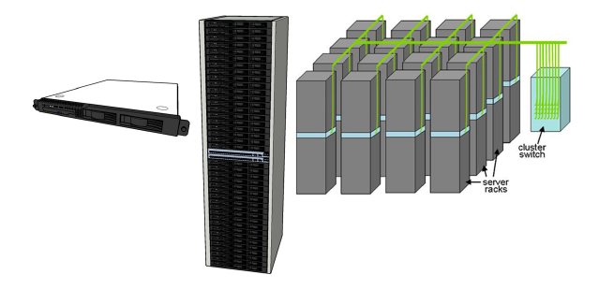
WSC Architecture
1U Server:
8-16 cores,
16 GB DRAM,
4x4 TB disk
+ disk pods
Array (aka cluster):
16-32 racks
Expensive switch
(10X bandwidth → 100x cost)
Rack:
40-80 severs,
Local Ethernet (1-10Gbps) switch
(30$/1Gbps/server)

Slide 14
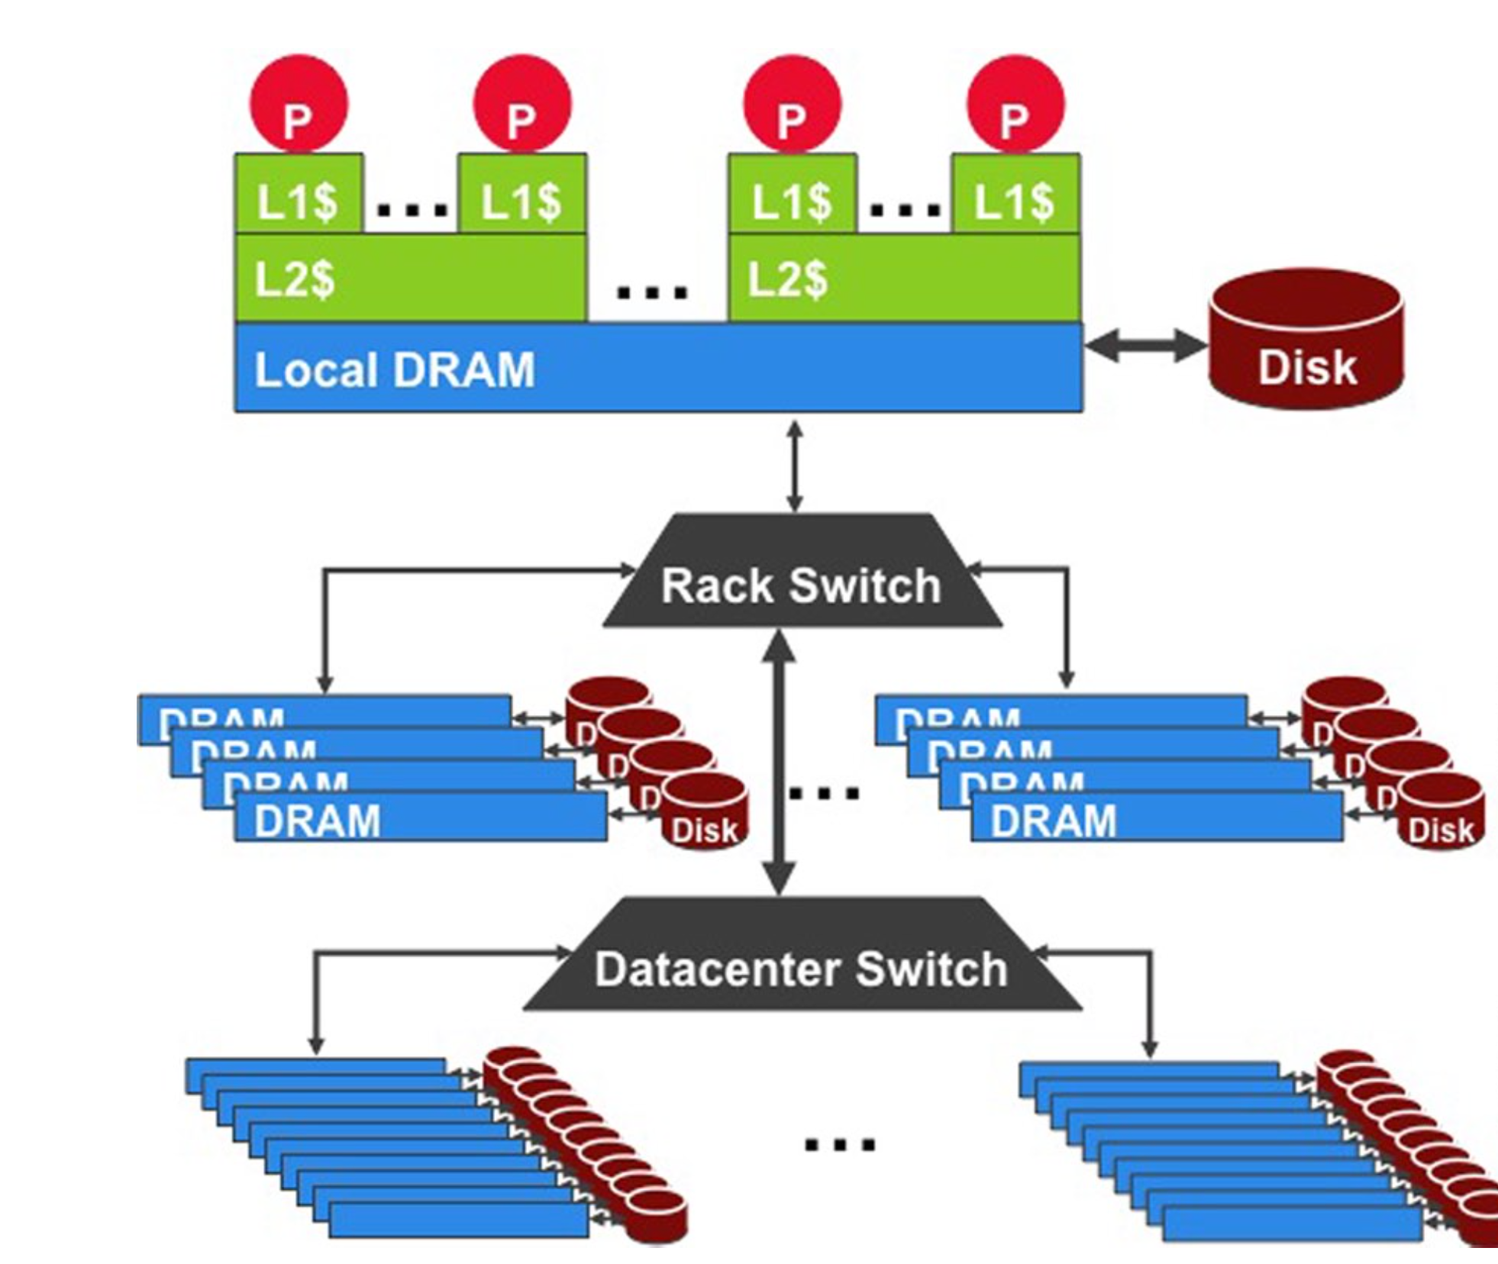
WSC Storage Hierarchy
Lower latency to DRAM in another server than local disk
Higher bandwidth to local disk than to DRAM in another server
1U Server:
DRAM: 16GB, 100ns, 20GB/s
Disk: 2TB, 10ms, 200MB/s
Rack(80 severs):
DRAM: 1TB, 300us, 100MB/s
Disk: 160TB, 11ms, 100MB/s
Array(30 racks):
DRAM: 30TB, 500us, 10MB/s
Disk: 4.80PB, 12ms, 10MB/s

Slide 15
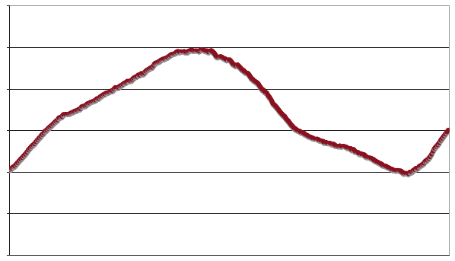
Workload Variation
Workload
2X
Midnight
Noon
Midnight
Online service: Peak usage 2X off-peak

Slide 16
Impact on WSC software
Latency, bandwidth → Performance
Independent data set within an array
Locality of access within server or rack
High failure rate → Reliability, Availability
Preventing failures is effectively impossible at this scale
Cope with failures gracefully by designing the system as a whole
Varying workloads → Availability
Scale up and down gracefully
More challenging than software for single computers!

Slide 17
Power Usage Effectiveness
Energy efficiency
Primary concern in the design of WSC
Important component of the total cost of ownership
Power Usage Effectiveness (PUE):
A power efficiency measure for WSC
Not considering efficiency of servers, networking
Perfection = 1.0
Google WSC’s PUE = 1.2
Getting pretty close to Amdahl's law limit
Total Building Power
IT equipment Power

Slide 18
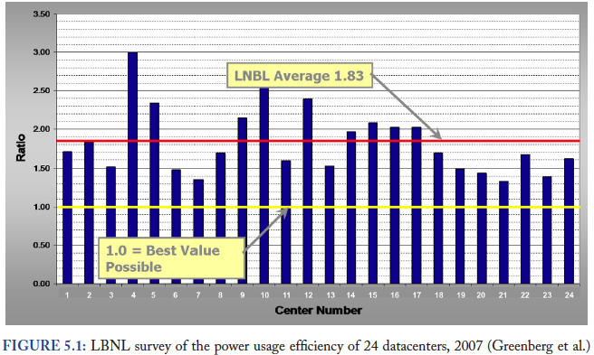
PUE in the Wild (2007)

Slide 20
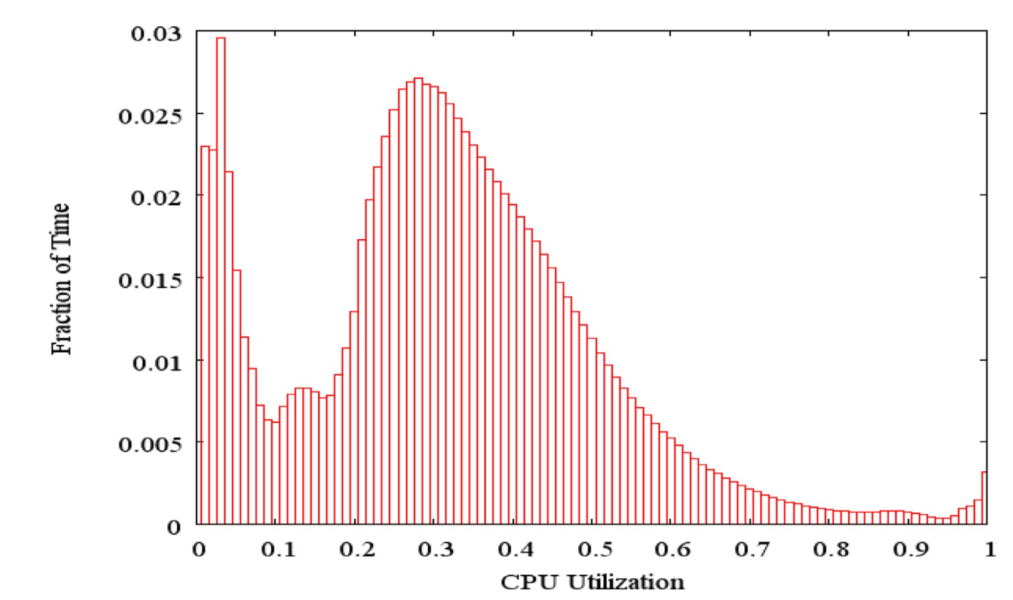
Load Profile of WSCs
Average CPU utilization of 5,000 Google servers, 6 month period
Servers rarely idle or fully utilized, operating most of the time at 10% to 50% of their maximum utilization

Slide 21
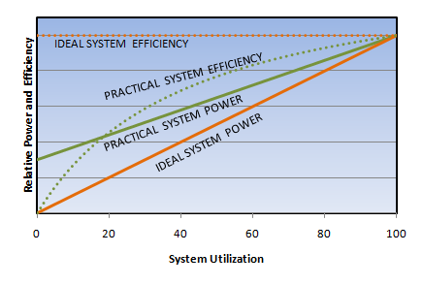
Energy-Proportional Computing: Design Goal of WSC
Energy = Power x Time, Efficiency = Computation / Energy
Desire:
Consume almost no power when idle (“Doing nothing well”)
Gradually consume more power as the activity level increases

Slide 22
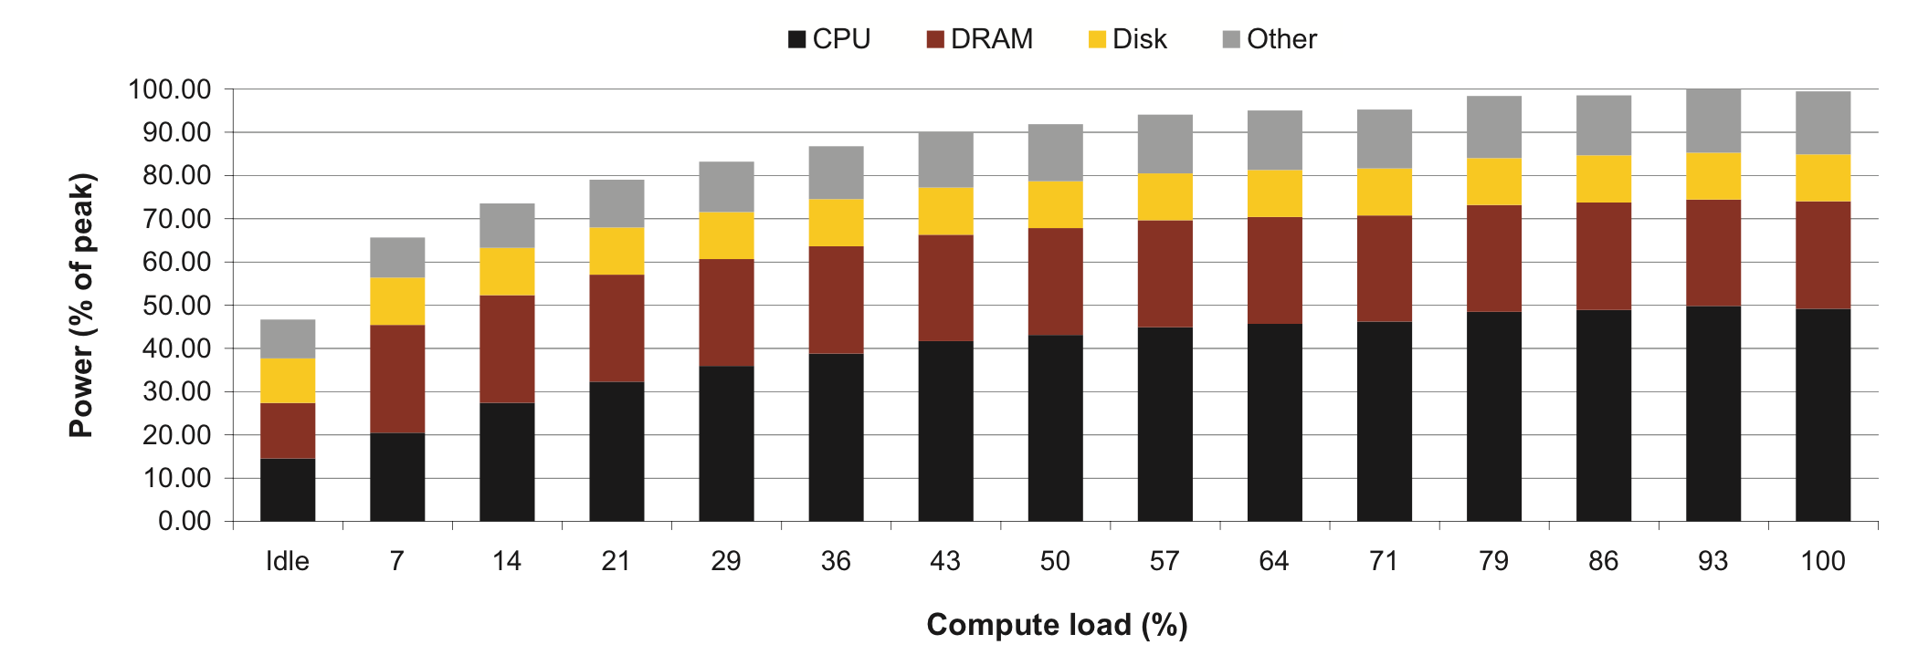
Cause of Poor Energy Proportionality
CPU: 50% at peek, 30% at idle
DRAM, disks, networking: 70% at idle!
Because they are never really idle unless they are powered off!
Need to improve the energy efficiency of peripherals

Slide 23
Clicker/Peer Instruction: Which Statement is True
A: Idle servers consume almost no power.
B: Disks will fail once in 20 years, so failure is not a problem of WSC.
C: The search requests of the same keyword from different users are dependent.
D: More than half of the power of WSCs goes into cooling.
E: WSCs contain many copies of data.

Slide 24
Administrivia
Reminder that Project 4 is out…

Slide 25
Agenda
Warehouse Scale Computing
Administrivia & Clickers/Peer Instructions
Request-level Parallelism
e.g. Web search

Slide 26
Request-Level Parallelism (RLP)
Hundreds of thousands of requests per sec.
Popular Internet services like web search, social networking, …
Such requests are largely independent
Often involve read-mostly databases
Rarely involve read-write sharing or synchronization across requests
Computation easily partitioned across different requests and even within a request

Slide 27
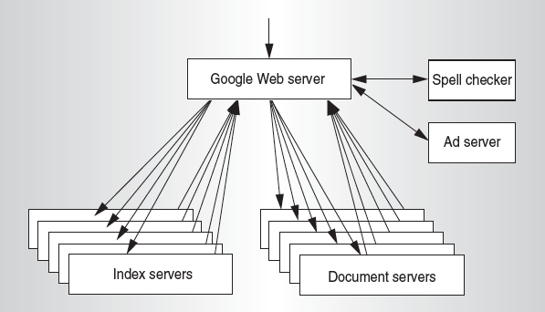
Google Query-Serving Architecture

Slide 28
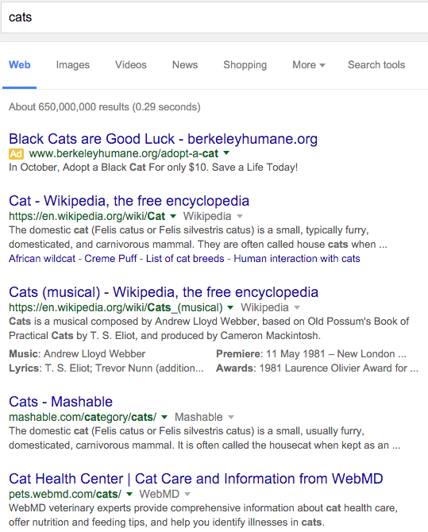
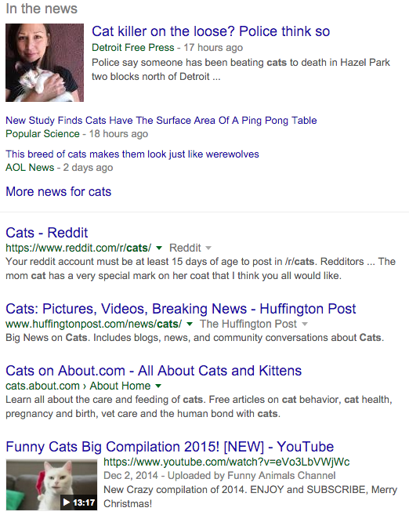
Anatomy of a Web Search

Slide 29
Anatomy of a Web Search (1/3)
Google “cats”
Direct request to “closest” Google WSC
Handled by DNS
Front-end load balancer directs request to one of many arrays (cluster of servers) within WSC
One of potentially many load balancers
Within array, select one of many Goggle Web Servers (GWS) to handle the request and compose the response pages
GWS communicates with Index Servers to find documents that contains the search word, “cats”
Index servers keep index in RAM, not on disk
Return document list with associated relevance score

Slide 30
Anatomy of a Web Search (2/3)
In parallel,
Ad system: run ad auction for bidders on search terms
Yes, you are being bought and sold in a realtime auction all over the web
Page ads are worse than search ads
Use docids (Document IDs) to access indexed documents
Compose the page
Result document extracts (with keyword in context) ordered by relevance score
Sponsored links (along the top) and advertisements (along the sides)

Slide 31
Anatomy of a Web Search (3/3)
Implementation strategy
Randomly distribute the entries
Make many copies of data (a.k.a. “replicas”)
Load balance requests across replicas
Redundant copies of indices and documents
Breaks up search hot spots, e.g. “Taylor Swift”
Increases opportunities for request-level parallelism
Makes the system more tolerant of failures

Slide 32
Summary
Warehouse Scale Computers
New class of computers
Scalability, energy efficiency, high failure rate
Request-level parallelism
e.g. Web Search
Data-level parallelism on a large dataset
A gazillion VMs for different people
MapReduce
Hadoop, Spark

