Slide 1
CS 61C: Great Ideas in Computer Architecture Performance Iron Law, Amdahl’s Law
Instructors:
Nicholas Weaver& Vladimir Stojanovic
http://inst.eecs.berkeley.edu/~cs61c/

Slide 2
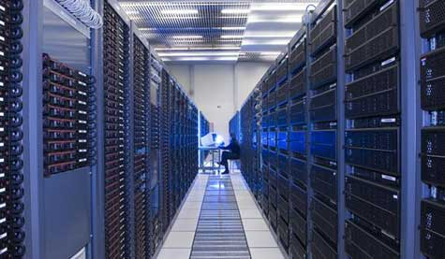
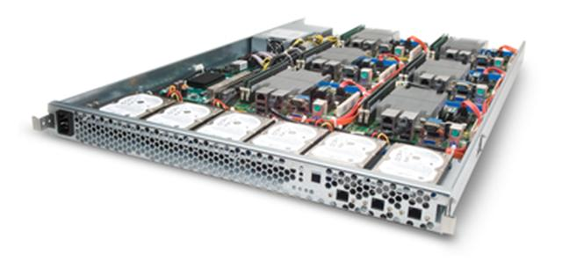
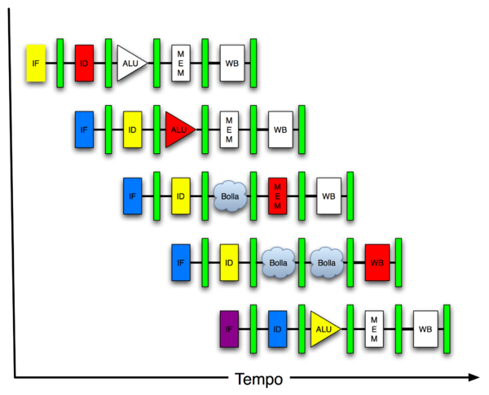
New-School Machine Structures (It’s a bit more complicated!)
Software Hardware
Parallel Requests
Assigned to computer
e.g., Search “Katz”
Parallel Threads
Assigned to core
e.g., Lookup, Ads
Parallel Instructions
>1 instruction @ one time
e.g., 5 pipelined instructions
Parallel Data
>1 data item @ one time
e.g., Add of 4 pairs of words
Hardware descriptions
All gates @ one time
Programming Languages
Warehouse Scale Computer
Smart Phone
Harness Parallelism &
Achieve High Performance
How do we know?
Computer
Core
…
Core
Memory (Cache)
Input/Output
Core
Instruction Unit(s)
Functional
Unit(s)
A₀+B₀
A₁+B₁
A₂+B₂
A₃+B₃
Cache Memory
Logic Gates

Slide 3
What is Performance?
Latency (or response time or execution time)
Time to complete one task
Bandwidth (or throughput)
Tasks completed per unit time
If you have sufficient independent tasks, you can always throw more money at the problem: Throughput/$ often a more important metric than just throughput

Slide 4
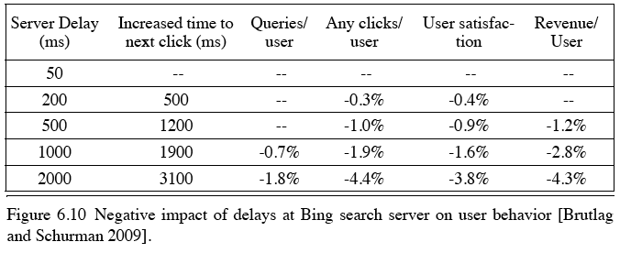
Cloud Performance: Why Application Latency Matters
Key figure of merit: application responsiveness
Longer the delay, the fewer the user clicks, the less the user happiness, and the lower the revenue per user

Slide 5
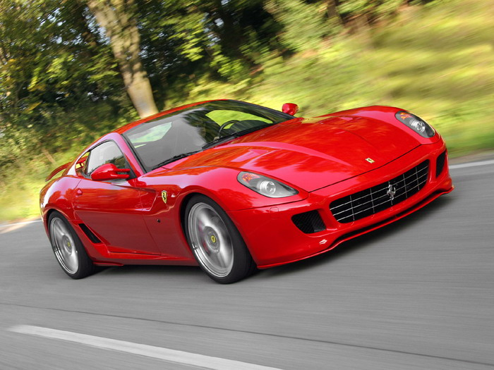
Defining CPU Performance
What does it mean to say X is faster than Y?
Ferrari vs. School Bus?
2013 Ferrari 599 GTB
2 passengers, quarter mile in 10 secs
2013 Type D school bus
50 passengers, quarter mile in 20 secs
Response Time (Latency): e.g., time to travel ¼ mile
Throughput (Bandwidth): e.g., passenger-mi in 1 hour

Slide 6
Defining Relative CPU Performance
Performance_{X} = 1/Program Execution Time_{X}
Performance_{X} > Performance_{Y} => 1/Execution Time_{X} > 1/Execution Time_{y} => Execution Time_{Y} > Execution Time_{X}
Computer X is N times faster than Computer Y Performance_{X} / Performance_{Y} = N or Execution Time_{Y} / Execution Time_{X} = N
Bus to Ferrari performance:
Program: Transfer 1000 passengers for 1 mile
Bus: 3,200 sec, Ferrari: 40,000 sec

Slide 7
Measuring CPU Performance
Computers use a clock to determine when events takes place within hardware
Clock cycles: discrete time intervals
aka clocks, cycles, clock periods, clock ticks
Clock rate or clock frequency: clock cycles per second (inverse of clock cycle time)
3 GigaHertz clock rate => clock cycle time = 1/(3x10⁹) seconds clock cycle time = 333 picoseconds (ps)

Slide 8
CPU Performance Factors
To distinguish between processor time and I/O, CPU time is time spent in processor
CPU Time/Program = Clock Cycles/Program x Clock Cycle Time
Or CPU Time/Program = Clock Cycles/Program ÷ Clock Rate

Slide 9
Iron Law of Performance by Emer and Clark
A program executes instructions
CPU Time/Program = Clock Cycles/Program x Clock Cycle Time = Instructions/Program x Average Clock Cycles/Instruction x Clock Cycle Time
1st term called Instruction Count
2nd term abbreviated CPI for average Clock Cycles Per Instruction
3rd term is 1 / Clock rate

Slide 10
Restating Performance Equation
Time = Seconds Program Instructions Clock cycles Seconds Program Instruction Clock Cycle
=
×
×

Slide 11
What Affects Each Component? A)Instruction Count, B)CPI, C)Clock Rate
 | Affects What? (click in letter of component not affected)
Algorithm
Programming Language
Compiler
Instruction Set Architecture
Notes:
Algorithm Instruction count, possibly CPI
The algorithm determines the number of source program instructions executed and hence the number of processor instructions executed. The algorithm may also affect the CPI, by
favoring slower or faster instructions. For example, if the algorithm uses more floating-point operations, it will tend to have a higher CPI.
Programming language
Instruction count, CPI
The programming language certainly affects the instruction count, since statements in the language are translated to processor
instructions, which determine instruction count. The language mayalso affect the CPI because of its features; for example, a language
with heavy support for data abstraction (e.g., Java) will require indirect calls, which will use higher CPI instructions.
Compiler
Instruction count, CPI
The efficiency of the compiler affects both the instruction count and average cycles per instruction, since the compiler determines
the translation of the source language instructions into computer instructions. The compiler’s role can be very complex and affect
the CPI in complex ways.
Instruction set
architecture
Instruction count, clock rate, CPI
The instruction set architecture affects all three a
ts of CPU performance, since it affects the instructions needed for a
function, the cost in cycles of each instruction, and the overall clock rate of the processor

Slide 12
What Affects Each Component? Instruction Count, CPI, Clock Rate
 | Affects What?
Algorithm | Instruction Count, CPI
Programming Language | Instruction Count, CPI
Compiler | Instruction Count, CPI
Instruction Set Architecture | Instruction Count, Clock Rate, CPI
Notes:
Algorithm Instruction count, possibly CPI
The algorithm determines the number of source program instructions executed and hence the number of processor instructions executed. The algorithm may also affect the CPI, by
favoring slower or faster instructions. For example, if the algorithm uses more floating-point operations, it will tend to have a higher CPI.
Programming language
Instruction count, CPI
The programming language certainly affects the instruction count, since statements in the language are translated to processor
instructions, which determine instruction count. The language mayalso affect the CPI because of its features; for example, a language
with heavy support for data abstraction (e.g., Java) will require indirect calls, which will use higher CPI instructions.
Compiler
Instruction count, CPI
The efficiency of the compiler affects both the instruction count and average cycles per instruction, since the compiler determines
the translation of the source language instructions into computer instructions. The compiler’s role can be very complex and affect
the CPI in complex ways.
Instruction set
architecture
Instruction count, clock rate, CPI
The instruction set architecture affects all three aspects of CPU performance, since it affects the instructions needed for a
function, the cost in cycles of each instruction, and the overall clock rate of the processor

Slide 13
Clickers
Computer | Clock frequency | Clock cycles per instruction | #instructions per program
A | 1GHz | 2 | 1000
B | 2GHz | 5 | 800
C | 500MHz | 1.25 | 400
D | 5GHz | 10 | 2000
Which computer has the highest performance for a given program?
Notes:
A: 1ns * 2 * 1000 = 2us
B: 0.5ns * 5*800 = 2us
C: 2ns*1.25*400 = 1us
D: 0.2ns*10*2000 = 4us

Slide 14
Workload and Benchmark
Workload: Set of programs run on a computer
Actual collection of applications run or made from real programs to approximate such a mix
Specifies programs, inputs, and relative frequencies
Benchmark: Program selected for use in comparing computer performance
Benchmarks form a workload
Usually standardized so that many use them

Slide 15
SPEC (System Performance Evaluation Cooperative)
Computer Vendor cooperative for benchmarks, started in 1989
SPECCPU2006
12 Integer Programs
17 Floating-Point Programs
Often turn into number where bigger is faster
SPECratio: reference execution time on old reference computer divide by execution time on new computer to get an effective speed-up

Slide 16
SPECINT2006 on AMD Barcelona
Description | Instruc-tion Count (B) | CPI | Clock cycle time (ps) | Execu-tion Time (s) | Refer-ence Time (s) | SPEC-ratio
Interpreted string processing | 2,118 | 0.75 | 400 | 637 | 9,770 | 15.3
Block-sorting compression | 2,389 | 0.85 | 400 | 817 | 9,650 | 11.8
GNU C compiler | 1,050 | 1.72 | 400 | 724 | 8,050 | 11.1
Combinatorial optimization | 336 | 10.0 | 400 | 1,345 | 9,120 | 6.8
Go game | 1,658 | 1.09 | 400 | 721 | 10,490 | 14.6
Search gene sequence | 2,783 | 0.80 | 400 | 890 | 9,330 | 10.5
Chess game | 2,176 | 0.96 | 400 | 837 | 12,100 | 14.5
Quantum computer simulation | 1,623 | 1.61 | 400 | 1,047 | 20,720 | 19.8
Video compression | 3,102 | 0.80 | 400 | 993 | 22,130 | 22.3
Discrete event simulation library | 587 | 2.94 | 400 | 690 | 6,250 | 9.1
Games/path finding | 1,082 | 1.79 | 400 | 773 | 7,020 | 9.1
XML parsing | 1,058 | 2.70 | 400 | 1,143 | 6,900 | 6.0

Slide 17
Summarizing Performance …
System
Rate (Task 1)
Rate (Task 2)
A
10
20
B
20
10
Clickers: Which system is faster?
A: System A
B: System B
C: Same performance
D: Unanswerable question!

Slide 18
… Depends Who’s Selling
System
Rate (Task 1)
Rate (Task 2)
Average
A
10
20
15
B
20
10
15
Average throughput
System
Rate (Task 1)
Rate (Task 2)
Average
A
0.50
2.00
1.25
B
1.00
1.00
1.00
Throughput relative to B
System
Rate (Task 1)
Rate (Task 2)
Average
A
1.00
1.00
1.00
B
2.00
0.50
1.25
Throughput relative to A

Slide 19
Summarizing SPEC Performance
Varies from 6x to 22x faster than reference computer
Geometric mean of ratios: N-th root of product of N ratios
Geometric Mean gives same relative answer no matter what computer is used as reference
Geometric Mean for Barcelona is 11.7

Slide 20
Administrivia
Midterm 2 in the evening next Monday
Project 2.1 grades in

Slide 21
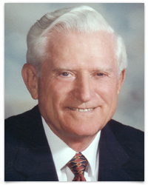
Big Idea: Amdahl’s (Heartbreaking) Law
Speedup due to enhancement E is
Exec time w/o E
Speedup w/ E = ----------------------
Exec time w/ E
Suppose that enhancement E accelerates a fraction F (F <1) of the task by a factor S (S>1) and the remainder of the task is unaffected
Execution Time w/o E × [ (1-F) + F/S]
Execution Time w/ E =
1 / [ (1-F) + F/S ]
Speedup w/ E =

Slide 22
Big Idea: Amdahl’s Law
Speedup = 1
(1 - F) + F
Non-speed-up part
S
Speed-up part
Example: the execution time of half of the program can be accelerated by a factor of 2. What is the program speed-up overall?
1
1
=
=
1.33
0.5 + 0.5
0.5 + 0.25
2

Slide 23
Example #1: Amdahl’s Law
Speedup w/ E = 1 / [ (1-F) + F/S ]
Consider an enhancement which runs 20 times faster but which is only usable 25% of the time
Speedup w/ E = 1/(.75 + .25/20) = 1.31
What if its usable only 15% of the time?
Speedup w/ E = 1/(.85 + .15/20) = 1.17
Amdahl’s Law tells us that to achieve linear speedup with 100 processors, none of the original computation can be scalar!
To get a speedup of 90 from 100 processors, the percentage of the original program that could be scalar would have to be 0.1% or less
Speedup w/ E = 1/(.001 + .999/100) = 90.99

Slide 24
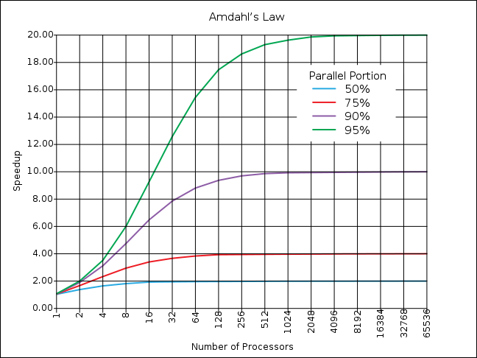
If the portion of the program that can be parallelized is small, then the speedup is limited
The non-parallel portion limits the performance

Slide 25
Strong and Weak Scaling
To get good speedup on a parallel processor while keeping the problem size fixed is harder than getting good speedup by increasing the size of the problem.
Strong scaling: when speedup can be achieved on a parallel processor without increasing the size of the problem
Weak scaling: when speedup is achieved on a parallel processor by increasing the size of the problem proportionally to the increase in the number of processors
Load balancing is another important factor: every processor doing same amount of work
Just one unit with twice the load of others cuts speedup almost in half
Notes:
Add load balancing example here – page 638

Slide 26
Clickers/Peer Instruction
Suppose a program spends 80% of its time in a square root routine. How much must you speedup square root to make the program run 5 times faster?
A: 5
B: 16
C: 20
D: 100
E: None of the above
Speedup w/ E = 1 / [ (1-F) + F/S ]
Notes:
VertLeftWhiteCheck1
Answer: 4th
Need infinitely fast to get to 5X
5 = 2.8
10 = 3.6
20 = 4.2
100 = 4.8

Slide 27
And In Conclusion, …
Time (seconds/program) is measure of performance Instructions Clock cycles Seconds Program Instruction Clock Cycle
Floating-point representations hold approximations of real numbers in a finite number of bits
=
×
×

