Slide 1
CS 61C: Great Ideas in Computer Architecture Floating Point Arithmetic
Instructors:
Vladimir Stojanovic & Nicholas Weaver
http://inst.eecs.berkeley.edu/~cs61c/

Slide 2
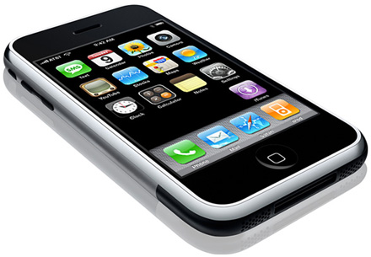
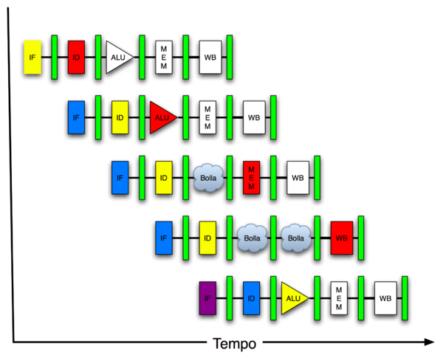
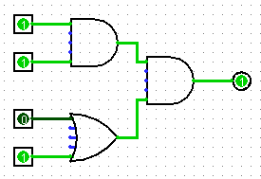
New-School Machine Structures (It’s a bit more complicated!)
Software Hardware
Parallel Requests
Assigned to computer
e.g., Search “Katz”
Parallel Threads
Assigned to core
e.g., Lookup, Ads
Parallel Instructions
>1 instruction @ one time
e.g., 5 pipelined instructions
Parallel Data
>1 data item @ one time
e.g., Add of 4 pairs of words
Hardware descriptions
All gates @ one time
Programming Languages
Warehouse Scale Computer
Smart Phone
Harness Parallelism &
Achieve High Performance
How do we know?
Computer
Core
…
Core
Memory (Cache)
Input/Output
Core
Instruction Unit(s)
Functional
Unit(s)
A₀+B₀
A₁+B₁
A₂+B₂
A₃+B₃
Cache Memory
Logic Gates

Slide 3
Review of Numbers
Computers are made to deal with numbers
What can we represent in N bits?
2^{N} things, and no more! They could be…
Unsigned integers:
0 to 2^{N} - 1
(for N=32, 2^{N}–1 = 4,294,967,295)
Signed Integers (Two’s Complement)
-2^{(N-1)} to 2^{(N-1)} - 1
(for N=32, 2^{(N-1)} = 2,147,483,648)

Slide 4
What about other numbers?
Very large numbers? (seconds/millennium) ⇒ 31,556,926,000_{ten} (3.1556926₁₀ x 10¹⁰)
Very small numbers? (Bohr radius) ⇒ 0.0000000000529177_{ten} (5.29177₁₀ x 10⁻¹¹)
Numbers with both integer & fractional parts? ⇒ 1.5
First consider #3.
…our solution will also help with #1 and #2.

Slide 5
Representation of Fractions
“Binary Point” like decimal point signifies boundary between integer and fractional parts:
xx.yyyy
Example 6-bit representation:
2¹
2⁻⁴
2⁰
2⁻¹
2⁻²
2⁻³
10.1010_{two} = 1x2¹ + 1x2⁻¹ + 1x2⁻³ = 2.625_{ten}
If we assume “fixed binary point”, range of 6-bit representations with this format:
0 to 3.9375 (almost 4)

Slide 6
Fractional Powers of 2
i 2^{-i}
0 1.0 1
0.5 1/2
0.25 1/4
0.125 1/8
0.0625 1/16
0.03125 1/32
0.015625
0.0078125
0.00390625
0.001953125
0.0009765625
0.00048828125
0.000244140625
0.0001220703125
0.00006103515625
0.000030517578125

Slide 7
Representation of Fractions with Fixed Pt.
What about addition and multiplication?
Addition is straightforward:
01.100 1.5_{ten}
+ 00.100 0.5_{ten}
10.000 2.0_{ten}
01.100 1.5_{ten}
00.100 0.5_{ten}
00 000
000 00
0110 0
00000
00000
0000110000
Multiplication a bit more complex:
Where’s the answer, 0.11? (need to remember where point is)

Slide 8
Representation of Fractions
So far, in our examples we used a “fixed” binary point. What we really want is to “float” the binary point. Why?
Floating binary point most effective use of our limited bits (and thus more accuracy in our number representation):
example: put 0.1640625_{ten} into binary. Represent with 5-bits choosing where to put the binary point.
… 000000.001010100000…
Store these bits and keep track of the binary point 2 places to the left of the MSB
Any other solution would lose accuracy!
With floating-point rep., each numeral carries an exponent field recording the whereabouts of its binary point.
The binary point can be outside the stored bits, so very large and small numbers can be represented.

Slide 9
Scientific Notation (in Decimal)
mantissa
exponent
6.02_{ten} x 10²³
decimal point
radix (base)
Normalized form: no leading 0s (exactly one digit to left of decimal point)
Alternatives to representing 1/1,000,000,000
Normalized: 1.0 x 10⁻⁹
Not normalized: 0.1 x 10⁻⁸,10.0 x 10⁻¹⁰

Slide 10
Scientific Notation (in Binary)
mantissa
exponent
1.01_{two} x 2⁻¹
“binary point”
radix (base)
Computer arithmetic that supports it called floating point, because it represents numbers where the binary point is not fixed, as it is for integers
Declare such variable in C as float
double for double precision.

Slide 11
Floating-Point Representation (1/2)
Normal format: +1.xxx…x_{two}*2^{yyy…y}two
Multiple of Word Size (32 bits)
31
30
23
22
0
S
Exponent
Significand
1 bit
8 bits
23 bits
S represents Sign Exponent represents y’s Significand represents x’s
Represent numbers as small as 2.0_{ten} x 10⁻³⁸ to as large as 2.0_{ten} x 10³⁸

Slide 12
Floating-Point Representation (2/2)
What if result too large?
(> 2.0x10³⁸ , < -2.0x10³⁸ )
Overflow! ⇒ Exponent larger than represented in 8-bit Exponent field
What if result too small?
(>0 & < 2.0x10⁻³⁸ , <0 & > -2.0x10⁻³⁸ )
Underflow! ⇒ Negative exponent larger than represented in 8-bit Exponent field
What would help reduce chances of overflow and/or underflow?
overflow
underflow
overflow
-2x10³⁸
-1
-2x10⁻³⁸
0
2x10⁻³⁸
1
2x10³⁸

Slide 13
IEEE 754 Floating-Point Standard (1/3)
Single Precision (Double Precision similar):
Sign bit: 1 means negative 0 means positive
Significand in sign-magnitude format (not 2’s complement)
To pack more bits, leading 1 implicit for normalized numbers
1 + 23 bits single, 1 + 52 bits double
always true: 0 < Significand < 1 (for normalized numbers)
Note: 0 has no leading 1, so reserve exponent value 0 just for number 0
31
30
23
22
0
S
Exponent
Significand
1 bit
8 bits
23 bits

Slide 14
IEEE 754 Floating Point Standard (2/3)
IEEE 754 uses “biased exponent” representation
Designers wanted FP numbers to be used even if no FP hardware; e.g., sort records with FP numbers using integer compares
Wanted bigger (integer) exponent field to represent bigger numbers
2’s complement poses a problem (because negative numbers look bigger)
Use just magnitude and offset by half the range

Slide 15
IEEE 754 Floating Point Standard (3/3)
Called Biased Notation, where bias is number subtracted to get final number
IEEE 754 uses bias of 127 for single prec.
Subtract 127 from Exponent field to get actual value for exponent
Summary (single precision):
31
30
23
22
0
S
Exponent
Significand
1 bit
8 bits
23 bits
(-1)^{S} x (1 + Significand) x 2^{(Exponent-127)}
Double precision identical, except with exponent bias of 1023 (half, quad similar)

Slide 16
“Father” of the Floating point standard
IEEE Standard 754 for Binary Floating-Point Arithmetic.
1989 ACM Turing Award Winner!
Prof. Kahan
www.cs.berkeley.edu/~wkahan/ieee754status/754story.html
Notes:
1:30 in

Slide 17
Clickers
Guess this Floating Point number:
1 1000 0000 1000 0000 0000 0000 0000 000
A: -1x 2¹²⁸
B: +1x 2⁻¹²⁸
C: -1x 2¹
D: +1.5x 2⁻¹
E: -1.5x 2¹
Notes:
E

Slide 18
Administrivia
Project 3-2 extended until 03/20 @ 23:59:59
Guerrilla Session: Caches/ Proj 3-2 OH
Sat 3/19 1 - 3 PM @ 521 Cory
Notes:
E

Slide 19
Representation for ± ∞
In FP, divide by 0 should produce ± ∞, not overflow.
Why?
OK to do further computations with ∞ E.g., X/0 > Y may be a valid comparison
IEEE 754 represents ± ∞
Most positive exponent reserved for ∞
Significands all zeroes

Slide 20
Representation for 0
Represent 0?
exponent all zeroes
significand all zeroes
What about sign? Both cases valid
+0: 0 00000000 00000000000000000000000
-0: 1 00000000 00000000000000000000000

Slide 21
Special Numbers
What have we defined so far? (Single Precision)
Exponent Significand Object
0 0 0
0 nonzero ???
1-254 anything +/- fl. pt. #
255 0 +/- ∞
255 nonzero ???
Professor Kahan had clever ideas:
Wanted to use Exp=0,255 & Sig!=0

Slide 22
Representation for Not a Number
What do I get if I calculate sqrt(-4.0)or 0/0?
If ∞ not an error, these shouldn’t be either
Called Not a Number (NaN)
Exponent = 255, Significand nonzero
Why is this useful?
Hope NaNs help with debugging?
They contaminate: op(NaN, X) = NaN
Can use the significand to identify which!

Slide 23
Representation for Denorms (1/2)
Problem: There’s a gap among representable FP numbers around 0
Smallest representable pos num:
a = 1.0… _{two} * 2⁻¹²⁶ = 2⁻¹²⁶
Second smallest representable pos num:
b = 1.000……1 _{two} * 2⁻¹²⁶ = (1 + 0.00…1_{two}) * 2⁻¹²⁶ = (1 + 2⁻²³) * 2⁻¹²⁶ = 2⁻¹²⁶ + 2⁻¹⁴⁹
a - 0 = 2⁻¹²⁶
b - a = 2⁻¹⁴⁹
Normalization and implicit 1 is to blame!
Gaps!
b
-
+
0
a

Slide 24
Representation for Denorms (2/2)
Solution:
We still haven’t used Exponent = 0, Significand nonzero
DEnormalized number: no (implied) leading 1, implicit exponent = -126.
Smallest representable pos num:
a = 2⁻¹⁴⁹
Second smallest representable pos num:
b = 2⁻¹⁴⁸
-
+
0

Slide 25
Special Numbers Summary
Reserve exponents, significands:
Exponent Significand Object
0 0 0
0 nonzero Denorm
1-254 anything +/- fl. pt. #
255 0 +/- ∞
255 nonzero NaN

Slide 26
Conclusion
www.h-schmidt.net/FloatApplet/IEEE754.html
Exponent tells Significand how much (2^{i}) to count by (…, 1/4, 1/2, 1, 2, …)
Floating Point lets us:
Represent numbers containing both integer and fractional parts; makes efficient use of available bits.
Store approximate values for very large and very small #s.
IEEE 754 Floating-Point Standard is most widely accepted attempt to standardize interpretation of such numbers (Every desktop or server computer sold since ~1997 follows these conventions)
Can store NaN, ± ∞
Summary (single precision):
31
30
23
22
0
S
Exponent
Significand
1 bit
8 bits
23 bits
(-1)^{S} x (1 + Significand) x 2^{(Exponent-127)}
Double precision identical, except with exponent bias of 1023 (half, quad similar)

