Slide 1
CS 61C: Great Ideas in Computer Architecture
Caches Part 3
Instructors:
Nicholas Weaver & Vladimir Stojanovic
http://inst.eecs.berkeley.edu/~cs61c

Slide 2





You Are Here!
Software Hardware
Parallel Requests
  Assigned to computer
  e.g., Search “Katz”
Parallel Threads
  Assigned to core
  e.g., Lookup, Ads
Parallel Instructions
  >1 instruction @ one time
  e.g., 5 pipelined instructions
Parallel Data
  >1 data item @ one time
  e.g., Add of 4 pairs of words
Hardware descriptions
  All gates @ one time
Programming Languages
Warehouse Scale Computer
Smart
Phone
Harness
Parallelism &
Achieve High
Performance
Computer
Today’s
Lecture
Core
…
Core
Memory (Cache)
Input/Output
Core
Instruction Unit(s)
Functional
Unit(s)
A₀+B₀
A₁+B₁
A₂+B₂
A₃+B₃
Main Memory
Logic Gates

Slide 3
CPU-Cache Interaction
(5-stage pipeline)
0x4
Add
E
Decode,
Register
Fetch
M
A
we
Y
addr
bubble
ALU
Y
IR
B
Primary
Data
Cache
rdata
PC
addr
inst
D
R
hit?
wdata
hit?
wdata
  PCen
Primary
Instruction
Cache
MD1
MD2
Stall entire CPU on data cache miss
To Memory Control
Cache Refill Data from Lower Levels of Memory Hierarchy
Notes:
How are writes to istream handled?

Slide 4
Improving Cache Performance
  AMAT = Time for a hit + Miss rate x Miss penalty
Reduce the time to hit in the cache
  E.g., Smaller cache
Reduce the miss rate
  E.g., Bigger cache
  Longer cache lines (somewhat)
Reduce the miss penalty
  E.g., Use multiple cache levels

Slide 5
Cache Design Space
Computer architects expend considerable effort optimizing organization of cache hierarchy – big impact on performance and power!
Several interacting dimensions
  Cache size
  Block size
  Associativity
  Replacement policy
  Write-through vs. write-back
  Write allocation
Optimal choice is a compromise
  Depends on access characteristics
    Workload
    Use (I-cache, D-cache)
  Depends on technology / cost
Simplicity often wins
Cache Size
Associativity
Block Size
Bad
Good
Factor A
Factor B
Less
More
Notes:
No fancy replacement policy is needed for the direct mapped cache.
As a matter of fact, that is what cause direct mapped trouble to begin with: only one place to go in the cache--causes conflict misses.
No fancy replacement policy is needed for the direct mapped cache.
As a matter of fact, that is what cause direct mapped trouble to begin with: only one place to go in the cache--causes conflict misses.
Besides working at Sun, I also teach people how to fly whenever I have time.
Statistic have shown that if a pilot crashed after an engine failure, he or she is more likely to get killed in a multi-engine light airplane than a single engine airplane.
The joke among us flight instructors is that: sure, when the engine quit in a single engine stops, you have one option: sooner or later, you land. Probably sooner.
But in a multi-engine airplane with one engine stops, you have a lot of options. It is the need to make a decision that kills those people.

Slide 6
Primary Cache Parameters
Block size
  how many bytes of data in each cache entry?
Associativity
  how many ways in each set?
  Direct-mapped => Associativity = 1
  Set-associative => 1 < Associativity < #Entries
  Fully associative => Associativity = #Entries
Capacity (bytes) = Total #Entries * Block size
#Entries = #Sets * Associativity

Slide 7
Clickers/Peer Instruction:
For fixed capacity and fixed block size, how does increasing associativity effect AMAT?
A: Increases hit time, decreases miss rate
B: Decreases hit time, decreases miss rate
C: Increases hit time, increases miss rate
D: Decreases hit time, increases miss rate

Slide 8
Increasing Associativity?
Hit time as associativity increases?
  Increases, with large step from direct-mapped to >=2 ways, as now need to mux correct way to processor
  Smaller increases in hit time for further increases in associativity
Miss rate as associativity increases?
  Goes down due to reduced conflict misses, but most gain is from 1->2->4-way with limited benefit from higher associativities
Miss penalty as associativity increases?
  Unchanged, replacement policy runs in parallel with fetching missing line from memory

Slide 9
Increasing #Entries?
Hit time as #entries increases?
  Increases, since reading tags and data from larger memory structures
Miss rate as #entries increases?
  Goes down due to reduced capacity and conflict misses
  Architects rule of thumb: miss rate drops ~2x for every ~4x increase in capacity (only a gross approximation)
Miss penalty as #entries increases?
  Unchanged
At some point, increase in hit time for a larger cache may overcome the improvement in hit rate, yielding a decrease in performance

Slide 10
Clickers: Impact of larger blocks on AMAT
For fixed total cache capacity and associativity, what is effect of larger blocks on each component of AMAT:
  A: Decrease, B: Unchanged, C: Increase
Hit Time?
Miss Rate?
Miss Penalty?

Slide 11
Increasing Block Size?
Hit time as block size increases?
  Hit time unchanged, but might be slight hit-time reduction as number of tags is reduced, so faster to access memory holding tags
Miss rate as block size increases?
  Goes down at first due to spatial locality, then increases due to increased conflict misses due to fewer blocks in cache
Miss penalty as block size increases?
  Rises with longer block size, but with fixed constant initial latency that is amortized over whole block

Slide 12
How to Reduce Miss Penalty?
Could there be locality on misses from a cache?
Use multiple cache levels!
With Moore’s Law, more room on die for bigger L1 caches and for second-level (L2) cache
And in some cases even an L3 cache!
IBM mainframes have ~1GB L4 cache off-chip.

Slide 13
Review: Memory Hierarchy
Processor
Inner
Increasing distance from processor,
decreasing speed
Levels in memory hierarchy
Level 1
Level 2
Level 3
Outer
. . .
Level n
Size of memory at each level
As we move to outer levels the latency goes up
and price per bit goes down.

Slide 14
IBM z13 Memory Hierarchy

Slide 15
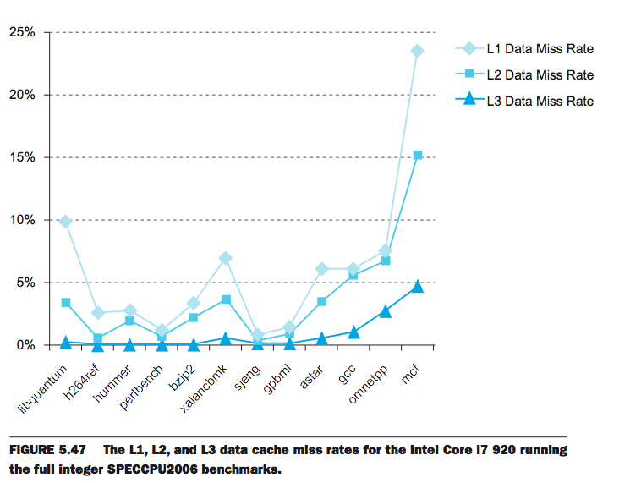
24% of CPU access miss in L1
15% also miss in L2
L1 Cache: 32KB I$, 32KB D$
L2 Cache: 256 KB
L3 Cache: 4 MB
4% also miss in L2

Slide 16
Local vs. Global Miss Rates
Global miss rate – the fraction of references that miss some level of a multilevel cache
  misses in this cache divided by the total number of memory accesses generated by the CPU
Local miss rate – the fraction of references to one level of a cache that miss
  Local Miss rate L2$ = L2$ Misses / L1$ Misses = L2$ Misses / total_L2_accesses
  L2$ local miss rate >> than the global miss rate

Slide 17
Clickers/Peer Instruction
Overall, what are L2 and L3 local miss rates?
A: L2 > 50%, L3 > 50%
B: L2 ~ 50%, L3 < 50%
C: L2 ~ 50%, L3 ~ 50%
D: L2 < 50%, L3 < 50%
E: L2 > 50%, L3 ~50%

Slide 18
Local vs. Global Miss Rates
Local miss rate – the fraction of references to one level of a cache that miss
  Local Miss rate L2$ = $L2 Misses / L1$ Misses
Global miss rate – the fraction of references that miss in all levels of a multilevel cache
    L2$ local miss rate >> than the global miss rate
  Global Miss rate = L2$ Misses / Total Accesses
  = (L2$ Misses / L1$ Misses) × (L1$ Misses / Total Accesses)
  = Local Miss rate L2$ × Local Miss rate L1$
  AMAT = Time for a hit + Miss rate × Miss penalty
  For 2-level cache system:
  AMAT = Time for a L1$ hit + Miss rate L1$ ×
  (Time for a L2$ hit + (local) Miss rate L2$ × L2$ Miss penalty)

Slide 19
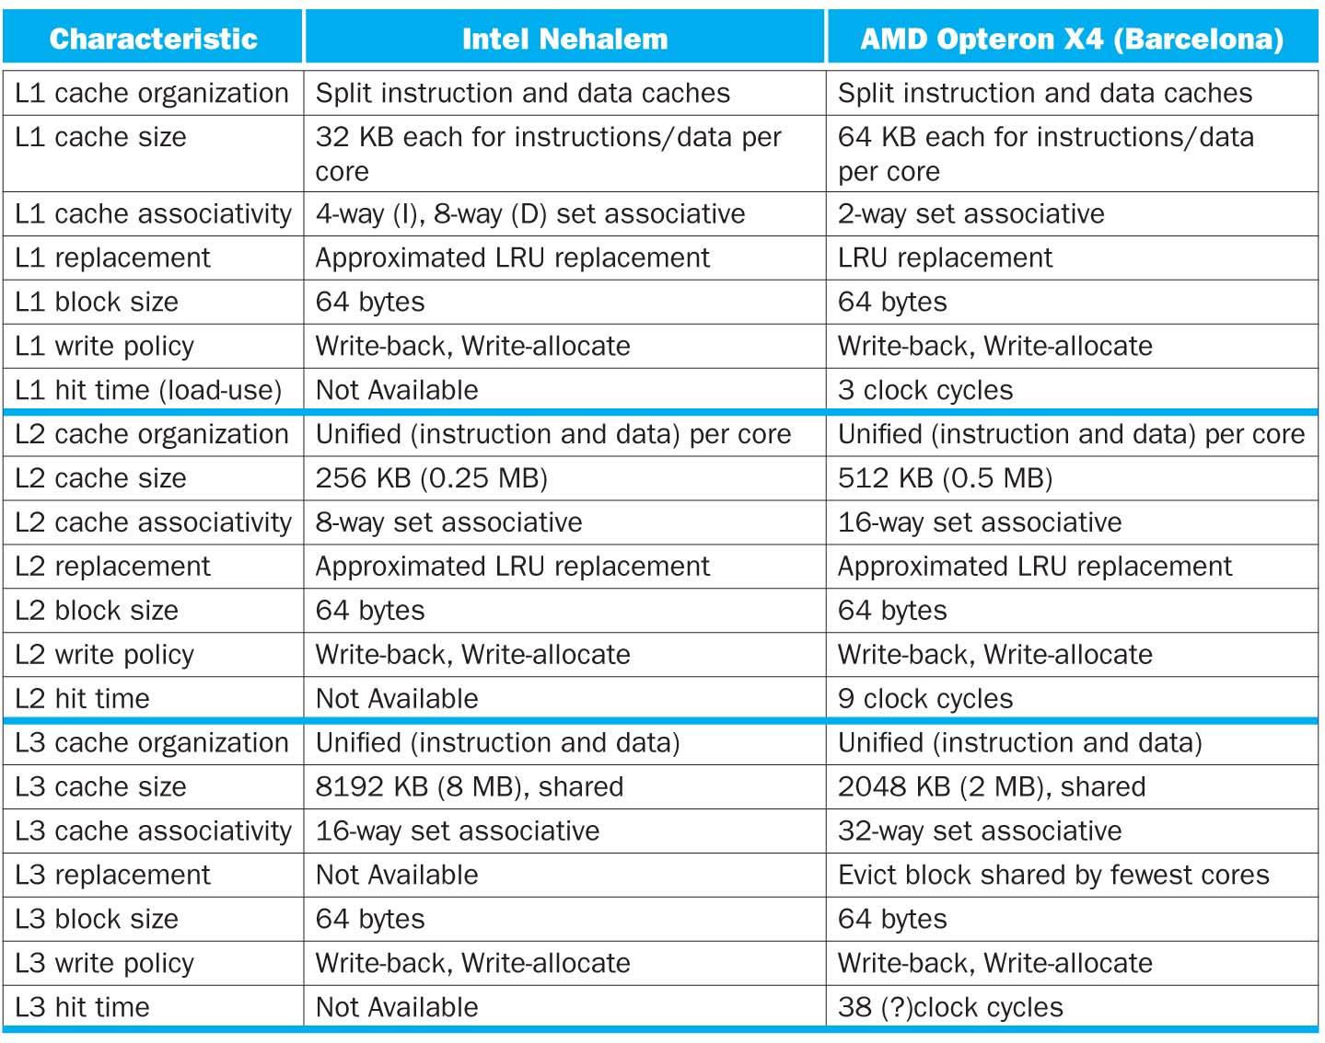

Slide 20
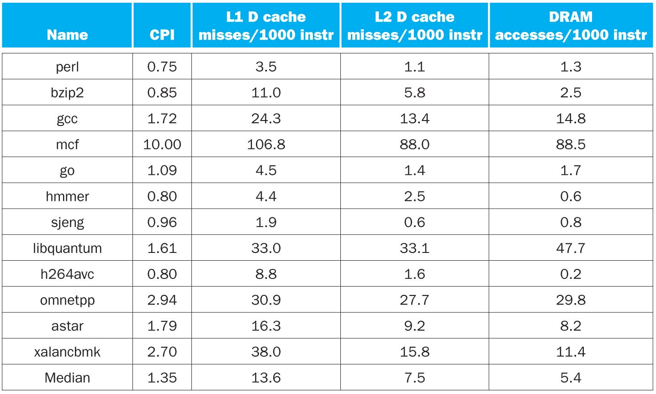
CPI/Miss Rates/DRAM Access
SpecInt2006
Data Only
Data Only
Instructions and Data

Slide 21
In Conclusion, Cache Design Space
Several interacting dimensions
  Cache size
  Block size
  Associativity
  Replacement policy
  Write-through vs. write-back
  Write-allocation
Optimal choice is a compromise
  Depends on access characteristics
    Workload
    Use (I-cache, D-cache)
  Depends on technology / cost
Simplicity often wins
Cache Size
Associativity
Block Size
Bad
Good
Factor A
Factor B
Less
More

Slide 22
More Misses…
We have Compulsory, Capacity, and Conflict…
We also have Coherence
  Two different processor may share memory...
    They implement cache coherence so that both processors see the same shared memory
    When one processor writes to memory, it invalidates the other processor's cache entry for that memory
  Thus if both processors are working on the same data…
    This causes Coherence misses
A related problem can occur if one shared cache is working on two unrelated problems
  You get additional capacity misses: Can happen in "multithreaded" (aka 'Intel Hyperthreaded') processor cores

Slide 23
Fun Additional Stuff: Nick's Caches
Note: These won't be on the exam, but they are interesting asides
  Nick's research has used this material in multiple ways
Predictability and caches
  Why its bad
  Unpredictable caches: Permutation caches and location-associative permutation caches

Slide 24
Predictability and Caches
Caches improve performance but…
  The performance improvement depends on the input
    E.g. conflict misses depend on input patterns
An attacker can take advantage of this
  Timing of operations can tell something about the input
  Attacker selected inputs can degrade performance

Slide 25
Why Timing Matters
Timing enables "side-channel" attacks on cryptography
  The ability to know some detail of an encryption system based on how long operations take
    Part of a larger class of side-channel attacks
It is a fundamentally hard problem to build cryptographic systems that don't have sidechanels
  Modern processors make this even harder

Slide 26
Attacker Selected Input
Alternatively, if the attacker can select the input…
  The attacker can select hard input:
  E.G. Traffic that causes ping-ponging
Nick's problem:
  He had to cache IP addresses (32 bit values)
    This is a network application for security
  He only wants to store a small amount of information
    On chip storage expensive (in this case, on an FPGA)

Slide 27
#1: Permutation Cache
Traditionally, you would hash the address
  With a "salt" to randomize things
  But this requires storing the whole hash value or whole IP for your tag
Instead of a hash, use a 32b keyed permutation
  Aka a 32b block cypher
Now you can use a conventional tag/index approach
  Requires only storing the tag -> space mattered in this application

Slide 28
#2: Location Associativity
The fabric Nick had used "dual-ported" memories
  Like your register file on your processor design: two independent read ports
Rather than using set associativity…
  Instead do two different permutations (keys) and have one of two possible locations
If X, Y, and Z map to the same location with one key...
  They probably do not on the other key: fewer conflict misses
  Even better, can probably move a value to further reduce conflict misses

Slide 29
Simulation…

