Slide 1
CS 61C: Great Ideas in Computer Architecture Caches Part 2
Instructors:
Nicholas Weaver & Vladimir Stojanovic
http://inst.eecs.berkeley.edu/~cs61c/fa15

Slide 2
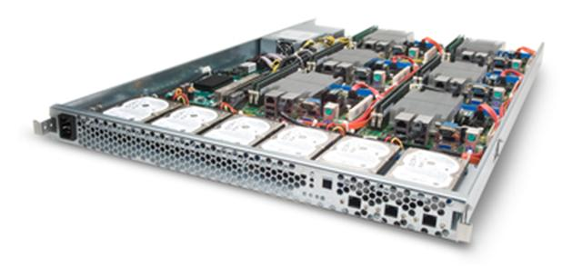
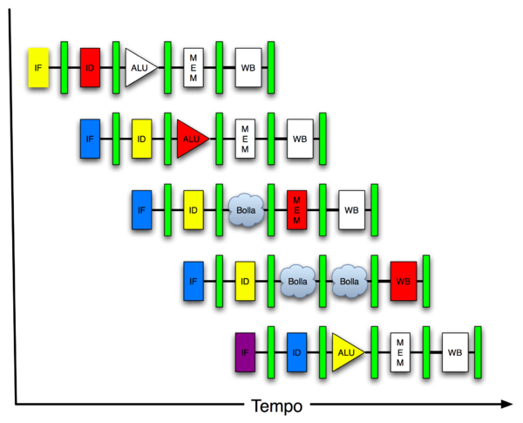
You Are Here!
Software Hardware
Parallel Requests
Assigned to computer
e.g., Search “Katz”
Parallel Threads
Assigned to core
e.g., Lookup, Ads
Parallel Instructions
>1 instruction @ one time
e.g., 5 pipelined instructions
Parallel Data
>1 data item @ one time
e.g., Add of 4 pairs of words
Hardware descriptions
All gates @ one time
Programming Languages
Warehouse Scale Computer
Smart Phone
Harness Parallelism &
Achieve High Performance
Computer
Today’s
Lecture
Core
…
Core
Memory (Cache)
Input/Output
Core
Instruction Unit(s)
Functional
Unit(s)
A₀+B₀
A₁+B₁
A₂+B₂
A₃+B₃
Main Memory
Logic Gates

Slide 3
Multiword-Block Direct-Mapped Cache
Four words/block, cache size = 1K words
Byte offset
Hit
31 30 . . . 13 12 11 . . . 4 3 2 1 0
Data
Tag
20
8
2
Word offset
Index
Index
Valid
Tag
Data
0
1
2
.
.
.
253
254
255
20
32
What kind of locality are we taking advantage of?
Notes:
to take advantage for spatial locality want a cache block that is larger than word word in size.

Slide 4
Processor Address Fields used by Cache Controller
Block Offset: Byte address within block
Set Index: Selects which set
Tag: Remaining portion of processor address
Size of Index = log2 (number of sets)
Size of Tag = Address size – Size of Index – log2 (number of bytes/block)
Processor Address (32-bits total)
Tag
Set Index
Block offset
Notes:
For class handout

Slide 5
Four-Way Set-Associative Cache
2⁸ = 256 sets each with four ways (each with one block)
31 30 . . . 13 12 11 . . . 2 1 0
Byte offset
Set Index
Tag
22
8
Index
V
Tag
Data
V
Tag
Data
V
Tag
Data
V
Tag
Data
0
1
2
.
.
.
253
254
255
0
1
2
.
.
.
253
254
255
0
1
2
.
.
.
253
254
255
0
1
2
.
.
.
253
254
255
Way 0
Way 1
Way 2
Way 3
32
4x1 select
Hit
Data
Notes:
This is called a 4-way set associative cache because there are four cache entries for each cache index. Essentially, you have four direct mapped cache working in parallel.
This is how it works: the cache index selects a set from the cache. The four tags in the set are compared in parallel with the upper bits of the memory address.
If no tags match the incoming address tag, we have a cache miss.
Otherwise, we have a cache hit and we will select the data from the way where the tag matches occur.
This is simple enough. What is its disadvantages?
+1 = 36 min. (Y:16)

Slide 6
Handling Stores with Write-Through
Store instructions write to memory, changing values
Need to make sure cache and memory have same values on writes: 2 policies
1) Write-Through Policy: write cache and write through the cache to memory
Every write eventually gets to memory
Too slow, so you need to include a Write Buffer to allow processor to continue once data in Buffer
Buffer updates memory in parallel to processor

Slide 7
Write-Through Cache
Processor
Write both values in cache and in memory
Write buffer stops CPU from stalling if memory cannot keep up
Write buffer may have multiple entries to absorb bursts of writes
What if store misses in cache?
32-bit
Address
32-bit
Data
Cache
F252
12
1022
99
Write Buffer
7
131C
2041
20
Addr
Data
32-bit
Address
32-bit
Data
Memory

Slide 8
Handling Stores with Write-Back
2) Write-Back Policy: write only to cache and then write cache block back to memory when evict block from cache
Writes collected in cache, only single write to memory per block
Include bit to see if wrote to block or not, and then only write back if bit is set
Called “Dirty” bit (writing makes it “dirty”)

Slide 9
Write-Back Cache
Processor
Store/cache hit, write data in cache only & set dirty bit
Memory has stale value
Store/cache miss, read data from memory, then update and set dirty bit
“Write-allocate” policy
On any miss, write back evicted block, only if dirty. Update cache with new block and clear dirty bit.
32-bit
Address
32-bit
Data
Cache
F252
D
12
1022
Dirty Bits
D
99
131C
D
7
2041
D
20
32-bit
Address
32-bit
Data
Memory

Slide 10
Write-Through vs. Write-Back
Write-Through:
Simpler control logic
More predictable timing simplifies processor control logic
Easier to make reliable, since memory always has copy of data (big idea: Redundancy!)
Write-Back
More complex control logic
More variable timing (0,1,2 memory accesses per cache access)
Usually reduces write traffic
Harder to make reliable, sometimes cache has only copy of data

Slide 11
Write Policy Choices
Cache hit:
write through: writes both cache & memory on every access
Generally higher memory traffic but simpler pipeline & cache design
write back: writes cache only, memory `written only when dirty entry evicted
A dirty bit per line reduces write-back traffic
Must handle 0, 1, or 2 accesses to memory for each load/store
Cache miss:
no write allocate: only write to main memory
write allocate (aka fetch on write): fetch into cache
Common combinations:
write through and no write allocate
write back with write allocate

Slide 12
Cache (Performance) Terms
Hit rate: fraction of accesses that hit in the cache
Miss rate: 1 – Hit rate
Miss penalty: time to replace a block from lower level in memory hierarchy to cache
Hit time: time to access cache memory (including tag comparison)
Abbreviation: “$” = cache (A Berkeley innovation!)

Slide 13
Average Memory Access Time (AMAT)
Average Memory Access Time (AMAT) is the average time to access memory considering both hits and misses in the cache
AMAT = Time for a hit + Miss rate × Miss penalty
Notes:
AMAT = 1 + 0.02x50 = 2

Slide 14
Clickers/Peer instruction
AMAT = Time for a hit + Miss rate x Miss penalty
Given a 200 psec clock, a miss penalty of 50 clock cycles, a miss rate of 0.02 misses per instruction and a cache hit time of 1 clock cycle, what is AMAT?
☐
A: ≤200 psec
☐
B: 400 psec
☐
C: 600 psec
☐
D: ≥ 800 psec
Notes:
VertLeftWhiteCheck1
B: Print It saves PC+4 …because ints in this system are 4-bytes long and the actual address increments by 4 even though it appears to only incrememt 1.

Slide 15
Example: Direct-Mapped Cache with 4 Single-Word Blocks, Worst-Case Reference String
Consider the main memory address reference string of word numbers: 0 4 0 4 0 4 0 4
Start with an empty cache - all blocks initially marked as not valid
0
4
0
4
0
4
0
4
Notes:
For class handout

Slide 16
Example: Direct-Mapped Cache with 4 Single-Word Blocks, Worst-Case Reference String
Consider the main memory address reference string of word numbers: 0 4 0 4 0 4 0 4
Start with an empty cache - all blocks initially marked as not valid
0
miss
01
4
miss
00
0
miss
01
4
miss
4
4
0
00 Mem(0)
00 Mem(0)
01 Mem(4)
00 Mem(0)
00
0
miss
0
01
4
miss
4
00
0
miss
0
01
4
miss
4
01 Mem(4)
00 Mem(0)
01 Mem(4)
00 Mem(0)
8 requests, 8 misses
Ping-pong effect due to conflict misses - two memory locations that map into the same cache block
Notes:
For class handout

Slide 17
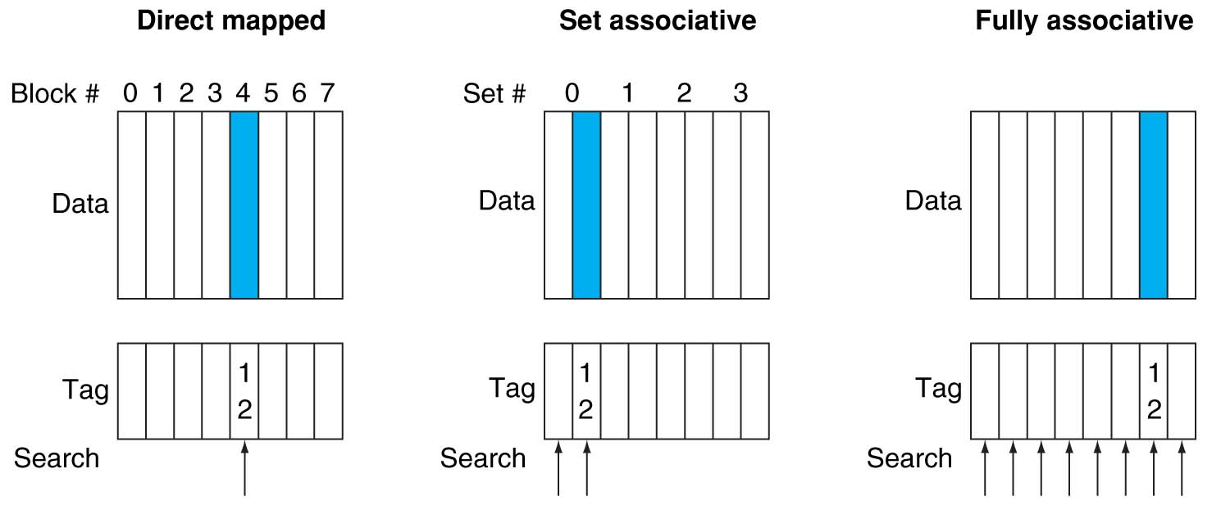
Alternative Block Placement Schemes
DM placement: mem block 12 in 8 block cache: only one cache block where mem block 12 can be found—(12 modulo 8) = 4
SA placement: four sets x 2-ways (8 cache blocks), memory block 12 in set (12 mod 4) = 0; either element of the set
FA placement: mem block 12 can appear in any cache blocks

Slide 18
Example: 4 Word 2-Way SA $ Same Reference String
Consider the main memory word reference string
0 4 0 4 0 4 0 4
Start with an empty cache - all blocks initially marked as not valid
0
4
0
4
Notes:
For class handout

Slide 19
Example: 4-Word 2-Way SA $ Same Reference String
Consider the main memory address reference string
0 4 0 4 0 4 0 4
Start with an empty cache - all blocks initially marked as not valid
0
miss
4
miss
0
hit
4
hit
000 Mem(0)
000 Mem(0)
000 Mem(0)
000 Mem(0)
010 Mem(4)
010 Mem(4)
010 Mem(4)
8 requests, 2 misses
Solves the ping-pong effect in a direct-mapped cache due to conflict misses since now two memory locations that map into the same cache set can co-exist!
Notes:
For lecture
Another sample string to try 0 1 2 3 0 8 11 0 3

Slide 20
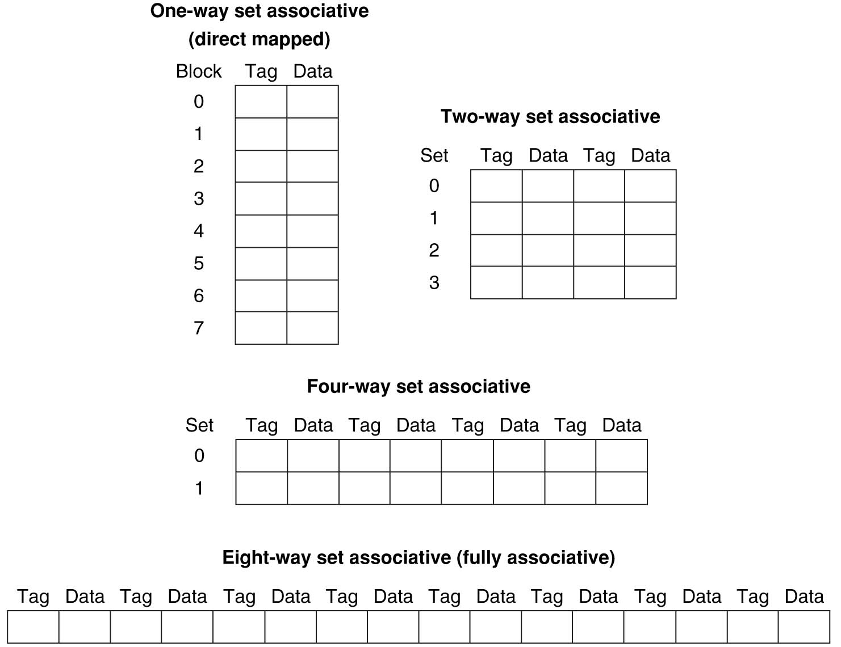
Different Organizations of an Eight-Block Cache
Total size of $ in blocks is equal to number of sets × associativity. For fixed $ size and fixed block size, increasing associativity decreases number of sets while increasing number of elements per set. With eight blocks, an 8-way set-associative $ is same as a fully associative $.

Slide 21
Range of Set-Associative Caches
For a fixed-size cache and fixed block size, each increase by a factor of two in associativity doubles the number of blocks per set (i.e., the number or ways) and halves the number of sets – decreases the size of the index by 1 bit and increases the size of the tag by 1 bit
Tag
Index
Word offset
Byte offset
Notes:
For class handout

Slide 22
Range of Set-Associative Caches
For a fixed-size cache and fixed block size, each increase by a factor of two in associativity doubles the number of blocks per set (i.e., the number or ways) and halves the number of sets – decreases the size of the index by 1 bit and increases the size of the tag by 1 bit
Used for tag compare
Selects the set
Selects the word in the block
Tag
Index
Word offset
Byte offset
Increasing associativity
Decreasing associativity
Fully associative
(only one set)
Tag is all the bits except
block and byte offset
Direct mapped
(only one way)
Smaller tags, only a single comparator
Notes:
For lecture
In 2008, the greater size and power consumption of CAMs generally leads to 2-way and 4-way set associativity being built from standard SRAMs with comparators with 8-way and above being built using CAMs

Slide 23
Total Cache Capacity =
Associativity × # of sets × block_size
Bytes = blocks/set × sets × Bytes/block
C = N × S × B
Tag
Index
Byte Offset
address_size = tag_size + index_size + offset_size
= tag_size + log₂(S) + log₂(B)

Slide 24
Clickers/Peer Instruction
For a cache with constant total capacity, if we increase the number of ways by a factor of 2, which statement is false:
A: The number of sets could be doubled
B: The tag width could decrease
C: The block size could stay the same
D: The block size could be halved
E: Tag width must increase

Slide 25
Total Cache Capacity =
Associativity × # of sets × block_size
Bytes = blocks/set × sets × Bytes/block
C = N × S × B
Tag
Index
Byte Offset
address_size = tag_size + index_size + offset_size
= tag_size + log₂(S) + log₂(B)
Clicker Question: C remains constant, S and/or B can change such that
C = 2N * (SB)’ => (SB)’ = SB/2
Tag_size = address_size – (log₂(S’) + log₂(B’)) = address_size – log₂(SB)’
= address_size – log₂(SB/2)
= address_size – (log₂(SB) – 1)

Slide 26
Costs of Set-Associative Caches
N-way set-associative cache costs
N comparators (delay and area)
MUX delay (set selection) before data is available
Data available after set selection (and Hit/Miss decision). DM $: block is available before the Hit/Miss decision
In Set-Associative, not possible to just assume a hit and continue and recover later if it was a miss
When miss occurs, which way’s block selected for replacement?
Least Recently Used (LRU): one that has been unused the longest (principle of temporal locality)
Must track when each way’s block was used relative to other blocks in the set
For 2-way SA $, one bit per set → set to 1 when a block is referenced; reset the other way’s bit (i.e., “last used”)
Notes:
First of all, a N-way set associative cache will need N comparators instead of just one comparator (use the right side of the diagram for direct mapped cache).
A N-way set associative cache will also be slower than a direct mapped cache because of this extra multiplexer delay.
Finally, for a N-way set associative cache, the data will be available AFTER the hit/miss signal becomes valid because the hit/mis is needed to control the data MUX.
For a direct mapped cache, that is everything before the MUX on the right or left side, the cache block will be available BEFORE the hit/miss signal (AND gate output) because the data does not have to go through the comparator.
This can be an important consideration because the processor can now go ahead and use the data without knowing if it is a Hit or Miss. Just assume it is a hit.
Since cache hit rate is in the upper 90% range, you will be ahead of the game 90% of the time and for those 10% of the time that you are wrong, just make sure you can recover.
You cannot play this speculation game with a N-way set-associative cache because as I said earlier, the data will not be available to you until the hit/miss signal is valid.
+2 = 38 min. (Y:18)

Slide 27
Cache Replacement Policies
Random Replacement
Hardware randomly selects a cache evict
Least-Recently Used
Hardware keeps track of access history
Replace the entry that has not been used for the longest time
For 2-way set-associative cache, need one bit for LRU replacement
Example of a Simple “Pseudo” LRU Implementation
Assume 64 Fully Associative entries
Hardware replacement pointer points to one cache entry
Whenever access is made to the entry the pointer points to:
Move the pointer to the next entry
Otherwise: do not move the pointer
(example of “not-most-recently used” replacement policy)
Entry 0
Entry 1
Replacement
:
Pointer
Entry 63

Slide 28
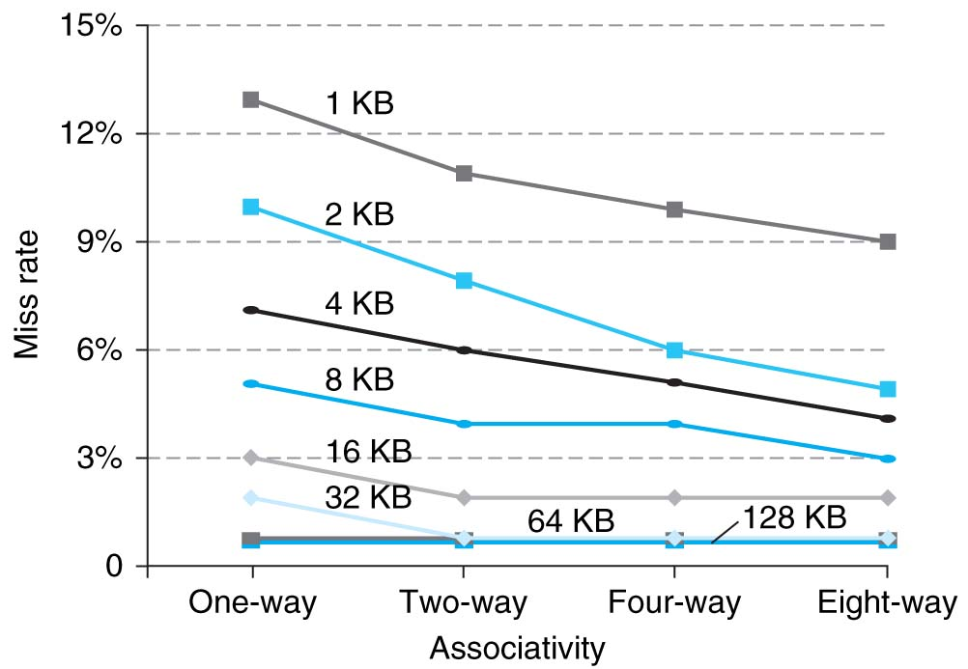
Benefits of Set-Associative Caches
Largest gains are in going from direct mapped to 2-way (20%+ reduction in miss rate)
Notes:
As cache sizes grow, the relative improvement from associativity increases only slightly; since the overall miss rate of a larger cache is lower, the opportunity for improving the miss rate decreases and the absolute improvement in miss rate from associativity shrinks significantly.

Slide 29
Sources of Cache Misses (3 C’s)
Compulsory (cold start, first reference):
1st access to a block, not a lot you can do about it.
If running billions of instructions, compulsory misses are insignificant
Capacity:
Cache cannot contain all blocks accessed by the program
Misses that would not occur with infinite cache
Conflict (collision):
Multiple memory locations mapped to same cache set
Misses that would not occur with ideal fully associative cache
Notes:
(Capacity miss) That is the cache misses are due to the fact that the cache is simply not large enough to contain all the blocks that are accessed by the program.
The solution to reduce the Capacity miss rate is simple: increase the cache size.
Here is a summary of other types of cache miss we talked about.
First is the Compulsory misses. These are the misses that we cannot avoid. They are caused when we first start the program.
Then we talked about the conflict misses. They are the misses that caused by multiple memory locations being mapped to the same cache location.
There are two solutions to reduce conflict misses. The first one is, once again, increase the cache size. The second one is to increase the associativity.
For example, say using a 2-way set associative cache instead of directed mapped cache.
But keep in mind that cache miss rate is only one part of the equation. You also have to worry about cache access time and miss penalty. Do NOT optimize miss rate alone.
Finally, there is another source of cache miss we will not cover today. Those are referred to as invalidation misses caused by another process, such as IO , update the main memory so you have to flush the cache to avoid inconsistency between memory and cache.
+2 = 43 min. (Y:23)

