Slide 1
CS 61C: Great Ideas in Computer Architecture Pipelining and Hazards
Instructors:
Vladimir Stojanovic and Nicholas Weaver
http://inst.eecs.Berkeley.edu/~cs61c/sp16

Slide 2
Pipelined Execution Representation
Time
IF
ID
EX
MEM
WB
IF
ID
EX
MEM
WB
IF
ID
EX
MEM
WB
IF
ID
EX
MEM
WB
IF
ID
EX
MEM
WB
IF
ID
EX
MEM
WB
Every instruction must take same number of steps, so some stages will idle
e.g. MEM stage for any arithmetic instruction
Notes:
Each instruction has identical latency!

Slide 3
Graphical Pipeline Diagrams
rd
Register
File
ALU
PC
instruction
memory
rs
Data
memory
rt
+4
imm
MUX
1. Instruction
Fetch
2. Decode/
Register Read
3. Execute
4. Memory
5. Write
Back
Use datapath figure below to represent pipeline:
IF
ID
EX
Mem
WB
I$
Reg
ALU
D$
Reg

Slide 4
Graphical Pipeline Representation
RegFile: left half is write, right half is read
Time (clock cycles)
I
n
s
t
r
O
r
d
e
r
Load
I$
Reg
ALU
D$
Reg
Add
I$
Reg
ALU
D$
Reg
Store
I$
Reg
ALU
D$
Reg
Sub
I$
Reg
ALU
D$
Reg
Or
I$
Reg
ALU
D$
Reg

Slide 5
Pipelining Performance (1/3)
Use T_{c} (“time between completion of instructions”) to measure speedup
Equality only achieved if stages are balanced (i.e. take the same amount of time)
If not balanced, speedup is reduced
Speedup due to increased throughput
Latency for each instruction does not decrease
In fact, latency must increase as the pipeline registers themselves add delay (why Nick's Ph.D. thesis has a "this was a stupid idea" chapter)

Slide 6
Pipelining Performance (2/3)
Assume time for stages is
100ps for register read or write
200ps for other stages
What is pipelined clock rate?
Compare pipelined datapath with single-cycle datapath
Instr | Instr fetch | Register read | ALU op | Memory access | Register write | Total time
lw | 200ps | 100 ps | 200ps | 200ps | 100 ps | 800ps
sw | 200ps | 100 ps | 200ps | 200ps |  | 700ps
R-format | 200ps | 100 ps | 200ps |  | 100 ps | 600ps
beq | 200ps | 100 ps | 200ps |  |  | 500ps

Slide 7
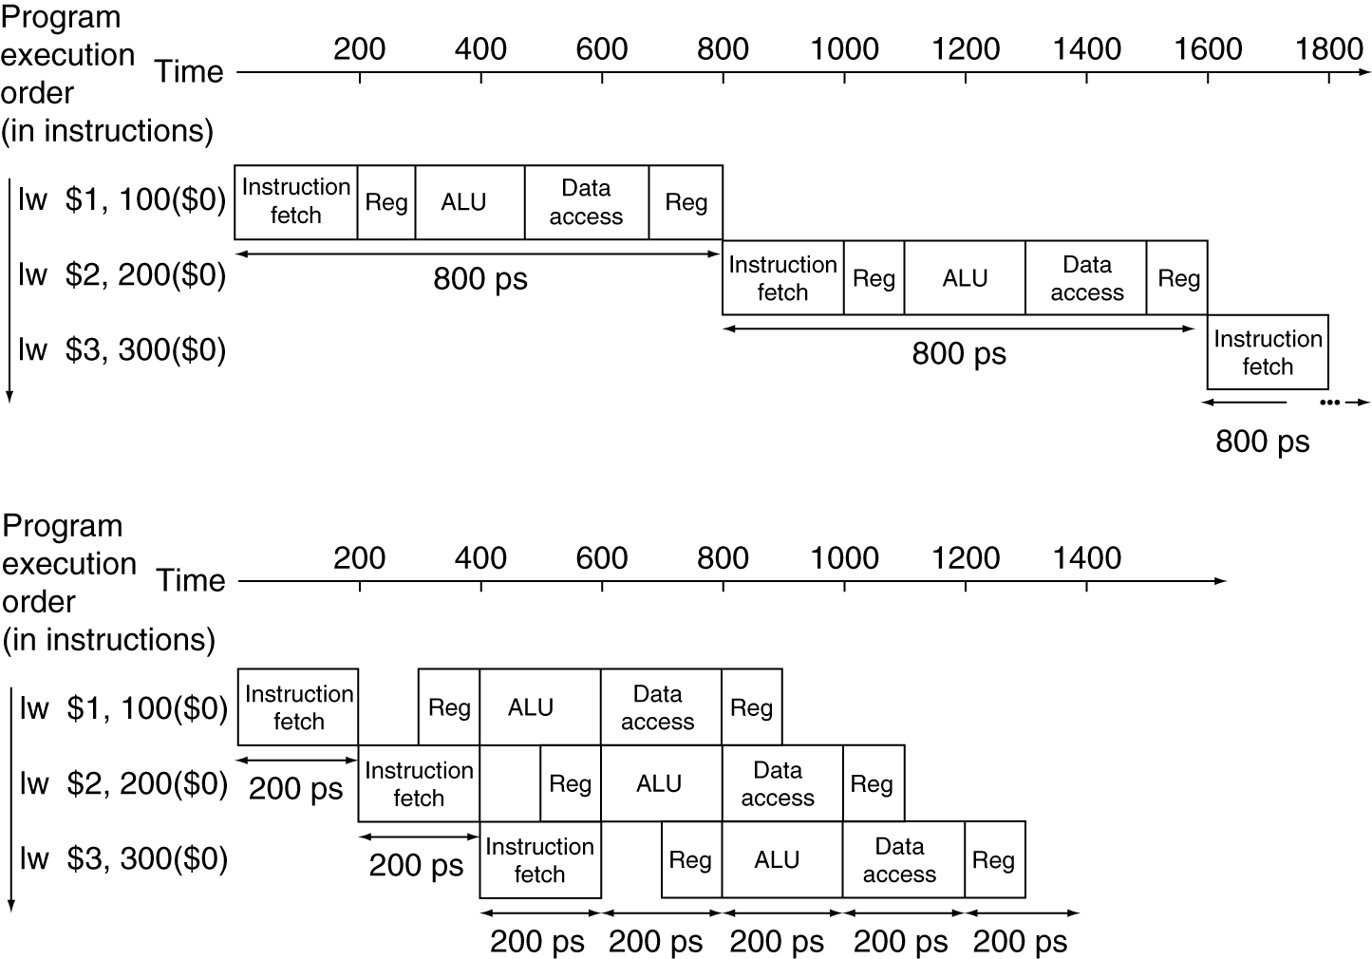
Pipelining Performance (3/3)
Single-cycle
T_{c} = 800 ps
f = 1.25GHz
Pipelined
T_{c} = 200 ps
f = 5GHz
Notes:
Here using T_{c} as “time between completion of instructions.”

Slide 8
Clicker/Peer Instruction
Logic in some stages takes 200ps and in some 100ps. Clk-Q delay is 30ps and setup-time is 20ps. What is the maximum clock frequency at which a pipelined design can operate?
A: 10GHz
B: 5GHz
C: 6.7GHz
D: 4.35GHz
E: 4GHz

Slide 9
Administrivia…
Start on Project 3-1 now
Logisim can be a bit, well, tedious: The project isn't necessarily hard but it will take a fair amount of time
Alternative would be to have you learn yet another programming language in this class!
For reference, it took Nick about an hour of tediously drawing lines for his solution to part 1
5 minutes to know what he wanted to do…
And 55 minutes to actually do it. ☹

Slide 10
Pipelining Hazards
A hazard is a situation that prevents starting the next instruction in the next clock cycle
Structural hazard
A required resource is busy (e.g. needed in multiple stages)
Data hazard
Data dependency between instructions
Need to wait for previous instruction to complete its data read/write
Control hazard
Flow of execution depends on previous instruction

Slide 11
Structural Hazard #1: Single Memory
Time (clock cycles)
I
n
s
t
r
O
r
d
e
r
Trying to read same memory twice in same clock cycle
Load
I$
Reg
ALU
D$
Reg
Instr 1
I$
Reg
ALU
D$
Reg
Instr 2
I$
Reg
ALU
D$
Reg
Instr 3
I$
Reg
ALU
D$
Reg
Instr 4
I$
Reg
ALU
D$
Reg

Slide 12
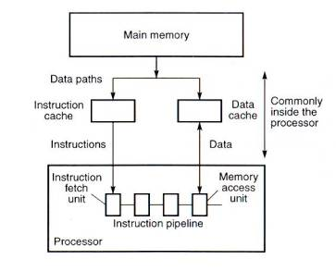
Solving Structural Hazard #1 with Caches

Slide 13
Structural Hazard #2: Registers (1/2)
Time (clock cycles)
I
n
s
t
r
O
r
d
e
r
Load
I$
Reg
ALU
D$
Reg
Can we read and write to registers simultaneously?
Instr 1
I$
Reg
ALU
D$
Reg
Instr 2
I$
Reg
ALU
D$
Reg
Instr 3
I$
Reg
ALU
D$
Reg
Instr 4
I$
Reg
ALU
D$
Reg

Slide 14
Structural Hazard #2: Registers (2/2)
Two different solutions have been used:
Split RegFile access in two: Write during 1st half and Read during 2nd half of each clock cycle
Possible because RegFile access is VERY fast (takes less than half the time of ALU stage)
Build RegFile with independent read and write ports (E.g. for your project)
Conclusion: Read and Write to registers during same clock cycle is okay
Structural hazards can (almost) always be removed by adding hardware resources

Slide 15
Data Hazards (1/2)
Consider the following sequence of instructions:
add $t0, $t1, $t2
sub $t4, $t0, $t3
and $t5, $t0, $t6
or $t7, $t0, $t8
xor $t9, $t0, $t10

Slide 16
2. Data Hazards (2/2)
Data-flow backwards in time are hazards
Time (clock cycles)
I
n
s
t
r
O
r
d
e
r
IF
ID/RF
EX
MEM
WB
add $t0,$t1,$t2
I$
Reg
ALU
D$
Reg
sub $t4,$t0,$t3
I$
Reg
ALU
D$
Reg
and $t5,$t0,$t6
I$
Reg
ALU
D$
Reg
or $t7,$t0,$t8
I$
Reg
ALU
D$
Reg
xor $t9,$t0,$t10
I$
Reg
ALU
D$
Reg

Slide 17
Data Hazard Solution: Forwarding
Forward result as soon as it is available
OK that it’s not stored in RegFile yet
IF
ID/RF
EX
MEM
WB
add $t0,$t1,$t2
I$
Reg
ALU
D$
Reg
sub $t4,$t0,$t3
I$
Reg
ALU
D$
Reg
and $t5,$t0,$t6
I$
Reg
ALU
D$
Reg
or $t7,$t0,$t8
I$
Reg
ALU
D$
Reg
xor $t9,$t0,$t10
I$
Reg
ALU
D$
Reg

Slide 18
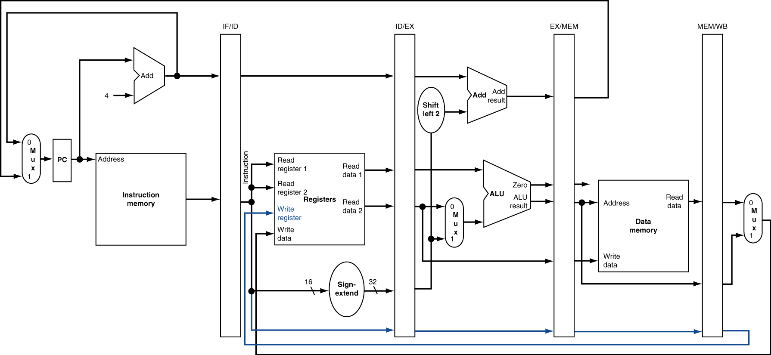
Datapath for Forwarding (1/2)
What changes need to be made here?

Slide 19
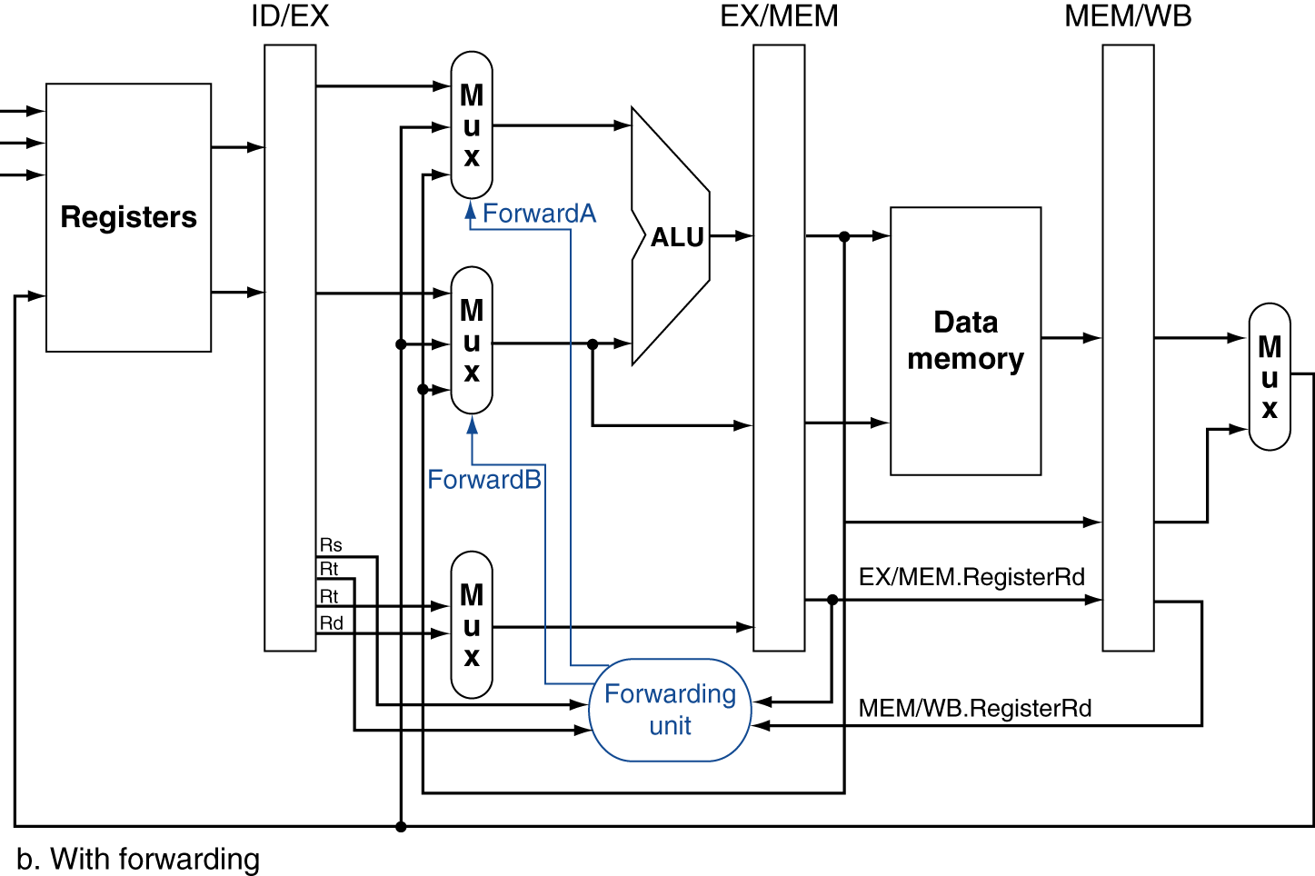
Datapath for Forwarding (2/2)
Handled by forwarding unit
Notes:
Scan figure 4.54 on p. 368.

Slide 20
Datapath and Control
The control signals are pipelined, too

Slide 21
Data Hazard: Loads (1/3)
Recall: Dataflow backwards in time are hazards
Can’t solve all cases with forwarding
Must stall instruction dependent on load, then forward (more hardware)
IF
ID/RF
EX
MEM
WB
lw $t0,0($t1)
I$
Reg
ALU
D$
Reg
sub $t3,$t0,$t2
I$
Reg
ALU
D$
Reg

Slide 22
Data Hazard: Loads (2/3)
Stalled instruction converted to “bubble”, acts like nop
lw $t0, 0($t1)
I$
Reg
ALU
D$
Reg
sub $t3,$t0,$t2
bubble
bubble
bubble
I$
Reg
sub $t3,$t0,$t2
I$
Reg
ALU
D$
Reg
and $t5,$t0,$t4
I$
Reg
ALU
Reg
D$
First two pipe stages stall by repeating stage one cycle later
or $t7,$t0,$t6
I$
Reg
ALU
D$

Slide 23
Data Hazard: Loads (4/4)
Slot after a load is called a load delay slot
If that instruction uses the result of the load, then the hardware interlock will stall it for one cycle
Letting the hardware stall the instruction in the delay slot is equivalent to putting an explicit nop in the slot (except the latter uses more code space)
Idea: Let the compiler put an unrelated instruction in that slot → no stall!

Slide 24
Clicker Question
How many cycles (pipeline fill+process+drain) does it take to execute the following code?
lw $t1, 0($t0)
lw $t2, 4($t0)
add $t3, $t1, $t2
sw $t3, 12($t0)
lw $t4, 8($t0)
add $t5, $t1, $t4
sw $t5, 16($t0)
7
9
11
13
14

Slide 25
Code Scheduling to Avoid Stalls
Reorder code to avoid use of load result in the next instruction!
MIPS code for D=A+B; E=A+C;
# Method 1:
lw $t1, 0($t0)
lw $t2, 4($t0)
add $t3, $t1, $t2
sw $t3, 12($t0)
lw $t4, 8($t0)
add $t5, $t1, $t4
sw $t5, 16($t0)
# Method 2:
lw $t1, 0($t0)
lw $t2, 4($t0)
lw $t4, 8($t0)
add $t3, $t1, $t2
sw $t3, 12($t0)
add $t5, $t1, $t4
sw $t5, 16($t0)
Stall!
Stall!
13 cycles
11 cycles

Slide 26
3. Control Hazards
Branch determines flow of control
Fetching next instruction depends on branch outcome
Pipeline can’t always fetch correct instruction
Still working on ID stage of branch
BEQ, BNE in MIPS pipeline
Simple solution Option 1: Stall on every branch until branch condition resolved
Would add 2 bubbles/clock cycles for every Branch! (~ 20% of instructions executed)

Slide 27
Stall => 2 Bubbles/Clocks
Time (clock cycles)
I
n
s
t
r.
O
r
d
e
r
beq
I$
Reg
ALU
D$
Reg
Instr 1
I$
Reg
ALU
D$
Reg
Instr 2
I$
Reg
ALU
D$
Reg
Instr 3
I$
Reg
ALU
D$
Reg
Instr 4
I$
Reg
ALU
D$
Reg
Where do we do the compare for the branch?

Slide 28
Control Hazard: Branching
Optimization #1:
Insert special branch comparator in Stage 2
As soon as instruction is decoded (Opcode identifies it as a branch), immediately make a decision and set the new value of the PC
Benefit: since branch is complete in Stage 2, only one unnecessary instruction is fetched, so only one no-op is needed
Side Note: means that branches are idle in Stages 3, 4 and 5

Slide 29
One Clock Cycle Stall
Time (clock cycles)
I
n
s
t
r.
O
r
d
e
r
beq
I$
Reg
ALU
D$
Reg
Instr 1
I$
Reg
ALU
D$
Reg
Instr 2
I$
Reg
ALU
D$
Reg
Instr 3
I$
Reg
ALU
D$
Reg
Instr 4
I$
Reg
ALU
D$
Reg
Branch comparator moved to Decode stage.

Slide 30
Control Hazards: Branching
Option 2: Predict outcome of a branch, fix up if guess wrong
Must cancel all instructions in pipeline that depended on guess that was wrong
This is called “flushing” the pipeline
Simplest hardware if we predict that all branches are NOT taken
Why?

Slide 31
Control Hazards: Branching
Option #3: Redefine branches
Old definition: if we take the branch, none of the instructions after the branch get executed by accident
New definition: whether or not we take the branch, the single instruction immediately following the branch gets executed (the branch-delay slot)
Delayed Branch means we always execute inst after branch
This optimization is used with MIPS

Slide 32
Example: Nondelayed vs. Delayed Branch
Nondelayed Branch
Delayed Branch
or $8, $9, $10
add $1, $2,$3
add $1, $2, $3
sub $4, $5, $6
sub $4, $5, $6
beq $1, $4, Exit
beq $1, $4, Exit
or $8, $9, $10
xor $10, $1, $11
xor $10, $1, $11
Exit:
Exit:

Slide 33
Control Hazards: Branching
Notes on Branch-Delay Slot
Worst-Case Scenario: put a nop in the branch-delay slot
Better Case: place some instruction preceding the branch in the branch-delay slot—as long as the changed doesn’t affect the logic of program
Re-ordering instructions is common way to speed up programs
Compiler usually finds such an instruction 50% of time
Jumps also have a delay slot …

Slide 34
Greater Instruction-Level Parallelism (ILP)
Deeper pipeline (5 => 10 => 15 stages)
Less work per stage ⇒ shorter clock cycle
Multiple issue “superscalar”
Replicate pipeline stages ⇒ multiple pipelines
Start multiple instructions per clock cycle
CPI < 1, so use Instructions Per Cycle (IPC)
E.g., 4GHz 4-way multiple-issue
16 BIPS, peak CPI = 0.25, peak IPC = 4
But dependencies reduce this in practice
“Out-of-Order” execution
Reorder instructions dynamically in hardware to reduce impact of hazards
"Multithreading"
Share functional units between independent threads of execution
Take CS152 next to learn about these techniques!

Slide 35
In Conclusion
Pipelining increases throughput by overlapping execution of multiple instructions in different pipestages
Pipestages should be balanced for highest clock rate
Three types of pipeline hazard limit performance
Structural (always fixable with more hardware)
Data (use interlocks or bypassing to resolve)
Control (reduce impact with branch prediction or branch delay slots)

