Slide 1
CS 61C: Great Ideas in Computer Architecture Control and Pipelining
Instructors:
Vladimir Stojanovic and Nicholas Weaver
http://inst.eecs.Berkeley.edu/~cs61c/sp16

Slide 2
Datapath Control Signals
ExtOp: “zero”, “sign”
ALUsrc: 0 ⇒ regB; 1 ⇒ immed
ALUctr: “ADD”, “SUB”, “OR”
MemWr: 1 ⇒ write memory
MemtoReg: 0 ⇒ ALU; 1 ⇒ Mem
RegDst: 0 ⇒ “rt”; 1 ⇒ “rd”
RegWr: 1 ⇒ write register
RegDst
Rd
Rt
ALUctr
MemtoReg
Inst Address
1
0
MemWr
nPC_sel & Equal
RegWr
Rs
Rt
4
5
5
5
Rw
Ra
Rb
busA
32
Adder
busW
0
00
32
32
RegFile
busB
ALU
0
Mux
PC
0
clk
32
1
32
WrEn
Adr
Adder
Imm16
Data In
clk
Extender
1
Data
Memory
1
PC Ext
16
32
ALUSrc
clk
ExtOp
Imm16

Slide 3
Summary of the Control Signals (1/2)
inst Register Transfer
add R[rd] ← R[rs] + R[rt]; PC ← PC + 4
ALUsrc=RegB, ALUctr=“ADD”, RegDst=rd, RegWr, nPC_sel=“+4”
sub R[rd] ← R[rs] – R[rt]; PC ← PC + 4
ALUsrc=RegB, ALUctr=“SUB”, RegDst=rd, RegWr, nPC_sel=“+4”
ori R[rt] ← R[rs] + zero_ext(Imm16); PC ← PC + 4
ALUsrc=Im, Extop=“Z”, ALUctr=“OR”, RegDst=rt,RegWr, nPC_sel=“+4”
lw R[rt] ← MEM[ R[rs] + sign_ext(Imm16)]; PC ← PC + 4
ALUsrc=Im, Extop=“sn”, ALUctr=“ADD”, MemtoReg, RegDst=rt, RegWr, nPC_sel = “+4”
sw MEM[ R[rs] + sign_ext(Imm16)] ← R[rs]; PC ← PC + 4
ALUsrc=Im, Extop=“sn”, ALUctr = “ADD”, MemWr, nPC_sel = “+4”
beq if (R[rs] == R[rt]) then PC ← PC + sign_ext(Imm16)] || 00 else PC ← PC + 4
nPC_sel = “br”, ALUctr = “SUB”

Slide 4
Summary of the Control Signals (2/2)
See
func
10 0000
10 0010
We Don’t Care :-)
Appendix A
op
00 0000
00 0000
00 1101
10 0011
10 1011
00 0100
00 0010
add
sub
ori
lw
sw
beq
jump
RegDst
1
1
0
0
x
x
x
ALUSrc
0
0
1
1
1
0
x
MemtoReg
0
0
0
1
x
x
x
RegWrite
1
1
1
1
0
0
0
MemWrite
0
0
0
0
1
0
0
nPCsel
0
0
0
0
0
1
?
Jump
0
0
0
0
0
0
1
ExtOp
x
x
0
1
1
x
x
ALUctr<2:0>
Add
Subtract
Or
Add
Add
Subtract
x
31
26
21
16
11
6
0
R-type
op
rs
rt
rd
shamt
funct
add, sub
I-type
op
rs
rt
immediate
ori, lw, sw, beq
J-type
op
target address
jump
Notes:
Here is a table summarizing the control signals setting for the seven (add, sub, ...) instructions we have looked at.
Instead of showing you the exact bit values for the ALU control (ALUctr), I have used the symbolic values here.
The first two columns are unique in the sense that they are R-type instrucions and in order to uniquely identify them, we need to look at BOTH the op field as well as the func fiels.
Ori, lw, sw, and branch on equal are I-type instructions and Jump is J-type. They all can be uniquely idetified by looking at the opcode field alone.
Now let’s take a more careful look at the first two columns. Notice that they are identical except the last row.
So we can combine these two rows here if we can “delay” the generation of ALUctr signals.
This lead us to something call “local decoding.”
+3 = 42 min. (Y:22)

Slide 5
Boolean Expressions for Controller
RegDst = add + sub ALUSrc = ori + lw + sw MemtoReg = lw RegWrite = add + sub + ori + lw MemWrite = sw nPCsel = beq Jump = jump ExtOp = lw + sw ALUctr[0] = sub + beq (assume ALUctr is 00 ADD, 01 SUB, 10 OR) ALUctr[1] = or
Where:
rtype = ~op₅ • ~op₄ • ~op₃ • ~op₂ • ~op₁ • ~op₀, ori = ~op₅ • ~op₄ • op₃ • op₂ • ~op₁ • op₀ lw = op₅ • ~op₄ • ~op₃ • ~op₂ • op₁ • op₀ sw = op₅ • ~op₄ • op₃ • ~op₂ • op₁ • op₀ beq = ~op₅ • ~op₄ • ~op₃ • op₂ • ~op₁ • ~op₀ jump = ~op₅ • ~op₄ • ~op₃ • ~op₂ • op₁ • ~op₀
add = rtype • func₅ • ~func₄ • ~func₃ • ~func₂ • ~func₁ • ~func₀ sub = rtype • func₅ • ~func₄ • ~func₃ • ~func₂ • func₁ • ~func₀
How do we implement this in gates?
Notes:
ADD 0000 00ss ssst tttt dddd d000 0010 0000
SUB 0000 00ss ssst tttt dddd d000 0010 0010
ORI 0011 01ss ssst tttt iiii iiii iiii iiii
LW 1000 11ss ssst tttt iiii iiii iiii iiii
SW 1010 11ss ssst tttt iiii iiii iiii iiii
BEQ 0001 00ss ssst tttt iiii iiii iiii iiii
JUMP 0000 10ii iiii iiii iiii iiii iiii iiii

Slide 6
Controller Implementation
opcode
func
add
RegDst
ALUSrc
sub
MemtoReg
ori
RegWrite
“AND” logic
lw
“OR” logic
MemWrite
sw
nPCsel
Jump
beq
ExtOp
jump
ALUctr[0]
ALUctr[1]

Slide 7
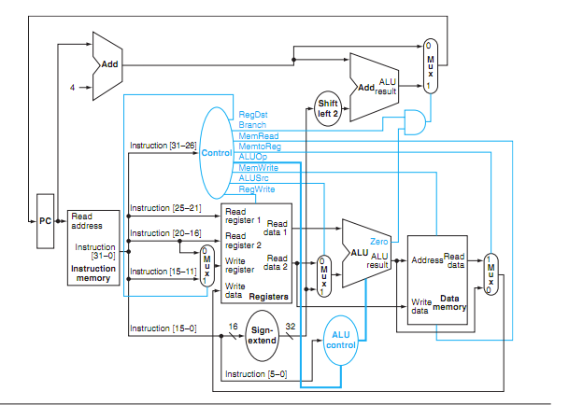
P&H Figure 4.17

Slide 8
Summary: Single-cycle Processor
Five steps to design a processor:
1. Analyze instruction set → datapath requirements
2. Select set of datapath components & establish clock methodology
3. Assemble datapath meeting the requirements
4. Analyze implementation of each instruction to determine setting of control points that effects the register transfer.
5. Assemble the control logic
Formulate Logic Equations
Design Circuits
Processor
Input
Control
Memory
Datapath
Output

Slide 9
Single Cycle Performance
Assume time for actions are
100ps for register read or write; 200ps for other events
Clock period is?
Instr | Instr fetch | Register read | ALU op | Memory access | Register write | Total time
lw | 200ps | 100 ps | 200ps | 200ps | 100 ps | 800ps
sw | 200ps | 100 ps | 200ps | 200ps |  | 700ps
R-format | 200ps | 100 ps | 200ps |  | 100 ps | 600ps
beq | 200ps | 100 ps | 200ps |  |  | 500ps
Clock rate (cycles/second = Hz) = 1/Period (seconds/cycle)
Notes:
1.25 GHz

Slide 10
Single Cycle Performance
Assume time for actions are
100ps for register read or write; 200ps for other events
Clock period is?
Instr | Instr fetch | Register read | ALU op | Memory access | Register write | Total time
lw | 200ps | 100 ps | 200ps | 200ps | 100 ps | 800ps
sw | 200ps | 100 ps | 200ps | 200ps |  | 700ps
R-format | 200ps | 100 ps | 200ps |  | 100 ps | 600ps
beq | 200ps | 100 ps | 200ps |  |  | 500ps
What can we do to improve clock rate?
Will this improve performance as well?
Want increased clock rate to mean faster programs
Notes:
1.25 GHz

Slide 11
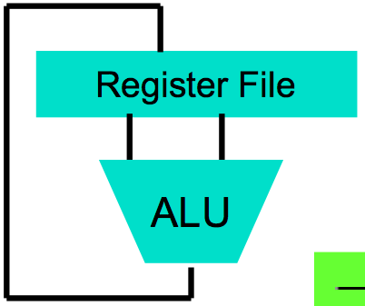
Levels of Representation/Interpretation
High Level Language Program (e.g., C)
temp = v[k];
v[k] = v[k+1];
v[k+1] = temp;
Compiler
Anything can be represented as a number, i.e., data or instructions
lw $t0, 0($2)
lw $t1, 4($2)
sw $t1, 0($2)
sw $t0, 4($2)
Assembly Language Program (e.g., MIPS)
Assembler
0000 1001 1100 0110 1010 1111 0101 1000
1010 1111 0101 1000 0000 1001 1100 0110
1100 0110 1010 1111 0101 1000 0000 1001
0101 1000 0000 1001 1100 0110 1010 1111
Machine Language Program (MIPS)
Machine Interpretation
Hardware Architecture Description (e.g., block diagrams)
Architecture Implementation
Logic Circuit Description (Circuit Schematic Diagrams)

Slide 12
No More Magic!
CS61A
CS61B
CS61C ✔
CS61C ✔
CS61C ✔
CS61C ⬅
CS61C ✔
EE40
Phys 7B
Application (ex: browser)
Operating
Compiler
System
(Mac OSX)
Software
Assembler
Instruction Set Architecture
Hardware
Processor
Memory
I/O system
Datapath & Control
Digital Design
Circuit Design
transistors

Slide 13
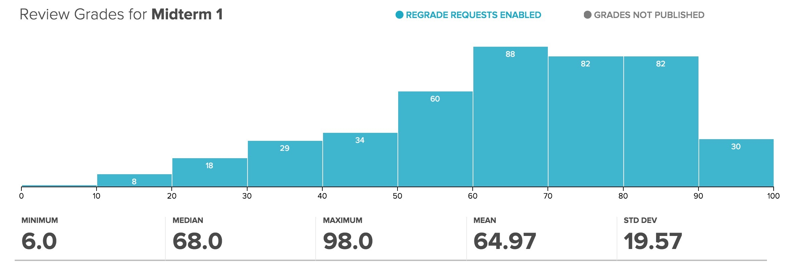
Administrivia
Project 2-2 due 3/8 @ 23:59:59 (Tue)
Guerrilla Sessions: MIPS CPU
Wed 3/09 3 - 5 PM @ 241 Cory
Sat 3/12 1 - 3 PM @ 651 @ 611 Soda

Slide 14
Gotta Do Laundry
Ann, Brian, Cathy, Dave each have one load of clothes to wash, dry, fold, and put away
Washer takes 30 minutes
Dryer takes 30 minutes
“Folder” takes 30 minutes
“Stasher” takes 30 minutes to put clothes into drawers
A
B
C
D

Slide 15
Sequential Laundry
Sequential laundry takes 8 hours for 4 loads
6 PM
7
8
9
10
11
12
1
2 AM
T
a
s
k
O
r
d
e
r
30
30
30
30
30
30
30
30
30
30
30
30
30
30
30
30
Time
A
B
C
D

Slide 16
Pipelined Laundry
Pipelined laundry takes 3.5 hours for 4 loads!
6 PM
7
8
9
10
11
12
1
2 AM
30
30
30
30
30
Time
T
a
s
k
O
r
d
e
r
30
30
A
B
C
D

Slide 17
Pipelining Lessons (1/2)
6 PM
7
8
9
Pipelining doesn’t help latency of single task, it helps throughput of entire workload
Multiple tasks operating simultaneously using different resources
Potential speedup = Number pipe stages
Time to “fill” pipeline and time to “drain” it reduces speedup: 2.3x (8/3.5) v. 4x (8/2) in this example
T
a
s
k
O
r
d
e
r
Time
30
30
30
30
30
30
30
A
B
C
D

Slide 18
Pipelining Lessons (2/2)
6 PM
7
8
9
Suppose new Washer takes 20 minutes, new Stasher takes 20 minutes. How much faster is pipeline?
Pipeline rate limited by slowest pipeline stage
Unbalanced lengths of pipe stages reduces speedup
T
a
s
k
O
r
d
e
r
Time
30
30
30
30
30
30
30
A
B
C
D

Slide 19
Execution Steps in MIPS Datapath
1) IFtch: Instruction Fetch, Increment PC
2) Dcd: Instruction Decode, Read Registers
3) Exec: Mem-ref: Calculate Address Arith-log: Perform Operation
4) Mem: Load: Read Data from Memory Store: Write Data to Memory
5) WB: Write Data Back to Register

Slide 20
Single Cycle Datapath
rd
PC
instruction
memory
registers
rs
Data
memory
rt
ALU
+4
imm
2. Decode/
Register Read
1. Instruction
Fetch
5. Write Back
3. Execute
4. Memory

Slide 21
Pipeline registers
rd
PC
instruction
memory
registers
rs
Data
memory
rt
ALU
+4
imm
2. Decode/
Register Read
1. Instruction
Fetch
5. Write Back
3. Execute
4. Memory
Need registers between stages
To hold information produced in previous cycle

Slide 22
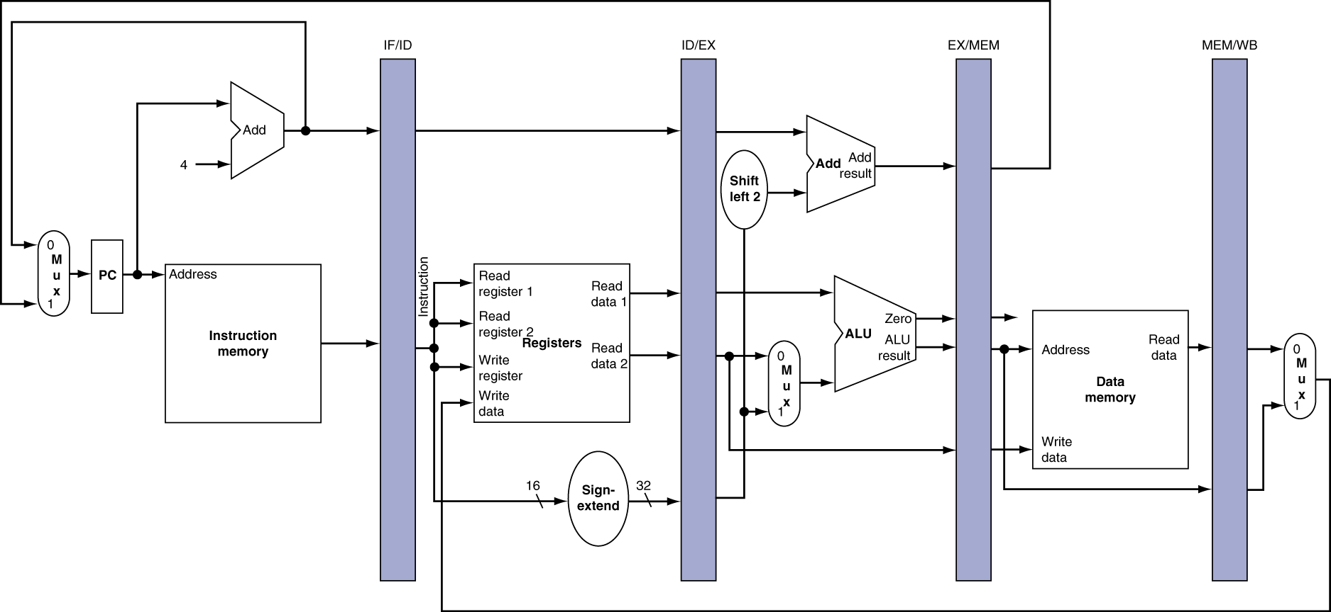
More Detailed Pipeline

Slide 23
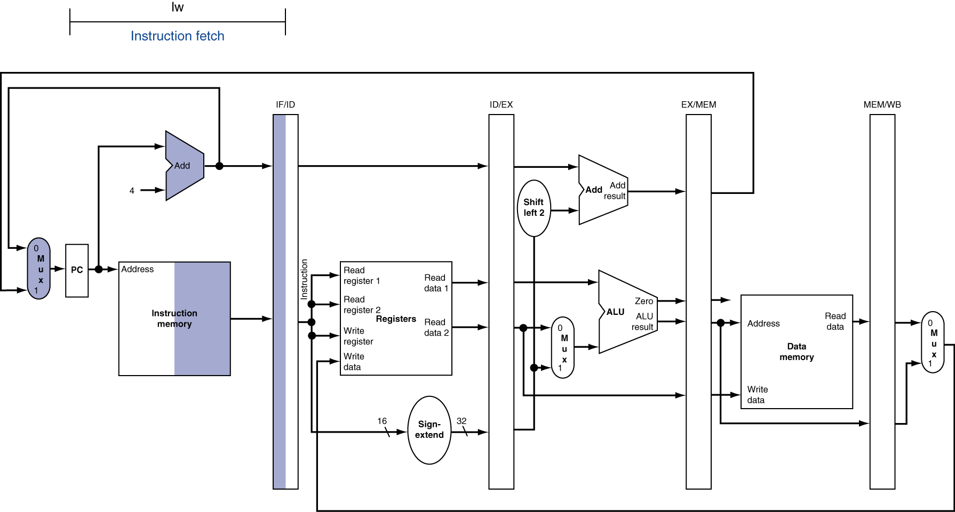
IF for Load, Store, …

Slide 24
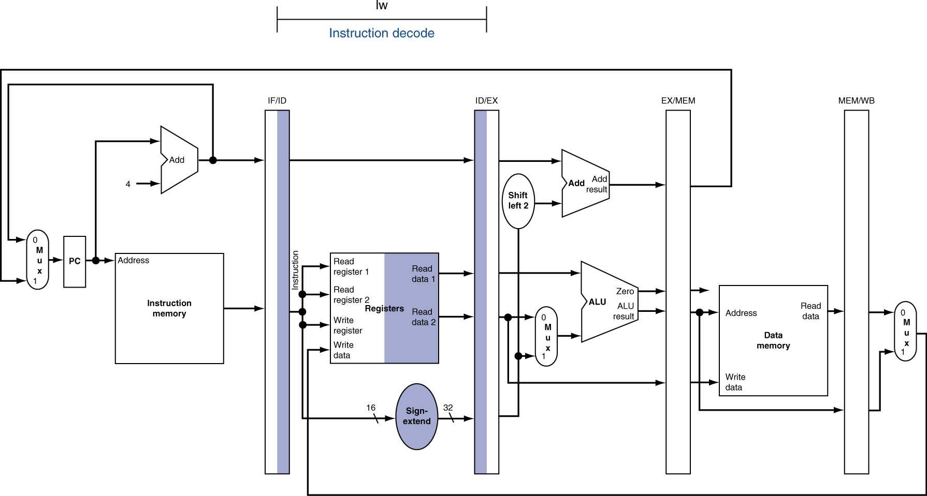
ID for Load, Store, …

Slide 25
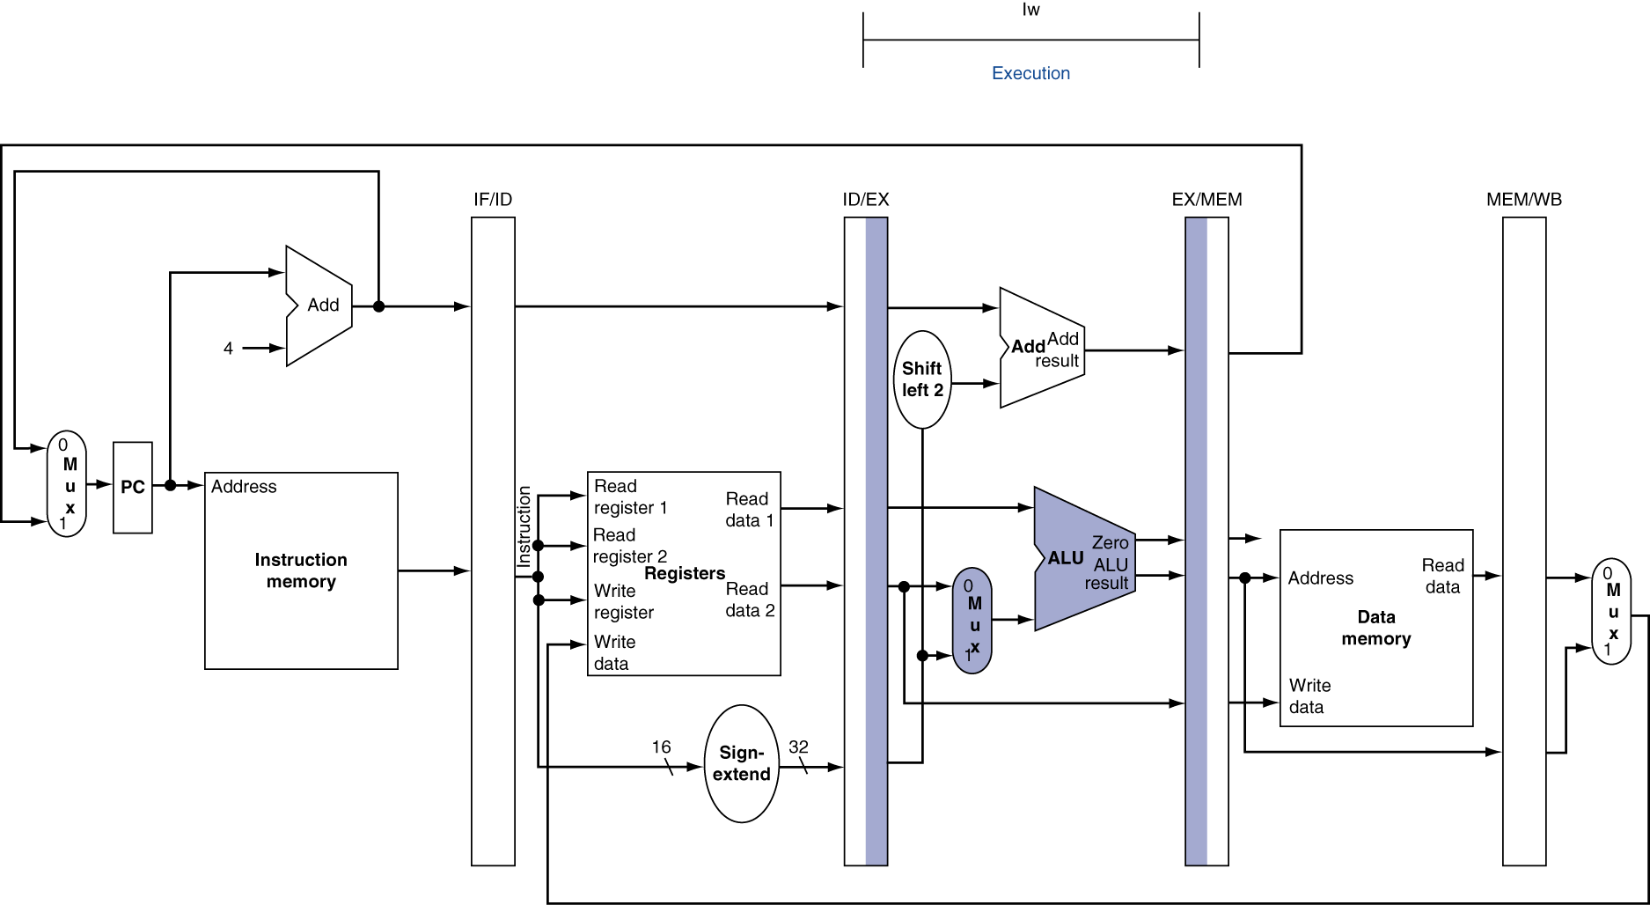
EX for Load

Slide 26
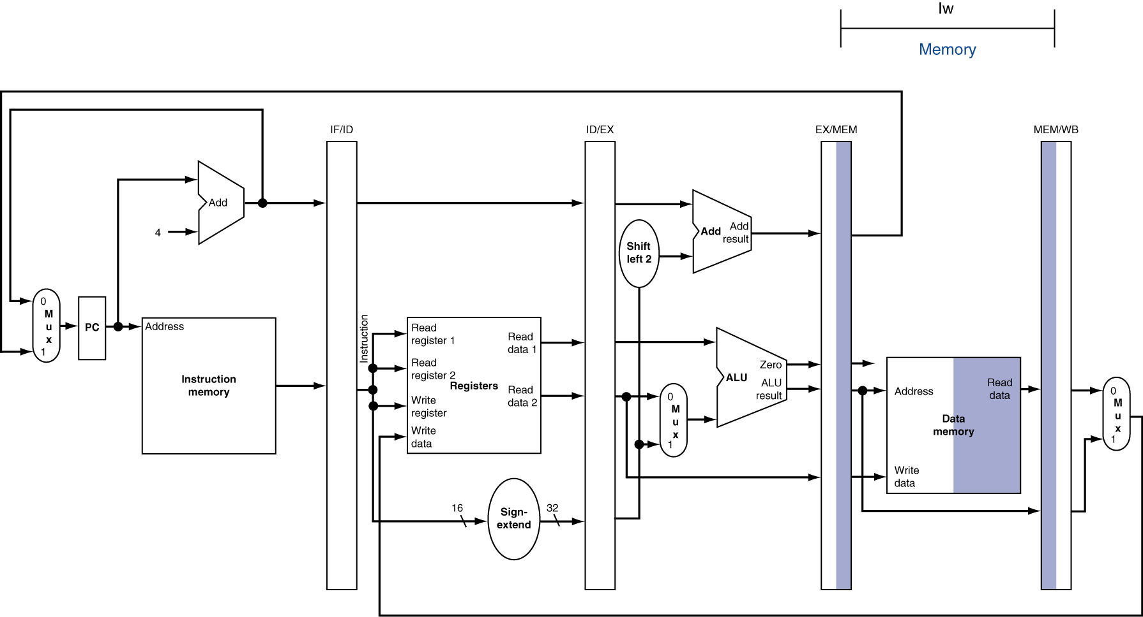
MEM for Load

Slide 27
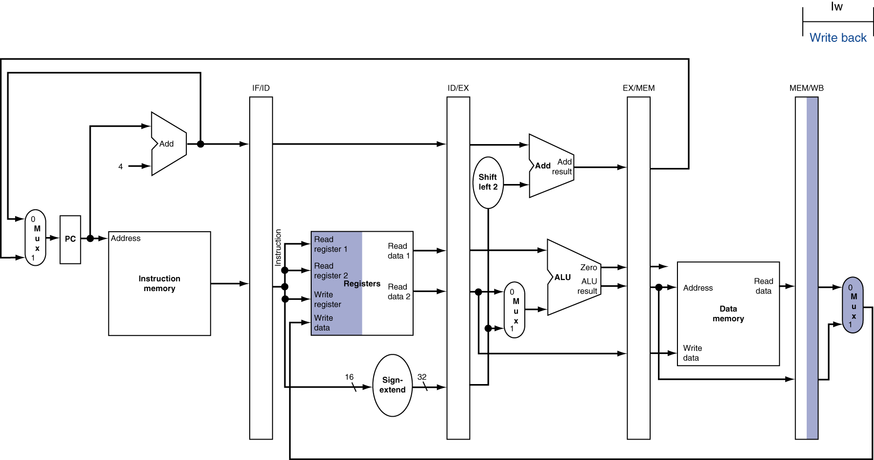
WB for Load – Oops!
Wrong register number!

Slide 28
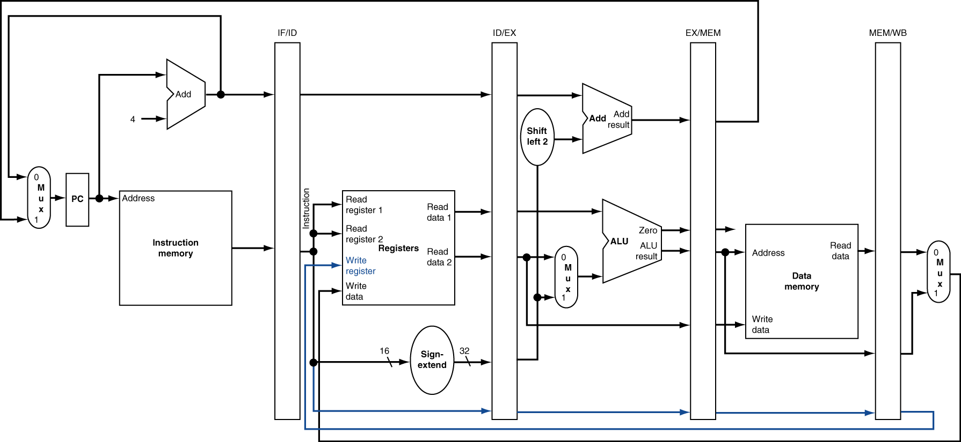
Corrected Datapath for Load

Slide 29
Pipelined Execution Representation
Time
IF
ID
EX
MEM
WB
IF
ID
EX
MEM
WB
IF
ID
EX
MEM
WB
IF
ID
EX
MEM
WB
IF
ID
EX
MEM
WB
IF
ID
EX
MEM
WB
Every instruction must take same number of steps, so some stages will idle
e.g. MEM stage for any arithmetic instruction
Notes:
Each instruction has identical latency!

Slide 30
Graphical Pipeline Diagrams
rd
Register
File
ALU
PC
instruction
memory
rs
Data
memory
rt
+4
imm
MUX
1. Instruction
Fetch
2. Decode/
Register Read
3. Execute
4. Memory
5. Write
Back
Use datapath figure below to represent pipeline:
IF
ID
EX
Mem
WB
I$
Reg
ALU
D$
Reg

Slide 31
Graphical Pipeline Representation
RegFile: left half is write, right half is read
Time (clock cycles)
I
n
s
t
r
O
r
d
e
r
Load
I$
Reg
ALU
D$
Reg
Add
I$
Reg
ALU
D$
Reg
Store
I$
Reg
ALU
D$
Reg
Sub
I$
Reg
ALU
D$
Reg
Or
I$
Reg
ALU
D$
Reg

Slide 32
Pipelining Performance (1/3)
Use T_{c} (“time between completion of instructions”) to measure speedup
Equality only achieved if stages are balanced (i.e. take the same amount of time)
If not balanced, speedup is reduced
Speedup due to increased throughput
Latency for each instruction does not decrease

Slide 33
Pipelining Performance (2/3)
Assume time for stages is
100ps for register read or write
200ps for other stages
What is pipelined clock rate?
Compare pipelined datapath with single-cycle datapath
Instr | Instr fetch | Register read | ALU op | Memory access | Register write | Total time
lw | 200ps | 100 ps | 200ps | 200ps | 100 ps | 800ps
sw | 200ps | 100 ps | 200ps | 200ps |  | 700ps
R-format | 200ps | 100 ps | 200ps |  | 100 ps | 600ps
beq | 200ps | 100 ps | 200ps |  |  | 500ps

Slide 34
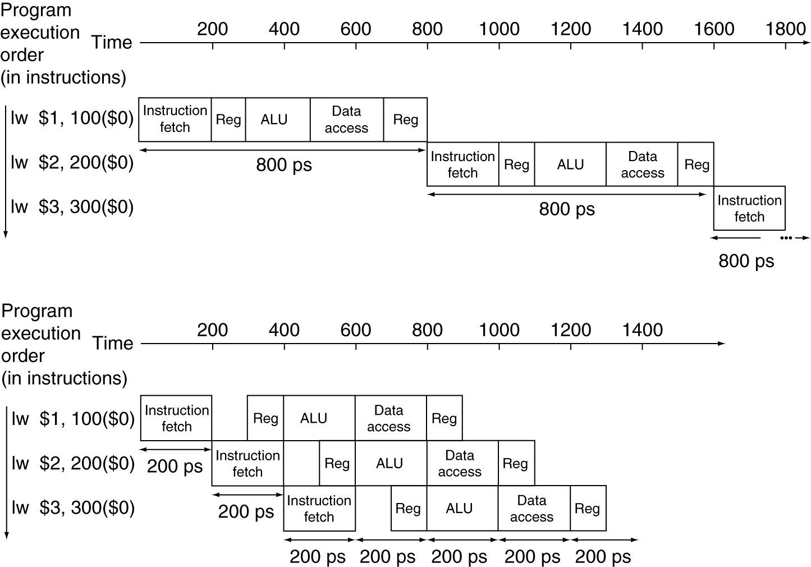
Pipelining Performance (3/3)
Single-cycle
T_{c} = 800 ps
f = 1.25GHz
Pipelined
T_{c} = 200 ps
f = 5GHz
Notes:
Here using T_{c} as “time between completion of instructions.”

Slide 35
Clicker/Peer Instruction
Logic in some stages takes 200ps and in some 100ps. Clk-Q delay is 30ps and setup-time is 20ps. What is the maximum clock frequency at which a pipelined design can operate?
A: 10GHz
B: 5GHz
C: 6.7GHz
D: 4.35GHz
E: 4GHz

