Slide 1
CS 61C: Great Ideas in Computer Architecture MIPS Datapath
Instructors:
Nicholas Weaver & Vladimir Stojanovic
http://inst.eecs.Berkeley.edu/~cs61c/sp16

Slide 2
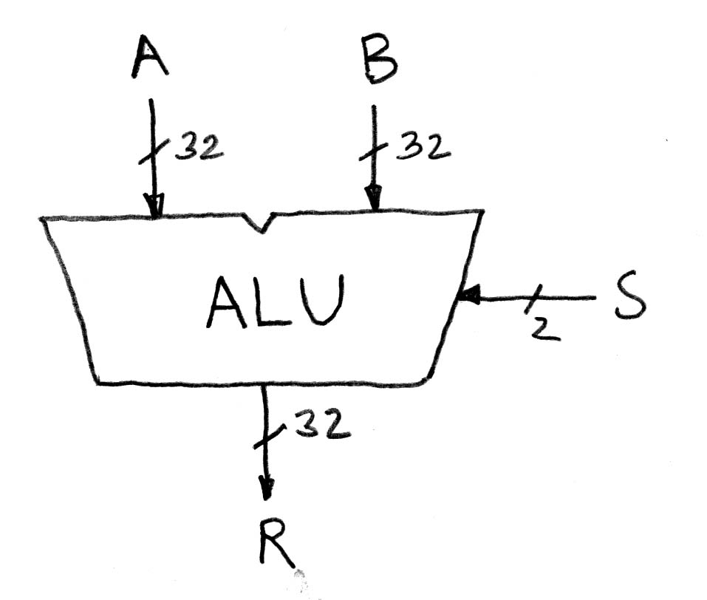
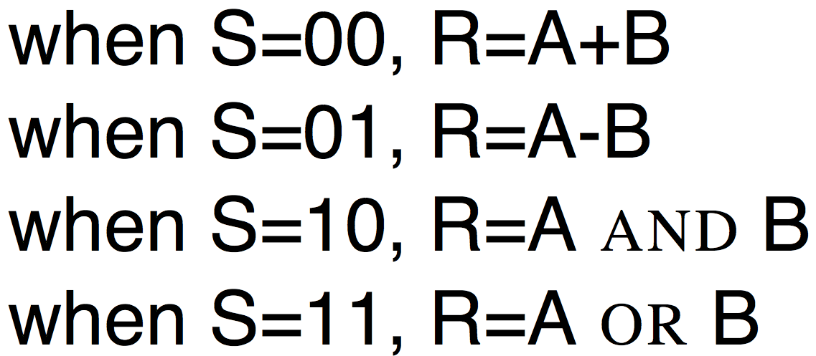
Arithmetic and Logic Unit
Most processors contain a special logic block called the “Arithmetic and Logic Unit” (ALU)
We’ll show you an easy one that does ADD, SUB, bitwise AND, bitwise OR

Slide 3
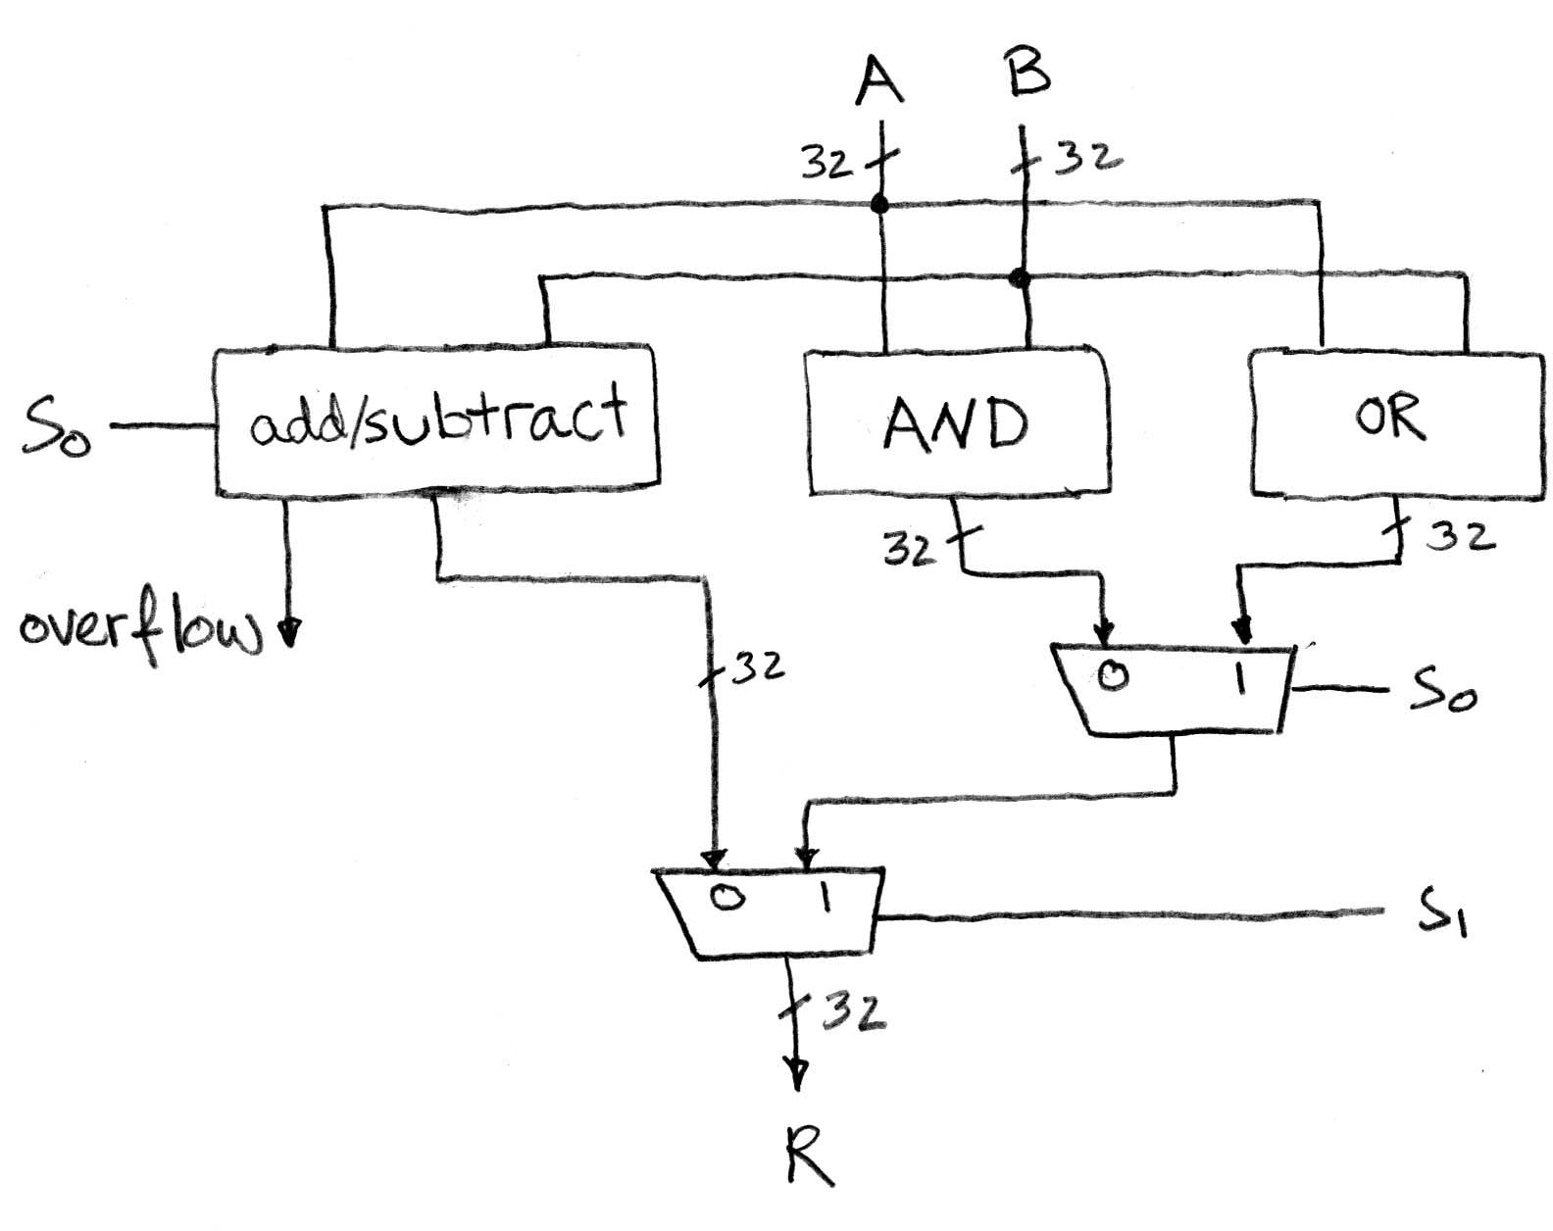
Our simple ALU

Slide 4
How to design Adder/Subtractor?
Truth-table, then determine canonical form, then minimize and implement as we’ve seen before
Look at breaking the problem down into smaller pieces that we can cascade or hierarchically layer

Slide 5
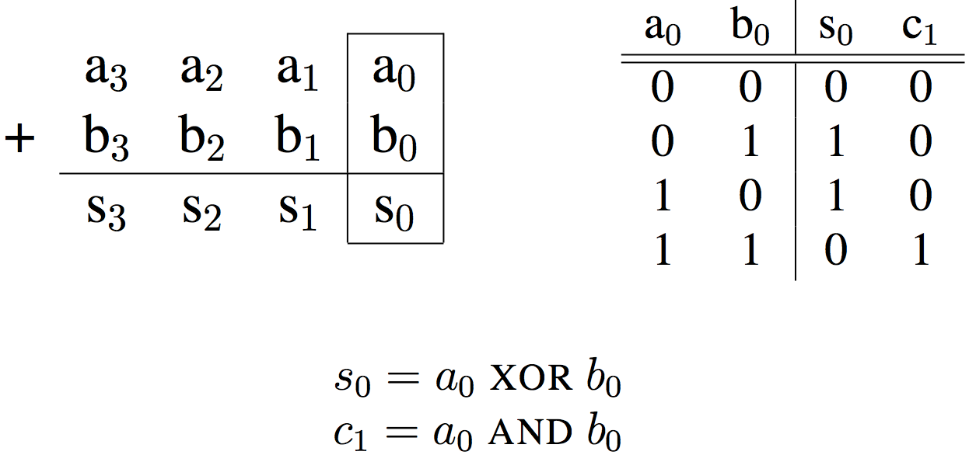
Adder/Subtractor – One-bit adder LSB… (Half Adder)

Slide 6
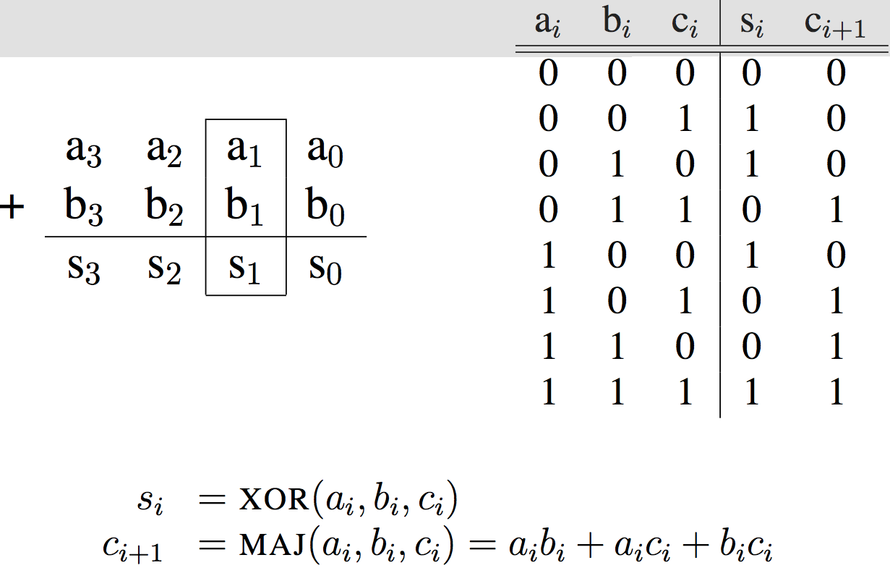
Adder/Subtractor – One-bit full-adder (1/2)…

Slide 7
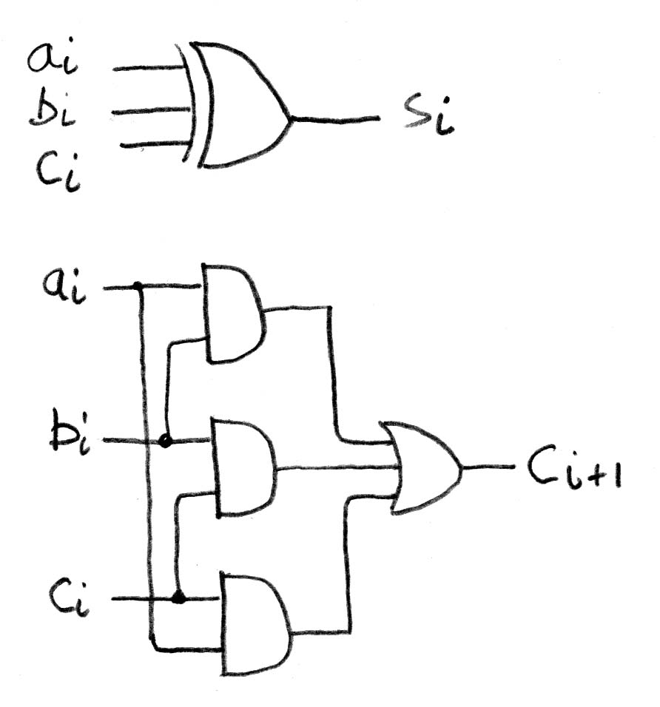
Adder/Subtractor – One-bit adder (2/2)

Slide 8
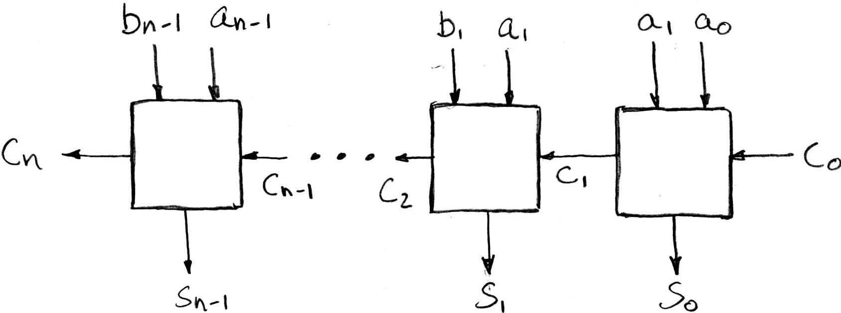
N 1-bit adders ⇒ 1 N-bit adder
b₀
+
+
+
What about overflow?
Overflow = c_{n}?

Slide 9
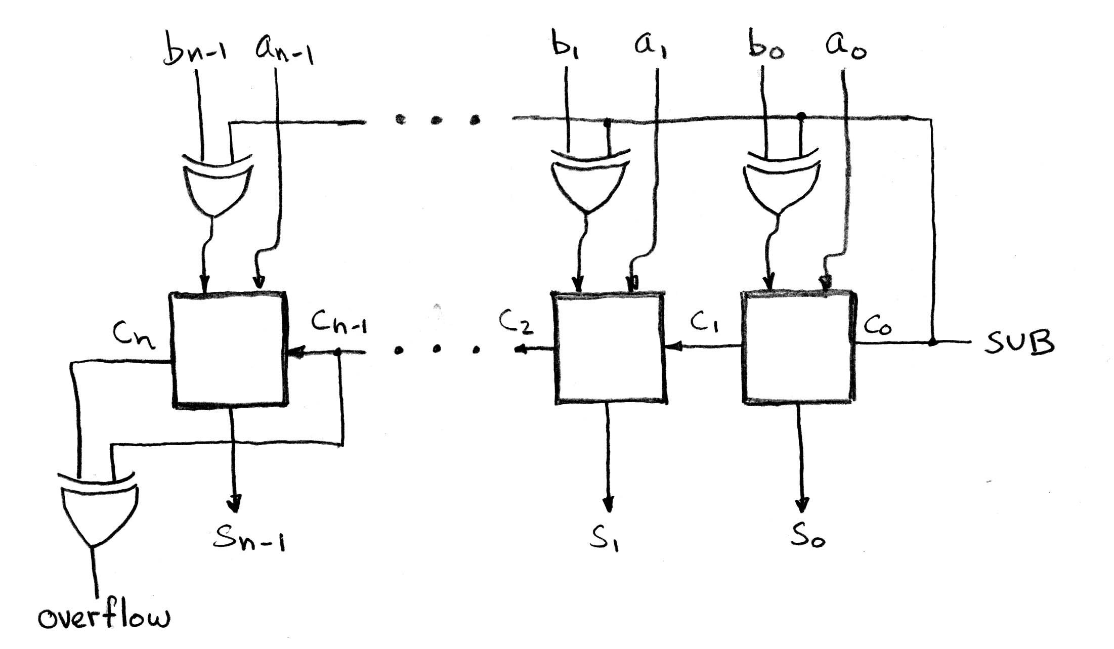
Extremely Clever Adder/Subtractor
+
+
+
XOR serves as conditional inverter!
Aka "Subtract is Invert and add 1"
x | y | XOR(x,y)
0 | 0 | 0
0 | 1 | 1
1 | 0 | 1
1 | 1 | 0

Slide 10
Clicker Question
Convert the truth table to a boolean expression
(no need to simplify):
A: F = xy + x(~y)
B: F = xy + (~x)y + (~x)(~y)
C: F = (~x)y + x(~y)
D: F = xy + (~x)y
E: F = (x+y)(~x+~y)
x | y | F(x,y)
0 | 0 | 0
0 | 1 | 1
1 | 0 | 0
1 | 1 | 1

Slide 11
Administrivia
Project 2-2 is out!

Slide 12
Components of a Computer
Memory
Processor
Input
Enable?
Read/Write
Control
Program
Datapath
Address
Bytes
PC
Registers
Write Data
Data
Arithmetic & Logic Unit
(ALU)
ReadData
Output
Processor-Memory Interface
I/O-Memory Interfaces

Slide 13
The CPU
Processor (CPU): the active part of the computer that does all the work (data manipulation and decision-making)
Datapath: portion of the processor that contains hardware necessary to perform operations required by the processor (the brawn)
Control: portion of the processor (also in hardware) that tells the datapath what needs to be done (the brain)

Slide 14
Datapath and Control
Datapath designed to support data transfers required by instructions
Controller causes correct transfers to happen
rd
PC
instruction
memory
registers
rs
Data
memory
rt
ALU
+4
imm
opcode, funct
Controller

Slide 15
Five Stages of Instruction Execution
Stage 1: Instruction Fetch
Stage 2: Instruction Decode
Stage 3: ALU (Arithmetic-Logic Unit)
Stage 4: Memory Access
Stage 5: Register Write

Slide 16
Stages of Execution on Datapath
rd
PC
instruction
memory
registers
rs
Data
memory
rt
ALU
+4
imm
2. Decode/
Register
Read
3. Execute
4. Memory
1. Instruction
Fetch
5. Register
Write
Notes:
missing: multiplexors or “data selectors” – where should they be in this picture and why?
also missing – opcode for control of what operations to perform
state elements vs combinational ones – combinational given the same input will always produce the same output – out depends only on the current input

Slide 17
Stages of Execution (1/5)
There is a wide variety of MIPS instructions: so what general steps do they have in common?
Stage 1: Instruction Fetch
no matter what the instruction, the 32-bit instruction word must first be fetched from memory (the cache-memory hierarchy)
also, this is where we Increment PC (that is, PC = PC + 4, to point to the next instruction: byte addressing so + 4)

Slide 18
Stages of Execution (2/5)
Stage 2: Instruction Decode
upon fetching the instruction, we next gather data from the fields (decode all necessary instruction data)
first, read the opcode to determine instruction type and field lengths
second, read in data from all necessary registers
for add, read two registers
for addi, read one register
for jal, no reads necessary

Slide 19
Stages of Execution (3/5)
Stage 3: ALU (Arithmetic-Logic Unit)
the real work of most instructions is done here: arithmetic (+, -, *, /), shifting, logic (&, |), comparisons (slt)
what about loads and stores?
lw $t0, 40($t1)
the address we are accessing in memory = the value in $t1 PLUS the value 40
so we do this addition in this stage

Slide 20
Stages of Execution (4/5)
Stage 4: Memory Access
actually only the load and store instructions do anything during this stage; the others remain idle during this stage or skip it all together
since these instructions have a unique step, we need this extra stage to account for them
as a result of the cache system, this stage is expected to be fast

Slide 21
Stages of Execution (5/5)
Stage 5: Register Write
most instructions write the result of some computation into a register
examples: arithmetic, logical, shifts, loads, slt
what about stores, branches, jumps?
don’t write anything into a register at the end
these remain idle during this fifth stage or skip it all together

Slide 22
Stages of Execution on Datapath
rd
PC
instruction
memory
registers
rs
Data
memory
rt
ALU
+4
imm
2. Decode/
Register
Read
3. Execute
4. Memory
1. Instruction
Fetch
5. Register
Write
Notes:
missing: multiplexors or “data selectors” – where should they be in this picture and why?
also missing – opcode for control of what operations to perform
state elements vs combinational ones – combinational given the same input will always produce the same output – out depends only on the current input

Slide 23
Datapath Walkthroughs (1/3)
add $r3,$r1,$r2 # r3 = r1+r2
Stage 1: fetch this instruction, increment PC
Stage 2: decode to determine it is an add, then read registers $r1 and $r2
Stage 3: add the two values retrieved in Stage 2
Stage 4: idle (nothing to write to memory)
Stage 5: write result of Stage 3 into register $r3

Slide 24
Example: add Instruction
add r3, r1, r2
reg[1] + reg[2]
reg[1]
3
PC
instruction
memory
registers
1
Data
memory
reg[2]
ALU
2
+4
imm

Slide 25
Datapath Walkthroughs (2/3)
slti $r3,$r1,17 # if (r1 <17 ) r3 = 1 else r3 = 0
Stage 1: fetch this instruction, increment PC
Stage 2: decode to determine it is an slti, then read register $r1
Stage 3: compare value retrieved in Stage 2 with the integer 17
Stage 4: idle
Stage 5: write the result of Stage 3 (1 if reg source was less than signed immediate, 0 otherwise) into register $r3

Slide 26
Example: slti Instruction
slti r3, r1, 17
reg[1] < 17?
reg[1]
x
instruction
memory
PC
1
registers
Data
memory
ALU
3
+4
imm
17

Slide 27
Datapath Walkthroughs (3/3)
sw $r3,16($r1) # Mem[r1+16]=r3
Stage 1: fetch this instruction, increment PC
Stage 2: decode to determine it is a sw, then read registers $r1 and $r3
Stage 3: add 16 to value in register $r1 (retrieved in Stage 2) to compute address
Stage 4: write value in register $r3 (retrieved in Stage 2) into memory address computed in Stage 3
Stage 5: idle (nothing to write into a register)

Slide 28
Example: sw Instruction
sw r3, 16(r1)
reg[1] + 16
reg[1]
x
instruction
memory
registers
PC
1
Data
memory
reg[3]
ALU
3
+4
imm
16
MEM[r1+17] = r3

Slide 29
Why Five Stages? (1/2)
Could we have a different number of stages?
Yes, other ISAs have different natural number of stages
And these days, pipelining can be much more aggressive than the "natural" 5 stages MIPS uses
Why does MIPS have five if instructions tend to idle for at least one stage?
Five stages are the union of all the operations needed by all the instructions.
One instruction uses all five stages: the load

Slide 30
Why Five Stages? (2/2)
lw $r3,16($r1) # r3=Mem[r1+16]
Stage 1: fetch this instruction, increment PC
Stage 2: decode to determine it is a lw, then read register $r1
Stage 3: add 16 to value in register $r1 (retrieved in Stage 2)
Stage 4: read value from memory address computed in Stage 3
Stage 5: write value read in Stage 4 into register $r3

Slide 31
Example: lw Instruction
lw r3, 17(r1)
reg[1] + 16
reg[1]
x
instruction
memory
PC
1
registers
Data
memory
ALU
3
+4
imm
16
MEM[r1+16]

Slide 32
Clickers/Peer Instruction
Which type of MIPS instruction is active in the fewest stages?
A: LW
B: BEQ
C: J
D: JAL
E: ADDU

Slide 33
Processor Design: 5 steps
Step 1: Analyze instruction set to determine datapath requirements
Meaning of each instruction is given by register transfers
Datapath must include storage element for ISA registers
Datapath must support each register transfer
Step 2: Select set of datapath components & establish clock methodology
Step 3: Assemble datapath components that meet the requirements
Step 4: Analyze implementation of each instruction to determine setting of control points that realizes the register transfer
Step 5: Assemble the control logic

Slide 34
The MIPS Instruction Formats
All MIPS instructions are 32 bits long. 3 formats:
R-type
I-type
J-type
The different fields are:
op: operation (“opcode”) of the instruction
rs, rt, rd: the source and destination register specifiers
shamt: shift amount
funct: selects the variant of the operation in the “op” field
address / immediate: address offset or immediate value
target address: target address of jump instruction
31
26
21
16
11
6
0
op
rs
rt
rd
shamt
funct
6 bits
5 bits
5 bits
5 bits
5 bits
6 bits
31
26
21
16
0
op
rs
rt
address/immediate
6 bits
5 bits
5 bits
16 bits
31
26
0
op
target address
6 bits
26 bits
Notes:
One of the most important thing you need to know before you start designing a processor is how the instructions look like.
Or in more technical term, you need to know the instruction format. One good thing about the MIPS instruction set is that it is very simple.
First of all, all MIPS instructions are 32 bits long and there are only three instruction formats: (a) R-type, (b) I-type, and (c) J-type.
The different fields of the R-type instructions are:
(a) OP specifies the operation of the instruction.
(b) Rs, Rt, and Rd are the source and destination register specifiers.
(c) Shamt specifies the amount you need to shift for the shift instructions.
(d) Funct selects the variant of the operation specified in the “op” field.
For the I-type instruction, bits 0 to 15 are used as an immediate field. I will show you how this immediate field is used differently by different instructions.
Finally for the J-type instruction, bits 0 to 25 become the target address of the jump.
+3 = 10 min. (X:50)

Slide 35
The MIPS-lite Subset
ADDU and SUBU
addu rd,rs,rt
subu rd,rs,rt
OR Immediate:
ori rt,rs,imm16
LOAD and STORE Word
lw rt,rs,imm16
sw rt,rs,imm16
BRANCH:
beq rs,rt,imm16
31
26
21
16
11
6
0
op
rs
rt
rd
shamt
funct
6 bits
5 bits
5 bits
5 bits
5 bits
6 bits
31
26
21
16
0
op
rs
rt
immediate
6 bits
5 bits
5 bits
16 bits
31
26
21
16
0
op
rs
rt
immediate
6 bits
5 bits
5 bits
16 bits
31
26
21
16
0
op
rs
rt
immediate
6 bits
5 bits
5 bits
16 bits
Notes:
In today’s lecture, I will show you how to implement the following subset of MIPS instructions: add, subtract, or immediate, load, store, branch, and the jump instruction.
The Add and Subtract instructions use the R format. The Op together with the Func fields together specified all the different kinds of add and subtract instructions.
Rs and Rt specifies the source registers. And the Rd field specifies the destination register.
The Or immediate instruction uses the I format. It only uses one source register, Rs. The other operand comes from the immediate field. The Rt field is used to specified the destination register. (Note that dest is the Rt field!)
Both the load and store instructions use the I format and both add the Rs and the immediate filed together to from the memory address.
The difference is that the load instruction will load the data from memory into Rt while the store instruction will store the data in Rt into the memory.
The branch on equal instruction also uses the I format. Here Rs and Rt are used to specified the registers we need to compare.
If these two registers are equal, we will branch to a location offset by the immediate field.
Finally, the jump instruction uses the J format and always causes the program to jump to a memory location specified in the address field.
I know I went over this rather quickly and you may have missed something. But don’t worry, this is just an overview. You will keep seeing these (point to the format) all day today.
start at 7min

Slide 36
Register Transfer Level (RTL)
Colloquially called “Register Transfer Language”
RTL gives the meaning of the instructions
All start by fetching the instruction itself
{op , rs , rt , rd , shamt , funct} ← MEM[ PC ]
{op , rs , rt , Imm16} ← MEM[ PC ]
Inst Register Transfers
ADDU R[rd] ← R[rs] + R[rt]; PC ← PC + 4
SUBU R[rd] ← R[rs] – R[rt]; PC ← PC + 4
ORI R[rt] ← R[rs] | zero_ext(Imm16); PC ← PC + 4
LOAD R[rt] ← MEM[ R[rs] + sign_ext(Imm16)]; PC ← PC + 4
STORE MEM[ R[rs] + sign_ext(Imm16) ] ← R[rt]; PC ← PC + 4
BEQ if ( R[rs] == R[rt] ) PC ← PC + 4 + {sign_ext(Imm16), 2’b00}
else PC ← PC + 4
Notes:
RTL – like most programming langs:
precise and unambiguous
must be debugged
code can be checked automatically for certain properties – type checking, check against abstract state machine, etc.
TOOLS – simulator, processor, tape out
Verilog is a popular RTL (used in 150 for FPGA development)
10 mins

Slide 37
In Conclusion
“Divide and Conquer” to build complex logic blocks from smaller simpler pieces (adder)
Five stages of MIPS instruction execution
Mapping instructions to datapath components
Single long clock cycle per instruction

