Slide 1
CS 61C:
Great Ideas in Computer Architecture
Sequential Elements, Synchronous Digital Systems
Instructors:
Vladimir Stojanovic & Nicholas Weaver
http://inst.eecs.Berkeley.edu/~cs61c/sp16

Slide 2


Levels of Representation/Interpretation
High Level Language
Program (e.g., C)
temp = v[k];
v[k] = v[k+1];
v[k+1] = temp;
Compiler
Anything can be represented
as a number,
i.e., data or instructions
lw $t0, 0($2)
lw $t1, 4($2)
sw $t1, 0($2)
sw $t0, 4($2)
Assembly Language Program (e.g., MIPS)
Assembler
0000 1001 1100 0110 1010 1111 0101 1000
1010 1111 0101 1000 0000 1001 1100 0110
1100 0110 1010 1111 0101 1000 0000 1001
0101 1000 0000 1001 1100 0110 1010 1111
Machine Language Program (MIPS)
Machine Interpretation
Hardware Architecture Description
(e.g., block diagrams)
Architecture Implementation
Logic Circuit Description
(Circuit Schematic Diagrams)

Slide 3
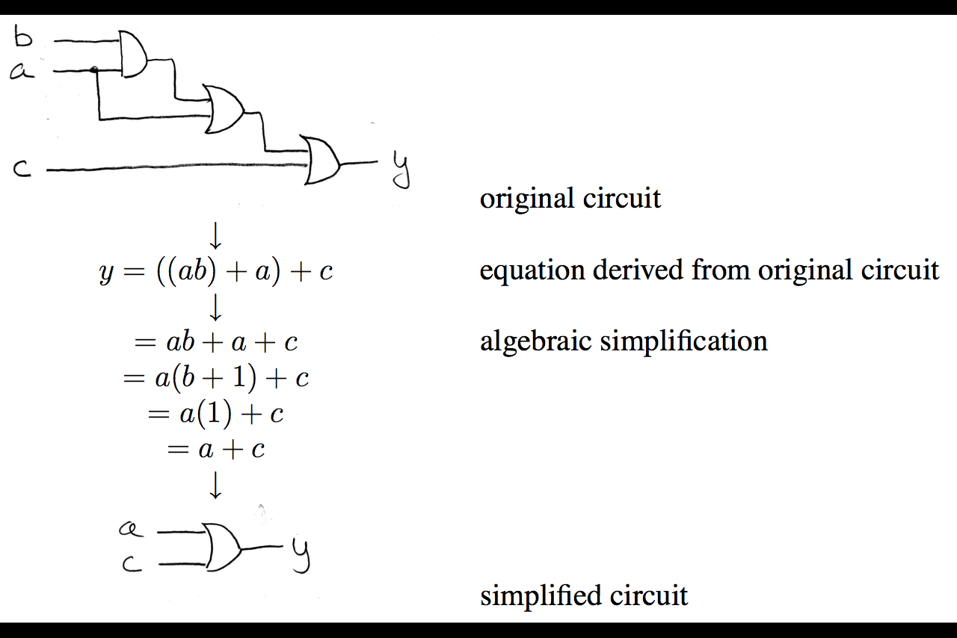
Boolean Algebra: Circuit & Algebraic Simplification

Slide 4
Laws of Boolean Algebra
X X = 0
X 0 = 0
X 1 = X
X X = X
X Y = Y X
(X Y) Z = Z (Y Z)
X (Y + Z) = X Y + X Z
X Y + X = X
X Y + X = X + Y
X Y = X + Y
X + X = 1
X + 1 = 1
X + 0 = X
X + X = X
X + Y = Y + X
(X + Y) + Z = Z + (Y + Z)
X + Y Z = (X + Y) (X + Z)
(X + Y) X = X
(X + Y) X = X Y
X + Y = X Y
Complementarity
Laws of 0’s and 1’s
Identities
Idempotent Laws
Commutativity
Associativity
Distribution
Uniting Theorem
Uniting Theorem v. 2
DeMorgan’s Law

Slide 5
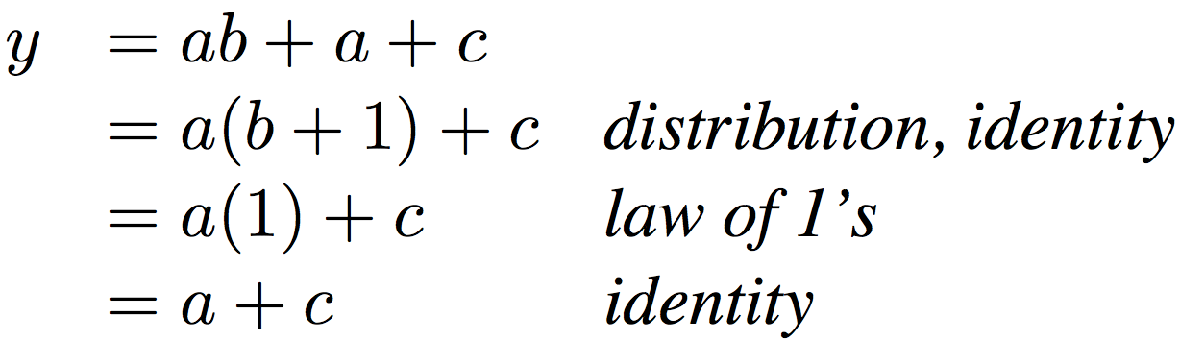
Boolean Algebraic Simplification Example
Notes:
Do on black board
First write truth table
Then minimize and check truth table
From distribution: a(b +1) + c
Froms laws of 0s and 1s: b+1 = 1
= a + c
Truth Table
a b c y
0 0 0 0
0 0 1 1
0 0 1 1

Slide 6
Boolean Algebraic Simplification Example
a b c y
0 0 0 0
0 0 1 1
0 1 0 0
0 1 1 1
1 0 0 1
1 0 1 1
1 1 0 1
1 1 1 1
Notes:
Do on black board
From distribution: a(b +1) + c
Froms laws of 0s and 1s: b+1 = 1
= a + c
Truth Table
a b c y
0 0 0 0
0 0 1 1
0 1 0 0
0 1 1 1
1 0 0 1
1 0 1 1
1 1 0 1
1 1 1 1

Slide 7
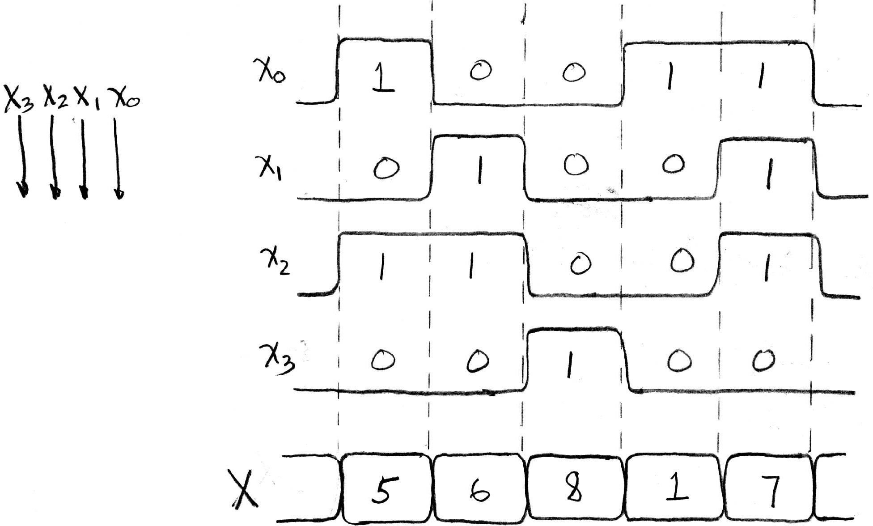
Signals and Waveforms: Grouping

Slide 8
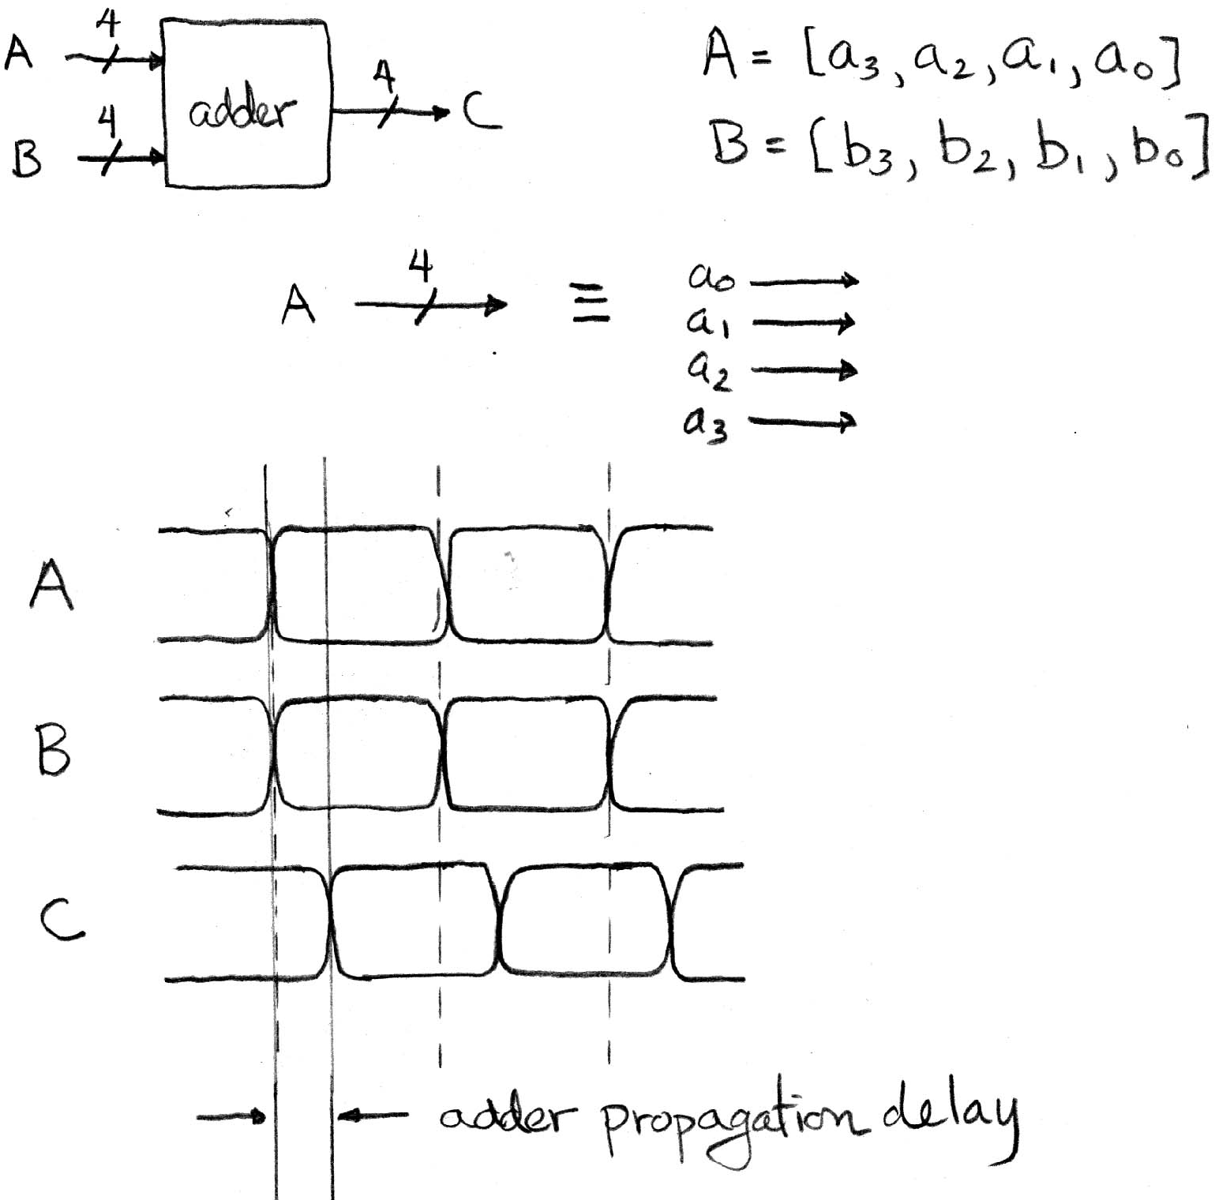
Signals and Waveforms: Circuit Delay
2
3
4
5
3
10
0
1
5
13
4
6

Slide 9
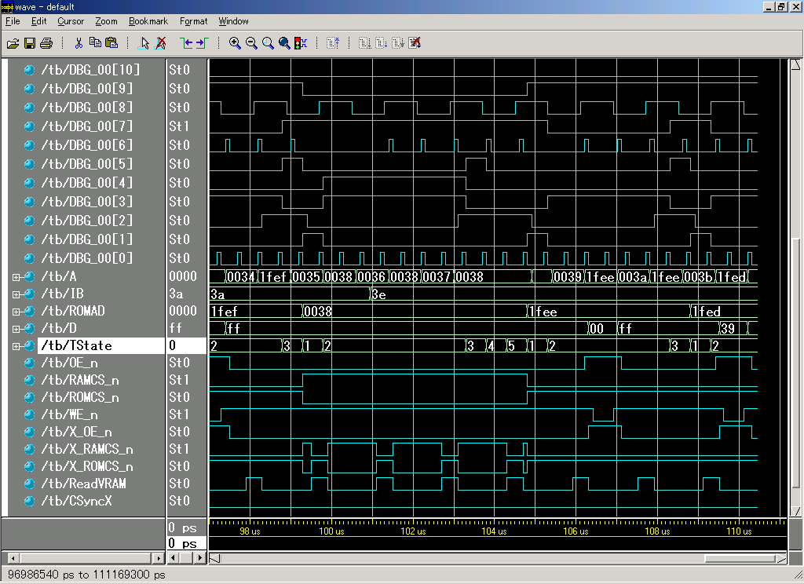
Sample Debugging Waveform

Slide 10
Clickers/Peer Instruction
Simplify Z = A+BC + A(BC)
A: Z = 0
B: Z = A(1+ BC)
C: Z = (A + BC)
D: Z = BC
E: Z = 1

Slide 11
Type of Circuits
Synchronous Digital Systems consist of two basic types of circuits:
  Combinational Logic (CL) circuits
    Output is a function of the inputs only, not the history of its execution
    E.g., circuits to add A, B (ALUs)
  Sequential Logic (SL)
    Circuits that “remember” or store information
    aka “State Elements”
    E.g., memories and registers (Registers)

Slide 12
Uses for State Elements
Place to store values for later re-use:
  Register files (like $1-$31 in MIPS)
  Memory (caches and main memory)
Help control flow of information between combinational logic blocks
  State elements hold up the movement of information at input to combinational logic blocks to allow for orderly passage

Slide 13
Accumulator Example
Why do we need to control the flow of information?
SUM
X_{i}
S
Want: S=0;
for (i=0;i<n;i++)
S = S + X_{i}
Assume:
  Each X value is applied in succession, one per cycle
  After n cycles the sum is present on S

Slide 14
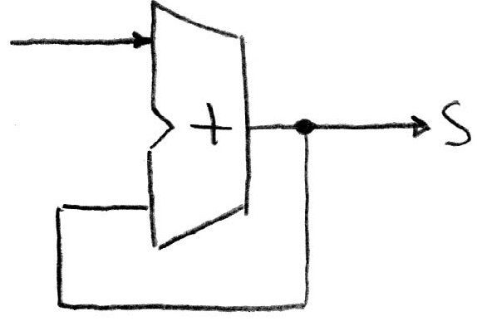
First Try: Does this work?
Feedback
No!
Reason #1: How to control the next iteration of the ‘for’ loop?
Reason #2: How do we say: ‘S=0’?

Slide 15
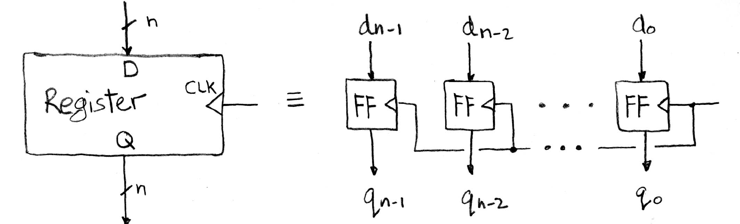
Register Internals
n instances of a “Flip-Flop”
Flip-flop name because the output flips and flops between 0 and 1
D is “data input”, Q is “data output”
Also called “D-type Flip-Flop”

Slide 16
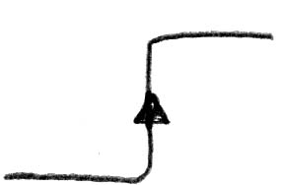
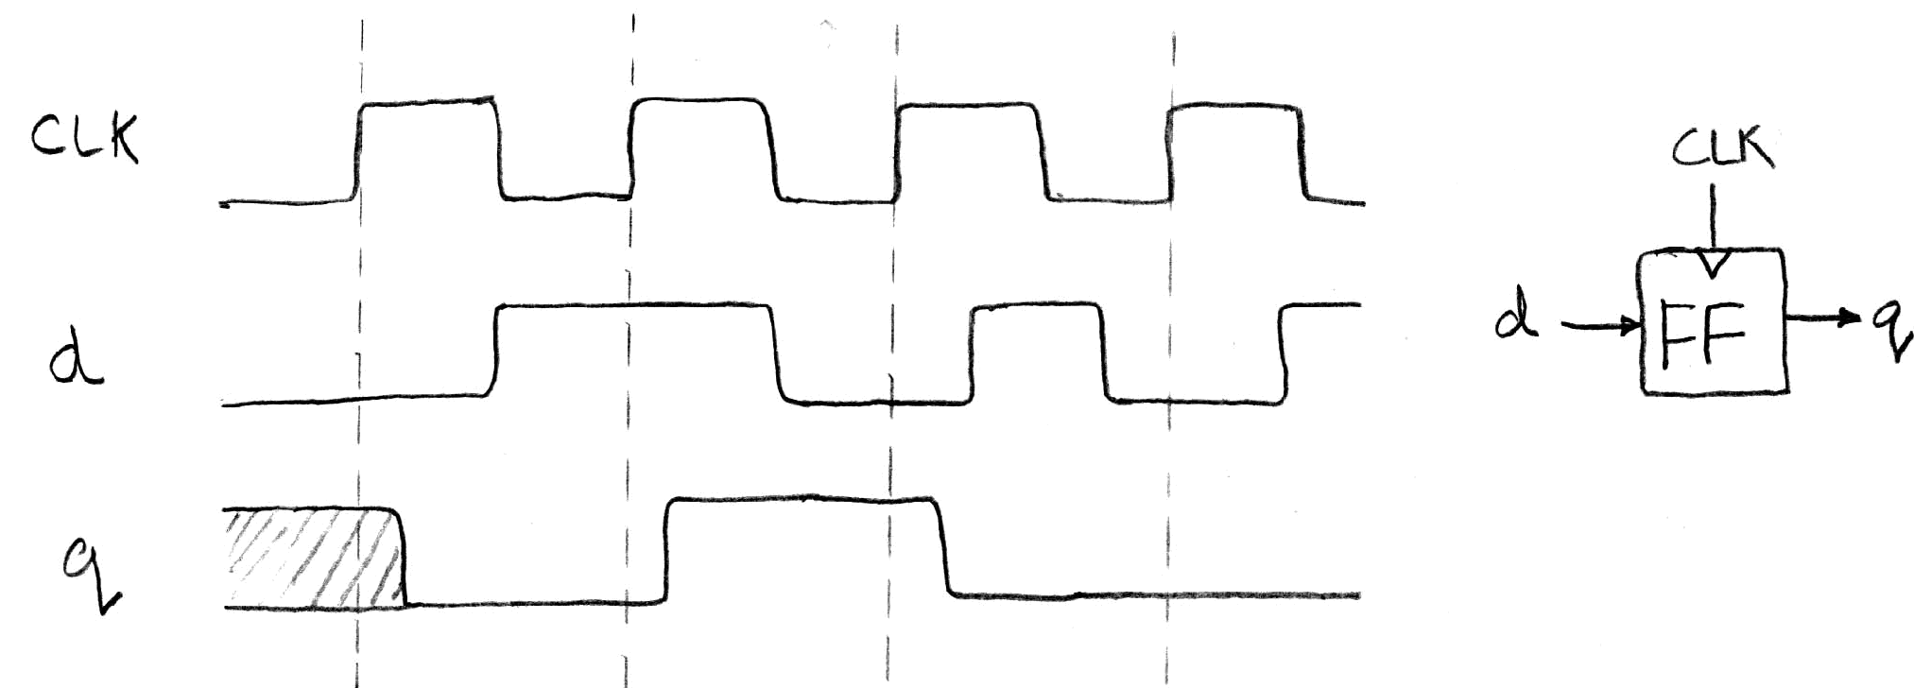
Flip-Flop Operation
Edge-triggered d-type flip-flop
  This one is “positive edge-triggered”
“On the rising edge of the clock, the input d is sampled and transferred to the output. At all other times, the input d is ignored.”
Example waveforms:

Slide 17
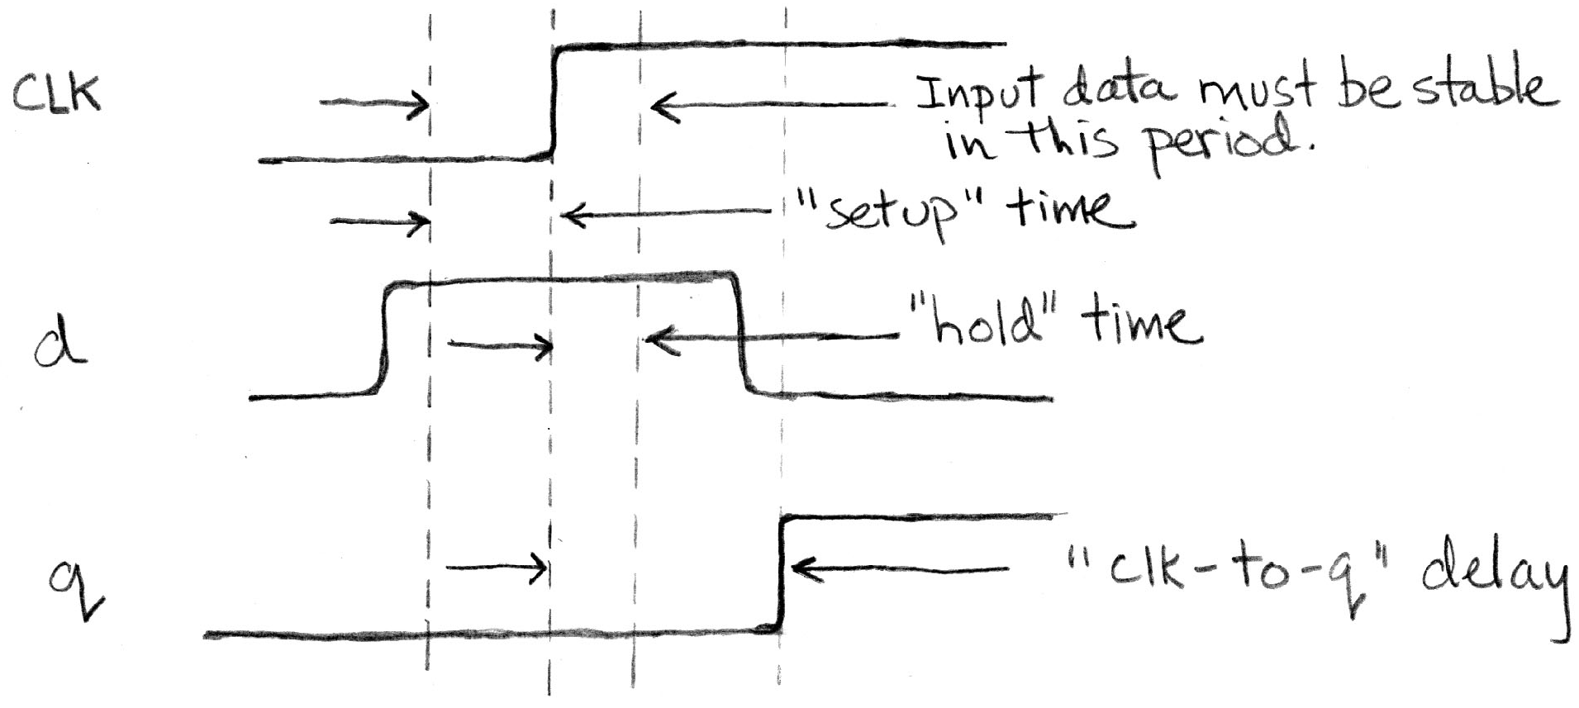
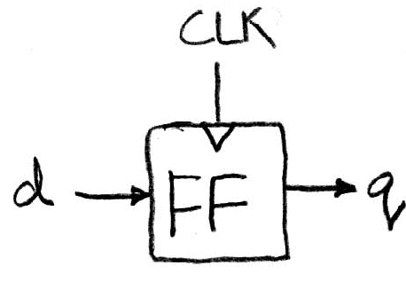
Flip-Flop Timing
Edge-triggered d-type flip-flop
  This one is “positive edge-triggered”
“On the rising edge of the clock, the input d is sampled and transferred to the output. At all other times, the input d is ignored.”
Example waveforms (more detail):

Slide 18
Camera Analogy Timing Terms
Want to take a portrait – timing right before and after taking picture
Set up time – don’t move since about to take picture (open camera shutter)
Hold time – need to hold still after shutter opens until camera shutter closes
Time click to data – time from open shutter until can see image on output (viewscreen)

Slide 19
Hardware Timing Terms
Setup Time: when the input must be stable before the edge of the CLK
Hold Time: when the input must be stable after the edge of the CLK
“CLK-to-Q” Delay: how long it takes the output to change, measured from the edge of the CLK

Slide 20
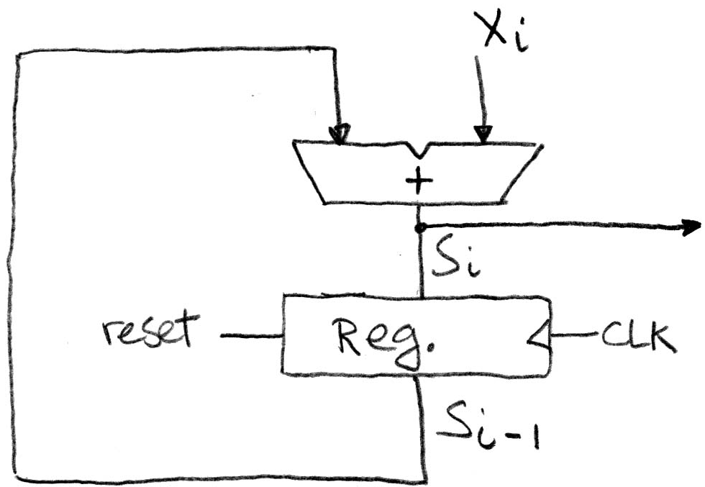
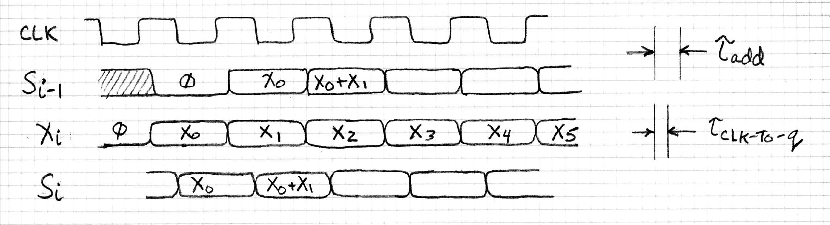
Accumulator Timing 1/2
Reset input to register is used to force it to all zeros (takes priority over D input).
S_{i-1} holds the result of the i^{th}-1 iteration.
Analyze circuit timing starting at the output of the register.

Slide 21
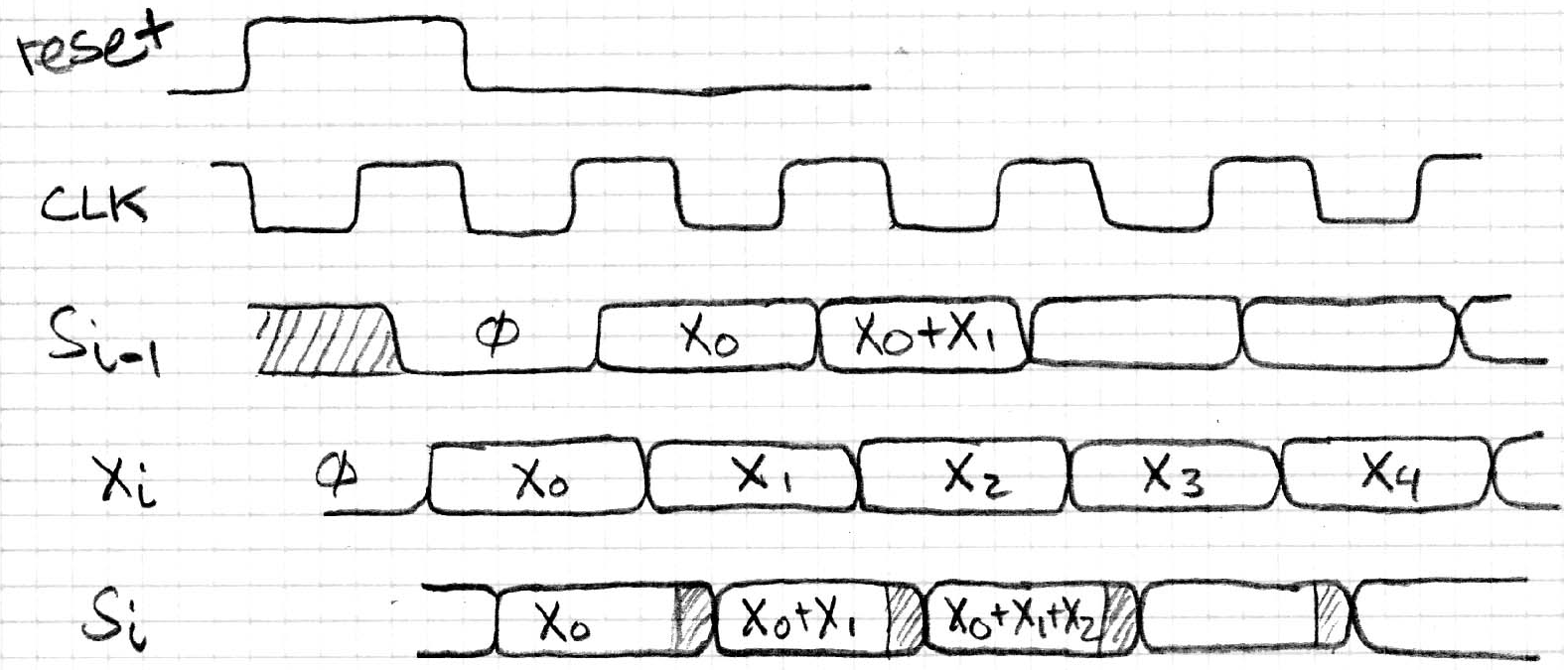
Accumulator Timing 2/2
reset signal shown.
Also, in practice X might not arrive to the adder at the same time as S_{i-1}
S_{i} temporarily is wrong, but register always captures correct value.
In good circuits, instability never happens around rising edge of clk.

Slide 22
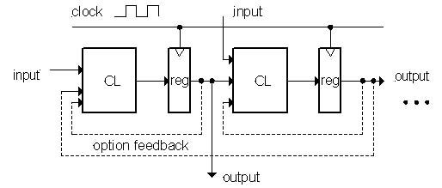
Model for Synchronous Systems
Collection of Combinational Logic blocks separated by registers
Feedback is optional
Clock signal(s) connects only to clock input of registers
Clock (CLK): steady square wave that synchronizes the system
Register: several bits of state that samples on rising edge of CLK (positive edge-triggered) or falling edge (negative edge-triggered)

Slide 23
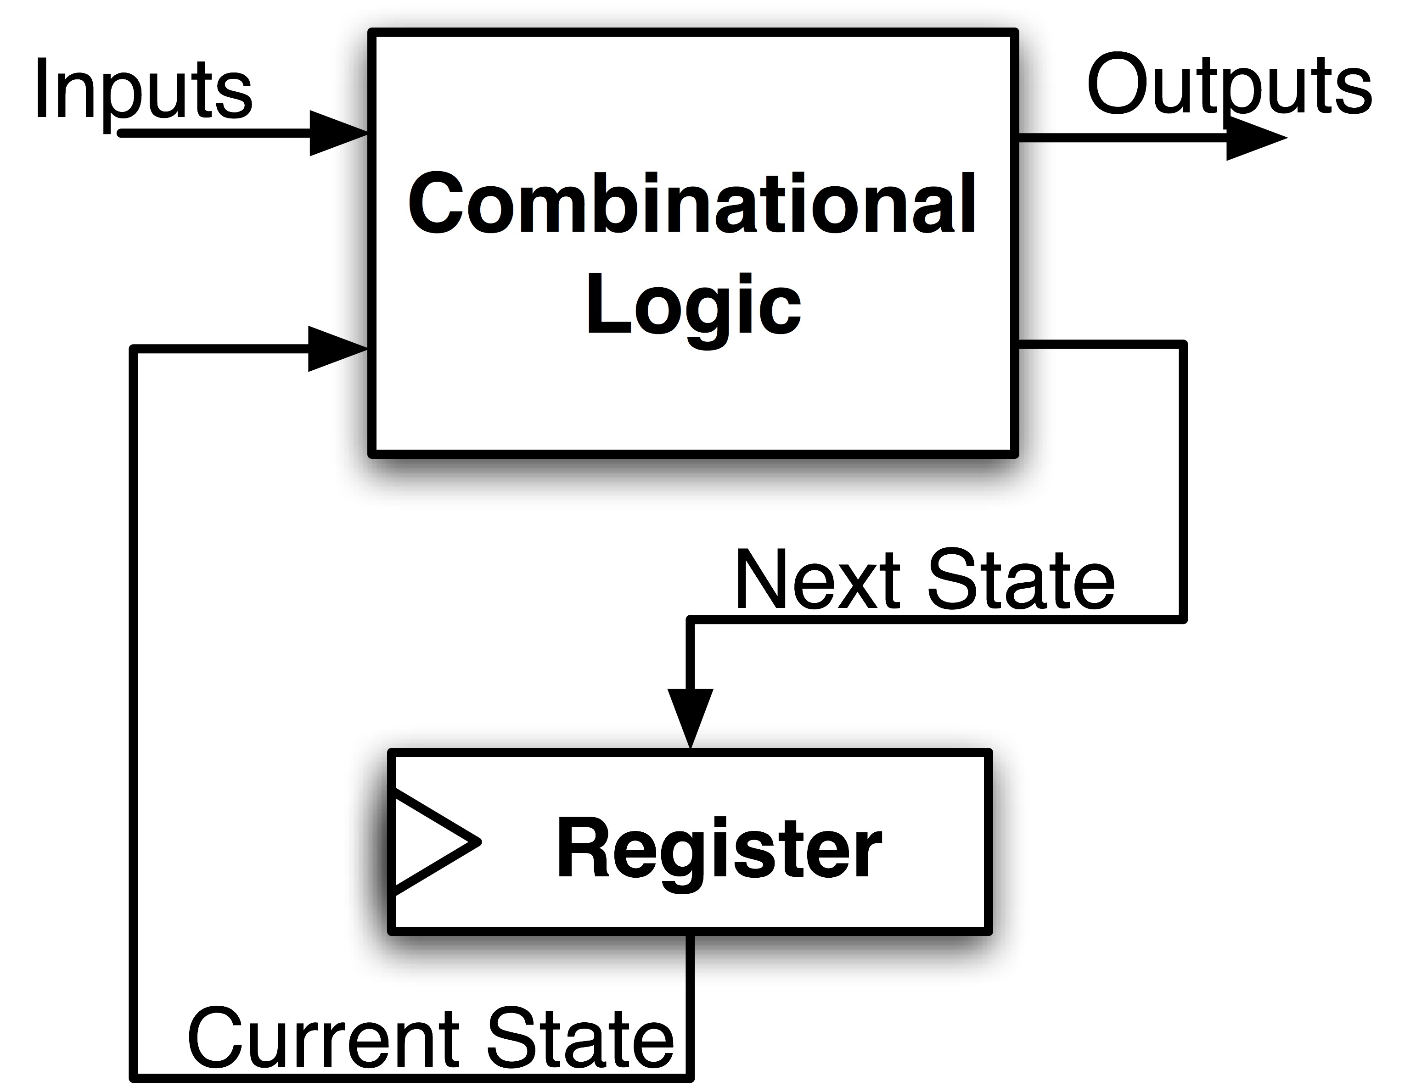
Maximum Clock Frequency
What is the maximum frequency of this circuit?
Hint:
Frequency = 1/Period
Period = Max Delay = CLK-to-Q Delay + CL Delay + Setup Time

Slide 24
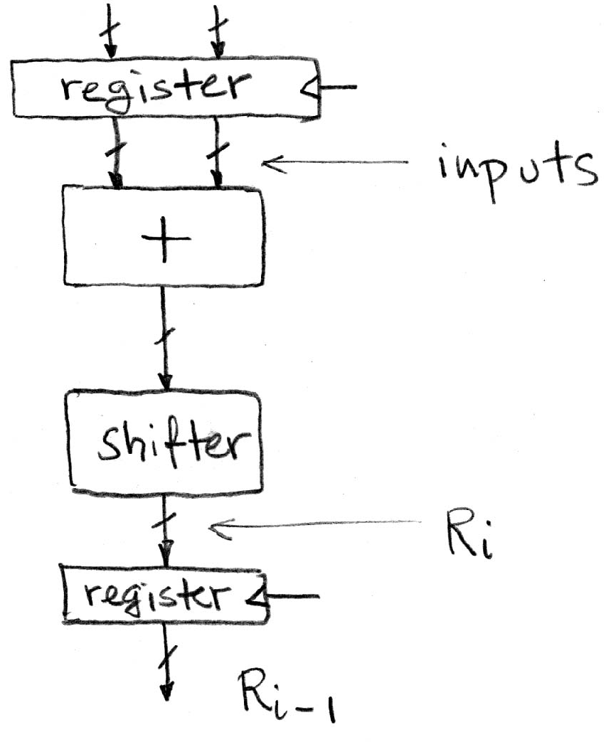
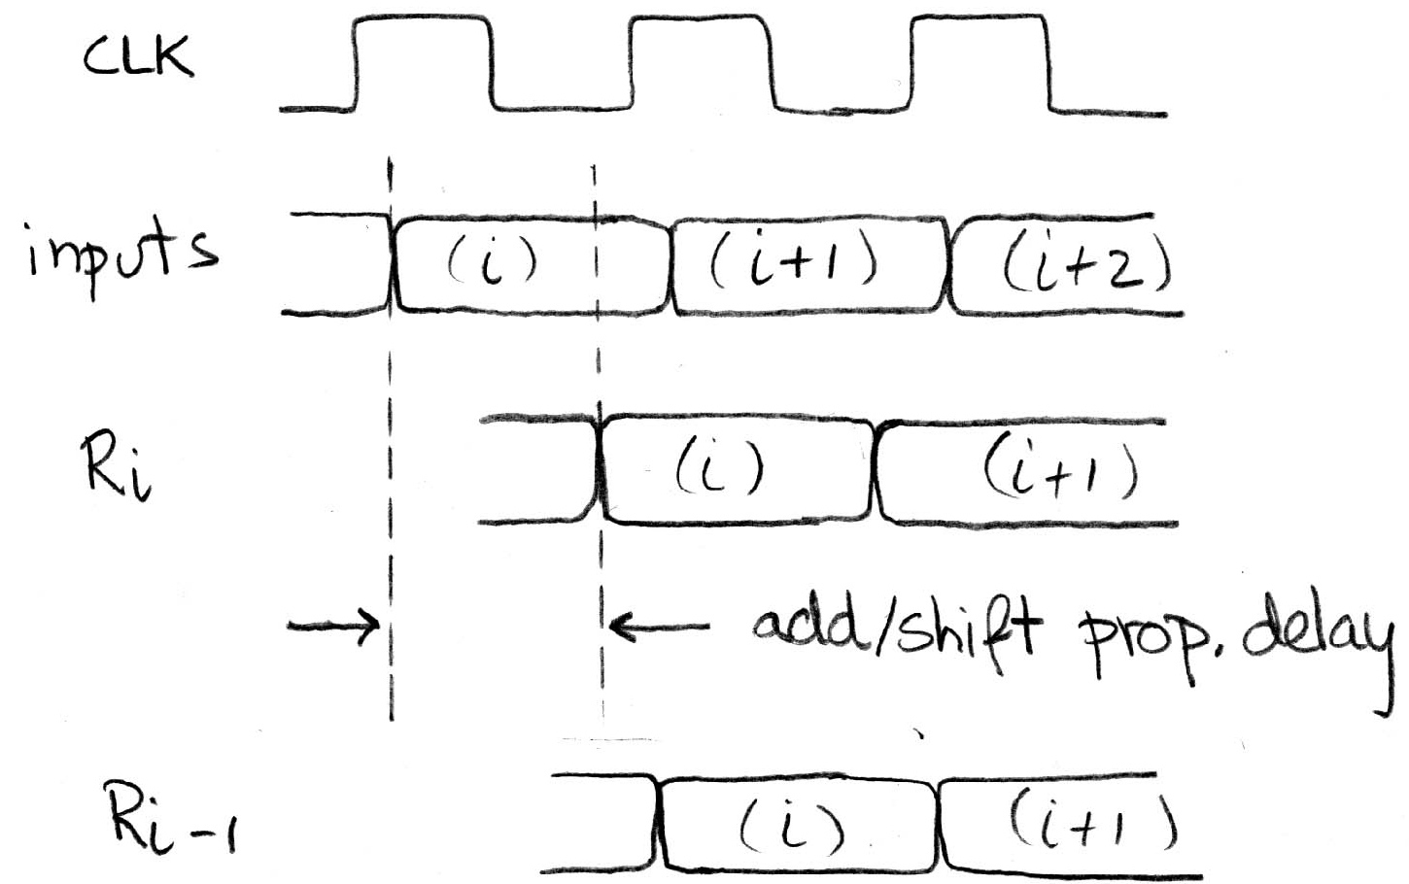
Critical Paths
Timing…
Note: delay of 1 clock cycle from input to output.
Clock period limited by propagation delay of adder/shifter.

Slide 25
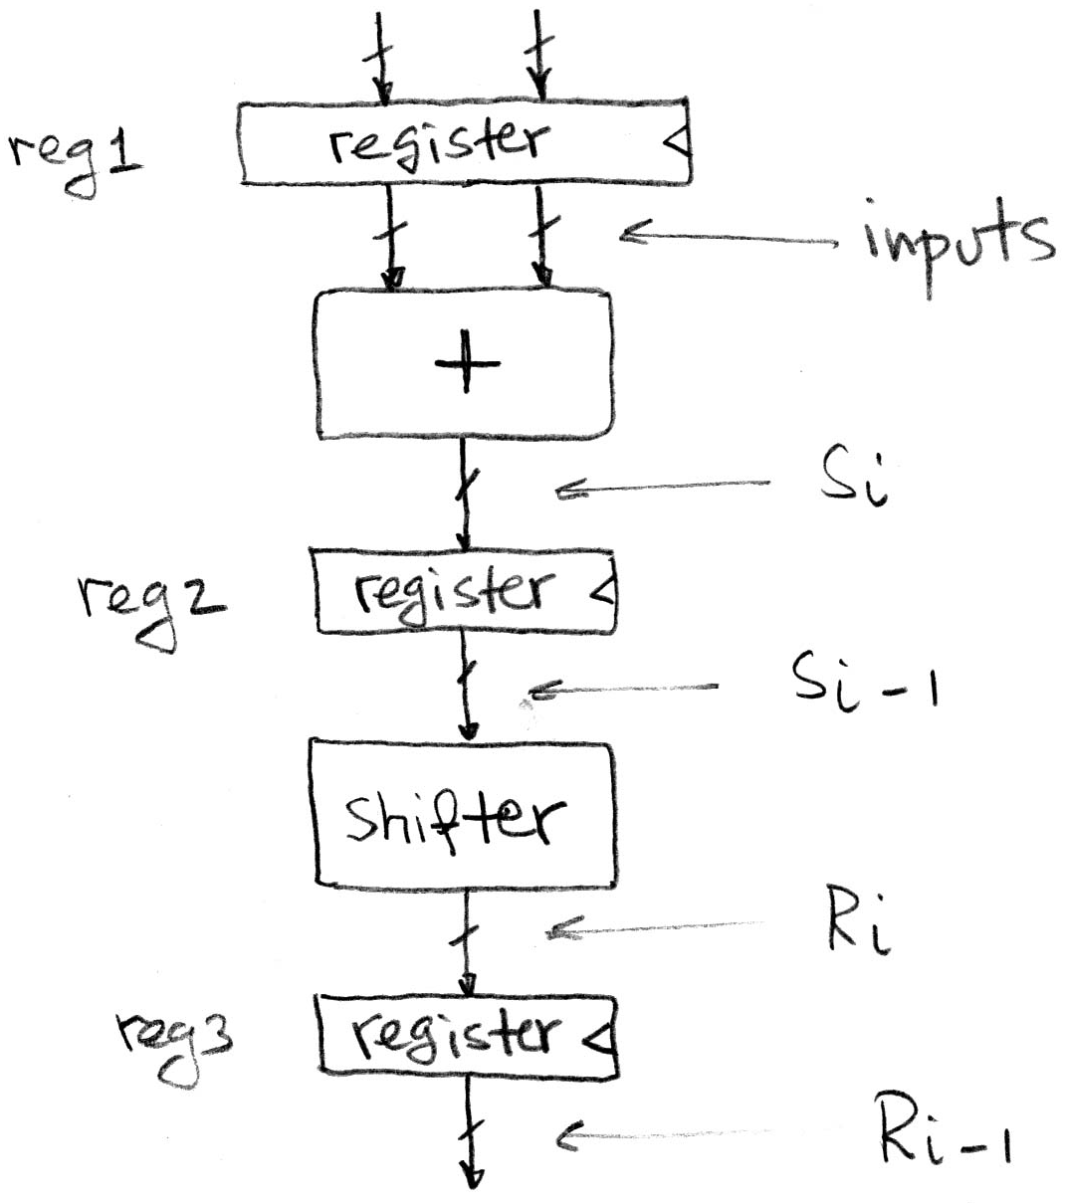
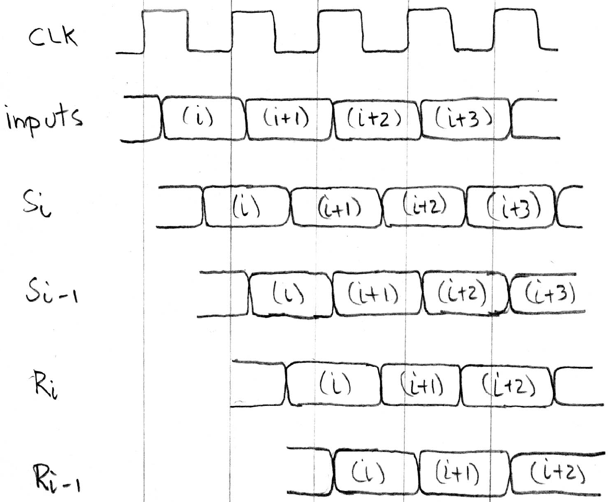
Pipelining to improve performance
Timing…
Insertion of register allows higher clock frequency
More outputs per second (higher bandwidth)
But each individual result takes longer (greater latency)

Slide 26
Recap of Timing Terms
Clock (CLK) - steady square wave that synchronizes system
Setup Time - when the input must be stable before the rising edge of the CLK
Hold Time - when the input must be stable after the rising edge of the CLK
“CLK-to-Q” Delay - how long it takes the output to change, measured from the rising edge of the CLK
Flip-flop - one bit of state that samples every rising edge of the CLK (positive edge-triggered)
Register - several bits of state that samples on rising edge of CLK or on LOAD (positive edge-triggered)

Slide 27
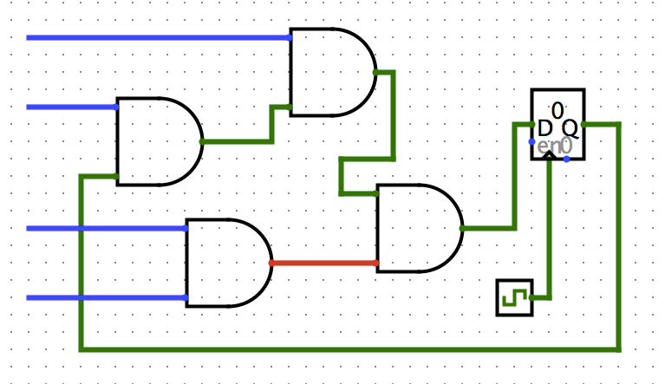
Clickers/Peer Instruction
Clock->Q 1ns
Setup 1ns
Hold 1ns
AND delay 1ns
What is maximum clock frequency? (assume all unconnected inputs come from some register)
A: 5 GHz
B: 200 MHz
C: 500 MHz
D: 1/7 GHz
E: 1/6 GHz

Slide 28
Administrivia
No lecture on Wed – study for midterm
Midterm 1 is on Thu 2/25
  Time 6-8pm
  Location
    2050 VLSB(aa-lz)
    1 Pimentel(ma-zz)
  Covers up to and including 02/17 lecture (CALL 2)
  1 handwritten, double sided, 8.5”x11” cheat sheet
  We’ll give you MIPS green sheet
Emails sent-out to students requiring special accommodation for the exam – please respond

Slide 29
Study Advice
Review slides, book, worksheets, etc. and add to your cheatsheet as you do so
  This step is not the end
Take a mock exam in the allotted time, using only your cheatsheet
Go over solutions, look at why the answers are what they are (especially for questions you answered incorrectly)
Update cheatsheet as necessary
if (!perfect) goto 2;
Notes:
see hkn for old exams

