Slide 1
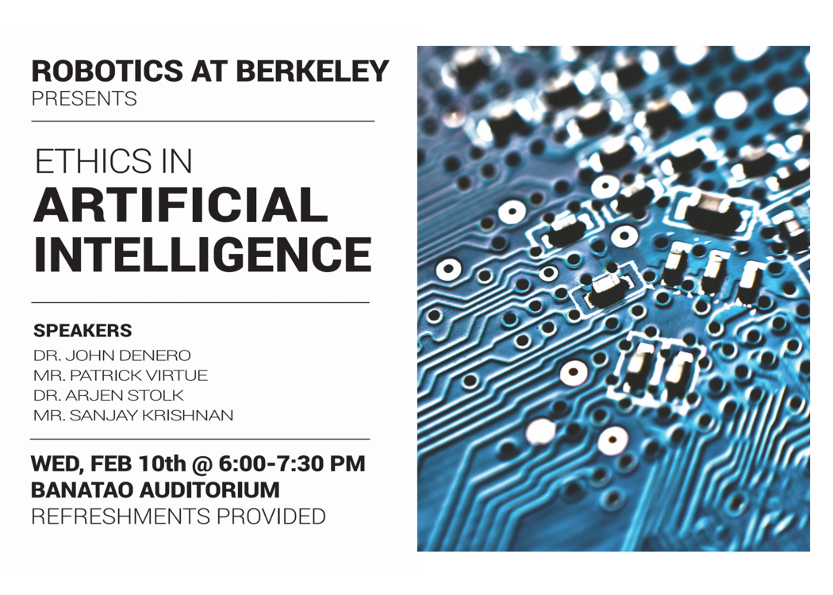

Slide 2
CS 61C: Great Ideas in Computer Architecture More MIPS, MIPS Functions
Instructors:
Vladimir Stojanovic & Nicholas Weaver
http://inst.eecs.Berkeley.edu/~cs61c/sp16

Slide 3
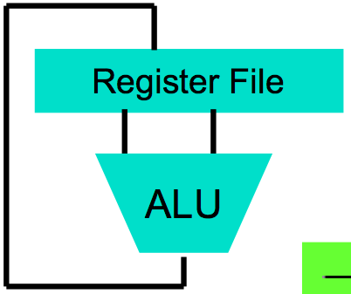
Levels of Representation/Interpretation
High Level Language Program (e.g., C)
temp = v[k];
v[k] = v[k+1];
v[k+1] = temp;
Compiler
Anything can be represented as a number, i.e., data or instructions
lw $t0, 0($2)
lw $t1, 4($2)
sw $t1, 0($2)
sw $t0, 4($2)
Assembly Language Program (e.g., MIPS)
Assembler
0000 1001 1100 0110 1010 1111 0101 1000
1010 1111 0101 1000 0000 1001 1100 0110
1100 0110 1010 1111 0101 1000 0000 1001
0101 1000 0000 1001 1100 0110 1010 1111
Machine Language Program (MIPS)
Machine Interpretation
Hardware Architecture Description (e.g., block diagrams)
Architecture Implementation
Logic Circuit Description (Circuit Schematic Diagrams)

Slide 4
MIPS Logical Instructions
Useful to operate on fields of bits within a word
e.g., characters within a word (8 bits)
Operations to pack /unpack bits into words
Called logical operations
Logical operations | C operators | Java operators | MIPS instructions
Bit-by-bit AND | & | & | and
Bit-by-bit OR | | | | | or
Bit-by-bit NOT | ~ | ~ | not
Shift left | << | << | sll
Shift right | >> | >>> | srl

Slide 5
Logic Shifting
Shift Left: sll $s1,$s2,2 #s1=s2<<2
Store in $s1 the value from $s2 shifted 2 bits to the left (they fall off end), inserting 0’s on right; << in C.
Before: 0000 0002_{hex} 0000 0000 0000 0000 0000 0000 0000 0010_{two}
After: 0000 0008_{hex} 0000 0000 0000 0000 0000 0000 0000 1000_{two}
What arithmetic effect does shift left have?
Shift Right: srl is opposite shift; >>

Slide 6
Arithmetic Shifting
Shift right arithmetic moves n bits to the right (insert high order sign bit into empty bits)
For example, if register $s0 contained
1111 1111 1111 1111 1111 1111 1110 0111_{two}= -25_{ten}
If executed sra $s0, $s0, 4, result is:
1111 1111 1111 1111 1111 1111 1111 1110_{two}= -2_{ten}
Unfortunately, this is NOT same as dividing by 2^{n}
Fails for odd negative numbers
C arithmetic semantics is that division should round towards 0
Notes:
\

Slide 7
Computer Decision Making
Based on computation, do something different
In programming languages: if-statement
MIPS: if-statement instruction is
beq register1,register2,L1
means: go to statement labeled L1 if (value in register1) == (value in register2)
….otherwise, go to next statement
beq stands for branch if equal
Other instruction: bne for branch if not equal

Slide 8
Types of Branches
Branch – change of control flow
Conditional Branch – change control flow depending on outcome of comparison
branch if equal (beq) or branch if not equal (bne)
Unconditional Branch – always branch
a MIPS instruction for this: jump (j)

Slide 9
Example if Statement
Assuming translations below, compile if block
f → $s0 g → $s1 h → $s2
i → $s3 j → $s4
if (i == j) bne $s3,$s4,Exit
f = g + h; add $s0,$s1,$s2
Exit:
May need to negate branch condition

Slide 10
Example if-else Statement
Assuming translations below, compile
f → $s0 g → $s1 h → $s2
i → $s3 j → $s4
if (i == j) bne $s3,$s4,Else
f = g + h; add $s0,$s1,$s2
else j Exit
f = g – h; Else: sub $s0,$s1,$s2
Exit:

Slide 11
Inequalities in MIPS
Until now, we’ve only tested equalities (== and != in C). General programs need to test < and > as well.
Introduce MIPS Inequality Instruction:
“Set on Less Than”
Syntax: slt reg1,reg2,reg3
Meaning: if (reg2 < reg3) reg1 = 1; else reg1 = 0;
“set” means “change to 1”, “reset” means “change to 0”.

Slide 12
Inequalities in MIPS Cont.
How do we use this? Compile by hand: if (g < h) goto Less; #g:$s0, h:$s1
Answer: compiled MIPS code…
slt $t0,$s0,$s1 # $t0 = 1 if g<h bne $t0,$zero,Less # if $t0!=0 goto Less
Register $zero always contains the value 0, so bne and beq often use it for comparison after an slt instruction
sltu treats registers as unsigned

Slide 13
Immediates in Inequalities
slti an immediate version of slt to test against constants
Loop: . . . slti $t0,$s0,1 # $t0 = 1 if # $s0<1 beq $t0,$zero,Loop # goto Loop # if $t0==0 # (if ($s0>=1))

Slide 14
Loops in C/Assembly
Simple loop in C; A[] is an array of ints
do { g = g + A[i]; i = i + j; } while (i != h);
Use this mapping: g, h, i, j, &A[0] $s1, $s2, $s3, $s4, $s5
Loop: sll $t1,$s3,2 # $t1= 4*i addu $t1,$t1,$s5 # $t1=addr A+4i lw $t1,0($t1) # $t1=A[i] add $s1,$s1,$t1 # g=g+A[i] addu $s3,$s3,$s4 # i=i+j bne $s3,$s2,Loop # goto Loop # if i!=h

Slide 15
Administrivia
We’ve added temporary sections to handle overflow before the drop date
Lab: M 3-5pm 271 Soda
Dis: W 3-4pm 320 Soda
Project 1 due on Sunday 02/07 @23:59:59
Progress Poll

Slide 16
Six Fundamental Steps in Calling a Function
Put parameters in a place where function can access them
Transfer control to function
Acquire (local) storage resources needed for function
Perform desired task of the function
Put result value in a place where calling code can access it and restore any registers you used
Return control to point of origin, since a function can be called from several points in a program

Slide 17
MIPS Function Call Conventions
Registers faster than memory, so use them
$a0–$a3: four argument registers to pass parameters ($4 - $7)
$v0,$v1: two value registers to return values ($2,$3)
$ra: one return address register to return to the point of origin ($31)
Notes:
$at – assembler temporary register, used for pseudo instructions

Slide 18
Instruction Support for Functions (1/4)
... sum(a,b);... /* a,b:$s0,$s1 */ } int sum(int x, int y) { return x+y; }
address (shown in decimal) 1000 1004 1008 1012 1016 … 2000 2004
C
M I P S
In MIPS, all instructions are 4 bytes, and stored in memory just like data. So here we show the addresses of where the programs are stored.

Slide 19
Instruction Support for Functions (2/4)
... sum(a,b);... /* a,b:$s0,$s1 */ } int sum(int x, int y) { return x+y; }
address (shown in decimal) 1000 add $a0,$s0,$zero # x = a 1004 add $a1,$s1,$zero # y = b 1008 addi $ra,$zero,1016 #$ra=1016 1012 j sum #jump to sum 1016 … # next instruction … 2000 sum: add $v0,$a0,$a1 2004 jr $ra # new instr. “jump register”
C
M I P S

Slide 20
Instruction Support for Functions (3/4)
... sum(a,b);... /* a,b:$s0,$s1 */ } int sum(int x, int y) { return x+y; }
2000 sum: add $v0,$a0,$a1 2004 jr $ra # new instr. “jump register”
C
Question: Why use jr here? Why not use j?
Answer: sum might be called by many places, so we can’t return to a fixed place. The calling proc to sum must be able to say “return here” somehow.
M I P S

Slide 21
Instruction Support for Functions (4/4)
Single instruction to jump and save return address: jump and link (jal)
Before: 1008 addi $ra,$zero,1016 #$ra=1016 1012 j sum #goto sum
After: 1008 jal sum # $ra=1012,goto sum
Why have a jal?
Make the common case fast: function calls very common.
Don’t have to know where code is in memory with jal!

Slide 22
MIPS Function Call Instructions
Invoke function: jump and link instruction (jal)
(really should be laj “link and jump”)
“link” means form an address or link that points to calling site to allow function to return to proper address
Jumps to address and simultaneously saves the address of the following instruction in register $ra
jal FunctionLabel
Return from function: jump register instruction (jr)
Unconditional jump to address specified in register
jr $ra

Slide 23
Notes on Functions
Calling program (caller) puts parameters into registers $a0-$a3 and uses jal X to invoke (callee) at address labeled X
Must have register in computer with address of currently executing instruction
Instead of Instruction Address Register (better name), historically called Program Counter (PC)
It’s a program’s counter; it doesn’t count programs!
What value does jal X place into $ra? ????
jr $ra puts address inside $ra back into PC
Notes:
PC+4

Slide 24
Where are Old Register Values Saved to Restore Them After Function Call?
Need a place to save old values before call function, restore them when return, and delete
Ideal is stack: last-in-first-out queue (e.g., stack of plates)
Push: placing data onto stack
Pop: removing data from stack
Stack in memory, so need register to point to it
$sp is the stack pointer in MIPS ($29)
Convention is grow from high to low addresses
Push decrements $sp, Pop increments $sp

Slide 25
Example
int Leaf (int g, int h, int i, int j)
{
int f;
f = (g + h) – (i + j);
return f;
}
Parameter variables g, h, i, and j in argument registers $a0, $a1, $a2, and $a3, and f in $s0
Assume need one temporary register $t0

Slide 26
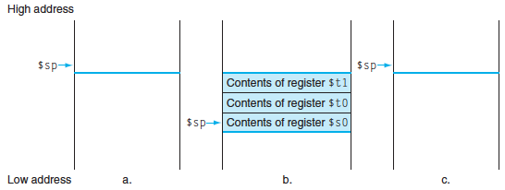
Stack Before, During, After Function
Need to save old values of $s0 and $t0
Contents of $t0
Contents of $s0

Slide 27
MIPS Code for Leaf()
Leaf: addi $sp,$sp,-8 # adjust stack for 2 items
sw $t0, 4($sp) # save $t0 for use afterwards
sw $s0, 0($sp) # save $s0 for use afterwards
add $s0,$a0,$a1 # f = g + h
add $t0,$a2,$a3 # t0 = i + j
sub $v0,$s0,$t0 # return value (g + h) – (i + j)
lw $s0, 0($sp) # restore register $s0 for caller
lw $t0, 4($sp) # restore register $t0 for caller
addi $sp,$sp,8 # adjust stack to delete 2 items
jr $ra # jump back to calling routine

Slide 28
What If a Function Calls a Function? Recursive Function Calls?
Would clobber values in $a0 to $a3 and $ra
What is the solution?
Notes:
Save $ra on the stack

Slide 29
Nested Procedures (1/2)
int sumSquare(int x, int y) { return mult(x,x)+ y; }
Something called sumSquare, now sumSquare is calling mult
So there’s a value in $ra that sumSquare wants to jump back to, but this will be overwritten by the call to mult
Need to save sumSquare return address before call to mult

Slide 30
Nested Procedures (2/2)
In general, may need to save some other info in addition to $ra.
When a C program is run, there are 3 important memory areas allocated:
Static: Variables declared once per program, cease to exist only after execution completes - e.g., C globals
Heap: Variables declared dynamically via malloc
Stack: Space to be used by procedure during execution; this is where we can save register values

Slide 31
Optimized Function Convention
To reduce expensive loads and stores from spilling and restoring registers, MIPS divides registers into two categories:
Preserved across function call
Caller can rely on values being unchanged
$sp, $gp, $fp, “saved registers” $s0- $s7
Not preserved across function call
Caller cannot rely on values being unchanged
Return value registers $v0,$v1, Argument registers $a0-$a3, “temporary registers” $t0-$t9,$ra

Slide 32
Clickers/Peer Instruction
Which statement is FALSE?
A: MIPS uses jal to invoke a function and jr to return from a function
B: jal saves PC+1 in $ra
C: The callee can use temporary registers ($ti) without saving and restoring them
D: The caller can rely on save registers ($si) without fear of callee changing them
Notes:
B: Print It saves PC+4 …because instructions in this system are 4-bytes long and the actual address increments by 4 bytes even though it appears to only increment by one instruction.

