Slide 1
CS 61C: Great Ideas in Computer Architecture Lecture 2: Introduction to C, Part I
Instructors:
Vladimir Stojanovic & Nicholas Weaver
http://inst.eecs.berkeley.edu/~cs61c/

Slide 2
Agenda
Everything is a Number
Computer Organization
Compile vs. Interpret

Slide 3
Key Concepts
Inside computers, everything is a number
But numbers usually stored with a fixed size
8-bit bytes, 16-bit half words, 32-bit words, 64-bit double words, …
Integer and floating-point operations can lead to results too big/small to store within their representations: overflow/underflow

Slide 4
Number Representation
Value of i-th digit is d × Base^{i} where i starts at 0 and increases from right to left:
123₁₀ = 1₁₀ x 10₁₀² + 2₁₀ x 10₁₀¹ + 3₁₀ x 10₁₀⁰
= 1x100₁₀ + 2x10₁₀ + 3x1₁₀ = 100₁₀ + 20₁₀ + 3₁₀
= 123₁₀
Binary (Base 2), Hexadecimal (Base 16), Decimal (Base 10) different ways to represent an integer
We’ll use 1_{two}, 5_{ten}, 10_{hex} to be clearer (vs. 1₂, 4₈, 5₁₀, 10₁₆ )

Slide 5
Number Representation
Hexadecimal digits: 0,1,2,3,4,5,6,7,8,9,A,B,C,D,E,F
FFF_{hex} = 15_{ten}x 16_{ten}² + 15_{ten}x 16_{ten}¹ + 15_{ten}x 16_{ten}⁰ = 3840_{ten} + 240_{ten} + 15_{ten} = 4095_{ten}
1111 1111 1111_{two} = FFF_{hex} = 4095_{ten}
May put blanks every group of binary, octal, or hexadecimal digits to make it easier to parse, like commas in decimal

Slide 6
Signed and Unsigned Integers
C, C++, and Java have signed integers, e.g., 7, -255:
int x, y, z;
C, C++ also have unsigned integers, which are used for addresses
32-bit word can represent 2³² binary numbers
Unsigned integers in 32 bit word represent 0 to 2³²-1 (4,294,967,295)

Slide 7
Unsigned Integers
0000 0000 0000 0000 0000 0000 0000 0000_{two} = 0_{ten}
0000 0000 0000 0000 0000 0000 0000 0001_{two} = 1_{ten}
0000 0000 0000 0000 0000 0000 0000 0010_{two} = 2_{ten}
... ...
0111 1111 1111 1111 1111 1111 1111 1101_{two} = 2,147,483,645_{ten}
0111 1111 1111 1111 1111 1111 1111 1110_{two} = 2,147,483,646_{ten}
0111 1111 1111 1111 1111 1111 1111 1111_{two} = 2,147,483,647_{ten}
1000 0000 0000 0000 0000 0000 0000 0000_{two} = 2,147,483,648_{ten}
1000 0000 0000 0000 0000 0000 0000 0001_{two} = 2,147,483,649_{ten}
1000 0000 0000 0000 0000 0000 0000 0010_{two} = 2,147,483,650_{ten}
... ...
1111 1111 1111 1111 1111 1111 1111 1101_{two} = 4,294,967,293_{ten}
1111 1111 1111 1111 1111 1111 1111 1110_{two} = 4,294,967,294_{ten}
1111 1111 1111 1111 1111 1111 1111 1111_{two} = 4,294,967,295_{ten}

Slide 8
Signed Integers and Two’s-Complement Representation
Signed integers in C; want ½ numbers <0, want ½ numbers >0, and want one 0
Two’s complement treats 0 as positive, so 32-bit word represents 2³² integers from -2³¹ (–2,147,483,648) to 2³¹-1 (2,147,483,647)
Note: one negative number with no positive version
Book lists some other options, all of which are worse
Every computer uses two’s complement today
Most-significant bit (leftmost) is the sign bit, since 0 means positive (including 0), 1 means negative
Bit 31 is most significant, bit 0 is least significant

Slide 9
Two’s-Complement Integers
Sign Bit
0000 0000 0000 0000 0000 0000 0000 0000_{two} = 0_{ten}
0000 0000 0000 0000 0000 0000 0000 0001_{two} = 1_{ten}
0000 0000 0000 0000 0000 0000 0000 0010_{two} = 2_{ten}
... ...
0111 1111 1111 1111 1111 1111 1111 1101_{two} = 2,147,483,645_{ten}
0111 1111 1111 1111 1111 1111 1111 1110_{two} = 2,147,483,646_{ten}
0111 1111 1111 1111 1111 1111 1111 1111_{two} = 2,147,483,647_{ten}
1000 0000 0000 0000 0000 0000 0000 0000_{two} = –2,147,483,648_{ten}
1000 0000 0000 0000 0000 0000 0000 0001_{two} = –2,147,483,647_{ten}
1000 0000 0000 0000 0000 0000 0000 0010_{two} = –2,147,483,646_{ten}
... ...
1111 1111 1111 1111 1111 1111 1111 1101_{two} = –3_{ten}
1111 1111 1111 1111 1111 1111 1111 1110_{two} = –2_{ten}
1111 1111 1111 1111 1111 1111 1111 1111_{two} = –1_{ten}

Slide 10
Ways to Make Two’s Complement
For N-bit word, complement to 2_{ten}^{N}
For 4 bit number 3_{ten}=0011_{two}, two’s complement (i.e. -3_{ten}) would be 16_{ten}-3_{ten}=13_{ten} or 10000_{two} – 0011_{two} = 1101_{two}
Here is an easier way:
Invert all bits and add 1
Computers actually do it like this, too
3_{ten}
0011_{two}
1100_{two}
+ 1_{two}
Bitwise complement
-3_{ten}
1101_{two}

Slide 11
Binary Addition Example
Carry
0
0
1
0
3
+2
0011
0010
5
0
0
1
0
1

Slide 12
Two’s-Complement Examples
Assume for simplicity 4 bit width, -8 to +7 represented
3
+2
0011
0010
3
+ (-2)
0011
1110
-3
+ (-2)
1101
1110
5
0101
1
1 0001
-5
1 1011
Overflow when magnitude of result too big to fit into result representation
7
+1
0111
0001
-8
+ (-1)
1000
1111
Carry into MSB =
Carry Out MSB
-8
1000
+7
1 0111
Overflow!
Overflow!
Carry into MSB =
Carry Out MSB
Carry in = carry from less significant bits
Carry out = carry to more significant bits

Slide 13
Suppose we had a 5-bit word. What integers can be represented in two’s complement?
☐
-32 to +31
☐
0 to +31
☐
-16 to +15
☐
-15 to +16
Notes:
VertLeftWhiteCheck1
B: Print 4 …because ints in this system are 4-bytes long and the actual address increments by 4 even though it appears to only incrememt 1.

Slide 14
Suppose we had a 5 bit word. What integers can be represented in two’s complement?
☐
-32 to +31
☐
0 to +31
☐
-16 to +15
☐
-15 to +16
Notes:
VertLeftWhiteCheck1
B: Print 4 …because ints in this system are 4-bytes long and the actual address increments by 4 even though it appears to only incrememt 1.

Slide 15
Agenda
Everything is a Number
Computer Organization
Compile vs. Interpret

Slide 16
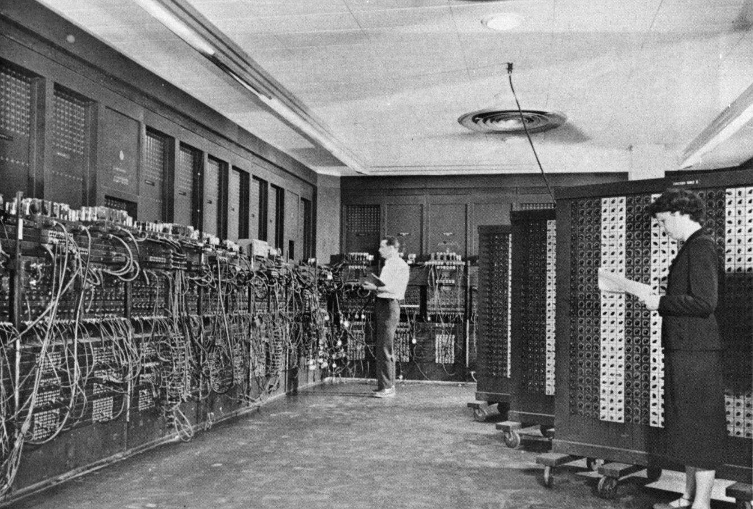
ENIAC (U.Penn., 1946) First Electronic General-Purpose Computer
Blazingly fast (multiply in 2.8ms!)
10 decimal digits x 10 decimal digits
But needed 2-3 days to setup new program, as programmed with patch cords and switches
Notes:
-Electronic Numerical Integrator and Computer
-Digital (electronic), capable of being reprogrammed to solve a variety of mathematical problems
-Dev began at the end of WWII, was designed and primarily used to calculate artillery firing tables for the US Army’s
-Very slow to program
-Story about 2 architects who designed it and Von Neumann, how it led to EDSAC
-Slow program entry, I/O

Slide 17
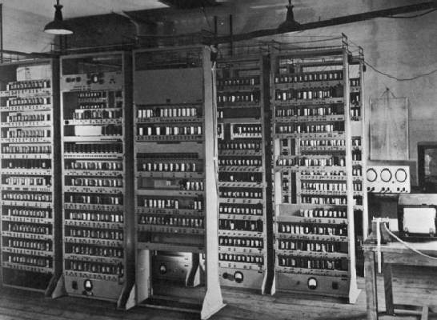
EDSAC (Cambridge, 1949) First General Stored-Program Computer
Programs held as numbers in memory
35-bit binary 2’s complement words
Notes:
Programming EDSAC

Slide 18
Components of a Computer
Memory
Processor
Input
Enable?
Read/Write
Control
Program
Datapath
Address
Bytes
PC
Registers
Write Data
Data
Arithmetic & Logic Unit
(ALU)
ReadData
Output
Processor-Memory Interface
I/O-Memory Interfaces
Notes:
7:00

Slide 19
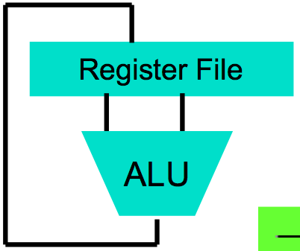
Great Idea: Levels of Representation/Interpretation
High Level Language Program (e.g., C)
temp = v[k];
v[k] = v[k+1];
v[k+1] = temp;
We are here!
Compiler
Anything can be represented as a number, i.e., data or instructions
lw $t0, 0($2)
lw $t1, 4($2)
sw $t1, 0($2)
sw $t0, 4($2)
Assembly Language Program (e.g., MIPS)
Assembler
0000 1001 1100 0110 1010 1111 0101 1000
1010 1111 0101 1000 0000 1001 1100 0110
1100 0110 1010 1111 0101 1000 0000 1001
0101 1000 0000 1001 1100 0110 1010 1111
Machine Language Program (MIPS)
Machine Interpretation
Hardware Architecture Description (e.g., block diagrams)
Architecture Implementation
Logic Circuit Description (Circuit Schematic Diagrams)
Notes:
9:00
-Programming EDSAC in binary

Slide 20
Introduction to C “The Universal Assembly Language”
“Some” experience is required before CS61C
C++ or Java OK
Class pre-req included classes teaching Java
Python used in two labs
C used for everything else

Slide 21
Language Poll!
Please raise hand for first one of following you can say yes to
☐
I have programmed in C, C++, C#, or Objective-C
☐
I have programmed in Java
I have programmed in FORTRAN, Cobol, Algol-68, Ada, Pascal, or Basic
☐
☐
None of the above

Slide 22
Intro to C
C is not a “very high-level” language, nor a “big” one, and is not specialized to any particular area of application. But its absence of restrictions and its generality make it more convenient and effective for many tasks than supposedly more powerful languages.
Kernighan and Ritchie
Enabled first operating system not written in assembly language: UNIX - A portable OS!

Slide 23
Intro to C
Why C?: we can write programs that allow us to exploit underlying features of the architecture – memory management, special instructions, parallelism
C and derivatives (C++/Obj-C/C#) still one of the most popular application programming languages after >40 years!

Slide 24
TIOBE Index of Language Popularity
The ratings are based on the number of skilled engineers world-wide, courses and third party vendors.
http://www.tiobe.com
Notes:
http://www.tiobe.com/index.php/content/paperinfo/tpci/index.html

Slide 25
TIOBE Programming Community Index

Slide 26
Disclaimer
You will not learn how to fully code in C in these lectures! You’ll still need your C reference for this course
K&R is a must-have
Check online for more sources
“JAVA in a Nutshell,” O’Reilly
Chapter 2, “How Java Differs from C”
http://oreilly.com/catalog/javanut/excerpt/index.html
Brian Harvey’s helpful transition notes
On CS61C class website: pages 3-19
http://inst.eecs.berkeley.edu/~cs61c/resources/HarveyNotesC1-3.pdf
Key C concepts: Pointers, Arrays, Implications for Memory management

Slide 27
Agenda
Everything is a Number
Computer Organization
Compile vs. Interpret

Slide 28
Compilation: Overview
C compilers map C programs into architecture-specific machine code (string of 1s and 0s)
Unlike Java, which converts to architecture-independent bytecode
Unlike Python environments, which interpret the code
These differ mainly in exactly when your program is converted to low-level machine instructions (“levels of interpretation”)
For C, generally a two part process of compiling .c files to .o files, then linking the .o files into executables;
Assembling is also done (but is hidden, i.e., done automatically, by default); we’ll talk about that later

Slide 29
C Compilation Simplified Overview (more later in course)
foo.c
bar.c
C source files (text)
Compiler
Compiler
Compiler/assembler combined here
foo.o
bar.o
Machine code object files
Linker
lib.o
Pre-built object file libraries
a.out
Machine code executable file

Slide 30
Compilation: Advantages
Excellent run-time performance: generally much faster than Scheme or Java for comparable code (because it optimizes for a given architecture)
Reasonable compilation time: enhancements in compilation procedure (Makefiles) allow only modified files to be recompiled

Slide 31
Compilation: Disadvantages
Compiled files, including the executable, are architecture-specific, depending on processor type (e.g., MIPS vs. RISC-V) and the operating system (e.g., Windows vs. Linux)
Executable must be rebuilt on each new system
I.e., “porting your code” to a new architecture
“Change → Compile → Run [repeat]” iteration cycle can be slow during development
but Make tool only rebuilds changed pieces, and can do compiles in parallel (linker is sequential though -> Amdahl’s Law)
Notes:
28:07

Slide 32
C Pre-Processor (CPP)
foo.c
foo.i
Compiler
CPP
C source files first pass through macro processor, CPP, before compiler sees code
CPP replaces comments with a single space
CPP commands begin with “#”
#include “file.h” /* Inserts file.h into output */
#include <stdio.h> /* Looks for file in standard location */
#define M_PI (3.14159) /* Define constant */
#if/#endif /* Conditional inclusion of text */
Use –save-temps option to gcc to see result of preprocessing
Full documentation at: http://gcc.gnu.org/onlinedocs/cpp/
Notes:
show this on term

