Slide 1
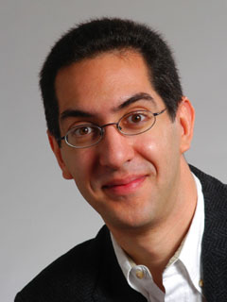
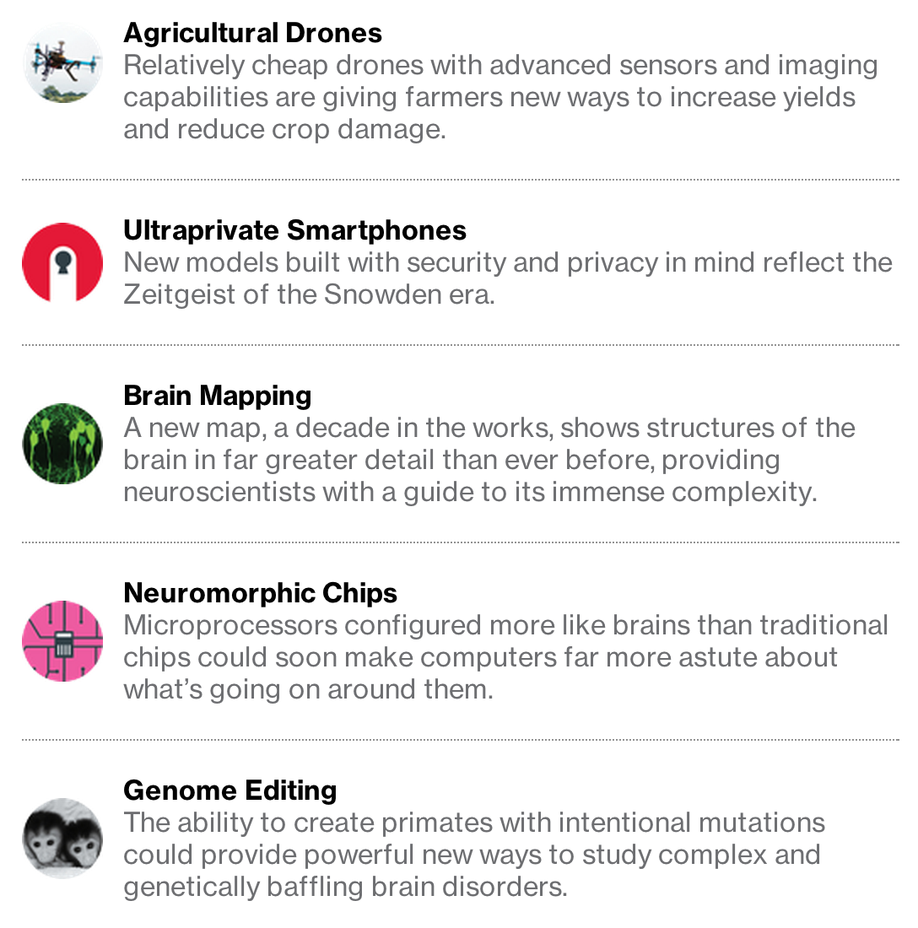
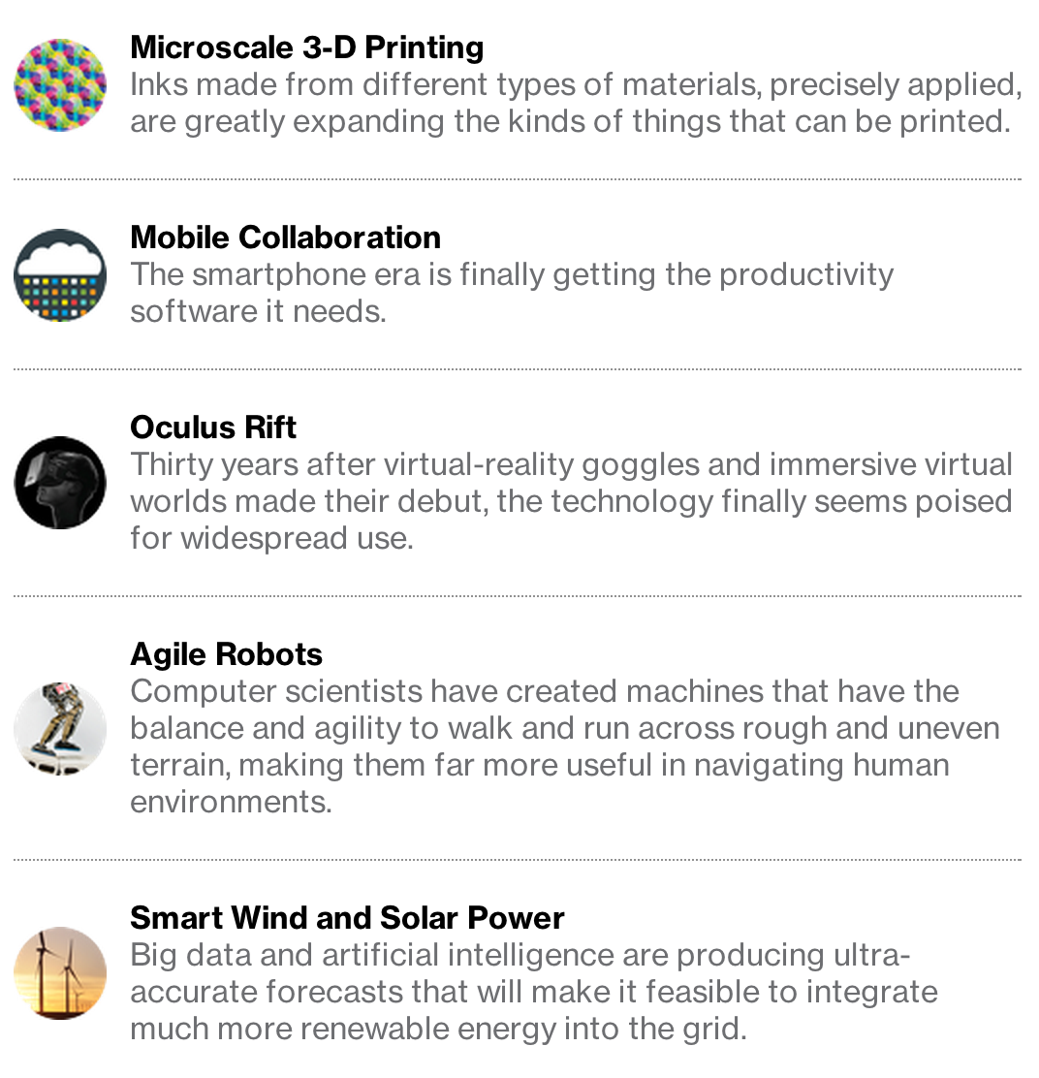
Top 10 breakthrough technologies (Mit TR)
inst.eecs.berkeley.edu/~cs61c UCB CS61C Great Ideas in Computer Architecture (aka Machine Structures)
Lecture 40 – Summary & Goodbye
Register your iclickers!
Sr Lecturer SOE Dan Garcia
www.technologyreview.com/lists/technologies/2014/

Slide 2
6 Great Ideas in Computer Architecture
Abstraction (Layers of Representation/Interpretation)
Moore’s Law
Principle of Locality/Memory Hierarchy
Parallelism
Performance Measurement & Improvement
Dependability via Redundancy

Slide 3
We learned Old-School “Machine Structures”
Application (ex: browser)
CS61C
Operating
Compiler
System
(Mac OSX)
Software
Assembler
Instruction Set
Architecture
Hardware
Processor
Memory
I/O system
Datapath & Control
Digital Design
Circuit Design
transistors
Coordination of many levels (layers) of abstraction

Slide 4
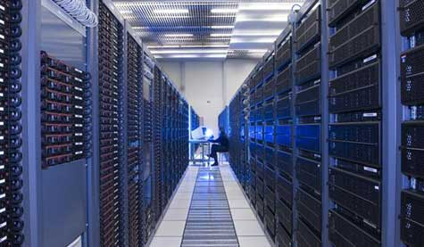
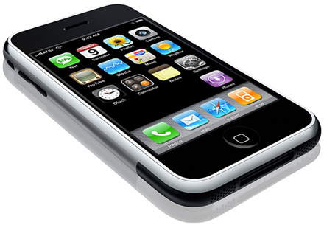
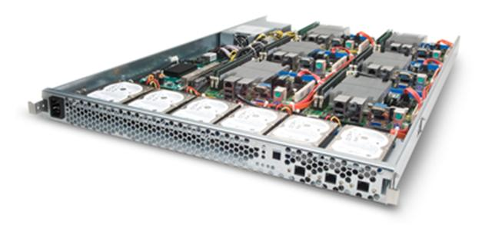
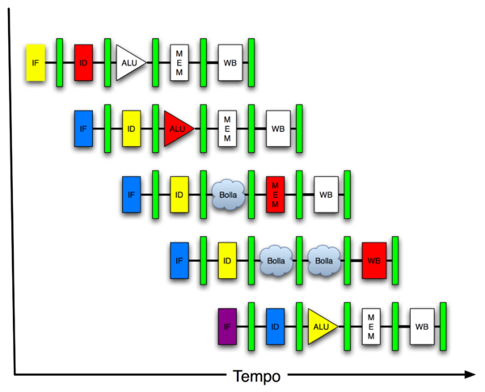
…and New-School Machine Structures (It’s a bit more complicated!)
Software Hardware
Project 2
Parallel Requests
Assigned to computer
e.g., Search “CS61C”
Parallel Threads
Assigned to core
e.g., Lookup, Ads
Parallel Instructions
>1 instruction @ one time
e.g., 5 pipelined instructions
Parallel Data
>1 data item @ one time
e.g., Add of 4 pairs of words
Hardware descriptions
All gates functioning in parallel at same time
Warehouse Scale Computer
Smart Phone
Harness Parallelism &
Achieve High Performance
Project 1
Computer
Core
…
Core
Memory (Cache)
Project 3
Input/Output
Core
Instruction Unit(s)
Functional
Unit(s)
A₀+B₀
A₁+B₁
A₂+B₂
A₃+B₃
Main Memory
Logic Gates
Project 4

Slide 5
We made HW/SW contact!
High Level Language Program (e.g., C)
temp = v[k];
v[k] = v[k+1];
v[k+1] = temp;
Compiler
Assembly Language Program (e.g.,MIPS)
lw $t0, 0($2)
lw $t1, 4($2)
sw $t1, 0($2)
sw $t0, 4($2)
Assembler
Machine Language Program (MIPS)
0000 1001 1100 0110 1010 1111 0101 1000
1010 1111 0101 1000 0000 1001 1100 0110
1100 0110 1010 1111 0101 1000 0000 1001
0101 1000 0000 1001 1100 0110 1010 1111
Machine Interpretation
Hardware Architecture Description (e.g., block diagrams)
Architecture Implementation
Logic Circuit Description (Circuit Schematic Diagrams)

Slide 6
Upcoming Calendar
Week # | Mon | Tue | Wed | Thu | Fri
#14 Last week o’ classes | I/O Disks | VM + I/O | GPU Coding | Open Lab | Today Summary
#15 RRR Week |  |  | Review 12-3pm 155 Dwinelle
#16 Finals Week |  | Final Exam 11:30-2:30pm 1 Pimentel

Slide 7
Administrivia: Become active!
Final Exam details
Only bring pen{,cil}s, two 8.5”x11” handwritten sheets (writing on both sides) + green sheet.
Leave backpacks, books, calculators home!
Everyone must take ALL of the final!
If you did well in CS10 or 61[ABC] (B or above) and want to be on staff?
Usual path: Lab Assistant  Reader  TA
Reader/TA/LA forms: www.eecs.berkeley.edu/Scheduling/ta_applications.shtml
I strongly encourage anyone who gets an B or above in the class to follow this path…

Slide 8
Taking advantage of Cal Opportunities
“The Godfather answers all of life’s questions” – Heard in “You’ve got Mail”
Why are we one of the top Univ in the WORLD?
Research, reseach, research!
Whether you want to go to grad school or industry, you need someone to vouch for you!
…as is the case with the Mob
Techniques
Find out what you like, do lots of web research (read published papers), hit OH of Prof, be a go-getter!
http://research.berkeley.edu/
http://researchmatch.heroku.com/

Slide 9
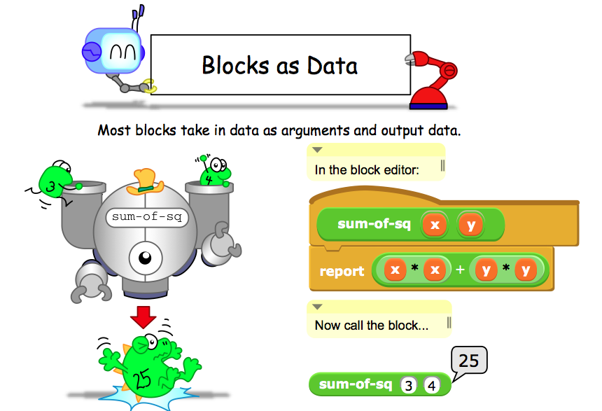
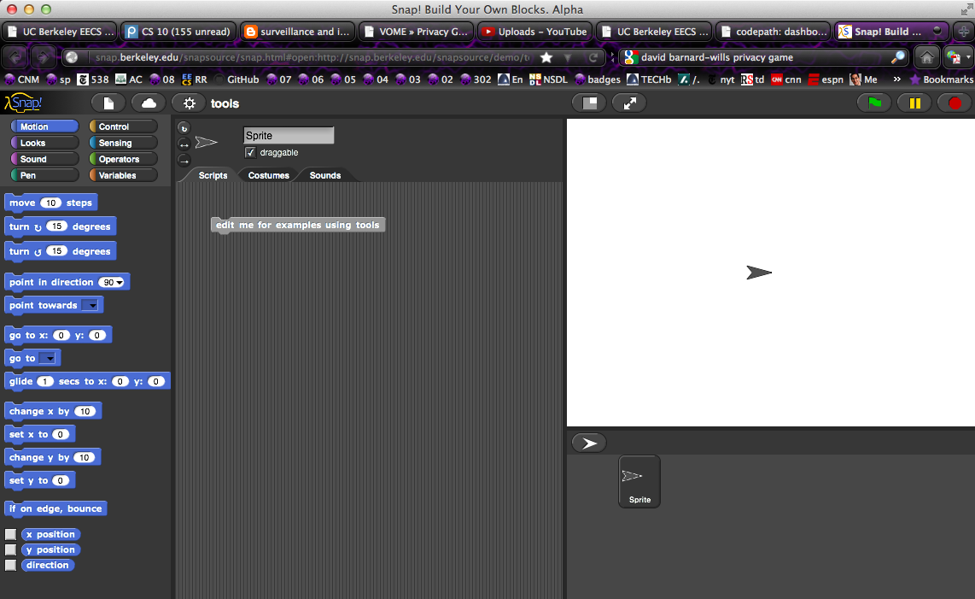
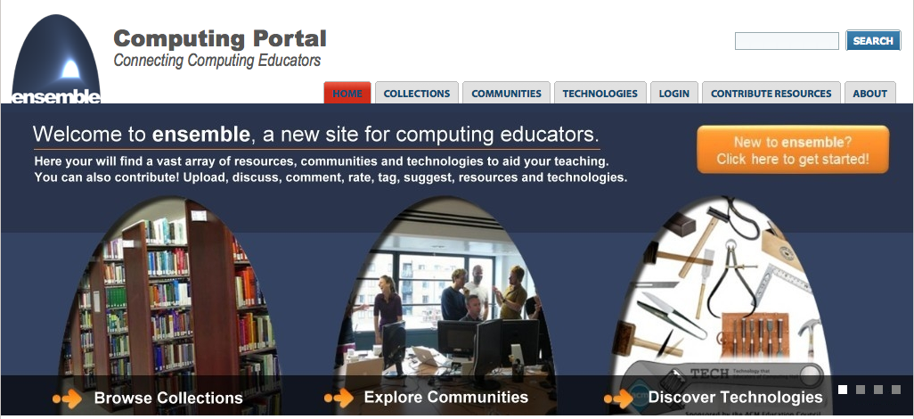
Dan’s Research Projects
CS Illustrated
Ensemble
Improve CS10/Snap!
Game Theory!
edX!

Slide 10
Opportunities Next Semester
CS150 (Digital Systems Design Techniques)
If you liked SDS, this is a great follow-on course!
CS9 series (learn a second language)
I would recommend Python next, CS9H
GamesCrafters DeCal (Game Theory R & D)
Develop SW, analysis on 2-person games of no chance. (e.g., go, chess, connect-4, nim, etc.)
Req: Game Theory / SW Interest
MS-DOS X DeCal (Mac Student Developers)
Learn to program Macintoshes.
Req: Interest. Owning a mac helps, not required.
UCBUGG DeCal (Recreational Graphics)
Develop computer-generated images, animations.
Req: 3D interest

Slide 11
Review: 5 components of any Computer
In the future, what’ll be the most important computer component?
Computer
Processor
Devices
Control
(“brain”)
Memory
Input
Control
Datapath
Memory
Input
Output
Datapath (“brawn”)
Output
Notes:
That is, any computer, no matter how primitive or advance, can be divided into five parts:
1. The input devices bring the data from the outside world into the computer.
2. These data are kept in the computer’s memory until ...
3. The datapath request and process them.
4. The operation of the datapath is controlled by the computer’s controller.
All the work done by the computer will NOT do us any good unless we can get the data back to the outside world.
5. Getting the data back to the outside world is the job of the output devices.
The most COMMON way to connect these 5 components together is to use a network of busses.

Slide 12
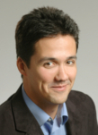
Peer Instruction Opinion
“Forget cloning. Forget TVs on your wrist watch. The biggest invention of the next 100 years will be the ability to directly connect your brain to a machine, aka wet computing.” – Dan Garcia
A macaque monkey at Duke University can already control a robotic arm with thought.
DARPA interested for mind-control robots & flying
Virtual Reality achieved with proper I/O interfacing…
Jose Carmena, UCB EECS Prof Research: Brain-Machine Interface www.eecs.berkeley.edu/~carmena/

Slide 13
Penultimate slide: Thanks to the staff!
TAs
Head TA Alan Christopher
Jeffrey Dong
Kevin Liston
Roger Chen
Sagar Karandikar
Shreyas Chand
Sung Roa Yoon
William Ku
Readers
William Huang
Ryoko Janlie
Neal Lawton
Jerry Lung
Matthew Griffin
Thanks to all the former CS61C instructors who have added to these notes…

Slide 14
The Future for Future Cal Alumni
What’s The Future?
New Millennium
Ubiquitous & Quantum Computing, Nanotechnology, 10 M “volunteer” CPUs, the Parallel revolution...
Rapid Changes in Technology, Post-PC Era!
Arguably World’s Best Education
Never Give Up!
“The best way to predict the future is to invent it” – Alan Kay
The Future is up to you!

