Slide 1
CS 61C: Great Ideas in Computer Architecture
Pipelining Hazards
Instructor: Senior Lecturer SOE Dan Garcia

Slide 2
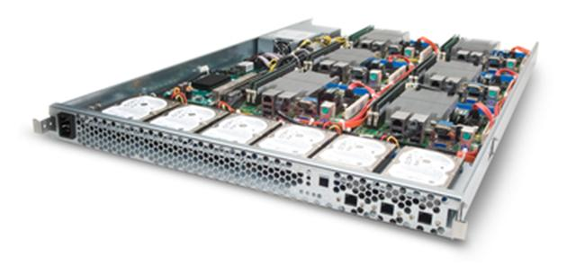
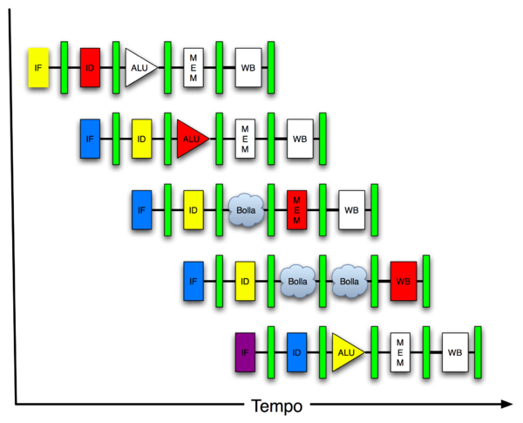
Great Idea #4: Parallelism
Software Hardware
Parallel Requests
Assigned to computer
e.g. search “Garcia”
Parallel Threads
Assigned to core
e.g. lookup, ads
Parallel Instructions
> 1 instruction @ one time
e.g. 5 pipelined instructions
Parallel Data
> 1 data item @ one time
e.g. add of 4 pairs of words
Hardware descriptions
All gates functioning in parallel at same time
Warehouse Scale Computer
Smart Phone
Leverage Parallelism &
Achieve High Performance
Computer
Core
…
Core
Memory
Input/Output
Core
Instruction Unit(s)
Functional
Unit(s)
A₀+B₀
A₁+B₁
A₂+B₂
A₃+B₃
Cache Memory
Logic Gates

Slide 3
Review of Last Lecture
Implementing controller for your datapath
Take decoded signals from instruction and generate control signals
Use “AND” and “OR” Logic scheme
Pipelining improves performance by exploiting Instruction Level Parallelism
5-stage pipeline for MIPS: IF, ID, EX, MEM, WB
Executes multiple instructions in parallel
What can go wrong???

Slide 4
Agenda
Pipelining Performance
Structural Hazards
Administrivia
Data Hazards
Forwarding
Load Delay Slot
Control Hazards

Slide 5
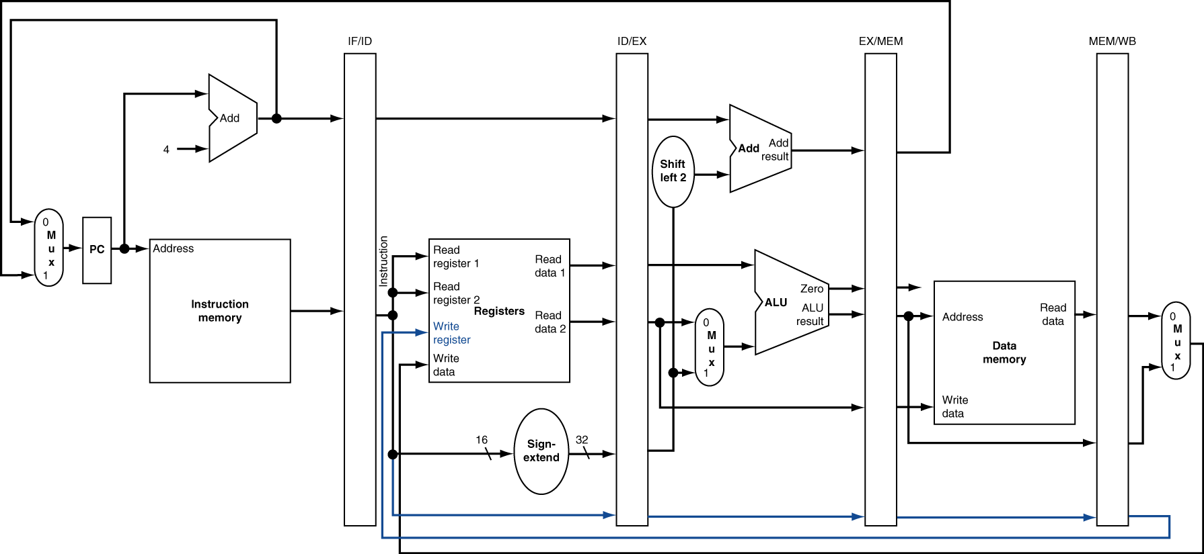
Review: Pipelined Datapath

Slide 6
Pipelined Execution Representation
Time
IF
ID
EX
MEM
WB
IF
ID
EX
MEM
WB
IF
ID
EX
MEM
WB
IF
ID
EX
MEM
WB
IF
ID
EX
MEM
WB
IF
ID
EX
MEM
WB
Every instruction must take same number of steps, so some stages will idle
e.g. MEM stage for any arithmetic instruction
Notes:
Each instruction has identical latency!

Slide 7
Graphical Pipeline Diagrams
rd
Register
File
ALU
PC
instruction
memory
rs
Data
memory
rt
+4
imm
MUX
1. Instruction
Fetch
2. Decode/
Register Read
3. Execute
4. Memory
5. Write
Back
Use datapath figure below to represent pipeline:
IF
ID
EX
Mem
WB
I$
Reg
ALU
D$
Reg

Slide 8
Graphical Pipeline Representation
RegFile: left half is write, right half is read
Time (clock cycles)
I
n
s
t
r
O
r
d
e
r
Load
I$
Reg
ALU
D$
Reg
Add
I$
Reg
ALU
D$
Reg
Store
I$
Reg
ALU
D$
Reg
Sub
I$
Reg
ALU
D$
Reg
Or
I$
Reg
ALU
D$
Reg

Slide 9
Pipelining Performance (1/3)
Use T_{c} (“time between completion of instructions”) to measure speedup
Equality only achieved if stages are balanced (i.e. take the same amount of time)
If not balanced, speedup is reduced
Speedup due to increased throughput
Latency for each instruction does not decrease

Slide 10
Pipelining Performance (2/3)
Assume time for stages is
100ps for register read or write
200ps for other stages
What is pipelined clock rate?
Compare pipelined datapath with single-cycle datapath
Instr | Instr fetch | Register read | ALU op | Memory access | Register write | Total time
lw | 200ps | 100 ps | 200ps | 200ps | 100 ps | 800ps
sw | 200ps | 100 ps | 200ps | 200ps |  | 700ps
R-format | 200ps | 100 ps | 200ps |  | 100 ps | 600ps
beq | 200ps | 100 ps | 200ps |  |  | 500ps

Slide 11
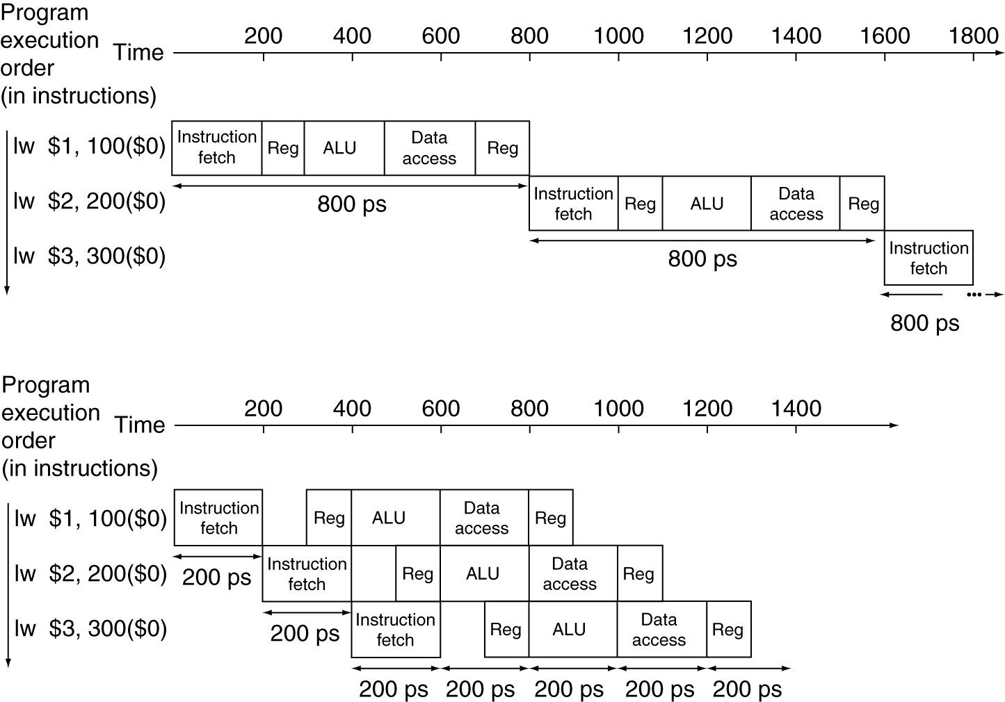
Pipelining Performance (3/3)
Single-cycle
T_{c} = 800 ps
Pipelined
T_{c} = 200 ps
Notes:
Here using T_{c} as “time between completion of instructions.”

Slide 12
Pipelining Hazards
A hazard is a situation that prevents starting the next instruction in the next clock cycle
Structural hazard
A required resource is busy (e.g. needed in multiple stages)
Data hazard
Data dependency between instructions
Need to wait for previous instruction to complete its data read/write
Control hazard
Flow of execution depends on previous instruction

Slide 13
Agenda
Pipelining Performance
Structural Hazards
Administrivia
Data Hazards
Forwarding
Load Delay Slot
Control Hazards

Slide 14
1. Structural Hazards
Conflict for use of a resource
MIPS pipeline with a single memory?
Load/Store requires memory access for data
Instruction fetch would have to stall for that cycle
Causes a pipeline “bubble”
Hence, pipelined datapaths require separate instruction/data memories
Separate L1 I$ and L1 D$ take care of this

Slide 15
Structural Hazard #1: Single Memory
Time (clock cycles)
I
n
s
t
r
O
r
d
e
r
Trying to read same memory twice in same clock cycle
Load
I$
Reg
ALU
D$
Reg
Instr 1
I$
Reg
ALU
D$
Reg
Instr 2
I$
Reg
ALU
D$
Reg
Instr 3
I$
Reg
ALU
D$
Reg
Instr 4
I$
Reg
ALU
D$
Reg

Slide 16
Structural Hazard #2: Registers (1/2)
Time (clock cycles)
I
n
s
t
r
O
r
d
e
r
Load
I$
Reg
ALU
D$
Reg
Can we read and write to registers simultaneously?
Instr 1
I$
Reg
ALU
D$
Reg
Instr 2
I$
Reg
ALU
D$
Reg
Instr 3
I$
Reg
ALU
D$
Reg
Instr 4
I$
Reg
ALU
D$
Reg

Slide 17
Structural Hazard #2: Registers (2/2)
Two different solutions have been used:
Split RegFile access in two: Write during 1st half and Read during 2nd half of each clock cycle
Possible because RegFile access is VERY fast (takes less than half the time of ALU stage)
Build RegFile with independent read and write ports
Conclusion: Read and Write to registers during same clock cycle is okay

Slide 18
Agenda
Pipelining Performance
Structural Hazards
Administrivia
Data Hazards
Forwarding
Load Delay Slot
Control Hazards

Slide 19
Administrivia
Check-in with Project 3…

Slide 20
Agenda
Pipelining Performance
Structural Hazards
Administrivia
Data Hazards
Forwarding
Load Delay Slot
Control Hazards

Slide 21
2. Data Hazards (1/2)
Consider the following sequence of instructions:
add $t0, $t1, $t2
sub $t4, $t0, $t3
and $t5, $t0, $t6
or $t7, $t0, $t8
xor $t9, $t0, $t10

Slide 22
2. Data Hazards (2/2)
Data-flow backwards in time are hazards
Time (clock cycles)
I
n
s
t
r
O
r
d
e
r
IF
ID/RF
EX
MEM
WB
add $t0,$t1,$t2
I$
Reg
ALU
D$
Reg
sub $t4,$t0,$t3
I$
Reg
ALU
D$
Reg
and $t5,$t0,$t6
I$
Reg
ALU
D$
Reg
or $t7,$t0,$t8
I$
Reg
ALU
D$
Reg
xor $t9,$t0,$t10
I$
Reg
ALU
D$
Reg

Slide 23
Data Hazard Solution: Forwarding
Forward result as soon as it is available
OK that it’s not stored in RegFile yet
IF
ID/RF
EX
MEM
WB
add $t0,$t1,$t2
I$
Reg
ALU
D$
Reg
sub $t4,$t0,$t3
I$
Reg
ALU
D$
Reg
and $t5,$t0,$t6
I$
Reg
ALU
D$
Reg
or $t7,$t0,$t8
I$
Reg
ALU
D$
Reg
xor $t9,$t0,$t10
I$
Reg
ALU
D$
Reg

Slide 24
Datapath for Forwarding (1/2)
What changes need to be made here?

Slide 25
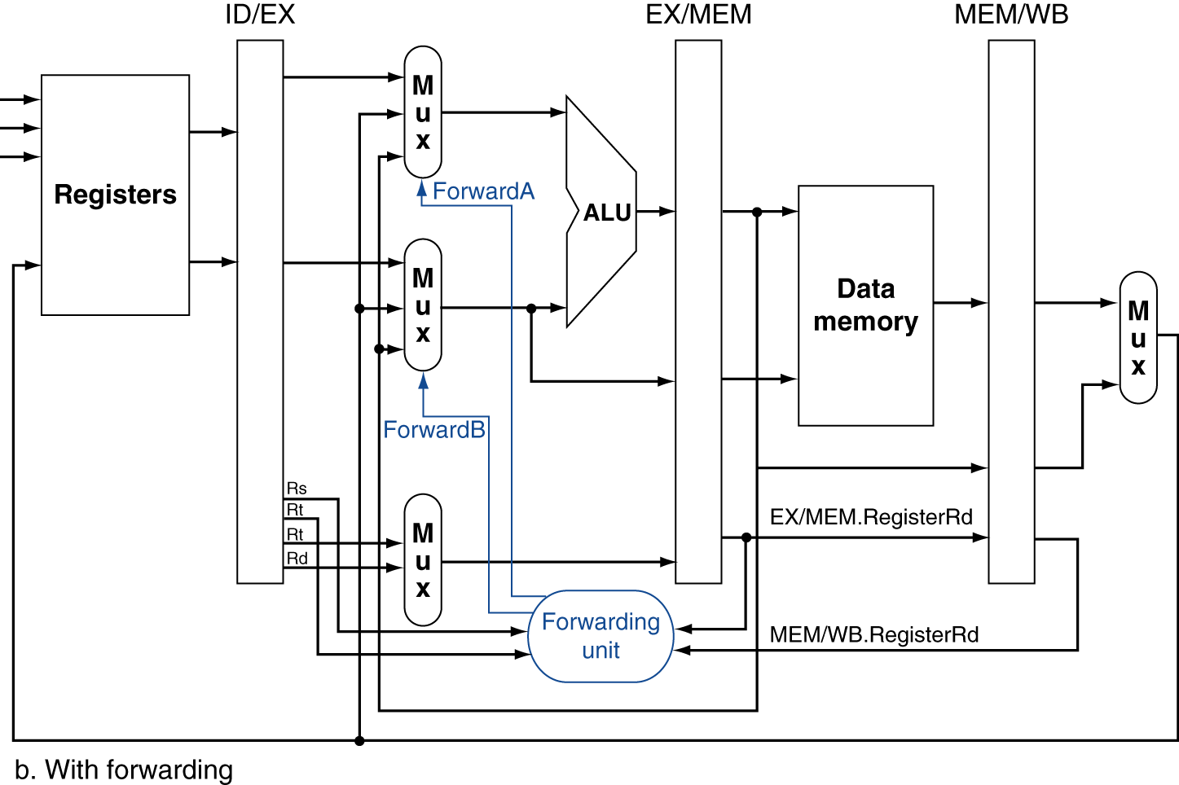
Datapath for Forwarding (2/2)
Handled by forwarding unit
Notes:
Scan figure 4.54 on p. 368.

Slide 26
Data Hazard: Loads (1/4)
Recall: Dataflow backwards in time are hazards
Can’t solve all cases with forwarding
Must stall instruction dependent on load, then forward (more hardware)
IF
ID/RF
EX
MEM
WB
lw $t0,0($t1)
I$
Reg
ALU
D$
Reg
sub $t3,$t0,$t2
I$
Reg
ALU
D$
Reg

Slide 27
Data Hazard: Loads (2/4)
Schematically, this is what we want, but in reality stalls done “horizontally”
Hardware stalls pipeline
Called “hardware interlock”
IF
ID/RF
EX
MEM
WB
lw $t0, 0($t1)
I$
Reg
ALU
D$
Reg
sub $t3,$t0,$t2
bubble
I$
Reg
ALU
D$
Reg
and $t5,$t0,$t4
I$
bubble
Reg
ALU
D$
Reg
or $t7,$t0,$t6
How to stall just part of pipeline?
bubble
I$
Reg
ALU
D$

Slide 28
Data Hazard: Loads (3/4)
Stall is equivalent to nop
lw $t0, 0($t1)
I$
Reg
ALU
D$
Reg
nop
bubble
bubble
bubble
bubble
bubble
sub $t3,$t0,$t2
I$
Reg
ALU
D$
Reg
and $t5,$t0,$t4
I$
Reg
ALU
Reg
D$
or $t7,$t0,$t6
I$
Reg
ALU
D$

Slide 29
Data Hazard: Loads (4/4)
Slot after a load is called a load delay slot
If that instruction uses the result of the load, then the hardware interlock will stall it for one cycle
Letting the hardware stall the instruction in the delay slot is equivalent to putting a nop in the slot (except the latter uses more code space)
Idea: Let the compiler put an unrelated instruction in that slot → no stall!

Slide 30
Code Scheduling to Avoid Stalls
Reorder code to avoid use of load result in the next instruction!
MIPS code for D=A+B; E=A+C;
# Method 1:
lw $t1, 0($t0)
lw $t2, 4($t0)
add $t3, $t1, $t2
sw $t3, 12($t0)
lw $t4, 8($t0)
add $t5, $t1, $t4
sw $t5, 16($t0)
# Method 2:
lw $t1, 0($t0)
lw $t2, 4($t0)
lw $t4, 8($t0)
add $t3, $t1, $t2
sw $t3, 12($t0)
add $t5, $t1, $t4
sw $t5, 16($t0)
Stall!
Stall!
13 cycles
11 cycles

Slide 31
Agenda
More Pipelining
Structural Hazards
Administrivia
Data Hazards
Forwarding
Load Delay Slot
Control Hazards

Slide 32
3. Control Hazards
Branch (beq, bne) determines flow of control
Fetching next instruction depends on branch outcome
Pipeline can’t always fetch correct instruction
Still working on ID stage of branch
Simple Solution: Stall on every branch until we have the new PC value
How long must we stall?

Slide 33
Branch Stall
When is comparison result available?
Time (clock cycles)
I
n
s
t
r
O
r
d
e
r
beq
I$
Reg
ALU
D$
Reg
TWO bubbles required per branch!
Instr 1
I$
Reg
ALU
D$
Reg
Instr 2
I$
Reg
ALU
D$
Reg
Instr 3
I$
Reg
ALU
D$
Reg
Instr 4
I$
Reg
ALU
D$
Reg

Slide 34
Summary
Hazards reduce effectiveness of pipelining
Cause stalls/bubbles
Structural Hazards
Conflict in use of datapath component
Data Hazards
Need to wait for result of a previous instruction
Control Hazards
Address of next instruction uncertain/unknown
More to come next lecture!

Slide 35
Question: For each code sequences below, choose one of the statements below:
1: lw $t0,0($t0) add $t1,$t0,$t0 | 2: add $t1,$t0,$t0 addi $t2,$t0,5 addi $t4,$t1,5 | 3: addi $t1,$t0,1 addi $t2,$t0,2 addi $t3,$t0,2 addi $t3,$t0,4 addi $t5,$t1,5
A)
No stalls as is
B)
No stalls with forwarding
C)
Must stall

Slide 36
Code Sequence 1
Time (clock cycles)
I
n
s
t
r
O
r
d
e
r
lw
I$
Reg
ALU
D$
Reg
Must stall
add
I$
Reg
ALU
D$
Reg
instr
I$
Reg
ALU
D$
Reg
instr
I$
Reg
ALU
D$
Reg
instr
I$
Reg
ALU
D$
Reg

Slide 37
Code Sequence 2
Time (clock cycles)
forwarding
I
n
s
t
r
O
r
d
e
r
no forwarding
add
I$
Reg
ALU
D$
Reg
No stalls with forwarding
addi
I$
Reg
ALU
D$
Reg
addi
I$
Reg
ALU
D$
Reg
instr
I$
Reg
ALU
D$
Reg
instr
I$
Reg
ALU
D$
Reg

Slide 38
Code Sequence 3
Time (clock cycles)
I
n
s
t
r
O
r
d
e
r
I$
Reg
ALU
D$
Reg
No stalls as is
addi
addi
I$
Reg
ALU
D$
Reg
addi
I$
Reg
ALU
D$
Reg
addi
I$
Reg
ALU
D$
Reg
addi
I$
Reg
ALU
D$
Reg

