Slide 1
CS 61C: Great Ideas in Computer Architecture (Machine Structures) Lecture 30: Pipeline Parallelism 1
Lecturer:
Alan Christopher

Slide 2
Datapath Control Signals
ExtOp: “zero”, “sign”
ALUsrc: 0 ⇒ regB; 1 ⇒ immed
ALUctr: “ADD”, “SUB”, “OR”
MemWr: 1 ⇒ write memory
MemtoReg: 0 ⇒ ALU; 1 ⇒ Mem
nPC_sel: 0 ⇒ “+4”; 1 ⇒ “br”
RegDst: 0 ⇒ “rt”; 1 ⇒ “rd”
RegWr: 1 ⇒ write register
RegDst
Rd
Rt
ALUctr
MemtoReg
Inst Address
1
0
MemWr
nPC_sel & Equal
RegWr
Rs
Rt
4
5
5
5
Rw
Ra
Rb
busA
32
Adder
busW
0
00
32
32
RegFile
busB
ALU
0
Mux
PC
0
clk
32
1
32
WrEn
Adr
Adder
imm16
Data In
clk
Extender
1
Data
Memory
1
PC Ext
16
32
ALUSrc
clk
ExtOp
imm16

Slide 3
Where Do Control Signals Come From?
Instruction<31:0>
Inst
Memory
<0:5>
<21:25>
<16:20>
<11:15>
<0:15>
<26:31>
Adr
Op
Fun
Rt
Rs
Rd
Imm16
Control
nPC_sel
RegWr
RegDst
ExtOp
ALUSrc
ALUctr
MemWr
MemtoReg
DATA PATH

Slide 4
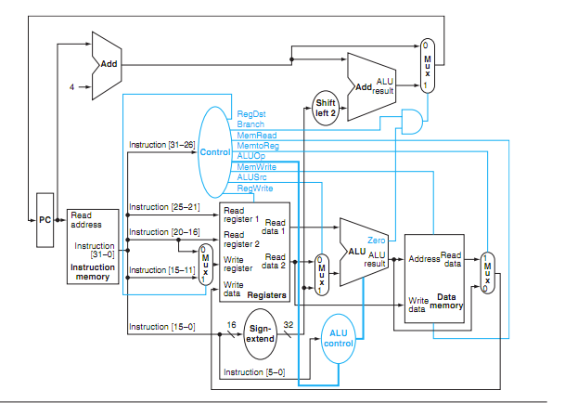
P&H Figure 4.17

Slide 5
Summary of the Control Signals (1/2)
inst Register Transfer
add R[rd] ← R[rs] + R[rt]; PC ← PC + 4
ALUsrc=RegB, ALUctr=“ADD”, RegDst=rd, RegWr, nPC_sel=“+4”
sub R[rd] ← R[rs] – R[rt]; PC ← PC + 4
ALUsrc=RegB, ALUctr=“SUB”, RegDst=rd, RegWr, nPC_sel=“+4”
ori R[rt] ← R[rs] + zero_ext(Imm16); PC ← PC + 4
ALUsrc=Im, Extop=“Z”, ALUctr=“OR”, RegDst=rt,RegWr, nPC_sel=“+4”
lw R[rt] ← MEM[ R[rs] + sign_ext(Imm16)]; PC ← PC + 4
ALUsrc=Im, Extop=“sn”, ALUctr=“ADD”, MemtoReg, RegDst=rt, RegWr, nPC_sel = “+4”
sw MEM[ R[rs] + sign_ext(Imm16)] ← R[rs]; PC ← PC + 4
ALUsrc=Im, Extop=“sn”, ALUctr = “ADD”, MemWr, nPC_sel = “+4”
beq if (R[rs] == R[rt]) then PC ← PC + sign_ext(Imm16)] || 00 else PC ← PC + 4
nPC_sel = “br”, ALUctr = “SUB”

Slide 6
Summary of the Control Signals (2/2)
See
func
10 0000
10 0010
We Don’t Care :-)
Appendix A
op
00 0000
00 0000
00 1101
10 0011
10 1011
00 0100
00 0010
add
sub
ori
lw
sw
beq
jump
RegDst
1
1
0
0
x
x
x
ALUSrc
0
0
1
1
1
0
x
MemtoReg
0
0
0
1
x
x
x
RegWrite
1
1
1
1
0
0
0
MemWrite
0
0
0
0
1
0
0
nPCsel
0
0
0
0
0
1
?
Jump
0
0
0
0
0
0
1
ExtOp
x
x
0
1
1
x
x
ALUctr<2:0>
Add
Subtract
Or
Add
Add
Subtract
x
31
26
21
16
11
6
0
R-type
op
rs
rt
rd
shamt
funct
add, sub
I-type
op
rs
rt
immediate
ori, lw, sw, beq
J-type
op
target address
jump
Notes:
Here is a table summarizing the control signals setting for the seven (add, sub, ...) instructions we have looked at.
Instead of showing you the exact bit values for the ALU control (ALUctr), I have used the symbolic values here.
The first two columns are unique in the sense that they are R-type instrucions and in order to uniquely identify them, we need to look at BOTH the op field as well as the func fiels.
Ori, lw, sw, and branch on equal are I-type instructions and Jump is J-type. They all can be uniquely idetified by looking at the opcode field alone.
Now let’s take a more careful look at the first two columns. Notice that they are identical except the last row.
So we can combine these two rows here if we can “delay” the generation of ALUctr signals.
This lead us to something call “local decoding.”
+3 = 42 min. (Y:22)

Slide 7
Boolean Exprs for Controller
rtype = ~op₅ • ~op₄ • ~op₃ • ~op₂ • ~op₁ • ~op₀, ori = ~op₅ • ~op₄ • op₃ • op₂ • ~op₁ • op₀ lw = op₅ • ~op₄ • ~op₃ • ~op₂ • op₁ • op₀ sw = op₅ • ~op₄ • op₃ • ~op₂ • op₁ • op₀ beq = ~op₅ • ~op₄ • ~op₃ • op₂ • ~op₁ • ~op₀ jump = ~op₅ • ~op₄ • ~op₃ • ~op₂ • op₁ • ~op₀
Instruction<31:0>
Inst
Memory
Op 0-5 are really Instruction bits 26-31
<0:5>
<21:25>
<16:20>
<11:15>
<0:15>
<26:31>
Func 0-5 are really Instruction bits 0-5
Adr
Op
Fun
Rt
Rs
Rd
Imm16
add = rtype • func₅ • ~func₄ • ~func₃ • ~func₂ • ~func₁ • ~func₀ sub = rtype • func₅ • ~func₄ • ~func₃ • ~func₂ • func₁ • ~func₀
How do we implement this in gates?
Notes:
ADD 0000 00ss ssst tttt dddd d000 0010 0000
SUB 0000 00ss ssst tttt dddd d000 0010 0010
ORI 0011 01ss ssst tttt iiii iiii iiii iiii
LW 1000 11ss ssst tttt iiii iiii iiii iiii
SW 1010 11ss ssst tttt iiii iiii iiii iiii
BEQ 0001 00ss ssst tttt iiii iiii iiii iiii
JUMP 0000 10ii iiii iiii iiii iiii iiii iiii

Slide 8
Controller Implementation
opcode
func
add
RegDst
ALUSrc
sub
MemtoReg
ori
RegWrite
“AND” logic
lw
“OR” logic
MemWrite
sw
nPCsel
Jump
beq
ExtOp
jump
ALUctr[0]
ALUctr[1]

Slide 9
Boolean Exprs for Controller
RegDst = add + sub ALUSrc = ori + lw + sw MemtoReg = lw RegWrite = add + sub + ori + lw MemWrite = sw nPCsel = beq Jump = jump ExtOp = lw + sw ALUctr[0] = sub + beq ALUctr[1] = ori
(assume ALUctr is 00 ADD, 01 SUB, 10 OR)
How do we implement this in gates?
Notes:
ADD 0000 00ss ssst tttt dddd d000 0010 0000
SUB 0000 00ss ssst tttt dddd d000 0010 0010
ORI 0011 01ss ssst tttt iiii iiii iiii iiii
LW 1000 11ss ssst tttt iiii iiii iiii iiii
SW 1010 11ss ssst tttt iiii iiii iiii iiii
BEQ 0001 00ss ssst tttt iiii iiii iiii iiii
JUMP 0000 10ii iiii iiii iiii iiii iiii iiii

Slide 10
Controller Implementation
opcode
func
add
RegDst
ALUSrc
sub
MemtoReg
ori
RegWrite
“AND” logic
lw
“OR” logic
MemWrite
sw
nPCsel
Jump
beq
ExtOp
jump
ALUctr[0]
ALUctr[1]

Slide 11
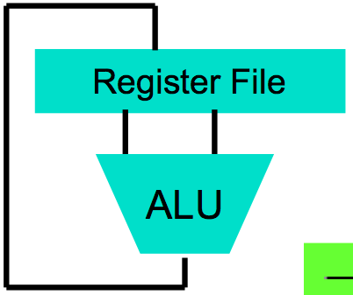
Call home, we’ve made HW/SW contact!
High Level Language Program (e.g., C)
temp = v[k];
v[k] = v[k+1];
v[k+1] = temp;
Compiler
Assembly Language Program (e.g.,MIPS)
lw $t0, 0($2)
lw $t1, 4($2)
sw $t1, 0($2)
sw $t0, 4($2)
Assembler
Machine Language Program (MIPS)
0000 1001 1100 0110 1010 1111 0101 1000
1010 1111 0101 1000 0000 1001 1100 0110
1100 0110 1010 1111 0101 1000 0000 1001
0101 1000 0000 1001 1100 0110 1010 1111
Machine Interpretation
Hardware Architecture Description (e.g., block diagrams)
Architecture Implementation
Logic Circuit Description (Circuit Schematic Diagrams)

Slide 12
Administrivia/Clicker
How many hours of fun from proj3 so far?
0 <= F <= 4
4 < F <= 8
8 < F <= 12
12 < F <= 16
16 < F

Slide 13
Administrivia/Clicker
How many Gflop/s right now?
0 <= F <= 4
4 < F <= 8
8 < F <= 12
12 < F <= 16
16 < F

Slide 14
Review: Single-cycle Processor
Five steps to design a processor:
1. Analyze instruction set → datapath requirements
2. Select set of datapath components & establish clock methodology
3. Assemble datapath meeting the requirements
4. Analyze implementation of each instruction to determine setting of control points that effects the register transfer.
5. Assemble the control logic
Formulate Logic Equations
Design Circuits
Processor
Input
Control
Memory
Datapath
Output

Slide 15
Single Cycle Performance
Assume time for actions are
100ps for register read or write; 200ps for other events
Clock rate is?
Instr | Instr fetch | Register read | ALU op | Memory access | Register write | Total time
lw | 200ps | 100 ps | 200ps | 200ps | 100 ps | 800ps
sw | 200ps | 100 ps | 200ps | 200ps |  | 700ps
R-format | 200ps | 100 ps | 200ps |  | 100 ps | 600ps
beq | 200ps | 100 ps | 200ps |  |  | 500ps
What can we do to improve clock rate?
Will this improve performance as well?
Want increased clock rate to mean faster programs
Notes:
1.25 GHz

Slide 16
Single Cycle Performance
Assume time for actions are
100ps for register read or write; 200ps for other events
Clock rate is?
Instr | Instr fetch | Register read | ALU op | Memory access | Register write | Total time
lw | 200ps | 100 ps | 200ps | 200ps | 100 ps | 800ps
sw | 200ps | 100 ps | 200ps | 200ps |  | 700ps
R-format | 200ps | 100 ps | 200ps |  | 100 ps | 600ps
beq | 200ps | 100 ps | 200ps |  |  | 500ps
What can we do to improve clock rate?
Will this improve performance as well?
Want increased clock rate to mean faster programs
Notes:
1.25 GHz

Slide 17
Gotta Do Laundry
Ann, Brian, Cathy, Dave each have one load of clothes to wash, dry, fold, and put away
Washer takes 30 minutes
Dryer takes 30 minutes
“Folder” takes 30 minutes
“Stasher” takes 30 minutes to put clothes into drawers
A
B
C
D

Slide 18
Sequential Laundry
Sequential laundry takes 8 hours for 4 loads
6 PM
7
8
9
10
11
12
1
2 AM
T
a
s
k
O
r
d
e
r
30
30
30
30
30
30
30
30
30
30
30
30
30
30
30
30
Time
A
B
C
D

Slide 19
Pipelined Laundry
Pipelined laundry takes 3.5 hours for 4 loads!
6 PM
7
8
9
10
11
12
1
2 AM
30
30
30
30
30
Time
T
a
s
k
O
r
d
e
r
30
30
A
B
C
D

Slide 20
Pipelining Lessons (1/2)
6 PM
7
8
9
Pipelining doesn’t help latency of single task, it helps throughput of entire workload
Multiple tasks operating simultaneously using different resources
Potential speedup = Number pipe stages
Time to “fill” pipeline and time to “drain” it reduces speedup: 2.3X v. 4X in this example
T
a
s
k
O
r
d
e
r
Time
30
30
30
30
30
30
30
A
B
C
D

Slide 21
Pipelining Lessons (2/2)
6 PM
7
8
9
Suppose new Washer takes 20 minutes, new Stasher takes 20 minutes. How much faster is pipeline?
Pipeline rate limited by slowest pipeline stage
Unbalanced lengths of pipe stages reduces speedup
T
a
s
k
O
r
d
e
r
Time
30
30
30
30
30
30
30
A
B
C
D

Slide 22
Steps in Executing MIPS
1) IFtch: Instruction Fetch, Increment PC
2) Dcd: Instruction Decode, Read Registers
3) Exec: Mem-ref: Calculate Address Arith-log: Perform Operation
4) Mem: Load: Read Data from Memory Store: Write Data to Memory
5) WB: Write Data Back to Register

Slide 23
Single Cycle Datapath
rd
PC
instruction
memory
registers
rs
Data
memory
rt
ALU
+4
imm
2. Decode/
Register Read
1. Instruction
Fetch
5. Write Back
3. Execute
4. Memory

Slide 24
Pipeline registers
rd
PC
instruction
memory
registers
rs
Data
memory
rt
ALU
+4
imm
2. Decode/
Register Read
1. Instruction
Fetch
5. Write Back
3. Execute
4. Memory
Need registers between stages
To hold information produced in previous cycle

Slide 25
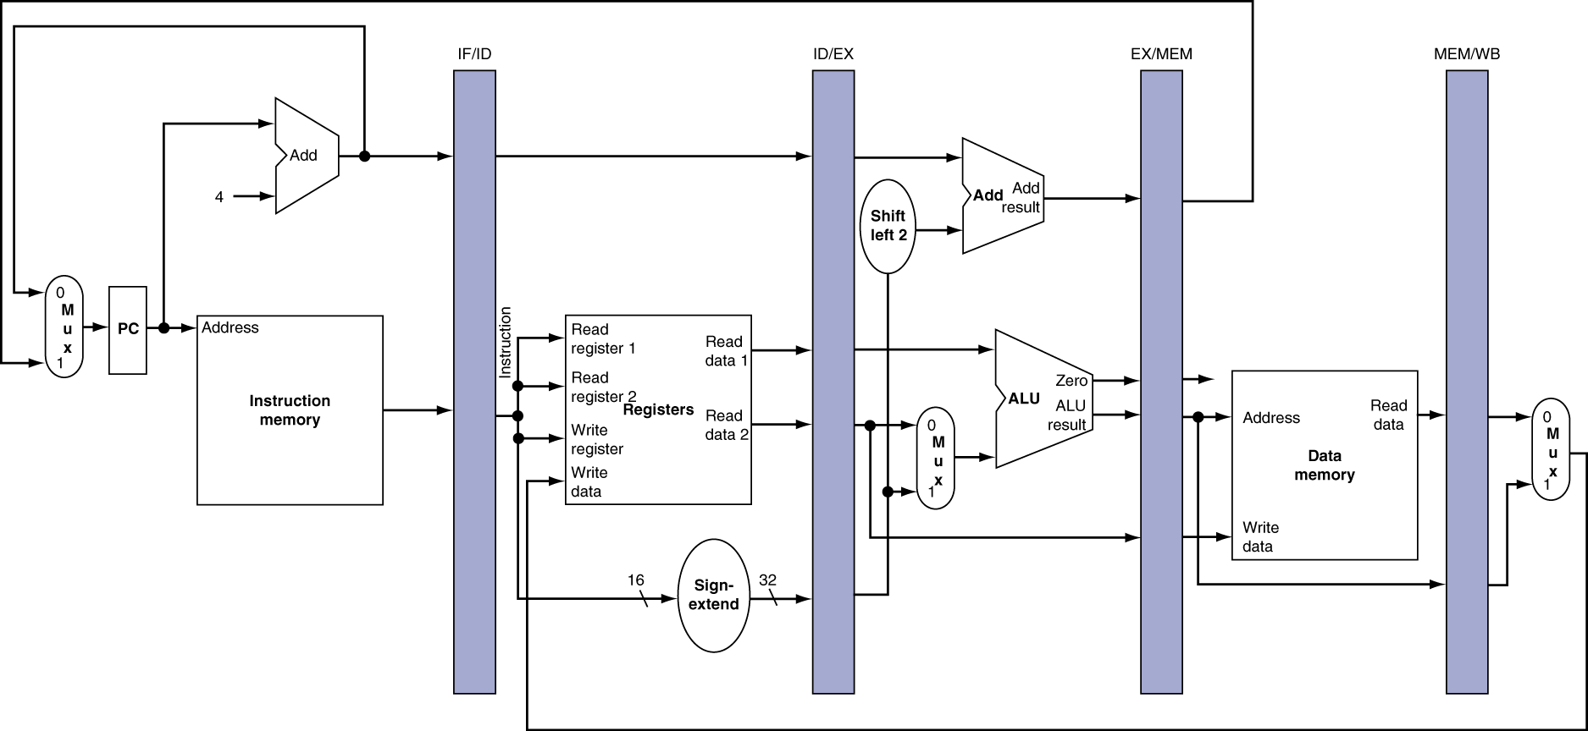
More Detailed Pipeline

Slide 26
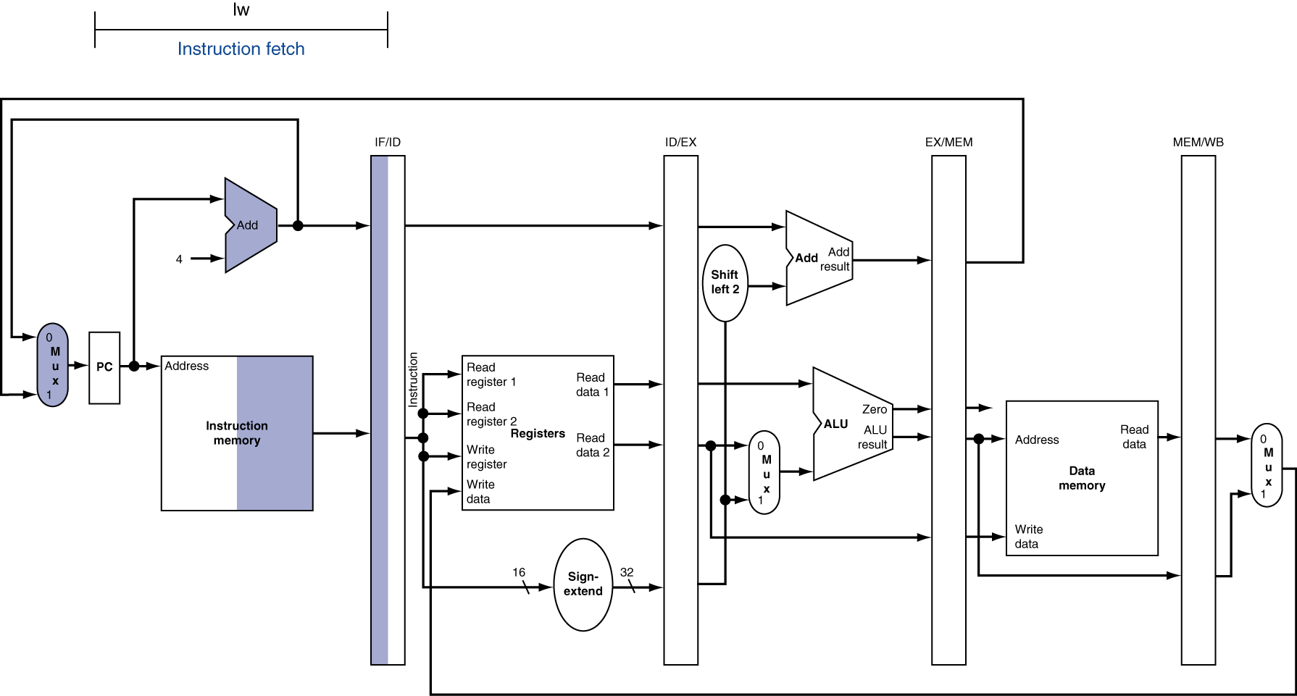
IF for Load, Store, …

Slide 27
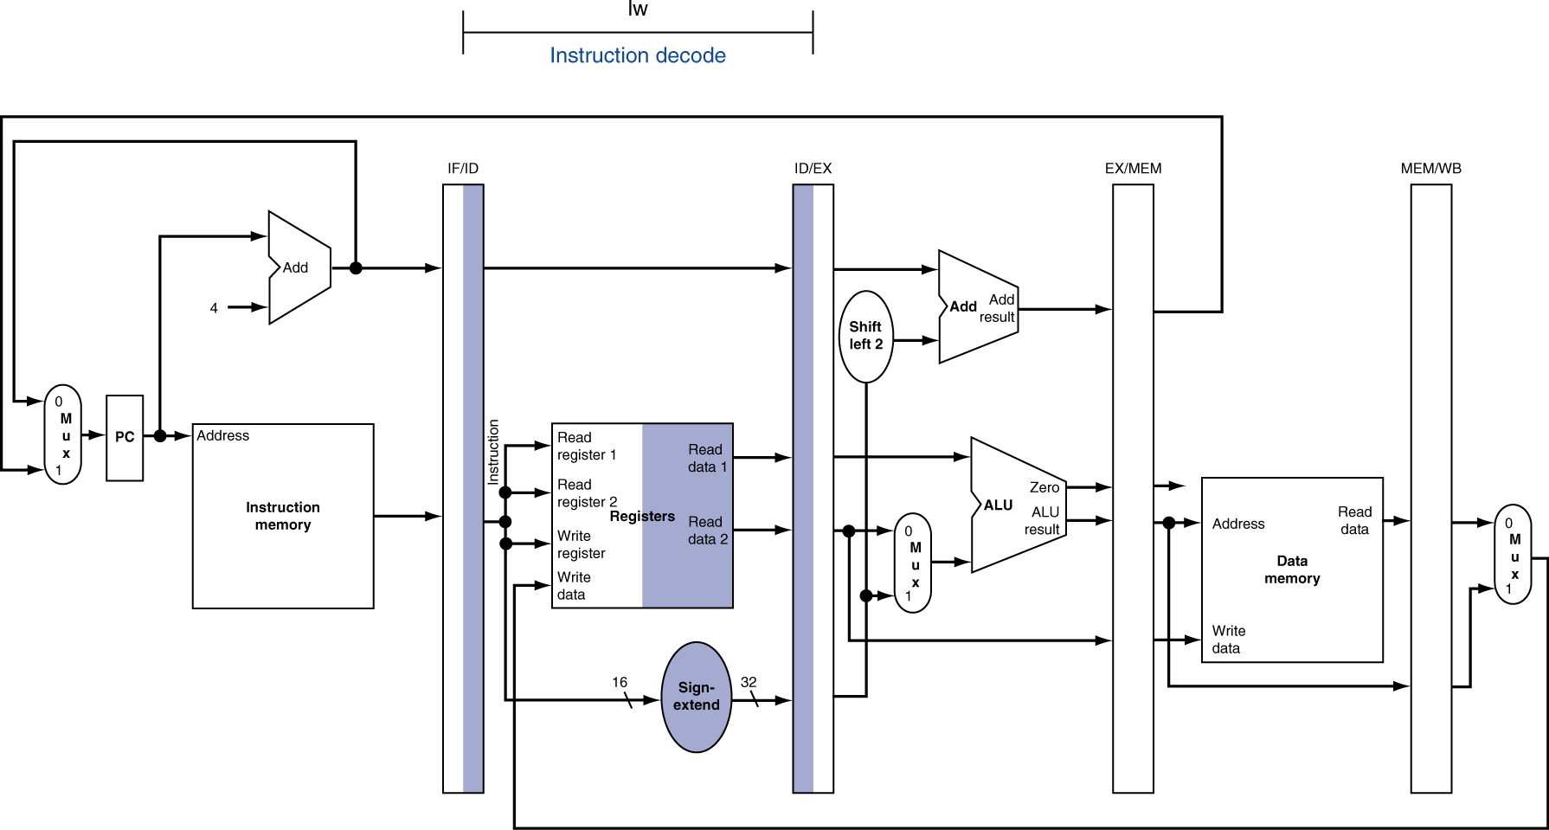
ID for Load, Store, …

Slide 28
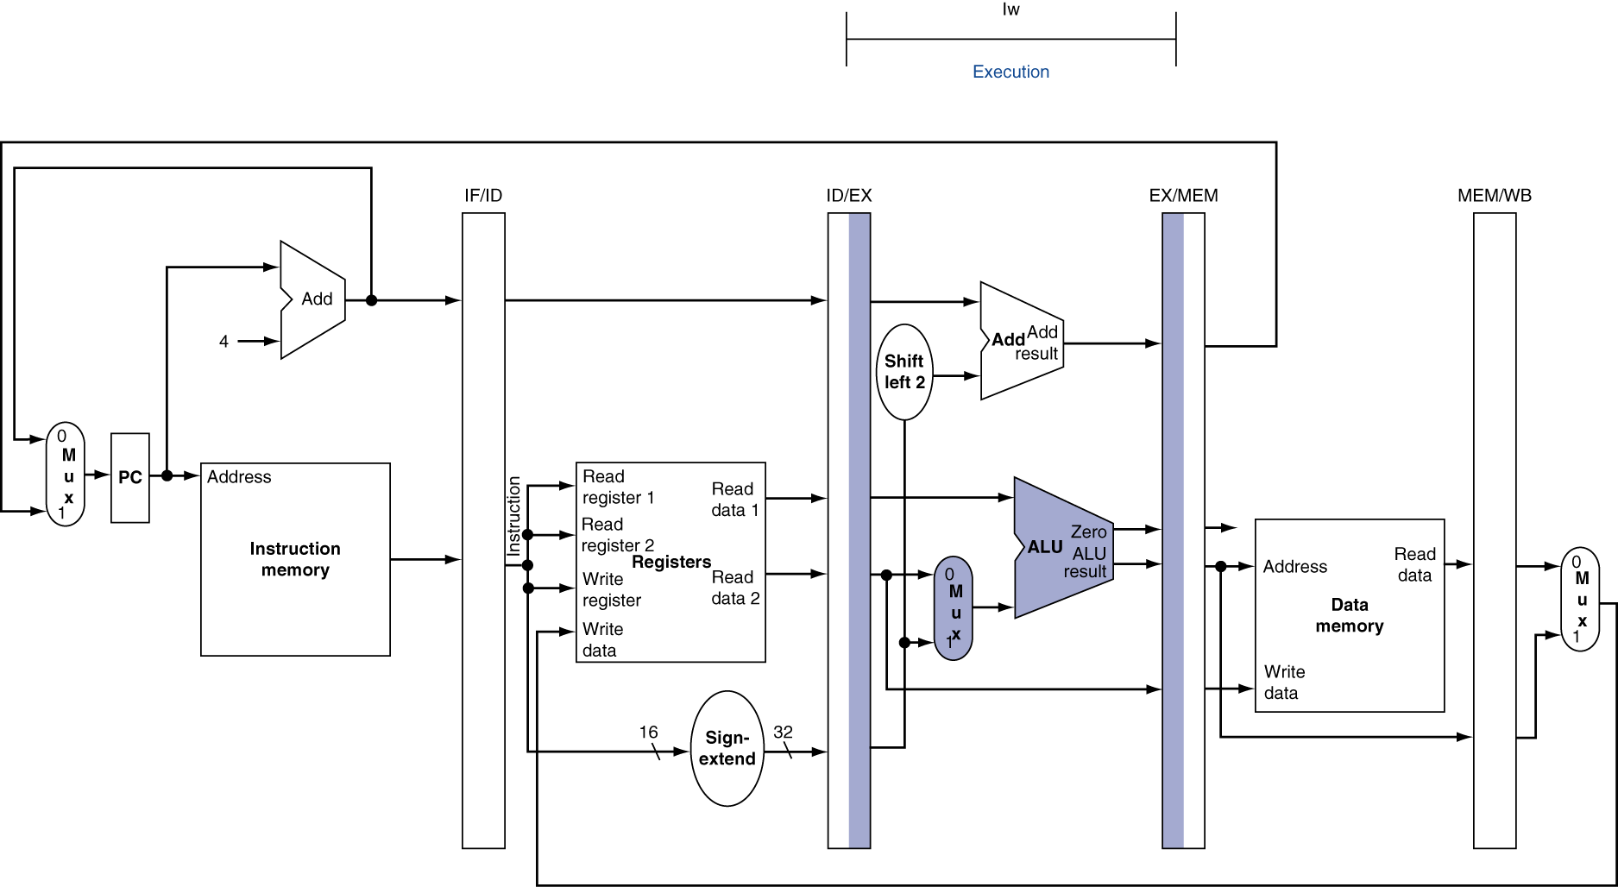
EX for Load

Slide 29
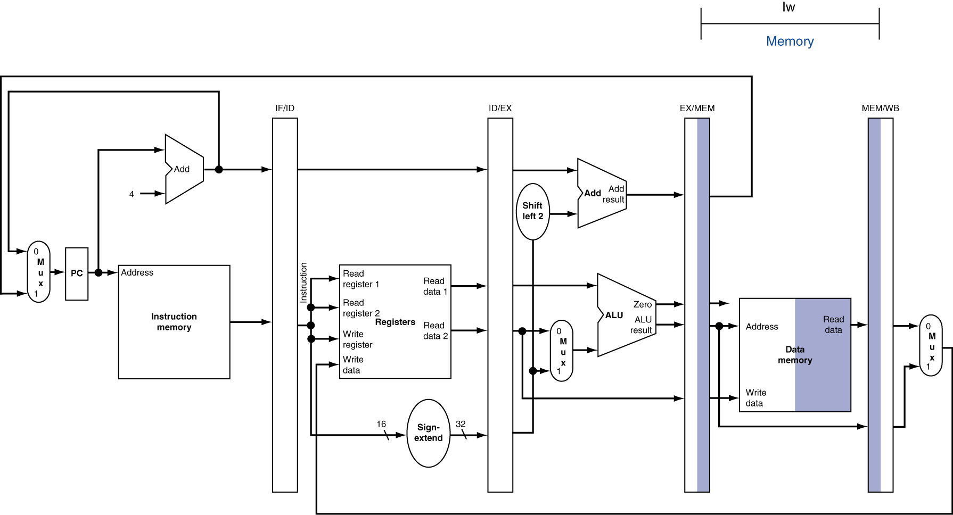
MEM for Load

Slide 30
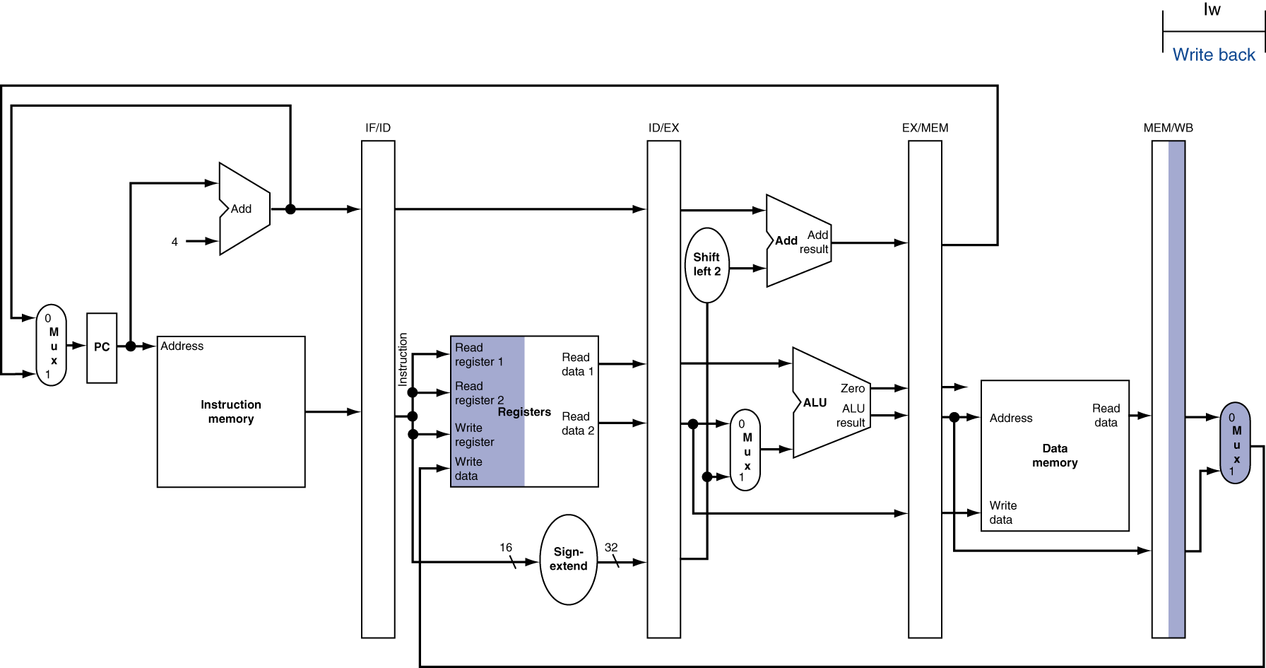
WB for Load – Oops!
Wrong register number

Slide 31
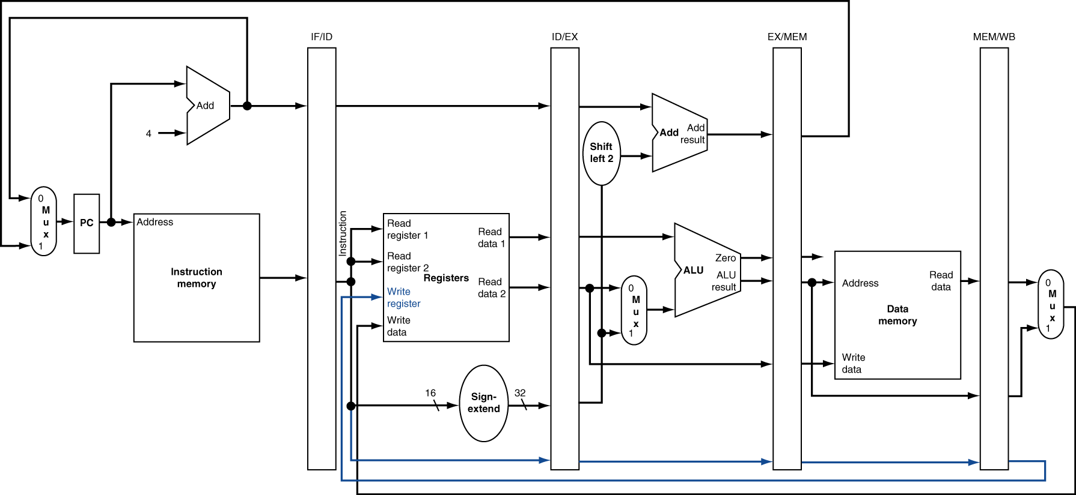
Corrected Datapath for Load

Slide 32
Peer Instruction
123
a: FFF
b: FFT
b: FTF
c: FTT
c: TFF
d: TFT
d: TTF
e: TTT
Thanks to pipelining, I have reduced the time it took me to wash my shirt.
Longer pipelines are always a win (since less work per stage & a faster clock).
We can rely on compilers to help us avoid data hazards by reordering instrs.

Slide 33
So, in conclusion
You now know how to implement the control logic for the single-cycle CPU.
(actually, you already knew it!)
Pipelining improves performance by increasing instruction throughput: exploits ILP
Executes multiple instructions in parallel
Each instruction has the same latency
Next: hazards in pipelining:
Structure, data, control

