Slide 1
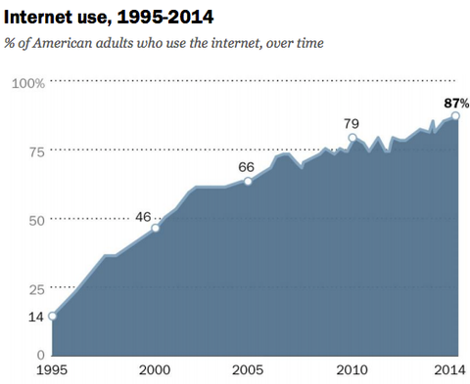
inst.eecs.berkeley.edu/~cs61c CS61C : Machine Structures Lecture 23
Introduction to Synchronous Digital Systems (SDS) Switches, Transistors, Gates
Senior Lecturer SOE Dan Garcia
www.cs.berkeley.edu/~ddgarcia
Web turns 25 ⇒ In 1989, Sir Tim Berners-Lee sat in an office in CERN and developed the WWW. Celebrate: #web25
bits.blogs.nytimes.com/2014/03/11/as-the-world-wide-web-turns-25-fear-about-its-future
Notes:
Greet class

Slide 2
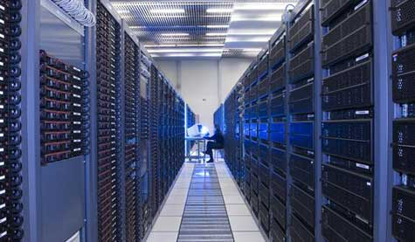
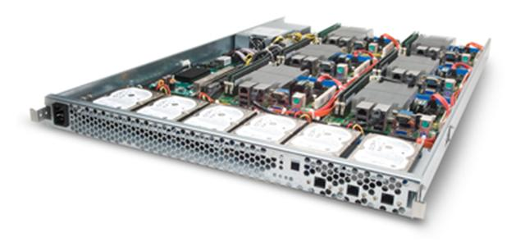
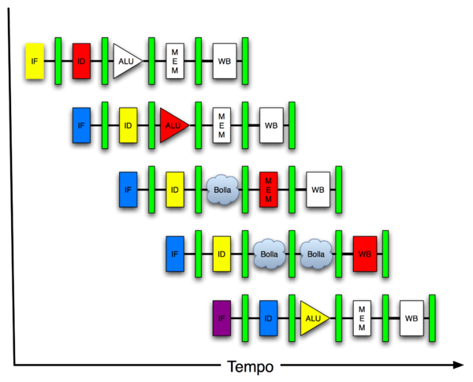
New-School Machine Structures (It’s a bit more complicated!)
Software Hardware
Parallel Requests
Assigned to computer
e.g., Search “Garcia”
Parallel Threads
Assigned to core
e.g., Lookup, Ads
Parallel Instructions
>1 instruction @ one time
e.g., 5 pipelined instructions
Parallel Data
>1 data item @ one time
e.g., Add of 4 pairs of words
Hardware descriptions
All gates @ one time
Warehouse Scale Computer
Smart Phone
Harness Parallelism &
Achieve High Performance
Computer
Core
…
Core
Memory (Cache)
Input/Output
Core
Instruction Unit(s)
Functional
Unit(s)
A₀+B₀
A₁+B₁
A₂+B₂
A₃+B₃
Main Memory
Logic Gates
Today’s Lecture

Slide 3
What is Machine Structures?
Application (Chrome)
Operating
61C
Compiler
System
(MacOS X)
Software
Assembler
Instruction Set
Architecture
Hardware
Processor
Memory
I/O system
Datapath & Control
Digital Design
Circuit Design
transistors
Coordination of many levels of abstraction
ISA is an important abstraction level: contract between HW & SW

Slide 4
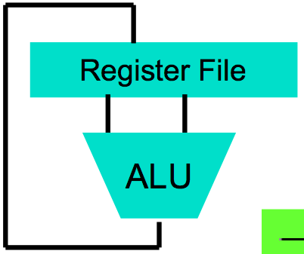
Levels of Representation/Interpretation
High Level Language Program (e.g., C)
temp = v[k];
v[k] = v[k+1];
v[k+1] = temp;
Compiler
Anything can be represented as a number, i.e., data or instructions
lw $t0, 0($2)
lw $t1, 4($2)
sw $t1, 0($2)
sw $t0, 4($2)
Assembly Language Program (e.g., MIPS)
Assembler
0000 1001 1100 0110 1010 1111 0101 1000
1010 1111 0101 1000 0000 1001 1100 0110
1100 0110 1010 1111 0101 1000 0000 1001
0101 1000 0000 1001 1100 0110 1010 1111
Machine Language Program (MIPS)
Machine Interpretation
Hardware Architecture Description (e.g., block diagrams)
Architecture Implementation
Logic Circuit Description (Circuit Schematic Diagrams)

Slide 5
Synchronous Digital Systems
Hardware of a processor, such as the MIPS, is an example of a Synchronous Digital System
Synchronous:
All operations coordinated by a central clock
“Heartbeat” of the system!
Digital:
All values represented by discrete values
Electrical signals are treated as 1s and 0s; grouped together to form words

Slide 6
Logic Design
Next several weeks: we’ll study how a modern processor is built; starting with basic elements as building blocks
Why study hardware design?
Understand capabilities and limitations of hw in general and processors in particular
What processors can do fast and what they can’t do fast (avoid slow things if you want your code to run fast!)
Background for more in depth hw courses (CS 150, CS 152)
There is just so much you can do with standard processors: you may need to design own custom hw for extra performance

Slide 7
Switches: Basic Element of Physical Implementations
Implementing a simple circuit (arrow shows action if wire changes to “1”):
A
Z
Close switch (if A is “1” or asserted) and turn on light bulb (Z)
Z
A
Open switch (if A is “0” or unasserted) and turn off light bulb (Z)
Z ≡ A

Slide 8
Switches (cont’d)
Compose switches into more complex ones (Boolean functions):
A
B
AND
Z ≡ A and B
A
OR
Z ≡ A or B
B

Slide 9
Transistor Networks
Modern digital systems designed in CMOS
MOS: Metal-Oxide on Semiconductor
C for complementary: normally-open and normally-closed switches
MOS transistors act as voltage-controlled switches

Slide 10
MOS Transistors
http://youtu.be/ZaBLiciesOU
Three terminals: drain, gate, and source
Switch action: if voltage on gate terminal is (some amount) higher/lower than source terminal then conducting path established between drain and source terminals
G
G
S
D
S
D
n-channel open when voltage at G is low closes when:
voltage(G) > voltage (S) + ε
p-channel closed when voltage at G is low opens when:
voltage(G) < voltage (S) – ε

Slide 11
MOS Networks
X
what is the relationship between x and y?
“1” (voltage source)
3v
x
y
Y
0 volts
0v
3 volts
“0” (ground)

Slide 12
Transistor Circuit Rep. vs. Block diagram
Chips are composed of nothing but transistors and wires.
Small groups of transistors form useful building blocks.
Block are organized in a hierarchy to build higher-level blocks: ex: adders.
“1” (voltage source)
a
b
c
0
0
1
0
1
1
1
0
1
1
1
0
“0” (ground)
(You can build AND, OR, NOT out of NAND!)

Slide 13
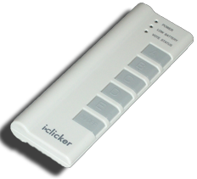
How many hours h on Project 2a?
0 ≤ h < 10
10 ≤ h < 20
20 ≤ h < 30
30 ≤ h < 40
40 ≤ h
Other administrivia?

Slide 14
I could live without your handouts…
Strongly disagree
Mildly disagree
Neutral
Mildly agree
Strongly agree

Slide 15
Signals and Waveforms: Clocks
Signals
When digital is only treated as 1 or 0
Is transmitted over wires continuously
Transmission is effectively instant
Implies that any wire only contains 1 value at a time

Slide 16
Signals and Waveforms

Slide 17
Signals and Waveforms: Grouping

Slide 18
Signals and Waveforms: Circuit Delay
2
3
4
5
3
10
0
1
5
13
4
6

Slide 19
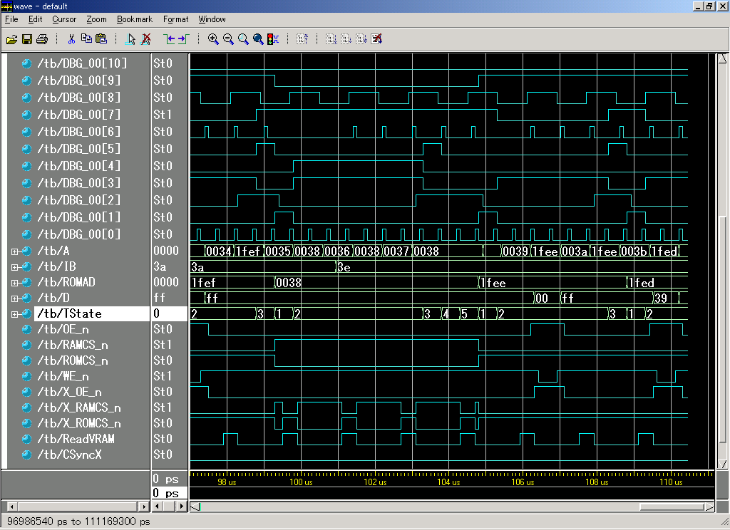
Sample Debugging Waveform

Slide 20
Type of Circuits
Synchronous Digital Systems are made up of two basic types of circuits:
Combinational Logic (CL) circuits
Our previous adder circuit is an example.
Output is a function of the inputs only.
Similar to a pure function in mathematics, y = f(x). (No way to store information from one invocation to the next. No side effects)
State Elements: circuits that store information.

Slide 21
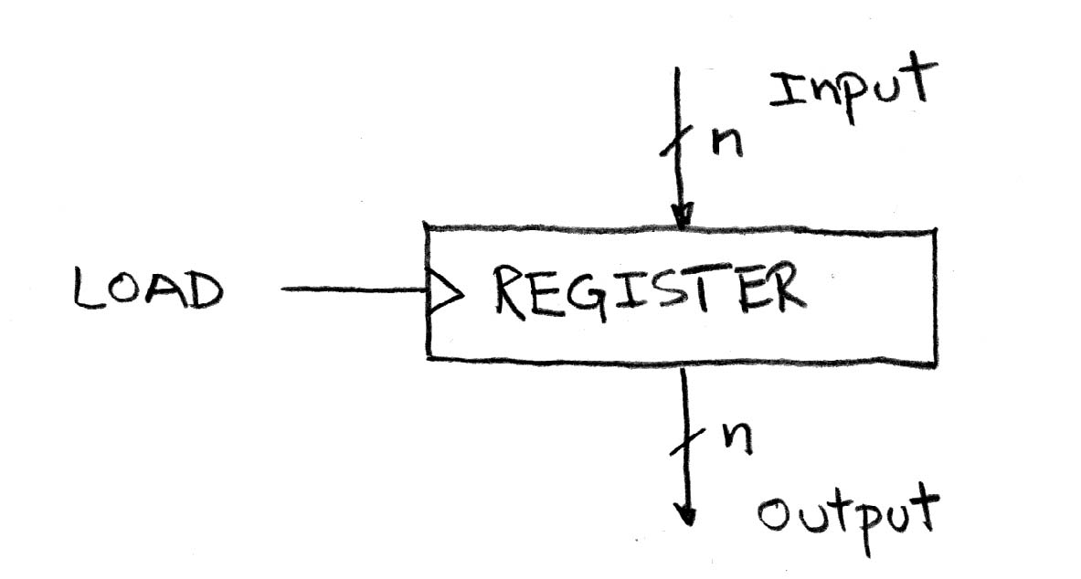
Circuits with STATE (e.g., register)

Slide 22
Peer Instruction
SW can peek at HW (past ISA abstraction boundary) for optimizations
SW can depend on particular HW implementation of ISA
12
a) FF
b) FT
c) TF
d) TT
Notes:
Answer: [correct=5, TFF] Individual (6, 3, 6, 3, 34, 37, 7, 4)% & Team (9, 4, 4, 4, 39, 34, 0, 7)%
A: T [18/82 & 25/75] (The game breaks up very quickly into separate, independent games -- big win to solve separated & put together)
B: F [80/20 & 86/14] (The game tree grows exponentially! A better static evaluator can make all the difference!)
C: F [53/57 & 52/48] (If you're just looking for the best move, just keep theBestMove around [ala memoizing max])

Slide 23
Design Hierarchy
system
datapath
control
code registers
state registers
combinational logic
multiplexer
comparator
register
logic
switching networks

Slide 24
And in conclusion…
ISA is very important abstraction layer
Contract between HW and SW
Clocks control pulse of our circuits
Voltages are analog, quantized to 0/1
Circuit delays are fact of life
Two types of circuits:
Stateless Combinational Logic (&,|,~)
State circuits (e.g., registers)

