Slide 1
CS 61C: Great Ideas in Computer Architecture
Synchronization,
OpenMP
Senior Lecturer SOE Dan Garcia

Slide 2
Review of Last Lecture
Multiprocessor systems uses shared memory (single address space)
Cache coherence implements shared memory even with multiple copies in multiple caches
Track state of blocks relative to other caches (e.g. MOESI protocol)
False sharing a concern

Slide 3
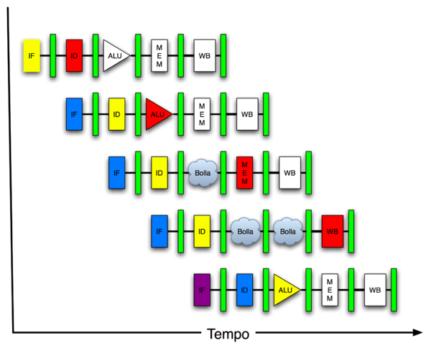
Great Idea #4: Parallelism
Software Hardware
Parallel Requests
Assigned to computer
e.g. search “Garcia”
Parallel Threads
Assigned to core
e.g. lookup, ads
Parallel Instructions
> 1 instruction @ one time
e.g. 5 pipelined instructions
Parallel Data
> 1 data item @ one time
e.g. add of 4 pairs of words
Hardware descriptions
All gates functioning in parallel at same time
Warehouse Scale Computer
Smart Phone
Leverage Parallelism &
Achieve High Performance
Computer
Core
…
Core
Memory
Input/Output
Core
Instruction Unit(s)
Functional
Unit(s)
A₀+B₀
A₁+B₁
A₂+B₂
A₃+B₃
Cache Memory
Logic Gates

Slide 4
Agenda
Synchronization - A Crash Course
Administrivia
OpenMP Introduction
OpenMP Directives
Workshare
Synchronization
Bonus: Common OpenMP Pitfalls

Slide 5
Data Races and Synchronization
Two memory accesses form a data race if different threads access the same location, and at least one is a write, and they occur one after another
Means that the result of a program can vary depending on chance (which thread ran first?)
Avoid data races by synchronizing writing and reading to get deterministic behavior
Synchronization done by user-level routines that rely on hardware synchronization instructions

Slide 6
Analogy: Buying Milk
Your fridge has no milk. You and your roommate will return from classes at some point and check the fridge
Whoever gets home first will check the fridge, go and buy milk, and return
What if the other person gets back while the first person is buying milk?
You’ve just bought twice as much milk as you need!
It would’ve helped to have left a note…

Slide 7
Lock Synchronization (1/2)
Use a “Lock” to grant access to a region (critical section) so that only one thread can operate at a time
Need all processors to be able to access the lock, so use a location in shared memory as the lock
Processors read lock and either wait (if locked) or set lock and go into critical section
0 means lock is free / open / unlocked / lock off
1 means lock is set / closed / locked / lock on

Slide 8
Lock Synchronization (2/2)
Pseudocode:
Check lock
Set the lock
Critical section
(e.g. change shared variables)
Unset the lock
Can loop/idle here if locked

Slide 9
Possible Lock Implementation
Lock (a.k.a. busy wait)
Get_lock: # $s0 -> addr of lock
addiu $t1,$zero,1 # t1 = Locked value
Loop: lw $t0,0($s0) # load lock
bne $t0,$zero,Loop # loop if locked
Lock: sw $t1,0($s0) # Unlocked, so lock
Unlock
Unlock:
sw $zero,0($s0)
Any problems with this?

Slide 10
Possible Lock Problem
Thread 1
addiu $t1,$zero,1
Loop: lw $t0,0($s0)
bne $t0,$zero,Loop
Lock: sw $t1,0($s0)
Thread 2
addiu $t1,$zero,1
Loop: lw $t0,0($s0)
bne $t0,$zero,Loop
Lock: sw $t1,0($s0)
Time
Both threads think they have set the lock!
Exclusive access not guaranteed!

Slide 11
Hardware Synchronization
Hardware support required to prevent an interloper (another thread) from changing the value
Atomic read/write memory operation
No other access to the location allowed between the read and write
How best to implement in software?
Single instr? Atomic swap of register ↔ memory
Pair of instr? One for read, one for write
Notes:
Interloper thread can be from same core or another core.

Slide 12
Synchronization in MIPS
Load linked: ll rt,off(rs)
Store conditional: sc rt,off(rs)
Returns 1 (success) if location has not changed since the ll
Returns 0 (failure) if location has changed
Note that sc clobbers the register value being stored (rt)!
Need to have a copy elsewhere if you plan on repeating on failure or using value later
Notes:
Here using the Green Sheet convention of rs and rt for source register and target register.

Slide 13
Synchronization in MIPS Example
Atomic swap (to test/set lock variable)
Exchange contents of register and memory: $s4 ↔ Mem($s1)
try: add $t0,$zero,$s4 #copy value
ll $t1,0($s1) #load linked
sc $t0,0($s1) #store conditional
beq $t0,$zero,try #loop if sc fails
add $s4,$zero,$t1 #load value in $s4
sc would fail if another threads executes sc here

Slide 14
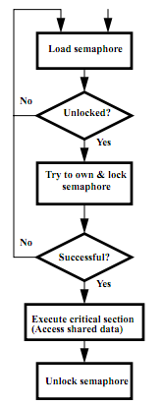
Test-and-Set
In a single atomic operation:
Test to see if a memory location is set (contains a 1)
Set it (to 1) if it isn’t (it contained a zero when tested)
Otherwise indicate that the Set failed, so the program can try again
While accessing, no other instruction can modify the memory location, including other Test-and-Set instructions
Useful for implementing lock operations

Slide 15
Test-and-Set in MIPS
Example: MIPS sequence for implementing a T&S at ($s1)
Try: addiu $t0,$zero,1
ll $t1,0($s1)
bne $t1,$zero,Try
sc $t0,0($s1)
beq $t0,$zero,try
Locked:
# critical section
Unlock:
sw $zero,0($s1)

Slide 16
Question: Consider the following code when executed concurrently by two threads.
What possible values can result in *($s0)?
# *($s0) = 100
lw $t0,0($s0)
addi $t0,$t0,1
sw $t0,0($s0)
☐
101 or 102
☐
100, 101, or 102
☐
100 or 101
☐
102
Notes:
- 102 if one thread starts executing after the other completely finishes.
- 101 if both threads execute the lw before either thread executes the sw. One thread will see “stale data”.

Slide 17
Agenda
Synchronization - A Crash Course
Administrivia
OpenMP Introduction
OpenMP Directives
Workshare
Synchronization
Bonus: Common OpenMP Pitfalls

Slide 18
Administrivia
Midterm grade update
Project 2: MapReduce
Work in groups of two!
Part 1: Due March 19 (next Wed)
Part 2: Due April 2 (after Spring Break)

Slide 19
Agenda
Synchronization - A Crash Course
Administrivia
OpenMP Introduction
OpenMP Directives
Workshare
Synchronization
Bonus: Common OpenMP Pitfalls

Slide 20
What is OpenMP?
API used for multi-threaded, shared memory parallelism
Compiler Directives
Runtime Library Routines
Environment Variables
Portable
Standardized
Resources: http://www.openmp.org/ and http://computing.llnl.gov/tutorials/openMP/
Notes:
API: Application Programming Interface

Slide 21
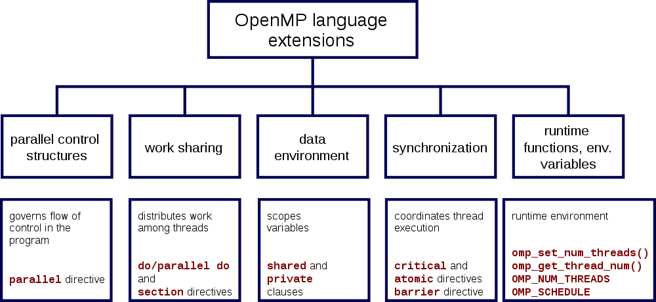
OpenMP Specification

Slide 22
Shared Memory Model with Explicit Thread-based Parallelism
Multiple threads in a shared memory environment, explicit programming model with full programmer control over parallelization
Pros:
Takes advantage of shared memory, programmer need not worry (that much) about data placement
Compiler directives are simple and easy to use
Legacy serial code does not need to be rewritten
Cons:
Code can only be run in shared memory environments
Compiler must support OpenMP (e.g. gcc 4.2)

Slide 23
OpenMP in CS61C
OpenMP is built on top of C, so you don’t have to learn a whole new programming language
Make sure to add #include <omp.h>
Compile with flag: gcc -fopenmp
Mostly just a few lines of code to learn
You will NOT become experts at OpenMP
Use slides as reference, will learn to use in lab
Key ideas:
Shared vs. Private variables
OpenMP directives for parallelization, work sharing, synchronization

Slide 24
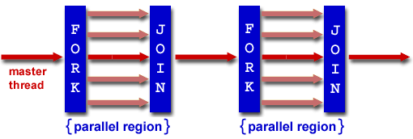
OpenMP Programming Model
Fork - Join Model:
OpenMP programs begin as single process (master thread) and executes sequentially until the first parallel region construct is encountered
FORK: Master thread then creates a team of parallel threads
Statements in program that are enclosed by the parallel region construct are executed in parallel among the various threads
JOIN: When the team threads complete the statements in the parallel region construct, they synchronize and terminate, leaving only the master thread

Slide 25
OpenMP Extends C with Pragmas
Pragmas are a preprocessor mechanism C provides for language extensions
Commonly implemented pragmas: structure packing, symbol aliasing, floating point exception modes (not covered in 61C)
Good mechanism for OpenMP because compilers that don't recognize a pragma are supposed to ignore them
Runs on sequential computer even with embedded pragmas

Slide 26
parallel Pragma and Scope
Basic OpenMP construct for parallelization:
#pragma omp parallel
{
/* code goes here */
}
Each thread runs a copy of code within the block
Thread scheduling is non-deterministic
OpenMP default is shared variables
To make private, need to declare with pragma:
#pragma omp parallel private (x)
This is annoying, but curly brace MUST go on separate line from #pragma

Slide 27
Thread Creation
How many threads will OpenMP create?
Defined by OMP_NUM_THREADS environment variable (or code procedure call)
Set this variable to the maximum number of threads you want OpenMP to use
Usually equals the number of cores in the underlying hardware on which the program is run

Slide 28
OMP_NUM_THREADS
OpenMP intrinsic to set number of threads:
omp_set_num_threads(x);
OpenMP intrinsic to get number of threads:
num_th = omp_get_num_threads();
OpenMP intrinsic to get Thread ID number:
th_ID = omp_get_thread_num();

Slide 29
Parallel Hello World
#include <stdio.h>
#include <omp.h>
int main () {
int nthreads, tid;
/* Fork team of threads with private var tid */
#pragma omp parallel private(tid)
{
tid = omp_get_thread_num(); /* get thread id */
printf("Hello World from thread = %d\n", tid);
/* Only master thread does this */
if (tid == 0) {
nthreads = omp_get_num_threads();
printf("Number of threads = %d\n", nthreads);
}
} /* All threads join master and terminate */
}

Slide 30
Agenda
Synchronization - A Crash Course
Administrivia
OpenMP Introduction
OpenMP Directives
Workshare
Synchronization
Bonus: Common OpenMP Pitfalls

Slide 31
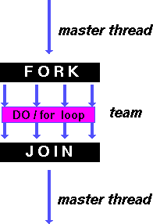
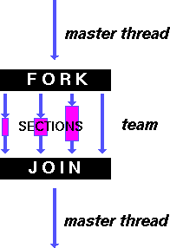
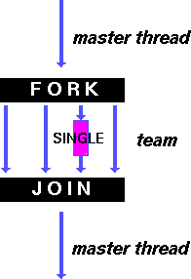
OpenMP Directives (Work-Sharing)
These are defined within a parallel section
Shares iterations of a loop across the threads
Each section is executed by a separate thread
Serializes the execution of a thread
Notes:
A work-sharing construct divides the execution of the enclosed code region among the members of the team that encounter it.

Slide 32
Parallel Statement Shorthand
#pragma omp parallel
{
#pragma omp for
for(i=0;i<len;i++) { … }
}
can be shortened to:
#pragma omp parallel for
for(i=0;i<len;i++) { … }
Also works for sections
This is the only directive in the parallel section

Slide 33
Building Block: for loop
for (i=0; i<max; i++) zero[i] = 0;
Break for loop into chunks, and allocate each to a separate thread
e.g. if max = 100 with 2 threads: assign 0-49 to thread 0, and 50-99 to thread 1
Must have relatively simple “shape” for an OpenMP-aware compiler to be able to parallelize it
Necessary for the run-time system to be able to determine how many of the loop iterations to assign to each thread
No premature exits from the loop allowed
i.e. No break, return, exit, goto statements
In general, don’t jump outside of any pragma block
Notes:
“Shape” restrictions: The FOR loop can not be a DO WHILE loop, or a loop without loop control. Also, the loop iteration variable must be an integer and the loop control parameters must be the same for all threads.

Slide 34
Parallel for pragma
#pragma omp parallel for
for (i=0; i<max; i++) zero[i] = 0;
Master thread creates additional threads, each with a separate execution context
All variables declared outside for loop are shared by default, except for loop index which is private per thread (Why?)
Implicit synchronization at end of for loop
Divide index regions sequentially per thread
Thread 0 gets 0, 1, …, (max/n)-1;
Thread 1 gets max/n, max/n+1, …, 2*(max/n)-1
Why?

Slide 35
OpenMP Timing
Elapsed wall clock time:
double omp_get_wtime(void);
Returns elapsed wall clock time in seconds
Time is measured per thread, no guarantee can be made that two distinct threads measure the same time
Time is measured from “some time in the past,” so subtract results of two calls to omp_get_wtime to get elapsed time

Slide 36
Matrix Multiply in OpenMP
start_time = omp_get_wtime();
#pragma omp parallel for private(tmp, i, j, k)
for (i=0; i<Mdim; i++){
for (j=0; j<Ndim; j++){
tmp = 0.0;
for( k=0; k<Pdim; k++){
/* C(i,j) = sum(over k) A(i,k) * B(k,j)*/
tmp += *(A+(i*Pdim+k)) * *(B+(k*Ndim+j));
}
*(C+(i*Ndim+j)) = tmp;
}
}
run_time = omp_get_wtime() - start_time;
Outer loop spread across N threads; inner loops inside a single thread

Slide 37
Notes on Matrix Multiply Example
More performance optimizations available:
Higher compiler optimization (-O2, -O3) to reduce number of instructions executed
Cache blocking to improve memory performance
Using SIMD SSE instructions to raise floating point computation rate (DLP)

Slide 38
OpenMP Directives (Synchronization)
These are defined within a parallel section
master
Code block executed only by the master thread (all other threads skip)
critical
Code block executed by only one thread at a time
atomic
Specific memory location must be updated atomically (like a mini-critical section for writing to memory)
Applies to single statement, not code block

Slide 39
OpenMP Reduction
Reduction specifies that one or more private variables are the subject of a reduction operation at end of parallel region
Clause reduction(operation:var)
Operation: Operator to perform on the variables at the end of the parallel region
Var: One or more variables on which to perform scalar reduction
#pragma omp for reduction(+:nSum)
for (i = START ; i <= END ; i++)
nSum += i;

Slide 40
Summary
Data races lead to subtle parallel bugs
Synchronization via hardware primitives:
MIPS does it with Load Linked + Store Conditional
OpenMP as simple parallel extension to C
During parallel fork, be aware of which variables should be shared vs. private among threads
Work-sharing accomplished with for/sections
Synchronization accomplished with critical/atomic/reduction

Slide 41
BONUS SLIDES
You are responsible for the material contained on the following slides, though we may not have enough time to get to them in lecture.
They have been prepared in a way that should be easily readable and the material will be touched upon in the following lecture.

Slide 42
Agenda
Synchronization - A Crash Course
Administrivia
OpenMP Introduction
OpenMP Directives
Workshare
Synchronization
Bonus: Common OpenMP Pitfalls

Slide 43
OpenMP Pitfall #1: Data Dependencies
Consider the following code:
a[0] = 1;
for(i=1; i<5000; i++)
a[i] = i + a[i-1];
There are dependencies between loop iterations!
Splitting this loop between threads does not guarantee in-order execution
Out of order loop execution will result in undefined behavior (i.e. likely wrong result)

Slide 44
Open MP Pitfall #2: Sharing Issues
Consider the following loop:
#pragma omp parallel for
for(i=0; i<n; i++){
temp = 2.0*a[i];
a[i] = temp;
b[i] = c[i]/temp;
}
temp is a shared variable!
#pragma omp parallel for private(temp)
for(i=0; i<n; i++){
temp = 2.0*a[i];
a[i] = temp;
b[i] = c[i]/temp;
}

Slide 45
OpenMP Pitfall #3: Updating Shared Variables Simultaneously
Now consider a global sum:
for(i=0; i<n; i++)
sum = sum + a[i];
This can be done by surrounding the summation by a critical/atomic section or reduction clause:
#pragma omp parallel for reduction(+:sum)
{
for(i=0; i<n; i++)
sum = sum + a[i];
}
Compiler can generate highly efficient code for reduction

Slide 46
OpenMP Pitfall #4: Parallel Overhead
Spawning and releasing threads results in significant overhead
Better to have fewer but larger parallel regions
Parallelize over the largest loop that you can (even though it will involve more work to declare all of the private variables and eliminate dependencies)

Slide 47
OpenMP Pitfall #4: Parallel Overhead
Too much overhead in thread generation to have this statement run this frequently.
Poor choice of loop to parallelize.
start_time = omp_get_wtime();
for (i=0; i<Ndim; i++){
for (j=0; j<Mdim; j++){
tmp = 0.0;
#pragma omp parallel for reduction(+:tmp)
for( k=0; k<Pdim; k++){
/* C(i,j) = sum(over k) A(i,k) * B(k,j)*/
tmp += *(A+(i*Ndim+k)) * *(B+(k*Pdim+j));
}
*(C+(i*Ndim+j)) = tmp;
}
}
run_time = omp_get_wtime() - start_time;

