Slide 1
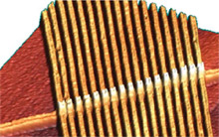
Memristor memory on its way (hopefully)
inst.eecs.berkeley.edu/~cs61c UCB CS61C : Machine Structures Lecture 13 – Caches II 2014-02-21
Guest Lecturer Alan Christopher
HP has begun testing research prototypes of a novel non-volatile memory element, the memristor. They have double the storage density of flash, and has 10x more read-write cycles than flash (10⁶ vs 10⁵). Memristors are (in principle) also capable of being memory and logic, how cool is that? Originally slated to be ready by 2013, HP later pushed that date to some time 2014.
www.technologyreview.com/computing/25018
http://www.technologyreview.com/view/512361/can-hp-save-itself/

Slide 2
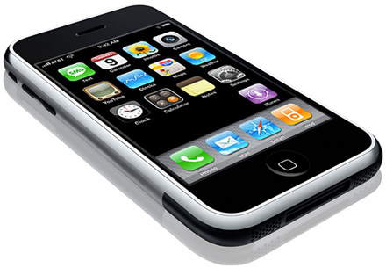
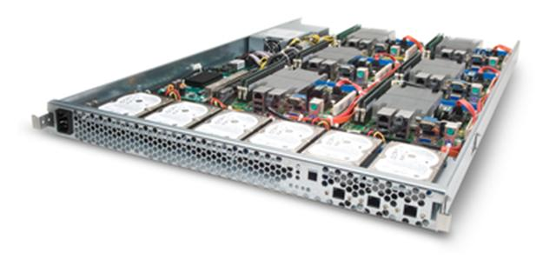
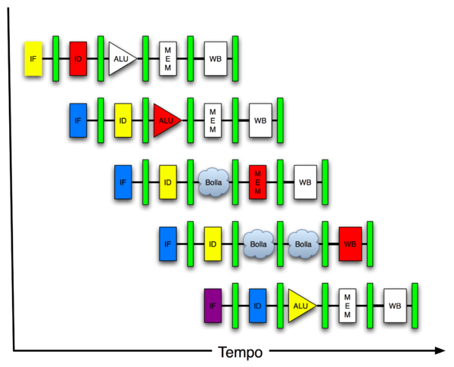
Review: New-School Machine Structures
Software Hardware
Parallel Requests
Assigned to computer
e.g., Search “Katz”
Parallel Threads
Assigned to core
e.g., Lookup, Ads
Parallel Instructions
>1 instruction @ one time
e.g., 5 pipelined instructions
Parallel Data
>1 data item @ one time
e.g., Add of 4 pairs of words
Hardware descriptions
All gates @ one time
Programming Languages
Warehouse Scale Computer
Smart Phone
Harness Parallelism &
Achieve High Performance
Computer
Core
…
Core
Memory (Cache)
Today’s
Lecture
Input/Output
Core
Instruction Unit(s)
Functional
Unit(s)
A₀+B₀
A₁+B₁
A₂+B₂
A₃+B₃
Cache Memory
Logic Gates

Slide 3
Review: Direct-Mapped Cache
All fields are read as unsigned integers.
Index
specifies the cache index (or “row”/block)
Tag
distinguishes betw the addresses that map to the same location
Offset
specifies which byte within the block we want
tttttttttttttttttt iiiiiiiiii oooo
tag index byte to check to offset if have select within correct block block block

Slide 4
TIO Dan’s great cache mnemonic
AREA (cache size, B) = HEIGHT (# of blocks) * WIDTH (size of one block, B/block)
2^{(H+W)} = 2^{H} * 2^{W}
WIDTH (size of one block, B/block)
Tag Index Offset
Addr size (often 32 bits)
AREA (cache size, B)
HEIGHT (# of blocks)

Slide 5
Memory Access without Cache
Load word instruction: lw $t0, 0($t1)
$t1 contains 1022_{ten,} Memory[1022] = 99
Processor issues address 1022_{ten} to Memory
Memory reads word at address 1022_{ten} (99)
Memory sends 99 to Processor
Processor loads 99 into register $t1

Slide 6
Memory Access with Cache
Load word instruction: lw $t0, 0($t1)
$t1 contains 1022_{ten,} Memory[1022] = 99
With cache (similar to a hash)
Processor issues address 1022_{ten} to Cache
Cache checks to see if has copy of data at address 1022_{ten}
2a. If finds a match (Hit): cache reads 99, sends to processor
2b. No match (Miss): cache sends address 1022 to Memory
Memory reads 99 at address 1022_{ten}
Memory sends 99 to Cache
Cache replaces word with new 99
Cache sends 99 to processor
Processor loads 99 into register $t1

Slide 7
Caching Terminology
When reading memory, 3 things can happen:
cache hit: cache block is valid and contains proper address, so read desired word
cache miss: nothing in cache in appropriate block, so fetch from memory
cache miss, block replacement: wrong data is in cache at appropriate block, so discard it and fetch desired data from memory (cache always copy)

Slide 8
Cache Terms
Hit rate: fraction of access that hit in the cache
Miss rate: 1 – Hit rate
Miss penalty: time to replace a block from lower level in memory hierarchy to cache
Hit time: time to access cache memory (including tag comparison)
Abbreviation: “$” = cache (A Berkeley innovation!)

Slide 9
Accessing data in a direct mapped cache
Ex.: 16KB of data, direct-mapped, 4 word blocks
Can you work out height, width, area?
Read 4 addresses
0x00000014
0x0000001C
0x00000034
0x00008014
Memory vals here:
Memory
Address (hex)
Value of Word
...
...
00000010
a
00000014
b
00000018
c
0000001C
d
...
...
00000030
e
00000034
f
00000038
g
0000003C
h
...
...
00008010
i
00008014
j
00008018
k
0000801C
l
...
...

Slide 10
Accessing data in a direct mapped cache
4 Addresses:
0x00000014, 0x0000001C, 0x00000034, 0x00008014
4 Addresses divided (for convenience) into Tag, Index, Byte Offset fields
000000000000000000 0000000001 0100
000000000000000000 0000000001 1100
000000000000000000 0000000011 0100
000000000000000010 0000000001 0100 Tag Index Offset

Slide 11
16 KB Direct Mapped Cache, 16B blocks
Valid bit: determines whether anything is stored in that row (when computer initially turned on, all entries invalid)
Valid
Index
Tag
0xc-f
0x8-b
0x4-7
0x0-3
0
0
1
0
2
0
3
0
4
0
5
0
6
0
7
0
...
...
1022
0
1023
0

Slide 12
1. Read 0x00000014
000000000000000000 0000000001 0100
Tag field
Index field
Offset
Valid
Index
Tag
0xc-f
0x8-b
0x4-7
0x0-3
0
0
1
0
2
0
3
0
4
0
5
0
6
0
7
0
...
...
1022
0
1023
0

Slide 13
So we read block 1 (0000000001)
000000000000000000 0000000001 0100
Tag field
Index field
Offset
Valid
Index
Tag
0xc-f
0x8-b
0x4-7
0x0-3
0
0
1
0
2
0
3
0
4
0
5
0
6
0
7
0
...
...
1022
0
1023
0

Slide 14
No valid data
000000000000000000 0000000001 0100
Tag field
Index field
Offset
Valid
Index
Tag
0xc-f
0x8-b
0x4-7
0x0-3
0
0
1
0
2
0
3
0
4
0
5
0
6
0
7
0
...
...
1022
0
1023
0

Slide 15
So load that data into cache, setting tag, valid
000000000000000000 0000000001 0100
Tag field
Index field
Offset
Valid
Index
Tag
0xc-f
0x8-b
0x4-7
0x0-3
0
0
1
1
0
d
c
b
a
2
0
3
0
4
0
5
0
6
0
7
0
...
...
1022
0
1023
0

Slide 16
Read from cache at offset, return word b
000000000000000000 0000000001 0100
Tag field
Index field
Offset
Valid
Index
Tag
0xc-f
0x8-b
0x4-7
0x0-3
0
0
1
1
0
d
c
b
a
2
0
3
0
4
0
5
0
6
0
7
0
...
...
1022
0
1023
0

Slide 17
2. Read 0x0000001C = 0…00 0..001 1100
000000000000000000 0000000001 1100
Tag field
Index field
Offset
Valid
Index
Tag
0xc-f
0x8-b
0x4-7
0x0-3
0
0
1
1
0
d
c
b
a
2
0
3
0
4
0
5
0
6
0
7
0
...
...
1022
0
1023
0

Slide 18
Index is Valid
000000000000000000 0000000001 1100
Tag field
Index field
Offset
Valid
Index
Tag
0xc-f
0x8-b
0x4-7
0x0-3
0
0
1
1
0
d
c
b
a
2
0
3
0
4
0
5
0
6
0
7
0
...
...
1022
0
1023
0

Slide 19
Index valid, Tag Matches
000000000000000000 0000000001 1100
Tag field
Index field
Offset
Valid
Index
Tag
0xc-f
0x8-b
0x4-7
0x0-3
0
0
1
1
0
d
c
b
a
2
0
3
0
4
0
5
0
6
0
7
0
...
...
1022
0
1023
0

Slide 20
Index Valid, Tag Matches, return d
000000000000000000 0000000001 1100
Tag field
Index field
Offset
Valid
Index
Tag
0xc-f
0x8-b
0x4-7
0x0-3
0
0
1
1
0
d
c
b
a
2
0
3
0
4
0
5
0
6
0
7
0
...
...
1022
0
1023
0

Slide 21
3. Read 0x00000034 = 0…00 0..011 0100
000000000000000000 0000000011 0100
Tag field
Index field
Offset
Valid
Index
Tag
0xc-f
0x8-b
0x4-7
0x0-3
0
0
1
1
0
d
c
b
a
2
0
3
0
4
0
5
0
6
0
7
0
...
...
1022
0
1023
0

Slide 22
So read block 3
000000000000000000 0000000011 0100
Tag field
Index field
Offset
Valid
Index
Tag
0xc-f
0x8-b
0x4-7
0x0-3
0
0
1
1
0
d
c
b
a
2
0
3
0
4
0
5
0
6
0
7
0
...
...
1022
0
1023
0

Slide 23
No valid data
000000000000000000 0000000011 0100
Tag field
Index field
Offset
Valid
Index
Tag
0xc-f
0x8-b
0x4-7
0x0-3
0
0
1
1
0
d
c
b
a
2
0
3
0
4
0
5
0
6
0
7
0
...
...
1022
0
1023
0

Slide 24
Load that cache block, return word f
000000000000000000 0000000011 0100
Tag field
Index field
Offset
Valid
Index
Tag
0xc-f
0x8-b
0x4-7
0x0-3
0
0
1
1
0
d
c
b
a
2
0
3
1
0
h
g
f
e
4
0
5
0
6
0
7
0
...
...
1022
0
1023
0

Slide 25
4. Read 0x00008014 = 0…10 0..001 0100
000000000000000010 0000000001 0100
Tag field
Index field
Offset
Valid
Index
Tag
0xc-f
0x8-b
0x4-7
0x0-3
0
0
1
1
0
d
c
b
a
2
0
3
1
0
h
g
f
e
4
0
5
0
6
0
7
0
...
...
1022
0
1023
0

Slide 26
So read Cache Block 1, Data is Valid
000000000000000010 0000000001 0100
Tag field
Index field
Offset
Valid
Index
Tag
0xc-f
0x8-b
0x4-7
0x0-3
0
0
1
1
0
d
c
b
a
2
0
3
1
0
h
g
f
e
4
0
5
0
6
0
7
0
...
...
1022
0
1023
0

Slide 27
Cache Block 1 Tag does not match (0 != 2)
000000000000000010 0000000001 0100
Tag field
Index field
Offset
Valid
Index
Tag
0xc-f
0x8-b
0x4-7
0x0-3
0
0
1
1
0
d
c
b
a
2
0
3
1
0
h
g
f
e
4
0
5
0
6
0
7
0
...
...
1022
0
1023
0

Slide 28
Miss, so replace block 1 with new data & tag
000000000000000010 0000000001 0100
Tag field
Index field
Offset
Valid
Index
Tag
0xc-f
0x8-b
0x4-7
0x0-3
0
0
1
1
2
l
k
j
i
2
0
3
1
0
h
g
f
e
4
0
5
0
6
0
7
0
...
...
1022
0
1023
0

Slide 29
And return word J
000000000000000010 0000000001 0100
Tag field
Index field
Offset
Valid
Index
Tag
0xc-f
0x8-b
0x4-7
0x0-3
0
0
1
1
2
l
k
j
i
2
0
3
1
0
h
g
f
e
4
0
5
0
6
0
7
0
...
...
1022
0
1023
0

Slide 30
Do an example yourself. What happens?
Chose from: Cache: Hit, Miss, Miss w. replace Values returned: a ,b, c, d, e, ..., k, l
Read address 0x00000030 ? 000000000000000000 0000000011 0000
Read address 0x0000001c ? 000000000000000000 0000000001 1100
Cache
Valid
0xc-f
0x8-b
0x4-7
0x0-3
Index
Tag
0
0
1
1
2
l
k
j
i
2
0
3
1
0
h
g
f
e
4
0
5
0
6
0
7
0
...
...

Slide 31
Answers
0x00000030 a hit
Index = 3, Tag matches, Offset = 0, value = e
0x0000001c a miss
Index = 1, Tag mismatch, so replace from memory, Offset = 0xc, value = d
Since reads, values must = memory values whether or not cached:
0x00000030 = e
0x0000001c = d
Memory
Address (hex)
Value of Word
...
...
00000010
a
00000014
b
00000018
c
0000001C
d
...
...
00000030
e
00000034
f
00000038
g
0000003C
h
...
...
00008010
i
00008014
j
00008018
k
0000801C
l
...
...

Slide 32
Administrivia
Proj 1-2 due Sunday

Slide 33
Multiword-Block Direct-Mapped Cache
Four words/block, cache size = 4K words
Byte offset
Hit
31 30 . . . 15 14 13 . . . 4 3 2 1 0
Data
Tag
18
10
Block offset
Index
Index
Valid
Tag
Data
0
1
2
.
.
.
1021
1022
1023
18
2
“MUX” 4→1 Multiplexor
AND
32
What kind of locality are we taking advantage of?
Notes:
to take advantage for spatial locality want a cache block that is larger than word word in size.

Slide 34
Peer Instruction
1) Mem hierarchies were invented before 1950. (UNIVAC I wasn’t delivered ‘til 1951)
2) All caches take advantage of spatial locality.
3) All caches take advantage of temporal locality.
123
a) FFF
a) FFT
b) FTF
b) FTT
c) TFF
d) TFT
e) TTF
e) TTT
Notes:
Answer: [correct=5, TFF] Individual (6, 3, 6, 3, 34, 37, 7, 4)% & Team (9, 4, 4, 4, 39, 34, 0, 7)%
A: T [18/82 & 25/75] (The game breaks up very quickly into separate, independent games -- big win to solve separated & put together)
B: F [80/20 & 86/14] (The game tree grows exponentially! A better static evaluator can make all the difference!)
C: F [53/57 & 52/48] (If you're just looking for the best move, just keep theBestMove around [ala memoizing max])

Slide 35
Peer Instruction Answer
“We are…forced to recognize the possibility of constructing a hierarchy of memories, each of which has greater capacity than the preceding but which is less accessible.” – von Neumann, 1946
2) Block size = 1, no spatial!
3) That’s the idea of caches; We’ll need it again soon.
1) Mem hierarchies were invented before 1950. (UNIVAC I wasn’t delivered ‘til 1951)
2) All caches take advantage of spatial locality.
3) All caches take advantage of temporal locality.
123
a) FFF
a) FFT
b) FTF
b) FTT
c) TFF
d) TFT
e) TTF
e) TTT
T R U E
F A L S E
T R U E
Notes:
Answer: [correct=5, TFF] Individual (6, 3, 6, 3, 34, 37, 7, 4)% & Team (9, 4, 4, 4, 39, 34, 0, 7)%
A: T [18/82 & 25/75] (The game breaks up very quickly into separate, independent games -- big win to solve separated & put together)
B: F [80/20 & 86/14] (The game tree grows exponentially! A better static evaluator can make all the difference!)
C: F [53/57 & 52/48] (If you're just looking for the best move, just keep theBestMove around [ala memoizing max])

Slide 36
And in Conclusion…
Mechanism for transparent movement of data among levels of a storage hierarchy
set of address/value bindings
address ⇒ index to set of candidates
compare desired address with tag
service hit or miss
load new block and binding on miss
address: tag index offset
000000000000000000 0000000001 1100
Valid
Tag
0xc-f
0x8-b
0x4-7
0x0-3
0
1
1
0
d
c
b
a
2
3
...

