Slide 1
CS 61C: Great Ideas in Computer Architecture Control and Pipelining
Instructor:
David A. Patterson
http://inst.eecs.Berkeley.edu/~cs61c/sp12

Slide 2
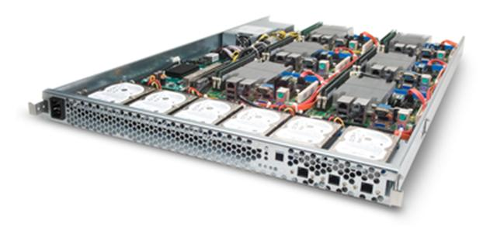
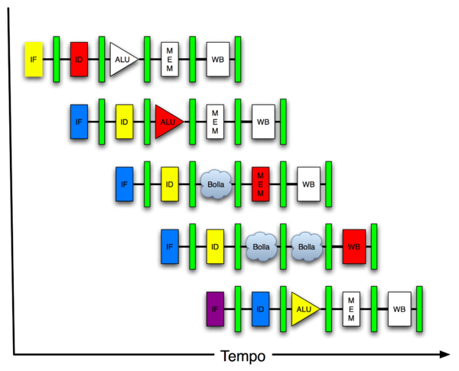
You Are Here!
Software Hardware
Parallel Requests
Assigned to computer
e.g., Search “Katz”
Parallel Threads
Assigned to core
e.g., Lookup, Ads
Parallel Instructions
>1 instruction @ one time
e.g., 5 pipelined instructions
Parallel Data
>1 data item @ one time
e.g., Add of 4 pairs of words
Hardware descriptions
All gates @ one time
Programming Languages
Warehouse Scale Computer
Smart Phone
Harness Parallelism &
Achieve High Performance
Computer
Core
…
Core
Memory (Cache)
Input/Output
Core
Today’s Lecture
Instruction Unit(s)
Functional
Unit(s)
A₀+B₀
A₁+B₁
A₂+B₂
A₃+B₃
Main Memory
Logic Gates

Slide 3
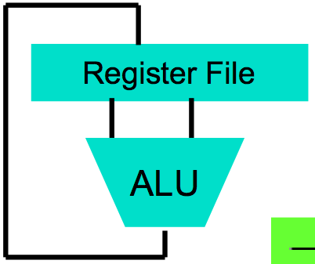
Levels of Representation/Interpretation
High Level Language Program (e.g., C)
temp = v[k];
v[k] = v[k+1];
v[k+1] = temp;
Compiler
Anything can be represented as a number, i.e., data or instructions
lw $t0, 0($2)
lw $t1, 4($2)
sw $t1, 0($2)
sw $t0, 4($2)
Assembly Language Program (e.g., MIPS)
Assembler
0000 1001 1100 0110 1010 1111 0101 1000
1010 1111 0101 1000 0000 1001 1100 0110
1100 0110 1010 1111 0101 1000 0000 1001
0101 1000 0000 1001 1100 0110 1010 1111
Machine Language Program (MIPS)
Machine Interpretation
Hardware Architecture Description (e.g., block diagrams)
Architecture Implementation
Logic Circuit Description (Circuit Schematic Diagrams)

Slide 4
Agenda
Control Implementation
Administrivia
Vtune Demo (Rimas Avizenis)
Pipelined Execution
Pipelined Datapath
(Pipeline Hazards)
Summary

Slide 5
Review: Single-Cycle Processor
Five steps to design a processor:
1. Analyze instruction set → datapath requirements
2. Select set of datapath components & establish clock methodology
3. Assemble datapath meeting the requirements: re-examine for pipelining
4. Analyze implementation of each instruction to determine setting of control points that effects the register transfer.
5. Assemble the control logic
Formulate Logic Equations
Design Circuits
Processor
Input
Control
Memory
Datapath
Output

Slide 6
Given Datapath: RTL → Control
Instruction<31:0>
Inst
Memory
<0:5>
<21:25>
<16:20>
<11:15>
<0:15>
<26:31>
Adr
Op
Fun
Rt
Rs
Rd
Imm16
Control
nPC_sel
RegWr
RegDst
ExtOp
ALUSrc
ALUctr
MemWr
MemtoReg
DATA PATH

Slide 7
Summary of the Control Signals (1/2)
inst Register Transfer
add R[rd] ← R[rs] + R[rt]; PC ← PC + 4
ALUsrc=RegB, ALUctr=“ADD”, RegDst=rd, RegWr, nPC_sel=“+4”
sub R[rd] ← R[rs] – R[rt]; PC ← PC + 4
ALUsrc=RegB, ALUctr=“SUB”, RegDst=rd, RegWr, nPC_sel=“+4”
ori R[rt] ← R[rs] + zero_ext(Imm16); PC ← PC + 4
ALUsrc=Im, Extop=“Z”, ALUctr=“OR”, RegDst=rt,RegWr, nPC_sel=“+4”
lw R[rt] ← MEM[ R[rs] + sign_ext(Imm16)]; PC ← PC + 4
ALUsrc=Im, Extop=“sn”, ALUctr=“ADD”, MemtoReg, RegDst=rt, RegWr, nPC_sel = “+4”
sw MEM[ R[rs] + sign_ext(Imm16)] ← R[rs]; PC ← PC + 4
ALUsrc=Im, Extop=“sn”, ALUctr = “ADD”, MemWr, nPC_sel = “+4”
beq if (R[rs] == R[rt]) then PC ← PC + sign_ext(Imm16)] || 00 else PC ← PC + 4
nPC_sel = “br”, ALUctr = “SUB”

Slide 8
Summary of the Control Signals (2/2)
See
func
10 0000
10 0010
We Don’t Care :-)
Appendix A
op
00 0000
00 0000
00 1101
10 0011
10 1011
00 0100
add
sub
ori
lw
sw
beq
RegDst
1
1
0
0
x
x
ALUSrc
0
0
1
1
1
0
MemtoReg
0
0
0
1
x
x
RegWrite
1
1
1
1
0
0
MemWrite
0
0
0
0
1
0
nPCsel
0
0
0
0
0
1
Jump
0
0
0
0
0
0
ExtOp
x
x
0
1
1
x
ALUctr<2:0>
Add
Subtract
Or
Add
Add
Subtract
31
26
21
16
11
6
0
R-type
op
rs
rt
rd
shamt
funct
add, sub
I-type
op
rs
rt
immediate
ori, lw, sw, beq
Notes:
Here is a table summarizing the control signals setting for the seven (add, sub, ...) instructions we have looked at.
Instead of showing you the exact bit values for the ALU control (ALUctr), I have used the symbolic values here.
The first two columns are unique in the sense that they are R-type instrucions and in order to uniquely identify them, we need to look at BOTH the op field as well as the func fiels.
Ori, lw, sw, and branch on equal are I-type instructions and Jump is J-type. They all can be uniquely idetified by looking at the opcode field alone.
Now let’s take a more careful look at the first two columns. Notice that they are identical except the last row.
So we can combine these two rows here if we can “delay” the generation of ALUctr signals.
This lead us to something call “local decoding.”
+3 = 42 min. (Y:22)

Slide 9
Boolean Expressions for Controller
RegDst = add + sub ALUSrc = ori + lw + sw MemtoReg = lw RegWrite = add + sub + ori + lw MemWrite = sw nPCsel = beq Jump = jump ExtOp = lw + sw ALUctr[0] = sub + beq (assume ALUctr is 00 ADD, 01: SUB, 10: OR) ALUctr[1] = or
Where:
rtype = ~op₅ • ~op₄ • ~op₃ • ~op₂ • ~op₁ • ~op₀, ori = ~op₅ • ~op₄ • op₃ • op₂ • ~op₁ • op₀ lw = op₅ • ~op₄ • ~op₃ • ~op₂ • op₁ • op₀ sw = op₅ • ~op₄ • op₃ • ~op₂ • op₁ • op₀ beq = ~op₅ • ~op₄ • ~op₃ • op₂ • ~op₁ • ~op₀ jump = ~op₅ • ~op₄ • ~op₃ • ~op₂ • op₁ • ~op₀
add = rtype • func₅ • ~func₄ • ~func₃ • ~func₂ • ~func₁ • ~func₀ sub = rtype • func₅ • ~func₄ • ~func₃ • ~func₂ • func₁ • ~func₀
How do we implement this in gates?

Slide 10
Controller Implementation
opcode
func
add
RegDst
ALUSrc
sub
MemtoReg
ori
RegWrite
“AND” logic
lw
“OR” logic
MemWrite
sw
nPCsel
ExtOp
beq
ALUctr[0]
ALUctr[1]

Slide 11
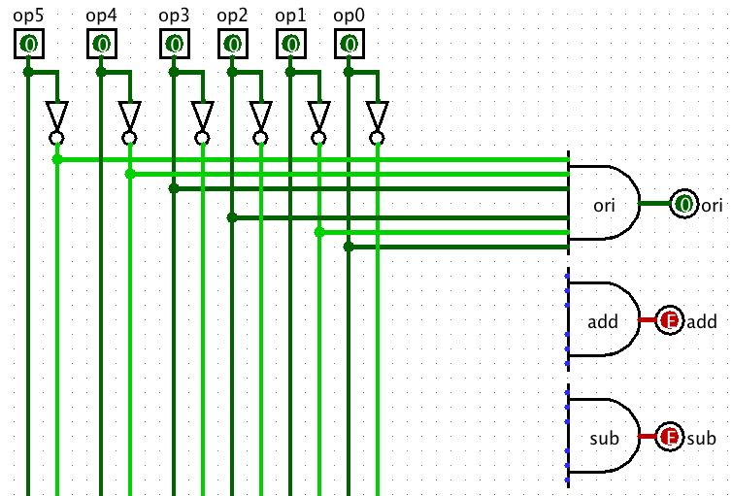
AND Control in Logisim
Notes:
Logisim file called “Control Plane MIPS.circ”

Slide 12
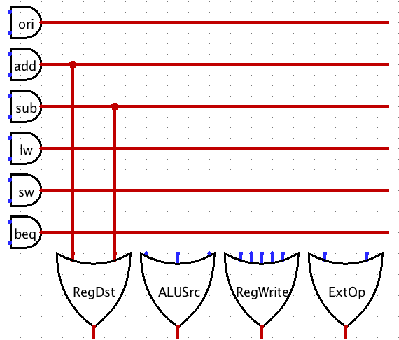
OR Control Logic in Logisim

Slide 13
Single Cycle Performance
Assume time for actions are
100ps for register read or write; 200ps for other events
Clock rate is?
Instr | Instr fetch | Register read | ALU op | Memory access | Register write | Total time
lw | 200ps | 100 ps | 200ps | 200ps | 100 ps | 800ps
sw | 200ps | 100 ps | 200ps | 200ps |  | 700ps
R-format | 200ps | 100 ps | 200ps |  | 100 ps | 600ps
beq | 200ps | 100 ps | 200ps |  |  | 500ps
What can we do to improve clock rate?
Will this improve performance as well?
Want increased clock rate to mean faster programs
Student Roulette?
Notes:
1.25 GHz

Slide 14
Administrivia
Project 4: Pipelined Cycle Processor in Logicsim
Due Part 1, datapath, due 4/8, Part 2 due 4/15
Extra Credit: Fastest Version of Project 3
Due 4/22 11:59 PM
Final Review: April 29, 2PM-5PM, 2050 VLSB
Final: Wednesday May 9 11:30-2:30 (TBD)

Slide 15
Getting To Know Your Prof
Decided when got PhD to try to maximize happiness vs. wealth
Family
A job you enjoy
Friends
Helping others
Playing?
www.authentichappiness.sas.upenn.edu

Slide 16
Getting to Know Your Prof
Play soccer on Sunday mornings for >30 years
After college, can forget it’s important to find time to play (if want to be happy)
2011
Me
My Son
Me
1994

Slide 17
Agenda
Control Implementation
Administrivia
Vtune Demo (Rimas Avizenis)
Pipelined Execution
Pipelined Datapath
(Pipeline Hazards)
Summary

Slide 18
Pipeline Analogy: Doing Laundry
Ann, Brian, Cathy, Dave each have one load of clothes to wash, dry, fold, and put away
Washer takes 30 minutes
Dryer takes 30 minutes
“Folder” takes 30 minutes
“Stasher” takes 30 minutes to put clothes into drawers
A
B
C
D

Slide 19
Sequential Laundry
Sequential laundry takes 8 hours for 4 loads
6 PM
7
8
9
10
11
12
1
2 AM
T
a
s
k
O
r
d
e
r
30
30
30
30
30
30
30
30
30
30
30
30
30
30
30
30
Time
A
B
C
D

Slide 20
Pipelined Laundry
Pipelined laundry takes 3.5 hours for 4 loads!
6 PM
7
8
9
10
11
12
1
2 AM
30
30
30
30
30
Time
T
a
s
k
O
r
d
e
r
30
30
A
B
C
D

Slide 21
Pipelining Lessons (1/2)
6 PM
7
8
9
Pipelining doesn’t help latency of single task, it helps throughput of entire workload
Multiple tasks operating simultaneously using different resources
Potential speedup = Number pipe stages (4 in this case)
Time to fill pipeline and time to drain it reduces speedup: 8 hours/3.5 hours or 2.3X v. potential 4X in this example
T
a
s
k
O
r
d
e
r
Time
30
30
30
30
30
30
30
A
B
C
D

Slide 22
Pipelining Lessons (2/2)
6 PM
7
8
9
Suppose new Washer takes 20 minutes, new Stasher takes 20 minutes. How much faster is pipeline?
Pipeline rate limited by slowest pipeline stage
Unbalanced lengths of pipe stages reduces speedup
T
a
s
k
O
r
d
e
r
Time
30
30
30
30
30
30
30
A
B
C
D

Slide 23
Review: RISC Design Principles
“A simpler core is a faster core”
Reduction in the number and complexity of instructions in the ISA → simplifies pipelined implementation
Common RISC strategies:
Fixed instruction length, generally a single word (MIPS = 32b); Simplifies process of fetching instructions from memory
Simplified addressing modes; (MIPS just register + offset) Simplifies process of fetching operands from memory
Fewer and simpler instructions in the instruction set; Simplifies process of executing instructions
Simplified memory access: only load and store instructions access memory;
Let the compiler do it. Use a good compiler to break complex high-level language statements into a number of simple assembly language statements

Slide 24
Review: Single Cycle Datapath
31
26
21
16
0
op
rs
rt
immediate
Data Memory {R[rs] + SignExt[imm16]} = R[rt]
Instruction<31:0>
nPC_sel=
instr
fetch
unit
RegDst=
<21:25>
<16:20>
<0:15>
clk
<11:15>
Rd
Rt
1
0
Rs
Rt
Rd
Imm16
zero
ALUctr=
RegWr=
Rs
Rt
MemtoReg=
5
5
5
busA
32
MemWr=
busW
Rw
Ra
Rb
=
32
32
RegFile
busB
ALU
0
0
clk
32
32
WrEn
Adr
imm16
1
Data In
1
16
Extender
Data
Memory
32
clk
ExtOp=
ALUSrc=
Notes:
The store instruction performs the inverse function of the load. Instead of loading data from memory, the store instruction sends the contents of register specified by Rt to data memory.
Similar to the load instruction, the store instruction needs to read the contents of register Rs (points to Ra port) and add it to the sign extended verion of the immediate filed (Imm16, ExtOp = 1, ALUSrc = 1) to form the data memory address (ALUctr = add).
However unlike the Load instructoion where busB is not used, the store instruction will use busB to send the data to the Data memory.
Consequently, the Rt field of the instruction has to be fed to the Rb port of the register file.
In order to write the Data Memory properly, the MemWr signal has to be set to 1.
Notice that the store instruction does not update the register file. Therefore, RegWr must be set to zero and consequently control signals RegDst and MemtoReg are don’t cares.
And once again we need to set the control signals Branch and Jump to zero to ensure proper Program Counter updataing.
Well, by now, you are probably tied of these boring stuff where Branch and Jump are zero so let’s look at something different--the bracnh instruction.
+3 = 31 min. (Y:11)

Slide 25
Steps in Executing MIPS
1) IF: Instruction Fetch, Increment PC
2) ID: Instruction Decode, Read Registers
3) EX: Execution Mem-ref: Calculate Address Arith-log: Perform Operation
4) Mem: Load: Read Data from Memory Store: Write Data to Memory
5) WB: Write Data Back to Register

Slide 26
Redrawn Single-Cycle Datapath
rd
PC
instruction
memory
registers
rs
Data
memory
rt
ALU
+4
imm
2. Decode/
Register Read
1. Instruction
Fetch
5. Write Back
3. Execute
4. Memory

Slide 27
Pipelined Datapath
rd
PC
instruction
memory
registers
rs
Data
memory
rt
ALU
+4
imm
2. Decode/
Register Read
1. Instruction
Fetch
5. Write Back
3. Execute
4. Memory
Add registers between stages
Hold information produced in previous cycle
5 stage pipeline; clock rate potential 5X faster

Slide 28
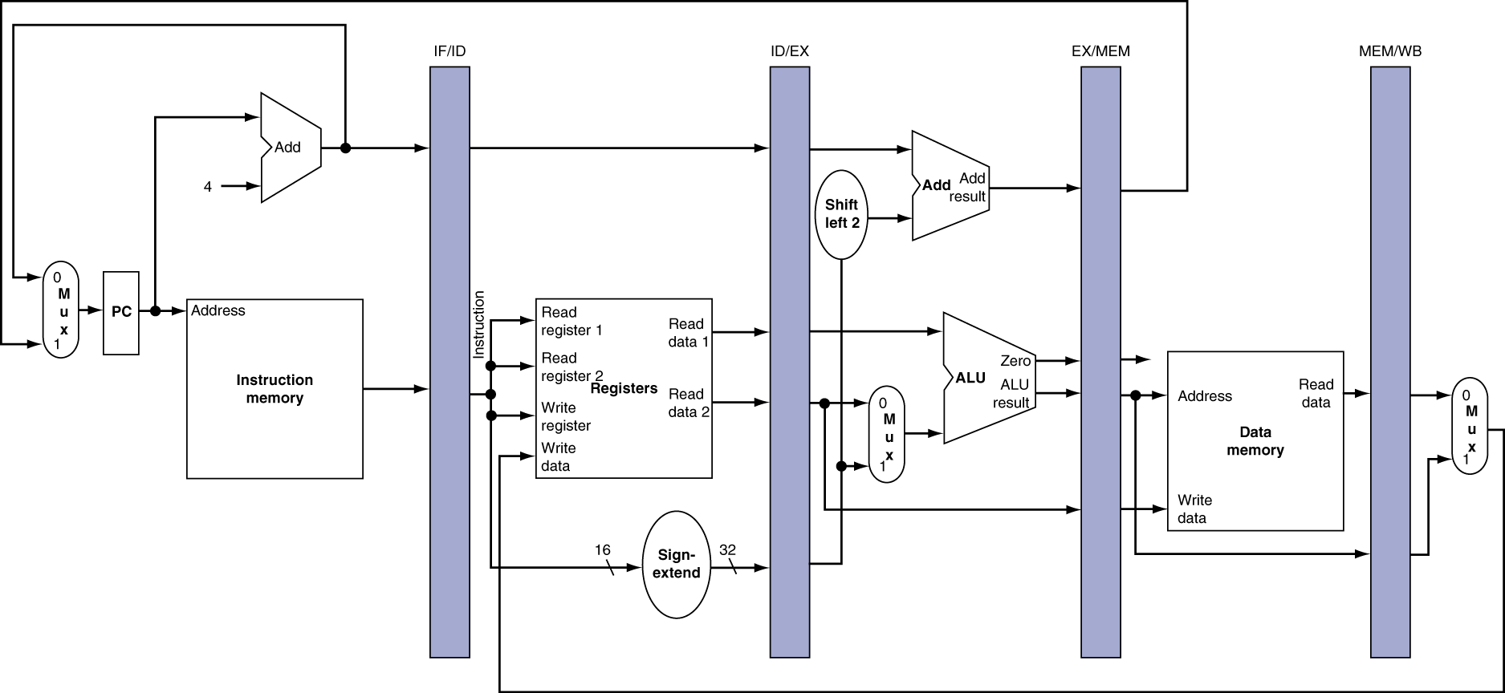
More Detailed Pipeline
Registers named for adjacent stages, e.g., IF/ID

Slide 29
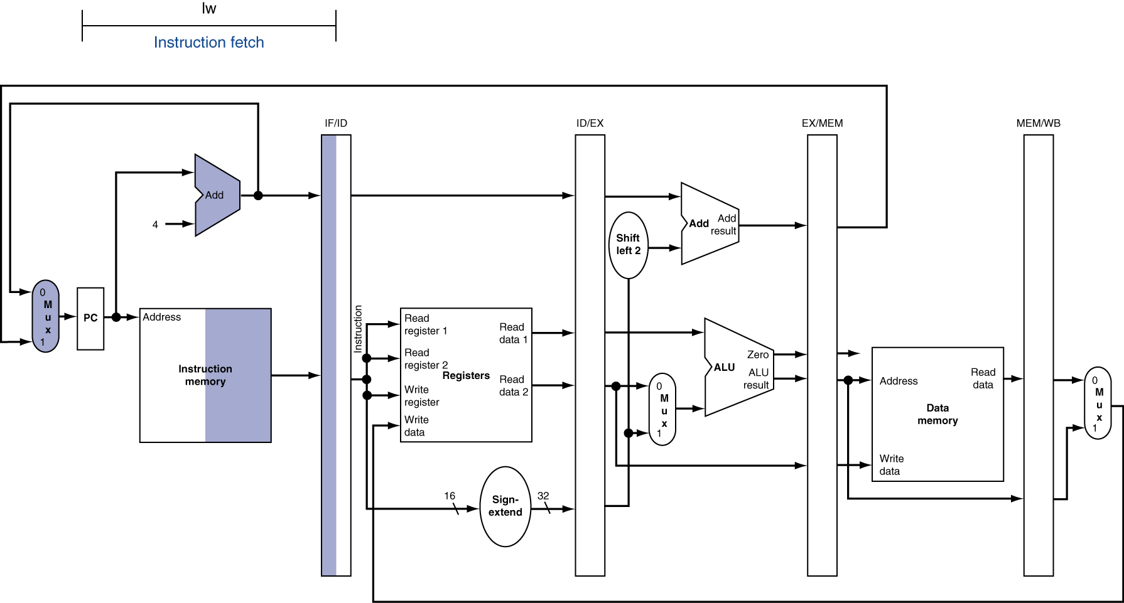
IF for Load, Store, …
Highlight combinational logic components used + right half of state logic on read, left half on write

Slide 30
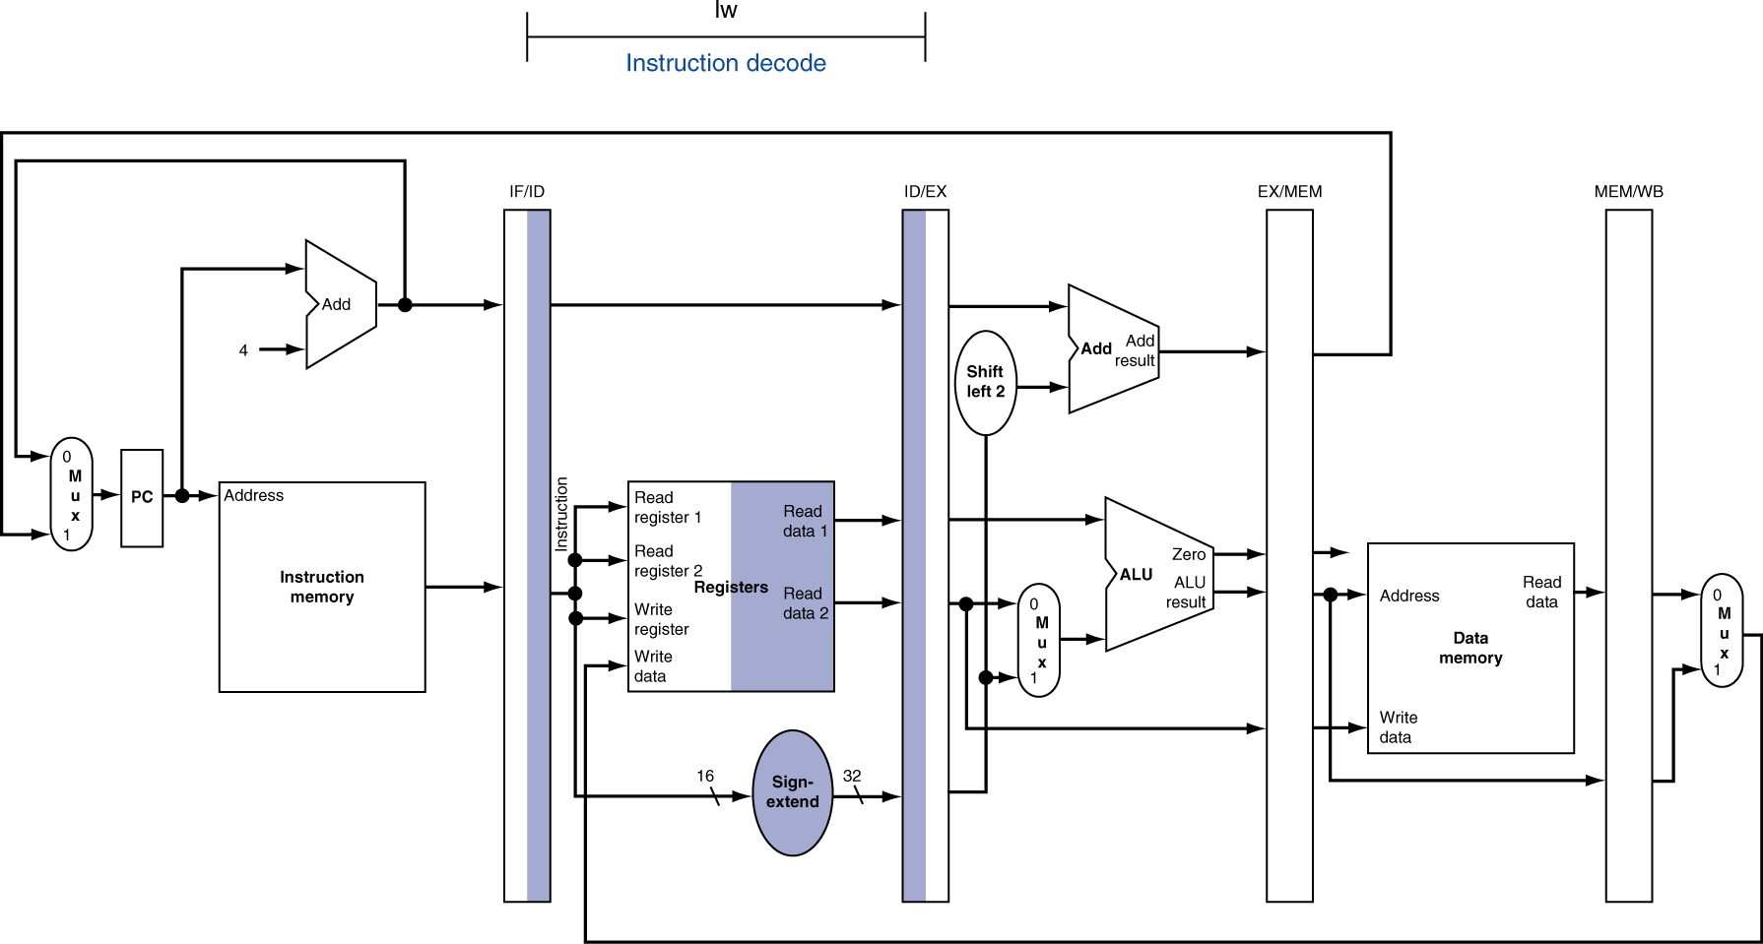
ID for Load, Store, …

Slide 31
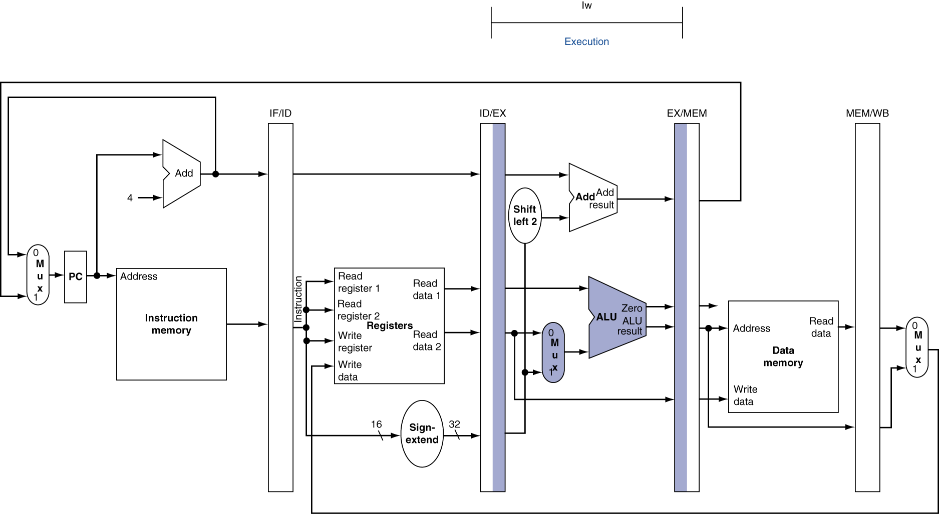
EX for Load

Slide 32
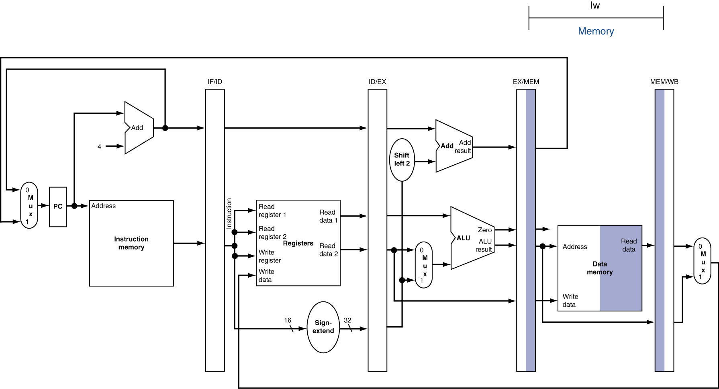
MEM for Load

Slide 33
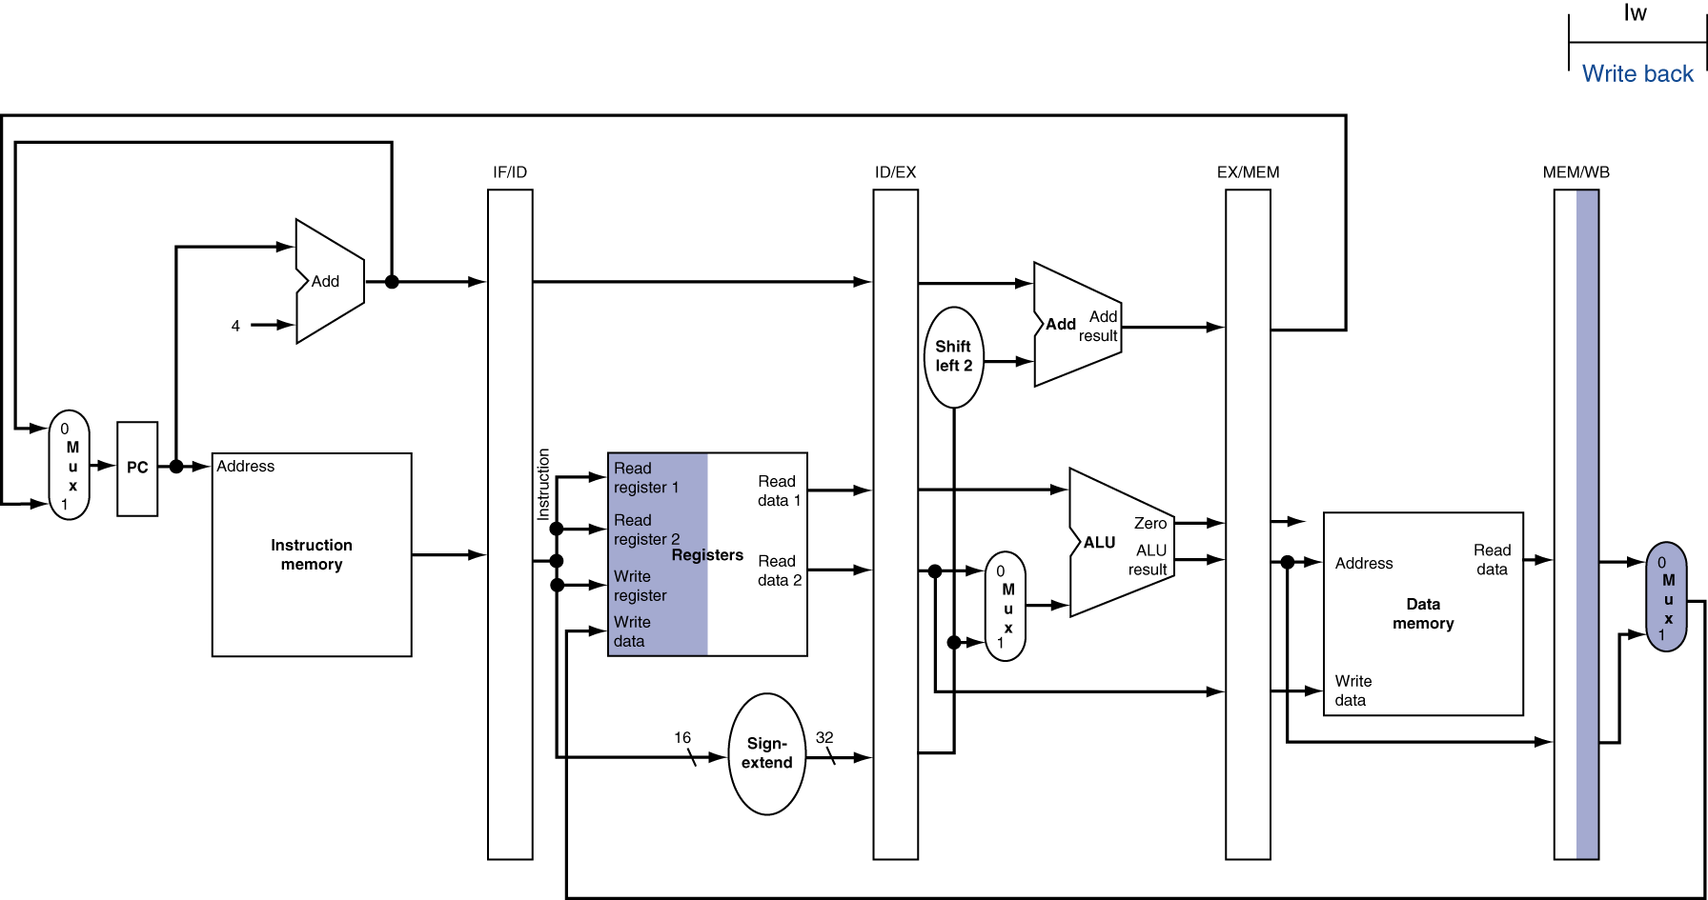
WB for Load
Has Bug that was in 1st edition of textbook!
Wrong register number

Slide 34
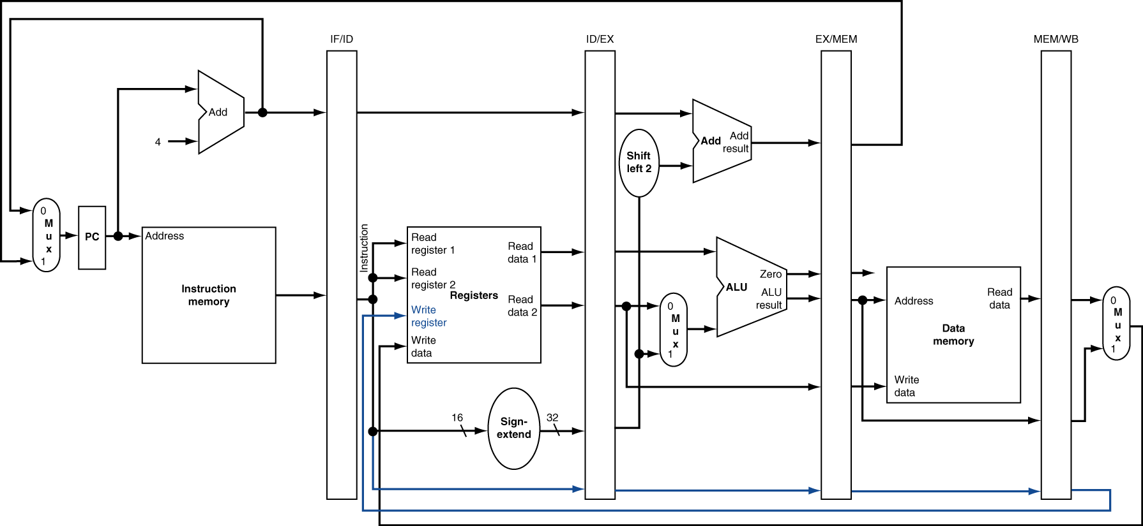
Corrected Datapath for Load
Correct register number

Slide 35
Pipelined Execution Representation
Time
IF
ID
EX
Mem
WB
IF
ID
EX
Mem
WB
IF
ID
EX
Mem
WB
IF
ID
EX
Mem
WB
IF
ID
EX
Mem
WB
IF
ID
EX
Mem
WB
Every instruction must take same number of steps, also called pipeline stages, so some will go idle sometimes

Slide 36
Graphical Pipeline Diagrams
rd
PC
instruction
memory
registers
rs
Data
memory
rt
ALU
+4
imm
2. Decode/
Register Read
1. Instruction
Fetch
5. Write Back
3. Execute
4. Memory
Use datapath figure below to represent pipeline
IF
ID
EX
Mem
WB
I$
Reg
ALU
D$
Reg

Slide 37
Graphical Pipeline Representation
(In Reg, right half highlight read, left half write)
Time (clock cycles)
I
n
s
t
r.
O
r
d
e
r
Load
I$
Reg
ALU
D$
Reg
Add
I$
Reg
ALU
D$
Reg
Store
I$
Reg
ALU
D$
Reg
Sub
I$
Reg
ALU
D$
Reg
Or
I$
Reg
ALU
D$
Reg

Slide 38
Pipeline Performance
Assume time for stages is
100ps for register read or write
200ps for other stages
What is pipelined clock rate?
Compare pipelined datapath with single-cycle datapath
Instr | Instr fetch | Register read | ALU op | Memory access | Register write | Total time
lw | 200ps | 100 ps | 200ps | 200ps | 100 ps | 800ps
sw | 200ps | 100 ps | 200ps | 200ps |  | 700ps
R-format | 200ps | 100 ps | 200ps |  | 100 ps | 600ps
beq | 200ps | 100 ps | 200ps |  |  | 500ps
Student Roulette?

Slide 39
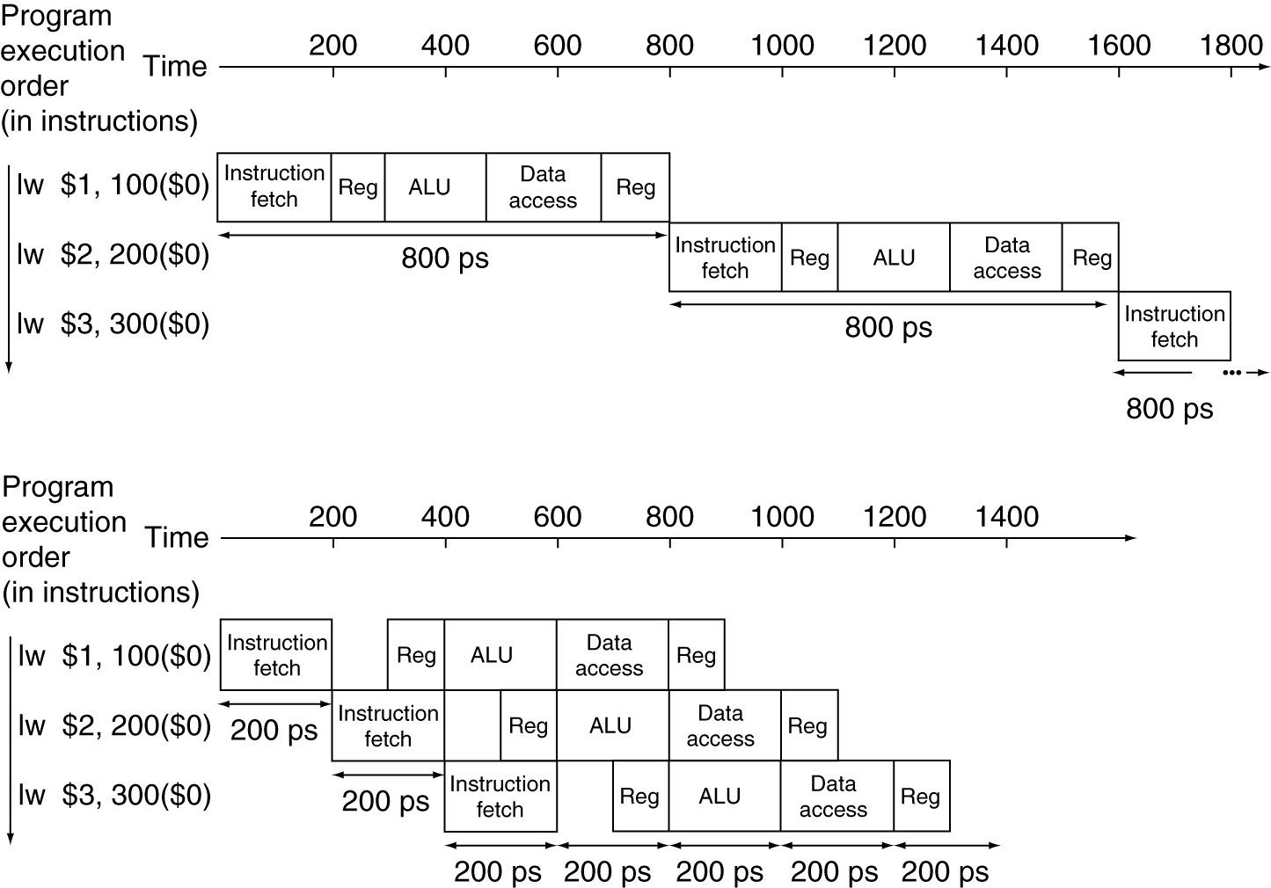
Pipeline Performance
Single-cycle (T_{c}= 800ps)
Pipelined (T_{c}= 200ps)

Slide 40
Pipeline Speedup
If all stages are balanced
i.e., all take the same time
Time between instructions_{pipelined} = Time between instructions_{nonpipelined} Number of stages
If not balanced, speedup is less
Speedup due to increased throughput
Latency (time for each instruction) does not decrease

Slide 41
Instruction Level Parallelism (ILP)
Another parallelism form to go with Request Level Parallelism and Data Level Parallelism
RLP – e.g., Warehouse Scale Computing
DLP – e.g., SIMD, Map-Reduce
ILP – e.g., Pipelined Instruction Execution
5 stage pipeline => 5 instructions executing simultaneously, one at each pipeline stage

Slide 42
Agenda
Control Implementation
Administrivia
Vtune Demo (Rimas Avizenis)
Pipelined Execution
Pipelined Datapath
(Pipeline Hazards)
Summary

Slide 43
Hazards
Situations that prevent starting the next logical instruction in the next clock cycle
Structural hazards
Required resource is busy (e.g., stasher is studying)
Data hazard
Need to wait for previous instruction to complete its data read/write (e.g., pair of socks in different loads)
Control hazard
Deciding on control action depends on previous instruction (e.g., how much detergent based on how clean prior load turns out)

Slide 44
1. Structural Hazards
Conflict for use of a resource
In MIPS pipeline with a single memory
Load/Store requires memory access for data
Instruction fetch would have to stall for that cycle
Causes a pipeline “bubble”
Hence, pipelined datapaths require separate instruction/data memories
In reality, provide separate L1 instruction cache and L1 data cache

Slide 45
1. Structural Hazard #1: Single Memory
Time (clock cycles)
I
n
s
t
r.
O
r
d
e
r
Load
I$
Reg
ALU
D$
Reg
Instr 1
I$
Reg
ALU
D$
Reg
Instr 2
I$
Reg
ALU
D$
Reg
Instr 3
I$
Reg
ALU
D$
Reg
Instr 4
I$
Reg
ALU
D$
Reg
Read same memory twice in same clock cycle

Slide 46
1. Structural Hazard #2: Registers (1/2)
I
n
s
t
r.
O
r
d
e
r
Time (clock cycles)
sw
I$
Reg
ALU
D$
Reg
Instr 1
I$
Reg
ALU
D$
Reg
Instr 2
I$
Reg
ALU
D$
Reg
Instr 3
I$
Reg
ALU
D$
Reg
Instr 4
I$
Reg
ALU
D$
Reg
Can we read and write to registers simultaneously?

Slide 47
1. Structural Hazard #2: Registers (2/2)
Two different solutions have been used:
1) RegFile access is VERY fast: takes less than half the time of ALU stage
Write to Registers during first half of each clock cycle
Read from Registers during second half of each clock cycle
2) Build RegFile with independent read and write ports
Result: can perform Read and Write during same clock cycle

Slide 48
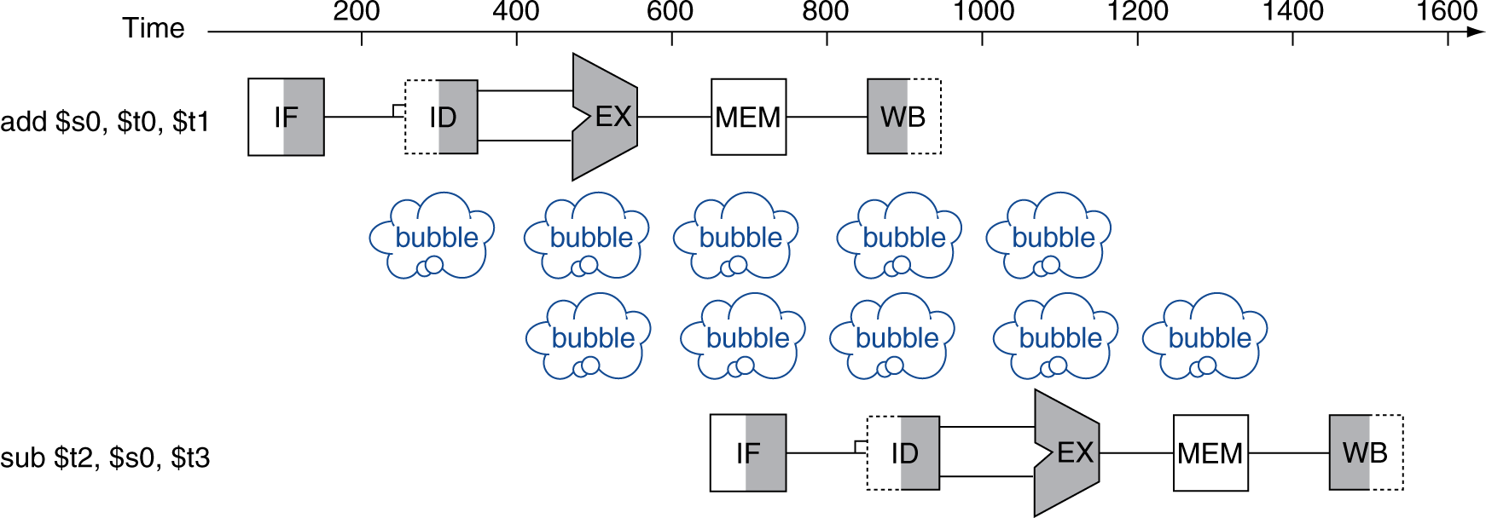
2. Data Hazards
An instruction depends on completion of data access by a previous instruction
add $s0, $t0, $t1 sub $t2, $s0, $t3

Slide 49
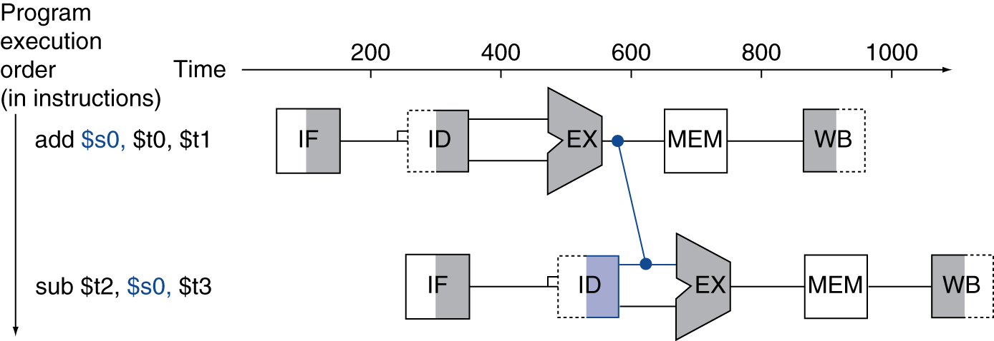
Forwarding (aka Bypassing)
Use result when it is computed
Don’t wait for it to be stored in a register
Requires extra connections in the datapath

Slide 50
Corrected Datapath for Forwarding?
Student Roulette?

Slide 51
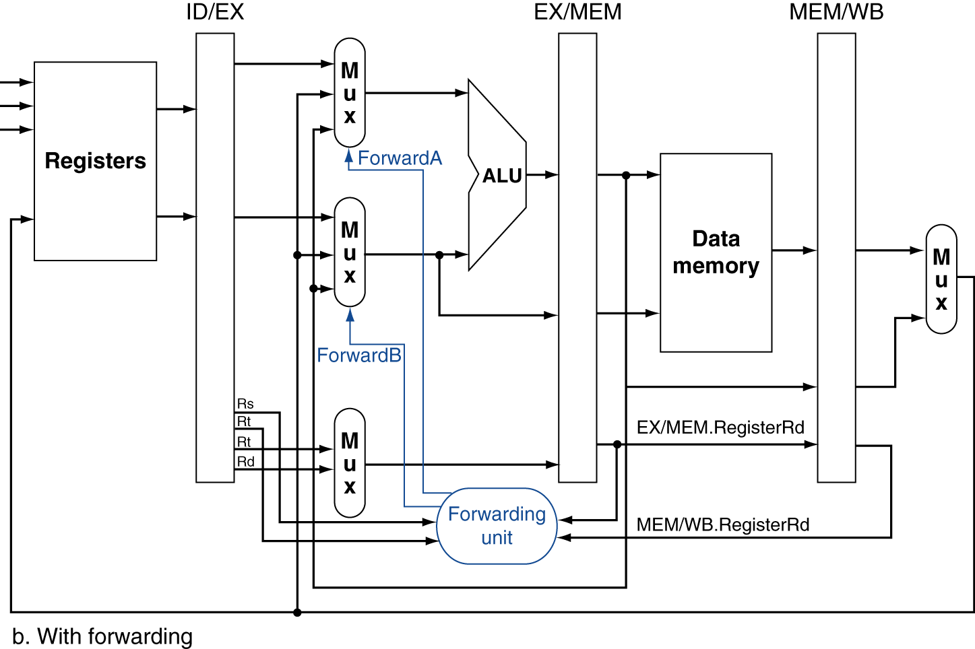
Forwarding Paths

Slide 52
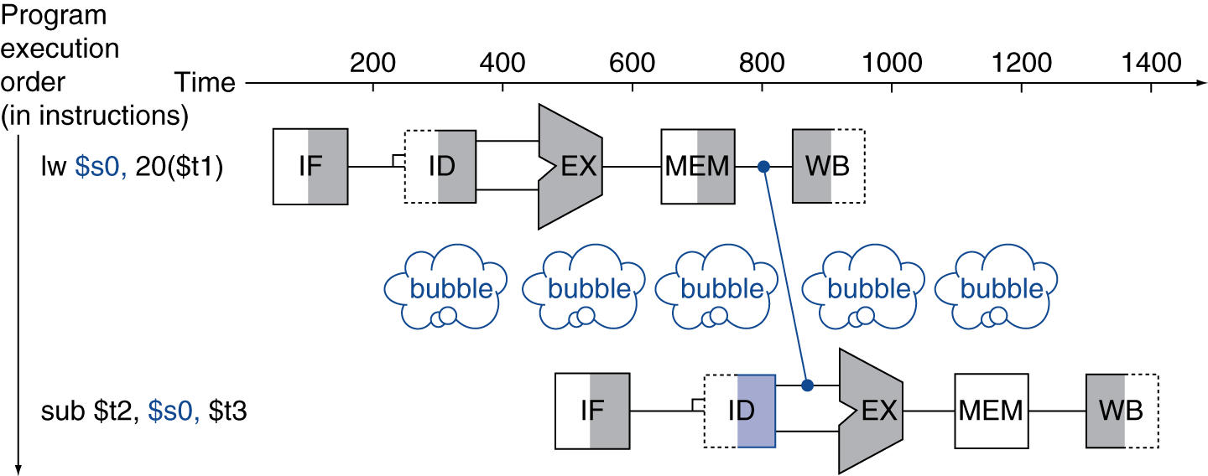
Load-Use Data Hazard
Can’t always avoid stalls by forwarding
If value not computed when needed
Can’t forward backward in time!

Slide 53
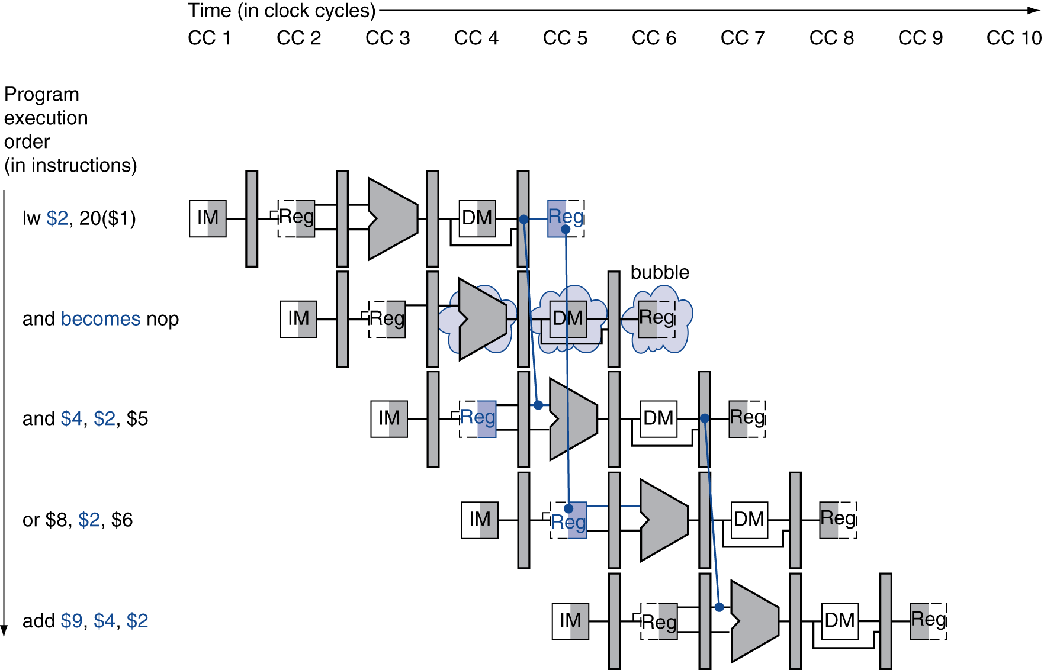
Stall/Bubble in the Pipeline
Stall inserted here

Slide 54
Pipelining and ISA Design
MIPS Instruction Set designed for pipelining
All instructions are 32-bits
Easier to fetch and decode in one cycle
x86: 1- to 17-byte instructions
(x86 HW actually translates to internal RISC instructions!)
Few and regular instruction formats, 2 source register fields always in same place
Can decode and read registers in one step
Memory operands only in Loads and Stores
Can calculate address 3rd stage, access memory 4th stage
Alignment of memory operands
Memory access takes only one cycle

Slide 55
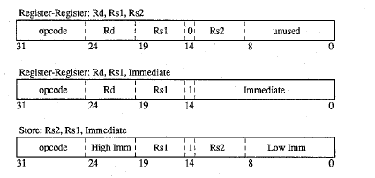
Why Isn’t the Destination Register Always in the Same Field in MIPS ISA?
31
26
21
16
11
6
0
op
rs
rt
rd
shamt
funct
31
6 bits
26
5 bits
21
5 bits
16
5 bits
5 bits
6 bits
0
op
rs
rt
immediate
6 bits
5 bits
5 bits
16 bits
Need to have 2 part immediate if 2 sources and 1 destination always in same place
SPUR processor
(A project Dave and Randy Katz worked on together)

Slide 56
3. Control Hazards
Branch determines flow of control
Fetching next instruction depends on branch outcome
Pipeline can’t always fetch correct instruction
Still working on ID stage of branch
BEQ, BNE in MIPS pipeline
Simple solution Option 1: Stall on every branch until have new PC value
Would add 2 bubbles/clock cycles for every Branch! (~ 20% of instructions executed)

Slide 57
Stall => 2 Bubbles/Clocks
Time (clock cycles)
I
n
s
t
r.
O
r
d
e
r
beq
I$
Reg
ALU
D$
Reg
Instr 1
I$
Reg
ALU
D$
Reg
Instr 2
I$
Reg
ALU
D$
Reg
Instr 3
I$
Reg
ALU
D$
Reg
Instr 4
I$
Reg
ALU
D$
Reg
Where do we do the compare for the branch?

Slide 58
3. Control Hazard: Branching
Optimization #1:
Insert special branch comparator in Stage 2
As soon as instruction is decoded (Opcode identifies it as a branch), immediately make a decision and set the new value of the PC
Benefit: since branch is complete in Stage 2, only one unnecessary instruction is fetched, so only one no-op is needed
Side Note: means that branches are idle in Stages 3, 4 and 5

Slide 59
Corrected Datapath for BEQ/BNE?
Student Roulette?

Slide 60
One Clock Cycle Stall
Time (clock cycles)
I
n
s
t
r.
O
r
d
e
r
beq
I$
Reg
ALU
D$
Reg
Instr 1
I$
Reg
ALU
D$
Reg
Instr 2
I$
Reg
ALU
D$
Reg
Instr 3
I$
Reg
ALU
D$
Reg
Instr 4
I$
Reg
ALU
D$
Reg
Branch comparator moved to Decode stage.

Slide 61
3. Control Hazards
Option 2: Predict outcome of a branch, fix up if guess wrong
Must cancel all instructions in pipeline that depended on guess that was wrong
Simplest hardware if we predict that all branches are NOT taken
Why?
Student Roulette?

Slide 62
3. Control Hazard: Branching
Option #3: Redefine branches
Old definition: if we take the branch, none of the instructions after the branch get executed by accident
New definition: whether or not we take the branch, the single instruction immediately following the branch gets executed (the branch-delay slot)
Delayed Branch means we always execute inst after branch
This optimization is used with MIPS

Slide 63
3. Control Hazard: Branching
Notes on Branch-Delay Slot
Worst-Case Scenario: put a no-op in the branch-delay slot
Better Case: place some instruction preceding the branch in the branch-delay slot—as long as the changed doesn’t affect the logic of program
Re-ordering instructions is common way to speed up programs
Compiler usually finds such an instruction 50% of time
Jumps also have a delay slot …

Slide 64
Example: Nondelayed vs. Delayed Branch
Nondelayed Branch
Delayed Branch
or $8, $9, $10
add $1, $2,$3
add $1, $2, $3
sub $4, $5, $6
sub $4, $5, $6
beq $1, $4, Exit
beq $1, $4, Exit
or $8, $9, $10
xor $10, $1, $11
xor $10, $1, $11
Exit:
Exit:

Slide 65
Delayed Branch/Jump and MIPS ISA?
Why does JAL put PC+8 in register 31?
Student Roulette?

Slide 66
Delayed Branch/Jump and MIPS ISA?
Why does JAL put PC+8 in register 31?
JAL executes following instruction (PC+4) so should return to PC+8

Slide 67
Code Scheduling to Avoid Stalls
Reorder code to avoid use of load result in the next instruction
C code for A = B + E; C = B + F;
lw $t1, 0($t0)
lw $t2, 4($t0)
add $t3, $t1, $t2
sw $t3, 12($t0)
lw $t4, 8($t0)
add $t5, $t1, $t4
sw $t5, 16($t0)
lw $t1, 0($t0)
lw $t2, 4($t0)
lw $t4, 8($t0)
add $t3, $t1, $t2
sw $t3, 12($t0)
add $t5, $t1, $t4
sw $t5, 16($t0)
stall
stall
13 cycles
11 cycles

Slide 68
Peer Instruction
Thanks to pipelining, I have reduced the time it took me to wash my one shirt.
Longer pipelines are always a win (since less work per stage & a faster clock).
A)(orange) I is True and II is True
B)(green) I is False and II is True
C)(pink) I is True and II is False
D)(yellow) I is False and II is False

Slide 69
Peer Instruction Answer
Throughput better, not latency!
“…longer pipelines do usually mean faster clock rate, but hazards can cause problems!”
F A L S E
Thanks to pipelining, I have reduced the time it took me to wash my one shirt.
Longer pipelines are always a win (since less work per stage & a faster clock).
12
a) FF
b) FT
c) TF
d) TT
F A L S E

Slide 70
And in Conclusion, …
The BIG Picture
Pipelining improves performance by increasing instruction throughput: exploits ILP
Executes multiple instructions in parallel
Each instruction has the same latency
Subject to hazards
Structure, data, control
Stalls reduce performance
But are required to get correct results
Compiler can arrange code to avoid hazards and stalls
Requires knowledge of the pipeline structure

