Slide 1
CS 61C: Great Ideas in Computer Architecture (formerly called Machine Structures) Map Reduce
Instructor:
David A. Patterson
http://inst.eecs.Berkeley.edu/~cs61c/sp12

Slide 2
Review
CS61c: Learn 6 great ideas in computer architecture to enable high performance programming via parallelism, not just learn C
Layers of Representation/Interpretation
Moore’s Law
Principle of Locality/Memory Hierarchy
Parallelism
Performance Measurement and Improvement
Dependability via Redundancy
Post PC Era: Parallel processing, smart phones to WSC
WSC SW must cope with failures, varying load, varying HW latency bandwidth
WSC HW sensitive to cost, energy efficiency

Slide 3
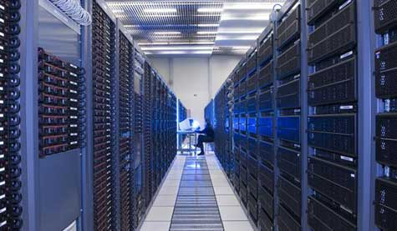
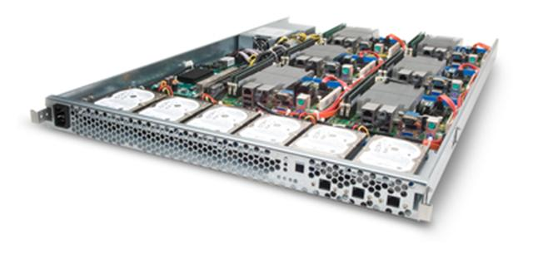
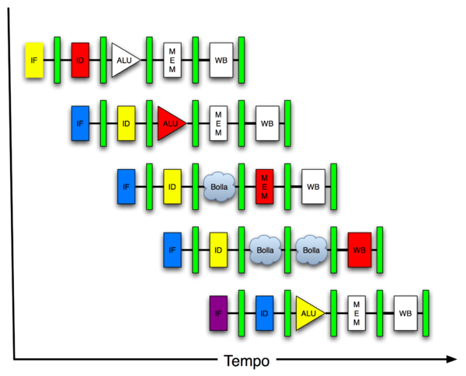
New-School Machine Structures (It’s a bit more complicated!)
Today’s Lecture
Software Hardware
Parallel Requests
Assigned to computer
e.g., Search “Katz”
Parallel Threads
Assigned to core
e.g., Lookup, Ads
Parallel Instructions
>1 instruction @ one time
e.g., 5 pipelined instructions
Parallel Data
>1 data item @ one time
e.g., Add of 4 pairs of words
Hardware descriptions
All gates @ one time
Programming Languages
Warehouse Scale Computer
Smart Phone
Harness Parallelism &
Achieve High Performance
Computer
Core
…
Core
Memory (Cache)
Input/Output
Core
Instruction Unit(s)
Functional
Unit(s)
A₀+B₀
A₁+B₁
A₂+B₂
A₃+B₃
Cache Memory
Logic Gates

Slide 4
Agenda
Request Level Parallelism
DataLevel Parallelism
MapReduce
Administrivia + 61C in the News + The secret to getting good grades at Berkeley
MapReduce Examples
Technology Break
Costs in Warehouse Scale Computer (if time permits)

Slide 5
Request-Level Parallelism (RLP)
Hundreds or thousands of requests per second
Not your laptop or cell-phone, but popular Internet services like Google search
Such requests are largely independent
Mostly involve read-only databases
Little read-write (aka “producer-consumer”) sharing
Rarely involve read–write data sharing or synchronization across requests
Computation easily partitioned within a request and across different requests

Slide 6
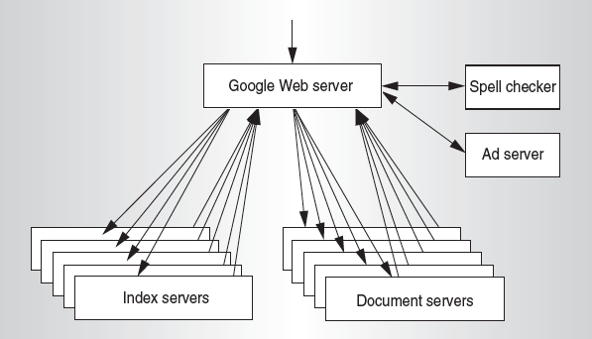
Google Query-Serving Architecture

Slide 7
Anatomy of a Web Search
Google “Randy H. Katz”
Direct request to “closest” Google Warehouse Scale Computer
Front-end load balancer directs request to one of many clusters of servers within WSC
Within cluster, select one of many Google Web Servers (GWS) to handle the request and compose the response pages
GWS communicates with Index Servers to find documents that contain the search words, “Randy”, “Katz”, uses location of search as well
Return document list with associated relevance score

Slide 8
Anatomy of a Web Search
In parallel,
Ad system: books by Katz at Amazon.com
Images of Randy Katz
Use docids (document IDs) to access indexed documents
Compose the page
Result document extracts (with keyword in context) ordered by relevance score
Sponsored links (along the top) and advertisements (along the sides)

Slide 9
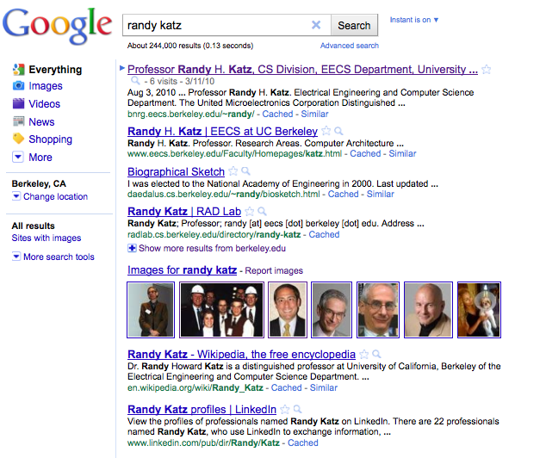

Slide 10
Anatomy of a Web Search
Implementation strategy
Randomly distribute the entries
Make many copies of data (aka “replicas”)
Load balance requests across replicas
Redundant copies of indices and documents
Breaks up hot spots, e.g., “Justin Bieber”
Increases opportunities for request-level parallelism
Makes the system more tolerant of failures

Slide 11
Question: Which statements are NOT TRUE about about Request Level Parallelism?
☐
RLP runs naturally independent requests in parallel
☐
RLP also runs independent tasks within a request
☐
RLP typically uses equal number of reads and writes
☐
Search uses redundant copies of indices and data to deliver parallelism
Notes:
VertLeftWhiteCheck1

Slide 12
Data-Level Parallelism (DLP)
2 kinds
Lots of data in memory that can be operated on in parallel (e.g., adding together 2 arrays)
Lots of data on many disks that can be operated on in parallel (e.g., searching for documents)
Feb 28 lecture and 3rd project does Data Level Parallelism (DLP) in memory
Today’s lecture and 1st project does DLP across 1000s of servers and disks using MapReduce

Slide 13
Problem Trying To Solve
How process large amounts of raw data (crawled documents, request logs, …) every day to compute derived data (inverted indicies, page popularity, …) when computation conceptually simple but input data large and distributed across 100s to 1000s of servers so that finish in reasonable time?
Challenge: Parallelize computation, distribute data, tolerate faults without obscuring simple computation with complex code to deal with issues
Jeffrey Dean and Sanjay Ghemawat, “MapReduce: Simplified Data Processing on Large Clusters,” Communications of the ACM, Jan 2008.

Slide 14
MapReduce Solution
Apply Map function to user supplied record of key/value pairs
Compute set of intermediate key/value pairs
Apply Reduce operation to all values that share same key to combine derived data properly
Often produces smaller set of values
Typically 0 or 1 output value per Reduce invocation
User supplies Map and Reduce operations in functional model so can parallelize, re-execute for fault tolerance

Slide 15
Data-Parallel “Divide and Conquer” (MapReduce Processing)
Map:
Slice data into “shards” or “splits”, distribute these to workers, compute sub-problem solutions
map(in_key,in_value)->list(out_key,intermediate value)
Processes input key/value pair
Produces set of intermediate pairs
Reduce:
Collect and combine sub-problem solutions
reduce(out_key,list(intermediate_value))->list(out_value)
Combines all intermediate values for a particular key
Produces a set of merged output values (usually just one)
Fun to use: focus on problem, let MapReduce library deal with messy details

Slide 16
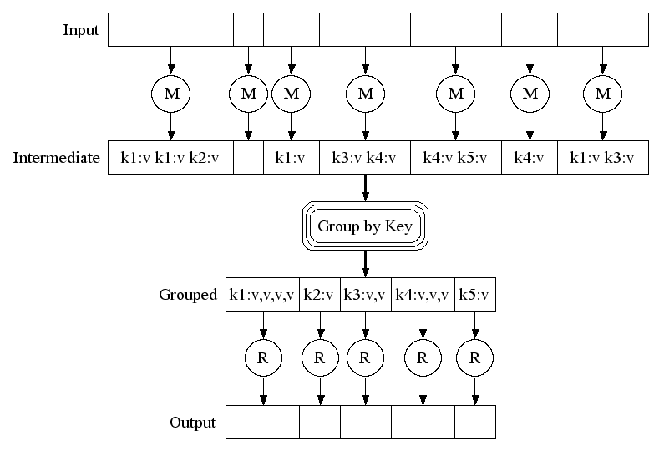
MapReduce Execution
Fine granularity tasks: many more map tasks than machines
Bucket sort
to get same keys
together
2000 servers => ≈ 200,000 Map Tasks, ≈ 5,000 Reduce tasks

Slide 17
Google Uses MapReduce For …
Web crawl: Find outgoing links from HTML documents, aggregate by target document
Google Search: Generating inverted index files using a compression scheme
Google Earth: Stitching overlapping satellite images to remove seams and to select high-quality imagery
Google Maps: Processing all road segments on Earth and render map tile images that display segments
More than 10,000 MR programs at Google in 4 years, run 100,000 MR jobs per day (2008)

Slide 18
MapReduce Popularity at Google
 | Aug-04 | Mar-06 | Sep-07 | Sep-09
Number of MapReduce jobs | 29,000 | 171,000 | 2,217,000 | 3,467,000
Average completion time (secs) | 634 | 874 | 395 | 475
Server years used | 217 | 2,002 | 11,081 | 25,562
Input data read (TB) | 3,288 | 52,254 | 403,152 | 544,130
Intermediate data (TB) | 758 | 6,743 | 34,774 | 90,120
Output data written (TB) | 193 | 2,970 | 14,018 | 57,520
Average number servers /job | 157 | 268 | 394 | 488

Slide 19
What if Ran Google Workload on EC2?
 | Aug-04 | Mar-06 | Sep-07 | Sep-09
Number of MapReduce jobs | 29,000 | 171,000 | 2,217,000 | 3,467,000
Average completion time (secs) | 634 | 874 | 395 | 475
Server years used | 217 | 2,002 | 11,081 | 25,562
Input data read (TB) | 3,288 | 52,254 | 403,152 | 544,130
Intermediate data (TB) | 758 | 6,743 | 34,774 | 90,120
Output data written (TB) | 193 | 2,970 | 14,018 | 57,520
Average number of servers per job | 157 | 268 | 394 | 488
Average Cost/job EC2 | $17 | $39 | $26 | $38
Annual Cost if on EC2 | $0.5M | $6.7M | $57.4M | $133.1M

Slide 20
Question: Which statements are NOT TRUE about about MapReduce?
☐
Users express computation as 2 functions, Map and Reduce, and supply code for them
☐
MapReduce works is good for tasks like Search and Matrix Multiply
☐
There are typically many more Map Tasks than Reduce Tasks (e.g., 40:1)
☐
MapReduce hides details of parallelization, fault tolerance, locality optimization, and load balancing
Notes:
VertLeftWhiteCheck1

Slide 21
Course Organization
Grading
Participation and Altruism (5%)
Homework (5%)
Labs (20%)
Projects (40%)
Data Parallelism (Map-Reduce on Amazon EC2, with partner)
Computer Instruction Set Simulator (C)
Performance Tuning of a Parallel Application/Matrix Multiply using cache blocking, SIMD, MIMD (OpenMP, with partner)
Computer Processor Design (Logisim)
Extra Credit: Matrix Multiply Competition, anything goes
Midterm (10%): 6-9 PM Tuesday March 6, 155 Dwinelle
How many taking CS188?
Final (20%): 11:30-2:30 PM Wednesday May 9

Slide 22
Late Policy
Assignments due Sundays at 11:59:59 PM
Late homeworks not accepted (100% penalty)
Late projects get 20% penalty, accepted up to Tuesdays at 11:59:59 PM
No credit if more than 48 hours late
No “slip days” in 61C
Used by Dan Garcia and a few faculty to cope with 100s of students who often procrastinate without having to hear the excuses, but not widespread in EECS courses
More late assignments if everyone has no-cost options; better to learn now how to cope with real deadlines

Slide 23
YOUR BRAIN ON COMPUTERS; Hooked on Gadgets, and Paying a Mental Price
NY Times, June 7, 2010, by Matt Richtel
SAN FRANCISCO -- When one of the most important e-mail messages of his life landed in his in-box a few years ago, Kord Campbell overlooked it.
Not just for a day or two, but 12 days. He finally saw it while sifting through old messages: a big company wanted to buy his Internet start-up.
''I stood up from my desk and said, 'Oh my God, oh my God, oh my God,' '' Mr. Campbell said. ''It's kind of hard to miss an e-mail like that, but I did.''
The message had slipped by him amid an electronic flood: two computer screens alive with e-mail, instant messages, online chats, a Web browser and the computer code he was writing.
While he managed to salvage the $1.3 million deal after apologizing to his suitor, Mr. Campbell continues to struggle with the effects of the deluge of data. Even after he unplugs, he craves the stimulation he gets from his electronic gadgets. He forgets things like dinner plans, and he has trouble focusing on his family. His wife, Brenda, complains, ''It seems like he can no longer be fully in the moment.''
This is your brain on computers.
Scientists say juggling e-mail, phone calls and other incoming information can change how people think and behave. They say our ability to focus is being undermined by bursts of information.
These play to a primitive impulse to respond to immediate opportunities and threats. The stimulation provokes excitement -- a dopamine squirt -- that researchers say can be addictive. In its absence, people feel bored.
The resulting distractions can have deadly consequences, as when cellphone-wielding drivers and train engineers cause wrecks. And for millions of people like Mr. Campbell, these urges can inflict nicks and cuts on creativity and deep thought, interrupting work and family life.
While many people say multitasking makes them more productive, research shows otherwise. Heavy multitaskers actually have more trouble focusing and shutting out irrelevant information, scientists say, and they experience more stress.
And scientists are discovering that even after the multitasking ends, fractured thinking and lack of focus persist. In other words, this is also your brain off computers.

Slide 24
The Rules (and we really mean it!)

Slide 25
Architecture of a Lecture
Full
Administrivia
Tech break
“And in conclusion…”
Attention
0
20
25
50
53
78
80
Time (minutes)

Slide 26
Peer Instruction
Increase real-time learning in lecture, test understanding of concepts vs. details mazur-www.harvard.edu/education/pi.phtml
As complete a “segment” ask multiple choice question
<1 minute: decide yourself, vote
<2 minutes: discuss in pairs, then team vote; flash card to pick answer
Try to convince partner; learn by teaching
Mark and save flash cards (get in discussion section)
1
2
3
4

Slide 27
61C in the News
IEEE Spectrum Top 11 Innovations of the Decade
61C
61C
61C

Slide 28
The Secret to Getting Good Grades
Grad student said he figured finally it out
(Mike Dahlin, now Professor at UT Texas)
My question: What is the secret?
Do assigned reading night before, so that get more value from lecture
61c Comment on End-of-Semester Survey: “I wish I had followed Professor Patterson's advice and did the reading before each lecture.”

Slide 29
Agenda
Request Level Parallelism
DataLevel Parallelism
MapReduce
Administrivia + 61C in the News + The secret to getting good grades at Berkeley
MapReduce Examples
Technology Break
Costs in Warehouse Scale Computer (if time permits)

Slide 30
MapReduce Processing Example: Count Word Occurrences
Pseudo Code: Simple case of assuming just 1 word per document
Reduce sums all counts emitted for a particular word
map(String input_key, String input_value):
// input_key: document name
// input_value: document contents
for each word w in input_value:
EmitIntermediate(w, "1"); // Produce count of words
reduce(String output_key, Iterator intermediate_values):
// output_key: a word
// intermediate_values: a list of counts
int result = 0;
for each v in intermediate_values:
result += ParseInt(v); // get integer from key-value
Emit(AsString(result));

Slide 31
Another Example: Word Index (How Often Does a Word Appear?)
Distribute
that that is is that that is not is not is that it it is
Map 1
Map 2
Map 3
Map 4
is 1, that 2
is 1, that 2
is 2, not 2
is 2, it 2, that 1
Shuffle
is 1
is 1,1
that 2
is 1,1,2,2
it 2
that 2,2
that 2,2,1
not 2
Reduce 1
Reduce 2
is 6; it 2
not 2; that 5
Collect
is 6; it 2; not 2; that 5

Slide 32
Types
map (k1,v1) ➔ list(k2,v2)
reduce (k2,list(v2)) ➔ list(v2)
Input keys and values from different domain than output keys and values
Intermediate keys and values from same domain as output keys and values

Slide 33
Execution Setup
Map invocations distributed by partitioning input data into M splits
Typically 16 MB to 64 MB per piece
Input processed in parallel on different servers
Reduce invocations distributed by partitioning intermediate key space into R pieces
E.g., hash(key) mod R
User picks M >> no. servers, R > no. servers
Big M helps with load balancing, recovery from failure
One output file per R invocation, so not too many

Slide 34
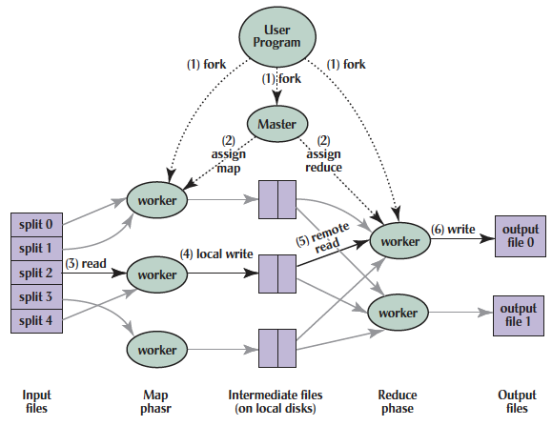
MapReduce Processing
Shuffle phase

Slide 35
MapReduce Processing
1. MR 1st splits the input files into M “splits” then starts many copies of
program on servers
Shuffle phase

Slide 36
MapReduce Processing
2. One copy—the master— is special. The rest
are workers. The master picks idle workers and
assigns each 1 of M map tasks or 1 of R reduce tasks.
Shuffle phase
Notes:
We subdivide the map phase into M pieces and the reduce phase into R pieces as described previously. Ideally, M and R should be much larger than the number of worker machines. Having each worker perform many different tasks improves dynamic load balancing and also speeds up recovery when a worker fails: the many map tasks it has completed can be spread out across all the other worker machines. There are practical bounds on how large M and R can be in our implementation since the master must make O(M+R) scheduling decisions and keep O(M*R) state in memory as described. (The constant factors for memory usage are small, however. The O(M*R) piece of the state consists of approximately one byte of data per map task/reduce task pair.) Furthermore, R is often constrained by users because the output of each reduce task ends up in a separate output file. In practice, we tend to choose M so that each individual task is roughly 16MB to 64MB of input data (so that the locality optimization described previously is most effective), and we make R a small multiple of the number of worker machines we expect to use. We often perform MapReduce computations with M=200,000 and R=5,000, using 2,000 worker machines.

Slide 37
MapReduce Processing
3. A map worker reads the input split. It parses key/value pairs of the input data and passes each pair to the user-defined map function.
(The intermediate
key/value pairs produced by the map function are buffered in memory.)
Shuffle phase

Slide 38
MapReduce Processing
4. Periodically, the buffered pairs are written to local disk, partitioned
into R regions by the partitioning function.
Shuffle phase
Notes:
The locations of these buffered pairs on the local disk are passed back to the master who is responsible for forwarding these locations to the reduce workers.

Slide 39
MapReduce Processing
5. When a reduce worker has read all intermediate data for its partition, it bucket sorts using inter-mediate keys so that occur-rences of same keys are grouped together
(The sorting is needed because typically many different keys map to
the same reduce task )
Shuffle phase

Slide 40
MapReduce Processing
6. Reduce worker iterates over sorted intermediate data and for each unique intermediate key, it passes key and corresponding set of values to the user’s reduce function.
The output of the reduce function is appended to a final output file for this reduce partition.
Shuffle phase

Slide 41
MapReduce Processing
7. When all map tasks and reduce tasks have been completed, the master
wakes up the user program. The MapReduce call
in user program returns back to user code.
Output of MR is in R output files (1 per reduce task, with file names specified by user); often passed into another MR job so don’t combine
Shuffle phase

Slide 42
Master Data Structurs
For each map task and reduce task
State: idle, in-progress, or completed
Identify of worker server (if not idle)
For each completed map task
Stores location and size of R intermediate files
Updates files and size as corresponding map tasks complete
Location and size are pushed incrementally to workers that have in-progress reduce tasks

Slide 43
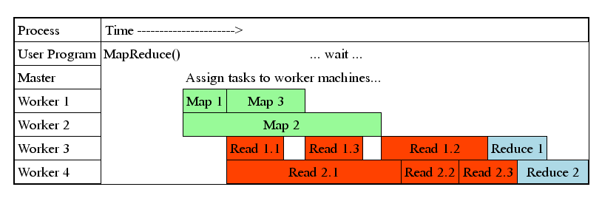
MapReduce Processing Time Line
Master assigns map + reduce tasks to “worker” servers
As soon as a map task finishes, worker server can be assigned a new map or reduce task
Data shuffle begins as soon as a given Map finishes
Reduce task begins as soon as all data shuffles finish
To tolerate faults, reassign task if a worker server “dies”

Slide 44
Show MapReduce Job Running
~41 minutes total
~29 minutes for Map tasks & Shuffle tasks
~12 minutes for Reduce tasks
1707 worker servers used
Map (Green) tasks read 0.8 TB, write 0.5 TB
Shuffle (Red) tasks read 0.5 TB, write 0.5 TB
Reduce (Blue) tasks read 0.5 TB, write 0.5 TB

Slide 45
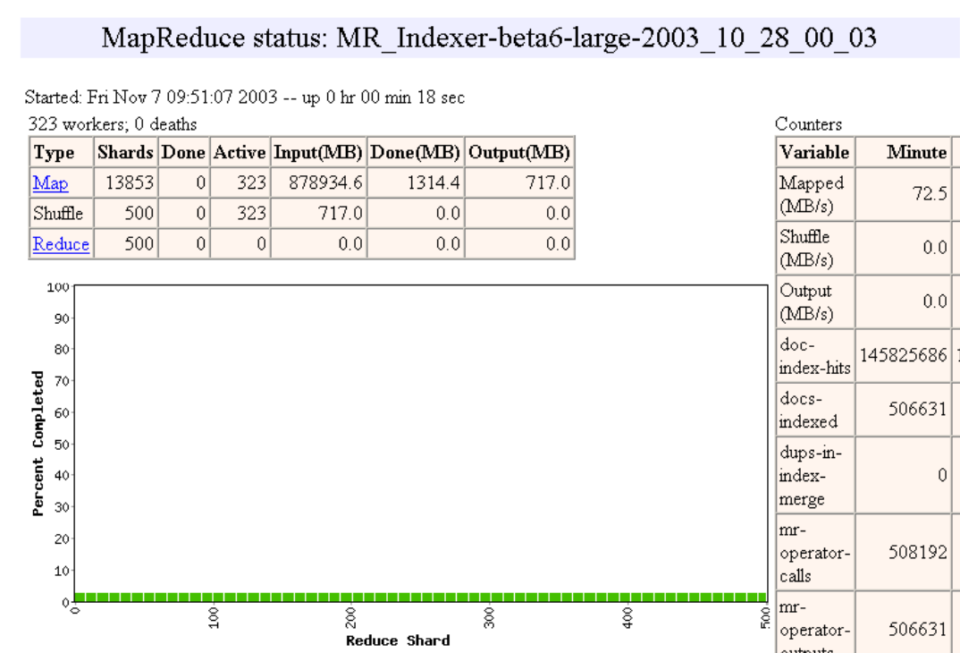

Slide 46
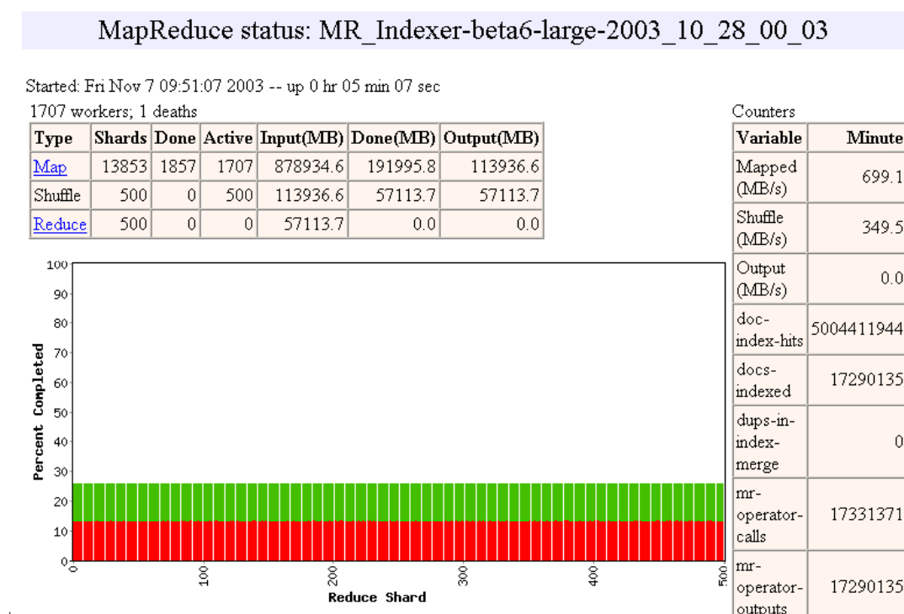

Slide 47
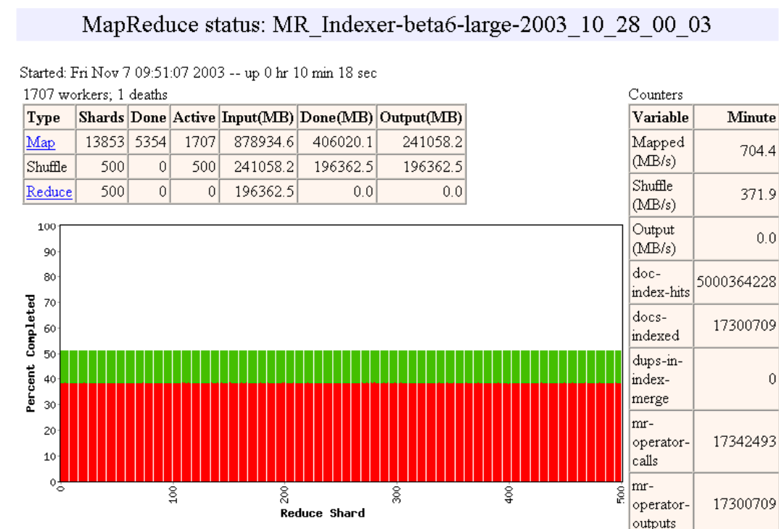

Slide 48
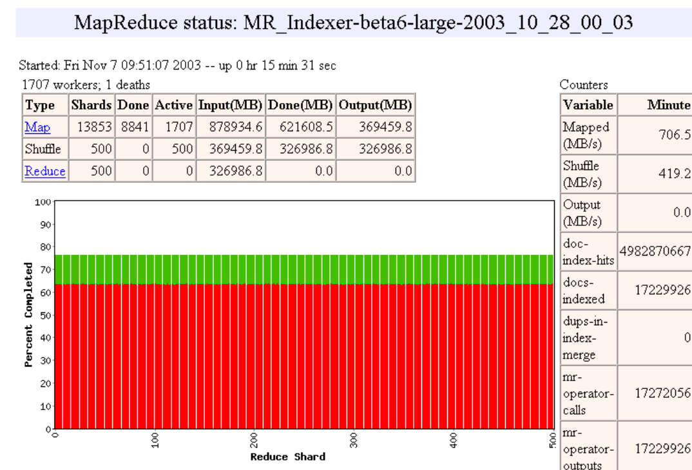

Slide 49
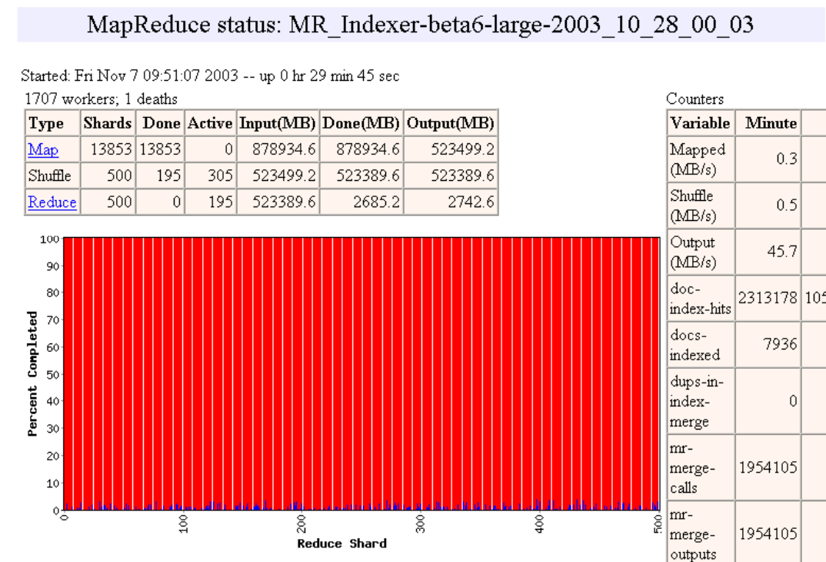

Slide 50
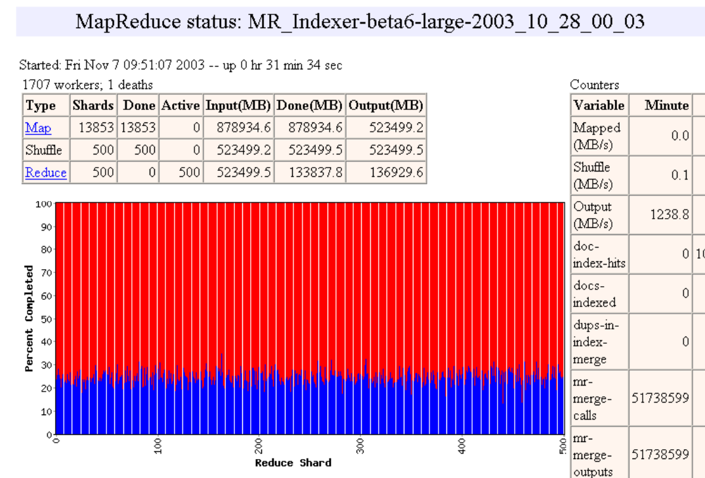

Slide 51
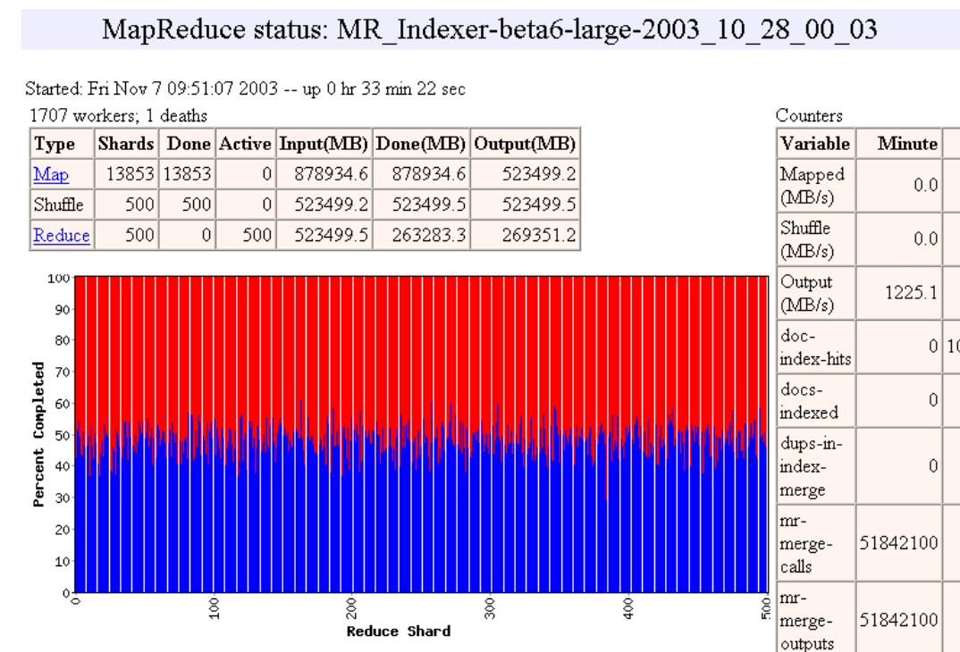

Slide 52
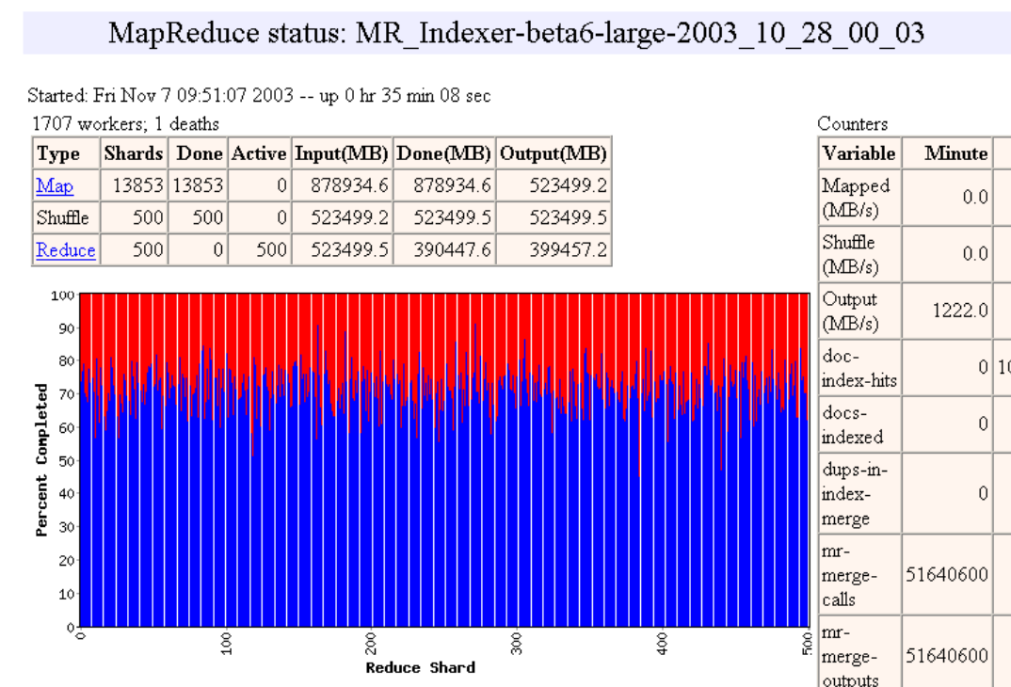

Slide 53
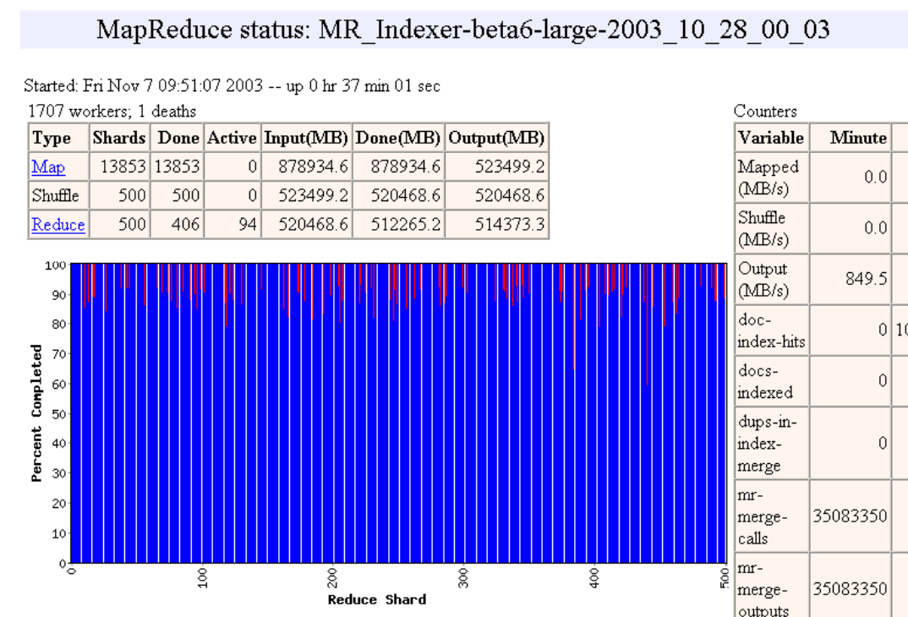

Slide 56
MapReduce Failure Handling
On worker failure:
Detect failure via periodic heartbeats
Re-execute completed and in-progress map tasks
Re-execute in progress reduce tasks
Task completion committed through master
Master failure:
Could handle, but don't yet (master failure unlikely)
Robust: lost 1600 of 1800 machines once, but finished fine

Slide 57
MapReduce Redundant Execution
Slow workers significantly lengthen completion time
Other jobs consuming resources on machine
Bad disks with soft errors transfer data very slowly
Weird things: processor caches disabled (!!)
Solution: Near end of phase, spawn backup backup copies of tasks
Whichever one finishes first "wins"
Effect: Dramatically shortens job completion time
3% more resources, large tasks 30% faster

Slide 58
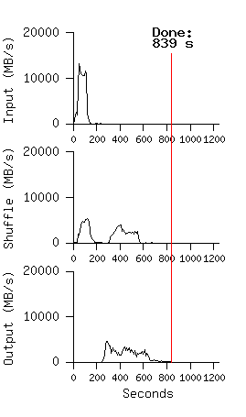
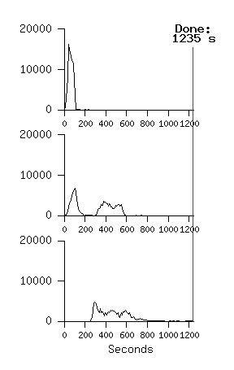
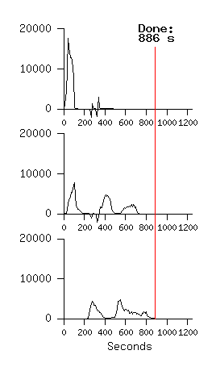
Impact on Execution of Restart, Failure for 10B record Sort using 1800 servers
No Backup Tasks
(44% Longer)
Kill 200 workers
(5% Longer)
Notes:
Figure 3 (a) shows the progress of a normal execution of the sort program.
The top-left graph shows the rate at which input is read. The rate peaks at about 13 GB/s and dies off fairly quickly since all map tasks finish before 200 seconds have elapsed.
The middle-left graph shows the rate at which data is sent over the network from the map tasks to the reduce tasks. This shuffling starts as soon as the first map task completes. The first hump in the graph is for the first batch of approximately 1700 reduce tasks (the entire MapReduce was assigned about 1700 machines, and each machine executes at most one reduce task at a time). Roughly 300 seconds into the computation, some of these first batch of reduce tasks finish and we start shuffling data for the remaining reduce tasks. All of the shuffling is done about 600 seconds into the computation.
The bottom-left graph shows the rate at which sorted data is written to the final output files by the reduce tasks. There is a delay between the end of the first shuffling period and the start of the writing period because the machines are busy sorting the intermediate data. The writes continue at a rate of about 2-4 GB/s for a while. All of the writes finish about 850 seconds into the computation.
Including startup overhead, the entire computation takes 891 seconds.
A few things to note: the input rate is higher than the shuffle rate and the output rate because of our locality optimization – most data is read from a local disk and bypasses our relatively bandwidth constrained network.
The shuffle rate is higher than the output rate because the output phase writes two copies of the sorted data (we make two replicas of the output for reliability and avail- ability reasons). We write two replicas because that is the mechanism for reliability and availability provided by our underlying file system.
In Figure 3 (b)[middle], we show an execution of the sort pro- gram with backup tasks disabled. The execution flow is similar to that shown in Figure 3 (a), except that there is a very long tail where hardly any write activity occurs. After 960 seconds, all except 5 of the reduce tasks are completed. However these last few stragglers don’t fin- ish until 300 seconds later. The entire computation takes 1283 seconds, an increase of 44% in elapsed time.
In Figure 3 (c)[right], we show an execution of the sort program where we intentionally killed 200 out of 1746 worker processes several minutes into the computation. The underlying cluster scheduler immediately restarted new worker processes on these machines (since only the pro- cesses were killed, the machines were still functioning properly).The worker deaths show up as a negative input rate since some previously completed map work disappears (since the corresponding map workers were killed) and needs to be redone. The re-execution of this map work happens relatively quickly. The entire computation fin- ishes in 933 seconds including startup overhead (just an increase of 5% over the normal execution time).

Slide 59
MapReduce Locality Optimization during Scheduling
Master scheduling policy:
Asks GFS (Google File System) for locations of replicas of input file blocks
Map tasks typically split into 64MB (== GFS block size)
Map tasks scheduled so GFS input block replica are on same machine or same rack
Effect: Thousands of machines read input at local disk speed
Without this, rack switches limit read rate

Slide 60
Question: Which statements are NOT TRUE about about MapReduce?
☐
MapReduce divides computers into 1 master and N-1 workers; masters assigns MR tasks
☐
Towards the end, the master assigns uncompleted tasks again; 1st to finish wins
☐
Map worker sorts by input keys to group all occurrences of same key
☐
Reduce worker sorts by intermediate keys to group all occurrences of same key
Notes:
VertLeftWhiteCheck1

Slide 61
Agenda
Request Level Parallelism
DataLevel Parallelism
MapReduce
Administrivia + 61C in the News + The secret to getting good grades at Berkeley
MapReduce Examples
Technology Break
Costs in Warehouse Scale Computer (if time permits)

Slide 62
Design Goals of a WSC
Unique to Warehouse-scale
Ample parallelism:
Batch apps: large number independent data sets with independent processing. Also known as Data-Level Parallelism
Scale and its Opportunities/Problems
Relatively small number of these make design cost expensive and difficult to amortize
But price breaks are possible from purchases of very large numbers of commodity servers
Must also prepare for high component failures
Operational Costs Count:
Cost of equipment purchases << cost of ownership

Slide 63
WSC Case Study Server Provisioning
WSC Power Capacity |  | 8.00 | MW
Power Usage Effectiveness (PUE) | 1.45
IT Equipment Power Share | 0.67 | 5.36 | MW
Power/Cooling Infrastructure | 0.33 | 2.64 | MW
IT Equipment Measured Peak (W) | 145.00
Assume Average Pwr @ 0.8 Peak | 116.00
# of Servers |  | 46207
# of Servers |  | 46000
# of Servers per Rack | 40.00
# of Racks |  | 1150
Top of Rack Switches |  | 1150
# of TOR Switch per L2 Switch | 16.00
# of L2 Switches |  | 72
# of L2 Switches per L3 Switch | 24.00
# of L3 Switches |  | 3
Internet
L3 Switch
L2 Switch
…
TOR Switch
Server
Rack …

Slide 64
Cost of WSC
US account practice separates purchase price and operational costs
Capital Expenditure (CAPEX) is cost to buy equipment (e.g. buy servers)
Operational Expenditure (OPEX) is cost to run equipment (e.g, pay for electricity used)

Slide 65
WSC Case Study Capital Expenditure (Capex)
Facility cost and total IT cost look about the same
Facility Cost | $88,000,000
Total Server Cost | $66,700,000
Total Network Cost | $12,810,000
Total Cost | $167,510,000
However, replace servers every 3 years, networking gear every 4 years, and facility every 10 years

Slide 66
Cost of WSC
US account practice allow converting Capital Expenditure (CAPEX) into Operational Expenditure (OPEX) by amortizing costs over time period
Servers 3 years
Networking gear 4 years
Facility 10 years

Slide 67
WSC Case Study Operational Expense (Opex)
Years
Amortization
Monthly Cost
Amortized
Capital
Expense
Server | 3 | $66,700,000 | $2,000,000 | 55%
Network | 4 | $12,530,000 | $295,000 | 8%
Facility |  | $88,000,000
Pwr&Cooling | 10 | $72,160,000 | $625,000 | 17%
Other | 10 | $15,840,000 | $140,000 | 4%
Amortized Cost |  |  | $3,060,000
Power (8MW) |  | $0.07 | $475,000 | 13%
People (3) |  |  | $85,000 | 2%
Total Monthly |  |  | $3,620,000 | 100%
Operational
Expense
$/kWh
Monthly Power costs
$475k for electricity
$625k + $140k to amortize facility power distribution and cooling
60% is amortized power distribution and cooling

Slide 68
How much does a watt cost in a WSC?
8 MW facility
Amortized facility, including power distribution and cooling is $625k + $140k = $765k
Monthly Power Usage = $475k
Watt-Year = ($765k+$475k)*12/8M = $1.86 or about $2 per year
To save a watt, if spend more than $2 a year, lose money

Slide 69
Flash memory is non-volatile,
$20 / GB, 10 GB capacity, 0.01 Watts. Disk $0.1/GB, 1000 GB, 10 Watts. Should we replace Disk with Flash to save $?
☐
No: Capex Costs are 100:1 of OpEx savings!
☐
We don’t have enough information to answer question
☐
Yes: Return investment in a single year!
☐
Notes:
VertLeftWhiteCheck1
No

Slide 70
WSC Case Study Operational Expense (Opex)
Years
Amortization
Monthly Cost
Amortized
Capital
Expense
Server | 3 | $66,700,000 | $2,000,000 | 55%
Network | 4 | $12,530,000 | $295,000 | 8%
Facility |  | $88,000,000
Pwr&Cooling | 10 | $72,160,000 | $625,000 | 17%
Other | 10 | $15,840,000 | $140,000 | 4%
Amortized Cost |  |  | $3,060,000
Power (8MW) |  | $0.07 | $475,000 | 13%
People (3) |  |  | $85,000 | 2%
Total Monthly |  |  | $3,620,000 | 100%
Operational
Expense
$/kWh
$3.8M/46000 servers = ~$80 per month per server in revenue to break even
~$80/720 hours per month = $0.11 per hour
So how does Amazon EC2 make money???

Slide 71
January 2012 AWS Instances & Prices
Instance | Per Hour | Ratio to Small | Compute Units | Virtual Cores | Compute Unit/ Core | Memory (GB) | Disk (GB) | Address
Standard Small | $0.085 | 1.0 | 1.0 | 1 | 1.00 | 1.7 | 160 | 32 bit
Standard Large | $0.340 | 4.0 | 4.0 | 2 | 2.00 | 7.5 | 850 | 64 bit
Standard Extra Large | $0.680 | 8.0 | 8.0 | 4 | 2.00 | 15.0 | 1690 | 64 bit
High-Memory Extra Large | $0.500 | 5.9 | 6.5 | 2 | 3.25 | 17.1 | 420 | 64 bit
High-Memory Double Extra Large | $1.200 | 14.1 | 13.0 | 4 | 3.25 | 34.2 | 850 | 64 bit
High-Memory Quadruple Extra Large | $2.400 | 28.2 | 26.0 | 8 | 3.25 | 68.4 | 1690 | 64 bit
High-CPU Medium | $0.170 | 2.0 | 5.0 | 2 | 2.50 | 1.7 | 350 | 32 bit
High-CPU Extra Large | $0.680 | 8.0 | 20.0 | 8 | 2.50 | 7.0 | 1690 | 64 bit
Cluster Quadruple Extra Large | $1.300 | 15.3 | 33.5 | 16 | 2.09 | 23.0 | 1690 | 64 bit
Closest computer in WSC example is Standard Extra Large
@$0.11/hr, Amazon EC2 can make money!
even if used only 50% of time

Slide 72
Summary
Request-Level Parallelism
High request volume, each largely independent of other
Use replication for better request throughput, availability
MapReduce Data Parallelism
Map: Divide large data set into pieces for independent parallel processing
Reduce: Combine and process intermediate results to obtain final result
WSC CapEx vs. OpEx
Economies of scale mean WSC can sell computing as a utility
Servers dominate cost
Spend more on power distribution and cooling infrastructure than on monthly electricity costs

