Slide 1
CS 61C: Great Ideas in Computer Architecture (Machine Structures) Modern Microprocessor Anatomy + RISC in Retrospect
Instructors: Randy H. Katz David A. Patterson
http://inst.eecs.Berkeley.edu/~cs61c/Sp11

Slide 3
Review
Virtual Memory, Paging really used for Protection, Translation, Some OS optimizations
Not really routinely paging to disk
Can think of as another level of memory hierarchy, but not really used like caches
Virtual Machines as even greater level of protection to allow greater level of sharing
Enables fine control, allocation, pricing of Cloud Computing

Slide 4
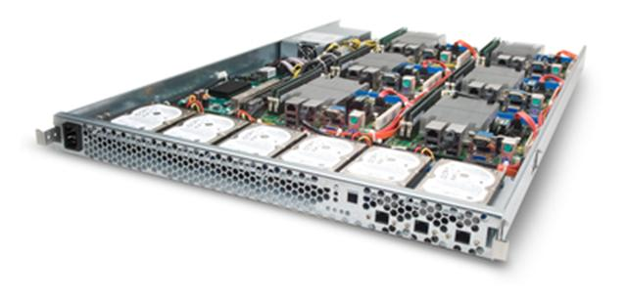
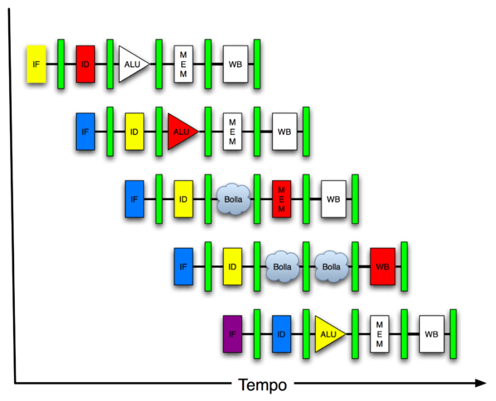
New-School Machine Structures
Today’s
Lecture
Software Hardware
Parallel Requests
Assigned to computer
e.g., Search “Katz”
Parallel Threads
Assigned to core
e.g., Lookup, Ads
Parallel Instructions
>1 instruction @ one time
e.g., 5 pipelined instructions
Parallel Data
>1 data item @ one time
e.g., Add of 4 pairs of words
Hardware descriptions
All gates @ one time
Warehouse Scale Computer
Smart Phone
Harness Parallelism &
Achieve High Performance
Computer
Core
…
Core
Memory (Cache)
Input/Output
Core
Instruction Unit(s)
Functional
Unit(s)
A₀+B₀
A₁+B₁
A₂+B₂
A₃+B₃
Main Memory
Logic Gates

Slide 5
Agenda
Update Q&A on Extra Credit Projects: Andrew Gearhart and Vasily Volkov
Administrivia
Intel Nehalem (including some Intel marketing slides)
RISC CISC in Retrospect 30 years later
Summary

Slide 6
Project 3 Extra Credit
Rubric:
Out of 3 points
3 points for Top 3 (ish) winning submissions and working Strassen
2 points for top %10 of performance in class
1 point for improving %20 over Part 2
0 points for incorrect code or improper speedup

Slide 7
Project 3 Extra Credit
Highlights:
3 groups implemented Strassen (more or less correctly)
One used a Z-Morton recusive layout!
Autotuning with Python, dynamic OMP schedule, specialized transpose and prefetch intrinsics
Most groups simply took advantage of symmetry to obtain the 20% speedup

Slide 8
Project 3 Extra Credit
Winners (Serial):
19.88 Gflop/s: Dong Yan and Jeffery Nieh
19.09 Gflop/s: Yongwoo Noh and Ji Hun Cho
17.69 Glfop/s: Sri Tallamraju and Christopher Lin

Slide 9
Project 3 Extra Credit
Winners (Parallel):
128.19 Gflop/s: Dong Yan and Jeffery Nieh
111.35 Gflop/s: Yongwoo Noh and Ji Hun Cho
105.10 Gflop/s: Tae Hoon Kim
103.17 Gflop/s: Quoc Huu Tran

Slide 10
Administrivia
Please fill out online survey in a lab to help next generation of 61C students!
Friday 4/30: Deadline to fix online grades for assignments
Thursday lecture: Course summary, Cal Heritage, HKN course evaluation
Discussion sections, but no lab this week
Final Review: Mon 5/2, 5 – 8PM, 2050 VLSB
Final Exam: Mon 5/9, 11:30-2:30PM, 100 Haas Pavilion
Designed for 90 minutes, you will have 3 hours
Comprehensive, but focused on course since midterm: lecture, lab, hws, and projects are fair game
8 ½ inch x 11 inch crib sheet like midterm
Sharing 100 Haas with another final! 61C front, Econ 175 back

Slide 11
61C in the News
“Amazon Cloud Failure Takes Down Web Sites”
NY Times 4/21/11
“A widespread failure in Amazon.com’s Web services business was still affecting many Internet sites on Friday morning, highlighting the risks involved when companies rely on so-called cloud computing. affected sites including Foursquare, Quora.com, Reddit.com, and Scvngr.com”
“Amazon Says 'Majority' of Cloud Problems Resolved”
Wall St. Journal 4/25/11
“Amazon… suffered from a glitch in one of its data centers that caused many companies to move to contingency plans as they waited for a full recovery. …. The Seattle-based company promises its Web services customers that its data centers will be available 99.95% of the time.”
Single point of failure: One AWS datacenter in Virginia
Some customers replicated to 2 AWS datacenters
99.95% => 4 hours or less downtime per year

Slide 12
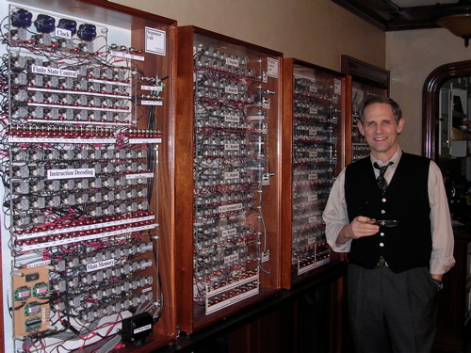
Harry Porter’s 8-bit Relay Computer
Before switches were transistors, built using electronic vacuum tubes
Before vacuum tubes as switches, built using were electro-mechanical replays
Porter (not Harry Potter) is a CS Prof at Portland State
http://web.cecs.pdx.edu/~harry/Relay/

Slide 13
Intel Nehalem
Look at microprocessor from Intel in servers in your 61C labs and your laptops
Nehalem is code name for microarchitecture at heart of Core i7 and Xeon 5500 series server chips
Intel legal said had to pick names of rivers for code names (vs. “Destroyer”)
First released at end of 2008
Die size 263mm² at 45 nm
731M transistors

Slide 14
Nehalem River, Oregon

Slide 15
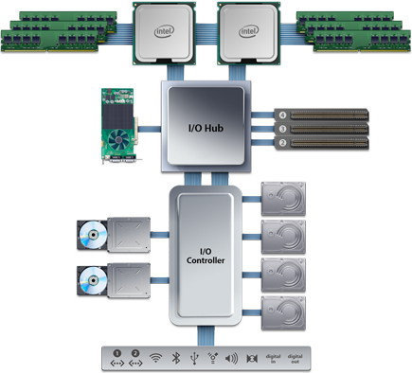
Nehalem System Example: Apple Mac Pro Desktop 2010
Two Nehalem Chips (“Sockets”), each containing four processors (“cores”) running at up to 2.93GHz
Each chip has three DRAM channels attached, each 8 bytes wide at 1.066Gb/s (3*8.5GB/s).
Can have up to two DIMMs on each channel (up to 4GB/DIMM)
“QuickPath” point-point system interconnect between CPUs and I/O.
Up to 25.6 GB/s per link.
PCI Express connections for Graphics cards and other extension boards. Up to 8 GB/s per slot.
Disk drives attached with 3Gb/s serial ATA link
Slower peripherals (Ethernet, USB, Firewire, WiFi, Bluetooth, Audio)

Slide 16
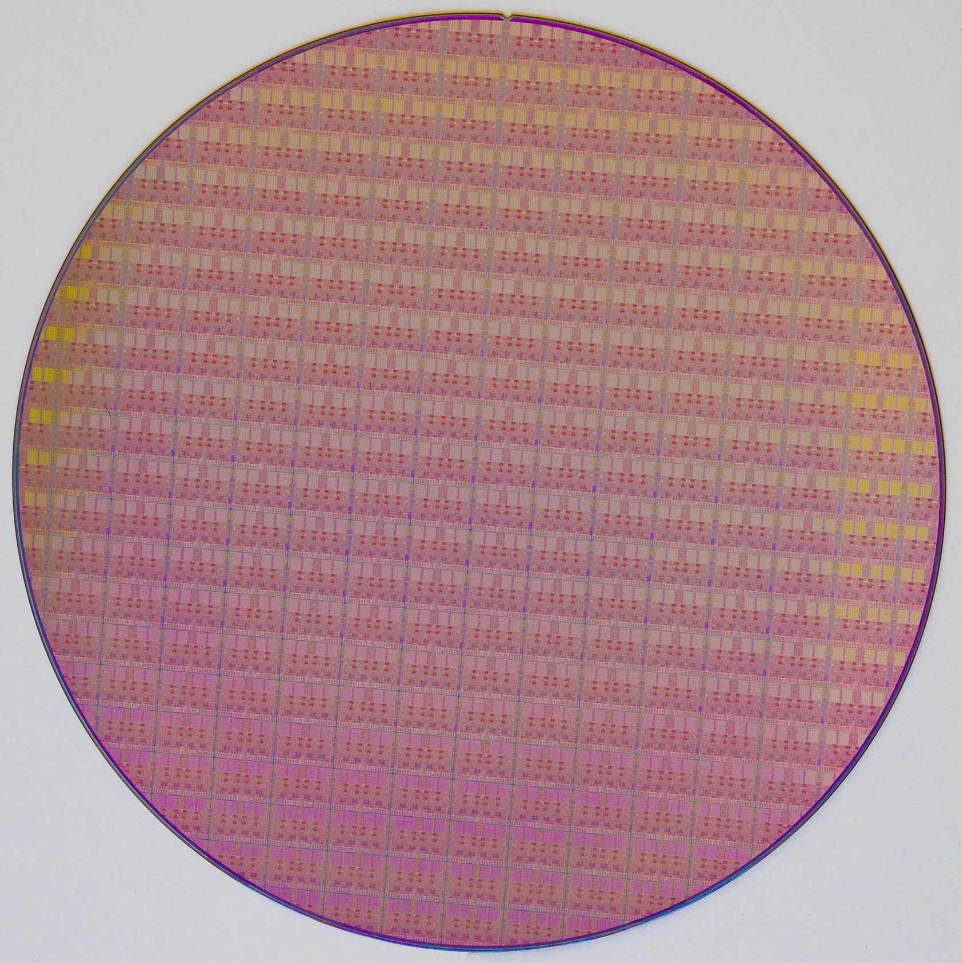
Nehalem 12-inch Wafer: 280 dies
Same diameter as medium Domino’s pizza

Slide 17
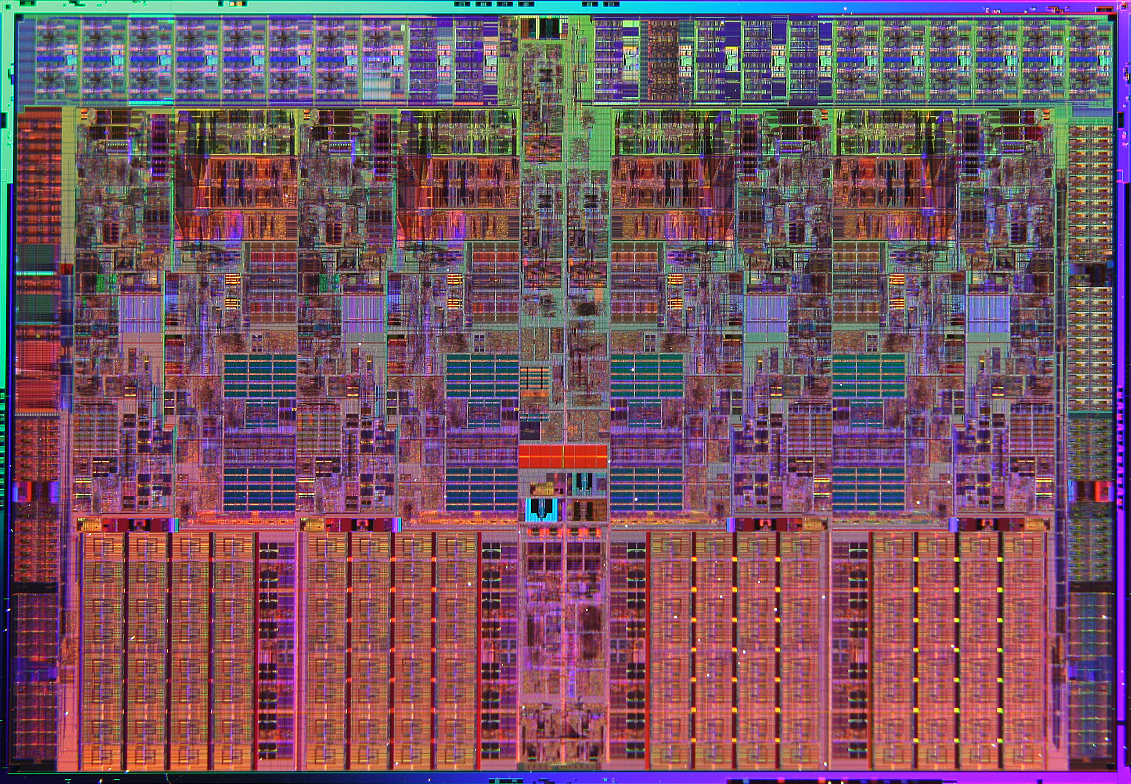
Nehalem Die Photo
Memory Controller
Misc IO
Misc IO
13.6 mm (0.54 inch)
Core
Core
Core
Core
Memory
Queue
QPI
QPI
Shared L3 Cache
18.9 mm (0.75 inch)

Slide 18
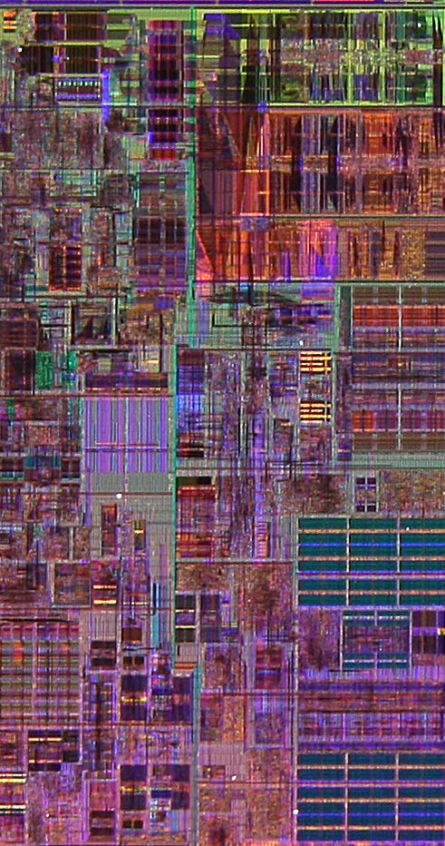
Core Area Breakdown
Memory Controller
Out-of-Order Scheduling & Instruction Commit
Execution Units
Instruction Decode,Reg Renaming & Microcode
Memory Ordering & Execution
L1 Data cache
L2 Cache & Interrupt Servicing
L1 Inst cache & Inst Fetch
Vir-tual Memory, TLB
Brnch Pre-dic-tion
L3 Cache
Load Store Queue

Slide 19
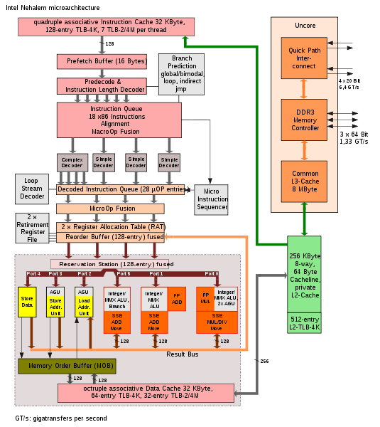
In-Order Fetch
In-Order Decode and Register Renaming
In-Order Commit
Out-of-Order Execution
2 Threads per Core
Out-of-Order Completion
Notes:
Unified Reservation Station
Schedules operations to Execution units
Single Scheduler for all Execution Units
Can be used by all integer, all FP, etc.
Execute 6 operations/cycle
3 Memory Operations
1 Load
1 Store Address
1 Store Data
3 “Computational” Operations

Slide 20
Notes:
Intel in its resolve to continue its leadership in ISA during 2008 is introducing a new set of instructions collectively called as SSE4.2.
SSE4 has been defined for Intel’s 45nm products. The first version SSE4.1 was introduced in the Penryn Arch based products. A set of 7 new instructions is being introduced in Nehalem architecture in 2008 collectively called as SSE4.2.
SSE4.2 is further divided into 2 distinct sub groups called STTNI and ATA. There are 4 instructions in STTNI and 2 ATA’s viz. POPCNT and CRC32.
STTNI is meant for accelerated string and text processing.
POPCNT is an ATA for fast pattern recognition while processing large data sets.
CRC32 is another ATA that provides hardware based CRC instruction allowing for new communication capabilities

Slide 22
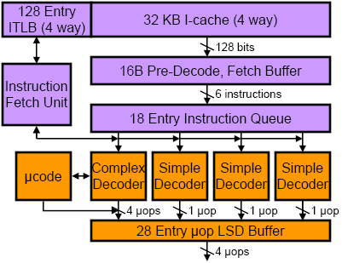
Front-End Instruction Fetch & Decode
x86 instruction bits
µOP is Intel name for internal RISC-like (MIPS) instruction, into which x86 instructions are translated
internal µOP bits
Loop Stream Detector (can run short loops out of the buffer)

Slide 23
x86 Decoding
Translate up to 4 x86 instructions into μOPS (≈MIPS or RISC instructions) each cycle
Only first x86 instruction in group can be complex (maps to 1-4 μOPS), rest must be simple (map to one μOP)
Even more complex instructions, jump into microcode engine which spits out stream of μOPS

Slide 24
Branch Prediction
Part of instruction fetch unit
Several different types of branch predictor
Details not public
Two-level Branch Table Buffer
Loop count predictor
How many backwards taken branches before loop exit
Return Stack Buffer
Holds subroutine targets
Separate return stack buffer for each SMT thread

Slide 25
Split x86 in small μOPs, then fuse back into bigger units

Slide 26
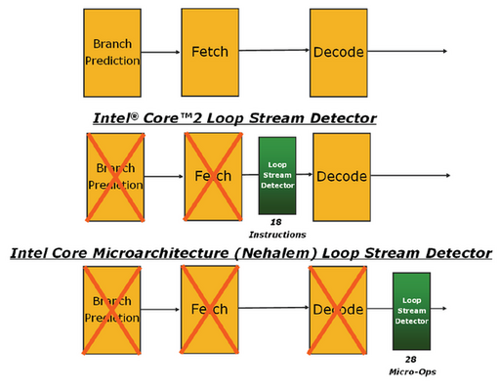
Loop Stream Detectors save Power
Notes:
Loop Stream Detector identifies software loops
Stream from Loop Stream Detector instead of normal path
Disable unneeded blocks of logic for power savings
Higher performance by removing instruction fetch limitations
Higher performance: Expand the size of the loops detected (vs Core 2)
Improved power efficiency: Disable even more logic (vs Core 2)

Slide 27
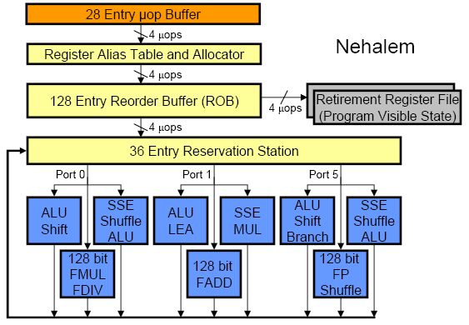
Out-of-Order Execution Engine
Renaming happens at uOP level (not original macro-x86 instructions)

Slide 28
Multithreading effects in Out-of-Order Execution Core
Reorder buffer (remembers program order and exception status for in-order commit) has 128 entries divided statically and equally between both threads
Reservation stations (instructions waiting for operands for execution) have 36 entries competitively shared by threads

Slide 29
Nehalem Memory Hierarchy Overview
32KB L1 I$
32KB L1 I$
CPU Core
4-8 Cores
CPU Core
Private L1/L2 per core
32KB L1 D$
32KB L1 D$
L3 fully inclusive of higher levels (but L2 not inclusive of L1)
256KB L2$
256KB L2$
Local memory access latency ~60ns
8MB Shared L3$
3 DDR3 DRAM Memory Controllers
QuickPath System Interconnect
Other sockets’ caches kept coherent using QuickPath messages
Each DRAM Channel is 64/72b wide at up to 1.33Gb/s
Each direction is 20b@6.4Gb/s
Notes:
Integrated Memory Controller
3 DDR3 channels per socket
Massive memory bandwidth
Memory Bandwidth scales with # of processors
Very low memory latency
Intel® QuickPath Interconnect (Intel® QPI)
New point-to-point interconnect
Socket to socket connections
Socket to chipset connections
Build scalable solutions
Up to 6.4 GT/sec (12.8 GB/sec)
Bidirectional (=> 25.6 GB/sec)

Slide 31
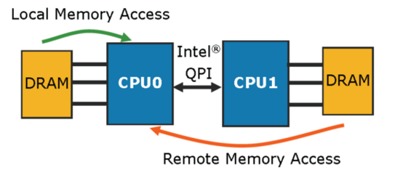
All Sockets can Access all Data
How ensure that get data allocated to local DRAM?
Lunix doesn’t allocate pages to physical memory after malloc until first access to page. Be sure to touch what each CPU wants nearby
~60ns
Such systems called “NUMA” for Non Uniform Memory Access: some addresses are slower than others
~100ns

Slide 32
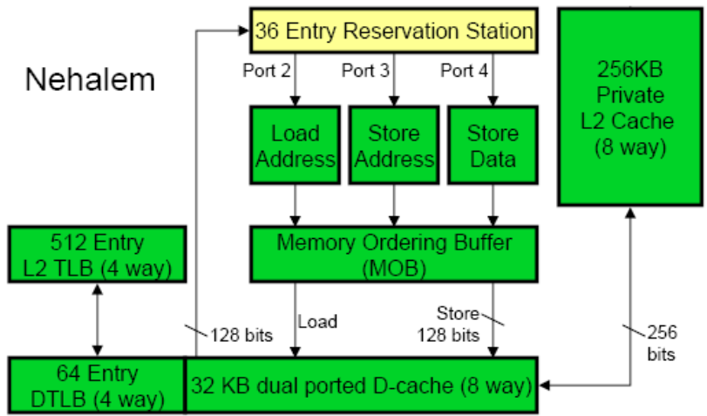
Core’s Private Memory System
Load queue 48 entries
Store queue 32 entries
Divided statically between 2 threads
Up to 16 outstanding misses in flight per core

Slide 33
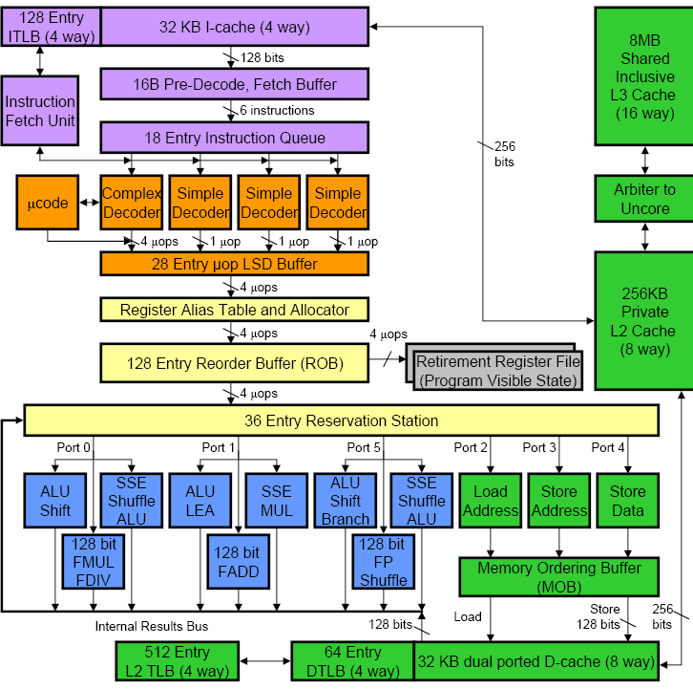

Slide 34
Cache Hierarchy Latencies
L1 I & D 32KB 8-way, latency 4 cycles, 64B blocks
Note: 4KB Page (12 bits) + 8-way associativity (3 bits) means cache index doesn’t need to use virtual part of address, so L1 cache access and TLB lookup can occur in parallel, L1 cache uses physical address tags
Address Tag 6-bit Cache Index 6-bit Block Offset
20-bit Virtual Page Num 12-bit Page Offset
L2 256 KB 8-way, latency <12 cycles
L3 8 MB, 16-way, latency 30-40 cycles
DRAM, latency ~180-200 cycles

Slide 37
Nehalem Virtual Memory Details
Implements 48-bit virtual address space, 40-bit physical address space
Two-level TLB
I-TLB (L1) has shared 128 entries 4-way associative for 4KB pages, plus 7 dedicated fully-associative entries per SMT thread for large page (2/4MB) entries
D-TLB (L1) has 64 entries for 4KB pages and 32 entries for 2/4MB pages, both 4-way associative, dynamically shared between SMT threads
Unified L2 TLB has 512 entries for 4KB pages only, also 4-way associative
Additional support for system-level virtual machines

Slide 38
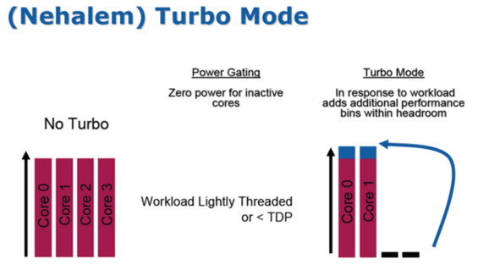

Slide 42
What to do with So Many Choices?
“Introduction to Performance Analysis on Nehalem Based Processors”, 72 pages
software.intel.com/sites/products/collateral/hpc/vtune/performance_analysis_guide.pdf
“Software optimization based on performance analysis of large existing applications, in most cases, reduces to optimizing the code generation by the compiler and optimizing the memory access. Optimizing the code generation by the compiler requires inspection of the assembler of the time consuming parts of the application and verifying that the compiler generated a reasonable code stream. Optimizing the memory access is a complex issue involving the bandwidth and latency capabilities of the platform, hardware and software prefetching efficiencies and the virtual address layout of the heavily accessed variables.”

Slide 43
Agenda
Update Q&A on Extra Credit Projects: Andrew Gearhart and Vasily Volkov
Administrivia
Intel Nehalem (including some Intel marketing slides)
RISC CISC in Retrospect 30 years later
Summary

Slide 44
RISC vs. CISC
Set up: From 1965 to 1980, virtually all computers implemented instruction sets using microcode (edited wikipedia entry):
“Microcode is a layer of hardware-level instructions involved in the implementation of higher-level machine code instructions; it resides in a special high-speed memory and translates machine instructions into sequences of detailed circuit-level operations. It helps separate the machine instructions from the underlying electronics so that instructions can be designed and altered more freely. It also makes it feasible to build complex multi-step instructions while still reducing the complexity of the electronic circuitry compared to other methods. Writing microcode is often called microprogramming and the microcode in a particular processor implementation is sometimes called a microprogram.”
1980s compilers rarely generated these complex instructions

Slide 45
RISC – CISC Wars
Round 1: The Beginning of Reduced vs. Complex Instruction Set
Instruction set made up of simple or reduced instructions using easy-to-decode instruction formats and lots of registers was a better match to integrated circuits and compiler technology than the instructions sets of the 1970s that featured complex instructions and formats.
Our counterexamples were the Digital VAX-11/780, the Intel iAPX-432, and the Intel 8086 architectures, which we labeled Complex Instruction Set Computers (CISC).
http://blogs.arm.com/software-enablement/375-risc-versus-cisc-wars-in-the-prepc-and-pc-eras-part-1/

Slide 46
RISC – CISC Wars
Round 1: The Beginning of Reduced vs. Complex Instruction Set
To implement their more sophisticated operations, CISCs relied on microcode, which is an internal interpreter with its own program memory.
RISC advocates essentially argued that these simpler internal instructions should be exposed to the compiler rather than buried inside an interpreter within a chip.
RISC architects took advantage of the simpler instruction sets to first demonstrate pipelining and later superscalar execution in microprocessors, both of which had been limited to the supercomputer realm.
http://blogs.arm.com/software-enablement/375-risc-versus-cisc-wars-in-the-prepc-and-pc-eras-part-1/

Slide 47
Original RISC Slides
See slides 1 to 16 from RISCTalk1981v6.pdf
Unedited transparencies from 1981 RISC talk + RISC I, RISC II die photos

Slide 48
RISC – CISC Wars
Round 1: The Beginning of Reduced vs. Complex Instruction Set
still amazing that was a time when graduate students could build a prototype chip that was actually faster than what Intel could build.
ARM, MIPS, and SPARC successfully demonstrated the benefits of RISC in the marketplace of the 1980s with rapidly increasing performance that kept pace with the rapid increase in transistors from Moore’s Law.
http://blogs.arm.com/software-enablement/375-risc-versus-cisc-wars-in-the-prepc-and-pc-eras-part-1/

Slide 49
RISC – CISC Wars
Round 2: Intel Responds and Dominates the PC Era
Most executed instructions simple
HW translated simple x86 instructions into internal RISC instructions, then use RISC ideas: pipelining, superscalar, ...
Intel “CISC tax”: longer pipelines, extra translation HW, and the microcode for complex operations but:
Intel’s fab line better than RISC companies, so smaller geometries hide some CISC Tax
Moore’s Law => on-chip integration of FPUs & caches, over time CISC Tax became smaller %
Increasing popularity of IBM PC + distribution of SW in binary made x86 ISA valuable, no matter tax

Slide 50
RISC – CISC Wars
Round 2: Intel Responds and Dominates in the PC Era
Wikipedia: “While early RISC designs were significantly different than contemporary CISC designs, by 2000 the highest performing CPUs in the RISC line were almost indistinguishable from the highest performing CPUs in the CISC line.”
http://blogs.arm.com/software-enablement/375-risc-versus-cisc-wars-in-the-prepc-and-pc-eras-part-1/

Slide 51
RISC – CISC Wars
RISC vs. CISC in the PostPC Era
CISC not a good match to the smartphones and tablets of the PostPC era
It’s a new software stack and software distribution is via the “App Store model” or the browser, which lessens the conventional obsession with binary compatibility.
RISC designs are more energy efficient.
RISC designs are smaller and thus cheaper.
http://blogs.arm.com/software-enablement/377-risc-versus-cisc-wars-in-the-postpc-eras-part-2/

Slide 52
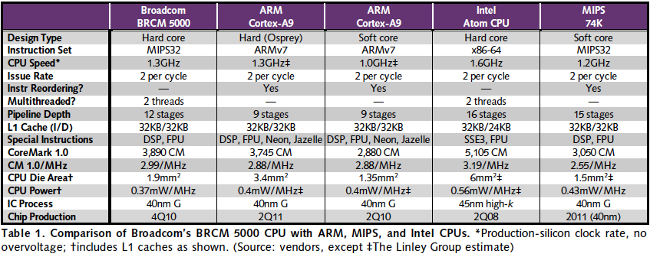
RISC vs. CISC 2010 (mobile client)
“Broadcom Shows Off New CPU,” Linley Gwennap, Microprocessor Report, November 22, 2010
X86 ≈ 1.04 – 1.08x better performance/MHz vs. MIPS, ARM
MIPS, ARM ≈ 1.4 – 1.5x better energy/MHz vs. x86
MIPS, ARM ≈ ⅓ to ¼ die area vs. x86

Slide 53
RESOLVING RISC-CISC DEBATE
Products shipped?
2010: 6.1B ARM, 0.3B x86
How USA resolves debates?
We ask celebrities!
Who is the biggest celebrity in the world?
Notes:
How do we decide important decisions in the USA?
We ask celebrities! What greater celebrity is there than Angelina Jolie?
Here is what she said in the movie Hackers in 1995
Hacker’s Part Six on Youtube, 2:27 into the movie
http://www.youtube.com/watch?v=onSQlpxpHoU

Slide 54
RESOLVING RISC-CISC Debate
Angelina Jolie as Kate Libby (aka as hacker Acid Burn) in movie “Hackers” (1995)
Notes:
How do we decide important decisions in the USA?
We ask celebrities! What greater celebrity is there than Angelina Jolie?
Here is what she said in the movie Hackers in 1995:
Movie via Netflix @ 50:55 in Hackers / 1995
This youtube video still has audio:http://www.youtube.com/watch?v=jwg4mbGL4JEAbout 50s into the clip.

Slide 55
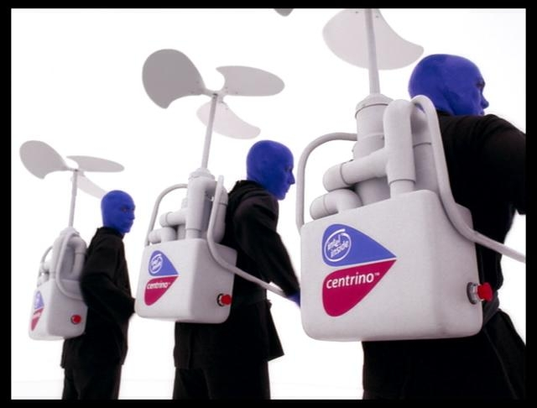
RESOLVING RISC-CISC Debate
Angelina Jolie: “RISC architecture is gonna change everything.”
Blue Man Group
“(silence)”
“Hackers” (1995)
Notes:
RISC has the endorsement of the biggest celebrity in the world.
The best Intel can do is the Blue Man group.
Who would you rather spend the weekend with talking about computer architecture?

Slide 56
“And In Conclusion”
Performance, Intel chip manufacturing => x86 ISA dominates Desktops/Servers
Speculative execution: branch prediction, out of order execution, data prefetching
Hardware translation and optimization of instruction sequences
Opportunistic acceleration (Turbo Mode)
Cost, energy => RISC ISA dominates mobile personal devices, embedded computing, games
What will the future hold for client+cloud?

Slide 57
Acknowledgements
Figures/Info from Intel, David Kanter at Real World Technologies.
These slides contain material developed and copyright by:
Krste Asanovic (UCB)
Beeman Strong (Intel)
UCB material derived from course CS152

