Slide 1
CS 61C: Great Ideas in Computer Architecture (Machine Structures)
Switches, Transistors, Gates, Flip-Flops
Instructors:
Randy H. Katz
David A. Patterson
http://inst.eecs.Berkeley.edu/~cs61c/sp11

Slide 2


Slide 3
Review
Sequential software is slow software
  SIMD and MIMD only path to higher performance
Multiprocessor/Multicore uses Shared Memory
  Cache coherency implements shared memory even with multiple copies in multiple caches
  False sharing a concern; watch block size!
Data races lead to subtle parallel bugs
Synchronization via atomic operations:
  MIPS does it with Load Linked + Store Conditional
OpenMP as simple parallel extension to C
  Threads, Parallel for, private, critical sections, …

Slide 4




You Are Here!
Software Hardware
Parallel Requests
  Assigned to computer
  e.g., Search “Katz”
Parallel Threads
  Assigned to core
  e.g., Lookup, Ads
Parallel Instructions
  >1 instruction @ one time
  e.g., 5 pipelined instructions
Parallel Data
  >1 data item @ one time
  e.g., Add of 4 pairs of words
Hardware descriptions
  All gates functioning in parallel at same time
Warehouse Scale Computer
Smart
Phone
Harness
Parallelism &
Achieve High
Performance
Computer
Core
…
Core
Memory (Cache)
Input/Output
Core
Instruction Unit(s)
Functional
Unit(s)
A₀+B₀
A₁+B₁
A₂+B₂
A₃+B₃
Main Memory
Today
Logic Gates

Slide 5

Levels of Representation/Interpretation
High Level Language
Program (e.g., C)
temp = v[k];
v[k] = v[k+1];
v[k+1] = temp;
Compiler
Anything can be represented
as a number,
i.e., data or instructions
lw $t0, 0($2)
lw $t1, 4($2)
sw $t1, 0($2)
sw $t0, 4($2)
Assembly Language Program (e.g., MIPS)
Assembler
0000 1001 1100 0110 1010 1111 0101 1000
1010 1111 0101 1000 0000 1001 1100 0110
1100 0110 1010 1111 0101 1000 0000 1001
0101 1000 0000 1001 1100 0110 1010 1111
Machine Language Program (MIPS)
Machine Interpretation
Hardware Architecture Description
(e.g., block diagrams)
Architecture Implementation
Logic Circuit Description
(Circuit Schematic Diagrams)

Slide 6
Agenda
Switching Networks, Transistors
Administrivia
Gates and Truth Tables for Circuits
Technology Break
Boolean Algebra
States and Flip-Flops
Summary

Slide 7
Hardware Design
Next several weeks: we’ll study how a modern processor is built; starting with basic elements as building blocks
Why study hardware design?
  Understand capabilities and limitations of hw in general and processors in particular
  What processors can do fast and what they can’t do fast
  (avoid slow things if you want your code to run fast!)
  Background for more in depth hw courses (CS 150, CS 152)
  There is just so much you can do with standard processors: you may need to design own custom hw for extra performance
    Even some commercial processors today have customizable hardware!

Slide 8
Synchronous Digital Systems
Hardware of a processor, such as the MIPS, is an example of a Synchronous Digital System
Synchronous:
  All operations coordinated by a central clock
    “Heartbeat” of the system!
Digital:
  Represent All values by 2 discrete values
  Electrical signals are treated as 1’s and 0’s
    1 and 0 are complements of each other
  High /low voltage for true / false, 1 / 0

Slide 9
Switches: Basic Element of Physical Implementations
Implementing a simple circuit (arrow shows action if wire changes to “1” or is asserted):
A
Z
Close switch (if A is “1” or asserted)
and turn on light bulb (Z)
Z
A
Open switch (if A is “0” or unasserted)
and turn off light bulb (Z)
Z ≡ A

Slide 10
Switches (cont’d)
Compose switches into more complex ones (Boolean functions):
A
B
AND
Z ≡ A and B
A
OR
Z ≡ A or B
B

Slide 11
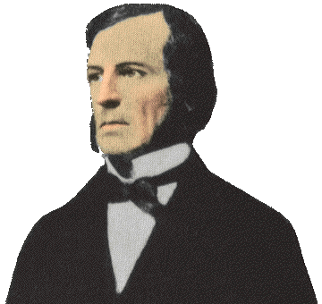
Historical Note
Early computer designers built ad hoc circuits from switches
Began to notice common patterns in their work: ANDs, ORs, …
Master’s thesis (by Claude Shannon) made link between work and 19th Century
Mathematician George Boole
  Called it “Boolean” in his honor
Could apply math to give theory to
hardware design, minimization, …

Slide 12
Transistor Networks
Modern digital systems designed in CMOS
  MOS: Metal-Oxide on Semiconductor
  C for complementary: use pairs of normally-open and normally-closed switches
CMOS transistors act as voltage-controlled switches
  Similar, though easier to work with, than relay switches from earlier era

Slide 13
CMOS Transistors
High voltage (V_{dd}) represents 1, or true
Low voltage (0 volts or Ground) represents 0, or false
Let threshold voltage (V_{th}) decide if a 0 or a 1
If switches control whether voltages can propagate through a circuit, can build a computer
Our switches: CMOS transistors

Slide 14
CMOS Transistors
Gate
Source
Drain
Three terminals: source, gate, and drain
  Switch action:
  if voltage on gate terminal is (some amount) higher/lower than source terminal then conducting path established between drain and source terminals (switch is closed)
Note circle symbol to indicate “NOT” or “complement”
Gate
Gate
Source
Drain
Source
Drain
n-channel transitor
open when voltage at Gate is low
closes when:
voltage(Gate) > voltage (Threshold)
p-channel transistor
closed when voltage at Gate is low
opens when:
voltage(Gate) > voltage (Threshold)
Notes:
From wikipedia:
The field-effect transistor (FET) relies on an electric field to control the shape and hence the conductivity of a channel of one type of charge carrier in a semiconductor material.
The most commonly used FET is the MOSFET. The CMOS (complementary-symmetry metal oxide semiconductor) process technology is the basis for modern digital integrated circuits. This process technology uses an arrangement where the (usually "enhancement-mode") p-channel MOSFET and n-channel MOSFET are connected in series such that when one is on, the other is off.

Slide 15
CMOS circuit rules
Never create a path from V_{dd} to gnd (ground)
Don’t pass weak values
  N-type transistors pass weak 1’s (V_{dd} - V_{th})
  N-type transistors pass strong 0’s (gnd)
  Use N-type transistors only to pass 0’s (n to negative)
  Conversely for P-type transistors
    Pass weak 0’s (V_{th}), strong 1’s (V_{dd})
    Use P-type transistors only to pass 1’s (p to positive)
  Use pairs of N-type and P-type to get strong values
Never leave a wire undriven
  Make sure there’s always a path to V_{dd} or gnd

Slide 16
MOS Networks
p-channel transistor
closed when voltage at Gate is low
opens when:
voltage(Gate) > voltage (Threshold)
X
what is the
relationship
between x and y?
3v
x
y
Y
0 volts
(gnd)
0v
3 volts
(Vdd)
n-channel transitor
open when voltage at Gate is low
closes when:
voltage(Gate) > voltage (Threshold)
Called an invertor or not gate
Notes:
X = 0 implies top switch is closed, so 3V sent Y
X = 0 implies bottom switch is open, so nothing sent to Y
X = 3v implies Top switch is open, so nothing sent to Y
X = 3v implies Bottom switch is closed, so 0V sent Y
The most commonly used FET is the MOSFET. The CMOS (complementary-symmetry metal oxide semiconductor) process technology is the basis for modern digital integrated circuits. This process technology uses an arrangement where the (usually "enhancement-mode") p-channel MOSFET and n-channel MOSFET are connected in series such that when one is on, the other is off.

Slide 17
MOS Networks
n-channel transitor
open when voltage at Gate is low
closes when voltage(Gate) > voltage (Source) + ε
X
what is the
relationship
between x and y?
3v
x
y
Y
0 volts
(gnd)
3 volts (Vdd)
0v
3 volts
(Vdd)
0 volts (gnd)
p-channel transistor
closed when voltage at Gate is low
opens when voltage(Gate) < voltage (Source) – ε
Called an invertor or not gate
Notes:
X = 0 implies top switch is closed, so 3V sent Y
X = 0 implies bottom switch is open, so nothing sent to Y
X = 3v implies Top switch is open, so nothing sent to Y
X = 3v implies Bottom switch is closed, so 0V sent Y
The most commonly used FET is the MOSFET. The CMOS (complementary-symmetry metal oxide semiconductor) process technology is the basis for modern digital integrated circuits. This process technology uses an arrangement where the (usually "enhancement-mode") p-channel MOSFET and n-channel MOSFET are connected in series such that when one is on, the other is off.

Slide 18
Agenda
Switching Networks, Transistors
Administrivia
Gates and Truth Tables for Circuits
Technology Break
Boolean Algebra
(States if time permits)
Summary

Slide 19
Administrivia
Need Partners for Project 3: Who has a partner? Who doesn’t?
Part 1 due Sunday March 27 before midnight
Homework due Sunday March 27 before midnight
OK to turn in before Spring Break

Slide 20
61c in the News
“Japan's Internet Largely Intact After Earthquake,
Tsunami” Computerworld (03/13/11) J. Vijayan
Japan's Internet infrastructure demonstrated surprising resilience in the face of the recent earthquake and tsunami, as most Web sites remain in operation and the Web is still accessible to support crucial communication functions. About 100 of Japan's 6,000 network prefixes were removed from service immediately following the quake, only to start to reappear on global routing tables in a matter of hours.
A similar recovery was seen in Web traffic to and from Japan, while traffic at Japan's Internet exchange service seems to have slowed by only 10% since March 11. … Japan's attempts to construct a dense web of domestic and international Internet connectivity "may have allowed the Internet to do what it does best: Route around catastrophic damage and keep the packets flowing, despite terrible chaos and uncertainty."

Slide 21



Getting to Know Your Prof
Calif. State Champion Wrestling Team
Play Soccer on Sundays
Lift weights with son

Slide 22
Two Input Networks
Student Roulette
what is the
relationship between x, y and z?
X
Y
x
y
z
3v
0 volts
0 volts
0 volts
3 volts
Z
3 volts
0 volts
0v
3 volts
3 volts
X
Y
x
y
z
0 volts
0 volts
3v
0 volts
3 volts
Z
3 volts
0 volts
3 volts
3 volts
0v
Notes:
Top
X = 0v Y = 0V both closed on top, so Z = 3v
X = 0v Y = 0V both open bottom
X = 0v Y = 3V 2nd closed on top, so Z = 3v
X = 0v Y = 3V 2nd in series open
X = 3v Y = 0V 1st closed on top, so Z = 3v
X = 3v Y = 0V 1st in series open
X = 3v Y = 3V both open on top
X = 3v Y = 0V both closed, so Z = 0v

Slide 23
Two Input Networks: Peer Instruction
what is the
relationship between x, y and z?
X
Y
x
y
z
Called NAND gate (NOT AND)
3v
0 volts
3 volts
0 volts
0 volts
3 volts
3 volts
Z
3 volts
3 volts
0 volts
0v
3 volts
3 volts
0 volts
X
Y
x
y
z
A B C D
0 volts
0 volts
0 0 3 3
volts
3v
0 volts
3 volts
0 3 0 3
volts
Z
3 volts
0 volts
0 3 0 3
volts
3 volts
3 volts
3 3 0 0
volts
0v
Notes:
Top
X = 0v Y = 0V both closed on top, so Z = 3v
X = 0v Y = 0V both open bottom
X = 0v Y = 3V 2nd closed on top, so Z = 3v
X = 0v Y = 3V 2nd in series open
X = 3v Y = 0V 1st closed on top, so Z = 3v
X = 3v Y = 0V 1st in series open
X = 3v Y = 3V both open on top
X = 3v Y = 0V both closed, so Z = 0v

Slide 24
Two Input Networks
what is the
relationship between x, y and z?
X
Y
x
y
z
Called NAND gate (NOT AND)
3v
0 volts
3 volts
0 volts
0 volts
3 volts
3 volts
Z
3 volts
3 volts
0 volts
0v
3 volts
3 volts
0 volts
X
Y
Called NOR gate (NOT OR)
x
y
z
3v
0 volts
0 volts
3 volts
0 volts
3 volts
0 volts
Z
3 volts
0 volts
0 volts
3 volts
3 volts
0 volts
0v
Notes:
Bottom
X = 0v Y = 0V both closed on top in series, so Z = 3v
X = 0v Y = 0V both open bottom
X = 0v Y = 3V 1st open on top,
X = 0v Y = 3V 2nd in series closed, so Z = 0v
X = 3v Y = 0V 2nd open on top
X = 3v Y = 0V 2nd in series closed, so Z = 0v
X = 3v Y = 3V both open on top
X = 3v Y = 3V both closed, so Z = 0v

Slide 25
Type of Circuits
Synchronous Digital Systems consist of two basic types of circuits:
  Combinational Logic (CL) circuits
    Output is a function of the inputs only, not the history of its execution
    E.g., circuits to add A, B (ALUs)
  Sequential Logic (SL)
    Circuits that “remember” or store information
    aka “State Elements”
    E.g., memories and registers (Registers)

Slide 26
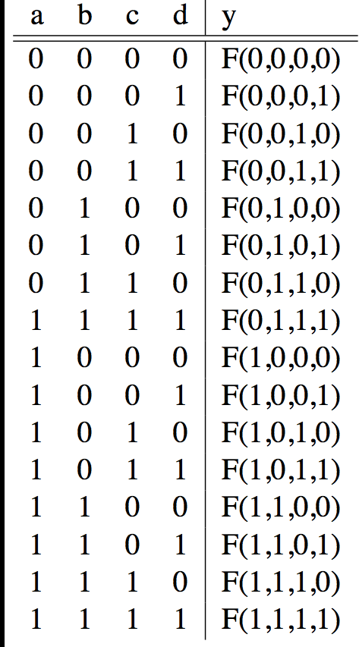
Truth Tables
A
F
B
Y
C
0
D

Slide 27
Truth Table Example #1: y= F(a,b): 1 iff a ≠ b
a | b | y
0 | 0 | 0
0 | 1 | 1
1 | 0 | 1
1 | 1 | 0
Y = A B + A B
Y = A + B
XOR

Slide 28
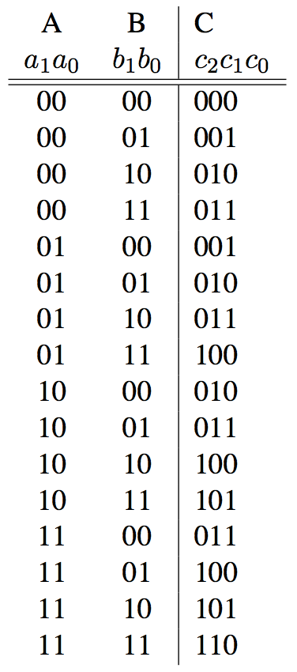
Truth Table Example #2:
2-bit Adder
How
Many
Rows?
A1
+
C2
A0
C1
B1
C0
B0

Slide 29
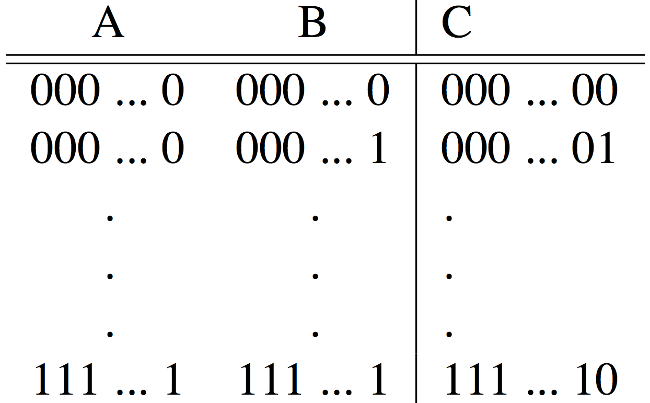
Truth Table Example #3:
32-bit Unsigned Adder
How
Many
Rows?

Slide 30
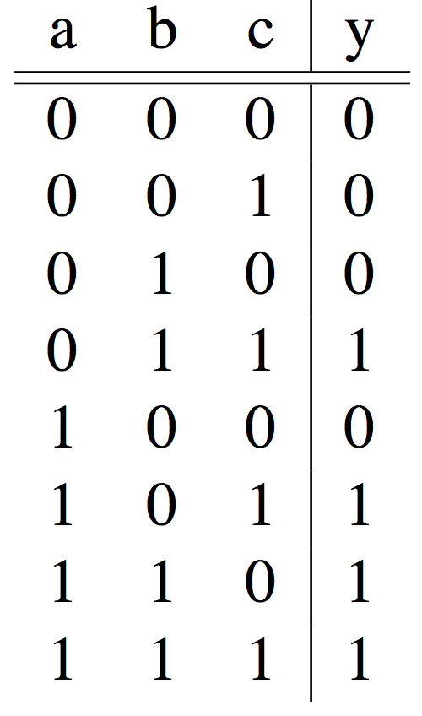
Truth Table Example #4:
3-input Majority Circuit
Y = A B C + A B C + A B C + A B C
This is called Sum of Products form;
Just another way to represent the TT
as a logical expression
Y = B C + A (B C + B C)
Y = B C + A (B + C)
More simplified forms
(fewer gates and wires)

Slide 31
Design Hierarchy
system
datapath
control
code
registers
state
registers
combinational
logic
multiplexer
comparator
register
logic
switching
networks

Slide 32
Combinational Logic Symbols
Common combinational logic systems have standard symbols called logic gates
  Buffer, NOT
  AND, NAND
  OR, NOR
A
Z
A
Z
Easy to implement
with CMOS transistors
(the switches we have
available and use most)
B
A
Z
B

Slide 33
Boolean Algebra
Use plus for OR
  “logical sum”
Use product for AND (a•b or implied via ab)
  “logical product”
“Hat” to mean complement (NOT)
Thus
ab + a + c
= a•b + a + c
= (a AND b) OR a OR (NOT c )

Slide 34
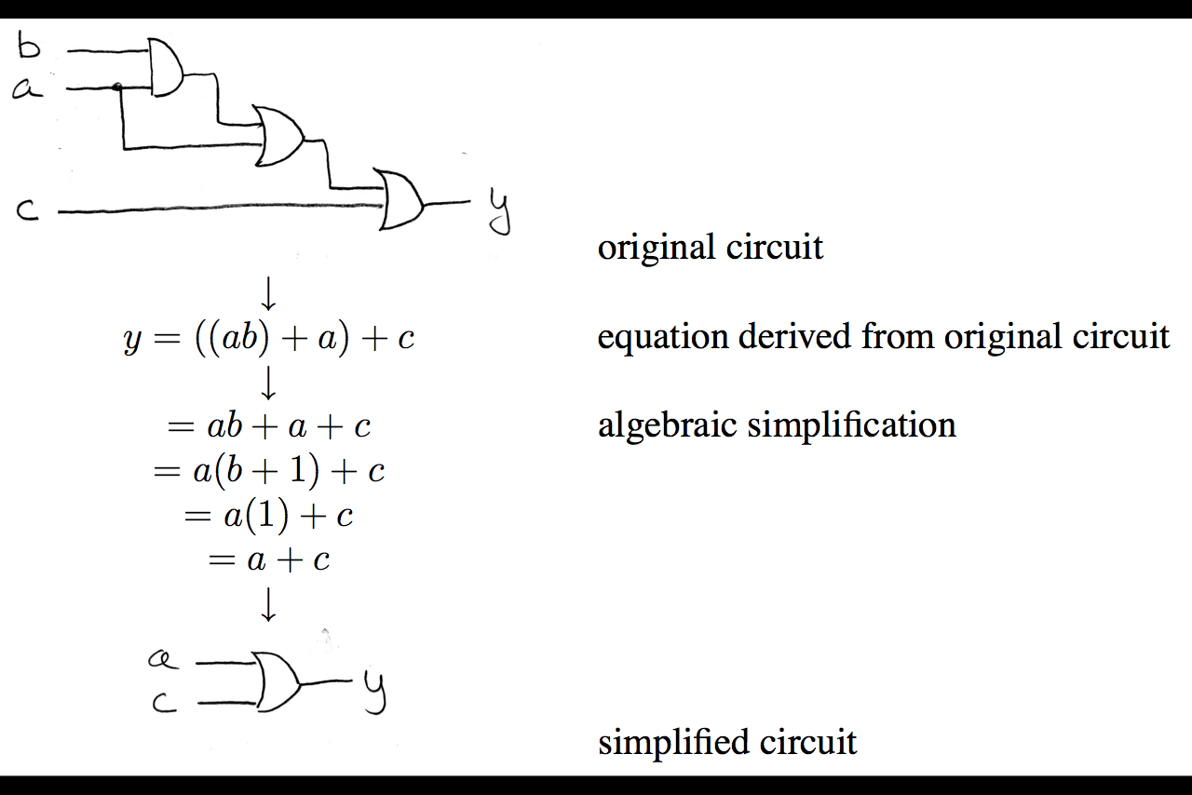
Boolean Algebra: Circuit & Algebraic Simplification

Slide 35
Laws of Boolean Algebra

Slide 36
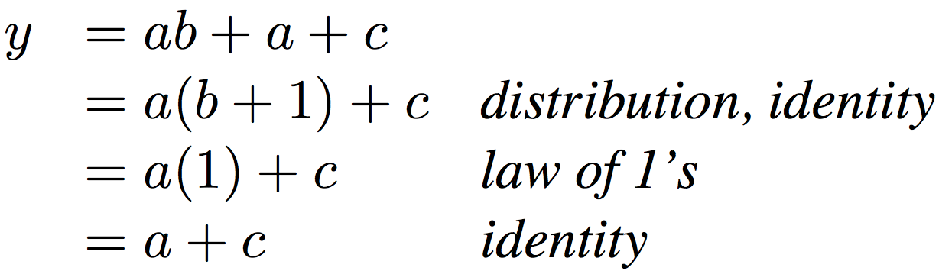
Boolean Algebraic Simplification Example
Notes:
Do on black board
From distribution: a(b +1) + c
Froms laws of 0s and 1s: b+1 = b
= ab + c
Truth Table
a b c y
0 0 0 0
0 0 1 1
0 0 1 1

Slide 37
Boolean Algebraic Simplification Example
a b c y
0 0 0 0
0 0 1 1
0 1 0 0
0 1 1 1
1 0 0 1
1 0 1 1
1 1 0 1
1 1 1 1
Notes:
Do on black board
From distribution: a(b +1) + c
Froms laws of 0s and 1s: b+1 = b
= ab + c
Truth Table
a b c y
0 0 0 0
0 0 1 1
0 0 1 1

Slide 38
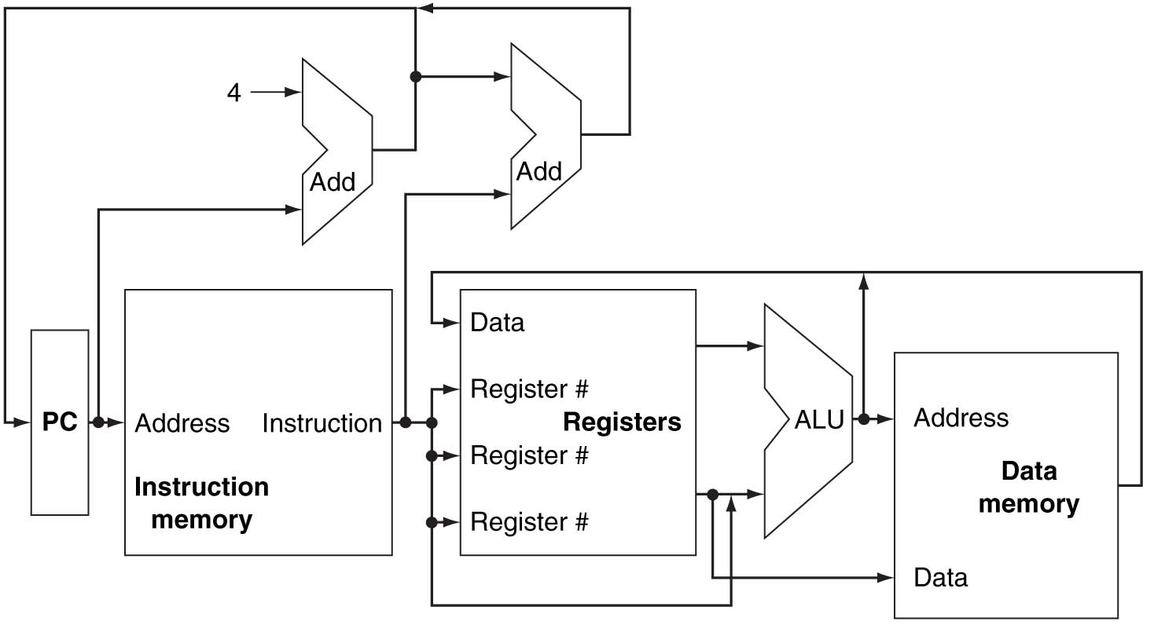
Remember This?
Conceptual MIPS Datapath

Slide 39
Uses for State Elements
Place to store values for some amount of time:
  Register files (like $1-$31 on the MIPS)
  Memory (caches, and main memory)
Help control flow of information between combinational logic blocks
  State elements are used to hold up the movement of information at the inputs to combinational logic blocks and allow for orderly passage

Slide 40
Accumulator Example
Why do we need to control the flow of information?
SUM
X_{i}
S
Want: S=0;
for (i=0;i<n;i++)
S = S + X_{i}
Assume:
  Each X value is applied in succession, one per cycle
  After n cycles the sum is present on S

Slide 41
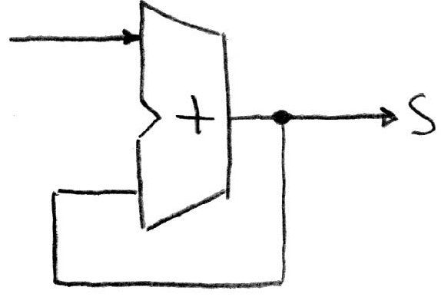
First Try: Does this work?
Feedback
No!
Reason #1: How to control the next iteration of the ‘for’ loop?
Reason #2: How do we say: ‘S=0’?

Slide 42
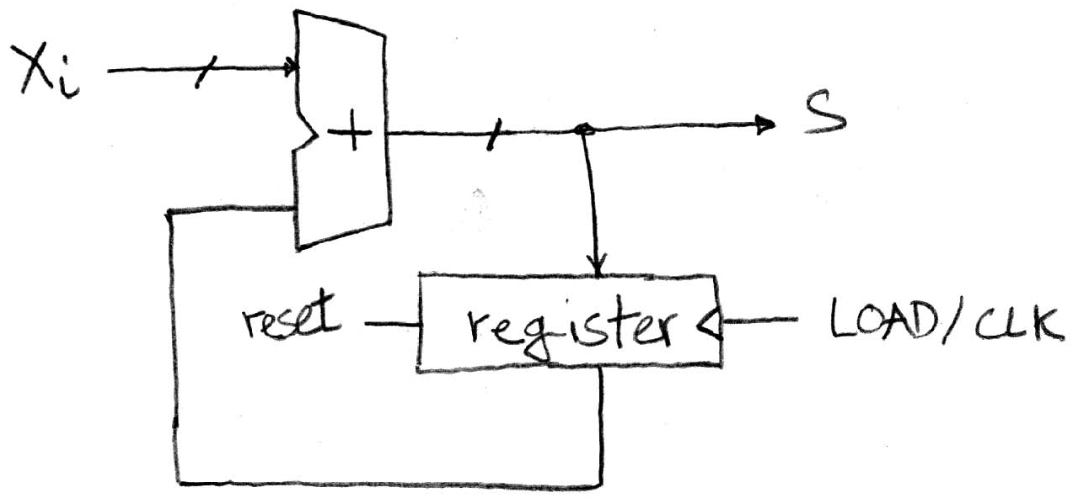
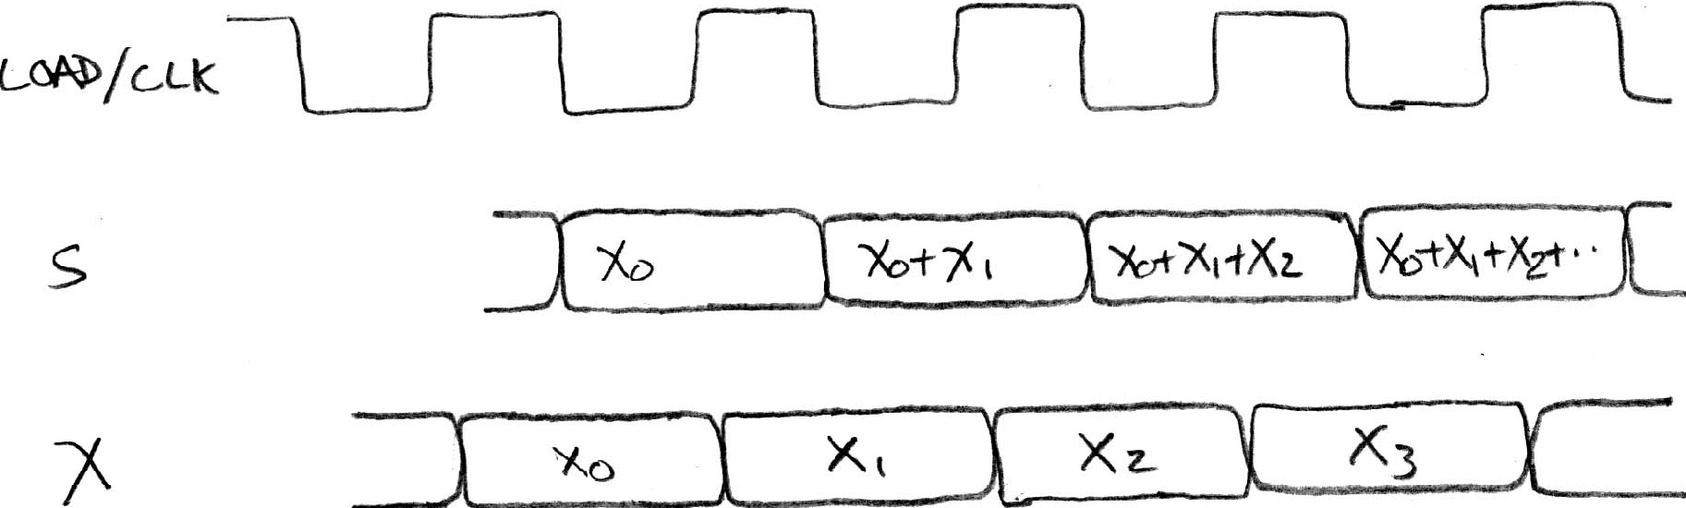
Second Try: How About This?
Register is used to
hold up the transfer
of data to adder
Rough
timing …
Time

Slide 43
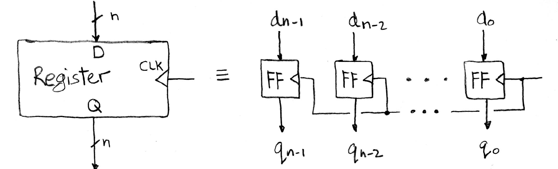
Register Internals
n instances of a “Flip-Flop”
Flip-flop name because the output flips and flops between 0 and 1
D is “data input”, Q is “data output”
Also called “D-type Flip-Flop”

Slide 44
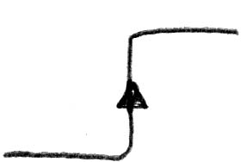
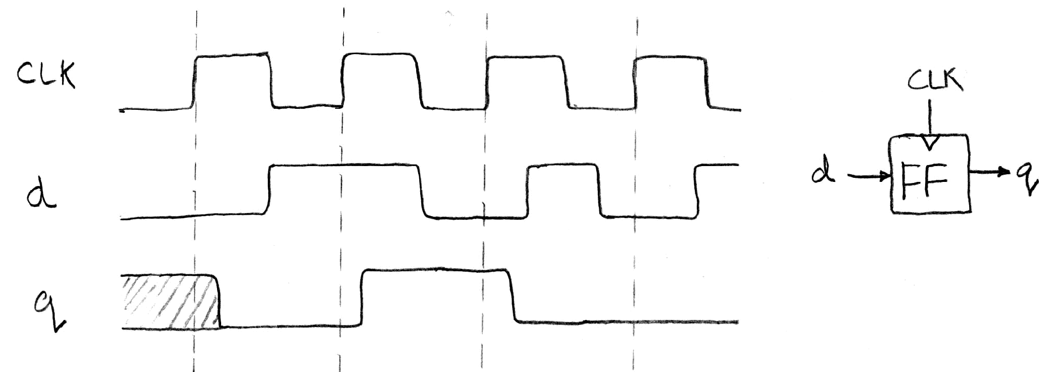
Flip-Flop Timing Behavior (1/2)
Edge-triggered d-type flip-flop
  This one is “positive edge-triggered”
“On the rising edge of the clock, input d is sampled and transferred to the output. At other times, the input d is ignored and the previously sampled value is retained.”
Example waveforms:

Slide 45
Camera Analogy
Want to take a portrait – timing right before and after taking picture
Set up time – don’t move since about to take picture (open camera shutter)
Hold time – need to hold still after shutter opens until camera shutter closes
Time to data – time from open shutter until can see image on output (viewfinder)

Slide 46
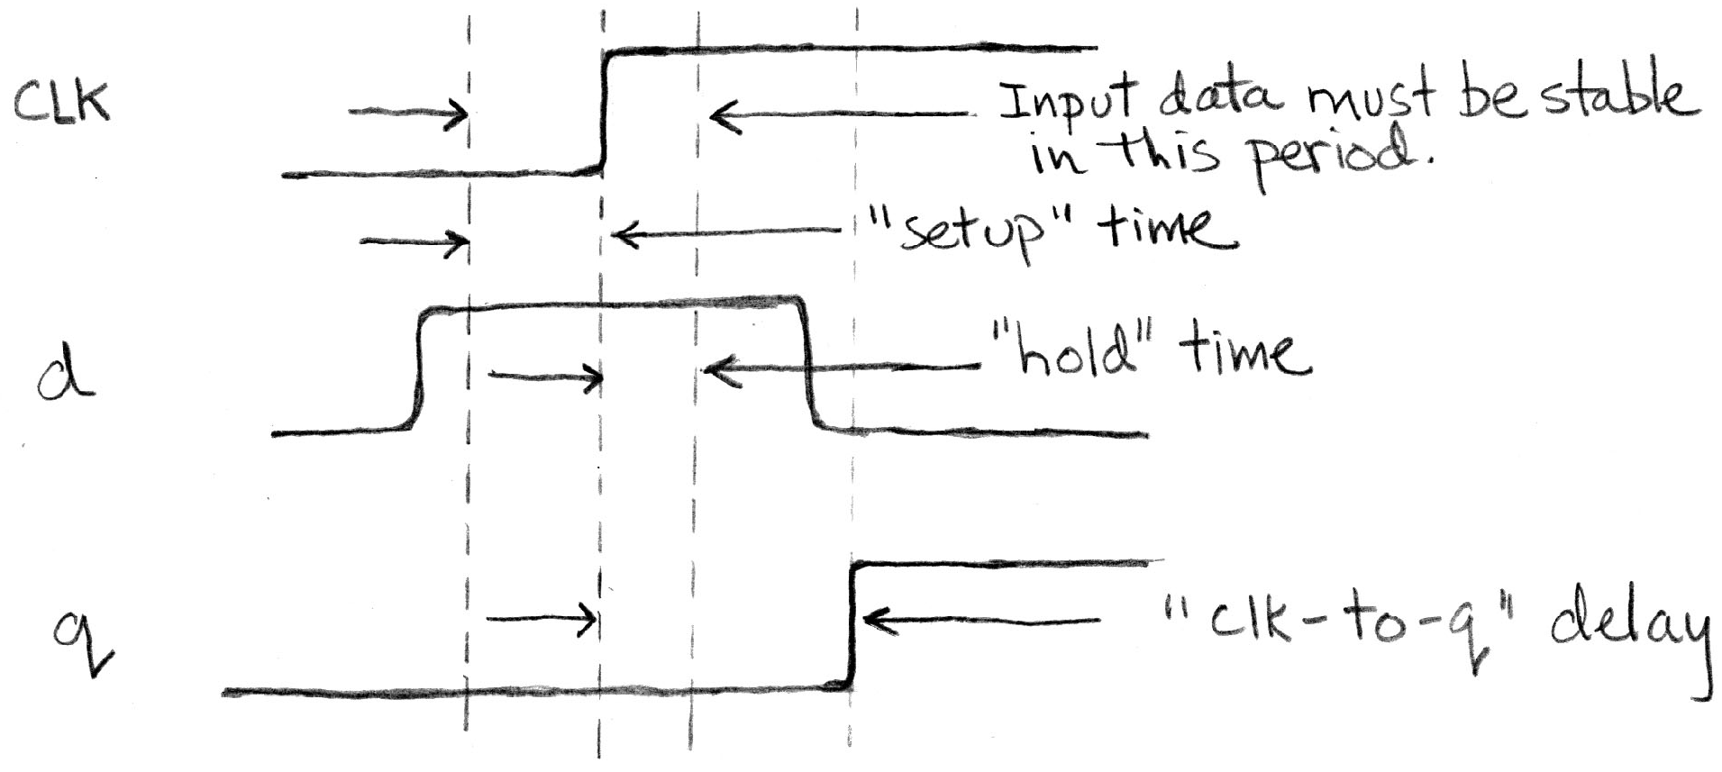
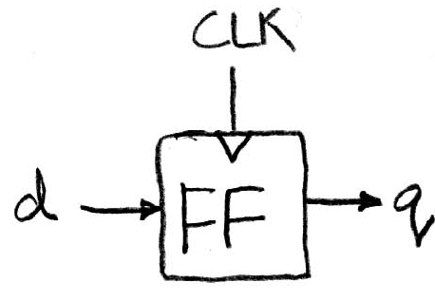
Flip-Flop Timing Behavior (2/2)
Edge-triggered d-type flip-flop
  This one is “positive edge-triggered”
“On the rising edge of the clock, input d is sampled and transferred to the output. At other times, the input d is ignored and the previously sampled value is retained.”

Slide 47
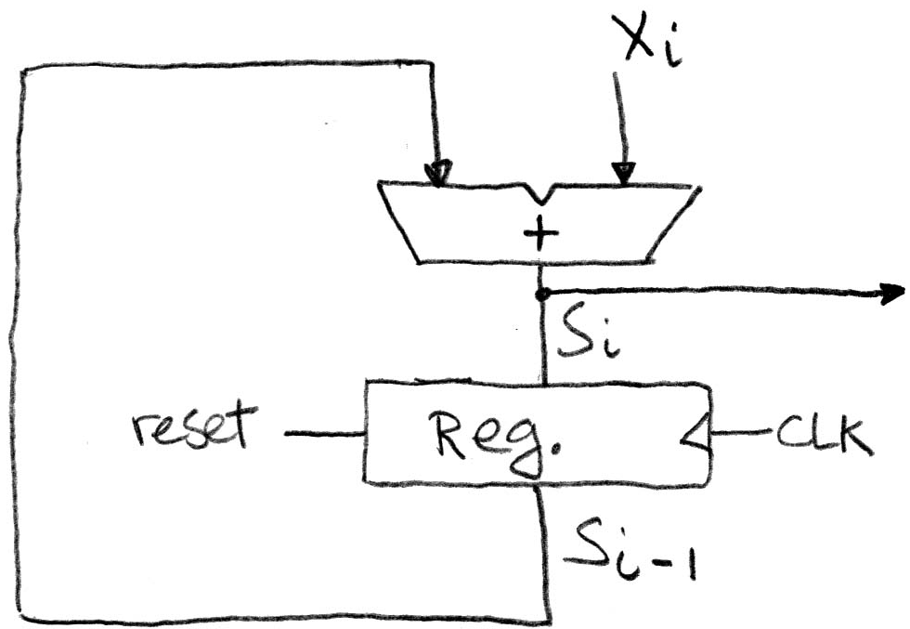
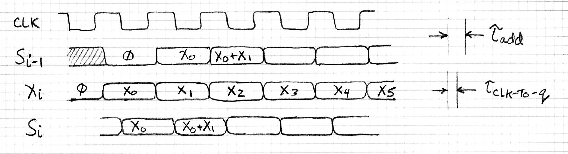
Accumulator Revisited
Proper Timing (1/2)
Reset input to register is used to force it to all zeros (takes priority over D input)
S_{i-1} holds the result of the i^{th}-1 iteration
Analyze circuit timing starting at the output of the register

Slide 48
How Long is a Clock Cycle?
Rising Clock Edge to Rising Clock Edge
Measure from Register back into Register
Clock to Q time for Si-1
Time for Xi to arrive at adder
Time for addition
Setup time for Register

Slide 49
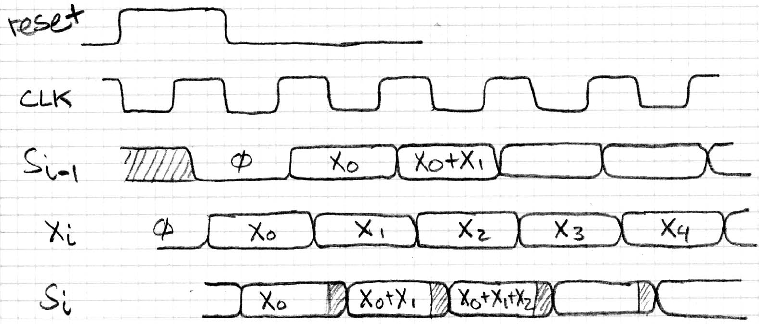
Accumulator Revisited
Proper Timing (2/2)
reset signal shown
Also, in practice X might not arrive to the adder at the same time as S_{i-1}
S_{i} temporarily is wrong, but register always captures correct value
In good circuits, instability never happens around rising edge of clk

Slide 50
Summary
Hardware systems are constructed from Stateless Combinational Logic and Stateful “Memory” Logic (Registers)
Real world voltages are analog, but are quantized to represent logic 0 and logic 1
Truth table can be mapped to gates for combinational logic design
Boolean algebra allows minimization of gates
State registers implemented from Flip-flops

